Slide 1
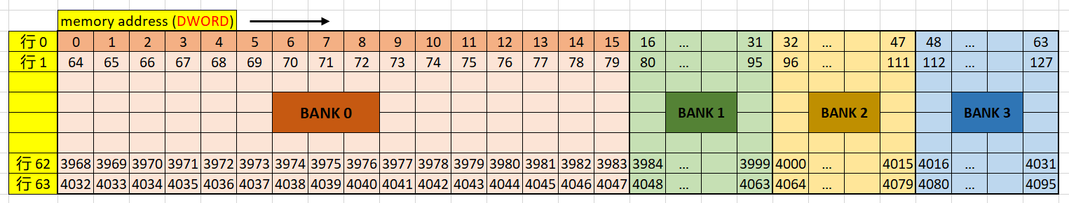
VMEM PERFORMANCE
Issue blocking due to l1 bank conflict
Reason
L1 = 4K DWORD = 4BANK
1 BANK = 1K DOWRD = 16 DWORD(width) * 64(depth)
address[7:6] select which bank
address[5:0] select inner one bank
Cacheline = 16DWORD = bank width

Slide 2
VMEM PERFORMANCE
Issue blocking due to l1 bank conflict
Best practice
cacheline usage = 100%
Every 16 thread has no bank conflict,
that means one wave cover 4 bank
also means address[7:6] should range from 00b to 11b within one wave

Slide 3
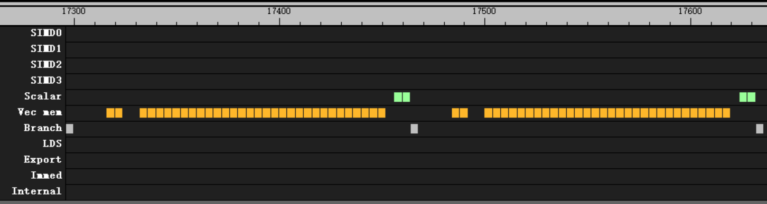
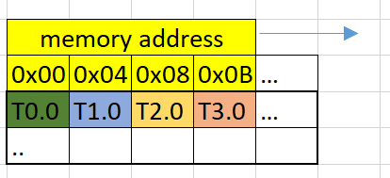
VMEM PERFORMANCE
Issue blocking due to l1 bank conflict
flat_load_dword with cacheline usage = 100%
Every continues 16 thread read one entire cacheline
No bank conflict
No block, every 4 clk per issue

Slide 4
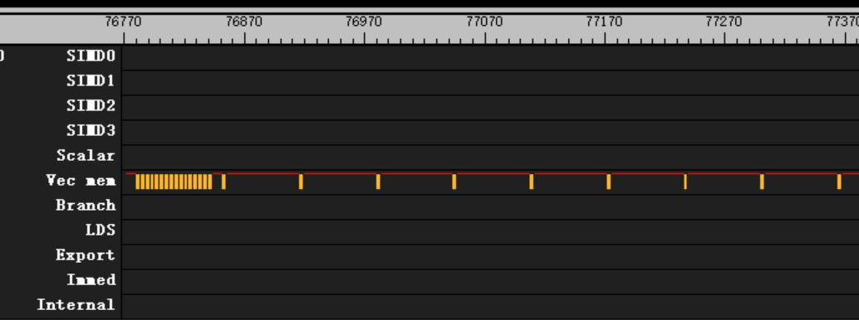
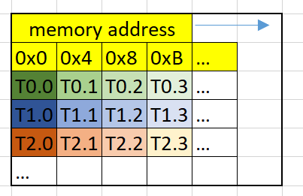
VMEM PERFORMANCE
Issue blocking due to l1 bank conflict
flat_load_dword with cacheline usage = 1/16
Every continues 16 thread read one entire cacheline
Every 16 thread has bank confilict
64 clk per issue after first 12 issue

Slide 5
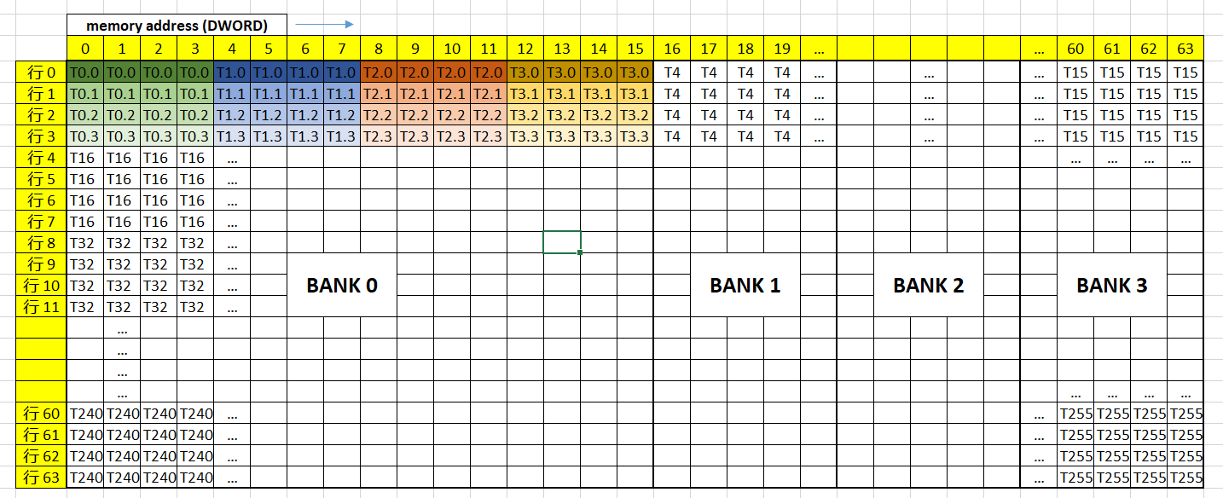
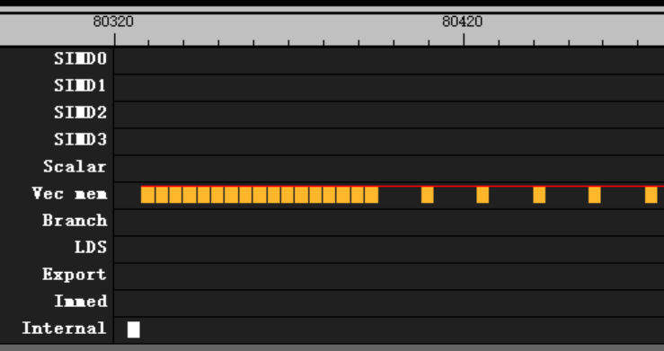
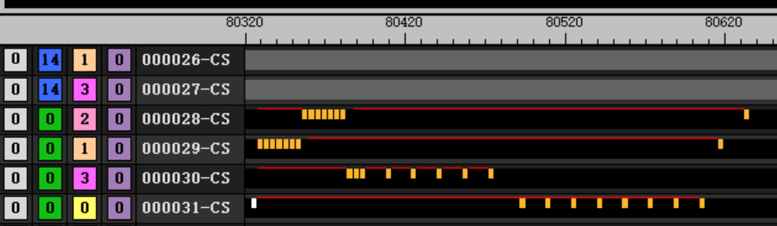
VMEM PERFORMANCE
Issue blocking due to l1 bank conflict
flat_load_dwordx4 with cacheline usage = 100%, no bank conflict
Every continues 4 thread read one entire cacheline
Every continues 16 thread cover 4 banks
16 clk per issue after first 12 issue

Slide 6
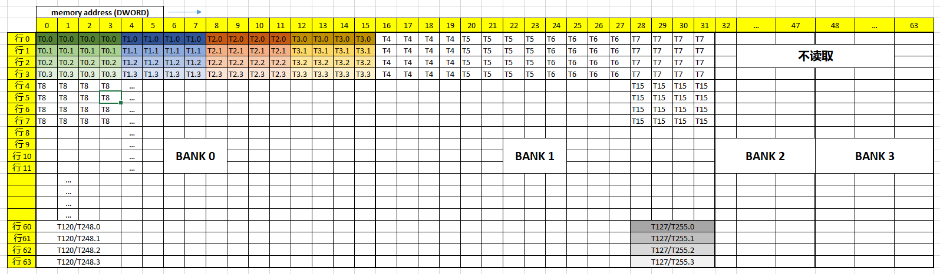
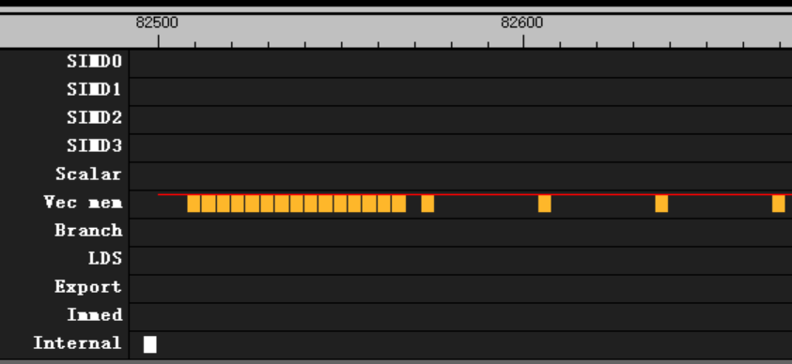
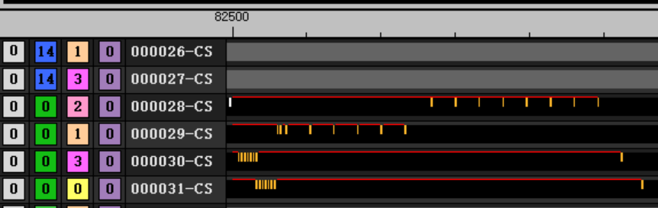
VMEM PERFORMANCE
Issue blocking due to l1 bank conflict
flat_load_dwordx4 with cacheline usage = 100%, with bank conflict
Every continues 4 thread read one entire cacheline
Every continues 16 thread cover only 2 banks, 2 bank conflict
32 clk per issue after first 12 issue

Slide 7
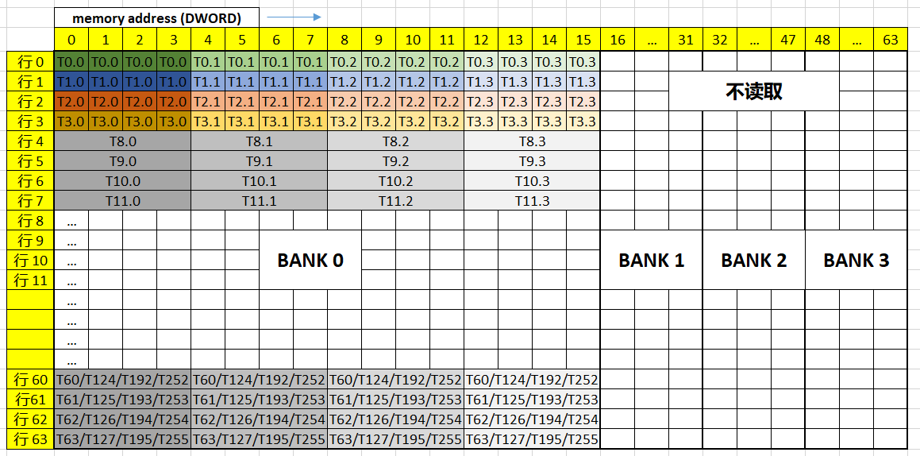
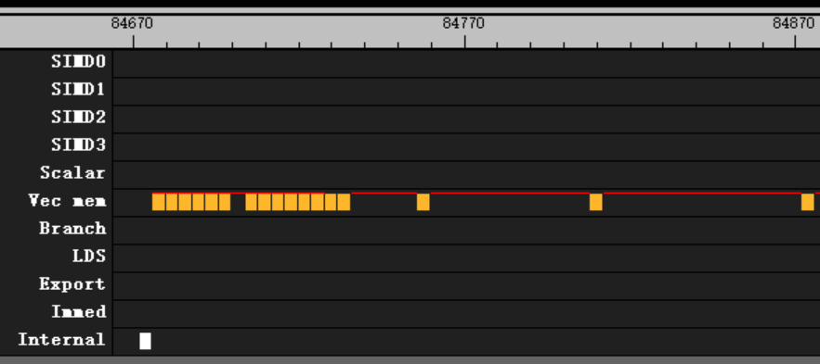
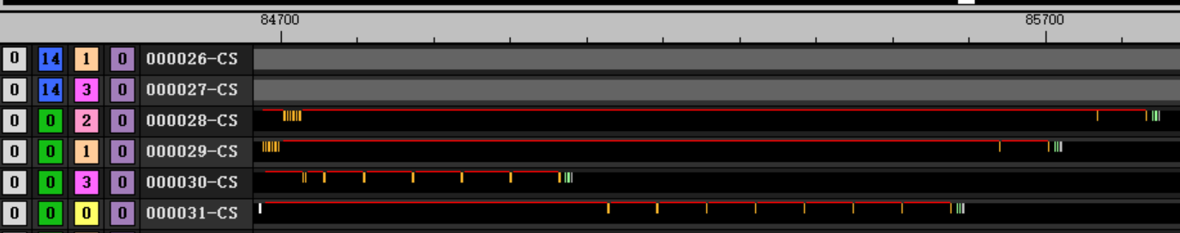
VMEM PERFORMANCE
Issue blocking due to l1 bank conflict
flat_load_dwordx4 with cacheline usage = ¼, with bank conflict
Every thread read different cacheline
Every continues 16 thread cover only 1 banks, 4 bank conflict
64 clk per issue after first 12 issue

