Slide 1
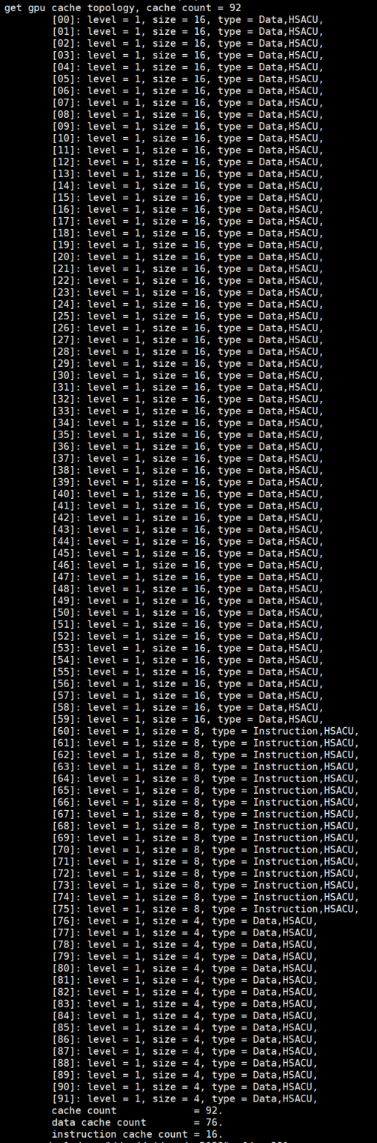
VMEM PERFORMANCE
Cache
topology
/sys/devices/virtual/kfd/kfd/topology/nodes/[nodeIdx]/caches/[cacheIdx]
total cache count = 96
64 L1 data cache, size = 16KB
16 instruction cache, size = 8KB
16 constant data cache, size = 4KB
CU0
CU1
CU2
CU3
HBM
L1 cache
L1 cache
L1 cache
L1 cache
Instruction cache
constant cache
L2 cache
BUS

Slide 2
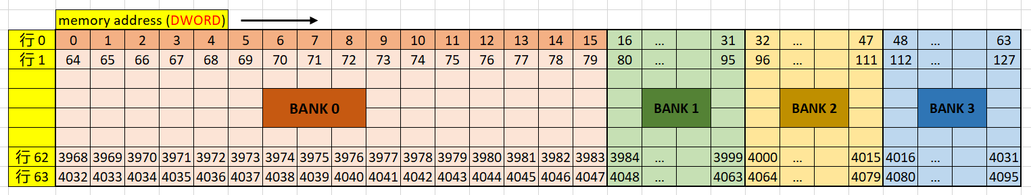
VMEM PERFORMANCE
cache
L1 data cache
L1 = 4K DWORD = 4BANK
1 BANK = 1K DOWRD = 16 DWORD(width) * 64(depth)
Bandwidth L1 -> CU = cacheline / clk = 16 DWORD / clk
address[13:12] select which bank, address[11:6] select cacheline
Cacheline = 16DWORD = bank width

Slide 3
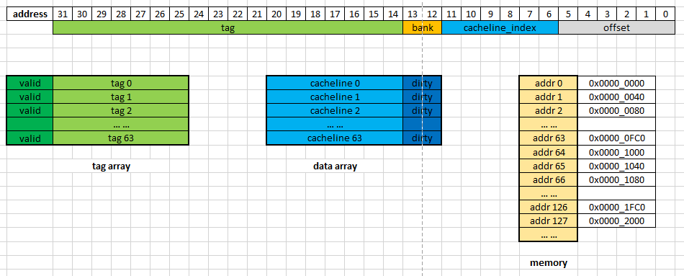
VMEM PERFORMANCE
Cache
Hit & miss
Get cacheline_idx from addr[cachelineIdx]
Get cacheline from cache by cacheline_idx
Check valid bit in cacheline
Get tag from cacheline
Compare tag with addr[tag]

Slide 4
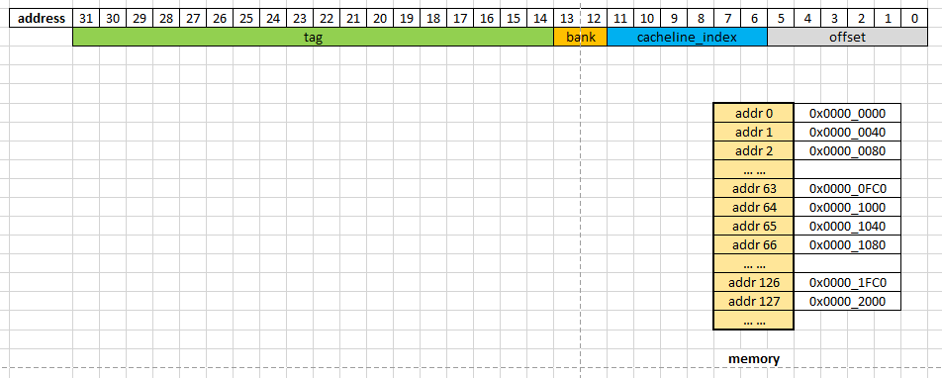
VMEM PERFORMANCE
Cache
4 way set
Reduce hardware usage
Reduce tag compare time
Bank 0
tag
cacheline
Bank 1
Bank 2
Bank 3

Slide 5
VMEM PERFORMANCE
Cache
L1 update policy
Write through: when sp write, if addr hit in L1, we update the data in L1 as well as data in L2, when sp read the addr after , it always gets the latest data

Slide 6
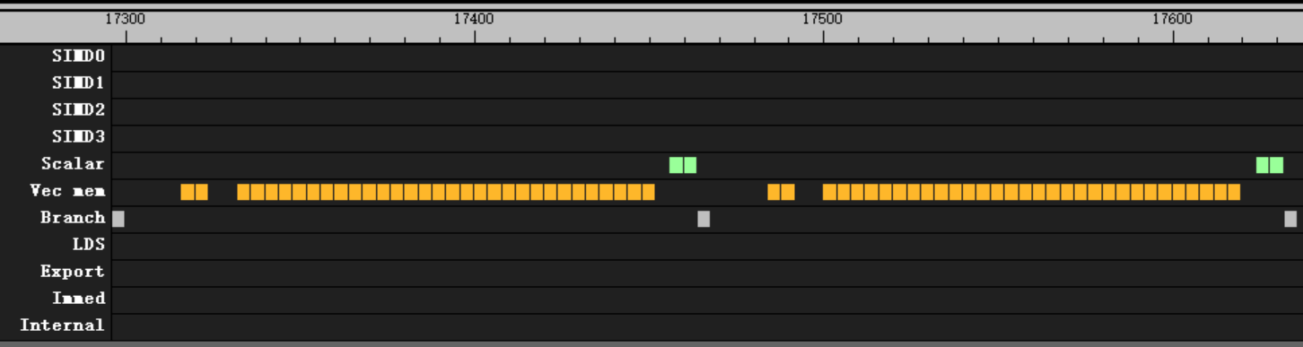
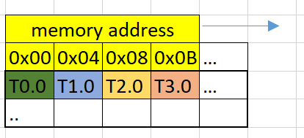
VMEM PERFORMANCE
Issue blocking due to l1 bank conflict
flat_load_dword with cacheline usage = 100%
Every continues 16 thread read one entire cacheline
No bank conflict
No block, every 4 clk per issue

Slide 7
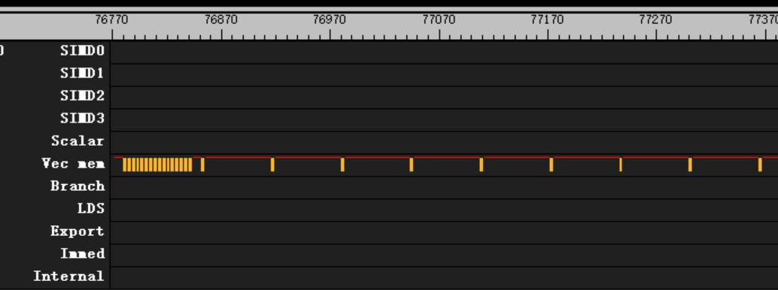
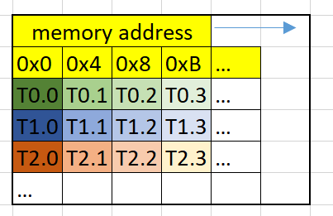
VMEM PERFORMANCE
Issue blocking due to l1 bank conflict
flat_load_dword with cacheline usage = 1/16
Every continues 16 thread read one entire cacheline
Every 16 thread has bank confilict
64 clk per issue after first 12 issue

Slide 8
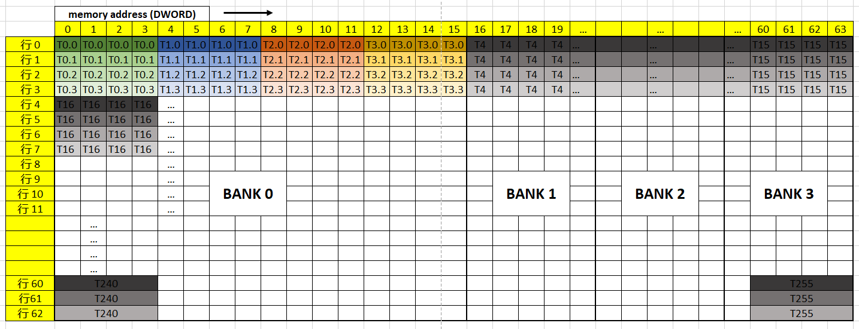
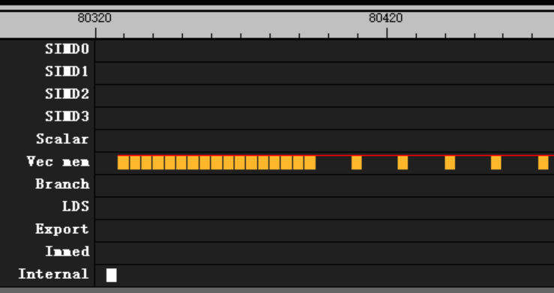
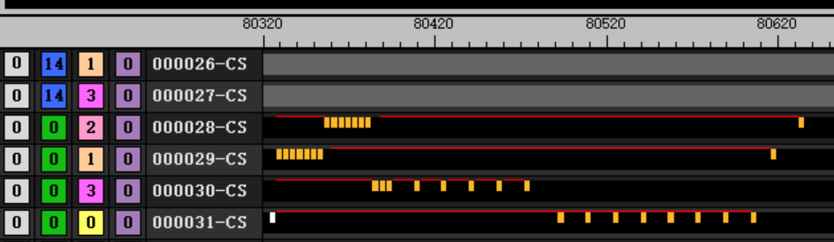
VMEM PERFORMANCE
Issue blocking due to l1 bank conflict
flat_load_dwordx4
cacheline usage = 100%, every continues 4 thread read one entire cacheline
bank usage = 100%, every continues 16 thread cover 4 banks
16 clk per issue after first 12 issue

Slide 9
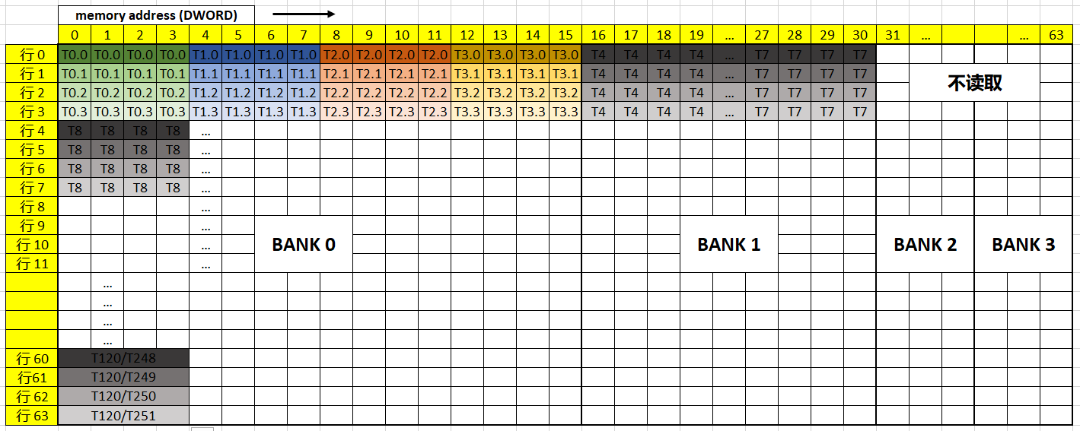
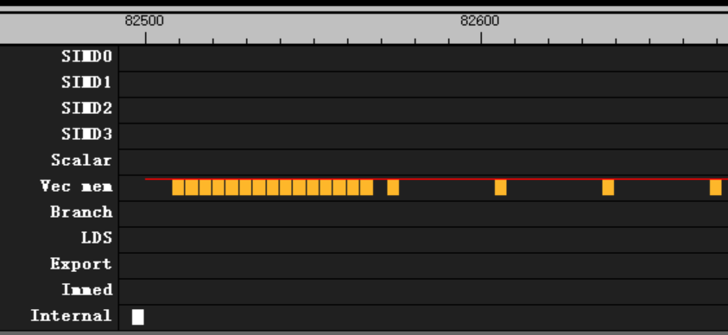
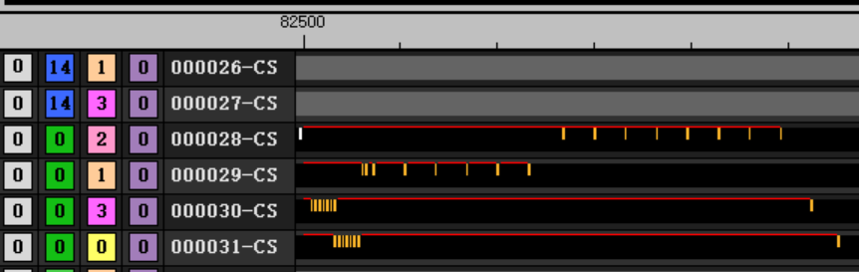
VMEM PERFORMANCE
Issue blocking due to l1 bank conflict
flat_load_dwordx4
cacheline usage = 100%, every continues 4 thread read one entire cacheline
bank usage = 50%, every continues 8 thread cover only 2 banks
32 clk per issue after first 12 issue

Slide 10
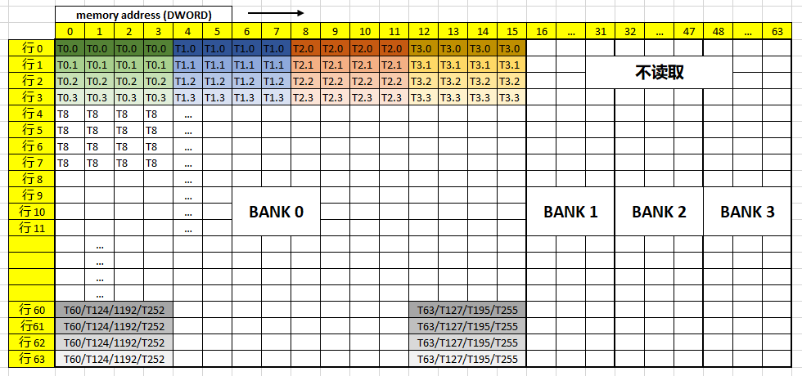
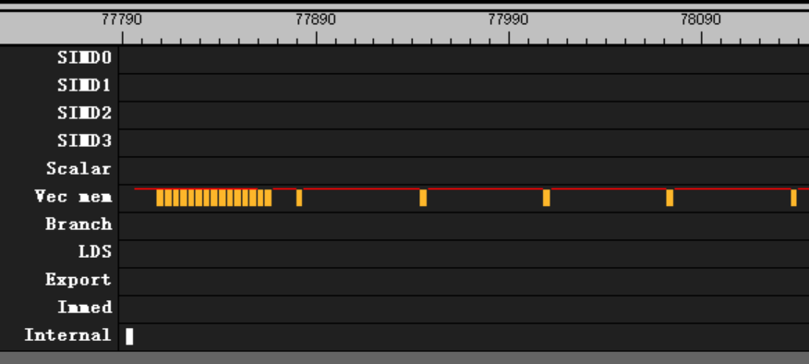
VMEM PERFORMANCE
Issue blocking due to l1 bank conflict
flat_load_dwordx4
cacheline usage = 100%, every continues 4 thread read one entire cacheline
bank usage = 25%, every continues 4 thread cover only 1 banks
64 clk per issue after first 12 issue

Slide 11
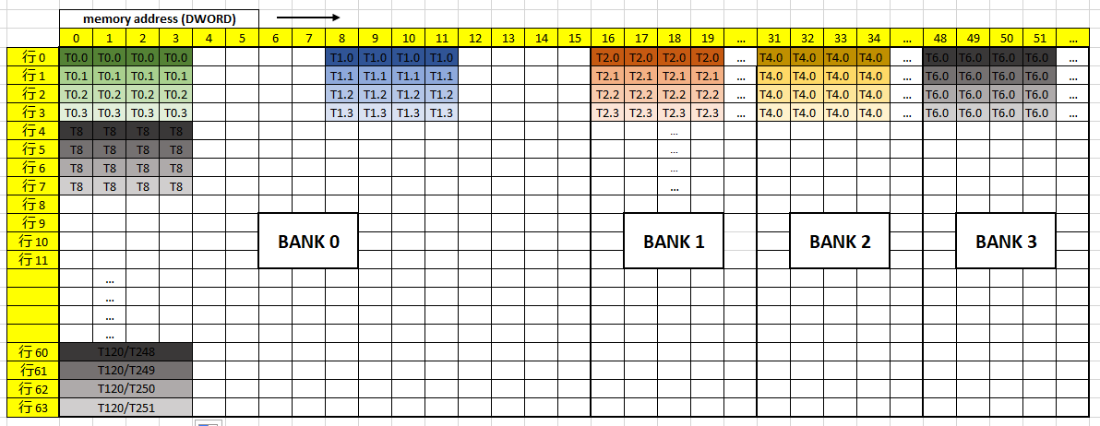
VMEM PERFORMANCE
Issue blocking due to l1 bank conflict
flat_load_dwordx4
cacheline usage = 50%, every continues 2 thread read half cacheline
bank usage = 100%, every continues 8 thread cover 4 banks
32 clk per issue after first 12 issue

Slide 12
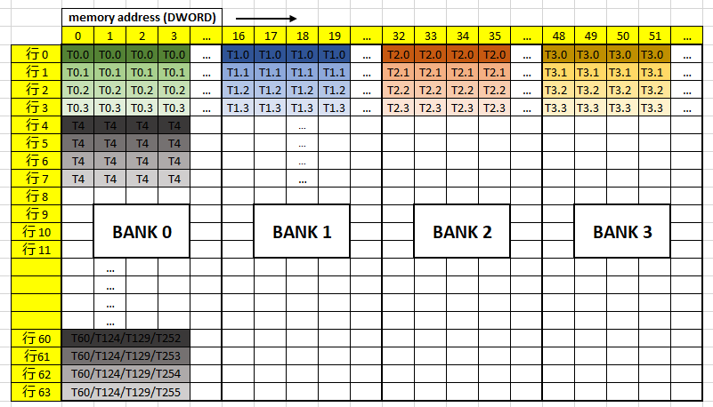
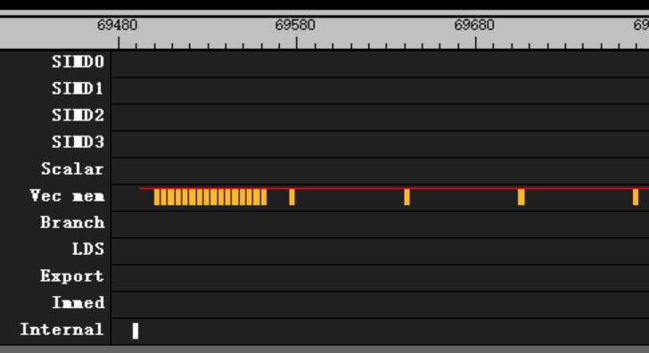
VMEM PERFORMANCE
Issue blocking due to l1 bank conflict
flat_load_dwordx4
cacheline usage = 25%, every thread read 1/4 cacheline
bank usage = 100%, every continues 4 thread cover 4 banks
64 clk per issue after first 12 issue

Slide 13
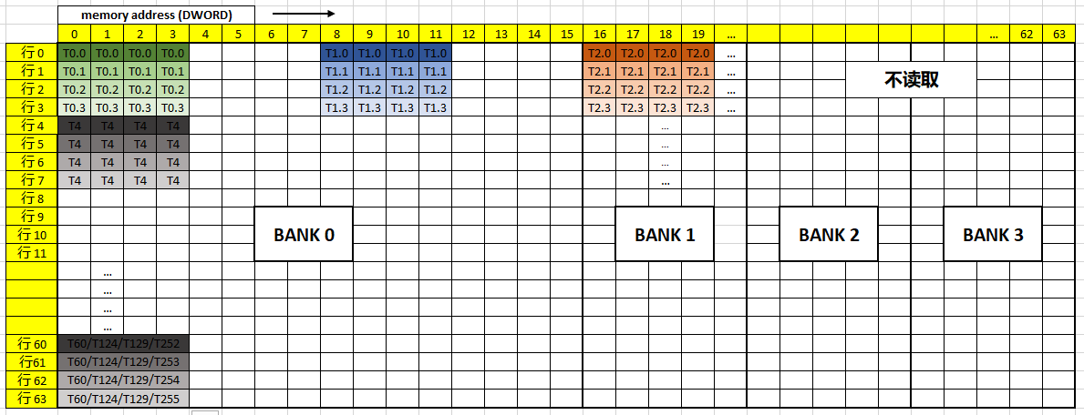
VMEM PERFORMANCE
Issue blocking due to l1 bank conflict
flat_load_dwordx4
cacheline usage = 50%, every continues 2 thread read half cacheline
bank usage = 50%, every continues 4 thread cover 2 banks
64 clk per issue after first 12 issue

Slide 14
VMEM PERFORMANCE
Issue blocking due to l1 bank conflict
flat_load_dwordx4
Other pattern
 |  | Bank usage
 |  | 100% | 50% | 25%
cacheline usage | 100% | 16 clk | 32 clk | 64 clk
 | 50% | 32 clk | 64 clk | 64 clk
 | 25% | 64 clk | 64 clk | 64 clk

Slide 15
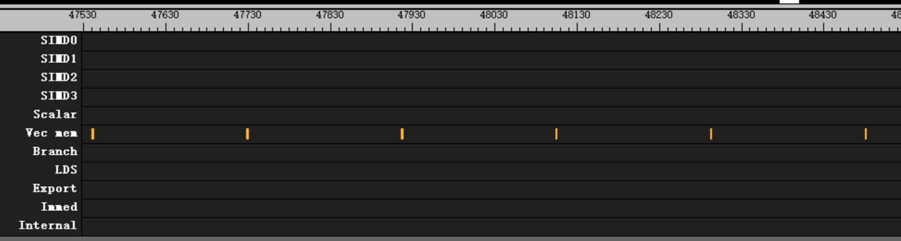
VMEM PERFORMANCE
Data return latency
Data return
1 wave per cu, flat_load_dwordx4 then waitcnt(0)
Total read = 4 DWORD * 64 thread = 256 DWORD
Theoretic elapsed = 256 / 16 = 16 clk
Data return in 184 clk
Latency = 168 clk

Slide 16
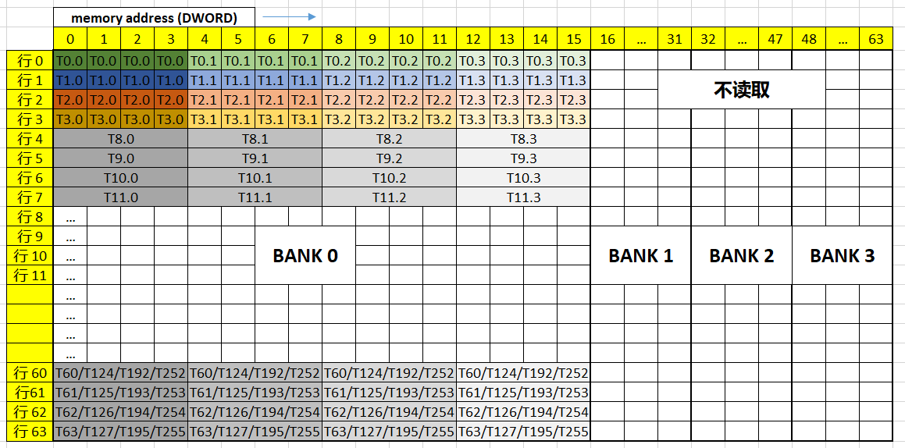
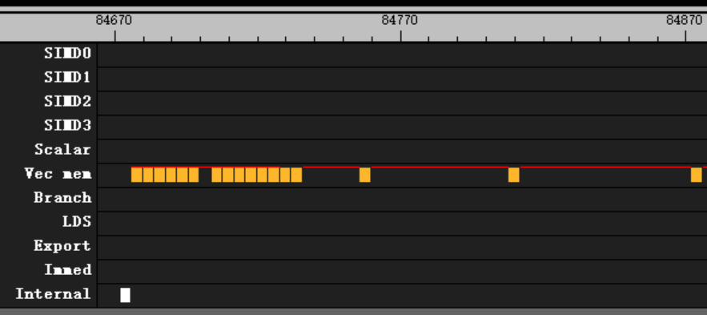
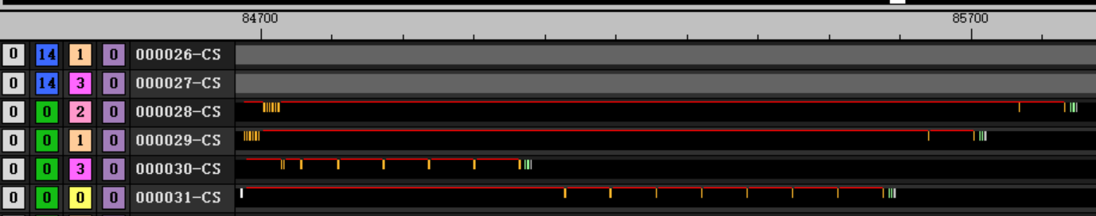
VMEM PERFORMANCE
Issue blocking due to l1 bank conflict
flat_load_dwordx4 with cacheline usage = ¼, with bank conflict
Every thread read different cacheline
Every continues 16 thread cover only 1 banks, 4 bank conflict
64 clk per issue after first 12 issue

Slide 17
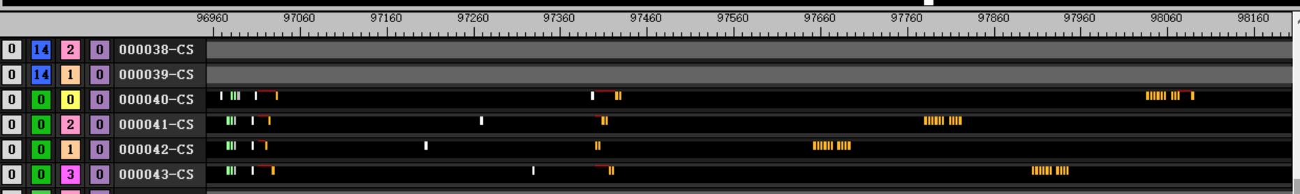
VMEM PERFORMANCE
Issue blocking due to l1 bank conflict
Best practice
cacheline usage = 100%
Every 16 thread has no bank conflict,
that means one wave cover 4 bank
also means address[7:6] should range from 00b to 11b within one wave
2 issue per wave after s_barrier
10 issue per wave after s_waitcnt

