Slide 1
VMEM PERFORMANCE
ISSUE BLOCKING DUE TO SQ BUFFER
Reason
12-depth Instruction buffer per wave
wait TA send back req-ack(not data back), then release
TA req takes 4 address token, one token takes 4 continues address data(dword)
So if 4wave/cu, flat_load_dwordx4, best coalescing
4 thread per req
1 wave = 64 thread = 16 req = 16 clk

Slide 2
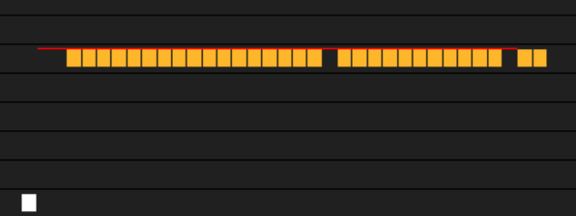
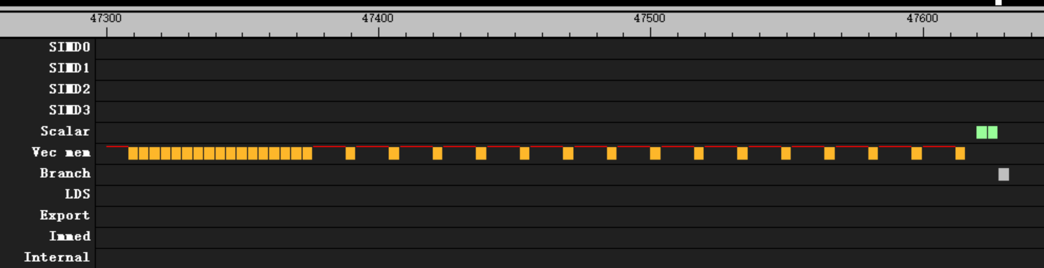
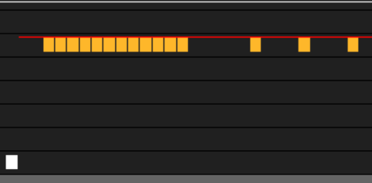
VMEM PERFORMANCE
ISSUE BLOCKING DUE TO SQ BUFFER
flat_load_dword
cacheline usage 100%: not block
cacheline usage<100%: first 12 issue not block
flat_load_dwordx4
only first 12 issue on the cu will not block
that means if we have 4 wave in one cu, we should only issue 3 flat_load_dwordx4 at most per thread to avoid issue blocking

