Slide 1
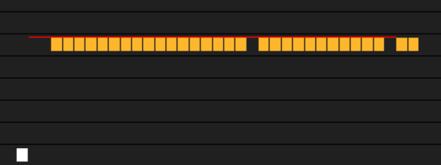
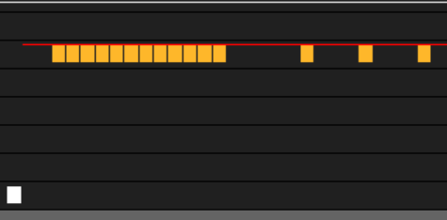
VMEM PERFORMANCE
ISSUE BLOCKING DUE TO SQ BUFFER
Reason
12-depth Instruction buffer per cu (TA?)
wait TA send back req-ack, then release
flat_load_dword
4 clk per issue per wave
will not block
flat_load_dwordx4
16 clk per issue per wave
only first 12 issue on the cu will not block
that means if we have 4 wave in one cu, we should only issue 3 flat_load_dwordx4 at most per thread to avoid issue blocking

