Slide 1
Software Engineering and Programming Basics
Data types, expressions, and methods
Authors of slides:
Prof. Dr.-Ing. Janet Siegmund
Prof. Dr.-Ing. Norbert Siegmund
Prof. Christian Lengauer
Partly extracted from script of PD Dr. Christian Bachmaier
Notes:
Zeit Folie : Zeit Gesamt (geschätzt)
1 : 1

Slide 2
Java Structure I
Object-oriented programming
Java consists of two parts:
Structure
Classes
Objects
Data types
How data/information is described and stored
Behavior
Methods
Which operations are executed on data
Example:
Components of a car vs. driving, filling up gas, scrapping it
Notes:
How is it with a library: What are its components, how can I describe ist behavior?
How about a person?
Zeit Folie : Zeit Gesamt (geschätzt)
3 : 1h20

Slide 3
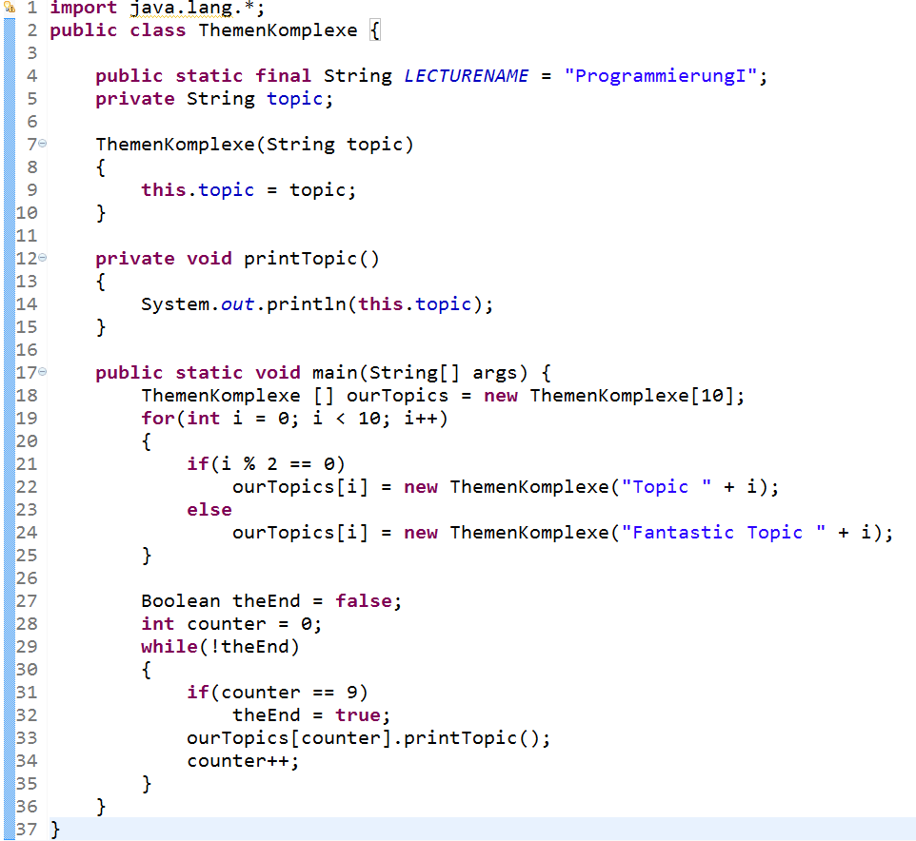
Example
Structure
Behavior
Notes:
Zeit Folie : Zeit Gesamt (geschätzt)
2 : 2

Slide 4
Topic today
Java classes
Structure
Variables, Constants
Data types (primitive & complex)
Notes:
Zeit Folie : Zeit Gesamt (geschätzt)
2 : 4

Slide 5
Learning Goals
Introduction to behavior of Java programs (i.e., how to describe what they should do)
Get to know methods (for reusing statements)
Get to know fundamental statements in Java
Get to know data types, especially primitive data types

Slide 6

Primitive and Complex Data Types
in Java
Notes:
Zeit Folie : Zeit Gesamt (geschätzt)
0 : 26

Slide 7
Why Data Types?
What is the result?
'1' + '2' =
1 + 2 =
'1' + 2 =
Data types define, what we can do with variables and constants, that is, which operations are necessary
99
3
51
What can I do with these?
Print to screen? Calculate? Combine? Search?
Does givenName + name make sense?
What would be the result
class Person {
givenName;
name;
age;
address;
}
Notes:
Studierende fragen…
Tafel: Vergleich mit Mathe: Gegeben x,y in R oder N -> bekannt, aber was ist wenn wir nun Gegeben: „x ist ein Stein“ oder „y ist ein Satz“ haben? Wir müssen ja dem Computer mitteilen, was wir damit vorhaben.
Zeit Folie : Zeit Gesamt (geschätzt)
4 : 30

Slide 8
Data types in Java I
Data types
Primitive
Complex
Numerical
array
boolean
class
Integer
Floating point
interface
byte
float
short
double
int
long
char
Notes:
Zeit Folie : Zeit Gesamt (geschätzt)
4 : 34
Come up with example and show in Eclipse

Slide 9
Data Types in Java II
Primitive data types are fundamental elements of every program
Complex data types are composed of primitive data types and other complex data types
class Person {
String givenName;
String name;
int age;
Address address;
}
Complex
Primitive
Notes:
Studierende fragen
Zeit Folie : Zeit Gesamt (geschätzt)
2 : 36

Slide 10
Internal Representations of Integers
Computer understands: Current or no current
Source of storage was 1 bit: Either 1 or 0
Thus, numbers are represented as binary numbers
8 Bit
2⁷ | 2⁶ | 2⁵ | 2⁴ | 2³ | 2² | 2¹ | 2⁰
[0;1] | [0;1] | [0;1] | [0;1] | [0;1] | [0;1] | [0;1] | [0;1]
2⁷ | 2⁶ | 2⁵ | 2⁴ | 2³ | 2² | 2¹ | 2⁰
0 | 0 | 0 | 0 | 1 | 0 | 1 | 0
10 =
=
8
+
2
Notes:
Zeit Folie : Zeit Gesamt (geschätzt)
4 : 48
Either there is power, or there isn‘t

Slide 11
Primitive Data Types I
Type | Length in bytes | Range
byte | 1 | -2⁷ to 2⁷ – 1 (-128 … 127)
short | 2 | -2¹⁵ to 2¹⁵ – 1 (-32768 … 32767)
int | 4 | -2³¹ to 2³¹ – 1 (-2147483648 … 2147483647)
long | 8 | -2⁶³ to 2⁶³ – 1 (−9223372036854775808 … 9223372036854775807)
float | 4 | ±(1.40239846E–45f . . . 3.40282347E+38f)
double | 8 | ±(4.94065645841246544E–324 . . . 1.79769131486231570E+308)
Notes:
These are lots of data types for numbers. Why do we need so many?
Zeit Folie : Zeit Gesamt (geschätzt)
3 : 44

Slide 12
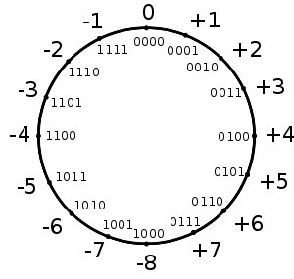

Negative Numbers in Binary
Ones' complement
Bit complement of absolute value
+5 = 0101₂ ; -5 = 1010₂
Range [-2^{b-1} +1; 2^{b-1} -1] ; b = 4 Bits
Problem: 0 = 0000₂ = 1111₂
Two‘s complement
Bit complement of absolute value + 1
-5 = 1010₂ + 1₂ = 1011₂
Range [-2^{b-1}; 2^{b-1} -1] ; b = 4 Bits
Careful with overflow
5+5 = -6
0 | 1 | 0 | 1
0 | 1 | 0 | 1
1 | 0 | 1 | 0
+
=
Notes:
Tafel: Einige Zahlen durchgehen, evt. auch Hexadezimal
Zeit Folie : Zeit Gesamt (geschätzt)
8 : 56

Slide 13
Internal Representation of Floating Point Numbers
float: Floating Point according to IEEE 754-Standard with 32 Bit
double: Fließkommazahl nach IEEE 754-Standard mit 64 Bit
Fraction = binary coded posive natural number
Exponent = binary coded posive natural number
Number x = Fraction * 10^2^Exponent
Sign
Exponent 8 Bit
Fraction 23 Bit
Sign
Exponent 11 Bit
Fraction 52 Bit
Notes:
2,345 * 10^2 -> exponent bestimmt stelle des Kommas == 234,5
Zahl: Mantisse * 2 ^ Exponent
Zahl x = m * 10^2^Exponent
Zeit Folie : Zeit Gesamt (geschätzt)
4 : 1h

Slide 14
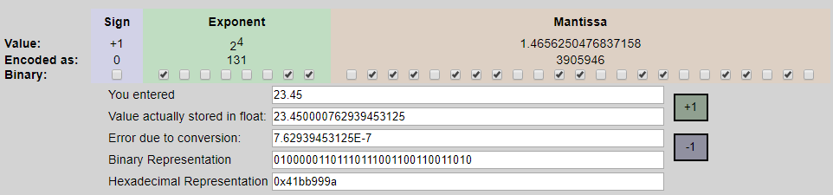
Example

Slide 15
Primitive Data Types II
Type | Length in Bytes | Range
char | 2 | 16-Bit Unicode Character ('\u0000' … '\uffff')
Characters:
All characters on the keyboard
National special characters ('ä', 'ß', 'ê‚…)
Characters of other languages (e.g., k
Zeichen aus anderen Sprachen (z.B., Cyrillic)
In Java labeled with „' “
Internal Representation:
4-digit number as hexadecimal value represent characteres ('a' = '\u0061')
Complete tabel(s) http://www.unicode.org/
\u lets Java know that it is a unicode character
Notes:
Tafel…
Zeit Folie : Zeit Gesamt (geschätzt)
5 : 41

Slide 16
Primitive Datentypen III
boolean: Two states: true oder false
Convention: primitive data types start with a small letter, complex data types start with a capital letter
The natural one exception: arrays
class Person {
String vorname;
String nachname;
int alter;
Ort wohnort;
}
Notes:
Zeit Folie : Zeit Gesamt (geschätzt)
2 : 1h2

Slide 17
Behavior in Java:
Methods
Notes:
Zeit Folie : Zeit Gesamt (geschätzt)
0 : 11

Slide 18

Methods in Java
Method head
Name
(Input)
{
Method body
}
Methods
Output
Method head
ReturnType Name([Parameter,…])
Type Name, Type Name, …
Method body
Sub program
[return expression];
Methods are also referred to as functions
Notes:
void isBirthday()
int getAge()
Song findSong(String title)
An Tafel den Zusammenhang mit Funktionen zeichnen y = f(x) = x^2 + 3x
Zeit Folie : Zeit Gesamt (geschätzt)
5 : 34

Slide 19
Content of Methods
Behavior of a program is encapsulated in methods
Goal: Split entire behavior of program in smaller methods
Behavior of objects of a class are stored in methods of this class
Possible content of methods:
Expressions: Computations/Operations/Assignments via data types
Creating (i.e., instantiating) an object: Construction of new objectsKonstruktion/Erschaffung neuer Objekte
Method calls: Activating and executing a method
Notes:
Zeit Folie : Zeit Gesamt (geschätzt)
2 : 36

Slide 20
Expressions in Java
Notes:
Zeit Folie : Zeit Gesamt (geschätzt)
0 : 36

Slide 21
Expressions
Constants and variables are combined with operators and assigned
There are different kind of operators:
Arithmetic to calculate with numbers
Logical to calculate with boolean values
Assignments, to assign values to variables or constants
Notes:
Zeit Folie : Zeit Gesamt (geschätzt)
1 : 37

Slide 22
Arithmetic Operators
# Operators | Operation | Example
unary | + - | int i = -5; int r = +5;
… | ++ -- (at the same time computation and assignment) | int i = 5; i++; // i == 6 ++i; // i == 7 --i; // i == 6 i--; // i == 5
… | ~ | int i = 1; i = ~i + 1; // ~ is one‘s complement: i == -1
binary | * / % + – | Arithmetic Operations (% == modulo → remainder of a division)
… | << >> >>> | int k = 2 << 3; // k == 16
 | & ^ | | int k = 2 & 1; // k == 0 k = 2|1; // k == 3
Arithmetic Operators are left associative:
1 / 2 / 4 == (1 / 2) / 4 == 0.125 but 1 / (2 / 4) == 2
Notes:
Frage an Studierende: i = ~5 +1; ? → -5
Warum +1? Weil Java Zweierkomplement verwendet
An Tafel: modulu zeigen ,
Aufgabe: Wochen zählen mit Hilfe von modulo Operation
Zeit Folie : Zeit Gesamt (geschätzt)
5 : 42

Slide 23
Logical Operators
# Operators | Operations | Example
unary | ! (NOT) | boolean a = false; a = !a; // a == true
binary | & (AND) | boolean a = true & false; // a == false
… | ^ (XOR) | boolean a = true ^ true; // a == false
… | | (OR) | boolean a = true | false; // a == true
… | && || | Lazy Evaluation: In case the first argument is sufficient for evaluation, the second argument is not evaluated. Useful, when: (x != 0) && (10 / x > 1) If the enitre expression would be evaluated and x was 0, division by zero! → error!
Logical operators are also follow left assocization:
false & false || true == (false & false) || true == false || true == true
but false & (false || true) == false & true == false
Overview: https://docs.oracle.com/javase/tutorial/java/nutsandbolts/opsummary.html
Notes:
Zeit Folie : Zeit Gesamt (geschätzt)
5 : 47

Slide 24
Relational and assignment operators
Assignment operators (right associative)
= += -= *= /= %= >>= <<= >>>= &= ^= |=
var x [operation]= y short for x = x [operation] y
Relational operators
< > >= <= == !=
Result is always boolean
Conditional expression/assignment
if [logical expression] ? [true case] : [false case]
int age = 20; String msg = age >= 18 ? „Access granted“ : „You are not old enough!";
Notes:
Zeit Folie : Zeit Gesamt (geschätzt)
3 : 50
Tafel

Slide 25
Examples
byte a = 28, b = 100;
byte c = a + b;
//c = -128
int d = a + b;
//d = 128;
int e = d<<1;
// e = 256
e >>= 1;
// e = 128
e *= -1;
// e = -128
e >>= 1;
// e = -64
e >>>= 1;
// e = 2147483616
byte f = 010;
// f = 8
byte g = 15;
g = (byte) (f|g);
// g = 15
f = (byte) (f&g);
// f = 8
f++;
// f = 9

Slide 26
Comments on Behavior
Increment is assignment at the same time
Operators are overloaded, i.e., have more than one meaning
int num1 = 2;
int num2 = ++num1; //num1 == num2 == 3; num = num1 + 1;
//num2 = [Operation] num1; kurz für:
num1 = num1 [Operation] 1;
num2 = num1;
num1 = 2;
num2 = ++num1 * 3; // ?
//num2 = num1[Operation];
kurz für num2 = num1;
num1 = num1 [Operation] 1;
num1 = 2;
num2 = num1++ * 3; // ?
String s = "Hi" + " there!";
//s == "Hi there!"
Notes:
Hiweis an Tafel:
Int a = 2;
(a++ > 2) || (x < 5)
//a == 2
Zeit Folie : Zeit Gesamt (geschätzt)
5 : 55
An Tafel umschreiben
num2 == 6

Slide 27
Binding Priorities (What is Evaluated First?)
Arithmetic before Comparison before logic before assignment
boolean b = x + 1 < 10 && x >= 5;
b = (((x + 1) < 10) && (x >= 5)); // false with x = 2
Unary before Multiplication/Division before Addition/Subtraction
int r = -1 * ++x + 3;
r = ((-1) * (++x)) + 3;
Hierarchy of priorties with 13 levels!
Setting braces changes priorities
int k = (2 + 4) * 5; // = 30 != 22
Could increase readability!
Notes:
Klammern entsprechen der Bindungspriorität
Zeit Folie : Zeit Gesamt (geschätzt)
2 : 57
Tafel

Slide 28
Quiz!!!
Arithmetic expressions: right or left associative?
Which of the following signatures are correct?
void int compute(int a, int b) {…}
double increment(int) {…}
void delay(double time) {…}
boolean isSaturday(today) {…}
char charForNumber(int nb,) {…}
What are the results of the following computations?
int a = 7;
int b = 2;
float c = 7/2;
c = ?
int t = -1;
int r = -1 * t++ + 3;
r = ? t = ?
int k = -1;
int l = -1 * ++k + 3;
l = ? k = ?
Notes:
Zeit Folie : Zeit Gesamt (geschätzt)
6 : 1h32
C = 2
T = 0
R = 4, da t++ erst nach der Berechnung erhöht wird
L = 3
K = 0

Slide 29
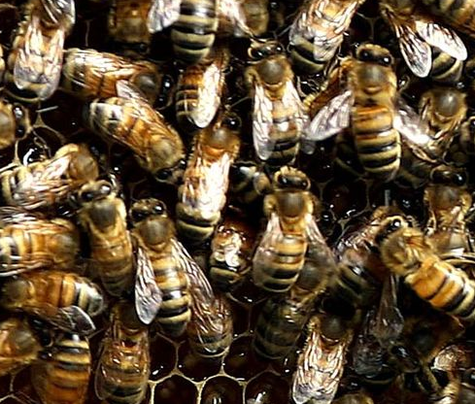
Modeling
Which attributes could the following classes have?
class Car {…};
class MusicCollection {…};
class Tweet {…}
Consider variables and constants as attributes
Combine complex types (classes) from other complex types (classes) and describe these, as well
3 to 5 minutes
Notes:
Live Eclipse Programmierung
Zeit Folie : Zeit Gesamt (geschätzt)
10 : 1h17

Slide 30




Was wissen wir schon?
Java classes
Data types (primitive & complex)
Notes:
Studierende fragen…
Zeit Folie : Zeit Gesamt (geschätzt)
4 : 1h21

Slide 31
Learning Goals:
Data types can be primitive or complex
Complex types conist of other types
Primitive types … you have to memorize them☺
Methods allow encapsulating several stateiments behind one dedicated name
Methods contain expressions to assign, change, or read values of variables and do computations
Notes:
Zeit Folie : Zeit Gesamt (geschätzt)
2 : 1h23

Slide 32
Coming Up Next
Control structures: How can I control how my program executes?
If-then-else statements
Switch-Case
Go to statements
Loops
Notes:
Zeit Folie : Zeit Gesamt (geschätzt)
2 : 1h25

Slide 33
Coming Up Next Time
Behavior of objects (not classes!)
What are methods?
How do I create objects of classes?
With the constructor!
Notes:
Zeit Folie : Zeit Gesamt (geschätzt)
1 : 1h24

