Slide 1
Software Engineering and Programming Basics
Control Structures
Authors of slides:
Prof. Dr.-Ing. Janet Siegmund
Prof. Dr.-Ing. Norbert Siegmund
Prof. Christian Lengauer
Partly extracted from script of PD Dr. Christian Bachmaier
Notes:
Zeit Folie : Zeit Gesamt (geschätzt)
1 : 1

Slide 2
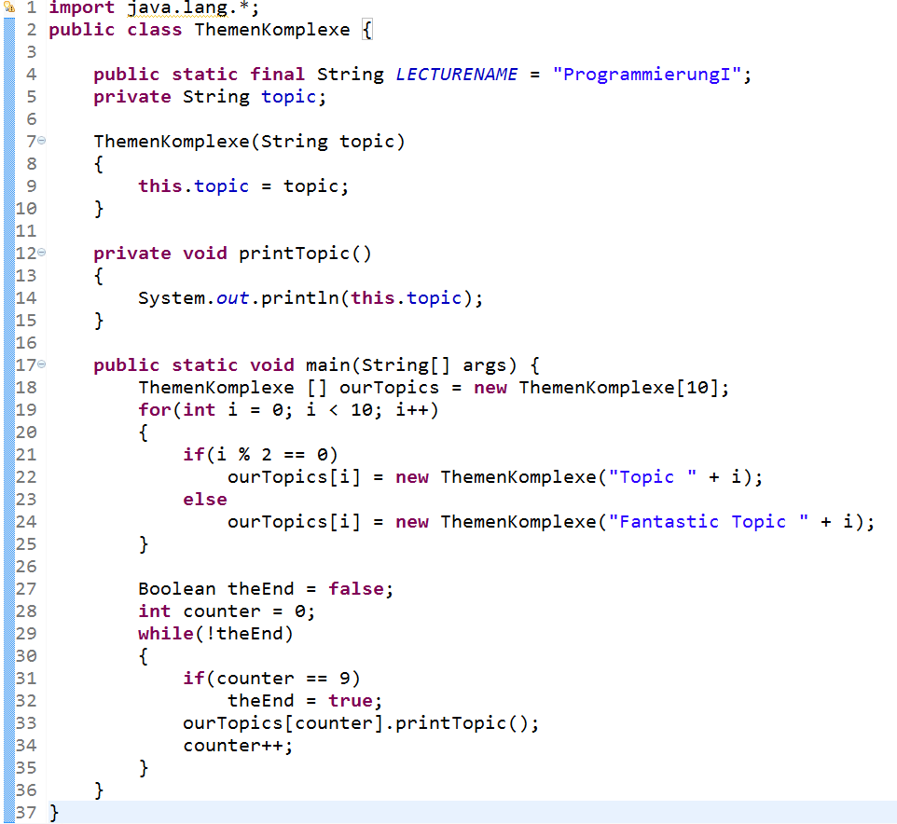
Catching Up I
Java-Klassen
Variablen, Konstanten
Zuweisungen,..
Methoden
Datentypen (primitiv & komplex)
Notes:
Zeit Folie : Zeit Gesamt (geschätzt)
1 : 1

Slide 3
Catching Up II
Methods implement behavior in Java
Methods have a head and a body
ReturnType Name ([Parameter, …] ) { [Body] }
void: nothing is returned
return indicates, what a method returns
There are special operations, that are defined in Java and which can be applied to variables and constants
Arithmetic, logical, relational, assignment
Have binding priorities
& und | evaluate both parts of an expression
&& und || are „lazy“, i.e., can return result after evaluation of left operand
Notes:
Zeit Folie : Zeit Gesamt (geschätzt)
2 : 3

Slide 4
Catching Up III
What categories of data types do exist?
Primitive
Complex
What are complex data types?
User defined classes
Composed from other (primitive or complex) data types
What are primitive data types?
Basic types that are provided by Java
Charactures, numbers, booleans
Notes:
Zeit Folie : Zeit Gesamt (geschätzt)
2 : 9

Slide 5
Today‘s Topic
Control structurers (if-then-else, loops)
Notes:
Zeit Folie : Zeit Gesamt (geschätzt)
1 : 7

Slide 6

The main method
Notes:
Zeit Folie : Zeit Gesamt (geschätzt)
0 : 1h15

Slide 7
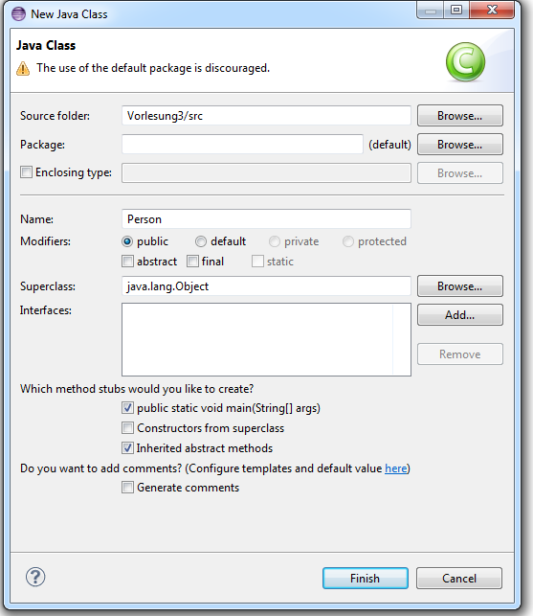
The „Start“-Method: main I
Problem: how should Java know, at which point in a program it should start?
Solution: special method that serves as entry point
public static void main(String[] args) {
// TODO Auto-generated method stub
}
Notes:
Zeit Folie : Zeit Gesamt (geschätzt)
2 : 1h17

Slide 8
The „Start“-Method: main II
Visibility:
Can be called from everywhere
(we‘ll get to that later)
Static:
The method can be called without creating an oject of this class (more details later)
public static void main(String[] args) {
// TODO Auto-generated method stub
}
Input paramters:
Array of String that are passed upon a program‘s start time
Return type:
Nothing is returned. Of course, when this metod ends, the program ends.
Identifier (the name of the method):
Java-specified name.
Notes:
Zeit Folie : Zeit Gesamt (geschätzt)
3 : 1h20

Slide 9
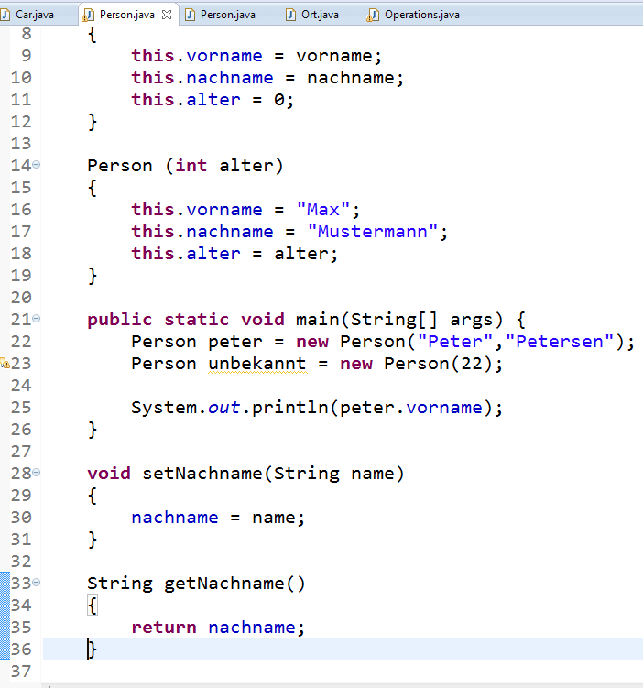
Eclipse Example
Printing text:
System.out.println(…);
Hint:
Type „syso“, then STRG+SPACE to let Eclipse
do the rest
Input of text:
Scanner sc = new Scanner(System.in);
sc.nextLine();
sc.nextInt();

Slide 10
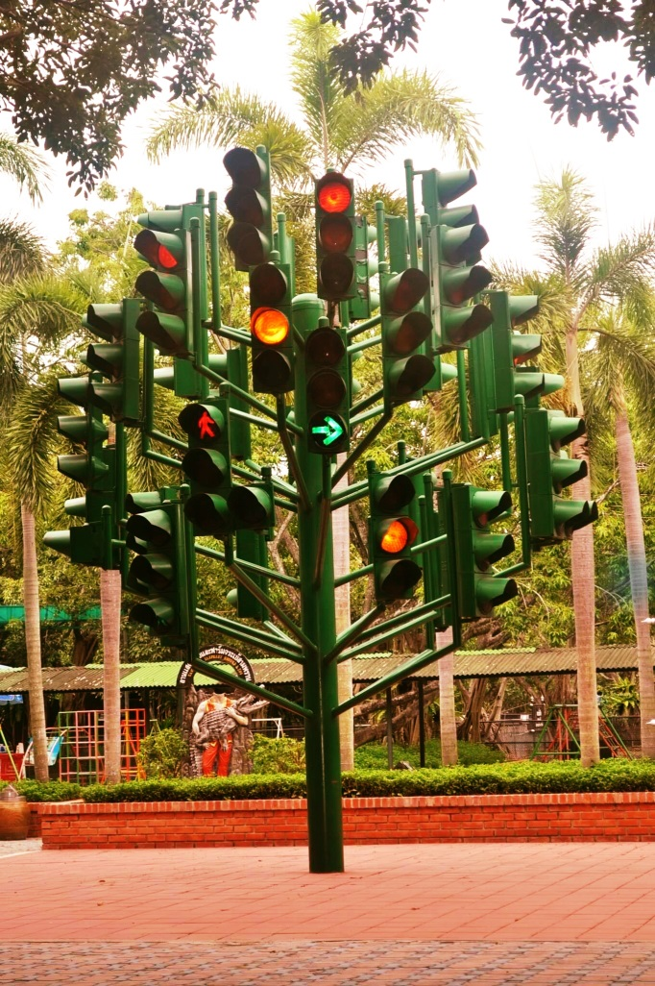
Control Structures
Notes:
Zeit Folie : Zeit Gesamt (geschätzt)
0 : 7

Slide 11

Conditional Branching I
Sequential Program Execution
Main method…
Create person of age 15
Logical Expression
Older than 18?
True
False
True
False
Buy beer
Buy lemonade
Branches influence sequential program execution
Keyword: if (logischer Ausdruck)
Can be nested
else (i.e., false case) is optional
Then, a single statement or a bock of statements (written between „{“ und „}“; i.e., they define start and end of a block)
Notes:
Zeit Folie : Zeit Gesamt (geschätzt)
3 : 10

Slide 12

Conditional Branching II
public static void main(String[] args) {
Person p = new Person(“Westley", “Crusher");
p.age = 15;
if (p.getAge() >= 18)
System.out.println(“full age!");
else if (p.getAge() >= 15){
System.out.println(“not yet full age");
}
else {
System.out.println(“Well, it takes some time.");
p.isBirthday();
}
}
Single statement, no curly braces necessary
18
Optional, but possible
Necessary for more than one statement
Jave needs to know what exactly should be executed in case true and in case false. Curly braces denote which statements belong to which case.
Notes:
Zeit Folie : Zeit Gesamt (geschätzt)
2 : 12
Frage an Studierende, wann kann es sinnvoll sein, den else Teil wegzulassen?

Slide 13
Pecularity
int b = 1;
int c = -1;
if (b == 1)
if (c > 0)
System.out.println("c is greater than 0");
else
System.out.println("c is smaller than or equal to 0");
No braces necessary, because another conditional is following
Watch out for the „dangling else“
int i = 1;
if (i <= 0)
if (i == 0)
System.out.println("i is zero");
else
System.out.println(i);
Immer Klammern verwenden!
else wird an das „nächste“ if gebunden: Keine Ausgabe
Notes:
Zeit Folie : Zeit Gesamt (geschätzt)
2 : 14
Wie lautet die bessere Schachtelung?

Slide 14
Selection: switch – case I
What do to with lots and lots of if-else statement?
Simpler alternative: switch – case!
if (a > 20) System.out.println(a);
else if (a > 19) System.out.println(a);
else if (a > 18) System.out.println(a);
else if (a > 17) System.out.println(a);
else if (a > 16) System.out.println(a);
else if (a > 15) System.out.println(a);
else if (a > 14) System.out.println(a);
else if (a > 13) System.out.println(a);
else if (a > 12) System.out.println(a);
else if (a > 11) System.out.println(a);
Notes:
Zeit Folie : Zeit Gesamt (geschätzt)
1 : 15

Slide 15
Selection: switch – case II
Enables multiple branching
case describes constant
Read: In case variable x == 10 evaluates to true, execute statements until break; for the case that x == 11 evaluates to true, execute statements until break;
Sequential program execution
switch (expression) {
case x:
case y:
case z:
case t:
Statements
break;
Statements
break;
Statements
break;
Statements
break;
}
Notes:
Zeit Folie : Zeit Gesamt (geschätzt)
2 : 17

Slide 16
Selection: switch – case II
Expressions can also contain computation
switch (3 * age) {
case 9:
System.out.println("You are 3 years old!");
break;
case 12:
System.out.println("You are 4 years old!");
break;
case 15:
System.out.println("You are 5 years old!"); ");
case 18:
System.out.println(" You are 5 or 6 years old!"); ");
break;
default:
System.out.println(„I‘m not sure about your age.");
}
Normal case
Without break, the following statements will be executed until the next break
Default: Standard case. Here is everything that does not fulfull the conditions covered by all the cases. (e.g.,: 6, 3, 3000, -21).
Notes:
Zeit Folie : Zeit Gesamt (geschätzt)
2 : 19

Slide 17
Selection: switch – case IV
Only certain expressions can be used with switch
Depends on return type of expression
Some primitive data types (char, byte, short, int, long)
A few complex data types (specified by Java)
Character, Byte, Short, Integer, Long, String
Enumarations (more details later)
Case expression needs
to be constant
final int ONE = 1;
int three = 3;
switch (a) {
case ONE:
System.out.println("One"); // Konstante -> ok
break;
case ONE + 1:
System.out.println("Two"); // Konstanter Ausdruck -> ok
break;
case three:
System.out.println("Three"); // Fehler: Kein konstanter Ausdruck
break;}
Notes:
Zeit Folie : Zeit Gesamt (geschätzt)
2 : 21

Slide 18

Loops
Notes:
Zeit Folie : Zeit Gesamt (geschätzt)
0 : 7

Slide 19

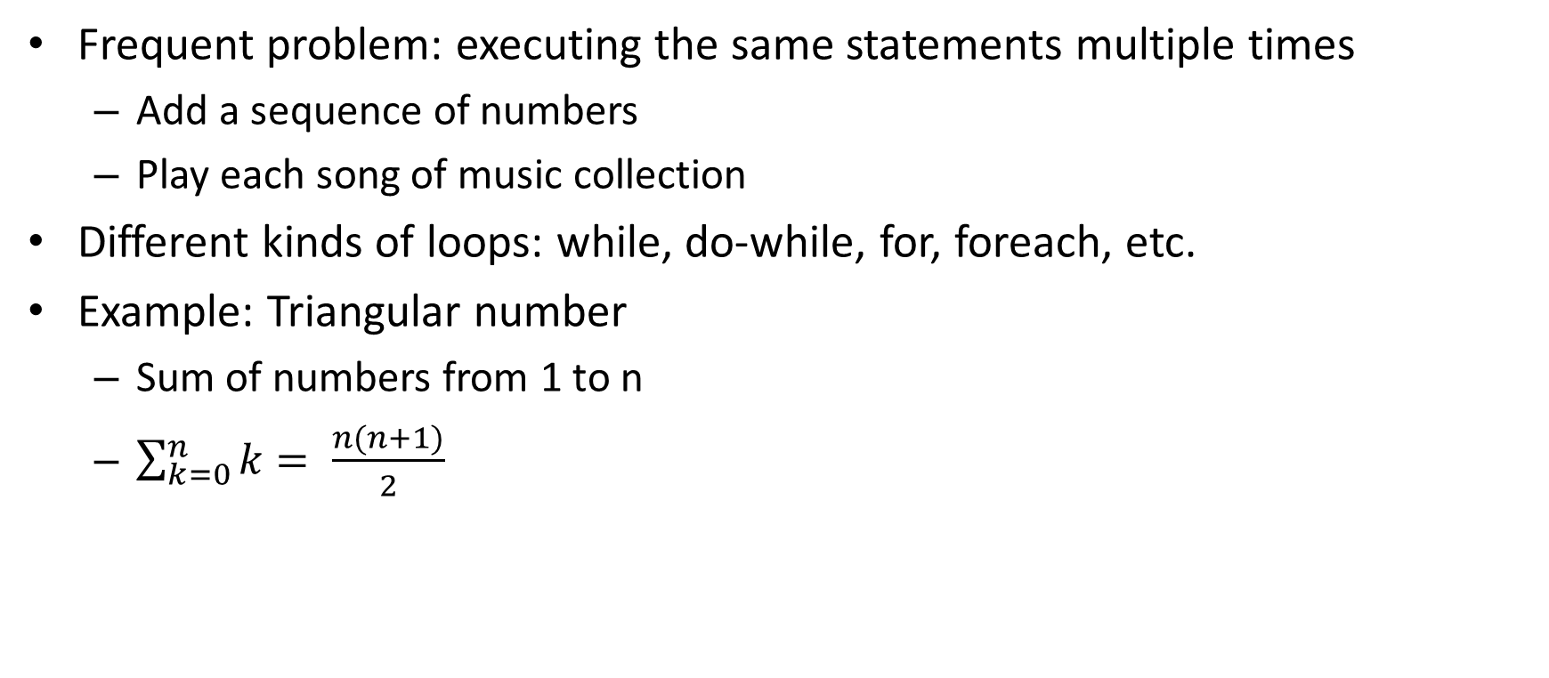
Loops I
Frequent problem: executing the same statements multiple times
Add a sequence of numbers
Play each song of music collection
Different kinds of loops: while, do-while, for, foreach, etc.
Example: Triangular number
Sum of numbers from 1 to n
$\sum_{k=0}^{n}{k= \frac{n(n+1)}{2}}$

Slide 20
Actually Used in First Lecture
1234
+5678
4
Setze Zeiger auf rechte Ziffer
Nimm Ziffer unter Zeiger 1. Zahl
Nimm Ziffer unter Zeiger 2. Zahl
Addiere beide Ziffern und merke sie in Variable sum
Schreibe rechte Ziffer der Variablen sum unter den Strich
Setze Zeiger eine Stelle weiter links
Falls keine Ziffer unter Zeiger
Falls linke Ziffer von sum > 0: Schreibe Ziffer unter Strich
Fertig!
Falls linke Ziffer von sum > 0: Nimm linke Ziffer von sum
Nimm Ziffer unter Zeiger 1. Zahl
Nimm Ziffer unter Zeige 2. Zahl
Addiere alle drei Ziffern und merke sie in Variable sum
Schreibe rechte Ziffer von sum unter den Strich
Gehe zu Schritt [6]
8
sum = 12
1234
+5678
2
3
7
sum = 11
1234
+5678
12
Notes:
Zeit Folie : Zeit Gesamt (geschätzt)
1 : 24

Slide 21
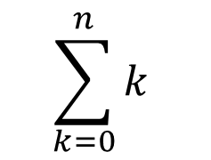
While – Loop
Rejecting loop (first condition is evaluated, then loop body is executed if condition evaluates to true)
while ([logical expression])
{
[statement]
}
public int triangularNumber(int n) {
int sum = 0;
int k = 0;
while(k <= n) {
sum = sum + k;
k = k + 1;
}
return sum;
}
Alternatively:
sum += k;
++k;
Notes:
Zeit Folie : Zeit Gesamt (geschätzt)
3 : 27
Tafel: main-methode anschreiben
Ausführung simulieren

Slide 22
do-while-loop
Non-rejecting loop (i.e., loop body will be executed at least once; post-test)
„;“ Don‘t forget!
do {
[statement]
} while ([logical expression]);
public int triangularNumber2(int n) {
int sum = 0;
int k = 0;
do {
sum = sum + k;
k = k + 1;
} while(k <= n);
return sum;
}
while(k <= n) {
sum = sum + k;
k = k + 1;
}
Notes:
Zeit Folie : Zeit Gesamt (geschätzt)
2 : 29

Slide 23
What Does the Following Code Print?
public void questionInLecture()
{
int line = 1;
while (line <= 5) {
int star = 1;
while (star <= 2 * line) {
System.out.print("*");
++star;
}
System.out.println();
++line;
}
}
**
****
******
********
**********
System.out.print() – Print to console
System.out.println() – Print to console and make new line
Notes:
Zeit Folie : Zeit Gesamt (geschätzt)
2 : 31

Slide 24
Hints
Termination: avoid infinite loops
Safe Stop condition:
Take care of overflow (e.g., values > 9)
Consider possible inaccuracies in computation
while(true);
public int unsafeAbort(int value)
{
while(value != 9)
++value;
return value;
}
public int safeAbort(int value)
{
while(value < 9)
{++value;}
return value;
}
better:
public void loop() {
double d = 0.0;
while (d != 1.0) {
d += 0.1;}}
public void loop() {
double d = 0.0;
while (d >= 0.99 || d <= 1.01) {
d += 0.1;}}
better:
Notes:
In Eclipse die untere Schleife programmieren und Ausgabe tätigen lassen
Zeit Folie : Zeit Gesamt (geschätzt)
3 : 34

Slide 25
Counting Loop: for
Counts ( [Start] ; [END] ; [DELTA COUNTER] ) { [Statements] }
[Initialization] is done once
Until [logical expression] evaluates to false, [statements] are executed
After each execution [assignment] is done
for ([Initialization]; [logical expression]; [assignment]) {
[statements];
}
public int triangularNumber3(int n) {
int sum = 0;
for (int k = 0; k <= n; ++k) {
sum = sum + k; //alternative: sum += k;
}
return sum;
}
while(k <= n) {
sum = sum + k;
k = k + 1;
}
Notes:
Zeit Folie : Zeit Gesamt (geschätzt)
2 : 36

Slide 26
Hints
A variable should be defined in head of loop and is then valid only in the loop body (not outside of loop)
The variable initialized in the head can be used in the loop body (but you should not do this)
public int triangularNumber3(int n) {
int sum = 0;
for (int k = 0; k <= n; ++k) {
sum = sum + k; //sum += k;
}
k++; //Error, k does not exist anymore!
return sum;
}
Notes:
Zeit Folie : Zeit Gesamt (geschätzt)
2 : 38

Slide 27
Relationship Between for and while
Translate the for loop to a while loop
public int triangularNumber3(int n) {
int sum = 0;
for (int k = 0; k <= n; ++k) {
sum = sum + k; //sum += k;
}
return sum;
}
public int triangularNumber(int n) {
int sum = 0;
int k = 0;
while(k <= n) {
sum = sum + k;
k = k + 1;
}
return sum;
}
3 to 5 minutes
for ([Initialization]; [Logical expression]; [Assignment]) {
[Statement];
}
[Initialization];
while ([logical expression]) {
[Statement];
[Assignment];
}
Don‘t forget to avoid inifite loops!
Notes:
Zeit Folie : Zeit Gesamt (geschätzt)
2 : 40

Slide 28
When for, when while?
Rule of thumb: for only for clean counting loops
Some informal critiera to use for:
Terminating condition is known before first iteration
Counting with a counting variable
All three expressions in loop head refer to the same variable
Assignments to counting variables do not appear in the loop body
Termination is easy to garanty, or even better…
… number of iterations (i.e., how often the loop is executed) is known before
Notes:
Zeit Folie : Zeit Gesamt (geschätzt)
2 : 44

Slide 29
„Go To“ Statements
Premature termination with break;
Execute next loop iteration with continue;
With nested loops, always the local loop is referred to
boolean run = true;
while(run) {
char option = readOption();
if(option == 'q') {//quit
break;
}}
for (int i = 0; i <= 10; ++i) {
if (i % 2 == 1) {
continue;
}
System.out.println("Number: " + i);
}
Notes:
2. Code gibt alle geraden Zahlen aus
Zeit Folie : Zeit Gesamt (geschätzt)
2 : 46

Slide 30
Scope I
Until now: curly braces to indicate where statements belong to
if ([logical expression])
{ [Statements in case true] }
else { [Statements in case false] }
Loops: while (…) { [Statements in loop] }
Method: void triangularNumber () { [Statements in Method] }
Klasse: class myClass { [Attributes, methods in class] }
New: curly braces show how long variables are valid
Notes:
Zeit Folie : Zeit Gesamt (geschätzt)
1 : 47

Slide 31
Scope II
Variables are valid only after their declaration in the block in which they are defined (and their sub blocks)
Variables with same name are not allowed in sub blocks (except class-/instance variables)
int i = 1;
if(i < 5){
int j = 3;
i++;
System.out.println(i + j); // 5
}
System.out.println(i); // 2
System.out.println(j); // Error: j is unknown here, is declared in inner block!
int i = 1;
if(i < 5){
double i = 1;
System.out.println(i); // unclear, which i is meant
Notes:
Zeit Folie : Zeit Gesamt (geschätzt)
2 : 49

Slide 32
Quizz!!!
Each loop contains two errors. Try finding and fixing them!:
public void errorLoops(char k) {
for(int i, i < 5; i++) {
System.out.println(i);
}
boolean run = true;
int x = 0;
while(k){
x++;
if(x > 5)
continue;
}
int counter;
do {
int counter = 10;
counter = counter - 2;
} while(counter > 0);
}
Semicolon instead of comma
i is not initialized. Fix: i = 0
No logical expression. Fix: while(run)
Infinite loop! Fix: break instead of continue
Scope-Error: counter declared twice
Infinite loop! counter is set to 10 again and again
Notes:
Zeit Folie : Zeit Gesamt (geschätzt)
5 : 57

Slide 33
Learning Goals
Loops allow executing the same statements multiple times:
while und for
Initialization of variables to evaluate terminating condition
Logical expression is checked at each iteration
Possibly change in counting variable
Scope „{ … }“ defines where variables are valid
Conditional branching with: if ([logical expression]) { [true] } + optional else { [false] }
The issues with the case statements
Notes:
Zeit Folie : Zeit Gesamt (geschätzt)
1 : 1h25

Slide 34
Coming Up Next
Object-oriented programming
Behavior of objects (not classes!)
What are methods?
How do I created objects of classes? -> With the constructor
Notes:
Zeit Folie : Zeit Gesamt (geschätzt)
1 : 1h27

