Slide 1
Einführung in die Programmierung Object Orientation
Authors of slides:
Prof. Dr.-Ing. Janet Siegmund
Prof. Dr.-Ing. Norbert Siegmund
Prof. Christian Lengauer
Partly extracted from script of PD Dr. Christian Bachmaier
Notes:
Zeit Folie : Zeit Gesamt (geschätzt)
1 : 1

Slide 2
Catching Up I
Klasse legt man in Java mit Schlüsselwort class an, gefolgt vom Namen der Klasse
Bisher: Nur Attribute der Klasse kennengelernt
Diese Vorlesung: Verhalten der Klasse
class Person {
String firstName;
String name;
int age;
Ort address;
}
Alles zwischen geschweiften Klammern beschreibt die Klasse (Struktur & Verhalten)
Notes:
Fragen: Wo ist hier das Objekt? -→ Keins da! Unterschied zw. Variable und tatsächlichem Objekt
Zeit Folie : Zeit Gesamt (geschätzt)
2 : 7

Slide 3

Scope I
Curly braces show scope of statements:
if ([logical expression])
{ [statements when true] }
else { [statements when false] }
Loops: while (…) { [statements in loop] }
Methods: void triangularNumber () { [statements in method] }
Class: class myClass { [attributes, methods in class] }
New: Curly braces show where variables are valid
Notes:
Zeit Folie : Zeit Gesamt (geschätzt)
1 : 47

Slide 4
Scope II
Variables are only valid in the block in which they have been declared (and in sub blocks)
Variables with same name in one block (including sub block) are not allowed (exepct class/instance variables)
int i = 1;
if(i < 5){
int j = 3;
i++;
System.out.println(i + j); // 5
}
System.out.println(i); // 2
System.out.println(j); // Error: j unknow here, is declared in inner block!
int i = 1;
if(i < 5){
double i = 1;
System.out.println(i); // unclear to which i is referred to
}
Notes:
Zeit Folie : Zeit Gesamt (geschätzt)
2 : 49

Slide 5
Catching Up: Quiz
There are two errors per loop. Find and fix them
public void errorLoops(char k) {
for(int i, i < 5; i++) {
System.out.println(i);
}
boolean run = true;
int x = 0;
while(k){
x++;
if(x > 5)
continue;
}
int counter;
do {
int counter = 10;
counter = counter - 2;
} while(counter > 0);
}
Semi colon instead of comma
i not initialized. Fix: i = 0
3 Minuten
No logical expression Fix: while(run)
Endless loop! Fix: break instead of continue
Scope-Error: counter is declared two times
Endless loop! counter is always set to 10
Notes:
Zeit Folie : Zeit Gesamt (geschätzt)
5 : 57

Slide 6
Wiederholung: Calculator
Implementieren Sie einen Taschenrechner auf Papier, der folgende Funktionen beherrscht:
Liest vom Nutzer 2 Ganzzahlen und die darauf anzuwendende Rechenoperation [+,-,/,*] ein
Berechnet das Ergebnis basierend auf der Eingabe und gibt das Ergebnis aus
Nach der Ausgabe des Ergebnisses, fragen Sie den Nutzer, ob er das Programm beenden möchte und reagieren sie auf die Eingabe „ja“ bzw. „Ja“ entsprechend

Slide 7
Java
Structure in Java: classes and objects
Variables
Data types
Constants
class Person {
String firstName;
String name;
int age;
Ort Address;
}
Notes:
Zeit Folie : Zeit Gesamt (geschätzt)
1 : 1h36

Slide 8
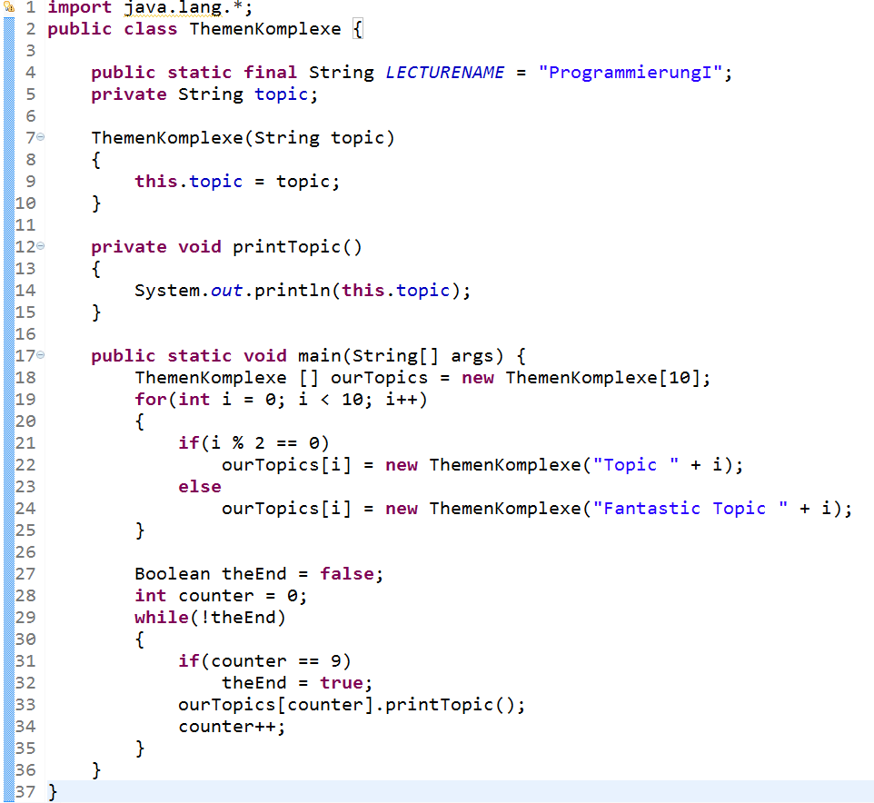
Example
Structure
Behavior
Notes:
Zeit Folie : Zeit Gesamt (geschätzt)
2 : 2

Slide 9
Today
Structure
Java classes
Variables, Constants
Constructors
OOP: Instantiation
Notes:
Zeit Folie : Zeit Gesamt (geschätzt)
2 : 4

Slide 10
Learning Goals
Getting to know object oriented programming
Getting to know the difference between classes and objects
Knowing how to create objects

Slide 11

Structure in Java
Notes:
Zeit Folie : Zeit Gesamt (geschätzt)
0 : 4

Slide 12
Variables
Variables of classes/objects = attributes
They have type and name: boolean hasSiblings;
Is called variable, because values can vary
class Person {
String vorname;
String nachname;
int alter;
Ort wohnort;
}
[TYPE] [NAME];
OPTIONAL: [TYPE] [NAME] = [WERT];
z.B.: int alter = 0; String vorname = "Max";
Notes:
Zeit Folie : Zeit Gesamt (geschätzt)
3 : 1h5

Slide 13
Constants
Defined once, cannot be changed once the program is running
Are described by type and name (like variables)
Name has to consist of capital letters
In Java, defined by keyword final (as in: „Java rocks, and that‘s final!“)
final [TYPE] [NAME] = [WERT];
final double PI = 3.14159265359;
final int DAYS_IN_YEAR = 365;
Notes:
Zeit Folie : Zeit Gesamt (geschätzt)
2 : 1h7

Slide 14
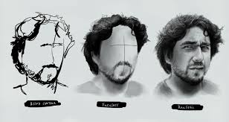



What Is Object-Oriented Programming?
Programming Paradigm
Idea: Structure program according to real-world structures
Different concpets
This time: Abstraction – Select only the relevant properties of an object
More concepts will follow
Notes:
Zeit Folie : Zeit Gesamt (geschätzt)
3 : 7
What do you think? What do I need to describe a person?
Abstraktion kommt immer auf den Anwendungsfall an:
z.B: Sinnesorgane -> Ohren, Auge, Nase, Mund; Haare egal; Friseur: Gesicht kann auch einfach nur Oval sein; Haare sind entscheidend

Slide 15
Why Do I Need Object-Oriented Programming?
Idea or problem needs to be put from your „head“ to the „computer“
Object-oriented programming is one way to do it
Example:
Store a music collection
How do I describe „music collection“ in a program?
Class for collection
Collection consists of single songs (class for songs)
Songs have composers, singers, titel, duration, etc.
Saving, searching, filtering, playing are actions that I apply to them
Structure
Behavior
Notes:
Zeit Folie : Zeit Gesamt (geschätzt)
3 : 10
Studierende fragen

Slide 16
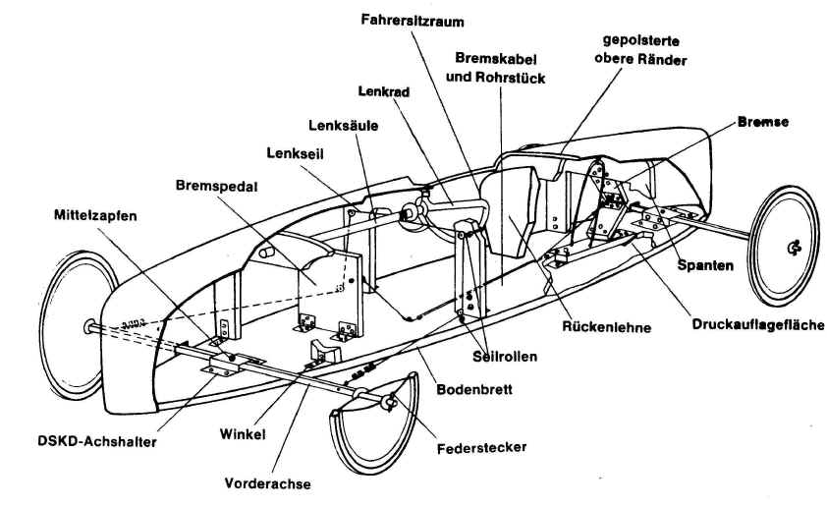

Classes and Objects
Classes = Template/Description of properties that an object must have
Example: Car
4 Tyres
Color
Engine (Horsepowers)
Object = Concrete instance of class
Example: „My Car“
4 Tyres: Sommer tyres of Pirelli
Color: Orange
Engine: 170 Horsepowers
Notes:
Zeit Folie : Zeit Gesamt (geschätzt)
4 : 14
Fragen: andere Instanz

Slide 17
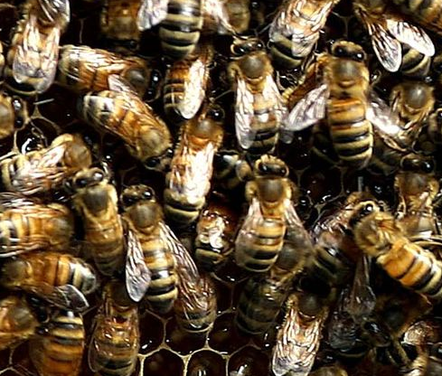
First Concrete Example of a class
In Java
class Person {
String givenName;
String name;
int age;
Ort address;
}
Class: Person
Given name
Name
Age
Address
Point
Line
Rectangle
class Point {
int xCoord,yCoord;
}
class Line {
Point start;
Point end;
}
3 to 5 minutes
class Rectangle {
Line horizontal;
Line vertical;
}
Notes:
Zeit Folie : Zeit Gesamt (geschätzt)
10 : 24
What kind of properties could the following classes have?
Evtl in Eclipse eingeben

Slide 18
Formal: Declaring a Class
class [Name] {
[Declaration of attributes]
[Declaration of methods]
}
Structure:
Attributes = Properties of a class
Example: Name und Age of a Person
Methods = Functions of the class
Example: maries, isGoingToWork
Convention: First attributes, then methods (you are helping your tutor a lot if you follow the conventions)
Notes:
Zeit Folie : Zeit Gesamt (geschätzt)
2 : 26
Why does this convention make sense? You first want to know the properties of a class, then you know what to take care of during abstraction

Slide 19
Behavior in Java:
Methods of Objects
Notes:
Zeit Folie : Zeit Gesamt (geschätzt)
0 : 11

Slide 20
What Does Behavior Mean?
Describes possible actions of an object of a class
A car can: drive, be filled up with gas, be repared, or get broken
A song can: be played, stopped, rewound, or deleted
All objects of a class have the same behavior
Behavior is defined via methods
A piece of code that defines exactily the behavior
Notes:
Zeit Folie : Zeit Gesamt (geschätzt)
2 : 13

Slide 21
Behavior of Objects
Is defined via (instance) methods
(Input)
Name
Methods
Output
class Person {
int age;
( )
getAge
Age of concrete person (int)
Method
(int newAge )
setAge
Nothing: void
Method
}
Notes:
Mit Studierenden die Methoden der Klasse Person entwickeln
Zeit Folie : Zeit Gesamt (geschätzt)
4 : 17

Slide 22

Methods of Objects
Example:
Instance methods are defined within a class, yet they apply to objects (instances) of this class
Thus, you need to first create an object, before you can use an instance method
In other words:
Before I can ask about age, I need a concrete person
class Person {
String givenName;
String name;
int age;
Residence address;
void setName(String name) {
this.name = name;
}
String getName() {
return this. name;
}
void isBirthday () {
this.age = this.age + 1;
}
void movesHouse(Residence newAddress) {
this.address = newAddress;
}
}
Notes:
Zeit Folie : Zeit Gesamt (geschätzt)
4 : 21
Remeber that a class is a template. I cannot ask the template how old it is.

Slide 23
Example
Class Person:
Object person1
Object person2
Name:
Sisko
Picard
GivenName:
Benjamin
Jean-Luc
Age:
42
52
Address:
Deep Space Nine
Enterprise
void isBirthday() {
this.age = this.age + 1;
}
int getAge() {
return this.age;
}
void setAge(int age) {
this.age = age;
}
Object person3
Janeway
Kathryn
37
Voyager

Slide 24
Methods of Objects II
What further behavior could an object of class person have?
Which behavior could be defined by the following classes?
class Book {…};
class MusicCollection {…};
class Tweet {…}
3 to 5 minutes
Notes:
Studierende sollen Murmelgruppen bilden
Zeit Folie : Zeit Gesamt (geschätzt)
8 : 29

Slide 25

Creating Objects
Constructor and Instantiation
Notes:
Zeit Folie : Zeit Gesamt (geschätzt)
0 : 57

Slide 26

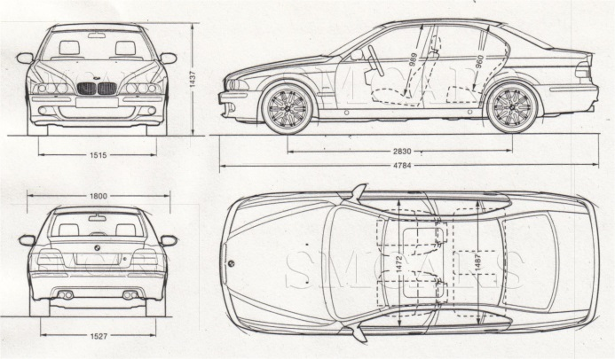

Constructor
How do I get from the class to an object
Factor / Constructor
Notes:
Zeit Folie : Zeit Gesamt (geschätzt)
1 : 58

Slide 27
Constructor in Java I
Special method: creates new object (a.k.a instance) of a class
Syntactical difference between a constructor and a method:
Constructor has the same name as the class of which it creates an object
Are the only method without a return type (side effect: creation of an object of that class, return: pointer to the object)
More than one constructor per method is possible, but with a different signature
Notes:
Zeit Folie : Zeit Gesamt (geschätzt)
5 : 1h3
Tafel: Methodensignatur?

Slide 28
Constructor in Java II
class Person {
String vorname;
String nachname;
int alter;
Person(String vorname, String nachname) {
this.vorname = vorname;
this.nachname = nachname;
this.alter = 0;
}
Person(int alter) {
this.vorname = "Max";
this.nachname = "Mustermann";
this.alter = alter;
}
}
Example:
Default-Constructor in Java
Is added automatically by the compiler and is empty
Does not contain any parameters or statements
Notes:
Zeit Folie : Zeit Gesamt (geschätzt)
2 : 1h5

Slide 29
Instantiation
Creation of new object with the new Operator
new triggers a call to the constructor
Example:
Consequences:
Object is created physically in memory
Return of call to constructor is pointer to new object of the class
Person peter = new Person("Peter","Petersen");
Person unknown = new Person(22);
Notes:
Zeit Folie : Zeit Gesamt (geschätzt)
2 : 1h7

Slide 30
Coming Soon: References/Pointers
Variable with class type contains reference/pointer to an object
Person peter = new Person("Peter","Petersen");
Variables:
Store references for complex data types
Memory:
peter
"Peter"
"Petersen"
0
Person x = peter;
"y"
"yx"
0
x
Person yyy = new Person("y","yx");
yyy

Slide 31
Constructor and Instantiation
What are the signatures of the constructors for the classes Book and MusicCollection?
What is the call to the constructors of the class Tweet?
class Buch {
Buch(String author, String title){…}
Buch(int jahr){…}
}
class Musiksammlung {
Musiksammlung(boolean myFavorite){…}
Musiksammlung(char category, double cost, String owner){…}
}
class Tweet {
public static void main(String[] args) {
Tweet myTweet = new Tweet(“Hello World!”);
Tweet repeatTweet = new Tweet(“yes”,5);
Tweet delayTweet = new Tweet(“Hihi”,3.5,true);
}
}
3 to 5 minutes
Notes:
Studierende sollen Murmelgruppen bilden
Zeit Folie : Zeit Gesamt (geschätzt)
8 : 1h15

Slide 32

Method Calls
Notes:
Zeit Folie : Zeit Gesamt (geschätzt)
0 : 1h15

Slide 33
Call to Methods of an Object
Done with „.“ (dot)
Variable + method name + (correct parameters)
Access to attributes of object also with „.“ (dot)
peter.isBirthday();
int age = peter.getAge(); // 1
peter.isBirthday();
age = peter.getAge(); // 2
peter.age = 20;
Notes:
Hatten ja gesagt:

Slide 34
Calling Methods of the Same Object
What if I am the person William and want to call my methods?
I can refer to „myself“ via this (or omit this, in case it is unambiguous)
Using this can avoid naming conflicts (this.x refers to attribute x; x possibly to local variable of a method)
william.turnsOlder();
void turnsOlder()
{
this.isBirthday();
isBirthday();
}
Here, I am the object, that is William

Slide 35
Scope in OOP
With a class/instance variable of the same name as a local variable, the local variable has precedence
class Person {
String firstName;
String name;
int age;
Person(String firstName, String name) {
this.firstName = vorname;
this.name = nachname;
this.age = 0;
}…}
Instance variables (store name and age for every object of type Person)
Local variable with the same name
Local variable has precedence
Using this, the instance variable is used
Notes:
Zeit Folie : Zeit Gesamt (geschätzt)
3 : 52

Slide 36
Quiz!!!
Define the subset relations for: Data types, classes, primitive types, complex types, boolean, int, char
Which of the following lines of code are correct?
class Auto = 5;
int alter = "30";
double zahl = 5;
char zeichen = 'a';
char zeichen2 = 'ab';
boolean hasChildren = 0;
What are the curly braces for?
Which errors do you see?
class Tank {
int fuel = 10
}
double preis := 1.31;
class Auto{}
int alter = 30; /String alter = "30";
double zahl = 5;
char zeichen = 'a';
char zeichen2 = 'b';
boolean hasChildren = true;
Notes:
Zeit Folie : Zeit Gesamt (geschätzt)
6 : 1h30

Slide 37
Take Aways
Class ≠ objects
A class is a form or template
An object of a class is an instance (a real representative) with according format
Necessity and special properties of constructors
Role of the keyword this

Slide 38





What Do We Know?
Java classes
Variables, constants
Constructors, assignments,..
Methods
OOP: Instantiation
Data types (primitive & complex)
Constrol structures
Notes:
Studierende fragen…
Zeit Folie : Zeit Gesamt (geschätzt)
1 : 1h28

