Slide 1
Software Engineering and Programming Basics Arrays, Strings, Static-Schlüsselwort
Authors of slides:
Prof. Dr.-Ing. Janet Siegmund
Prof. Dr.-Ing. Norbert Siegmund
Prof. Christian Lengauer
Partly extracted from script of PD Dr. Christian Bachmaier
Notes:
Zeit Folie : Zeit Gesamt (geschätzt)
1 : 1

Slide 2

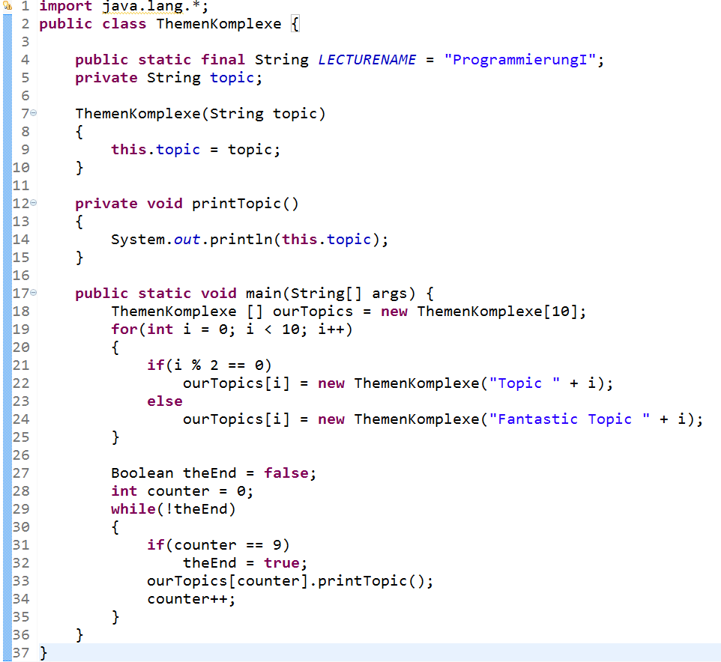




What Do We Know?
Java classes
Variables, constants
Constructors, assignments,..
Methods
OOP: Instantiation
Data types (primitive & complex)
Constrol structures
Notes:
Zeit Folie : Zeit Gesamt (geschätzt)
1 : 1

Slide 3
Catching Up I
Class consists of…
Attributes (structure)
Methods (behavior)
Object is…
eine Instanz einer Klasse
Attribute haben einen konkreten Wert
Notes:
Studierende fragen
Zeit Folie : Zeit Gesamt (geschätzt)
2 : 3

Slide 4

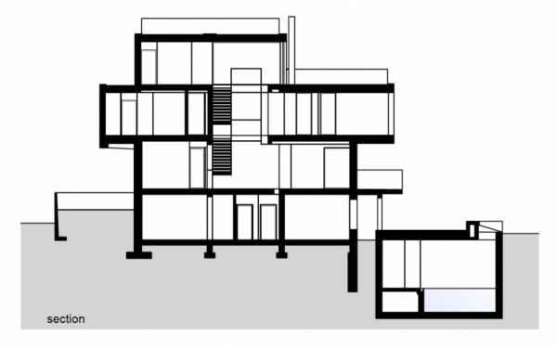


Catching Up II
Object
Class
Object or class?
Class
Class
Name:
Object
Given Name:
Age:
Address:
Notes:
Studierende fragen
Zeit Folie : Zeit Gesamt (geschätzt)
2 : 5

Slide 5
Catching Up III
There are special methods, a.k.a constructors, that create an object of a class
Constructors have no return type
Need to have the same name as the class
Constructors are called via new
Variables safe a reference (pointer) to a data of a complex data type in memory
Notes:
Zeit Folie : Zeit Gesamt (geschätzt)
2 : 3

Slide 6
Catching Up IV
What has precedence within a method: A local variable or an attribute in a class that has the same name as the local variable?
Local variable
How can I access instance variable instead?
Keyword this
Notes:
Zeit Folie : Zeit Gesamt (geschätzt)
2 : 5

Slide 7
Topic Today
Strings
Static
Arrays
Notes:
Zeit Folie : Zeit Gesamt (geschätzt)
1 : 1h14

Slide 8
Learning Goals
Getting to know the difference between static and instance methods and attributes
Getting to know the simplest of the complex data types: Array
Getting to know the class String
Notes:
Zeit Folie : Zeit Gesamt (geschätzt)
1 : 12

Slide 9

Static Attributs and Methods
Notes:
Geschätzte Zeit:
0:39

Slide 10

Methods of Objects
Example:
Instance methods are defined within a class, yet they apply to objects (instances) of this class
Thus, you need to first create an object, before you can use an instance method
In other words:
Before I can ask about age, I need a concrete person
class Person {
String givenName;
String name;
int age;
Residence address;
void setName(String name) {
this.name = name;
}
String getName() {
return this. name;
}
void isBirthday () {
this.age = this.age + 1;
}
void movesHouse(Residence newAddress) {
this.address = newAddress;
}
}
Notes:
Zeit Folie : Zeit Gesamt (geschätzt)
4 : 21
Remeber that a class is a template. I cannot ask the template how old it is.

Slide 11
static Keyword
Problem: Objects are not always necessary to execute some action
Mathematical computations
Physical formulas
In general: utility functions
Management variables to get some statistics about the objects of a class (e.g., the number of objects)
Idea: static denotes methods and attributes of classes that can be called without creating an object first
Notes:
Geschätzte Zeit:
2:41

Slide 12
Static vs. Instance: Methods
Instance:
Methods can only be applied to objects of a class (need to be instantiated first)
Static:
Methods can be used without creating an object
Statics methods cannot be applied to instnace (non-static) variables and methods within the same class (because this would require an object)
Notes:
Geschätzte Zeit:
2:43

Slide 13
Static vs. Instance: Variables
Instance:
Variables are valid only per object
Static:
Variables are independent of the objects of a class
Each object of a class sees exactly the same variable
Notes:
Geschätzte Zeit:
2:43

Slide 14
Using Static
Definition with keyword static
Usage:
className.Attribute
className.Method
Hinweis: CLASSNAME, not name of object!
Person. numPeople = 20; (not: kathryn.numPeople = 20)
Math.sqrt(4);
Constants
final double PI = 3.14159265359; // stored per object (not good)
final static double PI = 3.14159265359; // stored only once (good)
Notes:
In Enclipse zeigen inkl. Fehler, wenn von static auf nicht static zugegriffen wird
Geschätzte Zeit:
5:48

Slide 15
Static vs. Instance
Static oder Instance… Wie würden Sie die Methode / das Attribut implementieren?
Methode / Attribut: | Static (A) | Instance (B)
M: Change age of a person
A: Number of all created persons
M: Multiplying two numbers
M: Compare a person with another person
A: Friends of a person
A: Books of a library
A: Value-added tax (VAT)
3 to 5 minutes
Notes:
B;A;A;B;B;B;A

Slide 16

Arrays
Notes:
Zeit Folie : Zeit Gesamt (geschätzt)
0 : 57

Slide 17
Arrays I
What do we do, when we want to store the 9 best friends (also persons) of a person?
What do we do when we want to store our Twiiter-followers? Add 100 persons?
Songs of a music collection?
class Person {
Person freund1;
Person freund2;
Person freund3;
Person freund4;
Person freund5;
Person freund6;
Person freund7;
Person freund8;
Person freund9;
…
}
Notes:
Zeit Folie : Zeit Gesamt (geschätzt)
1 : 58

Slide 18
Arrays II
Answer: Array as composed complex data structure
Several values/objects of the same type will be summarized in one variable
Declaration via „[ ]“ and size
Index in arrays start with 0!
[] = new int[5]
int fiveInts ;
Type
Array
Name
Reserve memory
for five int values
0
1
2
3
4
Notes:
Zeit Folie : Zeit Gesamt (geschätzt)
3 : 1h
Beispiel mit leerem Array zeigen

Slide 19
Arrays III
When creating an object, no object is initialized
Only memory is reserved!
Person[] friends = new Person[10];
0
1
2
3
4
5
6
7
8
9
for (int i = 0; i < friends.length; ++i) {
friends[i] = new Person("Mein", "Freund");
}
i==0
i==1
i==2
i==9
p0 | p1 | p2 | p3 | p4 | p5 | p6 | p7 | p8 | p9
Notes:
Zeit Folie : Zeit Gesamt (geschätzt)
2 : 1h2
An Tafel: Speicher reservieren vs. Objekte initialisieren

Slide 20
Arrays IV
int[] fiveInts = new int[5];
int[] fourInts;
fourInts = new int[4];
Declaration
Initialization
Size of an array via variablename.length
Again: Access to array starting from 0 to size - 1
Initialization
(Memory is reserved)
char[] c = new char[3];
c[0]= 'a'; c[1] = 'b'; c[2] = 'c';
char[] c = new char[] {'a', 'b', 'c'};
double[] d = {1.2, 3.5, 2.1};
int[] fiveInts = new int[5];
int size = fiveInts.length; //returns 5
Notes:
Zeit Folie : Zeit Gesamt (geschätzt)
2 : 1h4

Slide 21
Multidimensional Arrays
Arrays are stored in arrays (e.g. matrix)
Declaration via additional „[ ]“
Here, it is possible without defining
the size, because not all rows need
to have the same length
int [][] twoD = new int[2][];
twoD[0] = new int[5];
twoD[1] = new int[3];
twoD[0]
twoD[0][0]
twoD[0][4]
twoD
twoD[1]
twoD[1][0]
twoD[1][2]
int [][] uniform = new int[5][8];
All rows have the same length
int [][] initWithElements = new int[][] {{2,4},{4,4,5,6,12}};
Notes:
Zeit Folie : Zeit Gesamt (geschätzt)
6 : 1h10
In Eclipse zeigen, wie man mit mehrdimensionalen Arrays umgeht
Note: Here is where many many students get off. Don‘t be one of those, go practice!

Slide 22
Some Background Information on Arrays
Connection to Computer Architecture
Direct model of main memory
Elements in array correspond to consecutive memory cells
Number of elements is fixed
Complications in Java
Only innermost dimension of arrays is stored in main memory
Java arrays are not necessarily rectangular
Careful when sub arrays have different size
Notes:
Erklären warum nur innerstes Array zusammenhängend im Speicher liegt
Beispiel für nicht rechteckiges Array und Probleme in Eclipse aufzeigen
Zeit Folie : Zeit Gesamt (geschätzt)
6 : 1h16

Slide 23
Strings I
String is an array of chars!
So it is a complex data type (composed of primitive data types)
String is initialized with "…"
String s = "Hello!";
H | e | l | l | o | !
char[] cs = {'H','e','l','l','o','!'};
Objects of class String
String s2 = new String("Hello");
String s3 = new String(cs);
Notes:
Mit Studierenden an Eclipse Klasse myString entwickeln
Zeit Folie : Zeit Gesamt (geschätzt)
6 : 1h22

Slide 24
Strings II
Comparison of Strings happens with equals
== returns unexpected result!
Background on this: Next time (it has to do with objects being references) ☺
String h = new String("Hi");
String t = new String("Hi");
if(h == t){
System.out.println("Same!");
}
else {
System.out.println("Not Same!");
}
Result: Not Same!
if(h.equals(t)){
System.out.println("Same!");
}
else{
System.out.println("Not Same!");
}
Result : Same!
Notes:
Zeit Folie : Zeit Gesamt (geschätzt)
2 : 1h24
Erklären, warum manchmal „==„ stimmt und manchmal nicht

Slide 25
Quiz!!!
Write a function to compute the mean of a one-dimensional array
What would be printed out for
this loop?
Where are the errors?
static int average(int[] data){?}
for(int i = 0; i < 10; i ++) {
if (i % 3 == 0)
continue;
if (i % 2 == 0)
System.out.print("*");
else
System.out.print("+");
}
5 to 8 minutes
public int errors(int i) {
boolean yesNo = new boolean[] {true, false,
false, true};
for(int i = 0; i <= yesNo; ++i) {
yesNo = 1.0;
}
}
Notes:
1.
int average(int[] data){
int sum = 0;
for(int i = 0; i < data.length; ++i) {
sum += data[i];
}
return sum / data.length;
}
2.
+**++*
Zeit Folie : Zeit Gesamt (geschätzt)
5 : 1h33

Slide 26
Take Aways I
An array is a simple data structure that stores several values of objects of the same type
Is initialized with size or directly with the data
Index starts with 0
With loops, we can iterate over all elements until length – 1
Reminder:
Implement a static method in Java for the following operation:
Input: 2-dimensional array with int values
Output: An int value, representing the sum of the largest values of all columns
Example: is 23, since: 5 + 3 + 7 + 8 = 23
5 | 2 | 7 | 8
3 | 3 | 5 | 4
Notes:
Zeit Folie : Zeit Gesamt (geschätzt)
1 : 1h26

Slide 27
Take Aways II
A string is an array of chars
Static methods and attributes can be used without instantiating objects

Slide 28
Coming Up Next
Internal Memory Usage in Java (Heap vs. Stack)
References in Java
Ways to pass parameters to functions
Cloning of objects
Notes:
Zeit Folie : Zeit Gesamt (geschätzt)
1 : 1h27

Slide 29
Was wissen wir schon?
Java-Klassen
Variablen, Konstanten
Konstruktoren, Zuweisungen,..
Methoden
OOP: Instanziierung
Datentypen (primitiv & komplex)
Kontrollstrukturen
(Bedingungen, etc.)
Notes:
Studierende fragen…
Zeit Folie : Zeit Gesamt (geschätzt)
1 : 1h28

Slide 30
Nächste Vorlesung
Aufzählungen, Kapselung
Static Schlüsselwort
Sichtbarkeit
Notes:
Zeit Folie : Zeit Gesamt (geschätzt)
1 : 1h14

Slide 31
Quiz
Was befindet sich auf dem Stack und was auf dem Heap?
public class Ungeheuer {
private int anzahlZaehne = 200;
private String name;
public static void main(String[] args) {
Ungeheuer ungeheuer = new Ungeheuer("Grarrar");
ungeheuer.erschrecken();
ungeheuer.kauen();
ungeheuer.flirten(new Ungeheuer("Buuuuuhhh!"));
}
public Ungeheuer(String name) {
this.name = name;
}
public void erschrecken() {
int lautstaerke = 5;
String schrei = "AAHHHHHHHHAAAA!!!111einself";
System.out.print(this.name + schrei);
for (int i = 0; i < lautstaerke; i++) {
System.out.print("!");
}
System.out.println("");
}
1
2
public void kauen() {
for(int i = 0; i < this.anzahlZaehne / 4; i++) {
System.out.print("Knirsch");
}
System.out.println("");
}
public void flirten(Ungeheuer ungeheuer) {
this.erschrecken();
ungeheuer.erschrecken();
}
}
3
16
4
5
6
7
8
9
10
11
12
13
14
15
Notes:
Heap: 1,2,3,5,9,10,14,16
Stack: 4,6,7,8,11,12,13,15
Zeit Folie : Zeit Gesamt (geschätzt)
5 : 1h19

Slide 32
Übersicht Themenkomplexe I
Java-Klassen, Aufzählungen, etc.
Variablen, Konstanten,
(static vs. instance)
Konstruktoren, Zuweisungen,..
Sichtbarkeit
Methoden, Übergabeparameter
Arrays, Listen, Stacks, etc.
OOP: Instanziierung
Datentypen (primitiv & komplex)
Kontrollstrukturen
(Schleifen, Bedingungen, etc.)

