Slide 1
Software Engineering and Programming Basics
Heap, Stack, Parameter, Cloning
Authors of slides:
Prof. Dr.-Ing. Janet Siegmund
Prof. Dr.-Ing. Norbert Siegmund
Prof. Christian Lengauer
Partly extracted from script of PD Dr. Christian Bachmaier
Notes:
Zeit Folie : Zeit Gesamt (geschätzt)
1 : 1

Slide 2

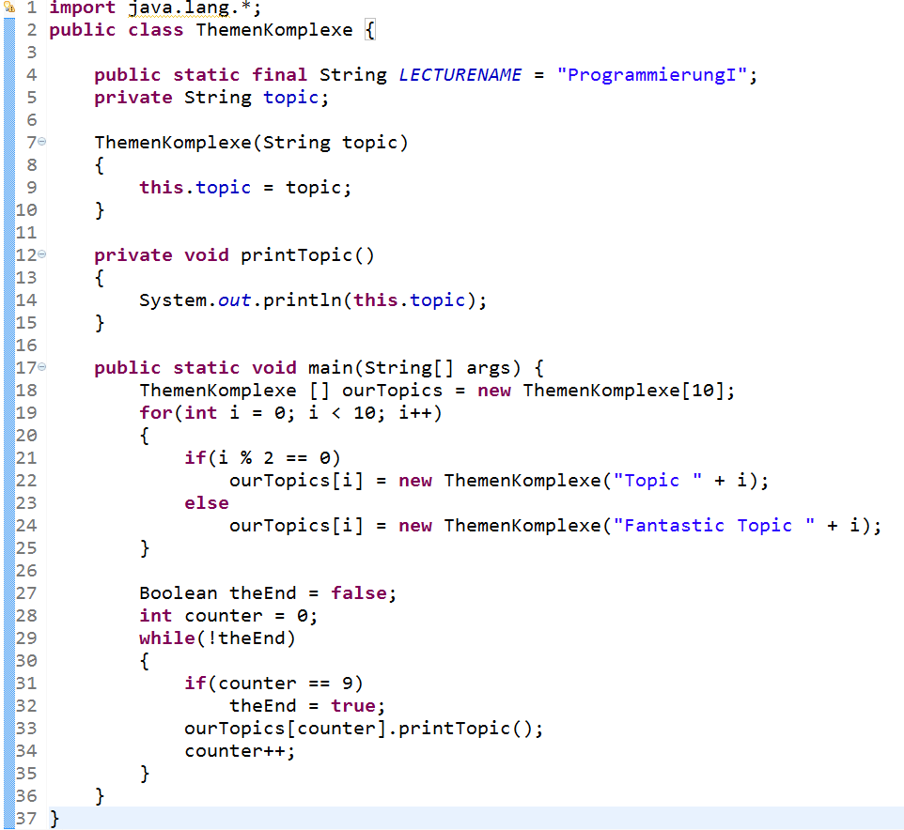




What Do We Know?
Java classes
Variables, constants
Constructors, assignments,..
Methods
Arrays
OOP: Instantiation
Data types (primitive & complex)
Constrol structures
Notes:
Zeit Folie : Zeit Gesamt (geschätzt)
1 : 1

Slide 3
Catching Up I
Two kinds of loops: (do-)while and for
Both have initialization, a logical expression, statements, and assignments
Goto-statements (i.e., break and continue) help to treat exceptions
Scope determines where variables are valid
The same name within a sub block is not allowed
Notes:
Zeit Folie : Zeit Gesamt (geschätzt)
2 : 3

Slide 4
Implement a method that returns how often a character is contained in a string
Proceed step by step
What is the method head? (parameter, return type)?
What does the method body look like?
Iteration over characters of a string with a loop… which loop?
Compare current character with a given character… how?
Increment the number of characters… how?
Return the sum… how?
Helpful methods of the class String:
- int length(): Returns the length of this string.
- char charAt(int index)
Returns the char value at the specified index.
3 to 5 minutes
Notes:
public static int nbChars(char toFind, String searchString){
int sum = 0;
for(int i = 0; i < searchString.length();i++)
{
if(toFind == searchString.charAt(i)
{
sum++;
}
}
return sum;
}
Zeit Folie : Zeit Gesamt (geschätzt)
5 : 11

Slide 5

Catching Up II: Multidimensional Arrays
Arrays werden in Arrays gespeichert (z.B. Matrix)
Deklaration mittels zusätzlichem „[ ]“
Keine Größenangabe,
da nicht zwangsläufig alle Zeilen
die gleiche Länge haben müssen!
int [][] twoD = new int[2][];
twoD[0] = new int[5];
twoD[1] = new int[3];
twoD[0]
twoD[0][0]
twoD[0][4]
twoD
twoD[1]
twoD[1][0]
twoD[1][2]
int [][] uniform = new int[5][8];
Alle Zeilen haben gleiche Spaltenanzahl.
int [][] initWithElements = new int[][] {{2,4},{4,4,5,6,12}};
Notes:
Zeit Folie : Zeit Gesamt (geschätzt)
6 : 1h10
In Eclipse zeigen, wie man mit mehrdimensionalen Arrays umgeht

Slide 6
Catching Up II: Multidimensional Arrays
Arrays are stored in arrays (e.g. matrix)
Declaration via additional „[ ]“
Here, it is possible without defining
the size, because not all rows need
to have the same length
int [][] twoD = new int[2][];
twoD[0] = new int[5];
twoD[1] = new int[3];
twoD[0]
twoD[0][0]
twoD[0][4]
twoD
twoD[1]
twoD[1][0]
twoD[1][2]
int [][] uniform = new int[5][8];
All rows have the same length
int [][] initWithElements = new int[][] {{2,4},{4,4,5,6,12}};
Notes:
Zeit Folie : Zeit Gesamt (geschätzt)
6 : 1h10
In Eclipse zeigen, wie man mit mehrdimensionalen Arrays umgeht
Note: Here is where many many students get off. Don‘t be one of those, go practice!

Slide 7
Learning Goals
Getting to know differences between Heap and Stack
Understanding relationship between objects and data types to main memory
Understanding what happens when parameters are passed to a method
Getting to know different methods to copy objects
Notes:
Zeit Folie : Zeit Gesamt (geschätzt)
1 : 12

Slide 8


Java-Virtual-Machine (JVM)
Stack and Heap
Notes:
Zeit Folie : Zeit Gesamt (geschätzt)
0 : 12

Slide 9
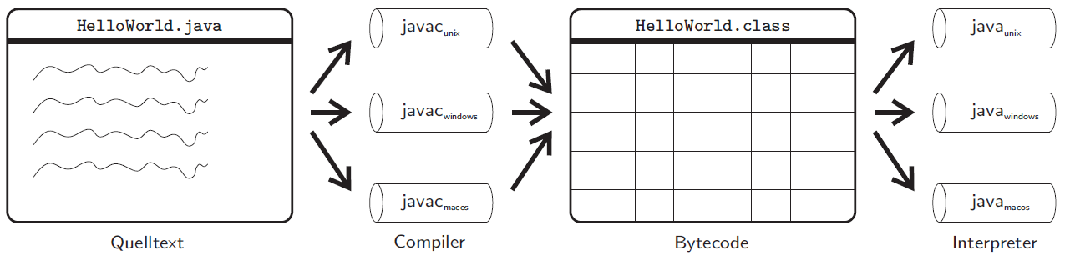
Java-Virtual-Machine (JVM)
Java is supposed to be independent of the platform
JVM emulates a non-physical machine
Idea: Code is transformed for this non-physical machine (Java bytecode)
Emulation (interface between Java bytecode and physical machine) does depend on hardware
Notes:
Zeit Folie : Zeit Gesamt (geschätzt)
2 : 14

Slide 10
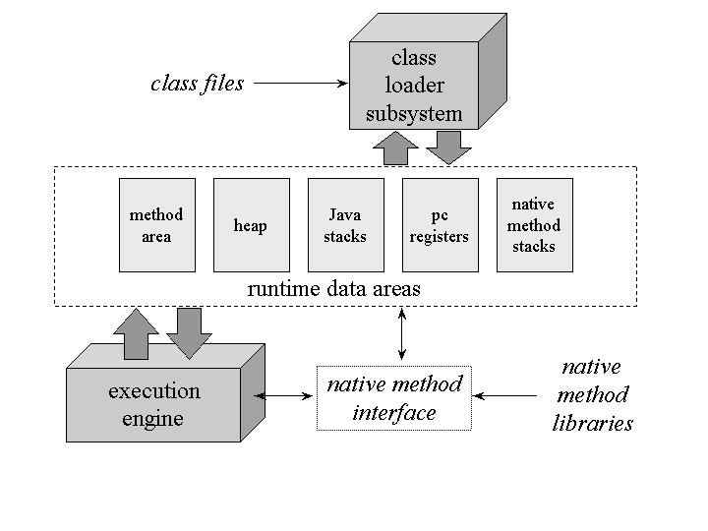
Komponenten der JVM
Notes:
Method area: The method area is shared by all threads, created when the JVM starts. It stores runtime constant pool, field and method information, static variable, and method bytecode for each of the classes and interfaces read by the JVM. The method area can be implemented in various formats by JVM vendor. Oracle Hotspot JVM calls it Permanent Area or Permanent Generation (PermGen). The garbage collection for the method area is optional for each JVM vendor.
Native method stack: A stack for native code written in a language other than Java. In other words, it is a stack used to execute C/C++ codes invoked through JNI (Java Native Interface). According to the language, a C stack or C++ stack is created.
Zeit Folie : Zeit Gesamt (geschätzt)
2 : 16

Slide 11

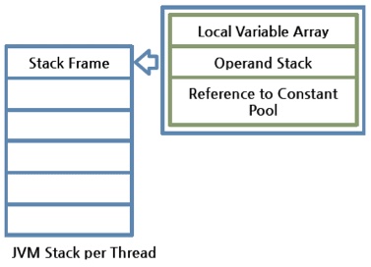
Java‘s Runtime Stack
Part of main memory, where the JAVA stacks all method calls
Roughly: All data that are not objects are stored in the stack
Local variables
Method parameters
Method calls
With each method call, a new form is created on the stack
When leaving the method, the form on top of the stack is removed
Notes:
Zeit Folie : Zeit Gesamt (geschätzt)
2 : 21

Slide 12

Heap
Part of main memory that stores objects/instances of a class (i.e., everything that is created with new)
Memory is managed dynamically (reserving and freeing memory)
No memory leaks, so less work and error-prone
However: maybe performance issues
Person picard = new Person(„Jean-Luc“, „Picard“);
Person caption = picard;
Jean-Luc
Picard
0
Prof
Nachtigaller
99
Heap
Person sisko = new Person(„Benjamin“, „Sisko“,99);
Notes:
Zeit Folie : Zeit Gesamt (geschätzt)
3 : 19

Slide 13
References
Variable mit Klassentyp hält Referenz (Zeiger) auf ein Objekt
Variables:
Store references of
complex data types
Person kathryn = new Person("Kathryn", "Janeway");
kathryn
Heap:
"Kathryn"
"Janeway"
0
Person x = kathryn;
x
"y"
"yx"
0
Person yyy = new Person("y","yx");
yyy

Slide 14
Recap: Comparison of Strings
== returns unexpected result!
Comparison with equals-method
String h = new String("Hi");
String t = new String("Hi");
if(h == t){
System.out.println("Same!");
}
else {
System.out.println("Not Same!");
}
Result: Not Same!
if(h.equals(t)){
System.out.println("Same!");
}
else{
System.out.println("Not Same!");
}
Result : Same!
Notes:
Zeit Folie : Zeit Gesamt (geschätzt)
2 : 1h24
Erklären, warum manchmal „==„ stimmt und manchmal nicht

Slide 15
Interaction of Heap and Stack
void isDoubleBirthday() {
this.isBirthday();
this.isBirthday();
}
void isBirthday() {
age = age + 1;
}
class Person {
String firstName;
String name;
int age;
Address address;
Person(String firstName, String name) {
this.firstName = firstName;
this.name = name;
this.age = 0;
}
Person(int age) {
this.firstName = „John";
this.name = „Doe";
this.age = alter;
this.address = new Ort("Enterprise");
}
public static void main(String[] args) {
Person picard = new Person(„Jean-Luc","Picard");
Person nobody = new Person(22);
Person x = picard;
picard.isBirthday();
x.isDoubleBirthday();
}
}
Stack
Address
address
Person
firstName
age
name
main
args
picard
nobody
x
Address
Person
Person
address
firstName
name
22
address
firstName
name
0
address
Heap
„Enterprise"
null
„John"
„Doe"
„Jean-Luc"
„Picard"
Notes:
Zeit Folie : Zeit Gesamt (geschätzt)
2 : 23

Slide 16
Zusammenspiel von Heap und Stack
void isDoubleBirthday() {
this.isBirthday();
this.isBirthday();
}
void isBirthday() {
age = age + 1;
}
class Person {
String firstName;
String name;
int age;
Address address;
Person(String firstName, String name) {
this.firstName = firstName;
this.name = name;
this.age = 0;
}
Person(int age) {
this.firstName = „John";
this.name = „Doe";
this.age = alter;
this.address = new Ort("Enterprise");
}
public static void main(String[] args) {
Person picard = new Person(„Jean-Luc","Picard");
Person nobody = new Person(22);
Person x = picard;
picard.isBirthday();
x.isDoubleBirthday();
}
}
Stack
isBirthday
isBirthday
isDoubleBirthday
main
args
picard
nobody
x
Address
Person
Person
address
firstName
name
22
address
firstName
name
0
address
Heap
1
3
2
„Enterprise"
null
„John"
„Doe"
„Jean-Luc"
„Picard"
Notes:
Zeit Folie : Zeit Gesamt (geschätzt)
2 : 25

Slide 17

Garbage Collection
Garbage Collector frees memory of objects that are not needed anymore
Methods for cleaning before memory is freed
protected void finalize()
Is counterpart of constructor
Is called automatically by Garbage Collector
Careful: Unclear when it is called (so avoid cleaning memory)
No explicit freeing of objects, but via System.gc(), you can set a hint for the garbage collector
Notes:
Frage: Wie bekommt der GC heraus, dass ein Objekt nicht mehr benötigt wird?
Zeit Folie : Zeit Gesamt (geschätzt)
2 : 27

Slide 18
Übung
public class Address {
String name;
boolean abroad = false;
public Address(String name) {
this.name = name;
}
public Address() {
this.name = "Enterprise";
}
public void moveHouse(String newAddress, Person p) {
if(name.equals(newAddress)) {
System.out.println(„You stay on this ship.");
}
else {
int index = registerNewAddress(newAddress);
if (!abroad) {
p.formerAddress[index] = this;
this.name = neuerOrt;
}
else {
p.formerAddress[index] = this;
this.name = "N/A";
}
}
}
public int registerNewAddress(String address) {
if(address.equals("Andromeda")) {
abroad = true;
return 2;
}
else {
abroad = false;
return 1;
}}}
class Person {
String firstName;
String name;
int age;
Address residence;
Address[] formerResidences;
Person (int age) {
this.firstName = "Jane";
this.name = "Doe";
this.age = alter;
this.residence = new Ort("Enterprise");
formerResidences = new Ort[2];
}
void movesHouse(String newResidence) {
residence.moveHouse(newResidence, this);
}
public static void main(String[] args) {
Person me = new Person(22);
me.movesHouse("Andromeda");
}
}
3 to 5 minutes
This program ends in an error. Where is the error? What is on the stack?
Notes:
Zeit Folie : Zeit Gesamt (geschätzt)
1 : 32

Slide 19
Input Parameters of Methods
Notes:
Zeit Folie : Zeit Gesamt (geschätzt)
0 : 32

Slide 20
References I
There is an additional primitive data type – we did not explicitly look at it, but we used it
Reference = „pointer“ to instances of classes
Variables that store complex types are references to according objects in memory
public static void main(String[] args) {
Person peter = new Person("Peter","Petersen");
Person nobody = new Person(22);
Person x = peter;
}
Ort
Person
Person
ort
vorname
nachname
22
wohnort
vorname
nachname
0
wohnort
Heap
"Passau"
null
"Max"
"Mustermann"
"Peter"
"Petersen"
Notes:
Zeit Folie : Zeit Gesamt (geschätzt)
2 : 34

Slide 21
References II
Internally: a reference is an integer
Points to identy (address in memory) of object
Number corresponds to first memory cell that is used by the object
Operator „==“ compares references, so only the addresses, not the state/content/value of object
Arrays are also references!
Notes:
Zeit Folie : Zeit Gesamt (geschätzt)
1 : 35

Slide 22
Parameter Passing
Call-by-Value
Values are copied in memory
Changes will be executed on copy
No effects outside of a method!
Call-by-Reference
There is no copying
A pointer is only passed, and the pointer points to the place in memory that is changed within a method
Changes of the values within method have an effect outside of the method
Notes:
An Tafel ein Beispiel je Art skizzieren,
Bsp mit array
Zeit Folie : Zeit Gesamt (geschätzt)
3 : 38

Slide 23
Parameter Passing in Java
Java always does call-by-value
Primitive data types are always copied (in the stack)
Changes do not have an effect outside of methods (because once a method is completed, everything is removed from the stack)
Careful! If parameter is a reference, it is copied (in the stack)
Referenced object is not copied
May lead to unexpected side effects
Changes within method may have an effect outside of the method
Notes:
Zeit Folie : Zeit Gesamt (geschätzt)
2 : 40

Slide 24

Primitive Type
public class Calculator {
void increment(int number) {
++ number;
System.out.print(number); //11
}
public static void main(String[] args) {
Calculator calc = new Calculator();
int z = 10;
calc.increment(z)
System.out.print(z); //10
}
}
3
4
Stack
1
1
int z = 10
2
2
Copied value
2
int number = 10 number = 11
3
Since primitive types are stored on the stack, they are removed when the method is completed.
[number removed from Stack]
4
Notes:
Zeit Folie : Zeit Gesamt (geschätzt)
2 : 42

Slide 25
Complex Type
Heap
firstName
name
int age = 0
1
3
public class Person {
void changeName(String name) {
this.name = name;
}
public static void main(String[] args) {
Person sisko = new Person("Ben","Sisko");
sisko.changeName("Yates")
System.out.print(sisko.name); //Yates
}
…
}
2
"Sisko"
3
"Ben"
2
"Yates"
1
2
Stack
1
max
Copied Values
changeName name
2
2
Notes:
Zeit Folie : Zeit Gesamt (geschätzt)
2 : 44

Slide 26
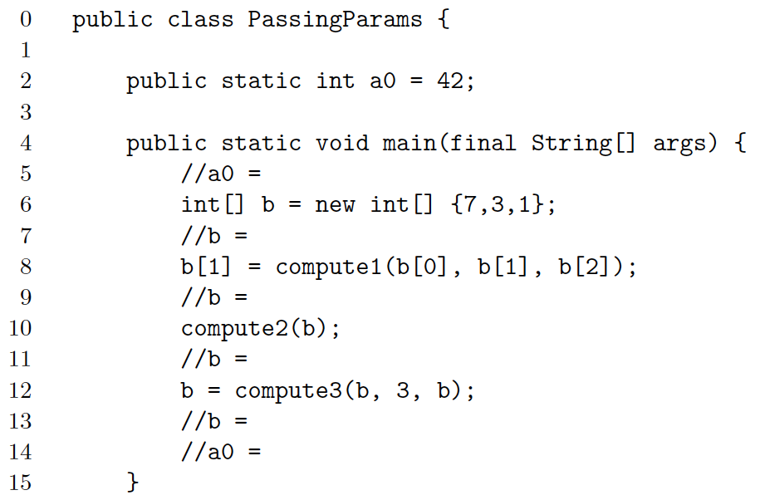
Parameter Passing I
42
[7,3,1]
Notes:
Aufgabe: die Kommentarzeilen mit den korrekten Werten ausfüllen
Zeit Folie : Zeit Gesamt (geschätzt)
1 : 45

Slide 27
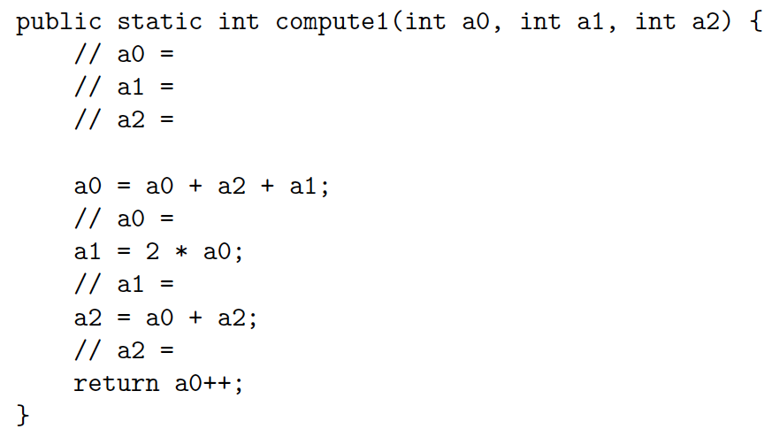
Parameter Passing II
7
3
Parameters are local variables
Careful: Parameter a0 has precedence before
class variable a0
Passing: Call-by-Value (i.e., copy of the value)
1
11
22
12
Notes:
Zeit Folie : Zeit Gesamt (geschätzt)
2 : 47

Slide 28
Parameter Passing III
42
[7,3,1]
[7,11,1]
Notes:
Zeit Folie : Zeit Gesamt (geschätzt)
1 : 48

Slide 29
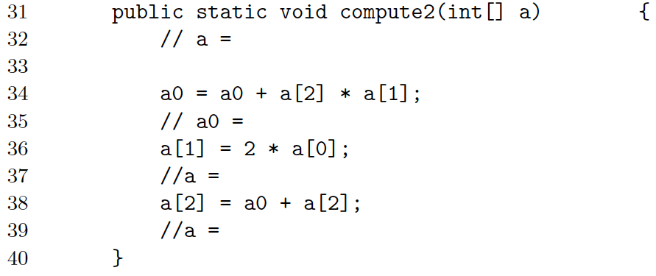
Parameter Passing IV
[7,11,1]
53
Local variable a contains reference to b
Passing: Call-by-Value
(Copy of the reference)
[7,14,1]
[7,14,54]
a0 is class variable
Notes:
Zeit Folie : Zeit Gesamt (geschätzt)
2 : 50

Slide 30
Parameter Passing V
42
[7,3,1]
[7,11,1]
[7,14,54]
Notes:
Zeit Folie : Zeit Gesamt (geschätzt)
1 : 51

Slide 31
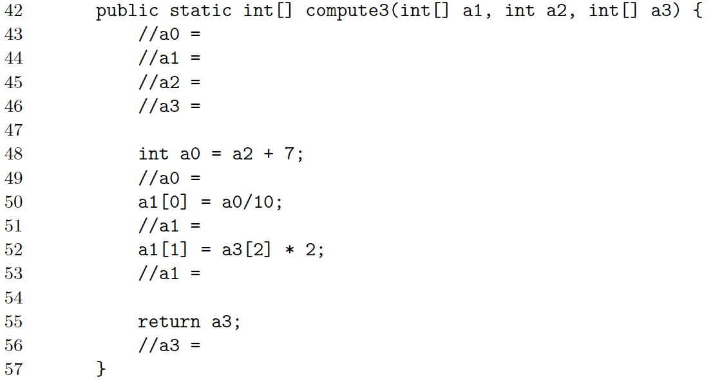
Parameter Passing VI
53
[7,14,54]
Local variable a1 contains reference to b
Passing: Call-by-Value (Copy of the reference)
3
[7,14,54]
Local variable a2
Passing: Call-by-Value (Copy of the value)
Local variable a0 has precedence over class variable a0
10
Local variable a3 contains reference to b
Passing: Call-by-Value (Copy of the reference)
[1,14,54]
[1,108,54]
[1,108,54]
Notes:
Zeit Folie : Zeit Gesamt (geschätzt)
3 : 54

Slide 32
Parameter Passing VII
42
[7,3,1]
[7,11,1]
[7,14,54]
[1,108,54]
53
Notes:
Zeit Folie : Zeit Gesamt (geschätzt)
1 : 55

Slide 33

Copying / Cloning Objects
Notes:
Zeit Folie : Zeit Gesamt (geschätzt)
0 : 55

Slide 34
Cloning of Objects
Problem: We need more objects with exactly the same values/attributes
Example: A car has 1000 properties that have been defined in many methods (e.g., by customer or federal laws, et)
We need this car again, and setting everything again is too tedious or information is missing
What to do?
Clone objects!
Idea: Get all values of an object to a new object
Two possibilities: shallow copy and deep copy
Notes:
Zeit Folie : Zeit Gesamt (geschätzt)
1 : 56

Slide 35
Shallow Copy
Each class has the method clone()
How it works:
New object is created in memory
All primitive types of object are copied
And this counts for references, as well!
Effect: Pointer is copied and so attributes of both objects point to the same sub objects
May lead to unexpected side effects
Not recommended
Notes:
Zeit Folie : Zeit Gesamt (geschätzt)
2 : 58

Slide 36
Deep Copy
Idea: implement own method that also clones all complex data types of object
Advantage:
Changes to attributes have no effect on clones
Full control about what is to be cloned
Disadvantage:
Implementation effort
Also the attributes need to provide a clone method
Notes:
Zeit Folie : Zeit Gesamt (geschätzt)
2 : 1h

Slide 37
Implementation
public class Point {
int x,y;
public Point(int x, int y) {
this.x = x;
this.y = y;
}
}
public class Line {
Point p1,p2;
public Line(Point p1, Point p2) {
this.p1 = p1;
this.p2 = p2;
}
public Line deepClone() {
Point p1clone = new Point(p1.x, p1.y);
Point p2clone = new Point(p2.x, p2.y);
Line clone = new Line(p1clone, p2clone);
return clone;
}
}
public static void main(String[] args) {
Point p1 = new Point(1,2);
Point p2 = new Point(3,4);
Line l1 = new Line(p1,p2);
Line l2 = l1.clone();
Line l3 = l1.deepClone();
}
Notes:
Zeit Folie : Zeit Gesamt (geschätzt)
2 : 1h2

Slide 38
„Behind the Scenes“
public class Point {
int x,y;
public Point(int x, int y) {
this.x = x;
this.y = y;
}
}
public class Line {
Point p1,p2;
public Line(Point p1, Point p2) {
this.p1 = p1;
this.p2 = p2;
}
}
Point p1 = new Point(1,2);
Point p2 = new Point(3,4);
Line l1 = new Line(p1,p2);
Line l2 = l1.clone();
Line l3 = l1.deepClone();
l2 is new object in storage, but has no copied attributes. The attributes point to the same objects in memory as the original object.
Memory:
p1
x=1; y=2;
p2
x=3; y=4;
l1
p1= ; p2= ;
l2
p1= ; p2= ;
x=1; y=2;
x=3; y=4;
l3
p1= ; p2= ;
Notes:
Zeit Folie : Zeit Gesamt (geschätzt)
3 : 1h5

Slide 39
Copy Constructor
Alternative (best practice) known from C++
Idea: Implement own constructor that receives an object of the same class
public class Complex {
double real, imaginary;
//Normal constructor
public Complex (double re, double im) {
this.real = re;
this.imaginary = im;
}
//Copy constructor
Complex (Complex c) {
this.real = c.real;
this.imaginary = c.imaginary;
}
public static void main(String[] args) {
//Instantiating object
Complex c1 = new Complex (5, 5);
//Copy constructor
Complex c2 = new Complex (c1);
//Now copy here. All non-primitive types are only references
Complex c3 = c2;
}
}
New object in memory
Passed parameter has the same type as the class
Notes:
- In Eclipse ein Beispiel machen, wo Complex z.B. einen komplexen Typ hält und den Unterschied bei c2 und c3 verdeutlichen wenn man diesen komplexen Typen ändert
Alternative zum Copy-Konstruktor: Aufruf des normalen Konstruktors mit Argumenten des zu kopierenden Objektes:
Complex (Complex c) {
this(c.real,c.imaginary);
}
Zeit Folie : Zeit Gesamt (geschätzt)
6 : 1h11

Slide 40
Übung
Was befindet sich auf dem Stack und was auf dem Heap?
public class Monster {
private int numberTeeth = 200;
private String name;
public static void main(String[] args) {
Monster monster = new Monster("Grarrar");
monster.scare();
monster.chew();
monster.flirt(new Monster("Buuuuuhhh!"));
}
public Monster(String name) {
this.name = name;
}
public void scare() {
int soundVolume = 5;
String scream = "AAHHHHHHHHAAAA!!!111";
System.out.print(this.name + scream);
for (int i = 0; i < soundVolume; i++) {
System.out.print("!");
}
System.out.println("");
}
1
2
public void chew() {
for(int i = 0; i < this.numberTeeth / 4; i++) {
System.out.print("Grind");
}
System.out.println("");
}
public void flirt(Monster monster) {
this.scare();
monster.scare();
}
}
3
16
4
5
6
7
8
9
10
3 to 5 minutes
11
12
13
14
15
Notes:
Heap: 1,2,3,5,9,10,14,16
Stack: 4,6,7,8,11,12,13,15
Zeit Folie : Zeit Gesamt (geschätzt)
5 : 1h19

Slide 41
Take Aways I
There are two memory in the Java Virtual Machine
Heap stores all objects (i.e., instances of complex data types)
Stack stores primitive types, methods calls, etc.
The stack is constructed with every method call und de-constructed with completed methods
Variables of complex types are references (pointers) to memory address of the object in the heap
Notes:
Zeit Folie : Zeit Gesamt (geschätzt)
1 : 1h12

Slide 42
Take Aways II
There are two ways of parameters passing
Call by values passes the value
Call by reference passes the pointer to the value
Java only uses call by value, but with references, the pointer is copied
Objects can be copied via cloning
Shallow Copy copies only "top level" of an object
Deep copy copies attributes of complex types
Notes:
Zeit Folie : Zeit Gesamt (geschätzt)
1 : 1h13

Slide 43
Coming Up Next
Enumerations, encapsulation
Visibility
Notes:
Zeit Folie : Zeit Gesamt (geschätzt)
1 : 1h14

