Slide 1
Software Engineering and Programming Basics
Enumeration, Packages, Recursion
Authors of slides:
Prof. Dr.-Ing. Janet Siegmund
Prof. Dr.-Ing. Norbert Siegmund
Prof. Christian Lengauer
Partly extracted from script of PD Dr. Christian Bachmaier
Notes:
Zeit Folie : Zeit Gesamt (geschätzt)
1 : 1

Slide 2


Catching Up I
There are two memory types in Java: Stack and Heap
Objects …
Variables and methods …
Method calls …
Passed parameters …
A variable pointing to an object, is …
The Garbage Collecte removes… from the …
The operator „==" compares …
Heap
Stack
Stack
Stack
A reference (primitive type)
Objects from the heap
Contents of the stack
Notes:
Geschätzte Zeit:
2:2

Slide 3
Catching Up II
Parameter passing of methods
What methods exist?
Call by value
Call by reference
…(others in other programming languages
What effect does changing a parameter within a method have for the caller?
Primitive types: none
Complex types: possibly a change of state
Notes:
Geschätzte Zeit:
1:3

Slide 4
Catching Up III
What kind of cloning does exist in Java?
Shallow Copy
Deep Copy
What are benefits and drawbacks?
Shallow copy: easy, but reference attributes are not copied
Deep copy: can be tedious, because copying may need to be implemented manually; however, full control
Notes:
Geschätzte Zeit:
2:5

Slide 5
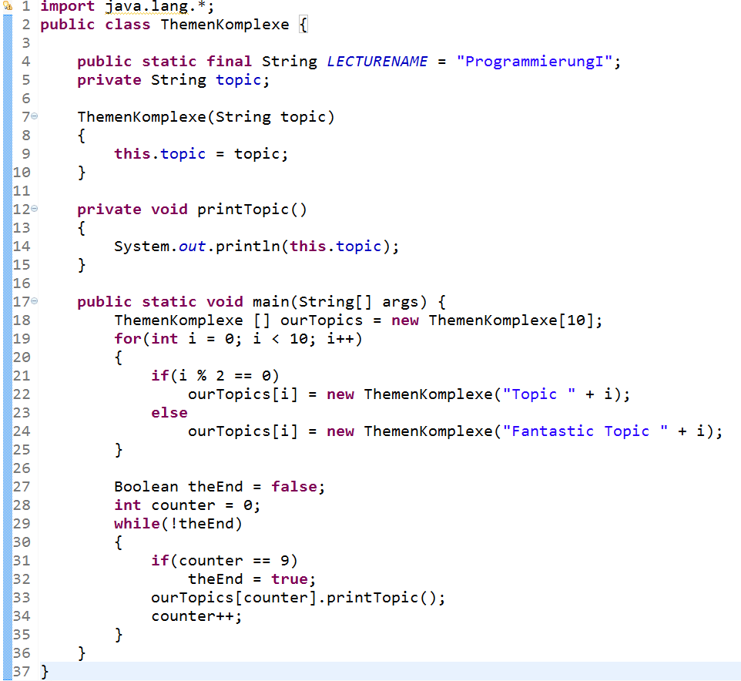
Topics Today
Enumerations, encapsulation
Visibility
Notes:
Zeit Folie : Zeit Gesamt (geschätzt)
1 : 8

Slide 6
Learning Goals
Managing classes of larger projects in packages
Understanding encapsulation in Java
Define enumerations
Getting to know recursion in Java
Notes:
Geschätzte Zeit:
1:9

Slide 7

Packages
Notes:
Geschätzte Zeit:
0:9

Slide 8
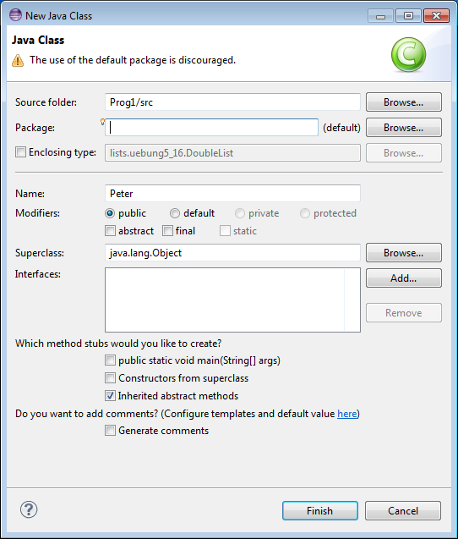
Why Packages?
Data base access
Idea: everything that belongs together semantically is summarized in a package
Allows encapsulation
Avoids naming conflicts
Makes debugging easier
Klassen
Attributes, methods
Packages
Management of personell
System logic
User interface
Web
Desktop
Program (e.g., computing salary)
Notes:
Geschätzte Zeit:
4:13

Slide 9
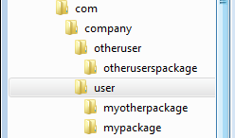
Defining Packages
Naming packages follows conventions
Like a URL read backwards
„-“ not allowed
„.“ separates different packages (encapsulation)
Only use small letters
Assigning a class to a package: package NAME;
Is listed at the beginning, before class definition
package com.company.user.mypackage;
package com.company.user.myotherpackage;
package com.company.otheruser.otherusersmypackage;
package de.tuc.siegmund.se_prog;
public class Excercise {
}
Notes:
Kleinbuchstaben verhindert Konflikte mit Klassennamen oder Interfaces
Geschätzte Zeit:
2:15

Slide 10
Importing and Using Packages
Importing of existing packages with import packagename.classenname;
Makes using classes from existing packages easier
Needs to be listed before class definition
„.*“ allows for importing all classes of a package
„*“ does not work for importing sub packages
package de.tuc.siegmund.se_prog;
import com.company.user.mypackage;
import java.util.*;
import java.*; //Error! Not allowed!
public class Excercise {
java.util.Calendar cal;//Without import
Calendar cal2; //With import
}
Notes:
Geschätzte Zeit:
2:17

Slide 11
Hints
Packages names always small letters, class names always start with capital letter
Standard package: java.lang
Contains basic classes (String, StringBuilder, Math, System)
Is imported automatically
package test;
public class test {
test.test t;
}
Error: Java does not know what is what!
Notes:
Geschätzte Zeit:
1:18

Slide 12
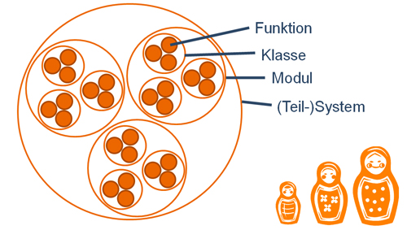
Encapsulation: Principle of „Information Hiding“
Notes:
Geschätzte Zeit:
0:20

Slide 13
Example
class Person {
String firstName;
String name;
int age;
Address residence;
void setName(String name) {
this.name = name;
}
String getNname() {
return this.name;
}
void isBirthday() {
this.age = this.age + 1;
}
Person(int alter) {
this.firstNname = "John";
this.name = "Doe";
this.age = age;
}
}
public static void main(String [] args){
Person kathryn = new Person(22);
peter.setNachname("Janeway");
peter.nachname = "Janeway";
}

Slide 14
Why encapsulation
Internal states should not be editable from the outside
Access only via a defined interface
public class BankAccount {
double balance = 0; // visibilty too far
BankAccount(double initialPayment) {
this.balance = initialPayment; }
private void deposit(double amount) { this.balance += amount; } //nicht sichtbar genug
public void transfer(double amount BankAccount recipient) { this.balance = balance - amount;
recipient.deposit(amount); }
}
public class Bank {
public static void main(String[] args) {
BankAccount fstAcct = new BankAccount(1000);
BankAccount sndAcct = new BankAccount(0);
//Correct transfer of money
fstAcct.transfer(50, sndAcct);
//Not good: destroying money
sndAcct.balance = 0;
//Not good: inventing money
fstAcct.balance = 2000;
}
}
Notes:
Analogie: 1-100 Zählen; Jemand anderes setzt Zahl willkürlich immer um
Geschätzte Zeit:
3:23

Slide 15
Improvement I
Change visibility of balance
public class BankAccount {
private double balance = 0;
// Zugriff nur in dieser Klasse
BankAccount(double initialPayment) {
this.balance = initialPayment; }
private void deposit(double amount) { this.balance += amount; } //nicht sichtbar genug
public void transfer(double amount BankAccount recipient) { this.balance = balance - amount;
recipient.deposit(amount); }
}
public class Bank {
public static void main(String[] args) {
BankAccount fstAcct = new BankAccount(1000);
BankAccount sndAcct = new BankAccount(0);
//Correct transfer of money
fstAcct.transfer(50, sndAcct);
//Error: access not allowed
sndAcct.balance = 0;
//Error: access not allowed
fstAcct.balance = 2000;
//The field BankAccount.balance is not visible
}
}
private: Access to variables and methods only within the class
Notes:
Analogie: 1-100 Zählen; Jemand anderes setzt Zahl willkürlich immer um
Geschätzte Zeit:
3:23

Slide 16
Access Modifiers
Private
Access to variables and methods only within the class
Protected
Access in subclasses (inheritance)
Package (that's the default and if not specified)
Access within entire package
Public
Access from everywhere
Is used for interfaces to the outside
So it is used for classes, constructors, and methods of the interface
Notes:
Geschätzte Zeit:
3:31

Slide 17
Improvement II
class BankAccount {…
public void transfer (double amount, BankAccount targetAccount) {
this.balance = this.balance – amount //Access ok, because it is the the object (this)
targetAccount.balance += amount; //Access possible, altough external object
//better: targetAccount.deposit(amount);
}
}
What would be a better (more secure) solution?
Move method transfer to class bank, so that no direct access to balance is possible
targetAccount.balance = 0;
public class Bank {…
public void transfer (double amount, BankAccount targetAccount) {
this.balance = this.balance – amount; //Error: access not allowed
targetAccount.balance += amount; //Error: access not allowed
}
}
Notes:
Geschätzte Zeit:
2:28

Slide 18
Improvement III
Method for withdrawing money, which allows control on actions
public boolean withdraw(double amount) {
if (this.balance < amount) {
System.out.println("You don't have this money. You can only withdraw"
+ this.balance);
return false;
} else if (amount < 0) {
System.out.println("That's not possible");
return false;
} else {
this.balance = this.balance - amount;
return true;
}
}
public class Bank {…
public void transfer (double amount, BankAccount source, BankAccount target) {
if (source.withdraw(amount))
target.deposit(amount);
}
}
Notes:
Geschätzte Zeit:
3:26

Slide 19
Verbesserung III
Fest definierte Schnittstelle ermöglicht volle Kontrolle über Ein- und Ausgang der Daten
Bereinigung von Daten
Prüfen, ob gewisse Aktionen erlaubt sind
Änderungen am Code betreffen nur eine bestimmte Stelle
public boolean withdraw(double amount) {
if (this.balance < amount) {
System.out.println("So viel Geld hast du nicht. Du kannst nur "
+ this.balance + " abheben");
return false;
} else if (amount < 0) {
System.out.println("Das geht leider nicht");
return false;
} else {
this.balance = this.balance - amount;
return true;
}
}
Notes:
Geschätzte Zeit:
3:26

Slide 20
The Main Method
Visibility:
Can be called from everywhere
Static:
I can call this method without creating an object of this class
public static void main(String[] args) {
// TODO Auto-generated method stub
}
Parameters:
Array of Strings that are passed on program start
Return type:
Nothing. Of course, because program ends when this method is completed
Identifier:
Specified by Java
Notes:
Geschätzte Zeit:
2:50

Slide 21
Static with Packages
When using static methods from a class
import static [packagename].[classname].[methodname]
import static java.lang.Math.sqrt; you can call sqrt(…), instead of Math.sqrt(…)
Also in combination with wildcard
import static java.lang.Math.*
imports all static methods of class Math
Notes:
Geschätzte Zeit:
1:51

Slide 22

Enumerations
Notes:
Geschätzte Zeit:
0:31

Slide 23
Enumerations I
List of constants that semantically belong together
Days of the week, TV channels, months, music generes, chess figures
Are defined during programming time
Should be used when a variable can only have a few, well-known values
Can avoid erros by increasing readibility
Compiler can check during compile time, whether only valid values are used
Notes:
Geschätzte Zeit:
1:32

Slide 24
Enumerations II
Defined with keyword enum NAME { … }
All valid values are defined when declaring the enum
Beispiel: public enum FleetShips {Enterprise, Voyager, Discovery}
In Java, enumerations are realized as classes
Definition of methods are possible
Notes:
Geschätzte Zeit:
2:33

Slide 25
Enumeration III
Example: definition
Usage:
[Name].[Value]
public enum FleetShips {
Enterprise, Voyager, Discovery;
}
Wert festlegen
Variable
public class Person {
FleetShips thisYear;
public static void main(String[] args) {
Person picard = new Person();
picard.thisYear = FleetShips.Enterprise;
System.out.println(picard.isCaptian());
}
public boolean needsMoney() {
switch (thisYear) {
case Enterprise:
return true;
case Voyager:
case Discovery:
return false;
default:
return true;
} } }
Notes:
In Eclipse zeigen!
Geschätzte Zeit:
6:39

Slide 26

Foreach Loop
Notes:
Geschätzte Zeit:
0:1h11

Slide 27
Foreach Loop
When iterating over containers (arrays, lists, etc.) we mostly used for loops:
public static void main(String[] args) {
int[] numbers = new int[] {0,4,7,23,12};
int sum = 0;
for(int i = 0; i < numbers.length; i++) {
sum += numbers[i];
}
sum = 0;
for (int num: numbers) {
sum += num;
}
}
Read: „For each num in numbers, increase sum by num…“
Data type that is stored in the container
Variable name in each iteration
Name of the container
Notes:
Geschätzte Zeit:
2:1h13

Slide 28

Foreach: Benefits
Iterates through entire container from start to beginning
Boundaries do not have to be taken care of
Shorter way to write it
In each iteration step you automatically have the variabe of the according type
int[] numbers = new int[] {0,4,7,23,12};
for (int num: numbers) {
num *= 2;
}
System.out.println(numbers[1])
int[] numbers = new int[] {0,4,7,23,12};
for(int i = 0; i < numbers.length; i++) {
int num = numbers[i];
zahl *= 2;
}
// 4
// num is copy of the value of numbers[i]
Notes:
Geschätzte Zeit:
2:1h15

Slide 29
Interlude: Jumping Out of a Loop
Exiting a special loop is possible in Java
But should be avoided because it impairs readability
label1:
for(){
label2:
for(){
if(condition1)
break label1; // break outerloop
if(condition2)
break label2; // break innerloop
}
}

Slide 30

Recursion
Notes:
Geschätzte Zeit:
0:51

Slide 31
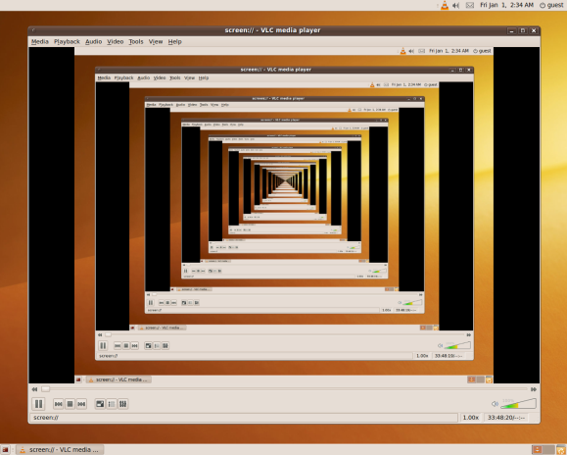

Recursion
Idea: Reduce a general task to a simpler task
$sum\left(n\right)= \sum_{i=0}^{n}{i}$
$sum\left(n\right)=sum\left(n−1\right)+n$
$sum\left(0\right)=0$
Notes:
Geschätzte Zeit:
1:51

Slide 32

Factorial With Recursion
Implement a recursive version of factorial
fac(n) = $\prod_{i=1}^{n}{i}$
fac(0) = 1
fac(1) = 1
fac(2) = 2*1 = 2
There are always to steps:
When to exit recursion
What is actually done in recursion
public class Calculator {
public static void main(String[] args) {
Calculator calc = new Calculator();
System.out.println(calc.factorial(3));
}
private int factorial(int n) {
if(n <= 1)
return 1;
else
return n * factorial(n-1);
}
}
3 to 5 minutes

Slide 33

Recursion vs. Iteration
Iteration is often the better choice in Java, because less steps and more efficient usage of memory
private static int fibRec(int n) {
stepsRec++;
if( n == 0) {
return 0;
} else if (n == 1) {
return 1;
} else {
return fibRec(n-1) + fibRec(n-2);
}
}
private static int fibIt(int n) {
int x = 0, y = 1, z = 1;
for (int i = 0; i < n; i++) {
stepsIt++;
x = y;
y = z;
z = x + y;
}
return x;
}
fibRec(10) needs 177 steps
fibIt(10) needs 10 steps
Notes:
In Eclipse: beide Varianten für Fakultät implementieren und Schritte mittels statischer Variable zählen und danach ausgeben
Geschätzte Zeit:
6:1h9

Slide 34
Recursion – Problems in Java
doSomething() {
Object o =
new Object()
doSomething() {
At this point, all objects are still referenced
doSomething()
Object o =
new Object()
doSomething() {
- Objects state in memory, when they are still referenced
doSomething()
Object o =
new Object()
doSomething() {
doSomething()
return someValue
Possible stack overflow!
- Objects are referenced when a variable is pointing to them or when tey are contained in a data structure
}
return someValue
}
Only when the scope ends, objects are de-referenced and removed from memory
return someValue
}
return someValue
}
Notes:
Geschätzte Zeit:
2:1h11

Slide 35
Take Aways II
Encapsulation is an important principle in object-oriented programming
Allows hiding the state of objects
Defines interface to the outside
Is realized with access modifiers in Java
Enumerations are an elegent way to enumerate finite values of a class and work with them
Notes:
Geschätzte Zeit:
2:1h17

Slide 36
Take Aways II
Recursion is an elegant way of programming to solve complex problems
Is often use when traversing a tree
May lead to performance and memory issues
Notes:
Geschätzte Zeit:
0:1h17

Slide 37

Quiz!!!
There is a method fac(n) to compute the factorial. Implement a method to compute the binomial coefficient. Bonus: Do it in one line (method body): $\left({n \atop k}\right)= \frac{n!}{k!∗\left(n−k\right)!}$
Which of the following statements are incorrect, and why?
public class StaticDemo {
public String data = "somedata";
public static void main (String args[]) {
System.out.println("error "+ data);
} }
public class StrDemo {
public static void main (String args[]){
String abc = 'abc';
System.out.println ("Char at 1 : " + abc.charAt(1));
System.out.println ("Char at 2 : " + abc.charAt(2));
System.out.println ("Char at 3 : " + abc.charAt(3));
}}
5 minutes
public class Test {
public static void main (String args){
int a = calcArea(7.4, 12);
System.out.println(a);
}
int calcArea(int height, int width) {
return height * width;
} }
Notes:
private int binomial(int n, int k) {
return (int) (factorial(n) / factorial(k) * factorial(n-k));
}
Code 1: Fehler non-static method called; calcArea takes two ints and not a double and an int
Code 2: access to non-static field
Code 3: index-array bounds; string is not correctly initialized

Slide 38
Coming Up Next
We are taking a look at important classes in Java
Object
String
StringBuilder
Math
Array
StringTokenizer
Streams
File
Read.In
Notes:
Geschätzte Zeit:
1:1h19

