Slide 1
Software Engineering and Programming Basics
Lists, Stacks, Queues
Authors of slides:
Prof. Dr.-Ing. Janet Siegmund
Prof. Dr.-Ing. Norbert Siegmund
Prof. Christian Lengauer
Partly extracted from script of PD Dr. Christian Bachmaier
Notes:
Zeit Folie : Zeit Gesamt (geschätzt)
1 : 1

Slide 2
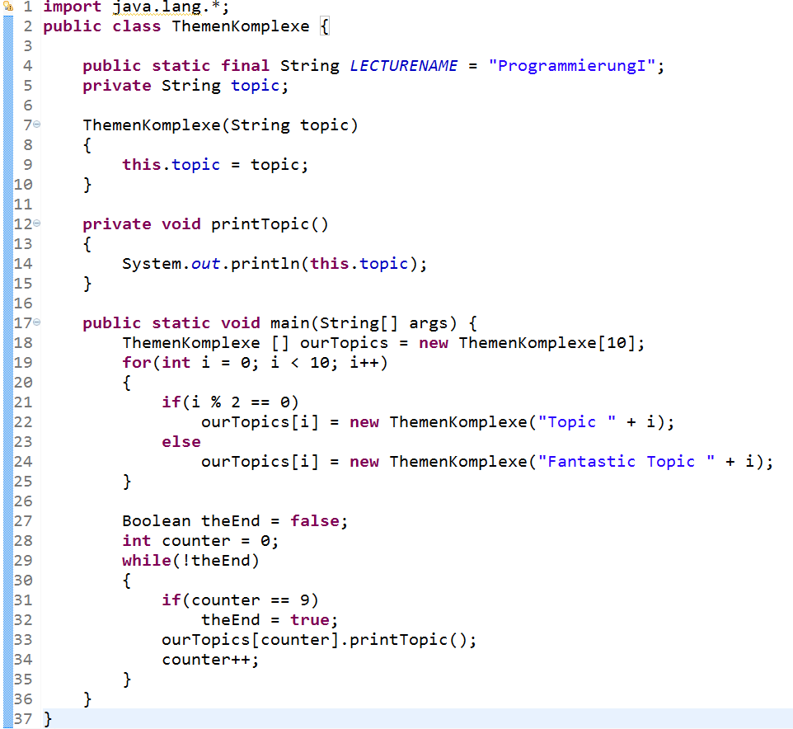

Overview Topics
How do we create our own data structures?

Slide 3
Learning Goals
Getting to know how lists and stacks work
Being able to implement composed data structures
Applying concepts of object oriented programming

Slide 4
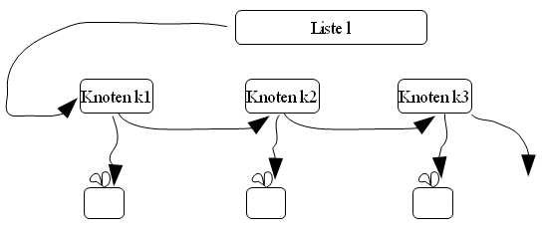
Lists

Slide 5
Problem: We Need Dynamically Growing Data Structures
Until now: array as composed data structure
Shortcoming 1: fixed size
Shortcoming 2: Inserting and deleting forces moving all elements with a higher index to avoid holes
H | e | l | l | o
+ '!'
1. Create new array
2. Copy all values
H | e | l | l | o | !
H | e | l | l | o
1. Deleting element
H | e |  | l | o
2. Move two elements
H | e | l | o

Slide 6
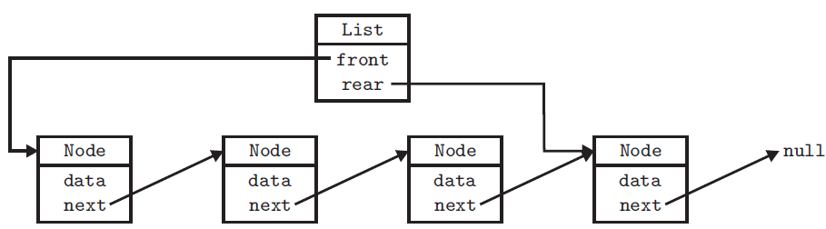
Solution: Simple Linked List
Idea: chaining of list elements
Each element knows it sucssor (pointer)
The "list" knows the first element
Adding or inserting new elements possible by re-pointing the pointer
Access is sequential (iterating from beginning to end)

Slide 7
Two Elements: Node + List
Node
Contains the actual data to be stored
Knows it successor
package list;
public class Node {
int data; //data type to be stored
Node next; //successor node
public Node(int dataValue) {
data = dataValue;
next = null; //No successor upon initialization
}
public String toString() {
return „[" + data + „] ";
}
}
Notes:
Tafel: toString-Methode von Person

Slide 8
Two Elements: Node + List
List
Provides view to the outside
Stores the first element of the list
package list;
public class List {
Node front;
public List() {
front = null;
}
public boolean isEmpty() {
return front == null;
}
public void printContent() {
for (Node it = front; it != null; it = it.next) {
System.out.print(it.toString());
}
}
}
Entry point (head)
Notes:
Durchhangeln in Liste
Wichtig: Liste kennt nur ersten Knoten (ist das einzige Attribut der Liste). D.h. eine Liste weiß erstmal nicht, welche Knoten sie hat. Aber jeder Knoten kennt seinen Nachfolger.

Slide 9
Inserting a Node I
Thought experiment: Which pointer do I need to rewire to add a node to a list?
Solution: there are different cases
1. Case: Insert as last element
List
front
Node
Node
Node
null
next
next
next
Node
null
next

Slide 10
Inserting a Node II
2. Case: Insert at the front
List
front
Node
Node
Node
null
next
next
next
Node
null
next

Slide 11
Inserting a Node III
3. Case: insert somewhere in the middle
List
front
Node
Node
Node
null
next
next
next
Node
null
next

Slide 12
Inserting a Node IV
class List { …
public void addAt(int position, int dataValue) {
Node n = this.front;
if (position == 0) {
addFront(dataValue);
} else {
for (int i = 1; n != null && i < position; ++i) {
n = n.next;
}
if (n != null) {
add(n, dataValue);
}
}
}
}
1
1. Storing head of list
1
2. Treat special case (inserting at the head?)
2
2
3
3. Iterating the list, until position to insert is found
3
4
4
4. Inserting the node
List
front
3
4
1
2
Node
Node
Node
next
next
next

Slide 13

Inserting at the Head of the List
2
class List { …
public void addFront(int dataValue) {
Node n = new Node(dataValue);
n.next = front;
front = n;
}
}
1. Create a new node
1
2
2. Defining the sucessor-node of the new node
1
2
3
3
3. Head of the list now points to the new node
List
front
Node
3
next
2
Order of statements is important
Node
null
1
next
Notes:
Front is kein spezieller Knoten, darum wird der neue Knoten der front knoten

Slide 14
Inserting After Certain Node
4
1
1. Check if we want to add after a valid node
class List { …
private void add(Node it, int dataValue) {
if (it == null) {
System.out.println("Cannot insert after null");
return;
}
Node n = new Node(dataValue);
n.next = it.next;
it.next = n;
}
2
2. Create a new node
1
3
3. Set next pointer of the new node (n) to node that the next pointer of the old node (it) is pointing to
2
3
4
4
4. Point the next pointer of the old node (it) to the new node (n)
1
Node
Node
null
it
next
next
4
Order of statement is important!
3
2
Node
null
n
next

Slide 15
Deleting Nodes I
Important: we need to successor of the node to be deleted to rewrire the pointers
Thus: look ahead one node
There are special cases for inserting at the beginning and end of a list
List
front
Node
Node
Node
null
next
next
next

Slide 16
Deleting Nodes II
class List { …
public void remove (int dataValue) {
if ((front != null) && (front.data == dataValue)) {
front = front.next;
} else if (front != null) {
Node it = front; // Here: it.data != dataValue
while (it.next != null) { // Run through the list
Node n = it.next;
if (n.data == dataValue) {
it.next = n.next;
break;
} else {
it = it.next; //Set loop counter to next node
}
}
}
}
1. Check whether list is empty and whether we want to delete at the front
1
1
2
2. Iterting list until the end (next pointer is null)
2
3
3. Check whether next node is the one to be deleted
3
4
4. In case the next node (n) iis the one to be deleted, rewire next pointer of current node (it) on successor of next node
2
4
4
List
2
3
1
front
Node
Node
Node
null
next
next
next

Slide 17
Für Profis: Revertieren der Liste
public void reverse() {
Node nextEntry, head;
Node temp = null;
if (!isEmpty()) { // No change if list empty
head = front;
while (head.next != null) { // While current head...
// ...not last list element...
nextEntry = head.next; // Note next element
head.next = temp; // Connect prev element to current head
temp = head; // Current head is the new prev element
head = nextEntry; // Advance current head
}
head.next = temp; // Finally, connect actual head
front = head;
}
}

Slide 18
Übung
The list object should store the tail node (in addition to the front node). How do we need to adapt the remove and add methods?
class List { …
public void remove (int dataValue) {
if ((front != null) && (front.data == dataValue)) {
front = front.next;
} else if (front != null) {
Node it = front; // Here: it.data != dataValue
while (it.next != null) { // Run through the list
Node n = it.next;
if (n.data == dataValue) {
it.next = n.next;
break;
} else {
it = it.next; // Set loop counter to next node }
}
}
}
}
class List { …
private void add(Node it, int dataValue) {
if (it == null) {
System.out.println("Cannot insert after null");
return;
}
Node n = new Node(dataValue);
n.next = it.next;
it.next = n;
}
3 to 5 minutes
Notes:
Bei Methode add(…): In vorletzte Zeile (vor it.next = n): if (n.next == null) { rear = n; }
Bei Methode remove(..):
In 3. Zeile (vor if…): if (front == null) { rear = null; }
Nach if(n.data == dataValue): if (n.next == null) { rear = it; }

Slide 19
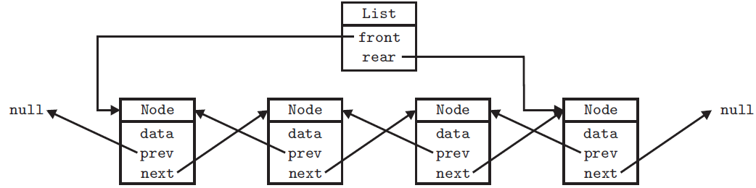
Double Linked List
Problem: When we are looking for something at the back of the list, we need to iterate over the entire list (performance drops)
Idee: Iterating backwards over list with the help of backward pointers

Slide 20
Inserting in Double Linked List
List
rear
front
Node
Node
Node
prev
prev
prev
null
null
next
next
next
Node
null
prev
next
Order of chaning pointers is important

Slide 21
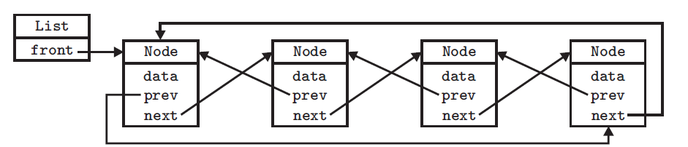
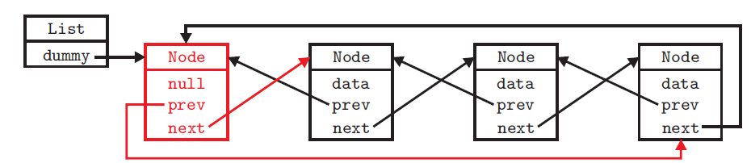
Cyclic Lists
Cyclic linking
Or with dummy elements
Is between head and tail of the list to avoid special cases
Does not contain any data

Slide 22
Reminder
Implement a double linked list based on the classes node and list. The list should store objects of type String and have the following methods:
public void display(): prints all elements of the list (i.e., content of the nodes) on the console, starting with the first element
public void add (int i, String content): adds the passed String at position i to the list
public void remove (int i): removes the element at place i from the list

Slide 23

Stack (Last-In-First-Out)

Slide 24
Stack: How It Works
Similar to list, it stores several elements in a data structure
However: No free access to any element in the list, but only to the element that was added last
Last in, first out (LIFO)
3. push(…)
1. pop()
2. push(…)
2. pop()
1. push(…)
3. pop()

Slide 25
Stack: Operations
Insert: void push([Type][Name])
Access to top element: [Type] peek()
Deleting top element: void pop()
Other operations: clear, size, isEmpty
Implementation:
List
push -> addFront; peek -> front; pop -> removeAt(0)
Array:
push -> Insert at first free spot; pop: -> last spot that contains data
Deleting objects by setting null: s[top] = null

Slide 26
ListStack
package stack;
public class ListStack {
List list;
public ListStack(){
list = new List();
}
public void push(int data) {
list.addFirst(data);
}
public void pop() {
list.removeAt(0);
}
public int peek(){
return list.front;
}
public void displayStack() {
list.display();
}
}

Slide 27
ArrayStack
package stack;
public class ArrayStack {
private int[] data;
private int size, front;
public ArrayStack () {
data = new int[256];
front = -1;
size = 0; }
public void push (int dataValue) {
assert size < data.length : "Stack can take no more";
++front;
data[front] = dataValue; ++size; }
public void pop () {
assert size > 0 : "Stack empty";
--front;
--size; }
public int peek () {
assert size > 0 : "Stack empty";
return data[front]; }
public void display () {
if (size == 0) return;
for (int i = front; i >= 0; --i) {
System.out.print(data[i] + " ");
}
System.out.println(); }}
Array, that stores the data
Initializing start values
Check whether array is already full
Setting pointer to next free spot in array and insert
Check whether array is empty
Reset pointer to realize deleting (in case object is stored in array: set the spot in the array to null
Return content of the spot at which our pointer is pointing

Slide 28
What For Can We Use a Stack?
Discuss several scenarios where a stack is useful
Recursive method calls (call stack!)
Checking whether braces are correct (([[([()])]]))
Iterating over trees / graphs
3 to 5 minutes

Slide 29

Queue (First-In-First-Out, FIFO)

Slide 30
Queue: How It Works
What is inserted earlier is removed earlier (first-in-first-out, FIFO)
Implementation:
List
Only insert at the back: offer([Type] [Name])
Access only to first element: [Type] peek()
Deleting only of the first element: [Type] poll ()
Array
Ring buffer

Slide 31
Queue: Ring Buffer
Idee: Array q is ring of length n
After q[n-1], q[0] follows (via % n)
Computing the indexes via modulo n
Two pointer: int first, int end
end points to next available position to insert
size is number of elements between the two pointers
Take care of over/undeflow of array

Slide 32
Implementierung
package queue;
public class ArrayQueue {
private int[] q;
private int first, end, size;
public ArrayQueue(int bufferSize) {
q = new int[bufferSize];
first = end = size = 0; }
public void offer(int newData) {
assert size < q.length : "Buffer can take no more";
q[end] = newData;
end = (end + 1) % q.length;
size++; }
public boolean isEmpty() {
return size == 0; }
public void display() {
int p = first;
for (int i = 0; i < size; i++) {
System.out.print(q[p % q.length] + " ");
p++;
}
System.out.println(); }
}
Array, das die Daten speichert
Initialisierung der Startwerte
Prüfen, ob Array voll ist
Einfügen am „Ende“ des Puffers
Zeiger des Endes weitersetzen und dabei die Array-Grenzen berücksichtigen

Slide 33
Take Aways
It is important to implement your own data structures
It is also important to understand existing data structures
Lists consits of nodes that point to there sucessors
This way, they can grow dynamically with out limits
Rewiring pointers is key to understand and implement different operations
Stacks and queues also consist of nodes, but access is limited to realize a certain behavior

