Slide 1
Software Engineering and Programming Basics
Polymorphism
Authors of slides:
Prof. Dr.-Ing. Janet Siegmund
Prof. Dr.-Ing. Norbert Siegmund
Prof. Christian Lengauer
Partly extracted from script of PD Dr. Christian Bachmaier
Notes:
Zeit Folie : Zeit Gesamt (geschätzt)
1 : 1

Slide 2
Implement a Queue based on a list:
offer([Type] [Name]): Add element
[Type] peek(): Show first element
[Type] poll (): Remove first element
display(): Show all elements of the Queue

Slide 3
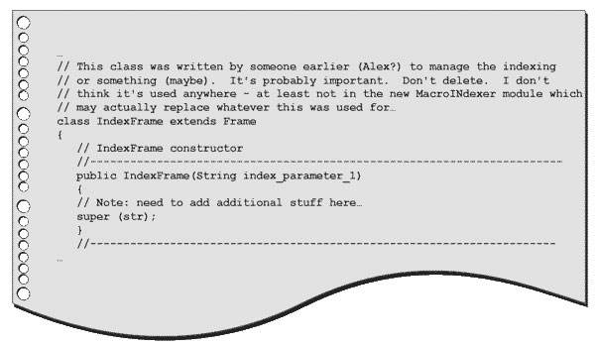
Catching Up
Benutzen Sie erklärende Namen für Variablen und Methoden
Bilden Sie kleine Methoden: eine Funktion pro Methode
Verwenden Sie Kommentare und halten Sie sich an die Code Conventions

Slide 4
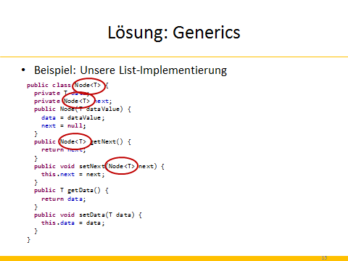
Wiederholung II
Was sind Generics?
Generische Datentypen bekommen einen –oder auch mehrere– Parameter, die je einen Typ spezifieren
Daher können einheitliche Datenstrukturen und Methoden für unterschiedliche Typen implementiert werden
Notes:
In Eclipse: IFahren

Slide 5
Wiederholung I
Welche Arten von Exceptions gibt es?
Statisch
Laufzeit (Runtime)
Was sind die Unterschiede?
Statische Ausnahmen muss man abfangen und entweder behandeln oder weiterleiten
Laufzeitausnahmen müssen nicht gefangen werden

Slide 6
Wiederholung II
Wie fängt man eine Exception?
Try-Catch-Finally Block
Wie definiert man eigene Exceptions?
Erweiterung der Klasse Exception bzw. RuntimeException
Bsp.: class MyException extends Exception {…}
Zwei Konstruktoren müssen implementiert werden
public MyException() {super();}
public MyException(String msg) {super(msg);}

Slide 7
Learning Goals
Understanding the concept of polymorphism
Learning how to create extandable programs and how to extend them
Getting to know generics

Slide 8
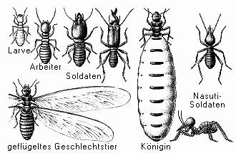
Polymorphism

Slide 9
Term: Polymorphism
Many forms
In Java: concept for object types (classes)
Allows that an identifier can represent objects of different types, depending on how it is used
Until now: One variable = one type
Now: one variable = different types for different instances
Fundamental principle for fundamental concepts of object orientation:
Generics, Interfaces, Inheritance

Slide 10
Types of Polymorphism
Polymorphism
Universal polymorphism
Ad-hoc Pplymorphism
Overloading: methods with the same name but different head (we have talked about this)
Inclusive polymorphism
Parametric polymorphism
Overriding:
Inheritance/Interfaces
Generics/generic types

Slide 11
Overloading (Specific Java Terminology!)
Several methods have the same name, but different input parameters
Depending on used signature, methods have different behavior
Example:
void add(int pos, String data) {
//adds data at position pos
}
void add(String data) {
//adds data at the back of the list
}

Slide 12
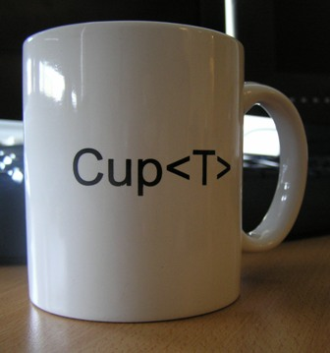
Generics / Templates / Generic Types

Slide 13

Problem: Unsafe Container
Example: Saving buttons in a list of objects
ArrayList al = new ArrayList();
al.add(new JButton("Button 1"));
al.add(new JButton("Button 2"));
al.add(new JButton("Button 3"));
al.add(new JButton("Button 4"));
al.add(new JButton("Button 5"));
al.add(new MyButton("Button 6"));
for (int i = 0; i < al.size(); i++) {
JButton button = (JButton)al.get(i);
button.setBackground(Color.white);
}
Problem 1: Casting
is error prone
Problem 2: No compiler errors, but an object with a different type is stored.
Problem 3: Run time error
MyButton does not extend JButton; so casting to JButton results in an error
Cast: We tell Java that the object that we are casting has a certain type

Slide 14
Solution: Generics
Stating type that should be stored in angle brackets: <Type>
No casting necessary, because type is already defiend
Type errors can already be detected during compile time
ArrayList<JButton> a1 = new ArrayList<JButton>();
ArrayList<Integer> a2 = new ArrayList<Integer>();
ArrayList<String> a3 = new ArrayList<String>();
Integer number = a2[0];
String s = a3[2];
a1[0].setBackground(Color.white);
ArrayList<JButton> al = new ArrayList<JButton>();
al.add(new JButton("Button 1"));
al.add(new MyButton("Button 2")); //Compiler error!!!
for (int i = 0; i < al.size(); i++) {
al.get(i).setBackground(Color.white);
}

Slide 15
Problem: Inflexible Data Structures
Example: Our list implementation
public class Node {
private int data;
private Node next;
public Node(int dataValue) {
data = dataValue;
next = null;
}
public Node getNext() {
return next;
}
public void setNext(Node next) {
this.next = next;
}
public int getData() {
return data;
}
public void setData(int data) {
this.data = data;
}
}
public class Node {
private String data;
private Node next;
public Node(int dataValue) {
data = dataValue;
next = null;
}
public Node getNext() {
return next;
}
public void setNext(Node next) {
this.next = next;
}
public String getData() {
return data;
}
public void setData(String data) {
this.data = data;
}
}
??
??
??
??
??
??
??
??

Slide 16
Solution: Generics
Example: Our list implementation
public class Node {
private int data;
private Node next;
public Node(int dataValue) {
data = dataValue;
next = null;
}
public Node getNext() {
return next;
}
public void setNext(Node next) {
this.next = next;
}
public int getData() {
return data;
}
public void setData(int data) {
this.data = data;
}
}
public class Node {
private String data;
private Node next;
public Node(int dataValue) {
data = dataValue;
next = null;
}
public Node getNext() {
return next;
}
public void setNext(Node next) {
this.next = next;
}
public String getData() {
return data;
}
public void setData(String data) {
this.data = data;
}
}
T
T
T
T
T
T
T
T

Slide 17
Solution: Generics
Example: Our list implementation
public class Node {
private T data;
private Node next;
public Node(T dataValue) {
data = dataValue;
next = null;
}
public Node getNext() {
return next;
}
public void setNext(Node next) {
this.next = next;
}
public T getData() {
return data;
}
public void setData(T data) {
this.data = data;
}
}

Slide 18
Solution: Generics
Example: Our list implementation
public class Node<T> {
private T data;
private Node<T> next;
public Node(T dataValue) {
data = dataValue;
next = null;
}
public Node<T> getNext() {
return next;
}
public void setNext(Node<T> next) {
this.next = next;
}
public T getData() {
return data;
}
public void setData(T data) {
this.data = data;
}
}

Slide 19
Solution: Generics
Idea: we implement generic data structures and method that work independent of the concrete type
Example: Liste, Queue, etc. should store objects that the user of the list defines (not the one who implements the list)
So what are generics?
Parametric classes
The parameters are type variables that are uninstanitated at implementation
These type variables are only specificied when the methods are used
Since Java 1.5: Concrete type is specified in angle brackets

Slide 20
Implementation I
To create a generic class, it has to be defined explicitly
T is a place holder for a parametric type element
Can also have a different name, but T is convention (short for template)
Most often, single upper case letters are used
public class Node <T> {…}

Slide 21
Implementation II
Everywhere we have added a concrete type and we want to have a generic type instead, we need to have the same identifier
Non-generic (old)
Generic (new)
public class Node {
int data;
Node next;
public Node(int dataValue) {
data = dataValue;
next = null;
}
public String toString() {
return "{" + data + "} ";
}
}
public class Node <T> {
T data;
Node<T> next;
public Node(T dataValue) {
data = dataValue;
next = null;
}
public String toString() {
return "{" + data + "} ";
}
}
Use the generic node

Slide 22
Excercise
How to we need to change the class List to make it generic?
T
<T>
public void addAt(int position, int dataValue) {
Node n = this.front;
if (position == 0) {
addFront(dataValue);
} else {
for (int i = 1; n != null && i < position; ++i) {
n = n.next;
} if (n != null) {
add(n, dataValue); }
}}
public void addFront(int dataValue) {
Node n = new Node(dataValue);
n.next = front;
front = n;
}
…
}
public class List {
private Node front;
private Node rear;
public List() {
front = null;
rear = null;
}
public boolean isEmpty() {
return front == null;
}
public void printContent() {
for (Node it = front; it != null; it = it.next) {
System.out.print(it);
}
System.out.println();
}
Node <T> n = this.front;
private Node <T> front;
private Node <T> rear;
3 to 5 minutes
T
Node <T> n = new Node(dataValue);
for (Node<T> it = front; it != null; it = it.next){
Notes:
In Eclipse, die Sache implementieren
Check: Does the constructor need to be generic?

Slide 23
Interlude: Wrapper
Problem: Java knows polymorphism only for objects
Thus, primitive types cannot be used for generics
Not allowed:
A generic List may only contain objects!
Solution:
The wrapper: a class that "wraps" a variable of a primitive type
List<int> a1 = new List<int>();

Slide 24
Idea of Wrappers
Encapsulate ("wrap") primivite data types in classes
Package java.lang provides wrappers for ist primitive data types:
Byte, Short, Integer, Long, Boolean, Float, Double, Character
The can be boxed and unboxed, which may also happen automatically
Prim. type
Complex type (wrapper)
int
int
Integer

Slide 25
Implementing Wrappers
List<Integer> list = new List<Integer>();
list.add(1); //1 is automatically transformed to Integer (=autoboxing)
list.add(new Integer(2));
Integer num = new Integer(3);
list.add(num);
int i = num.intValue(); //explicit transformation to primitive type (=unboxing)
int j = 4;
Integer anotherNum = new Integer(j); // explicit transformation to complex type (=boxing)

Slide 26
Comparing Wrappers
Careful when comparing wrappers!
Wrapper are objects and wrapper variables are, thus, references!
Integer i = new Integer(32);
Integer j = i;
Integer k = new Integer(32);
if (i == k) {
System.out.println(true);
}
else System.out.println(false);
„==" vs. equals!
if (i == j) {
System.out.println(true);
} else System.out.println(false);
if (i.equals(k)) {
System.out.println(true);
} else System.out.println(false);

Slide 27
Boxing/Unboxing
Automatic implicit transformation
Explicit:
However: no implicit casting for method calls
j.toString() instead of (new Integer(j)).toString() results in compiler error
Integer i = new Integer(10); i = 11;
int j = i + 1;
System.out.println(i + " " + j); // 11 12
i.intValue();
j is a primitive type
here, j is encapsulated in a wrapper that provides the method

Slide 28

Inheritance

Slide 29
Example of Inheritance
Living being
Mammal
Bird
Fish
Human
Cow
Shark
Carp

Slide 30
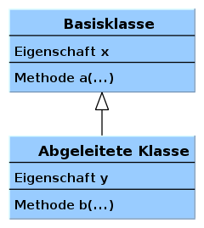
Terms
Do not let yourself get confused!
Super class == parent class == base class
Sub class == Inherited class == child class
Base class
attribute x
method a(...)
Symbol for inheritance
Child class
attribute y
method b(...)
Sub class also has attribute x and method a!

Slide 31
Keyword: extends
Define the class that you want to inherit from
In the sub class, only the methods and attributes are added that are needed in addition to the ones of the base class
public class Student extends Person {…}
class Person {
protected String firstName;
protected String name;
protected int age;
protected Ort Residence;
public Person (String name, int age) {
this.name = name;
this.age = age;
}…}
public class Student extends Person {
protected String mtrNr;
public Student (String name, int age, String mtrNr) {
super(name, age);
this.mtrNr = mtrNr;
}…}
Call to constructor of the base class

Slide 32
Inheritance – Idea
Build on an existing base class the implementation of a new class
Reuse all attributes and methods of the base class in the sub class
Add further attributes and methods
Override existing methods
Goal: allow a maximum of resusing existing implementations and options to easy extension and adaptation of programs

Slide 33
Access Modifier
Catching up:
Private:
Visibilty only within a class; no usage in sub classes
Protected:
Visibility within a class and all extended classes
class Person {
protected String firstName;
protected String name;
private int age;
}
class Student extends Person {
public void print() {
System.out.println(firstName);
System.out.println(name);
System.out.println(age);
}
}
Error! Access to private members of the base class is not possible!

Slide 34
Method Overriding
Sub class has the same method (identical head) as the super class, but different implementations
Sub class overrides implementation of super class
But: objects of super class remain unchanged
class Person {
protected String firstName;
protected String name;
protected int age;
public void printBusinessCard() {
System.out.println("Person " + name);
}
…}
public class Manager extends Person {
…
@Override
public void printBusinessCard() {
System.out.println
("Famous manager Mr. " + name);
}
}
public static void main(String[] args) {
Person p = new Person("Picard", 42);
Manager m = new Manager("Ross", 55);
Person k = new Manager("X", 22);
Manager r = new Person("Santa", 45);
}
//Person Picard
//Famous manger Mr. Ross
//Famous manger Mr. X
//Compiler error
Notes:
In Eclipse zeigen
Zeile mit Santa ergibt Compiler-Fehler

Slide 35
Virtual Methods
What do the two method calls print?
During execution time, the JVM executes the methods of the class Manager, since k was instantiated as object of type manager
This behavior is referred to as virtual method invocation
Java always executes the overriden methods
public static void main(String[] args) {
Manager m = new Manager("Hoeneß", 55);
m.printBusinessCard();
Person k = new Manager("X", 22);
k.printBusinessCard();
}
//Famous manager Mr. Hoeneß
//Famous manager Mr. X

Slide 36
Annotation @Override
Not necessary
But:
Compiler checks whether method is overriden (avoids typing errors or wrong expectations)
Increases understandability of code, because it is clear at once that base class has also such a method that is overriden
Also supports documentation of code

Slide 37
Keyword: instanceof
How can we check the type of an object?
Solution: instanceof checks whether object has a certain type
p is declared as person: only attributes and methods of class person can be used
Person p = new Manager();
if(p instanceof Manager) {
Manager m = (Manager)p;
}
If p is also manager Manager, we can also cast p to a manager

Slide 38

Compute price:
SuperPremiumSubscription and age < 18: 50% discount
PremiumSubscription and age < 18: 25% discount
NormalSubscription: no discount
public class Subscription {
Abonnent user;
double getPricePerYear();
}
public class SubscriptionPriceComputer {
public double computePriceWithDiscount(Subscription sup) {
double price = 0;
If (sup instanceof SuperPremiumSubscription && sup.user.age < 18)
price = sup.getPricePerYear() * 0.5;
return price;
}
}
public class PremiumSubscription extends Subscription {
…
}
3 to 5 minutes
public class SuperPremiumSubscription extends PremiumSubscription {
…
}
public class Subscriber {
int age;
}
Notes:
If (sup instanceof SuperPremiumSubscription && sup.user.age > 18)
price = sup.getPricePerYear() * 0.5;
Else If (….) {
}
Else {
price = sup.getPricePerYear();
}

Slide 39
Good to Know
Objects of sub class can be used like objects of the base class
All non-private members (methods + attributes) can be called and used
Container that store objects of the base class can also store objects of the subclass (e.g., Persons and Managers)
You can inherit from one class only in Java
Other programming languages allow multiple inheritance
Leads to the diamond problem
Keywords final or private in method heads prohibit that they can be overriden
Notes:
Show with Eclipse

Slide 40

Interfaces

Slide 41
Interface: Idea
An interface is kind of a contract:
The interface defines which methods have to be implemented
It defines the expected behavior!
Classes that implement an interface sign this contract and thus need to offer all methods, but can implement them in a different way (polymorphism)
public class Manager implements IEmployee{…}
public class Worker implements IEmployee{…}
public class Student implements IEmployee{…}

Slide 42
What Is an Interface?
Two meanings of the term "interface"
Interface of a class describes heads of public methods
Keyword interface in Java describes special classes without method bodies
Example:
public interface IEmployee {
public double paySalary(int workingHours);
public String getName();
public int getAge();
}

Slide 43
Using Interfaces I
A class that implements an interface has to follow the specifications of the interface: all methods need to be defined, including their bodies
public interface IEmployee {
public double paySalary(int workingHours);
public String getName();
public int getAge();
}
public class Manager implements IEmployee{
private String name;
private int age;
public double paySalary(int workingHours) {
return workingHours * 500;
}
public String getName() {
return getNachname();
}
Manager(String name, int alter) {
this.name = name;
this.age = alter;
}
…
public class Firma {
public static void main(String[] args) {
Manager manager = new Manager("Picard");
Student student = new Student("peter");
}
}
Notes:
In Eclipse zeigen, wie nun ein Student und ein Worker ebenfalls das Interface implementieren, aber anders

Slide 44
Interface: Applying Polymorphism
Mandatory actions are described as collection of method heads (interface)
One action can have different behavior in different instances/applications
The behavior depends on the data types of the parameters of the call
Different internal structures can offer the same interface

Slide 45


What Is It Good For?
What good is a class with only "empty" methods?
What uses cases exist?
Real-World Example:
User of this interface does not care what's behind
Interface
Same usage, but different behavior

Slide 46
Using Interfaces II
Often, interfaces are already defined and their methods need to be implemented
Example: Comparable
Goal: Store persons in a list and sort it
ArrayList<Person> persons = new ArrayList<Person>();
Person p1 = new Person("AAA", 10);
Person p2 = new Person("BBB", 20);
persons.add(p1);
persons.add(p2);
Collections.sort(persons);
for(Person temp: persons) {
System.out.println(temp.getNachname() + ", " + temp.getAge() );
}
Problem: How should Java know which criteria should be used for sorting (comparing two objects of type person)?

Slide 47
Interface Comparable
Java offers interface comparable
Class person has to implement this interface, so Java knows how to compare two objects of this class
Consequence: persons offer the method compareTo
public interface Comparable<T> {
public int compareTo(T o);
}
class Person implements Comparable <Person> {
public int compareTo(Person p) {
return Integer.signum(p.getAge() – this.age);
}
…
}
Notes:
In Eclipse zeigen
compareTo bei Studenten mit MtrNr, bei Manager mit Gehalt, bei Personen mit Namen

Slide 48
How Is This Related to Polymorhism?
Different classes can implement the method compareTo differently
So: different behavior, which depends on the type
In our example, the compiler knows which implementation of the method compareTo should be used
In general, this is only known during execution time

Slide 49
Good To Know
By convention, interfaces start with "I" (capital i), followed by its name (first letter is also capital)
A class can implement several interfaces
Interfaces should never be changed
Otherwise, all classes that implement this interface "break"
In other words: "the contract was broken"
Thus: take great care when designing an interface

Slide 50
Types of Polymorphism
Polymorphism
Universal polymorphism
Ad-hoc polymorphism
Overloading: methods with the same name but different head (we have talked about this)
Inclusive polymorphism
Parametric polymorphism
Overriding:
Inheritance/Interfaces
Generics/generic types

Slide 51
Take Aways
Polymorphism is a core concept in object oriented programming
The behavior of an action depends on the type of the used objects
Types:
Parametric (Generics)
Generic Type <T>, instead of concrete type
Method overloading
Interfaces
Forces the existence of certain methods
Inheritance
Extending an existing class by new members

Slide 52
Nächste Vorlesung
Exceptions
Wichtige Klassen in Java
Debugging

