Slide 1
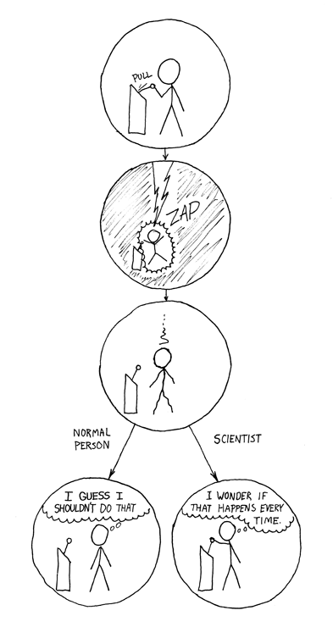
Empirical Software Engineering
Introduction

Slide 2
Details of Course
Close to research
Discussion of research papers
Project: Application to example
Discussion, questions, feedback: Any time!
There will be group work, sometimes also on Laptops
You can give a presentation on a topic that is especially interesting/relevant for you
You can make suggestions on content of the course

Slide 3
Formal Things
Oral exam
Admission:
Homework assignments
Presentation of exercise results
Conducting an experiment and writing a report
Participate in other experiments
Presentation for special topics
On request, the project will be graded and can be used to improve the grade of the oral
Deadline: 2 weeks before exam if you want it graded, 1 week otherwise

Slide 4
Project
Evaluate a self-selected research question and write a report on it
Do comments support comprehensibilty of source code?
Does my new prototype improve a workflow?
Working hours per person:
40 hours of research +
20 hours of writing
2 to 3 persons per project

Slide 5
Suggestion for a Project
Via e-Mail, optional: an appointment
Proposal contains (max 1 page)
Research question
Plan (bullet points)
What method, and why
What participants/case study/benchmark, and why
Expected result
Expected effort (rough estimation)

Slide 6
Grading Criteria
Relevant research question
Clear research hypothesis
Justified and suitable methods
Justified and suitable selection of participants
Quality of applying method (e.g., well-design interview question, plausible measures)
Quality of analysis (e.g., statistics, qualitative analysis)
Suitable discussion of validity
Clear and suitable structure of report (e.g., separation of data and interpretation)
Writing quality of report and adherence to template

Slide 7
Project Report -Points
0 to 2 points per criterion (3 for excellent realization)
Grading can be used to improve grade in oral exam
In that case, the report needs to
be handed in at least two weeks
before exam
If grade should not be used, one
week is sufficient
Points | Grade
> 17 | 1,0
16 | 1,3
15 | 1,7
14 | 2,0
… | …
8 | 4,0

Slide 8
Questions on the organizational part?

Slide 9

Guest Lecture
Norman Peitek
How can neuro-imaging methods be used to evaluate cognitive processes?

Slide 10
Tools
R (SPSS, PSPP, Python)
Java
PROPHET (Tool for conducting experiments)

Slide 11

Who are You?
Name
Course of study
Semester
Existing experience
Request for special topics

Slide 12
Goals of the Course
Overview of available empirical methods
Application to questions in computer science (e.g., for Master‘s thesis, Ph.D. thesis)
To come from oppinions/plausibility to neutrality/objectivity
Fun

Slide 13
Literature
Jutta Markgraf, Hans-Peter Musahl, Friedrich Wilkening, Karin Wilkening, and Viktor Sarris. Studieneinheit Versuchsplanung, 2001. FIM-Psychologie Modellversuch, Universität Erlangen-Nürnberg.
Jürgen Bortz. Statistik für Human- und Sozialwissenschaftler. Springer, 2004. http://www.springer.com/psychology/book/978-3-642-12769-4?changeHeader
Anderson and Finn. The New Statistical Analysis of Data. Springer Texts in Statistics. 2000.
Robert A. Donnelly Jr. The Complete Idiot's Guide to Statistics. Alpha, 2007
In addition, different research literature.

Slide 14
What Do We Need Empirical Methods for?

Slide 15
Learning Goals
Understand necessity for empirical research
Differentiate empirical methods from other methods
Understand problems of empirical research

Slide 16
Task
How would you evaluate the following statement:
The programming language Python makes developers more productive?

Slide 17
Aufgabe
Nennen Sie eine Ihnen bekannte Technik [OOP, Pair Programming, FOP, AOP, Unit-Tests]
Schreiben Sie zu dieser Technik mindestens eine Aussage/Theorie auf, die mit dieser Technik verbunden wird
Nennen Sie (nicht ausdenken!) einen Beleg, anhand dessen die Gültigkeit dieser Aussage festgemacht wird

Slide 18


Slide 20
What solid insights do we have?
What do you know about the following topics?
What statement/theory is linked to this topic? What have you learned in other courses?
Which evidence do you know (e.g., from other courses)?
Does that match with your experience?
What kinf of evidence would convince you?

Slide 21
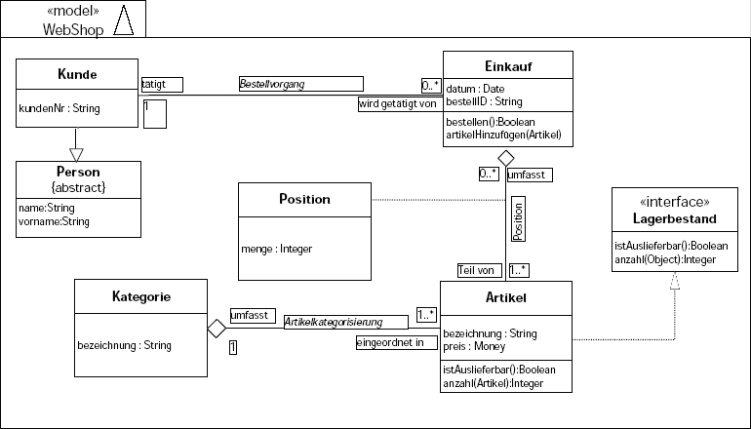
UML

Slide 22
What solid insights do we have?
What do you know about the following topics?
What statement/theory is linked to this topic? What have you learned in other courses?
Which evidence do you know (e.g., from other courses)?
Does that match with your experience?
What kinf of evidence would convince you?

Slide 23
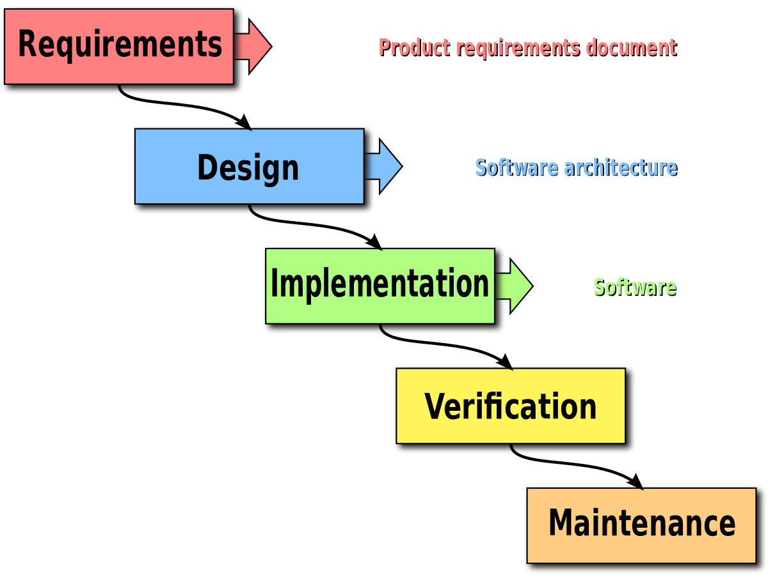
Development Processes

Slide 24
What solid insights do we have?
What do you know about the following topics?
What statement/theory is linked to this topic? What have you learned in other courses?
Which evidence do you know (e.g., from other courses)?
Does that match with your experience?
What kinf of evidence would convince you?

Slide 25
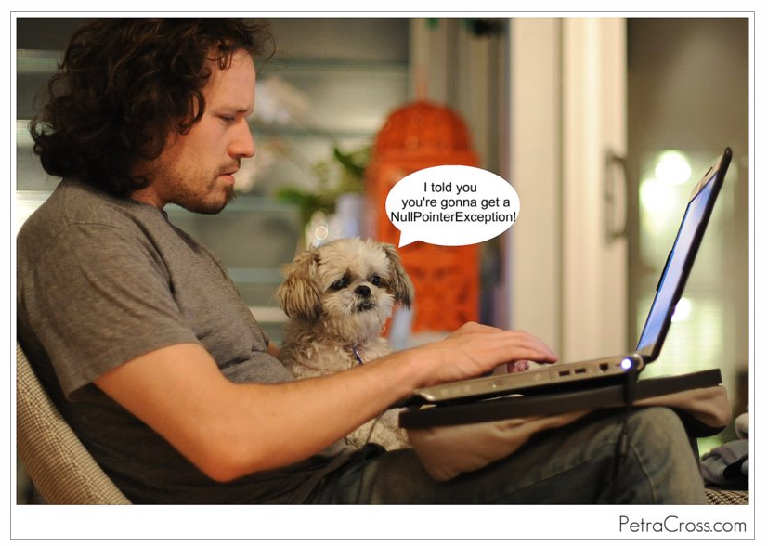
Pair Programming

Slide 26
What solid insights do we have?
What do you know about the following topics?
What statement/theory is linked to this topic? What have you learned in other courses?
Which evidence do you know (e.g., from other courses)?
Does that match with your experience?
What kinf of evidence would convince you?

Slide 27
Empirical Research

Slide 28
Empirical Research
Greek (empeiría): Experience, Observation
German dictionary:
Method based on scientific experience to gain insights
Knowledge gained from scientific experience

Slide 29
Empirical Research Does not Mean:
Theoretical thoughts
Intuition
Random selection
Authority
Persistence
Empiricism

Slide 30
The Scientific Method
Experiments
Hypotheses
Theory

Slide 31
Goals of the Scientific Method
Theory
Prediction
Explanation

Slide 32
Scientist
The scientist builds in order to study;
the engineer studies in order to build.
F. Brooks. The Computer Scientist as Toolsmith II. Communications of the ACM, 39:3, 1996.
Scientist
Understanding as goal (facts, relationships)
Construction as far as necessary to fulfill goal
Engineer
Construction of something useful as goal
Understanding as a way to better construction

Slide 33
Computer Science
Rooted in mathematics (theory)
Electrical Engineering
Today: huge engineering part in many areas (e.g., when constructing UIs)
Used by people (psychology, politics)
Empirical research is growing more and more important

Slide 34
Mathematical Proof vs. Empirical Research
Proof of a closed system
Formalization of statement and research topc
E.g., mathematical induction
Unchallengeable
Cannot always be formalized
E.g., interaction with people
Result is observable, but not provable
No final result
Collect evidence
Falsification

Slide 35
Statements that cannot be proven, but observed
Example
Copy & Paste causes errors
Behavior of users (errors) cannot be proven, because there is no formal model of a user
But behavior of users can be observed (e.g., during or after development, we can examine whether errors are related to copy & paste)

Slide 36
Problem of the Human Factor
Humans use a software tool or develop software
Human behavior is typically non-deterministic (mood, daily state of mind)
Intra-individual differences are difficult to determine
Most likely large difference between indivuduals
Skills, education, personal preferences
Many (possibly causal) relationships are currently unkown
When does a user/programmer make an error?
When is a UI/source code less usable/comprehensible?
…

Slide 37
Empirical Research – First Steps (1)
Single observations?
Can one single observation be used as evidence for a statement?
Example 1:
Write a program „Hello World“ in Java. Let your colleague write „Hello World“ Python. Who needs more time?
Would this support Java or Python?
Example 2:
Write „Hello World“ in Java. The next day, write „Hello World in Python. The day after that, write „Hello World“ in Java.
Development time on Day 3 will be different than on Day 1 and 2. Can you draw conclusions based on that?
… not really …

Slide 38
Empirical Research – First Steps (2)
Subjective perception?
Can the personal opinion be used to confirm a statement?
Example 3
Assume that you just love the new UI. Assume that your neighbour also loves the new UI. Does that mean that the new UI is good?
Example 4
Assume that the results of a survey show that most users love the new UI. Does that mean that the new UI is good?
…not really…

Slide 39
Empirical Research – Apparent Questions
How can we use observations as scientific method?
Empirical methods:
Data collection: What kind of data can we observe where?
Qualitative vs. quantitative Observations: Which kind of information can we collect?
Logic of empirical research: How can we conclude statements or contradictions from data?
Experiment, field studies, case study, etc.: Under which conditions can we conclude what kind of statements/contradictions?

Slide 40
Overview
Human--Technology
Qualitative---Quantitative
Time-series analysis
Controlled experiments with human participants
Performance
Questionnaires
Interviews
Proofs
Case studies
Think-Aloud Protocols

Slide 41
Learning Goals
Understand necessity for empirical research
Differentiate empirical methods from other methods
Understand problems of empirical research
1. Question in exam: Do we need empirical research?

