Slide 1
Empirisches Software Engineering

Slide 2

Einordnung
Wartung
Requirements Engineering
Testen
Design
Implementierung

Slide 3
Einordnung
Wartung
Requirements Engineering
Testen
Design
Implementierung

Slide 4
Faktor Mensch in der Software Entwicklung
Menschen unterhalten sich und bestimmen die Anforderungen an Software -> Gibt es bestimmte Strategien, die besonders erfolgreich sind? Ist das Volere Template besser/schlechter als andere Ansätze?
Menschen erstellen das Design -> Welche UML Tools sind am besten? Oder soll es überhaupt UML sein? Reichen nicht CRC-Karten?
Menschen implementieren, testen, und warten die Software -> Welche Sprache eignet sich am besten? Welche IDE? Welche Teamstruktur, welche Raumaufteilung? Wird genug kommuniziert? Pair Programming? Wie werden Paare zusammengesetzt?

Slide 5
Learning Goals
Design good research hypotheses
Design an experiment with high internal validity and high external validity

Slide 6
Experimental Phases
Objective Defintion
Design
Conduct
Analysis
Interpretation
Report
Hypotheses; Independent & Dependent Variables
Experimental Design;
Confounding factors
Accepted/ Rejected Hypotheses
Data

Slide 7
Variables
Objective Definition
Design
Conduct
Analysis
Interpretation
Report

Slide 8
Independent Variables
Varied by experimenter on purpose and systematic
Also called factor or predictor (-variable)
Has alternatives, levels, or treatments
Examples:
Programming language or paradigm
User interfaces
Interaction methods
Notes:
UV: Typsystem, 2 Stufen

Slide 9
Dependent Variable
Result of an experiment
Depends on variation of independent variable
Is observed
Examples:
Productivity of programmer
Bugs in a program
Operator error
Notes:
Entwicklungszeit

Slide 10
Latent Variables
Construct
Not observable directly
Examples
Program comprehension
Intelligence
Mental model of user

Slide 11
Operationalization
Defining operations that allows you to measure variables
Must not contradict common sense
Example:
Program comprehension
Number of bugs in a program
Development time

Slide 12
Task
Find operational definition for the following variables:
Usability of new UI
Maintainability of a program

Slide 13
Hypotheses
Expectations of results
Expecations need to be justified, e.g., in theory or practice
Hypotheses need to be simple and clear
Hypotheses need to be falsifiable
Falsifiability (Suggested reading: Make yourself familiar with the term and explain its role for experimental design)

Slide 14
Hypotheses
- Bad Examples
Bad source-code comments are bad for program comprehension
Good source-code comments are good for program comprehension

Slide 15
How can we do better?
Comments that describe every statement of source code do not affect the time developers need to understand a source-code snippet
Comments that contain wrong information about source code increase the time developers need to understand a source-code snippet
Comments describing the purpose of source-code statements decrease the time developers need to understand a source-code snippet

Slide 16
Why do we need Hypotheses?
They guide us when designing an experiment
Prohibit Fishing for Results
Connects theory and empirical research
Derived from theory
Evaluated with empirical research

Slide 17
Design
Objective Definition
Design
Conduct
Analysis
Interpretation
Report

Slide 18
Validity
Do we measure what we want to measure?

Slide 19
Internal Validity
Amount to which the value of the dependent variable can be explained my the systematic variation of the independent variable

Slide 20
External Validity
Amount to which results are transferable to other circumstances (participants, material,…)
Generalizability

Slide 21
Threats to Validity
Confounding factors:
Influence dependent variable in addition to indepedent variables
Learning effect
Hawthorne effect
Experience of participants
Preference for programming language
Selection bias

Slide 22
Task
Evaluating the effect of new UI: What confounding factors exist?
How could the influence of these factors be controlled?

Slide 23
Confounding Factors
There are numerous confounding factors
Carefully identify and control their influence:
Randomization
Matching/parallelization/balancing
Define confounding factors as independent variable
Keep confounding factor constant
Analyze afterwards

Slide 24
Randomization
Random numer generator
Toss a coin
Throw a dice
…
Issues:
Groups need to be sufficiently large
5 per group seems to be too low, 10 seems to be sufficient

Slide 25
Matching/parallelization/balancing
Participant | Value
P5 | 65
P9 | 56
P3 | 42
P4 | 34
P10 | 24
P6 | 23
P7 | 21
P8 | 16
P2 | 12
P1 | 5
Group A | Group B
65 | 56
34 | 42
24 | 23
16 | 21
12 | 6
odd-even-even-odd/
ABBA

Slide 26
Matching/parallelization/balancing
Drawback compared to randomization
Confounding factor needs to be measured
How to measure programming experience? How to measure intelligence?
Advantage compared to randomization:
More detailed knowledge about parameter

Slide 27
Define confounding factors as independent variable
Is varied systematically by experimenter
Confounding factor is operationalized
Experience with tool:
Haskell/low experience
Java/much experience
Jave/low experience
Haskells/much experience

Slide 28
Doing the Math…
23 confounding factors, each with 2 levels
= 8 388 608 possible combinations
How many participants do I need to cover each combination
at least 10 participants per group
83 886 080 (i.e., Germany)

Slide 29
Keep confounding factor constant
Only one leve of confounding factor
Programming experience:
Only undergraduate students
Only programming experts
Intelligence
Only students with a certain grade

Slide 30
Analyze afterwards
Measure factor during experiment
Analyze influence of a variable after the experiment
Issues
Could show that results are useless
Notes:
Wenn Probanden nicht den Gruppen zugewiesen werden können
Wenn etwas während des Experiments passiert ist (z.B. Stromausfall)

Slide 31
Relation between Internal and External Validity
Both kinds of validity request different things:
Internal: control everything
Extern: general setting
And now?
First maximize internal validity
Then increase external validity step by step

Slide 32
Quality Criteria of Empirical Studies
Validity
Reliability
Objectivity

Slide 33
Quality Criteria of Empirical Studies
Reliability:
Accuracy of measurement instrument
Objectivity:
Execution of experiment must not depend on person of experimenter
The same experiment, conducted by a different experimenter, should produce the same result

Slide 34
Example
Scale for measuring the weight:
Valid
Reliable depending on quality
Digital scale is more objective, as everyone sees the same number (analogous leaves more wiggle room)
The same scale for measuring the height
Less valid
Reliable depending on quality

Slide 35
Experimental Designs
Objective Definition
Design
Conduct
Analysis
Interpretation
Report

Slide 36
Designs
Between vs. Within Subject
With vs. without repeated measures
One-factorial vs. multi-factorial
One vs. several independent variables
Univariate vs. Multivariate
One vs. several dependent variables

Slide 37
Why Experimental Designs?
Instruction to act
Makes communication easier
Decision for statistical analysis

Slide 38
How to Select a Design
Depends on:
Effect size
Sample size
-> The bigger both are, the less the influence of confounding factors manifest
-> When both are small, a suitable design is very important
Unfortunately, you will very often have small samples and unknown effect sizes

Slide 39
One-Factorial

Slide 40
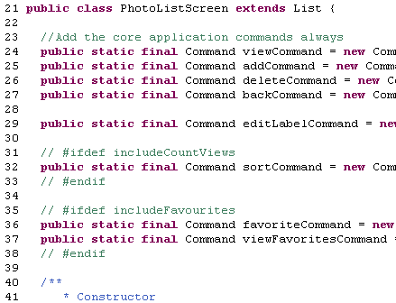
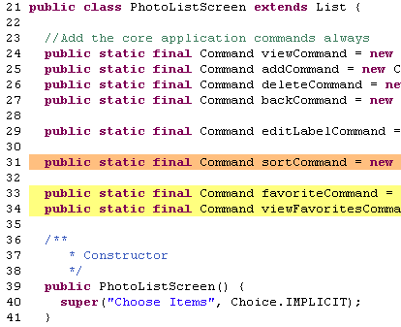
Between-Subjects
Participants are devided into two groups
As many group as there are levels of the independent variable
Results are compared
between groups
Group | Levels
A | Textual Annotation
B | Background colors
Notes:
Beide Gruppen hatten dieselbe Aufgabe

Slide 41
Issues
Variance between participants (i.e., inter individual differences) can be large
-> 10x (What does 10x Mean? Measuring Variations in Programmer Productivity. Steve McConnell.)
Sufficient number of participants
Balancing between groups

Slide 42
Within-Subjects
Inter individual differences need to be controlled for
Each participant is exposed to all levels of an independent variable
One Group | Session 1 | Session 2
 | Background colors | Textual Annotations

Slide 43
Issues
Learning effects
Especially with creative tasks
You need different, but similar tasks at the same time
Ordering effects
Intra individual differences
Fatigue
Motivation
Mortality

Slide 44
Crossover
Each participant is exposed to all levels
Comparison between and within groups is possible
Group | Session 1 | Session 2
A | Background colors | Textual annotations
B | Textual annotations | Background colors

Slide 45
Issues
Intra individual differences
Inter individuelle differences
Mortality

Slide 46
Benefits
Check for learning effects:
Difference between both sessions for both levels
Check for ordering effects:
Difference between both sessions for one level
Gruppe | Session 1 | Session 2
A | Background colors | Textual annotations
B | Textual annotations | Background colors
Notes:
Beispiel aus Using Background colors to support program comprehension… (EASE)

Slide 47
Comparison
Property | Between-Subjects | Within-Subjects | Cross-Over
Sample size
Group balancing
Learning effects
Ordering effects
Mortality
Motivation, fatigue
Experiment duration
Internal validity
External validity
2 | 1 | 2
2 | 1 | 2
2 | 3 | 1
2 | 3 | 1
1 | 2 | 2
1 | 2 | 2
1 | 2 | 2
2 | 2 | 1
2 | 2 | 1

Slide 48
Multi Factorial Designs

Slide 49
Latin Square
Group | Session 1 | Session 2
A | Background colors | Textual annotations
B | Textual annotations | Background colors
Task 1
Task 2
Special case of cross over
But different task in sessions -> Task is second factor

Slide 50
Two-factorial, Between-subjects
Programming experience
Variables | Groups
Background color/ novice | Group A
Background color/ expert | Group B
Textual/ novice | Group C
Textual/ Expert | Group D

Slide 51
Two-factorial, Within-Subjects
Group | Session 1 | Session 2 | Session 3 | Session 4
Background color/ novice | Group A | Group D | Group C | Group B
Background color/ expert | Group B | Group A | Group D | Group C
Textual/ novice | Group C | Group B | Group A | Group D
Textual/ Expert | Group D | Group C | Group B | Group A

Slide 52
Main- and Interaction Effects
PC
PC
Expert
Expert
Novice
Novice
PC
PC
Expert
Expert Novice
Novice

Slide 53
Multi-factorial Designs
In case the shown designs are not sufficient
4-factorial design (2x2x3x2)
Higher-order interaction
 |  | C₁ |  | C₂ |  | C₃
 |  | B₁ | B₂ | B₁ | B₂ | B₁ | B₂
A₁ | D₁
 | D₂
A₂ | D₁
 | D₂

Slide 54
Selecting a Design
Prefer a simple as possible design
Carefully consider benefits and disadvantages
Consider resource constraints

Slide 55
Homework assignments
Why do we need hypotheses?
What does falsifiability mean?
Research other kinds of validity
Design an experiment for a self-selected research question
Define hypotheses
Operationalize variables
Identify the most important confounding parameters (at least 5) and select suitable control techniques
(You do not need to think about statistical tests yet)

Slide 56
Conduct
Objective Definition
Design
Conduct
Analysis
Interpretation
Report

Slide 57
What Can Go Wrong?
Everything!
Pilot studies:
Test material and tools
Check that data is actually stored
Check instructions for participants
…
Exactly tell participants what they need to do
Observe that participants do exactly what you told them they should do
Do a warm-up task, so that participants can familiarze with everything
Notes:
1. Experiment:
Einen Papierfragebogen zu wenig
Pilottest: 6 Aufgaben (ohne Aufwärmaufgabe)
Experiment: 7 Aufgaben (mit Aufwärmaufgabe); aber Fragebogen nicht entsprechend angepasst
Probanden kamen zu spät (-> extra Einweisung)
Nicht genug Arbeitsplätze (-> extra Raum, laut/leise, process conformance?)
Probanden haben Editor zum Suchen benutzt, obwohl sie es nicht durften
Probanden haben Teamwork gemacht
2. Experiment:
Selbst implementiertes Tool; irgendwann sind Zeilennummern beim Scrollen nach oben verschwunden
3. Experiment:
Probanden haben Farbzuweisung nicht geladen
Daten verlorengegangen: Tool musste mit Klick auf "Experiment beenden" geschlossen werden, bei Klick auf x wurden Daten nicht gespeichert
Eine Frage konnte nicht beantwortet werden, da die HTML-Elemente von zwei Fragen diesselbe id hatten -> Copy-Paste beim Aufgaben erstellen

Slide 58
Ethics
Effort for participants need to be in line with insights that you gain
Evaluating teaching methods
Evaluating medicine
Ensure anonymity of participants
Be nice to your participants, they voluntarily invest their time
Notes:
Medizin: Vorgetäuschte Knie-OP
Anonymität sicherstellen und Daten zuordnen können: Code zuweisen
Was machen, wenn ein Proband offensichtlich keine Lust hat?

Slide 59
Analysis
Objective Definition
Design
Conduct
Analysis
Interpretation
Report

Slide 60
Look At Data
Go swim in the data!
Get an overview
Look at how data are distributed
Are there outliers?

Slide 61
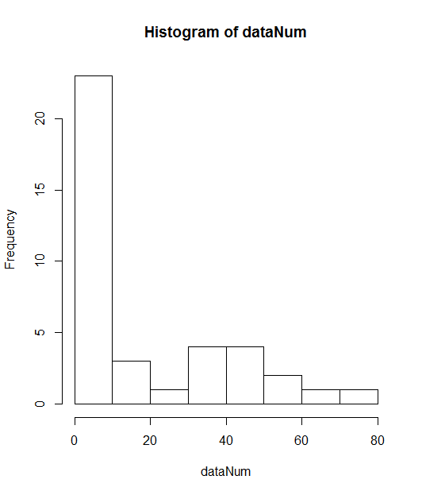
Histograms
Frequency of measurement values in fixed buckets
R
rtNum <-as.numeric(unlist(rt))
hist(rt)

Slide 62
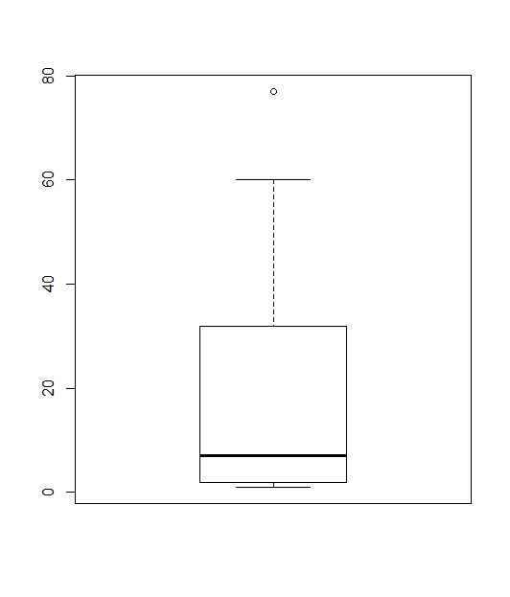
Boxplots
Median as thick line
Quartiles as box (50% of all values within the box)
Whiskers (-> box and whisker plots)
Outliers as dots
R: boxplot(rt)
Notes:
[Tafelbild]

Slide 63
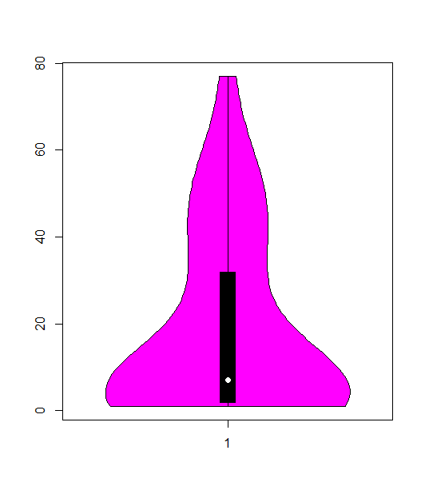
Violin-Plot
Like box plots, but show additionally the distribution of data
R:
install.packages("vioplot")
library(vioplot)
vioplot(rtNum)

Slide 64
Arithmetic Mean
Repeat measurement
Compute mean:
R:
mean(rt)

Slide 65
Median
Value that is in the middle
Robust against outliers
R:
median(rt)
Even number of measurements:
Arithmetic mean of the two middle values
Use one of the two middle values

Slide 66
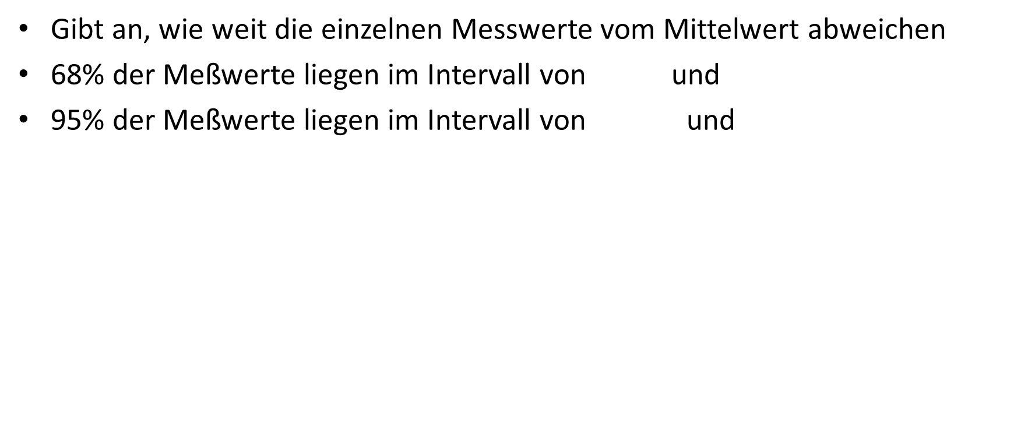
Standardabweichung
Gibt an, wie weit die einzelnen Messwerte vom Mittelwert abweichen
68% der Meßwerte liegen im Intervall von und
95% der Meßwerte liegen im Intervall von und

Slide 67
Significance Tests I
To evaluate whether an observed result appeared rather randomly or not
For example, developers who work with good comments (i.e., comments that describe the purpose of code statements) are 2 minutes faster than developers who work with useless comments (i.e., comments describing what a statement does)
Is this difference due to random noise or systematic?

Slide 68
Significance Tests II
Result of a significance test is a conditional probality
Determines probability of observed result, under the assumption that there actually is no difference
If probability is smaller than 5% (1%, 0.1%), assumption of no difference must be wrong
In other words: A significant difference means that there is no evidence that the assumption of no difference is correct

Slide 69
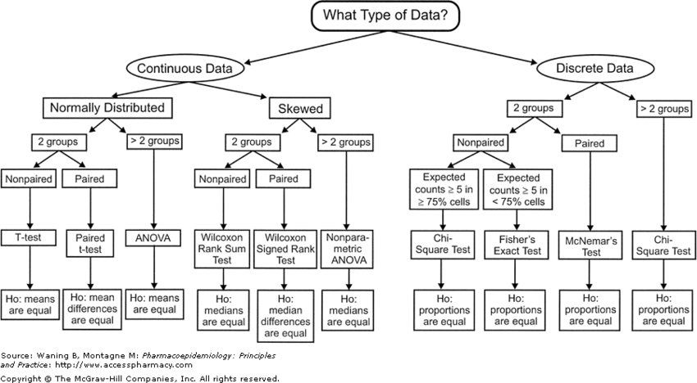
Decision Chart for Statistical Tests
If probability is smaller than:
0.001
0.01
0.05
0.10

Slide 70
Interpretation
Objective Definition
Design
Conduct
Analysis
Interpretation
Report

Slide 71
Discussion of Results
What do the results mean?
To define hyptoheses, we needed to restrict the setting
Now, it is important to come back to the overarching question

Slide 72
Faktor Mensch in der Software Entwicklung
Menschen unterhalten sich und bestimmen die Anforderungen an Software -> Gibt es bestimmte Strategien, die besonders erfolgreich sind? Ist das Volere Template besser/schlechter als andere Ansätze?
Menschen erstellen das Design -> Welche UML Tools sind am besten? Oder soll es überhaupt UML sein? Reichen nicht CRC-Karten?
Menschen implementieren, testen, und warten die Software -> Welche Sprache eignet sich am besten? Welche IDE? Welche Teamstruktur, welche Raumaufteilung? Wird genug kommuniziert? Pair Programming? Wie werden Paare zusammengesetzt?

Slide 73
Take Aways
Given is a research hypotheses "ABC". Is this a good hypotheses? Why? How can it be improved?
How would you operationalize maintainability/readability/project success?
An experiment yielded a mean difference of 1 hour in favor of learning the new programming language Mython (i.e., being able to implement standard algorithms of the lecture data structures), compared to Java. Should all students now start learning programming with Mython?

Slide 74
Literature
Jutta Markgraf, Hans-Peter Musahl, Friedrich Wilkening, Karin Wilkening, and Viktor Sarris. Studieneinheit Versuchsplanung, 2001. FIM-Psychologie Modellversuch, Universität Erlangen-Nürnberg.
Natalia Juristo and Ana Moreno. Basics of Software Engineering Experimentation. Kluwer, 2001.
Claes Wohlin. Experimentation in Software Engineering. Springer, 2000.
William Shadish, Thomas Cook, and Donald Campbell. Experimental and Quasi-Experimental Designs for Generalized Causal Inference. Houghton Mifflin Company, 2002.
James Goodwin. Research in Psychology: Methods and Design. Wiley Publishing, Inc., 1999.
Steve Easterbrook, Janice Singer, Margaret-Anne Storey, and Daniela Damian. Selecting Empirical Methods for Software Engineering Research. In Guide to Advanced Empirical Software Engineering, pages 285–311. Springer, 2008.
Steve McConnell. What does 10x Mean? In Making Software, O'Reilly, 2010.
Urban Wiesing. Die Ethik-Kommissionen – Neuere Entwicklungen und Richtlinien. Deutscher Ärzte-Verlag, 2003.

