Slide 1
Analysis

Slide 2
Homework Assignment
Falsifiability
Validity

Slide 3
Why Hypotheses?
Provide guidance
Avoid Fishing for Results
Combines theory and empirical research
Derived from theory
Evaluated with empirical research
Falsifiability:
When a hypothesis is wrong, it must be possible to disprove it

Slide 4
Further Kinds of Validity
Construct validty
Describes how well the construct is being measured
Statistical Conclusion Validity
Describes how suitable the statistical methods are
Notes:
Augenscheinvalidität,
onvergente/ diskriminante Validität,
Kriteriumsvalidität,
Inhaltsvalidität…

Slide 5
Learning Goals
Understand the principle of standard statistical tests
Understand the principle of correlations

Slide 6
Overview
Human--Technology
Qualitative---Quantitative
Time-series analysis
Controlled experiments with human participants
Performance
Questionnaires
Interviews
Proofs
Case studies
Think-Aloud Protocols

Slide 7
Analysis
Descriptive statistics
Vizualization
Significance tests

Slide 8
Arithmetic Mean
Repeat measurement
Compute mean:
R:
mean(rt)

Slide 9
Suggested Homework
Familiarize yourself with R (or another data-analysis tool, such as SPSS or PSPP)

Slide 10
Median
Value that is in the middle
Robust against outliers
R:
median(rt)
Even number of measurements:
Arithmetic mean of the two middle values
Use one of the two middle values

Slide 11
Median or Arithmetic Mean?
Median, if:
Ordinal Data*
Few measurement values
Non-normal distribution
Outliers
*Scale types
Nominal (z.B. Gender)
Ordinal (z.B. Ranking)
Metric (z.B. Temperature, response time)
Notes:
Woher weiß ich, ob es Ausreißer gibt oder Verteilung asymmetrisch ist?

Slide 12
Look at the Data
Get an overview
Estimate distribution and outliers

Slide 13
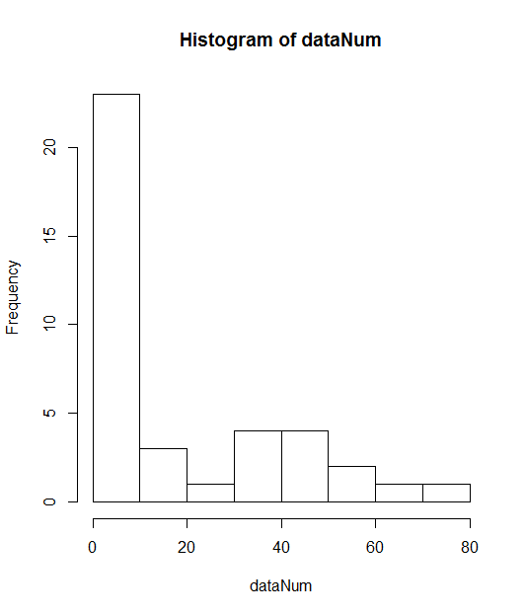
Histogram
Frequency of values in defined buckets
R
rtNum <-as.numeric(unlist(rt))
hist(rt)

Slide 14
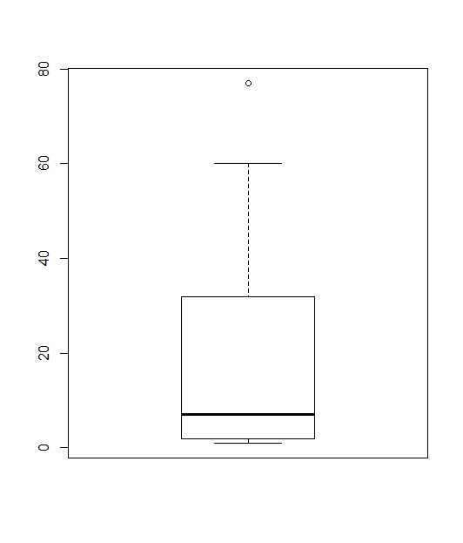
Boxplots
Boxplot shows
Median as thick line
Quartiles as Box (50% of all values are in the box)
Whiskers (25% of lowest and 25% of highest values)
(Outliers as dots)
Gives a hint about the distribution
R: boxplot(rt)
Notes:
[Tafelbild]

Slide 15
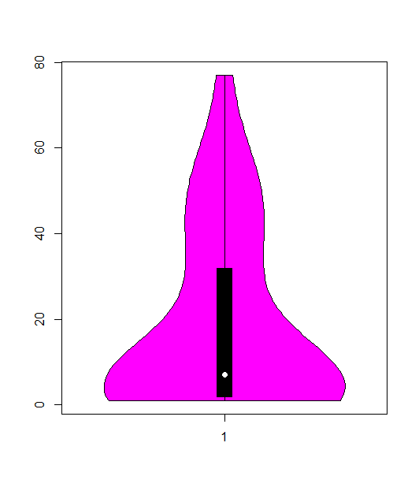
Violin-Plot
Like boxplots, only that it additionally shows the distribution
R:
install.packages("vioplot")
library(vioplot)
vioplot(rtNum)

Slide 16
Recap
Benchmarks
Metriken zur Performance-Messung
Daten visualisieren

Slide 17
Measurement Model
y = τ + ε
y: Observed value
τ: True value
ε: Error
Population: greek letters
Sample: german letters

Slide 18
Error Model
True mean: 10
1 random error, influence of +/- 1
Measurement: 9 (50%) and 11 (50%)
2 random errors, each +/- 1
Measurement: 8 (25%), 10 (50%), 12 (25%)
3 random errors, each +/- 1
Measurement: 7 (12.5%), 9 (37.5%), 11 (37.5%), 13 (12.5%)
N random errors, each +/- 1
Normal distribution

Slide 19
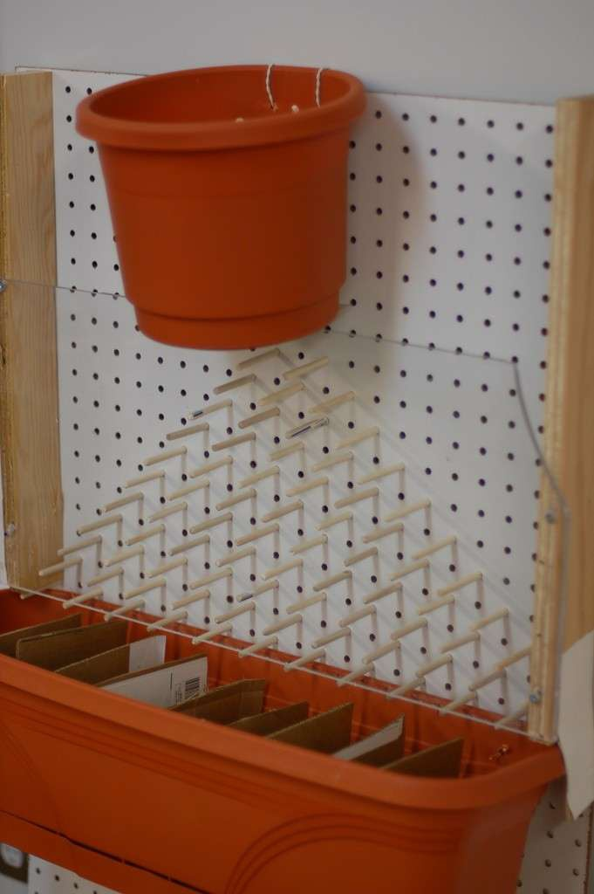
Normal Distribution

Slide 20
Dispersion
Mean: 45,55
Boxplot

Slide 21
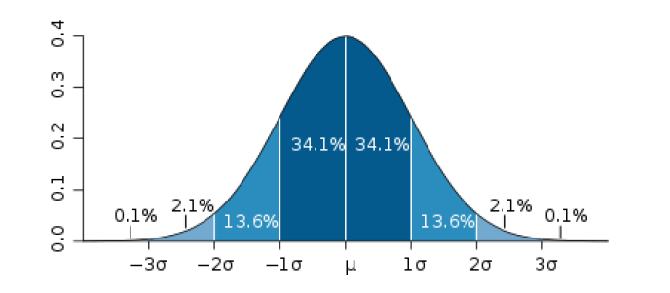
Standard Deviation
Bildquelle CC BY 2.5 Mwtoews

Slide 22
Standard Deviation
R:
sd(rtNum)
21,55
Mean: 45,55
24 –> 45,55 (34 % of measurement values)
45,55 –> 67,1 (34% of measurement values)

Slide 23
Use cases for Standard Deviation
Define outlier
Define giftedness
Announce the discovery of the Higgs-Boson

Slide 24
Variance
Is the squared standard deviation

Slide 25
Konfidenzintervall
: Mittelwert
z: x-Wert der Standardnormalverteilung
alpha: 1-Wert des Konfidenzintervall (z.B. 95%)
s: Standardaweichung
n: Anzahl der Messungen

Slide 26
Konfidenzintervall: Bedeutung
Bedeutung
Vertrauensintervall
Wahrer Mittelwert liegt in 95% im Intervall
Technischer: Bei grosser Anzahl von Wiederholungen des Experiments liegt in 95% der Fälle der wahre Mittelwert in dem jeweils berechneten Konfidenzintervall

Slide 27
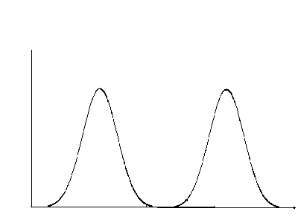
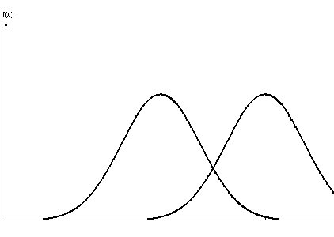
Konfidenzintervall: Anwendung
Überlappung: vmtl kein Unterschied
Keine Überlappung: vmtl Unterschied
Mehr Messungen verkleinert Intervalle
Notes:
Bei kleinerem Konfidenzintervall wird Präzision erhöht

Slide 28
Accuracy vs. Precision
Accuracy:
Deviation of observed mean from true mean
Important when measuring response time
Precision:
Dispersion around mean
Cause of measurement errors is unclear

Slide 29
Random vs. Systematic Errors
Systematic errors: Errors of the epxeriment/measurement methods
CPU speed: measurement during different tempertatures
State not resetted for second measurement
Low variance, or constant variance for all measurements
Need to be excluded during design, which requires practice and experience
Affect accuracy
Random errors:
Cannot be controlled
Requires statistical methods
Affect precision
Notes:
Für stochastische Methoden ist Signifikanzniveau wichtig

Slide 30
Significance Tests
To evaluate whether an observed result appeared rather randomly or not

Slide 31
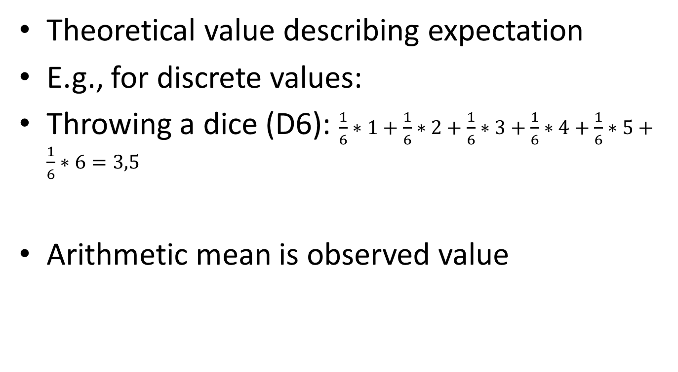
Expected Value
Theoretical value describing expectation
E.g., for discrete values:
Throwing a dice (D6): $\frac{1}{6}∗1+\frac{1}{6}∗2+\frac{1}{6}∗3+\frac{1}{6}∗4+\frac{1}{6}∗5+\frac{1}{6}∗6=3,5$
Arithmetic mean is observed value

Slide 32
T-Test
Designed by Student (William Sealy Gosset)
Comparision of two measurements
Null hypothesis (H₀) | Alternative hypothesis (H₁)
Statistical hypotheses
Measurements do not differ, i.e., they come from the same population | Data of both measurements are from different populations
Formal: | Formal:

Slide 33
T-Test: Result
Determines probability of observed result, under the assumption that the null hypothesis is valid -> conditional probability
If probability is smaller than:
0.001
0.01
0.05
0.10
null hypothesis must be wrong
Significance level must be defined in advance!
very very significant
very significant
typical significance level
for exploraty/initial studies
Notes:
wie wahrscheinlich ist das beobachtete Ergebnis, wenn die Nullhypothese korrekt ist?

Slide 34
T-Test: Conclusion
What does significant result mean?
Is null hypothesis incorrect? -> No
Is alternative hypotheses correct? -> No
There is no evidence that the null hypothesis is valid (thus, I can only make statements about the null hypothesis)
Writing a report:
Reject/could not reject null hypothesis
Never: Confirmation of null or alternative hypothesis

Slide 35
T-Test by Hand (1)
Computation of test value
Datensatz (rt.csv):
t = 1.522

Slide 36
T-Test by Hand (2)
Degrees of freedom, df
for t-Test: n₁ + n₂ _ 2 (in this example: 11)
Table with t distribution (e.g., wikipedia)
Comparison with calculated value (t_{emp} = 1.522)
is t_{emp} > ?
no, so not significant

Slide 37
One-tailed vs. Two-tailed
Two-tailed:
No assumption about direction of effect (e.g., which of two UIs is more usable
Compute half of significance level
One-tailed:
Assumption that one UI is more usable
No need to cut significance level in half

Slide 38
T-Test: R
t.test(rt1, rt2)
Output:
Welch Two Sample t-test
data: dataPC1 and dataPC2
t = 1.5222, df = 10.566, p-value = 0.1573
alternative hypothesis: true difference in means is not equal to 0
95 percent confidence interval:
-5.095727 27.583584
sample estimates:
mean of x mean of y
50.74243 39.49850
p value: conditional probability of having observed result under the assumption that nul hypothesis is valid
If p value is smaller than defined significance level, result is significant and null hypothesis can be rejected

Slide 39
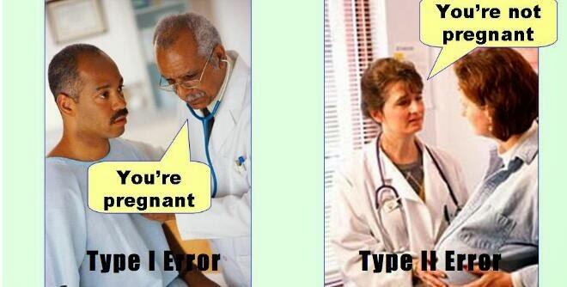

Types of errors
 |  | Valid is:
 |  | H₀ | H₁
Decision for: | H₀ |  | β error; Type-2 error
 | H₁ | α error; Type-1 error

Slide 40
T-Test: Variants
T test for independent samples:
Creation of samples must not be dependent on each other
E.g., random assignment of participants to one or the other sample
T test for dependent samples:
Creation of samples depends on each other
E.g., in a within-subjects design, or when spouses are distributed to different samples

Slide 41
T-Test: Prerequisits
Metric scale type
Normally distributed data (e.g., Shapiro-Wilk)
Or: sample size >= 30

Slide 42
Mann-Whitney-U
Non-parametric test
Ordinal data (or non-normal distributed metric data)
Computation of test:
r_{i} : Ranks in the sample

Slide 43
χ²-Test
Compares frequencies
Can answer two questions:
Do observed frequencies deviate from expected frequencies?
Do observed frequencies deviate from each other?

Slide 44
χ²-Test by Hand
Do observed values deviate from expected vaules?
Throwing a dice at a bar (20 times)
 | 3 | Not 3
Expected
Observed
3,33 | 16,66
0 | 20

Slide 45
χ²-Test by Hand
Compare calculated value with value from table:
3.84 < 3.99; significant
One-tailed or two-tailed?

Slide 46
χ²-Test by Hand
 | G 1 | G 2 | G 3
Task 1 | 6 | 18 | 16
Task 2 | 3 | 15 | 22
4,5
16,5
19
40
40
80
4,5
16,5
19
Sum | 9 | 33 | 38
Calculate expected frequencies (Sum of row*Sum of column/Overall sum)
2.22
Degrees of freedom: (Number of rows - 1)*(Number of columns - 1)

Slide 47
χ²-Test with R
Define a matrix:
freqs <- matrix(c(6,3,18,15,16,22),nrow=2)
chisq.test(freqs)

Slide 48
χ²-Test - Prerequisits
Comparison of frequencies
Expected frequencies > 5 (Fisher‘s exact test, otherwise)
Nominal scale type

Slide 49
Correlation
Value for relationship in data
No causality
Values range from: -1 <= r <=+1
r : 0.0-0.1: no relationship
r : 0.1-0.3: weak relationship
r : 0.3-0.5: median relationship
r : >0.5: strong relationship

Slide 50
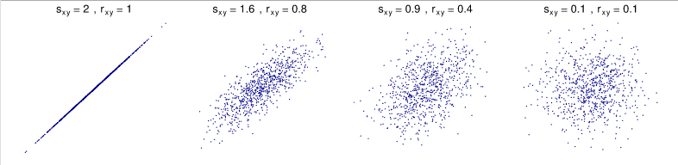
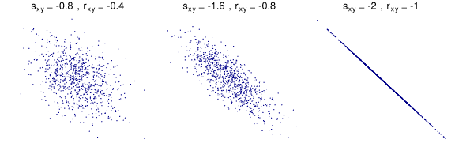
Visualisierung

Slide 51
Significance Tests for Correlation
Depending on correlation there are different tests
Null hypotheses:
H0: r = 0
Significance means that correlation is most likely different from 0s

Slide 52
Be Careful with Small, but Significant Correlations!
Back to the t test:

Slide 53
Pearson‘s r
Metric-Metric

Slide 54
Spearman - Correlation
Rank korrelation
Ordinal-ordinal, ordinal-metric
d: difference in ranks between two observations

Slide 55
Contingency Coefficient
Nominal-nominal

Slide 56
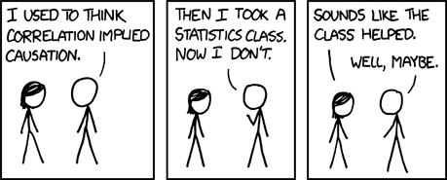
Correlation != Causality

Slide 57
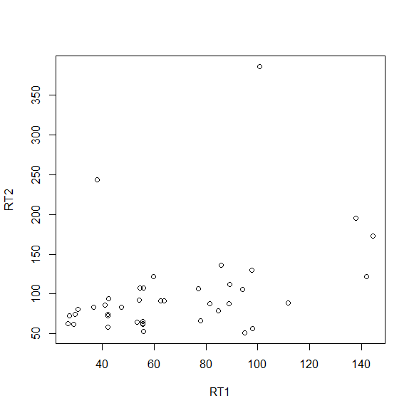
Regression
Vorhersage einer Variablen basierend auf Prädiktorvariable
Geradengleichung:
y=b*x + a
Quadrierte Abweichung der Punkte von der Geraden soll minimal sein
R: lm(x~y)

Slide 58
Zusammenhang Korrelation und Regression
Regression erweckt den Anschein von Kausalität
Aber auch statistisch nicht gegeben, sondern muss aus Versuchsdesign hervorgehen

Slide 59
Types of errors
 |  | Valid is:
 |  | H₀ | H₁
Decision for: | H₀ |  | β error Type-2s error
 | H₁ | α error Type-1 error

Slide 60
Multiple Testing - Example (1)
One factor with 4 levels, pairwise comparison between all levels
Altogether:
Probability of correctly accepting null hypothesis: 0.95
Probability of correctly accepting two null hypotheses: 0.95*0.95
Probability of correctly accepting six null hypotheses: 0.95⁶ = 0.74

Slide 61
Multiple Testing – Example (2)
Probability that for six tests, at least one is significant:
1 - 0.95⁶ = 0.26

Slide 62
Multiple Testing
When conducting multiple significance tests, the significance level needs to be adapted
Bonferoni correction:
t: Number of tests

Slide 63
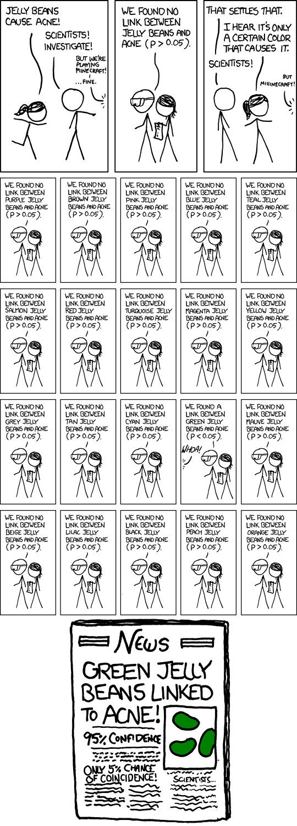
How many independent variables? How many levels?
α-Fehler (Type-1 error), that green jelly beans cause acne: 0.95²⁵ = 64%
Adjusted significance level:
0.05/20 = 0.0025

Slide 64
Analysis of Variances
ANOVA
Analysis to evaluate how much the variance in dependent variable can be explained by variance in independent variable
Variance is divided to treatment and error variance
H₀: Mean of all groups is the same
H₁: At least to means differ

Slide 65
ANOVA: Steps
Total sum of squares
Treatment sum of squares
Error sum of squares
Degrees of freedom and variances
F value
Pairwise comparison

Slide 66
Step 1: Total Sum of Squares
Squared difference of all measurement values from total mean
M: 4
SS_{tot} = 100
 | 4 | 1 | 4 | 1
 | 9 | 0 | 16 | 1
 | 1 | 1 | 9 | 1
 | 1 | 1 | 4 | 1
 | 9 | 16 | 16 | 4
 | A₁ | A₂ | A₃ | A₄
 | 2 | 3 | 6 | 5
 | 1 | 4 | 8 | 5
 | 3 | 3 | 7 | 5
 | 3 | 5 | 6 | 3
 | 1 | 0 | 8 | 2

Slide 67
Formal
n: Anzahl Probanden pro Gruppe
m: Anzahl Faktorstufen

Slide 68
Step 2: Treatment Sum of Squares
Part that can be attributed to 4 levels of independent variable
Assumption: Only independent variable causes variance in result
SS_{treat} = 70
Squared difference of all measurement value from total mean (4)
 | A₁ | A₂ | A₃ | A₄
 | 2 | 3 | 7 | 4
 | 2 | 3 | 7 | 4
 | 2 | 3 | 7 | 4
 | 2 | 3 | 7 | 4
 | 2 | 3 | 7 | 4
 | A₁ | A₂ | A₃ | A₄
 | 2 | 3 | 6 | 5
 | 1 | 4 | 8 | 5
 | 3 | 3 | 7 | 5
 | 3 | 5 | 6 | 3
 | 1 | 0 | 8 | 2
 | 2 | 3 | 7 | 4
 | 4 | 1 | 9 | 0
 | 4 | 1 | 9 | 0
 | 4 | 1 | 9 | 0
 | 4 | 1 | 9 | 0
 | 4 | 1 | 9 | 0

Slide 69
Formal
A_{i}: Gruppenmittelwert

Slide 70
Schritt 3: Error Sum of Squares
Assumption: Differences in result per group are only caused by confounding factors
Squared differences of individual measurement values from group mean
SS_{error} = 30
 | A₁ | A₂ | A₃ | A₄
 | 2 | 3 | 6 | 5
 | 1 | 4 | 8 | 5
 | 3 | 3 | 7 | 5
 | 3 | 5 | 6 | 3
 | 1 | 0 | 8 | 2
 | 2 | 3 | 7 | 4
 | 0 | 0 | 1 | 1
 | 1 | 1 | 1 | 1
 | 1 | 0 | 0 | 1
 | 1 | 4 | 1 | 1
 | 1 | 9 | 1 | 4

Slide 71
Formal

Slide 72
Relationship of Sum of Squares
SS_{tot} = 100
SS_{treat} = 70
SS_{error} = 30
SS_{tot} = SS_{treat} + SS_{error}

Slide 73
Step 4a: Degrees of Freedom
df_{tot}: Levels * Number of particpants per group – 1 (=19)
df_{treat} : Number of levels – 1 (=3)
df_{error}: Number of levels * (Number of particpants per group – 1) (=16)
df_{tot} = df_{treat} + df_{error}

Slide 74
Step 4b: Variances

Slide 75
Step 5: F value
H₀: Mean in all groups is the same
H₀:
Signiciant difference, i.e.:
At least two values differ

Slide 76
Step 6: Pairwise Comparisons
 | A₁ | A₂ | A₃ | A₄
Mean | 2 | 3 | 7 | 4

Slide 77
Two factorial ANOVA
Test whether influence of two factors is significant
Difference to one factorial ANOVA:
Main effects
Interaction effects

Slide 78
Main- and Interaction Effects
PC
PC
Expert
Expert
Novice
Novice
PC
PC
Expert
Expert Novice
Novice

Slide 79
Two factorial ANOVA
Null hypotheses:
H_{0A}: Same mean for levels of factor A
H_{0B}: Same mean for levels of factor B
H_{0AxB}: No interaction between A und B

Slide 80
Step 1: Total Sum of Squares
 | A₁ | A₂ | A₃
 | 22 | 16 | 13
 | 25 | 16 | 12
 | 22 | 16 | 12
 | 21 | 15 | 13
 | 22 | 15 | 12
B₁
26.01 | 0.81 | 15.21
65.61 | 0.81 | 24.01
26.01 | 0.81 | 24.01
16.81 | 3.61 | 15.21
26.01 | 3.61 | 24.01
Squared difference of all values from total mean
M: 16,9
SS_{tot} = 348.7
 | 18 | 19 | 16
 | 19 | 20 | 14
 | 17 | 17 | 16
 | 21 | 16 | 13
 | 19 | 16 | 14
B₂
1.21 | 4.41 | 0.81
4.41 | 9.61 | 8.41
0.01 | 0.01 | 0.81
16.81 | 0.81 | 15.21
4.41 | 0.81 | 8.41

Slide 81
Formal

Slide 82
Step 2: Sum of Squares per Cell
B₁A₁ | 5*(22.4-16.9)²
B₁A₂ | 5*(18.8-16.9)²
B₁A₃ | 5*(15.6-16.9)²
B₂A₁ | 5*(17.6-16.9)²
B₂A₂ | 5*(12.4-16.9)²
B₂A₃ | 5*(14.6-16.9)²
 | A₁ | A₂ | A₃
B₁ | 22.4 | 15.6 | 12.4
B₂ | 18.8 | 17.6 | 14.6
Squared difference of group mean from total mean
SS_{cells} = 307.9

Slide 83
Formal
AB_{ij}: Mittelwerte der einzelnen Gruppen

Slide 84
Schritt 3: Error Sum of Squares
B₁
 | A₁ | A₂ | A₃
 | 22 | 16 | 13
 | 25 | 16 | 12
 | 22 | 16 | 12
 | 21 | 15 | 13
 | 22 | 15 | 12
Mean | 22.4 | 15.6 | 12.4
Assumption: Differences in result per group are only caused by confounding factors
Squared differences of individual measurement values from group mean
SS_{error} = 40,80
0.16 | 0.16 | 0.36
6.76 | 0.16 | 0.16
0.16 | 0.16 | 0.16
1.96 | 0.36 | 0.36
0.16 | 0.36 | 0.16
 | 18 | 19 | 16
 | 19 | 20 | 14
 | 17 | 17 | 16
 | 21 | 16 | 13
 | 19 | 16 | 14
Mean | 18.8 | 17.6 | 14.6
B₂
0.64 | 1.96 | 1.96
0.04 | 5.76 | 0.36
3.24 | 0.36 | 1.96
4.84 | 2.56 | 2.56
0.04 | 2.56 | 0.36

Slide 85
Formal
AB_{ij}: Mittelwerte der einzelnen Gruppen

Slide 86
Relationship Sum of Squares
SS_{tot} = 348.7
SS_{cells} = 307.9
SS_{error} = 40.8
SS_{tot} = SS_{cells} + SS_{error}

Slide 87
Schritt 4: Main Effects Sum of Squares
 | A₁ | A₂ | A₃
 | 22 | 16 | 13
 | 25 | 16 | 12
 | 22 | 16 | 12
 | 21 | 15 | 13
 | 22 | 15 | 12
 | 18 | 19 | 16
 | 19 | 20 | 14
 | 17 | 17 | 16
 | 21 | 16 | 13
 | 19 | 16 | 14
Mean | 20.6 | 16.6 | 13.5
Factor A: Squared difference of group mean from total mean
Factor B is ignored
M: 16.9
Weighted with number of participants per group (5) * number of levels of B (2)
QS_{A}: 253.4
13.69 | 0.09 | 11.56

Slide 88
Formal
n: Anzahl Probanden pro Gruppe
q: Anzahl Faktorstufen B
A_{i}: Mittelwert Faktor (über alle Stufen von Faktor B)

Slide 89
Schritt 4: Main Effects Sum of Squares
Factor B (the same as for factor A)
Squared difference of group mean from total mean
Factor A is ignored
Weighted with number of participants per group (5) * number of levels of A (3)
SS_{B}: 0.30

Slide 90
Formal
n: Anzahl Probanden pro Gruppe
p: Anzahl Faktorstufen A
B_{i}: Mittelwert Faktor (über alle Stufen von Faktor A)

Slide 91
Relationship of Main Effect Square Sums
SS_{cells} = 307.9
SS_{A}= 253.4
SS_{B}= 0.30
SS_{cells} = SS_{A} + SS_{B} + SS_{AxB}
Observed means
Expected means
 | A₁ | A₂ | A₃
B₁ | 22.4 | 15.6 | 12.4
B₂ | 18.8 | 17.6 | 14.6
 | A₁ | A₂ | A₃
B₁ | 20.5 | 16.5 | 13.4 | 16.8
B₂ | 20.7 | 16.7 | 13.6 | 17.0
 | 20.6 | 16.6 | 13.5 | 16.9

Slide 92
Schritt 5: Quadratsumme Interaktionseffekt
 | A₁ | A₂ | A₃ | Mean B_{j}
B₁ | 20.5 | 16.5 | 13.4 | 16.8
B₂ | 20.7 | 16.7 | 13.6 | 17.0
Mean A_{i} | 20.6 | 16.6 | 13.5
3.61 | 0.81 | 1
3.61 | 0.81 | 1
 | A₁ | A₂ | A₃
B₁ | 22.4 | 15.6 | 12.4
B₂ | 18.8 | 17.6 | 14.6
Squared difference of expected and observed group means
Weighted with number of participants per group (5)
QS_{AxB} = 54.2

Slide 93
Formal

Slide 94
Relationship Sum of Squares
SS_{tot} = SS_{cells} + SS_{error}
SS_{tot} = SS_{A} + SS_{B} + SS_{AxB} + SS_{error}
348.7 = 253.4 + 0.3 + 54.2 + 40.8

Slide 95
Step 6a: Degrees of Freedom
df_{tot}: Levels (A) * Levels (B) * Number of participants per group – 1 (=29)
df_{A}: Levels (A) – 1 (=2)
df_{B}: Levels (B) – 1 (=1)
df_{AxB}: (Levels (A) – 1)*(Levels (B) – 1) (=2)
df_{error}: Levels (A) * Levels (B) * (Number of participants per group – 1) (=24)
df_{tot} = df_{A} + df_{B} + df_{AxB} + df_{error}

Slide 96
Step 6b: Variances

Slide 97
Step 7: Significance Tests

Slide 98
What does that mean?
 | A₁ | A₂ | A₃
 | 22 | 16 | 13
 | 25 | 16 | 12
 | 22 | 16 | 12
 | 21 | 15 | 13
 | 22 | 15 | 12
B₁
Pairwise comparisons, e.g., with a t test
 | 18 | 19 | 16
 | 19 | 20 | 14
 | 17 | 17 | 16
 | 21 | 16 | 13
 | 19 | 16 | 14
B₂

Slide 99
Effect Sizes
ANOVA:
Metric data, normally distributed: Cohen‘s d
Ordinal data (or metric non-normal data): Cliff‘s delta
Depending on concrete measure, different thresholds count for weak, medium, or strong effects
Overview: https://www.psychometrica.de/effect_size.html

Slide 100
Writing a Report
Literature:
Reporting Experiments in Software Engineering. Andreas Jedlitschka, Marcus Ciolkowski, and Dietmar Pfahl. In Shull, F., Singer, J., and Sjøberg, D.I. (Edtrs.): Advanced Topics in Empirical Software Engineering, Springer, 2007.

Slide 101
Introduction
Explain context
Motivate reader to read your paper

Slide 102
Background
Special knowledge on area, e.g., type systems, program comprehension, usability heuristics
Everything that the common computer scientist does not know
(You can omit that)

Slide 103
Objective
What is the goal of the experiment
Where does the goal come from?
What are the research questions/hypotheses

Slide 104
Variables
Independent and dependent variable, including operationalization
Important counfounding factors, including control techniques

Slide 105
Material
Source code
Tools
Questionnaires
Justification for selection

Slide 106
Tasks
What were participants supposed to do?
Why should they do this? How does it help to answer the hypotheses?

Slide 107
Participants
Where do they come from?
What characteristical values? -> Everything that might be a confounding factor, e.g., age, programming experience, gender
Why are the participants suitable to answer the research questions/hypotheses?

Slide 108
Design
What experimental design did you choose?
Why?

Slide 109
Conduct
Procedure of experiment
Was there training/warm up?
Why?
Were there deviations? Why?

Slide 110
Analysis
Descriptive statistics
Describing
Mean, standard deviation, box plots
Significance tests
Only analysis of data, no interpretation!

Slide 111
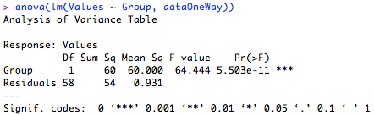
One-Way ANOVA with R
http://rtutorialseries.blogspot.de/
One-Way Omnibus ANOVA:

Slide 112
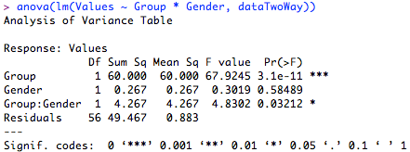
R: Two-Way ANOVA
Two-Way Omnibus ANOVA:
anova(lm(Values ~ Group * Gender, dataTwoWay))

Slide 113

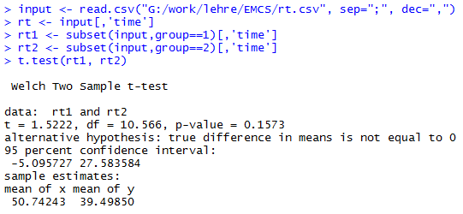
R: t-Test

Slide 114
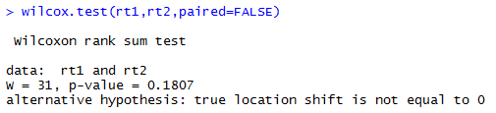
R: Mann-Whitney-U Test

Slide 115
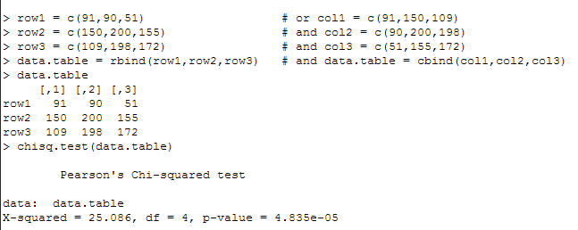
R: Chi^2
http://ww2.coastal.edu/kingw/statistics/R-tutorials/independ.html

Slide 116
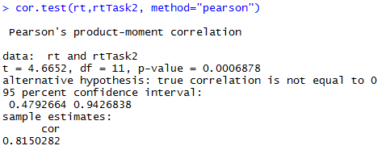
R: Correlation

Slide 117
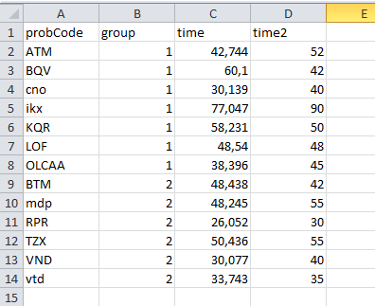
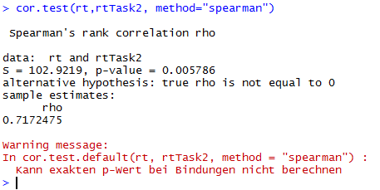
R: Correlation

Slide 118
Interpretation
What do the numbers mean?
What do results mean for research questions/hypotheses
Which further questions emerge?
Come back to introduction and context

Slide 119
Related Work
What have others done in this area?
Differences/similarities to own work
Can often help to interpret own results
(You can omit this)

Slide 120
Threats to Validity
What threatens the validity of the experiment?
Distinction between internal and external validity
Often also construct and stastical conclusion validity

Slide 121
Report
Style guide:
https://www.acm.org/publications/proceedings-template
Max. 10 pages (recommendation: at least 6)
Submit one or two weeks before exam
Background and related work is not necessary

Slide 122
Suggested Homework
Revisit the three research papers of the first session
Evaluate the paper

