Slide 1
Analysis

Slide 2
Learning Goals
Understand the principle of standard statistical tests
Understand the principle of correlations

Slide 3
Overview
Human--Technology
Qualitative---Quantitative
Time-series analysis
Controlled experiments with human participants
Performance
Questionnaires
Interviews
Proofs
Case studies
Think-Aloud Protocols

Slide 4
Confidence Interval
: arithmetic mean
z: z-value of standard normal distribution
alpha: 1 – value of confidence interval
s: standard deviation
n: number of measurements

Slide 5
Confidence Interval: Meaning
True means lies in 95% of cases within this interval
More technical: With a large number of repetitions, in 95% of the cases, the true mean lies in the respective confidence intervals

Slide 6
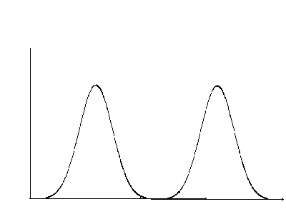
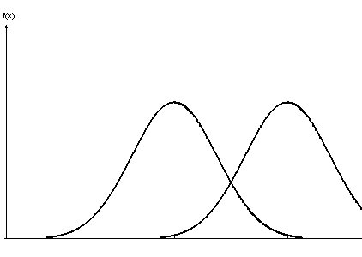
Confidence Interval: Usage
Overlap: likely no difference
No overlap: likely a difference
More measurements make intervals smaller
Notes:
Bei kleinerem Konfidenzintervall wird Präzision erhöht

Slide 7
Significance Tests

Slide 8


Types of errors
 |  | Valid is:
 |  | H₀ | H₁
Decision for: | H₀ |  | β error; Type-2 error
 | H₁ | α error; Type-1 error

Slide 9
Mann-Whitney-U
Non-parametric test
Ordinal data (or non-normal distributed metric data)
Computation of test:
r_{i} : Ranks in the sample
Notes:
Order by size, then compute the ranks

Slide 10
χ²-Test
Compares frequencies
Can answer two questions:
Do observed frequencies deviate from expected frequencies?
Do observed frequencies deviate from each other?

Slide 11
χ²-Test by Hand
Do observed values deviate from expected vaules?
Throwing a dice at a bar (20 times)
 | 3 | Not 3
Expected
Observed
3,33 | 16,66
0 | 20

Slide 12
χ²-Test by Hand
Compare calculated value with value from table:
3.84 < 3.99; significant
One-tailed or two-tailed?

Slide 13
χ²-Test by Hand
 | G 1 | G 2 | G 3
Task 1 | 6 | 18 | 16
Task 2 | 3 | 15 | 22
4,5
16,5
19
40
40
80
4,5
16,5
19
Sum | 9 | 33 | 38
Calculate expected frequencies (Sum of row*Sum of column/Overall sum)
2.22
Degrees of freedom: (Number of rows - 1)*(Number of columns - 1)

Slide 14
χ²-Test with R
Define a matrix:
freqs <- matrix(c(6,3,18,15,16,22),nrow=2)
chisq.test(freqs)

Slide 15
χ²-Test - Prerequisits
Comparison of frequencies
Expected frequencies > 5 (Fisher‘s exact test, otherwise)
Nominal scale type

Slide 16
When to Apply Which Test?
Depends (mostly) on:
Scale type
Distribution of data
T-test:
Metric data
Normal distribution
Homoscedasticity (equal variances, Levéne test)
Mann-Whitney-U test
Ordinal data
Non-parametric (i.e., does not care about distribution)
Carefull with small samples, there are special tables
Chi^2
Nominal data (i.e., frequencies)
Non-parametric
Expected frequencies should be larger than 5
Except with large enough sample sizes (> 30)

Slide 17
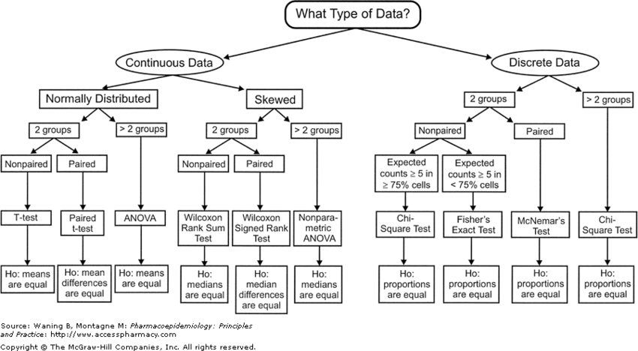
Decision Chart for Statistical Tests

Slide 18
Multiple Testing - Example (1)
One factor with 3 levels, pairwise comparison between all levels
Altogether:
Probability of correctly accepting null hypothesis: 0.95
Probability of correctly accepting two null hypotheses: 0.95*0.95
Probability of correctly accepting three null hypotheses: 0.95³ = 0.86
Probability of correctly accepting six null hypotheses: 0.95⁶ = 0.74

Slide 19
Multiple Testing – Example (2)
Probability that for three tests, at least one is significant:
1 - 0.95³ = 0.14
Probability that for six tests, at least one is significant:
1 - 0.95⁶ = 0.26

Slide 20
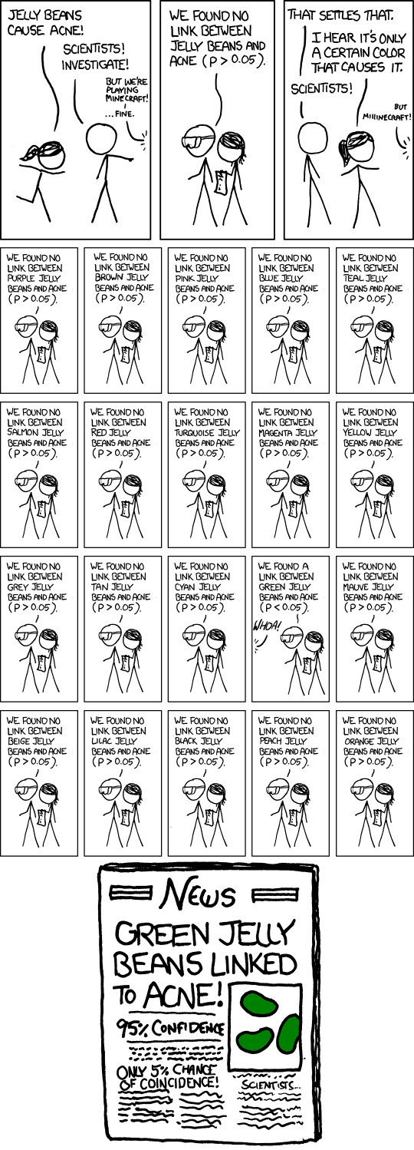
Extreme Example
How many independent variables? How many levels?
α-Fehler (Type-1 error), that green jelly beans cause acne: 0.95²⁵ = 64%
Adjusted significance level:
0.05/20 = 0.0025

Slide 21
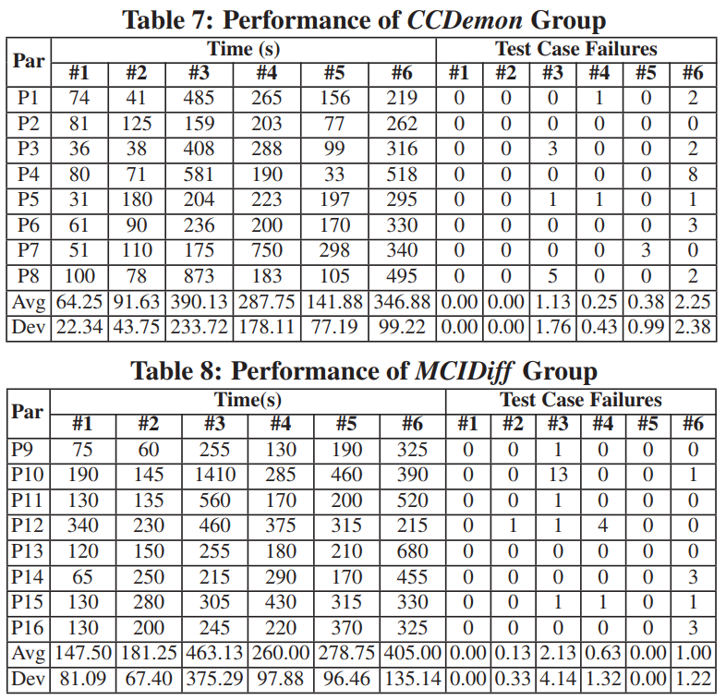
Real Example
No adjustment for multiple comparisons
Bonferoni correction ( )
0.008
False discovery rate/Benjamini-Hochberg:
0.89 > 0.05 (6/6*0.05)
0.67 > 0.042 (5/6*0.05)
0.48 > 0.033 (4/6*0.05)
0.04 > 0.025 (3/6*0.05)
0.02 > 0.017 (2/6*0.05)
0.01 > 0.008 (1/6*0.05)
p | .01 | .04 | .89 | .67 | .02 | .48 | 1 | .32 | .93 | .71 | .32 | .26

Slide 22
Experiments
Do code clones affect the quality of source code?
Pair programming improves software development
Testing improves the quality of source code
Define:
Hypotheses (Remember: be concrete, not complete)
Variables (Independent, dependent, confounding)
Experimental design
Analysis protocol

Slide 23
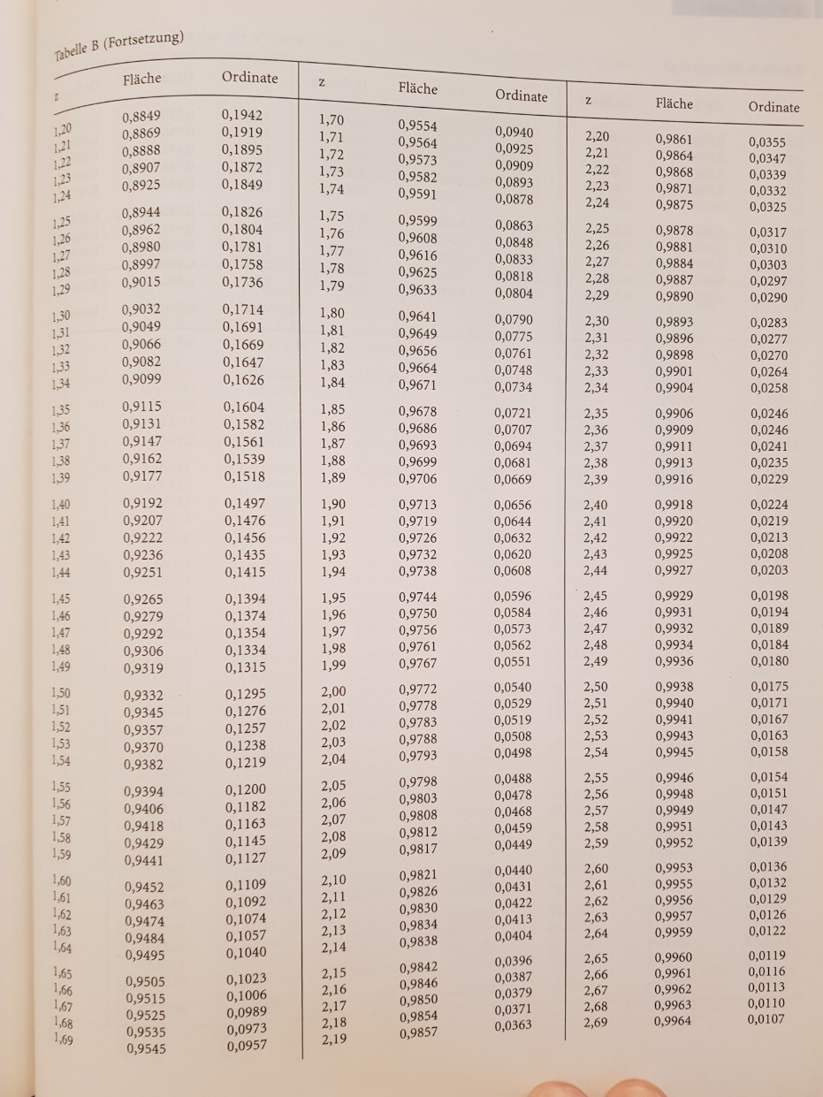
Open Questions From Last Time
Mann-Whitney-U:
U_{krit}: 20; U_{observed}: 87.5
U_{observed} needs to be smaller than U_{krit} to indicate a difference
Standard normal distribution (Bortz: Statistik für Human- und Sozialwissenschaftler)

Slide 24
Correlation
Value for relationship in data
No causality
Values range from: -1 <= r <=+1
r : 0.0-0.1: no relationship
r : 0.1-0.3: weak relationship
r : 0.3-0.5: median relationship
r : >0.5: strong relationship

Slide 25
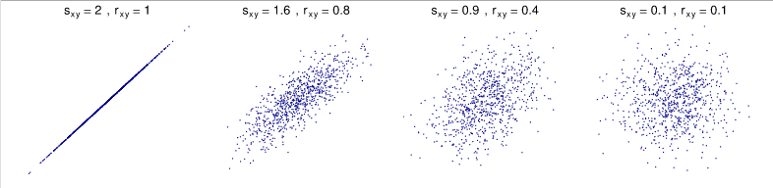
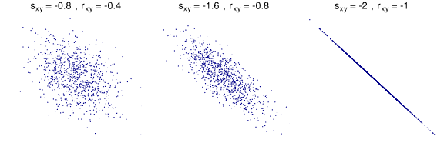
Visualization

Slide 26
Significance Tests for Correlation
Depending on correlation there are different tests
Null hypotheses:
H0: r = 0
Significance means that correlation is most likely different from 0s

Slide 27
Be Careful with Small, but Significant Correlations!
Back to the t test:

Slide 28
Pearson‘s r
Metric-Metric

Slide 29
Spearman - Correlation
Rank korrelation
Ordinal-ordinal, ordinal-metric
d: difference in ranks between two observations

Slide 30
Contingency Coefficient
Nominal-nominal

Slide 31
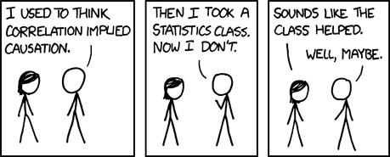
Correlation != Causality

Slide 32
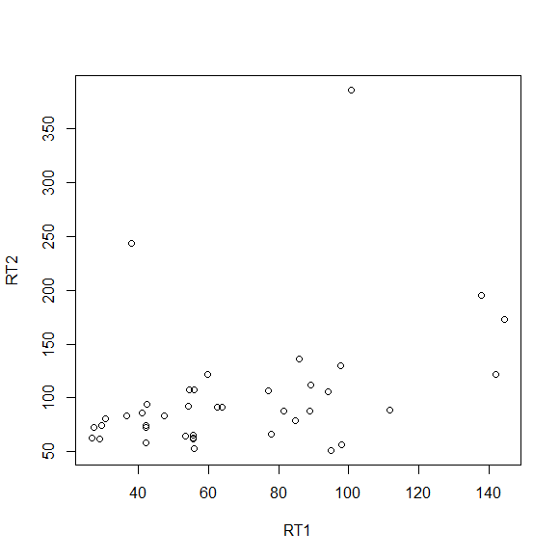
Regression
Vorhersage einer Variablen basierend auf Prädiktorvariable
Geradengleichung:
y=b*x + a
Quadrierte Abweichung der Punkte von der Geraden soll minimal sein
R: lm(x~y)

Slide 33
Zusammenhang Korrelation und Regression
Regression erweckt den Anschein von Kausalität
Aber auch statistisch nicht gegeben, sondern muss aus Versuchsdesign hervorgehen

Slide 34
Analysis of Variances
ANOVA
Analysis to evaluate how much the variance in dependent variable can be explained by variance in independent variable
Variance is divided to treatment and error variance
H₀: Mean of all groups is the same
H₁: At least to means differ

Slide 35
ANOVA: Steps
Total sum of squares
Treatment sum of squares
Error sum of squares
Degrees of freedom and variances
F value
Pairwise comparison

Slide 36
Step 1: Total Sum of Squares
Squared difference of all measurement values from total mean
M: 4
SS_{tot} = 100
 | 4 | 1 | 4 | 1
 | 9 | 0 | 16 | 1
 | 1 | 1 | 9 | 1
 | 1 | 1 | 4 | 1
 | 9 | 16 | 16 | 4
 | A₁ | A₂ | A₃ | A₄
 | 2 | 3 | 6 | 5
 | 1 | 4 | 8 | 5
 | 3 | 3 | 7 | 5
 | 3 | 5 | 6 | 3
 | 1 | 0 | 8 | 2

Slide 37
Formal
n: Anzahl Probanden pro Gruppe
m: Anzahl Faktorstufen

Slide 38
Step 2: Treatment Sum of Squares
Part that can be attributed to 4 levels of independent variable
Assumption: Only independent variable causes variance in result
SS_{treat} = 70
Squared difference of all measurement value from total mean (4)
 | A₁ | A₂ | A₃ | A₄
 | 2 | 3 | 7 | 4
 | 2 | 3 | 7 | 4
 | 2 | 3 | 7 | 4
 | 2 | 3 | 7 | 4
 | 2 | 3 | 7 | 4
 | A₁ | A₂ | A₃ | A₄
 | 2 | 3 | 6 | 5
 | 1 | 4 | 8 | 5
 | 3 | 3 | 7 | 5
 | 3 | 5 | 6 | 3
 | 1 | 0 | 8 | 2
 | 2 | 3 | 7 | 4
 | 4 | 1 | 9 | 0
 | 4 | 1 | 9 | 0
 | 4 | 1 | 9 | 0
 | 4 | 1 | 9 | 0
 | 4 | 1 | 9 | 0

Slide 39
Formal
A_{i}: Gruppenmittelwert

Slide 40
Schritt 3: Error Sum of Squares
Assumption: Differences in result per group are only caused by confounding factors
Squared differences of individual measurement values from group mean
SS_{error} = 30
 | A₁ | A₂ | A₃ | A₄
 | 2 | 3 | 6 | 5
 | 1 | 4 | 8 | 5
 | 3 | 3 | 7 | 5
 | 3 | 5 | 6 | 3
 | 1 | 0 | 8 | 2
 | 2 | 3 | 7 | 4
 | 0 | 0 | 1 | 1
 | 1 | 1 | 1 | 1
 | 1 | 0 | 0 | 1
 | 1 | 4 | 1 | 1
 | 1 | 9 | 1 | 4

Slide 41
Formal

Slide 42
Relationship of Sum of Squares
SS_{tot} = 100
SS_{treat} = 70
SS_{error} = 30
SS_{tot} = SS_{treat} + SS_{error}

Slide 43
Step 4a: Degrees of Freedom
df_{tot}: Levels * Number of particpants per group – 1 (=19)
df_{treat} : Number of levels – 1 (=3)
df_{error}: Number of levels * (Number of particpants per group – 1) (=16)
df_{tot} = df_{treat} + df_{error}

Slide 44
Step 4b: Variances

Slide 45
Step 5: F value
H₀: Mean in all groups is the same
H₀:
Signiciant difference, i.e.:
At least two values differ

Slide 46
Step 6: Pairwise Comparisons
 | A₁ | A₂ | A₃ | A₄
Mean | 2 | 3 | 7 | 4

Slide 47
Two factorial ANOVA
Test whether influence of two factors is significant
Difference to one factorial ANOVA:
Main effects
Interaction effects

Slide 48
Main- and Interaction Effects
PC
PC
Expert
Expert
Novice
Novice
PC
PC
Expert
Expert Novice
Novice

Slide 49
Two factorial ANOVA
Null hypotheses:
H_{0A}: Same mean for levels of factor A
H_{0B}: Same mean for levels of factor B
H_{0AxB}: No interaction between A und B

Slide 50
Step 1: Total Sum of Squares
 | A₁ | A₂ | A₃
 | 22 | 16 | 13
 | 25 | 16 | 12
 | 22 | 16 | 12
 | 21 | 15 | 13
 | 22 | 15 | 12
B₁
26.01 | 0.81 | 15.21
65.61 | 0.81 | 24.01
26.01 | 0.81 | 24.01
16.81 | 3.61 | 15.21
26.01 | 3.61 | 24.01
Squared difference of all values from total mean
M: 16,9
SS_{tot} = 348.7
 | 18 | 19 | 16
 | 19 | 20 | 14
 | 17 | 17 | 16
 | 21 | 16 | 13
 | 19 | 16 | 14
B₂
1.21 | 4.41 | 0.81
4.41 | 9.61 | 8.41
0.01 | 0.01 | 0.81
16.81 | 0.81 | 15.21
4.41 | 0.81 | 8.41

Slide 51
Formal

Slide 52
Step 2: Sum of Squares per Cell
B₁A₁ | 5*(22.4-16.9)²
B₁A₂ | 5*(18.8-16.9)²
B₁A₃ | 5*(15.6-16.9)²
B₂A₁ | 5*(17.6-16.9)²
B₂A₂ | 5*(12.4-16.9)²
B₂A₃ | 5*(14.6-16.9)²
 | A₁ | A₂ | A₃
B₁ | 22.4 | 15.6 | 12.4
B₂ | 18.8 | 17.6 | 14.6
Squared difference of group mean from total mean
SS_{cells} = 307.9

Slide 53
Formal
AB_{ij}: Mittelwerte der einzelnen Gruppen

Slide 54
Schritt 3: Error Sum of Squares
B₁
 | A₁ | A₂ | A₃
 | 22 | 16 | 13
 | 25 | 16 | 12
 | 22 | 16 | 12
 | 21 | 15 | 13
 | 22 | 15 | 12
Mean | 22.4 | 15.6 | 12.4
Assumption: Differences in result per group are only caused by confounding factors
Squared differences of individual measurement values from group mean
SS_{error} = 40,80
0.16 | 0.16 | 0.36
6.76 | 0.16 | 0.16
0.16 | 0.16 | 0.16
1.96 | 0.36 | 0.36
0.16 | 0.36 | 0.16
 | 18 | 19 | 16
 | 19 | 20 | 14
 | 17 | 17 | 16
 | 21 | 16 | 13
 | 19 | 16 | 14
Mean | 18.8 | 17.6 | 14.6
B₂
0.64 | 1.96 | 1.96
0.04 | 5.76 | 0.36
3.24 | 0.36 | 1.96
4.84 | 2.56 | 2.56
0.04 | 2.56 | 0.36

Slide 55
Formal
AB_{ij}: Mittelwerte der einzelnen Gruppen

Slide 56
Relationship Sum of Squares
SS_{tot} = 348.7
SS_{cells} = 307.9
SS_{error} = 40.8
SS_{tot} = SS_{cells} + SS_{error}

Slide 57
Schritt 4: Main Effects Sum of Squares
 | A₁ | A₂ | A₃
 | 22 | 16 | 13
 | 25 | 16 | 12
 | 22 | 16 | 12
 | 21 | 15 | 13
 | 22 | 15 | 12
 | 18 | 19 | 16
 | 19 | 20 | 14
 | 17 | 17 | 16
 | 21 | 16 | 13
 | 19 | 16 | 14
Mean | 20.6 | 16.6 | 13.5
Factor A: Squared difference of group mean from total mean
Factor B is ignored
M: 16.9
Weighted with number of participants per group (5) * number of levels of B (2)
QS_{A}: 253.4
13.69 | 0.09 | 11.56

Slide 58
Formal
n: Anzahl Probanden pro Gruppe
q: Anzahl Faktorstufen B
A_{i}: Mittelwert Faktor (über alle Stufen von Faktor B)

Slide 59
Schritt 4: Main Effects Sum of Squares
Factor B (the same as for factor A)
Squared difference of group mean from total mean
Factor A is ignored
Weighted with number of participants per group (5) * number of levels of A (3)
SS_{B}: 0.30

Slide 60
Formal
n: Anzahl Probanden pro Gruppe
p: Anzahl Faktorstufen A
B_{i}: Mittelwert Faktor (über alle Stufen von Faktor A)

Slide 61
Relationship of Main Effect Square Sums
SS_{cells} = 307.9
SS_{A}= 253.4
SS_{B}= 0.30
SS_{cells} = SS_{A} + SS_{B} + SS_{AxB}
Observed means
Expected means
 | A₁ | A₂ | A₃
B₁ | 22.4 | 15.6 | 12.4
B₂ | 18.8 | 17.6 | 14.6
 | A₁ | A₂ | A₃
B₁ | 20.5 | 16.5 | 13.4 | 16.8
B₂ | 20.7 | 16.7 | 13.6 | 17.0
 | 20.6 | 16.6 | 13.5 | 16.9

Slide 62
Schritt 5: Quadratsumme Interaktionseffekt
 | A₁ | A₂ | A₃ | Mean B_{j}
B₁ | 20.5 | 16.5 | 13.4 | 16.8
B₂ | 20.7 | 16.7 | 13.6 | 17.0
Mean A_{i} | 20.6 | 16.6 | 13.5
3.61 | 0.81 | 1
3.61 | 0.81 | 1
 | A₁ | A₂ | A₃
B₁ | 22.4 | 15.6 | 12.4
B₂ | 18.8 | 17.6 | 14.6
Squared difference of expected and observed group means
Weighted with number of participants per group (5)
QS_{AxB} = 54.2

Slide 63
Formal

Slide 64
Relationship Sum of Squares
SS_{tot} = SS_{cells} + SS_{error}
SS_{tot} = SS_{A} + SS_{B} + SS_{AxB} + SS_{error}
348.7 = 253.4 + 0.3 + 54.2 + 40.8

Slide 65
Step 6a: Degrees of Freedom
df_{tot}: Levels (A) * Levels (B) * Number of participants per group – 1 (=29)
df_{A}: Levels (A) – 1 (=2)
df_{B}: Levels (B) – 1 (=1)
df_{AxB}: (Levels (A) – 1)*(Levels (B) – 1) (=2)
df_{error}: Levels (A) * Levels (B) * (Number of participants per group – 1) (=24)
df_{tot} = df_{A} + df_{B} + df_{AxB} + df_{error}

Slide 66
Step 6b: Variances

Slide 67
Step 7: Significance Tests

Slide 68
What does that mean?
 | A₁ | A₂ | A₃
 | 22 | 16 | 13
 | 25 | 16 | 12
 | 22 | 16 | 12
 | 21 | 15 | 13
 | 22 | 15 | 12
B₁
Pairwise comparisons, e.g., with a t test
 | 18 | 19 | 16
 | 19 | 20 | 14
 | 17 | 17 | 16
 | 21 | 16 | 13
 | 19 | 16 | 14
B₂

Slide 69
Effect Sizes
ANOVA:
Metric data, normally distributed: Cohen‘s d
Ordinal data (or metric non-normal data): Cliff‘s delta
Depending on concrete measure, different thresholds count for weak, medium, or strong effects
Overview: https://www.psychometrica.de/effect_size.html

Slide 70
Writing a Report
Literature:
Reporting Experiments in Software Engineering. Andreas Jedlitschka, Marcus Ciolkowski, and Dietmar Pfahl. In Shull, F., Singer, J., and Sjøberg, D.I. (Edtrs.): Advanced Topics in Empirical Software Engineering, Springer, 2007.

Slide 71
Introduction
Explain context
Motivate reader to read your paper

Slide 72
Background
Special knowledge on area, e.g., type systems, program comprehension, usability heuristics
Everything that the common computer scientist does not know
(You can omit that)

Slide 73
Objective
What is the goal of the experiment
Where does the goal come from?
What are the research questions/hypotheses

Slide 74
Variables
Independent and dependent variable, including operationalization
Important counfounding factors, including control techniques

Slide 75
Material
Source code
Tools
Questionnaires
Justification for selection

Slide 76
Tasks
What were participants supposed to do?
Why should they do this? How does it help to answer the hypotheses?

Slide 77
Participants
Where do they come from?
What characteristical values? -> Everything that might be a confounding factor, e.g., age, programming experience, gender
Why are the participants suitable to answer the research questions/hypotheses?

Slide 78
Design
What experimental design did you choose?
Why?

Slide 79
Conduct
Procedure of experiment
Was there training/warm up?
Why?
Were there deviations? Why?

Slide 80
Analysis
Descriptive statistics
Describing
Mean, standard deviation, box plots
Significance tests
Only analysis of data, no interpretation!

Slide 81
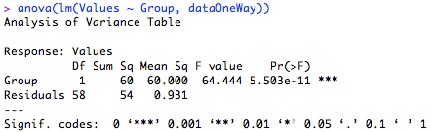
One-Way ANOVA with R
http://rtutorialseries.blogspot.de/
One-Way Omnibus ANOVA:

Slide 82
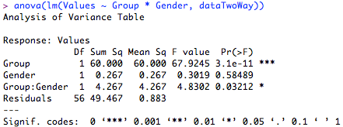
R: Two-Way ANOVA
Two-Way Omnibus ANOVA:
anova(lm(Values ~ Group * Gender, dataTwoWay))

Slide 83

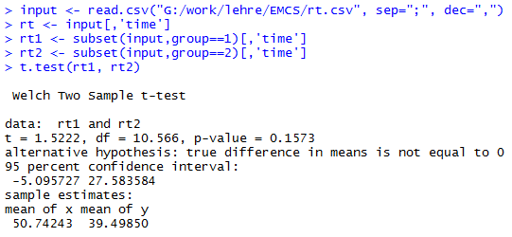
R: t-Test

Slide 84
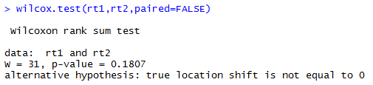
R: Mann-Whitney-U Test

Slide 85
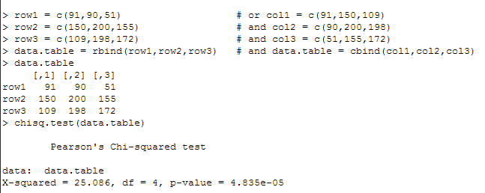
R: Chi^2
http://ww2.coastal.edu/kingw/statistics/R-tutorials/independ.html

Slide 86
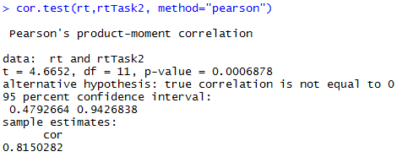
R: Correlation

Slide 87
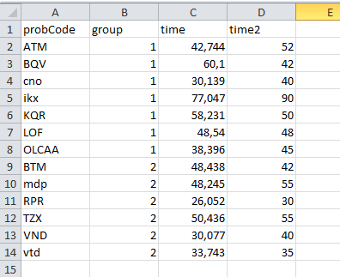
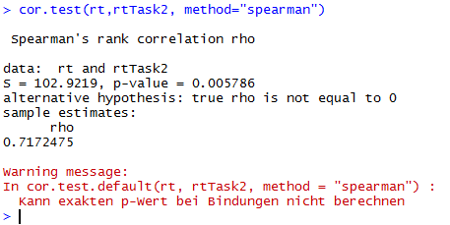
R: Correlation

Slide 88
Interpretation
What do the numbers mean?
What do results mean for research questions/hypotheses
Which further questions emerge?
Come back to introduction and context

Slide 89
Related Work
What have others done in this area?
Differences/similarities to own work
Can often help to interpret own results
(You can omit this)

Slide 90
Threats to Validity
What threatens the validity of the experiment?
Distinction between internal and external validity
Often also construct and stastical conclusion validity

Slide 91
Report
Style guide:
https://www.acm.org/publications/proceedings-template
Max. 10 pages (recommendation: at least 6)
Submit one or two weeks before exam
Background and related work is not necessary

Slide 92
Suggested Homework
Revisit the three research papers of the first session
Evaluate the paper

