Slide 1
Software Engineering and Programming Basics
Exceptions und Debugging
Authors of slides:
Prof. Dr.-Ing. Janet Siegmund
Prof. Dr.-Ing. Norbert Siegmund
Prof. Christian Lengauer
Partly extracted from script of PD Dr. Christian Bachmaier
Notes:
Zeit Folie : Zeit Gesamt (geschätzt)
1 : 1

Slide 2
Learning Goals
Getting to know exceptions
Getting to know debugging

Slide 3

Exceptions and Asserts

Slide 4
Example
public static float divide(int a, int b){
if (b == 0)
return -1;
return a/b;
}

Slide 5
Exceptions
Errors cannot be avoided entirely
However: I can define how the program should react to errors
Abort, repetition, continue with cleaned values
In Java, exceptions are thrown
Notes:
Beispiel an Tafel:
Int parseNumber(String s) {
Was passiert, wenn s keine Zahl enthält?
Was wird zurück gegeben?
}
2. Beispiel: GGT (was passiert, wenn eine Zahl 0 oder negativ ist?)

Slide 6
Example
public static float divide(int a, int b) throws DivisionByZeroException{
if (b == 0)
throw new DivisionByZeroException();
return a/b;
}

Slide 7
Recognizing Errors
Recognize errors and define possible error states
We need to detect erroneus states/conditions within the code
We need to tell Java that certain errors might occur, so userse can react to these
, YyyException, ...{
public void myMethod(...) throws XxxException
if (...) {
throw new XxxException ();
}
if (...) {
throw new YyyException ("message");
}
}

Slide 8
Which Exceptions?
Two options:
Look at Java API (many exceptions already exist)
Define your own exceptions

Slide 9
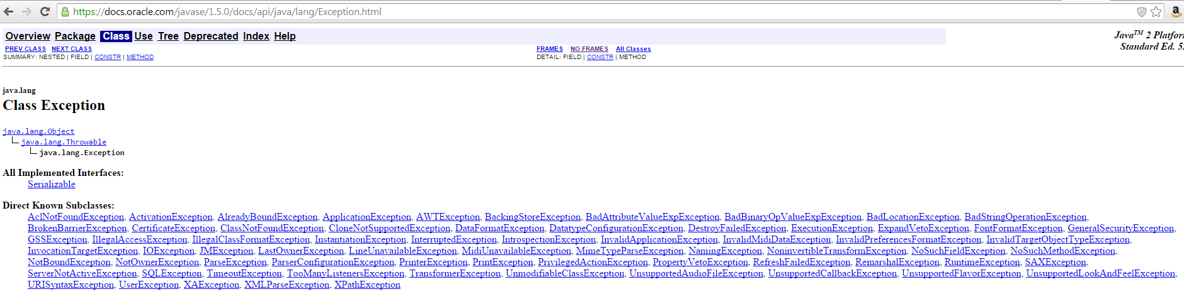
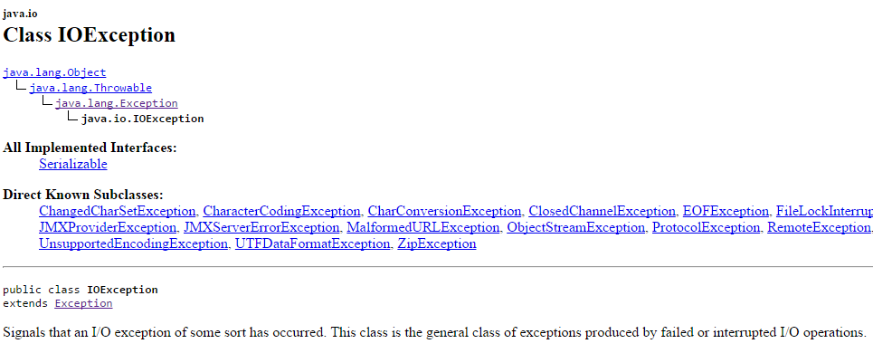
JAVA API - Exceptions

Slide 10
User-Defined Exceptions
Needs to offer at least two constructors
public class MyException extends Exception {
public MyException() {
super();
}
public MyException(String message) {
super(message);
}
...
}

Slide 11
Beispiel: ggT
public static int ggt(int nb1, int nb2) {
//Defensive Programmierung: Prüfen, ob Eingaben korrekt sind
if(nb1 < 1 || nb2 < 1) {
throw new IllegalArgumentException();
}
//Rekursionsabbruch
if (nb1 == nb2)
return nb1;
//Austausch der Zahlen
if (nb2 > nb1) {
int temp = nb1;
nb1 = nb2;
nb2 = temp;
}
//Rekursionsschritt
return ggt(nb1-nb2, nb2);
}
Da RuntimeException,
throws im Methodenkopf nicht zwingend erforderlich

Slide 12
Treating Errors I
Statements that enforce the treatment of errors (e.g., calling a method that may throw an exception) need to be treated
Solution: try-catch block
Two mandatory parts:
try: „Try executing the following code lines“
If everything wents well, code is executed normally
If an error occurs, the catch block is executed
catch: „In case code could not be executed“
Here the error can be treated
For each potentially occuring execption there should be a catch block
… an one optional part:
finally: Optional concluding statements that will be executed indepedent of whether error occurred or not

Slide 13
Treating Errors II
Will the finally block be executed when there is a return or break in the try-catch block?
YES! Finally is always executed
But return expression is not evaluated again
When does finally make sense?
Closing files (or scanners)
Termining a web connection
Cleaning up (e.g., erroneous bank transaction)

Slide 14
Example
public static void readInput() {
BufferedReader in = new BufferedReader(new InputStream(System.in));
try {
String s = in.readLine();
int i = Integer.parseInt(s);
System.out.println("ok");
} catch (IOException e) {
// must be treated
System.err.println("read problems");
} catch (NumberFormatException e) {
// may be treated
System.err.println("entry is no integer");
} finally {
// optional
System.out.println("anyway");
}
}

Slide 15
Controlled vs. Uncontrolled Exceptions
Controlled expections (Super class: Exception)
FileNoteFoundException, InterruptedException,…
Will be checked by compiler (checked exceptions)
Uncontrolled exceptions (Error, RuntimeException)
OutOfMemoryError, StackOverflowError, ArrayIndex-OutOfBoundsException, IllegalArgumentException,…
Are not checked by compiler(unchecked Exceptions)

Slide 16
Controlled vs. Uncontrolled Exceptions
Kontrollierte Ausnahmen (Oberklasse Exception)
FileNoteFoundException, InterruptedException,…
Nicht kontrollierte Ausnahmen (Error, RuntimeException)
OutOfMemoryError, StackOverflowError,…
ArrayIndexOutOfBoundsException, IllegalArgumentException,…
Define your own exceptions:
Exception that has to be caught (controlled)
public class MyException extends Exception {..}
Exception, that can be caught (uncontrolled, occurs during runtime)
public class MyOtherException extends RuntimeException {..}

Slide 17
Passing on the Error
Errors does not have to be treated directly where it occured (there is possibly a better place for this)
Error can be passed along the call hierarchy (i.e., the Java Stack
public static int input() throws IOException, NumberFormatException {
BufferedReader in = new BufferedReader(new InputStreamReader(System.in));
String s = in.readLine();
int i = Integer.parseInt(s);
System.out.println("ok");
return i;
}
public static void caller() throws IOException {
try {
input();
} catch (NumberFormatException e) {
System.out.println("Keine Zahl!");
}
}
Exception may occur here
Because of its passing, it needs to be treated here

Slide 18
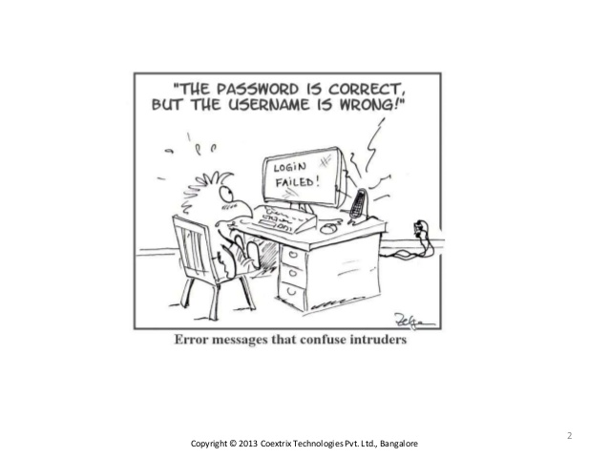
Hints
IOException: Never catch it or let main method throw it
How should you react programmatically to a hardware defect?
RuntimeException does not need to be declared with throws
Pass useful error messages to the user

Slide 19
Printing errors
Until now:
Standard output: System.out (typically the screen)
Standard input: System.in (typically the keyboard)
Problem:
Error output should not be mixed with standard output
Thus: System.err
Example: System.err.println(…) writes to error console

Slide 20
Printing Errors II
Exceptions are objects and have methods to print errors
String getMessage() returns error message, if constructor of has it as input method (null otherwise)
String toString() return name of exception and passed errors messages
printStackTrace() returns result of toString, Information where the error occurred and the Java Stack
Best solution: Java-Logging API

Slide 21
Assertions
Simple construct to find errors and treat them
Each asseration is a logical expression that always expects true
In case assertion evaluates to false, an exception will be thrown (more precisley: new AssertionError("message");)
Useful during program testing
Assumptions can be checked this way
In productive code, the tests have no consequences
Also useful for internal documentation of the code
assert it != null : "cannot insert after null";
if (it == null) {
throw new AssertionError("cannot insert after null");
}

Slide 22

Finding and Avoiding Errors

Slide 23
Avoiding: Know the Most Frequent Errors I
10. Accessing non-static member variables from static methods (such as main)
9. Mistyping the name of a method when overriding
“Typos” occur often
Use @Override
public class StaticDemo
{
public String my_member_variable = "somedata";
public static void main (String args[])
{
// Access a non-static member from static method
System.out.println ("This generates a compiler error" + my_member_variable);
}
}

Slide 24
Avoiding: Know the Most Frequent Errors II
8. Comparison assignment ( = rather than == )
7. Comparing two objects ( == instead of .equals)
boolean someVar = false; //Complex computation
if (someVar = true) {
//Wrong!!!
}
String abc = "abc"; String def = "def";
// Bad way
if ( (abc + def) == "abcdef" )
{//......}
// Good way
if ( (abc + def).equals("abcdef") )
{//.....}

Slide 25
Avoiding: Know the Most Frequent Errors III
6. Confusion of passing by value and passing by reference
Know difference of complex and primitive data types when passing parameters
5. Writing blank exception handlers
It is easy to ignore error messages and continue without a messagen, but there is no chance to find an error or its location
Solution: Try-Catch for entire code
public static void main(String args[]) {
try {
// Your code goes here..
} catch (Exception e) {
System.out.println ("Err - " + e );
}
}

Slide 26
Avoiding: Know the Most Frequent Errors IV
4. Forgetting that Java is zero-indexed
3. Preventing concurrent access to shared variables by threads
Parallele execution to the same data = difficult ☺
2. Capitalization errors
Problem: When names of classes and methods do not follow convention, they can be easily confused
char[] chars = new char[3];
System.out.println(chars[3]);

Slide 27

Drum Roll

Slide 28
Avoiding: Know the Most Frequent Errors V
1. Null pointers!
Only occur during runtime
Cannot be checked by compiler
Many methods return null to indicate an error, but this needs to be checked
However, since null is only returned when an error occurred, it is difficult to test…
public static void main(String args[]) {
// Accept up to three parameters
String[] list = new String[3];
int index = 0;
while ((index < args.length) && (index < 3)) {
list[index++] = args[index];
}
// Check all the parameters
for (int i = 0; i < list.length; i++) {
if (list[i].equals("-help")) {
// .........
} else if (list[i].equals("-cp")) {
.........
}
// else .....
}
}

Slide 29
Avoiding: Know the Special Cases
Special cases are often ignored
They occur rarely and the program has to behave differently than in the standard case (e.g., inserting the last/first element in a list)
„You cannot imagine what the user can enter to make the program crash“

Slide 30
Task
Imagine you should implement a calender that only runs on the console (only text input/output is possible) and should have the following features:
Compute the day of week for a date and print it on the console (e.g., 12/16/19 -> Monday)
Compute number of days between two dates and print on the console
Check for leap year
What special cases are there for the input and computations?
3-5 Minutes
Notes:
Julianische vs. gregorianische kalender

Slide 31
Special Cases
Treat causes instead of just the symptoms:
Example: Code returns correct results, but only when String does not contain 71 characters
Bad solution: Include special treatment of this case (this may lead to further errors in other positions of the code)
Better: Find reason for bug and refactor code to fix it

Slide 32
Finding: Use the Output
We looked at System.err
However: most important tool to find errors...
System.out.println("Hier");
Advantage:
You can easily see which execution path the program is taking
I can see content of variables, etc
Problem:
Lines need to be removed in productive code (easy to be overlooked)
Quick & Dirty ☺

Slide 33

The Eclipse Debugger

Slide 34
Step-by-Step Execution
Allows executing a program line by line
Really helpful to understand and check control flow (i.e., how the program executes)
Are methods called in correct order?
Do I forget operations?
Do I leave loops to early/too late?
Allows you to check the state of serveral variables simultaneuosly
What values do they have?
What objects have been created?

Slide 35
Breakpoints
Via double click on line number the code gets a break point
Program will run normally until the break point (waits for user to proceed)
Breakpoints can be refined
Logical condition (e.g., only wait when an int is larger than 0)
Number of passing a break point (especially useful for loops and recursion)
And many more …

Slide 36

Expression View
Allows the evaluation of an expression at any time
Complex conditions can be checked any time
Do they match with my assumptions?
Is my assumption correct?
Tutorials with Examples:
http://www.informit.com/articles/article.aspx?p=342034

Slide 37

Important Classes in Java II

Slide 38

The class Object
Notes:
Geschätzte Zeit:
0:1h11

Slide 39
Class: Object
Each class in Java inherits from the class Object
Thus, each class as all methods of class Object
This way, each class already has important methods
Offered methdos:
protected Object clone() throws CloneNotSupportedException
public boolean equals(Object obj)
protected void finalize() throws Throwable
public final Class getClass()
public int hashCode()
public String toString()

Slide 40
Class Object: Methods I
protected Object clone() throws CloneNotSupportedException
Allows the call to clone if it is implemented
public boolean equals(Object obj)
Compares value of primitive data types
Compares the address of two objects (i.e., the references) and returns true if they point to the same address
protected void finalize() throws Throwable
Destructor for hint to the garbage collector

Slide 41
Class Object: Methods II
public final Class getClass()
Returns an object of the type of this class
You can use this to get the class of an object at runtime
public int hashCode()
Memory address of object in hexadecimal
When two objects are the same (i.e., equals returns true), the hashCode is also the same
public String toString()
Returns a string representation of an object
Should always be implemented for the own class

Slide 42

Classes for Strings
Notes:
Geschätzte Zeit:
0:1h11

Slide 43
String I
Remember: Operator == comprares references
Use equal to compare the values of Strings
Important methods:
int length() – Length of string
char charAt(int i) – Char at position i
char[] toCharArray() – Changes String to char-Array
String[] split(String s) – Splites a String based on a regular expression
e.g., „\\s“ splits at any white space (Tab, Blank,…)
„a“ would split at every occurence of a

Slide 44
String II
static String format (String s, Object… args)
"% [argument index] [flag] [width] [.precision] type"
% zeigt an, dass eine Formatierungsanweisung folgt
[argument index] gibt explizit den Index des Arguments an (optional)
[flag] ist eine spezielle Instruktion (optional). Beispiel:
“+” Zahlen sollten immer mit Vorzeichen markiert werden
[width] gibt das Minimum an auszugebenden Zeichen an (optional)
[.precision] gibt die Genauigkeit (Zahl der Nachkommastellen) bei der Formatierung von Fließkommazahlen an (optional)
type gibt den Typ des Objektes an, das formatiert werden soll; int → d, String → s, float → f, usw.

Slide 45
StringBuilder I
Memory:
Numbers:
Problems when using Strings:
Each Manipulation creates a new String in memory
Performance drop
Waste of memory
Strings were not designed to be manipulated
Numbers: 1
public String stringTest() {
String result = „Numbers";
for (int i = 0; i <= 5; i++) {
result = result + 1;
}
return result;
}
Numbers: 12
Numbers: 123
Numbers: 1234
Numbers: 12345

Slide 46
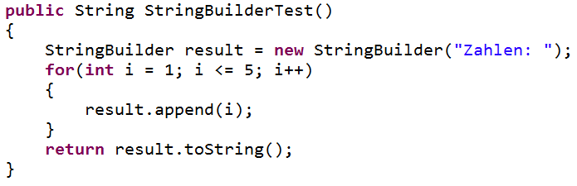
StringBuilder II
Solution: StringBuilder
Each change at the StringBuilder changes the object im memory
Good performance when you manipulate strings (in the sense of sequences of chars)
Zahlen: 123
Zahlen: 1234
Zahlen: 1
Zahlen: 12
Zahlen:
Zahlen: 12345

Slide 47
StringTokenizer
Splits a string in several parts, depending on criteria
import java.util.StringTokenizer;
Similar to split()- method of String class
split() is more powerful because it allows also regular expressions
However: old code often uses StringTokenizer
String s = „This is my test String!";
StringTokenizer st = new StringTokenizer(s," ");
while (st.hasMoreTokens()){
String token = st.nextToken();
System.out.println(token);
}
Criteria: [Space]
Iterating over all tokens in loop
Each token respresents a string
Notes:
String[] tokens = s.split("\\s+");
L Irgendein Leerzeichen als Trennzeichen (Tab, Blank, . . . )
L Bzw. beliebig viele (mindestens eines) von denen hintereinander
L Backslash als Escape-Zeichen für Backslash, der normalerweise Sonderzeichen
einleitet

Slide 48

Other Classes
Notes:
Geschätzte Zeit:
0:1h11

Slide 49
Math I
Contains static methods only
Trigonometry: Math.sin, Math.cos, . . .
Round: Math.round, Math.ceil, Math.floor
Exponentiation: Math.pow, Math.sqrt, Math.exp, Math.log
Extrema: Math.min, Math.max
Absolute: Math.abs
Sign: Math.signum
Constants: Math.PI, Math.E

Slide 50
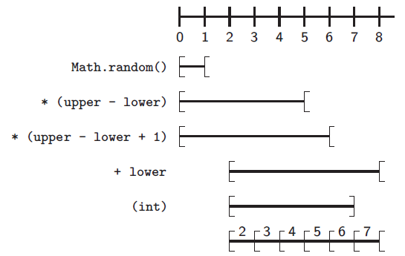
Math II
(Pseudo-)random numbers via double Math.random() > [0; 1[
Natural random number between 0 and 100:
int number = (int) Math.random() * 100;
int lower = 2, upper = 7;
int r = (int) (lower + Math.floor(Math.random() * (upper - lower + 1)));

Slide 51
Collections
Eine Klasse, die den Umgang mit Containern (Listen, Sets, Maps) erleichtert
Interessante Methoden
addAll(Collection<? super T> c, T... elements) – fügt alle Elemente zu der spezifizierten Liste hinzu
copy(List<? super T> dest, List<? extends T> src) – kopiert alle Elemente von der src-Liste zur dest-Liste
disjoint(Collection<?> c1, Collection<?> c2) – gibt true zurück, wenn beide Collections keine gemeinsamen Mitglieder haben
sort(List<T> list) – Sortiert die Liste anhand des per Interface assoziierten „Vergleichers“
http://docs.oracle.com/javase/7/docs/api/java/util/Collections.html
List<String> lst = new ArrayList<String>();
List<String> lst2 = new ArrayList<String>();
Collections.addAll(lst, "s","hallo","hihihi");
Collections.sort(lst);
Collections.copy(lst2, lst);

Slide 52
Array
Class java.util.Arrays contains static methods only
Important methods:
static void fill([Typ] [] a, [Typ] data) – fills a with data
static int binarySearch([Typ] [] a, [Typ] data) – returns index of data; assumes a is sorted
static void sort([Typ] [] a) – sorts element in ascending order
static boolean equals([Typ] [] a, [Typ] [] b) – checks whether content is the same
static String toString([Typ] [] a) – returns content of String
int[] a = 1, 2, 3, 4, 5;
String s = Arrays.toString(a); // [1, 2, 3, 4, 5]

Slide 53

Streams

Slide 54
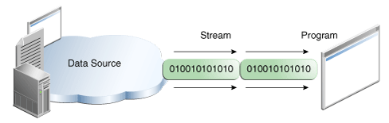
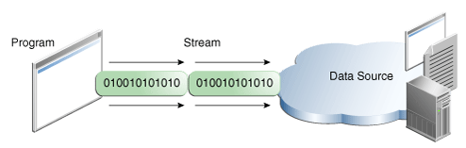
I/O Streams
Deshalb reden wir von „Strömen“:
Input Stream (System.in)
Output Stream (System.out, System.err)
Quellen: Dateien, Programme, Geräte, Speicherzellen,…

Slide 55
Bytestream
Basic stream that reads/writes data in a byte-wise manner
Does not know abstract structures, such as String or Numbers
public static void main(String[] args) throws IOException {
FileInputStream in = null;
FileOutputStream out = null;
try {
in = new FileInputStream(„fileToRead.txt");
out = new FileOutputStream(„fileToWrite.txt");
int c;
while ((c = in.read()) != -1) {
out.write(c);
}
} finally {
if (in != null) {
in.close();
}
if (out != null) {
out.close();
}
}
}
Initialization of streams with path to fiels
While loop for reading and writing
Important: Streams need to be closed so files are not blocked

Slide 56
Streams for Strings
BufferedReader und PrintWriter
Uses buffers for reading and writing
Streams can be nested to get them more structured
public static void main(String[] args) throws IOException {
BufferedReader inputStream = null;
PrintWriter outputStream = null;
try {
inputStream = new BufferedReader(new FileReader(" fileToRead.txt"));
outputStream = new PrintWriter(new FileWriter(" fileToWrite.txt"));
String l;
while ((l = inputStream.readLine()) != null) {
outputStream.println(l);
}
} finally {
if (inputStream != null) {
inputStream.close();
}
if (outputStream != null) {
outputStream.close();
}
}
}
readLine() reads exactly one line and println(String s) writes a string with line break to a stream

Slide 57
Scanner
Scanner: also uses streams:
Scanner s = null;
try {
s = new Scanner(new BufferedReader(new FileReader(“file.txt")));
while (s.hasNext()) {
System.out.println(s.next());
}
} finally {
if (s != null) {
s.close();
}
}

Slide 58
Learning Goals
Errors always occur, we need to react to them:
Define erroneous states and throw exceptions
Catch thrown exceptions and treat them accordingly
Either define your own exceptions or use existing ones
Asserts is a comfortable way to evaluate certain conditions
Use System.out.println() and Debugger to find errors

Slide 59
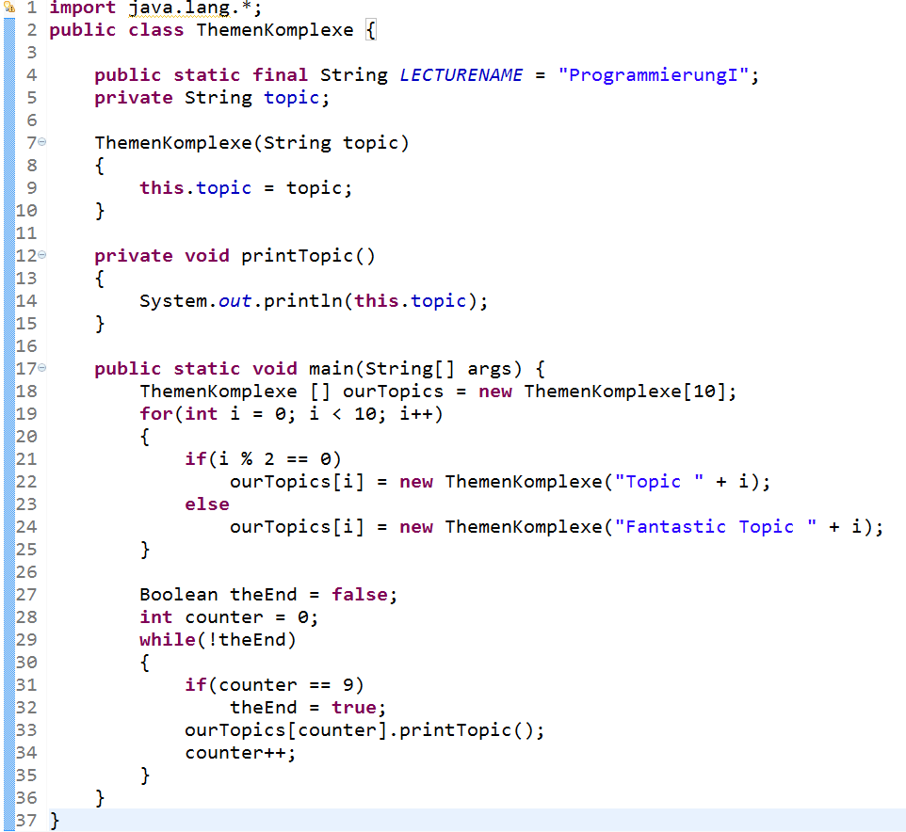
Übersicht Themenkomplexe I
Java-Klassen, Aufzählungen, etc.
Variablen, Konstanten,
(static vs. instance)
Konstruktoren, Zuweisungen,..
Sichtbarkeit
Methoden, Übergabeparameter
Arrays, Listen, Stacks, etc.
OOP: Instanziierung
Datentypen (primitiv & komplex)
Kontrollstrukturen
(Schleifen, Bedingungen, etc.)

