Slide 1
Experiments
Janet Feigenspan

Slide 2
Examples
Watching stars to detect planets
Evaluate efficiency of new warp drive
Compare two teaching methods

Slide 3
What are Experiments?
systematic research study
one or more factors intentionally varied
everthing else held constant
result of systematic variation is observed
here: human participants
  Wilhelm Wundt. Grundzüge der Physiologischen Psychologie. Engelmann, 1874.
  Wilhelm Wundt. Grundriß der Psychologie. Kröner, 1914.

Slide 4
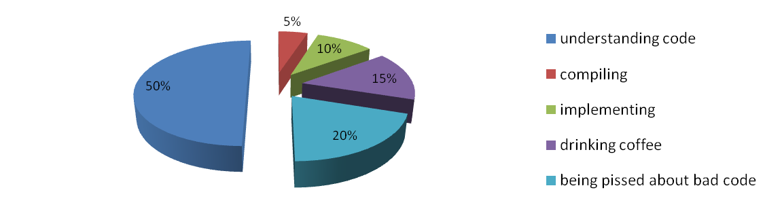
Why Experiments?
In general: Human Factors

Slide 5
Stages of Experiments
Objective Definition
Design
Execution
Analysis
Interpretation
Hypotheses; Independent & Dependent Variables
Experimental Design;
Confounding
Variables
Data
Accepted/Rejected Hypotheses

Slide 6
Outline
discuss each stage with a running example
discuss problems and solutions
Goal:
  get a feeling for design of experiments
  know what to do with data

Slide 7
//Comments in Source Code
Do they make code more comprehensible?
Do they make code more maintainable?
Do they increase development time?
Do they reduce maintenance costs?

Slide 8
Objective Definition

Slide 9
Independent Variable
factor, predictor (variable)
intentionally varied
influences dependent variable
comments

Slide 10
Operationalization
levels, alternatives
presence/absence of comments
good comments
bad comments
useless comments

Slide 11
Dependent variable
response variable
outcome of experiment
Program comprehension
Maintainability
Development time

Slide 12
Operationalization
Specify a measure
Program comprehension:
  subjective rating
  solutions to tasks (correctness? response time?)
  think aloud

Slide 13
Hypotheses
Expectations about outcome
Based on theory or practice -> expectations must have reason

Slide 14
Hypotheses - Example
Bad comments bad for program comprehension
good comments good for program comprehension

Slide 15
Good/Bad Hypotheses
what are good/bad comments?
what does good/bad for program comprehension mean? -> slower, more errors? by how much?
Hypothesis must be falsifiable
  - Karl Popper. The Logic of Scientific Discovery. Routledge, 1959.

Slide 16
Better Hypotheses
comments describing each statement of source code have no effect on the response time of understanding source code
comments containing wrong information about statements slow down comprehension
comments describing the purpose of statements speed up comprehension

Slide 17
Why Hypotheses?
why not just measure and see what the result is?
  influences experimental design
  fishing for results

Slide 18
Summary
Independent Variable
  Comment
  two levels: presence/absence
Dependent Variable
  Program Comprehension
  Response time for tasks
Hypotheses
  comments describing the purpose of statements speed up comprehension

Slide 19
Design

Slide 20
Validity
Do we measure what we want to measure?
Internal:
  degree to which the value of the dependent variable can be assigned to the manipulation of the independent variable
External:
  degree to which the results gained in one experiment can be generalized to other subjects and settings

Slide 21
Confounding Parameters
influence depending variable besides variations of independent variable

Slide 22
Confounding Parameters
Problem-solving ability
Programming experience
Culture
Data consistency
Ability
Comprehension Model
Education
Occupation
Color blindness
Evaluation apprehension
Attitude
Knowledge
Intelligence
Hawthorne
Ordering
Motivation
Familiarity with study object
Fatigue
Content of study object
Familiarity with tools
Instrumentation
Reading time
Treatment Preference
Working memory capacity
Gender
Learning effects

Slide 23
Controlling Confounding Variables
Randomization
Matching
Keep confounding parameter constant
Use confounding parameter as independent variable
Analyze influence of confounding parameter on result

Slide 24
Randomization
use random number generator
roll a dice
toss a coin
...

Slide 25
Matching
Proband | Wert
P5 | 65
P9 | 56
P3 | 42
P4 | 34
P10 | 24
P6 | 23
P7 | 21
P8 | 16
P2 | 12
P1 | 5
Group A | Group B
65 | 56
34 | 42
24 | 23
16 | 21
12 | 6
odd-even-even-odd

Slide 26
Matching
We have to measure a confounding parameter
Programming experience
  questionnaire, pretest, number of years, size of projects,...
Intelligence
  test (exhausting, more time), university grades as indicator,...

Slide 27
Keep Parameter Constant
Programming experience
  recruit students as participants (bachelor, master, PhD)
  recruit programming experts
Intelligence
  only participants with certain grades

Slide 28
Use parameter as Independent Variable
Reminder: 2 level of independent variable (comment/no comment)
Example: 2 levels of programming experience
  Comment/low experience
  Comment/high experience
  No comment/low experience
  No comment/high experience

Slide 29
Analyze Influence of Parameter on Result
when we cannot assign participants to groups, for example when comparing two companies
when something happened during the experiment, e.g., power failure in one session, but not in an other session

Slide 30
Which control technique is the best?
Randomization | Large sample
Matching | Measurement
Keep Constant | Measurement
Use as factor | Measurement, large sample
Analyze afterwards | Measurement

Slide 31
Validity
Internal and external validity need different things:
  internal: controlling everything
  external: broad setting so that we can generalize
first maximize internal validity
step by step increase external validity

Slide 32
Experimental Designs
One-factorial designs
Group | Levels
A | Comment
B | No comment
One Group | Session 1 | Session 2
 | Comment | No Comment
ordering effects
comparable groups
Group | Session 1 | Session 2
A | Comment | No Comment
B | No comment | Comment
learning effects
mortality

Slide 33
Experimental Designs
Two-factorial designs
Group
Comment/ Low Experience | Group A
Comment/ High Experience | Group B
No comment/Low Experience | Group C
No comment/High Experience | Group D
Session 1 | Session 2 | Session 3 | Session 4
 | Group D | Group C | Group B
 | Group A | Group D | Group C
 | Group B | Group A | Group D
 | Group C | Group B | Group A

Slide 34
Execution

Slide 35
What can go wrong?
Everything!
conduct pilot tests
  test material
  tools
  data storage
tell participants exactly what they have to do
observe that participants do what they are instructed to do
make backups of the data

Slide 36
Analysis

Slide 37
Experiment
Group | Time [s]
A (no comment) | 42
A | 60
A | 30
A | 77
A | 58
A | 49
A | 38
B (comment) | 48
B | 48
B | 26
B | 30
B | 50
B | 34
public static void main(String[] args) {
String word = "Hello";
String result = new String();
for (int j = word.length() - 1; j >= 0; j--)
result = result + word.charAt(j);
System.out.println(result);
}
public static void main(String[] args) {
String word = "Hello";
String result = new String();
//reverse character order
for (int j = word.length() - 1; j >= 0; j--)
result = result + word.charAt(j);
System.out.println(result);
}

Slide 38
Descriptive Statistics
what do we do with these data?
look at the data
  mean/average (=arithmetic mean)
  median
  standard deviation
  boxplots

Slide 39
Median
Group | Time [s] | Time [s]
A | 42 | 30
A | 60 | 38
A | 30 | 42
A | 77 | 49
A | 58 | 58
A | 49 | 60
A | 38 | 77
Group | Time [s] | Time [s]
B | 48 | 26
B | 48 | 30
B | 26 | 34
B | 30 | 48
B | 50 | 48
B | 34 | 50
Median: 49
Median: (34 + 48)/2 = 41

Slide 40
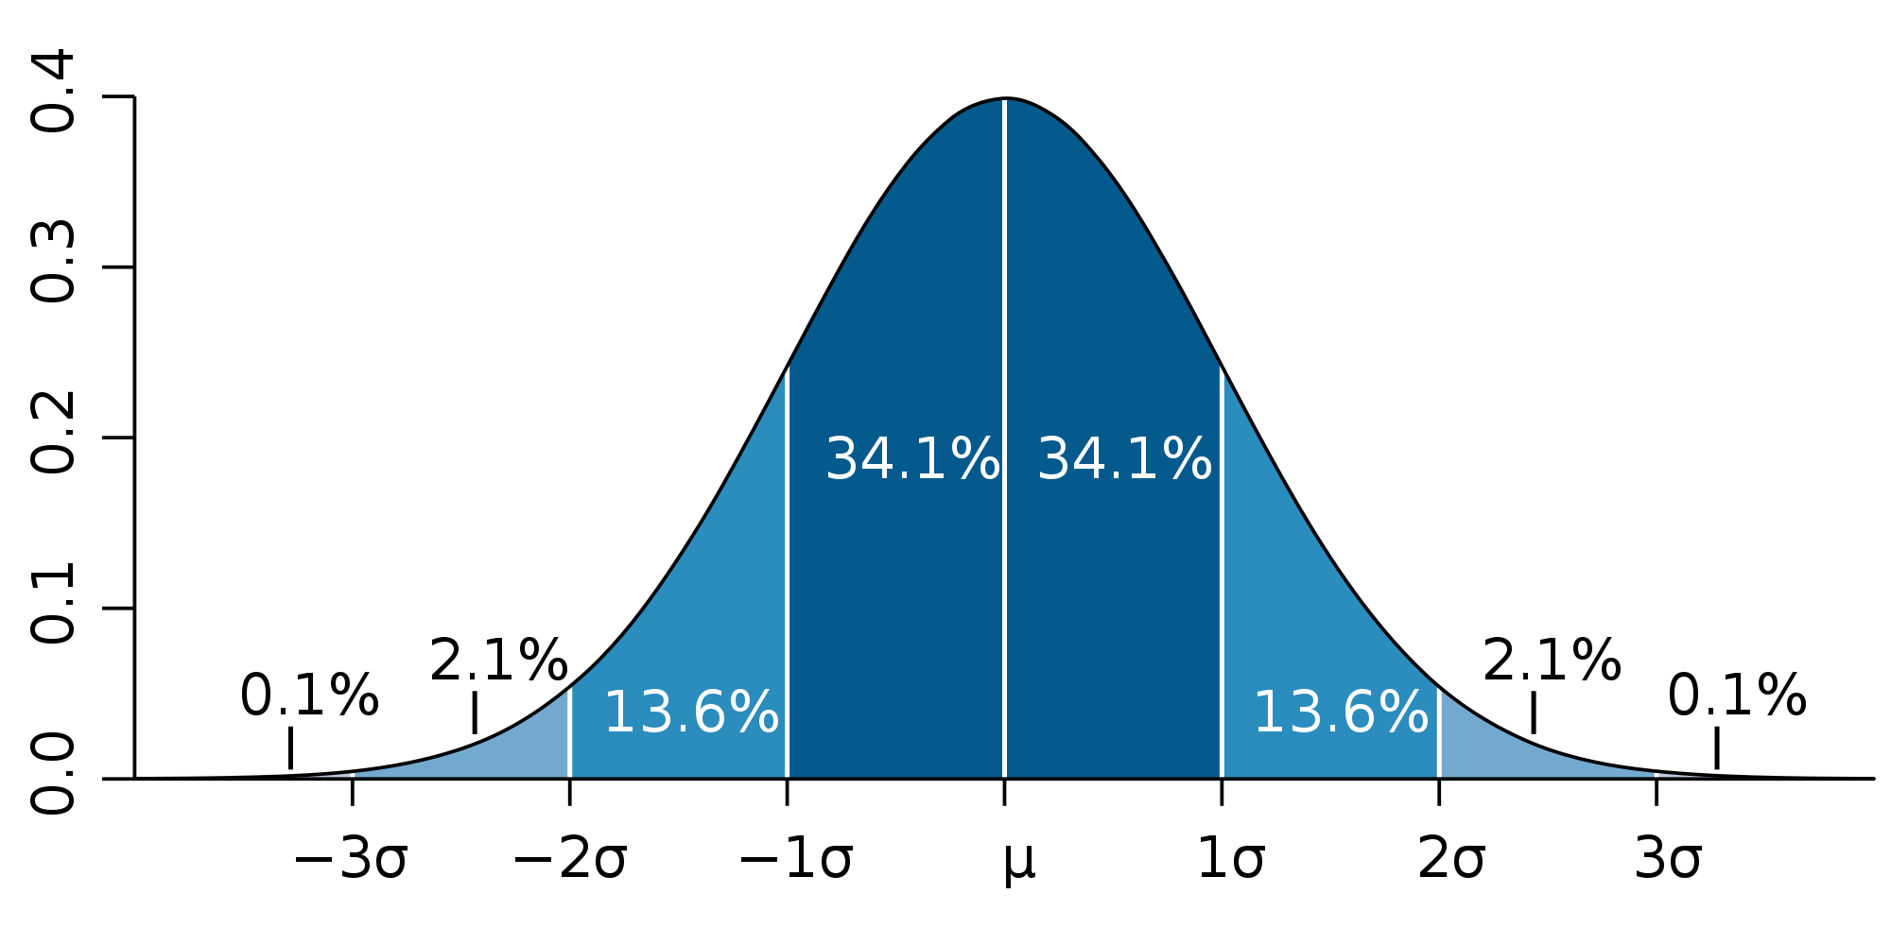
Standard Deviation
Group A:
Group B:
19
17
35
28
51
39
67
50
83
61

Slide 41
Boxplot
box: 50% of all values
line: median
whiskers: upper and lower 25% of data
dot:
  outlier (=values that deviate too much from mean/median)
  what is too much?
  1.5/2 standard deviations

Slide 42
Statistical Tests
When is a difference real, not coincidental?
Assumption: both values are the same (= null hypothesis; H₀)
Conditional probability: probability of observed result under assumption that values should be the same
if probability is low, then assumption must be wrong
  typical: 5%
  possible: 10%

Slide 43
T Test
interesting values:
  p value: smaller/larger than 0.05?
  (t value/degrees of freedom-df): when you report the test
p value > 0.05? -> no significant difference
p value <= 0.05? -> significant difference

Slide 44
Interpretation of T Test
we reject hypothesis, that comments speed up comprehension
in case p value is <= 0.05
  we did not confirm hypothesis
  we just did not find any evidence against it
  hence: we do not say that we confirmed a hypothesis, but that we can accept it
  (or even more correct: we can reject the null hypothesis)

Slide 45
Preconditions t test
normally distributed data
metric data
scale types
    metric data (e.g., response times)
    ordinal data (e.g., rankings, grades)
    nominal data (e.g., gender, party members)

Slide 46
Further tests
Mann-Whitney-U test
  ordinal scale type
  metric scale type, but not normally distributed
χ²-Test
  nominal scale type
(non-parametric test)

Slide 47
Interpretation

Slide 48
Are comments any good?
look at the size of the difference
did anything noteworthy happened during execution?
comments of participants?
what does that result mean for practice?

Slide 49
Ethics
Be nice to your participants, they voluntarily invest their time for you
Assure anonymity
Assure that benefit for science is worth the effort for participants
Urban Wiesing. Die Ethik-Kommissionen – Neuere Entwicklungen und Richtlinien. Deutscher Ärzte-Verlag, 2003.

Slide 50
And now?
You might feel frustrated
You might think that there is no way to create an absolutely waterproof experiment design
That is correct, there is no perfect design
Accept that every experiment has flaws, it is unavoidable
Do not look for a perfect design, look for a good, sufficient design to evaluate your hypotheses

Slide 51
Literature
Historical
  Wilhelm Wundt. Grundzüge der Physiologischen Psychologie. Engelmann, 1874.
  Wilhelm Wundt. Grundriß der Psychologie. Kröner, 1914.
  Karl Popper. The Logic of Scientific Discovery. Routledge, 1959
Experiment Design
  Jutta Markgraf, Hans-Peter Musahl, Friedrich Wilkening, Karin Wilkening, and Viktor Sarris. Studieneinheit Versuchsplanung, 2001. FIM-Psychologie Modellversuch, Universität Erlangen-Nürnberg.

Slide 52
Literature
Experimentation in general:
  C. James Goodwin. Research in Psychology: Methods and Design. Wiley Publishing, Inc., 1999.
  Claes Wohlin. Experimentation in Software Engineering: An Introduction. Kluwer Academic Publishers, 2000.

Slide 53
Literature
Analysis
  Theodore W. Anderson and Jeremy D. Finn. The New Statistical Analysis Analysis of Data. Springer, 1996
  Jürgen Bortz. Statistik für Human- und Sozialwissenschaftler. Springer, 2005.

