Slide 1
Empirical Software Engineering
Performance Messungen

Slide 2
Overview
Human--Technology
Qualitative---Quantitative
Time-series analysis
Controlled experiments with human participants
Performance
Questionnaires
Interviews
Proofs
Case studies
Think-Aloud Protocols

Slide 3
Task
Bestimmen Sie die schnellste Sortierfunktion
Gruppe 1: Merge sort vs. quick sort (http://rosettacode.org/wiki/Sorting_algorithms/Quicksort#Java)
Gruppe 2: Mergesort recursive vs. Mergesort iterative
Gruppe 3: Mergesort Java vs. Mergesort Python
Gruppe 4: Mergesort Java vs. Mergesort C
Link to all merge sorts: https://www.geeksforgeeks.org/iterative-merge-sort/
Put the results on a poster
Do you trust the results of your colleagues?

Slide 4
Goals
Understand difficulties of performance analyses
Evaluate performance analyses
Get a first impression of statistical tests

Slide 5
Why Performance Analysis?
Compare alternatives
Understand influence of a configuration option
System tuning
Understand relative performance (over time)
Understand absolute performance for single case
Set expectations (e.g., min/optimal system requirements for PC games)
Analyze system behavior
Notes:
Have you ever configured a Linux kernel? Or a data base, like MySQL? Optimized your phone/laptop for performance/energy? How do the predictions of how many time of power is left work?

Slide 6
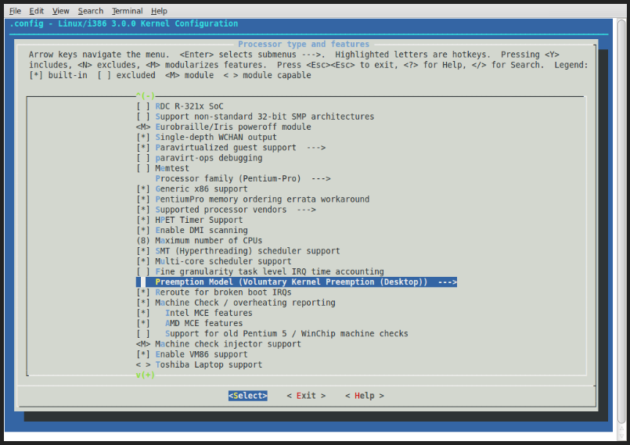

Slide 7
Analysis Techniques
Measurement
No simplifying assumptions
Most trustworthy results
Inflexible, one selected system
Simulation
Abstraction
Flexible
Analytical modeling
Mathematical description of system
Strong abstraction, results are often unrealistic
Especially for early validation
Notes:
Have you ever configured a Linux kernel? Or a data base, like MySQL? Optimized your phone/laptop for performance/energy? How do the predictions of how many time of power is left work?

Slide 8
Benchmark
Exectute existing programs on existing hardware components in realistic environment (no simulation)
Measure performance, memory consumption, etc.
Can be automated
No human influence
Notes:
Vermessungsingeneure:
Permanentes Objekt, dass Höhe über NN zeigt; wird dann als Referenz benutzt

Slide 9
Benchmark - Examples
3DMark (Graphics chip)
TCP-H (Datawarehouse)
TCP-C (On-line transaction processing)
Sintel (Video encoder)

Slide 10
What Can We Measure?
Execution time
CPU cycles
MIPS (Million instructions per second)
MFLOPS (Million floating-point operations per second)
SPEC (System Performance Evaluation Cooperative)
QUIPS (Quality improvements per second)
Transactions per second
Notes:
Million instructions per second = n/(t_e x 10^6)
Million floating-point operations per second = f/(t_e x 10^6)
System Performance Evaluation Cooperative
Execution time for standardized programs on tested systems is measured and normalized
Normalisierung: Execution time / execution time on standard computer
Quality Improvements per Second: Measure for quality of solution divided by time for solution (quality needs to be defined rigorously; specific to problems

Slide 11
What criteria should a good metric fulfill?
Are the presented metrics good metrics?
Execution time
CPU cycles
MIPS (Million instructions per second)
MFLOPS (Million floating-point operations per second)
SPEC (System Performance Evaluation Cooperative)
QUIPS (Quality improvements per second)
Transactions per second

Slide 12
Criteria
Criterion | Execution time | CPU Cycles | MIPS | MFLOPS | SPEC | QUIPS | Transactions/second
Linearity
Reliability
Repeatability
Easy to measure
Consistency
Independence
+ | - | - | + | - | + | +
+ | - | - | - | - | - | +
+ | + | + | + | + | + | +
+ | + | + | + | + | + | +
+ | + | - | - | + | + | +
+ | + | + | - | - | + | +
Notes:
Linearität: Wert einer Metrik verändert sich um Betrag -> Performance soll sich im gleichen Betrag ändern
Reliabilität/Zuverlässigkeit: Höherer Wert bei System A soll immer mehr Performance von System A bedeuten
Wiederholbarkeit: Bei selbem Experiment immer der selbe Wert einer Metrik; deterministisch
Einfache Messbarkeit: sonst wird sie nicht benutzt; ggfs. falsch benutzt
Konsistenz: funktioniert gleich auf allen Architekturen
Unabhängigkeit: Systeme sollten nicht auf Metriken optimiert werden können
MIPS: Meaningless indicator of performance

Slide 13
Confounding Parameters
Influence measurement result systematically or unsystematically
Examples:
Background processes
Differences in hardware
Differences in temperature
Input data, random?
Heap size
System interrupts
Parallel execution in single/multicore systems
Garbage collector

Slide 14
How can we control the influence of a confounding parameters

Slide 15
Typical: Best Measurement
Repeat measurement
Best, second best, or worst measurement
Bsp: Execution time
R: Read einlesen
data <- read.csv("rt.csv", header=TRUE, sep = ";", dec = ".")
header: Do variables have heading
sep: Separator for data entries
dec: Decimal point/comma
rt <- data[,’time’]
min(rt)/max(rt)

Slide 16
Arithmetic Mean
Repeat measurement
Compute mean:
R:
mean(rt)

Slide 17
Median
Value that is in the middle
Robust against outliers
R:
median(rt)
Even number of measurements:
Arithmetic mean of the two middle values
Use one of the two middle values

Slide 18
Median or Arithmetic Mean?
Median, if:
Ordinal Data*
Few measurement values
Non-normal distribution
Outliers
*Scale types
Nominal (z.B. Gender)
Ordinal (z.B. Ranking)
Metric (z.B. Temperature, response time)
Notes:
Woher weiß ich, ob es Ausreißer gibt oder Verteilung asymmetrisch ist?

Slide 19
Look At Data
Go swim in the data!
Get an overview
Look at how data are distributed
Are there outliers?

Slide 20
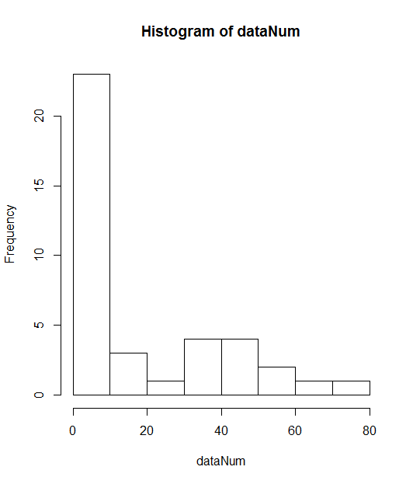
Histograms
Frequency of measurement values in fixed buckets
R
rtNum <-as.numeric(unlist(rt))
hist(rt)

Slide 21
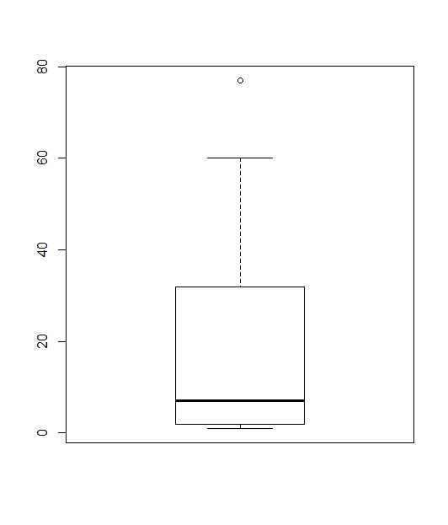
Boxplots
Median as thick line
Quartiles as box (50% of all values within the box)
Whiskers (-> box and whisker plots)
Outliers as dots
R: boxplot(rt)
Notes:
[Tafelbild]

Slide 22
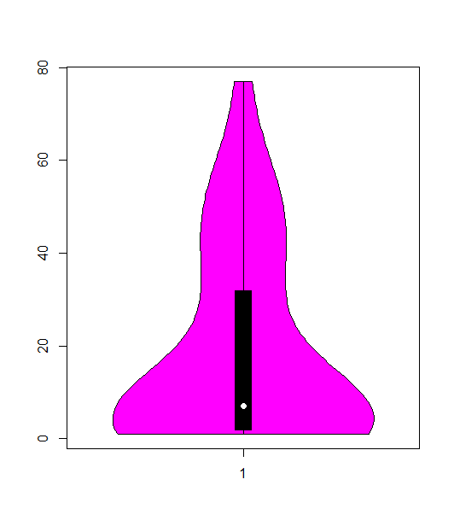
Violin-Plot
Like box plots, but show additionally the distribution of data
R:
install.packages("vioplot")
library(vioplot)
vioplot(rtNum)

Slide 23
Recap
Benchmarks
Metriken zur Performance-Messung
Daten visualisieren

Slide 24
Measurement Model
y = τ + ε
y: Observed value
τ: True value
ε: Error
Population: greek letters
Sample: german letters

Slide 25
Error Model
True mean: 10
1 random error, influence of +/- 1
Measurement: 9 (50%) and 11 (50%)
2 random errors, each +/- 1
Measurement: 8 (25%), 10 (50%), 12 (25%)
3 random errors, each +/- 1
Measurement: 7 (12.5%), 9 (37.5%), 11 (37.5%), 13 (12.5%)
N random errors, each +/- 1
Normal distribution

Slide 26
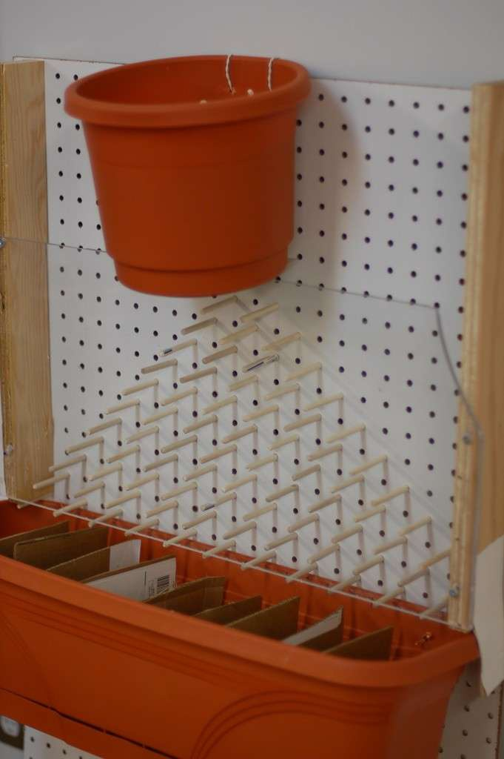
Normal Distribution

Slide 27
Dispersion
Mean: 45.55
Boxplot

Slide 28
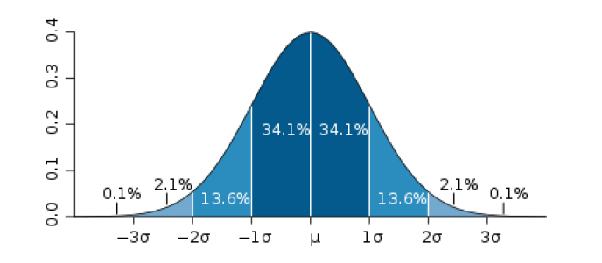
Standard Deviation
Bildquelle CC BY 2.5 Mwtoews

Slide 29
Standard Deviation
R:
sd(rtNum)
21.55
Mean: 45.55
45.55 - 21.55 = 24 –> 45.55 (34 % of measurement values)
45.55 + 21.55 = 67.1 (34% of measurement values)

Slide 30
Use cases for Standard Deviation
Define outlier
Define giftedness
Announce the discovery of the Higgs-Boson

Slide 31
Variance
Is the squared standard deviation

Slide 32
Konfidenzintervall
: Mittelwert
z: x-Wert der Standardnormalverteilung
alpha: 1-Wert des Konfidenzintervall (z.B. 95%)
s: Standardaweichung
n: Anzahl der Messungen

Slide 33
Konfidenzintervall: Bedeutung
Bedeutung
Vertrauensintervall
Wahrer Mittelwert liegt in 95% im Intervall
Technischer: Bei grosser Anzahl von Wiederholungen des Experiments liegt in 95% der Fälle der wahre Mittelwert in dem jeweils berechneten Konfidenzintervall

Slide 34
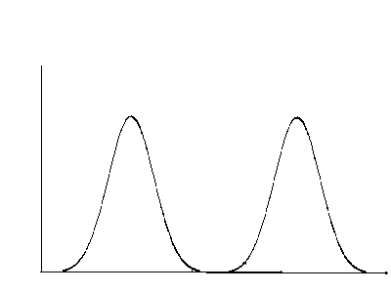
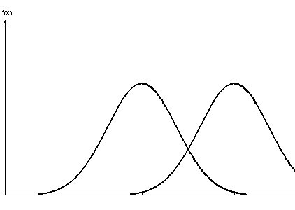
Konfidenzintervall: Anwendung
Überlappung: vmtl kein Unterschied
Keine Überlappung: vmtl Unterschied
Mehr Messungen verkleinert Intervalle
Notes:
Bei kleinerem Konfidenzintervall wird Präzision erhöht

Slide 35
Accuracy vs. Precision
Accuracy:
Deviation of observed mean from true mean
Important when measuring response time
Precision:
Dispersion around mean
Cause of measurement errors is unclear

Slide 36
Random vs. Systematic Errors
Systematic errors: Errors of the epxeriment/measurement methods
CPU speed: measurement during different tempertatures
State not resetted for second measurement
Low variance, or constant variance for all measurements
Need to be excluded during design, which requires practice and experience
Affect accuracy
Random errors:
Cannot be controlled
Requires statistical methods
Affect precision
Notes:
Für stochastische Methoden ist Signifikanzniveau wichtig

Slide 37
Significance Tests
To evaluate whether an observed result appeared rather randomly or not

Slide 38
T-Test
Designed by Student (William Sealy Gosset)
Comparision of two measurements
Null hypothesis (H₀) | Alternative hypothesis (H₁)
Statistical hypotheses
Measurements do not differ, i.e., they come from the same population | Data of both measurements are from different populations
Formal: | Formal:

Slide 39
T-Test: Result
Determines probability of observed result, under the assumption that the null hypothesis is valid -> conditional probability
If probability is smaller than:
0.001
0.01
0.05
0.10
null hypothesis must be wrong
Significance level must be defined in advance!
very very significant
very significant
typical significance level
for exploraty/initial studies
Notes:
wie wahrscheinlich ist das beobachtete Ergebnis, wenn die Nullhypothese korrekt ist?

Slide 40
T-Test: Conclusion
What does significant result mean?
Is null hypothesis incorrect? -> No
Is alternative hypotheses correct? -> No
There is no evidence that the null hypothesis is valid (thus, I can only make statements about the null hypothesis)
Writing a report:
Reject/could not reject null hypothesis
Never: Confirmation of null or alternative hypothesis

Slide 41
T-Test by Hand (1)
Computation of test value
rt.csv:
t = 1.522

Slide 42
T-Test by Hand (2)
Degrees of freedom, df
for t-Test: n₁ + n₂ _ 2 (in this example: 11)
Table with t distribution (e.g., wikipedia)
Comparison with calculated value (t_{emp} = 1.522)
is t_{emp} > ?
no, so not significant

Slide 43
One-tailed vs. Two-tailed
Two-tailed:
No assumption about direction of effect (e.g., which of two UIs is more usable
Compute half of significance level
One-tailed:
Assumption that one UI is more usable
No need to cut significance level in half

Slide 44
T-Test: R
t.test(rt1, rt2)
Output:
Welch Two Sample t-test
data: dataPC1 and dataPC2
t = 1.5222, df = 10.566, p-value = 0.1573
alternative hypothesis: true difference in means is not equal to 0
95 percent confidence interval:
-5.095727 27.583584
sample estimates:
mean of x mean of y
50.74243 39.49850
p value: conditional probability of having observed result under the assumption that nul hypothesis is valid
If p value is smaller than defined significance level, result is significant and null hypothesis can be rejected

Slide 45
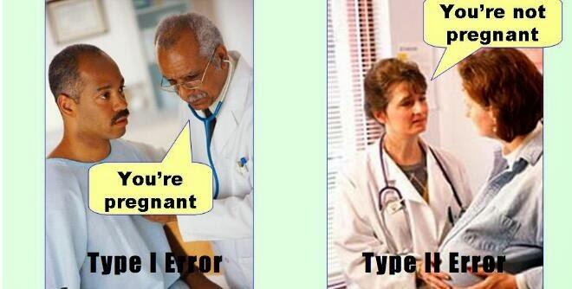

Types of errors
 |  | Valid is:
 |  | H₀ | H₁
Decision for: | H₀ |  | β error; Type-2 error
 | H₁ | α error; Type-1 error

Slide 46
T-Test: Variants
T test for independent samples:
Creation of samples must not be dependent on each other
E.g., random assignment of participants to one or the other sample
T test for dependent samples:
Creation of samples depends on each other
E.g., in a within-subjects design, or when spouses are distributed to different samples

Slide 47
T-Test: Prerequisits
Metric scale type
Normally distributed data (e.g., Shapiro-Wilk)
Or: sample size >= 30

Slide 48
Mann-Whitney-U
Non-parametric test
Ordinal data (or non-normal distributed metric data)
Computation of test:
r_{i} : Ranks in the sample

Slide 49
Goals
Understand difficulties of performance analyses
Evaluate performance analyses
Get a first impression of statistical tests

Slide 50
Literature
David Lilja. Measuring Computer Performance: A practitioner's guide. Cambridge University Press. 2000.
Performance-Paper
Beliebiges Statistikbuch

Slide 51
Assignment
Read excerpts of the following papers:
How Do Professional Developers Comprehend Software? (Section II, skim Section III)
An Experiment About Static and Dynamic Type Systems (Section 4, skim Section 5)
What do you think of the experiment
What would you do in the same way? Why?
What would you do differently? Why?

