Slide 1
React - 16 React Redux
May. 2021

Slide 2
React Redux
demo16:
https://github.com/feihub/react-demo/tree/master/demos/demo16
文档：
https://redux.js.org/introduction/getting-started
https://redux-toolkit.js.org/introduction/getting-started

Slide 3
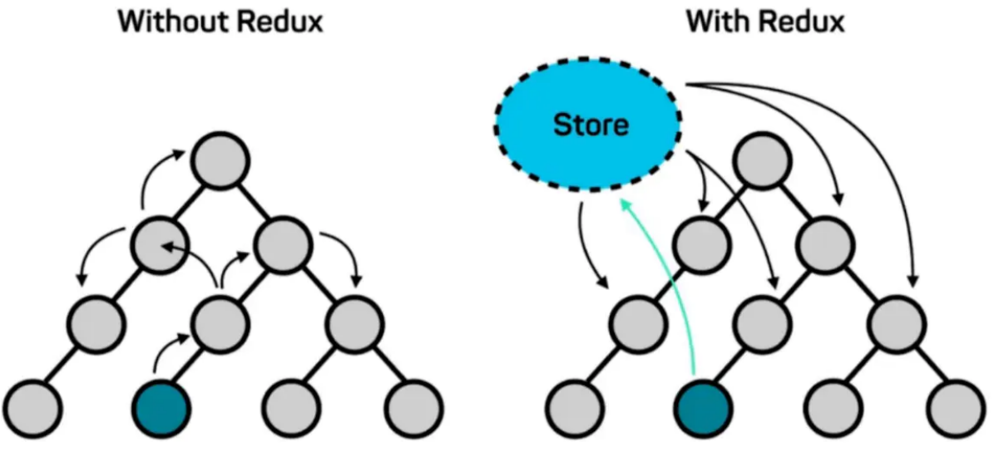
React Redux
Redux是JavaScript应用程序的可预测状态容器。
npx create-react-app my-app --template redux

Slide 4
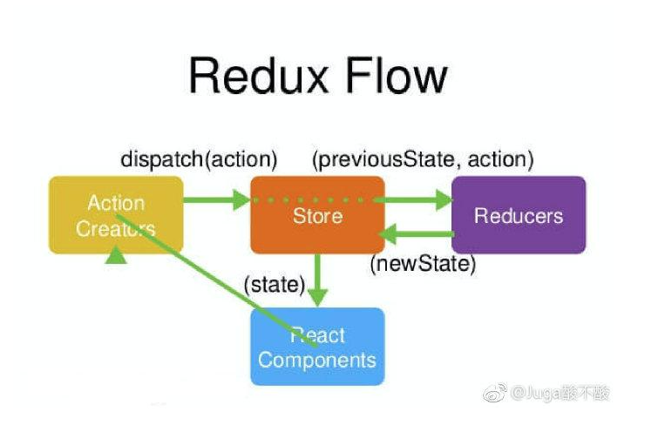
React Redux

Slide 5
Redux Toolkit
Redux Toolkit is our official, opinionated, batteries-included
toolset for efficient Redux development. It is intended to be the
standard way to write Redux logic, and we strongly recommend
that you use it.

Slide 6
Thank you

