Slide 1
GRIB in TDS 4.3

Slide 2
NetCDF 3D Data
dimensions:
lat = 360; lon = 720; time = 12;
variables:
float temp(time, lat, lon);
temp:coordinates = “time lat lon”;
float lat(lat);
lat:units = “degrees_north”;
float lon(lon);
lon:units = “degrees_east”;
float time(time);
time:units = “months since 01-01-2012”;

Slide 3
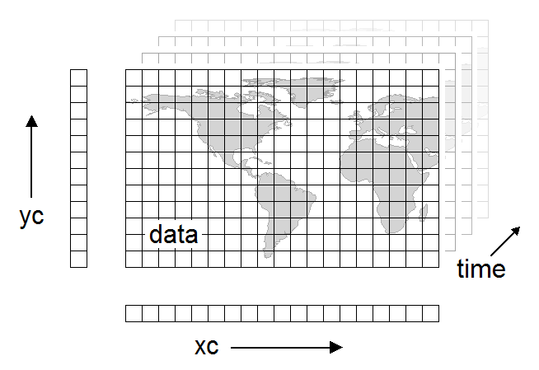
3D data

Slide 4
NetCDF 4D Multidimensional Data
dimensions:
lat = 360; lon = 720; time = 12; alt = 39;
variables:
float temp(time, alt, lat, lon);
temp:coordinates = “time alt lat lon”;
float lat(lat);
lat:units = “degrees_north”;
float lon(lon);
lon:units = “degrees_east”;
float alt(alt);
alt:units = “m”;
float time(time);
time:units = “months since 01-01-2012”;

Slide 5
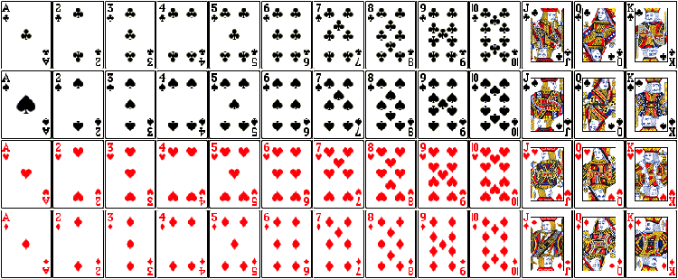
netCDF storage

Slide 6

GRIB storage

Slide 7
GRIB Rectilyzer
Turn unordered collection of 2D slices into 3-6D multidimensional array
Each GRIB record (2D slice) is independent
There is no overall schema to describe what its supposed to be
there is, but not able to be encoded in GRIB

Slide 8
GRIB collection indexing
GRIB file
1000x smaller
Index file
name.gbx9
TDS
Create
GRIB file
Collection Index
collectionName.ncx
Index file
name.gbx9
1000x smaller
CDM metadata
…
GRIB file
Index file
name.gbx9

Slide 9
GRIB time partitioning
GRIB file
gbx9
GRIB file
ncx
gbx9
TDS
…
GRIB file
gbx9
1983
GRIB file
Partition index
Collection.ncx
gbx9
GRIB file
ncx
gbx9
…
GRIB file
gbx9
1984
…
1985

Slide 10
NCEP GFS half degree
All data for one run in one file
3.65 Gbytes/run, 4 runs/day, 22 days
Total 321 Gbytes, 88 files
Partition by day (mostly for testing)
Index files
Gbx9: 2.67 Mbytes each
Ncx: 240 Kbytes each
Daily partition indexes : 260K each
Overall index is about 50K (CDM metadata)
Index overhead = grib file sizes / 1000

Slide 11
CFSR timeseries data at NCDC
Climate Forecast Series Reanalysis
1979 - 2009 (31 years, 372 months)
analyze one month (198909)
151 files, approx 15Gb. 15Mb gbx9 indexes.
101 variables, 721 - 840 time steps
records 144600 - duplicates 21493 (15%)
1.1M collection index, 60K needs to be read by TDS when opening.
Total 5.6 Tbytes, 56K files

Slide 12
Big Data
cfsr-hpr-ts9
9 month (275~ day run) 4x / day at every 5 day intervals.
run since 1982 to present!
~22 million files

Slide 13
What have we got ?
Fast indexing allows you to find the subsets that you want in under a second
Time partitioning should scale up as long as your data is time partitioned
No pixie dust: still have to read the data!
GRIB2 stores compressed horizontal slices
decompress entire slice to get one value
Experimenting with storing in netcdf-4
Chunk to get timeseries data at a single point

Slide 14

Future Plans
For World Domination
netCDF-4
GRIB

