Slide 1
NcML Aggregation vs Feature Collections

Slide 2
NcML functionality
Modify the objects found in CDM files
Especially Attributes
Don’t have to rewrite the files, esp on the server
Make modest changes “by hand”
Alternative to ncgen, ncdump
CDL in XML
Aggregations
Creating logical datasets out of file collections

Slide 3
NcML Aggregations
union
Logical union of objects inside multiple files
joinNew
Each file contains one slice – add new dimension
joinExisting
Concat existing multidim arrays together
tiled (never released)
Stitch horizontal tiles together
FMRC (deprecated as of 4.2)

Slide 4
NcML Aggregations
Syntactic aggregation
Manipulating multidimensional arrays
Doesn’t know what the data means
High homogeneity requirements
Files must be identical, except for certain things
Difficult for Users to understand or to track
Assemble at runtime
Inefficient for large collections
Caching strategies cause trouble for dynamic datasets

Slide 5
Feature Collections
Feature Types
Coverage: grid, swath, FMRC, ugrid*, image*
Discrete: point, station, profile, etc
Radial
Understands more of the dataset semantics
Mostly about the coordinate systems
Can “do the right thing” without user
Handle more inhomogeneity in the files
* Coming soon

Slide 6
Application
Scientific Feature Types
Datatype Adapter
NetCDF-Java/
CDM architecture
NetcdfDataset
CoordSystem Builder
NetcdfFile
THREDDS
I/O service provider
Catalog.xml
OPeNDAP
NetCDF-3
NIDS
NetCDF-4
GRIB
NcML
HDF5
GINI
Nexrad
DMSP

Slide 7
What do you need to know?
NcML aggregation works and is stable code
Must know how your collection of files varies
Use it for simple cases
Feature Collections are still work in progress
Much easier to work with
All future development is here
You have our attention
Details tommorrow
If you have GRIB files
You want to use GRIB feature collections (4.3)

Slide 8
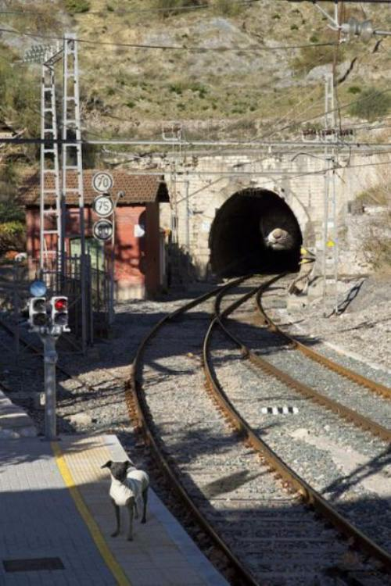
Good Luck!

