Slide 1

Writing Software

Slide 2
Local Elements

Slide 3
Mass element (ex: arrow): Summary
${p\left(t\right)}_{i}′=M_{i}′\overset{¨}{u′}\left(t\right)+q_{i}′\left(0,0\right)$
Equation of motion
Where,
$q_{i}\left(0,0\right)=K_{i}′u′\left(t\right)=\left[\begin{matrix}0 \\ 0\end{matrix}\right]$
No internal forces
$M_{i}′=m\left[\begin{matrix}1 & 0 \\ 0 & 1\end{matrix}\right]$
Where,
$p_{0,v}$
$p_{0,v}$
$K_{i}′=\left[\begin{matrix}0 & 0 \\ 0 & 0\end{matrix}\right]$
$v_{0}$
$v_{0}$
$u_{0}$
$p_{0,u}$

Slide 4
String (Bar) Element: Adapted from VirtualBow
$p_{1,v}$
$v_{1}$
$p_{0,v}$
$v_{0}$
$v_{0}$
$u_{1}$
$p_{1,u}$
$u_{0}$
$p_{0,u}$
Naming sugar
$u\left(t\right)=\left[\begin{matrix}u_{0}\left(t\right) \\ u_{1}\left(t\right) \\ u_{2}\left(t\right) \\ u_{3}\left(t\right)\end{matrix}\right]=\left[\begin{matrix}u_{0}\left(t\right) \\ v_{0}\left(t\right) \\ u_{1}\left(t\right) \\ v_{1}\left(t\right)\end{matrix}\right]$
$p\left(t\right)=\left[\begin{matrix}p_{0}\left(t\right) \\ p_{1}\left(t\right) \\ p_{2}\left(t\right) \\ p_{3}\left(t\right)\end{matrix}\right]=\left[\begin{matrix}p_{0,u}\left(t\right) \\ p_{0,v}\left(t\right) \\ p_{1,u}\left(t\right) \\ p_{1,v}\left(t\right)\end{matrix}\right]$

Slide 5
String element Summary
Equation of motion
${p\left(t\right)}_{i}′=M_{i}′\overset{¨}{u′}\left(t\right)+q_{i}′\left(u′\left(t\right),\overset{˙}{u}′\left(t\right)\right)$
$q_{i}\left(u′\left(t\right),\overset{˙}{u}′\left(t\right)\right)=K_{i}′u′\left(t\right)+D_{i}′\overset{˙}{u}′\left(t\right)$
$M_{i}′=\frac{ρ_{i}A_{i}L_{i}}{2}\left[\begin{matrix}1 & 0 & 0 & 0 \\ 0 & 1 & 0 & 0 \\ 0 & 0 & 1 & 0 \\ 0 & 0 & 0 & 1\end{matrix}\right]$
Where,
Elastic Part
Viscous
Part
Where,
$K_{i}^{′}=\frac{E_{i}A_{i}}{L_{i}}\left(1−\frac{L_{i}}{\sqrt{Δx^{2}+Δy^{2}}}\right)\left[\begin{matrix}1 & 0 & −1 & 0 \\ 0 & 1 & 0 & −1 \\ −1 & 0 & 1 & 0 \\ 0 & −1 & 0 & 1\end{matrix}\right],$
$D_{i}′=\frac{η_{i}A_{i}}{L_{i}}\left[\begin{matrix}1 & 0 & −1 & 0 \\ 0 & 1 & 0 & −1 \\ −1 & 0 & 1 & 0 \\ 0 & −1 & 0 & 1\end{matrix}\right]$
Tangent Stiffness Matrix
Tangent Dampening Matrix

Slide 6
Limb Element
$v_{1}$
$θ_{1}$
$s\left(x,t\right)$
$u_{1}$
$v_{0}$
$θ_{0}$
$r\left(x,t\right)$
$u_{0}$
Naming Sugar
$p\left(t\right)=\left[\begin{matrix}p_{0}\left(t\right) \\ p_{1}\left(t\right) \\ p_{2}\left(t\right) \\ p_{3}\left(t\right) \\ p_{4}\left(t\right) \\ p_{5}\left(t\right)\end{matrix}\right]=\left[\begin{matrix}P_{u_{0}}\left(t\right) \\ P_{v_{0}}\left(t\right) \\ p_{θ_{0}}\left(t\right) \\ p_{u_{1}}\left(t\right) \\ p_{v_{1}}\left(t\right) \\ p_{θ_{1}}\left(t\right)\end{matrix}\right]$
Small angle approximation
$u\left(t\right)=\left[\begin{matrix}u_{0}\left(t\right) \\ u_{1}\left(t\right) \\ u_{2}\left(t\right) \\ u_{3}\left(t\right) \\ u_{4}\left(t\right) \\ u_{5}\left(t\right)\end{matrix}\right]=\left[\begin{matrix}u_{0}\left(t\right) \\ v_{0}\left(t\right) \\ θ_{0}\left(t\right) \\ u_{1}\left(t\right) \\ v_{1}\left(t\right) \\ θ_{1}\left(t\right)\end{matrix}\right]$
$\begin{matrix}θ_{0}\left(t\right)=\frac{ds\left(0,t\right)}{dr\left(0,t\right)} \\ θ_{1}\left(t\right)=\frac{ds\left(1,t\right)}{dr\left(1,t\right)}\end{matrix}$

Slide 7
For reference: Beam Stiffness Matrix
$K′=\left[\begin{matrix}X & 0 & 0 & −X & 0 & 0 \\ 0 & Y_{1} & Y_{2} & 0 & −Y_{1} & Y_{2} \\ 0 & Y_{2} & Y_{3} & 0 & −Y_{2} & Y_{4} \\ −X & 0 & 0 & X & 0 & 0 \\ 0 & −Y_{1} & −Y_{2} & 0 & Y_{1} & −Y_{2} \\ 0 & Y_{2} & Y_{4} & 0 & −Y_{2} & Y_{3}\end{matrix}\right]$
Adapted from our book with no thinning modeled to better align with VB stiffness matrix.
$\begin{matrix}X=\frac{EA}{L}, & Y_{1}=\frac{12EI}{L^{3}}, & Y_{2}=\frac{6EI}{L^{2}}, & Y_{3}=\frac{4EI}{L}, & Y_{4}=\frac{2EI}{L}\end{matrix}$

Slide 8
Limb Element: Laminated Stiffness Matrix
$C=\left[\begin{matrix}X & 0 & Z & −X & 0 & −Z \\ 0 & Y_{1} & Y_{2} & 0 & −Y_{1} & Y_{2} \\ Z & Y_{2} & Y_{3} & −Z & −Y_{2} & Y_{4} \\ −X & 0 & −Z & X & 0 & Z \\ 0 & −Y_{1} & −Y_{2} & 0 & Y_{1} & −Y_{2} \\ −Z & Y_{2} & Y_{4} & Z & −Y_{2} & Y_{3}\end{matrix}\right]$
Where,
$\begin{matrix}A_{j}=w_{j}h_{j}, & I_{j}=A_{j}\left(\frac{h_{j}^{2}}{12}+y_{j}^{2}\right)\end{matrix}$
$y_{N}$
$h_{N}$
$y_{...}$
Layer_N
$h_{...}$
Layer_...
$y_{0}$
$\begin{matrix}X=\frac{C_{ee}}{L}, & Y_{1}=\frac{12C_{kk}}{L^{3}}, & Y_{2}=\frac{6C_{kk}}{L^{2}}, \\ Y_{3}=\frac{4C_{kk}}{L}, & Y_{4}=\frac{2C_{kk}}{L}, & Z=\frac{C_{ek}}{L}\end{matrix}$
$h_{0}$
Layer_0
$typicallyw_{j}=w_{i}$
The elastic constants account for lamination
$C_{ee}=\sum{E_{j}A_{j}}$
$C_{kk}=\sum{E_{j}I_{j}}$
$C_{ek}=−\sum{E_{j}A_{j}y_{j}}$
Note,
$y_{j}=\frac{h_{j}}{2}+\sum_{k=0}^{j−1}{h_{k}}$

Slide 9
Limb Element Summary
Equation of motion
${p\left(t\right)}_{i}′=M_{i}′\overset{¨}{u′}\left(t\right)+q_{i}′\left(u′\left(t\right),0\right)$
Where,
$q_{i}\left(u′\left(t\right)\right)=K_{i}′u′\left(t\right)$
Where,
$M_{i}′=\bar{ρ_{i}A_{i}}L_{i}\left[\begin{matrix}\frac{1}{2} & 0 & 0 & 0 & 0 & 0 \\ 0 & \frac{1}{2} & 0 & 0 & 0 & 0 \\ 0 & 0 & 0 & αL^{2} & 0 & 0 \\ 0 & 0 & 0 & \frac{1}{2} & 0 & 0 \\ 0 & 0 & 0 & 0 & \frac{1}{2} & 0 \\ 0 & 0 & 0 & 0 & 0 & αL^{2}\end{matrix}\right]$
The total mass using linear density
And, assign mass to the nodes
$\bar{ρ_{i}A_{i}}=\sum_{j}{ρ_{j}}A_{j}$
And, %alpha is a tunable parameter.
$α=\frac{1}{50}$
Because we will be using the coordinate transform method, not the floating frame of reference method:
$K_{i}′=C_{i}′$

Slide 10
Non-Linearities

Slide 11
Geometric Nonlinearity: Limb Element
While locally linear, the limb element is globaly nonlinear because its behavior depends on its orientation. And its orientation is dependent the other elements it is connected to.
$\begin{matrix}Ex:when, \\ {\left|u_{0}\right|}^{a}={\left|u_{0}\right|}^{b}, \\ {\left|θ_{0}\right|}^{a}>{\left|θ_{0}\right|}^{b}\end{matrix}$
$θ^{a}$
$θ^{b}$
VirtualBow transforms the element into one that accounts for its orientation. However, we will need to account for other nonlinearities anyway and iterate global K.
Our book’s definition for this kind of nonlinearity
$K=f\left(u\right)$
A single solution is inadequate. We need a sequence.

Slide 12
Transformations
Accounting for rotation in the global equation of motion.
$\begin{matrix}M=\sum_{i}{T_{i}^{T}}M_{i}′T_{i}, & q=\sum_{i}{T_{i}^{T}}q_{i}′\left(T_{i}u,T_{i}\overset{˙}{u}\right), & p=\sum_{i}{T_{i}^{T}}p_{i}′, & K\left(u\right)=\frac{δq}{δu}=\sum_{i}{T_{i}^{T}}K_{i}′T_{iv}\end{matrix}$
To global for q
To local for q_i
Using,
$\begin{matrix}{\left[M_{i}\right]}^{limb}=\left[T_{i}^{T}\right]\left[M′_{i}\right]\left[T_{i}\right], & {\left[K_{i}\right]}^{limb}=\left[T_{i}^{T}\right]\left[K′_{i}\right]\left[T_{i}\right], & {\left[q_{i}\right]}^{limb}={\left[K_{i}\right]}^{limb}u, & \left[p_{i}\right]′=\left[T_{i}\right]{\left[p_{i}\right]}^{limb}\end{matrix}$
Where M’, K’, and p’ are in the local frame; u is in the global frame.
String and mass elements transforms are useful for analysis:
$\begin{matrix}\left[M′_{i}\right]=\left[T_{i}\right]{\left[M_{i}\right]}^{string}\left[T_{i}^{T}\right], & \left[K′_{i}\right]=\left[T_{i}\right]{\left[K_{i}\right]}^{string}\left[T_{i}^{T}\right], & \left[D′_{i}\right]=\left[T_{i}\right]{\left[D_{i}\right]}^{string}\left[T_{i}^{T}\right], & {\left[q_{i}\right]}^{limb}={\left[K_{i}\right]}^{limb}\left[u\right]+{\left[D_{i}\right]}^{limb}\left[\overset{˙}{u}\right], & \left[q′_{i}\right]=\left[K′_{i}\right]\left[T_{i}\right]\left[u\right]+\left[D′_{i}\right]\left[T_{i}\right]\left[\overset{˙}{u}\right]\end{matrix}$
$\begin{matrix}\left[M′_{i}\right]=\left[T_{i}\right]{\left[M_{i}\right]}^{mass}\left[T_{i}^{T}\right],, & {\left[K_{i}\right]}^{mass}=\left[\begin{matrix}0 & 0 \\ 0 & 0\end{matrix}\right], & {\left[q_{i}\right]}^{mass}=\left[\begin{matrix}0 \\ 0\end{matrix}\right]\end{matrix}$

Slide 13
Transformation Matrix: Limb Element
${\left[T\right]}^{g→l}=\left[\begin{matrix}cosθ & sinθ & 0 & 0 & 0 & 0 \\ −sinθ & cosθ & 0 & 0 & 0 & 0 \\ 0 & 0 & 1 & 0 & 0 & 0 \\ 0 & 0 & 0 & cosθ & sinθ & 0 \\ 0 & 0 & 0 & −sinθ & cosθ & 0 \\ 0 & 0 & 0 & 0 & 0 & 1\end{matrix}\right]$
$y$
$\left(x_{1},y_{1}\right)$
$x$
$\left(x_{0},y_{0}\right)$
Using complex numbers to show that this is the global to local transform:
In practice we almost never need to calculate trig functions or use angles
$let,\begin{matrix}a=\frac{x}{\sqrt{x^{2}+y^{2}}}, \\ b=\frac{y}{\sqrt{x^{2}+y^{2}}}\end{matrix}$
$rotate,\left(a+bi\right)\left(u+vi\right)=\left(au−bv\right)+\left(bu+av\right)i$
${\left\|element\right\|}_{2}=L=\sqrt{{\left(x_{1}−x_{0}\right)}^{2}+{\left(y_{1}−y_{0}\right)}^{2}}$
$matrixform,\left[\begin{matrix}a & −b \\ b & a\end{matrix}\right]\left[\begin{matrix}u \\ v\end{matrix}\right]$
$cosθ=\frac{x_{1}−x_{0}}{L}$
$then,r=a+bi$
$sinθ=\frac{y_{1}−y_{0}}{L}$
Rotates by self orientation, so this is local to global transform

Slide 14
Contact Nonlinearity
Contacts change over the draw and release cycles. This means K = f(u).

Slide 15
Ancillary Algorithms

Slide 16
Interpolation: Monotone Cubic Interpolation (need to update to gridded method)
Monotone Cubic Interpolation is used for material thickness interpolation.
Like normal cubic interpolation use (need to update):
This is repeated for each section (k, k+1),
$Y_{n}=y_{k}h_{00}\left(t\right)+Δm_{k}h_{10}\left(t\right)+y_{k+1}h_{01}\left(t\right)+Δm_{k+1}h_{11}\left(t\right)$
Where,
$X_{n}=x_{k}+Δt$
$\begin{matrix}m_{0}=δ_{0} \\ m_{k+1}=\frac{δ_{k}+δ_{k+1}}{2} \\ m_{K}=δ_{K−1}\end{matrix}$
$δ_{k}=\frac{y_{k+1}−y_{k}}{x_{k+1}−x_{k}}$
Where,
$t=\frac{n}{N}$
N is the local resolution
Subject to,
$Δ=x_{k+1}−x_{k}$
$h_{00}=2t^{3}−3t^{2}+1$
$\begin{matrix}α_{k}≤3, & β_{k}≤3\end{matrix}$
$h_{10}=t^{3}−2t^{2}+t$
$\begin{matrix}α_{k}=\frac{m_{k}}{δ_{k}}, & β_{k}=\frac{m_{k+1}}{δ_{k}}\end{matrix}$
$h_{01}=−2t^{3}+3t^{2}$
$h_{11}=t^{3}−t^{2}$

Slide 17
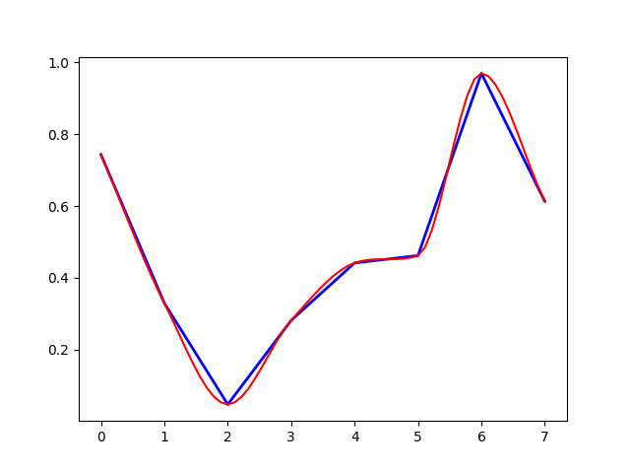
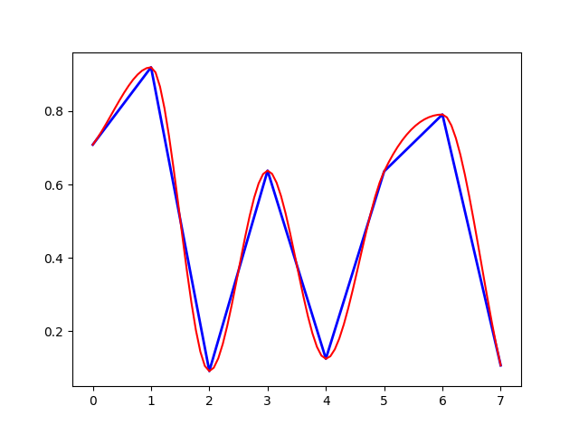
Monotone Cubic Interpolation Examples

Slide 18
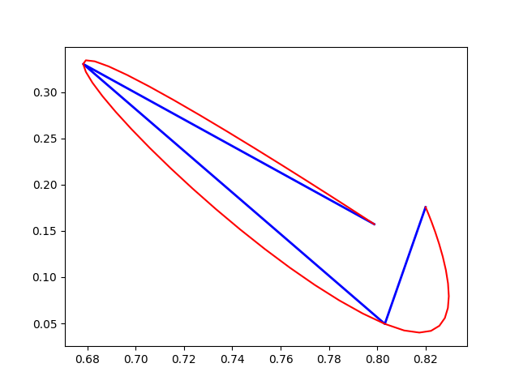
Interpolation: XY Cubic Hermite Interpolation
I used a modified Cubic Hermite Interpolation for the bow profiles
$Y_{n}=y_{k}h_{00}\left(t\right)+Δx_{k}h_{10}\left(t\right)+y_{k+1}h_{01}\left(t\right)+Δy_{k+1}h_{11}\left(t\right)$
$X_{n}=x_{k}h_{00}\left(t\right)+Δx_{k}h_{10}\left(t\right)+x_{k+1}h_{01}\left(t\right)+Δx_{k+1}h_{11}\left(t\right)$
Where,
$\begin{matrix}Δx_{k}=x_{k+1}−x_{k−1}, & Δy_{k}=y_{k+1}−y_{k−1}\end{matrix}$
Except,
$\begin{matrix}Δx_{0}=0, & Δy_{0}=0 \\ Δx_{K}=0, & Δy_{K}=0\end{matrix}$
Number of samples are assigned proportionaly

Slide 19
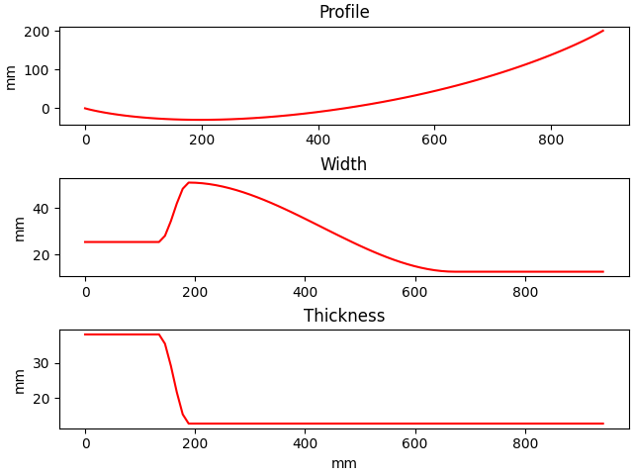
Interpolated Limb (76 elements)
After building the interpolated profile it is necessary to find the curved length:
$L_{limb}=\sum_{i}^{i−1}{\sqrt{{\left(x_{i+1}−x_{i}\right)}^{2}+{\left(y_{i+1}−y_{i}\right)}^{2}}}$
Observe that the width and thickness graphs can be longer because of this. They are projected along the curve.

Slide 20
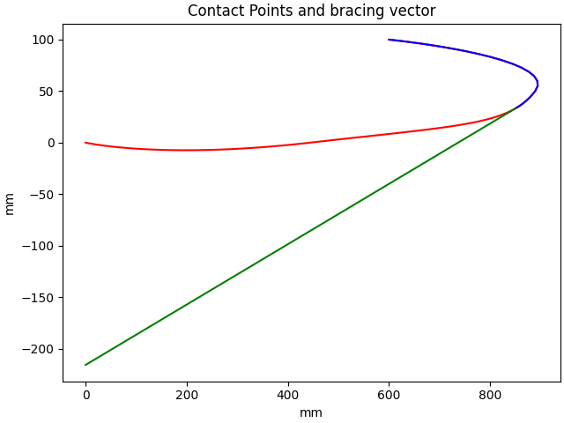
Finding the bracer
The last contact node is found by
$argmax\left(\left|cosΘ\right|\right)∨argmin\left(\left|sinΘ\right|\right)$
Where,
$\begin{matrix}cosΘ=\frac{dx}{\sqrt{{dx}^{2}+{dy}^{2}}}, & sinΘ=\frac{dy}{\sqrt{{dx}^{2}+{dy}^{2}}}\end{matrix}$
And,
$\begin{matrix}dx=x_{i}−x_{nock}, & dy=Y_{i}−y_{nock}\end{matrix}$

Slide 21
Solving – Newton-Raphson Attempt

Slide 22
VirtualBow
VB does not document it’s bracing algorithm, other than to say it use a constrained version of the Newton-Raphson method for all the steps.
$\begin{matrix}q\left(u\right)−λp=0 \\ c\left(u,λ\right)=0\end{matrix}$
Where %lambda is the load control parameter and c() are constraints.
The change in u for an iteration is described as:
$Δu_{i}=α+βΔλ_{i}$
Where,
$\begin{matrix}α=K_{i}^{−1}\left(λ_{i}p−q\left(u_{i}\right)\right), & β=K_{i}^{−1}p\end{matrix}$
And,
$Δλ_{i}=\frac{−c\left(u_{i},λ_{i}\right)+\frac{δc}{δu}\left(u_{i},λ_{i}\right)α}{\frac{δc}{δu}\left(u_{i},λ_{i}\right)β+\frac{δc}{δλ}\left(u_{i},λ_{i}\right)}$

Slide 23
VirtualBow – Displacement control
In displacement control,
Where, u^(k) is the kth displacement we want to control u bar is it’s value.
And then,
$c\left(u,λ\right)=u^{\left(k\right)}−\bar{u}$
$\begin{matrix}\frac{δc}{δu}=e_{k}, & \frac{δc}{δλ}=0\end{matrix}$
Where, e_k is the unit vector of the displacement we want to control
It’s not clear how this would work with multiply constraints, such as displace at the nock and fix at the handle, my guess is we could do this:
Where, u^k is a copy of u_i
And, ubar is a copy of u_i with the desired values inserted
And, deltac/deltau identifies which displacements are controlled
$c=\left[\begin{matrix}u_{0} \\ u_{0} \\ θ_{0} \\ u_{1} \\ ... \\ u_{N−1} \\ v_{N−1} \\ θ_{N−1}\end{matrix}\right]−\left[\begin{matrix}0 \\ 0 \\ 0 \\ u_{1} \\ ... \\ u_{N−1} \\ −1 \\ θ_{N−1}\end{matrix}\right]$
$\frac{δc}{δu}=\left[\begin{matrix}1 \\ 1 \\ 1 \\ 0 \\ ... \\ 0 \\ 1 \\ 0\end{matrix}\right]$

Slide 24
VirtualBow – Load control
In load control,
Where, lambda bar is the desired load.
And then,
$c\left(u,λ\right)=λ−\bar{λ}$
$c=\left[\begin{matrix}p_{u_{0}} \\ p_{u_{0}} \\ p_{θ_{0}} \\ ... \\ u_{N−1} \\ v_{N−1} \\ θ_{N−1}\end{matrix}\right]−\left[\begin{matrix}p_{u_{0}} \\ p_{u_{0}} \\ p_{θ_{0}} \\ 0 \\ ... \\ 0 \\ load \\ 0\end{matrix}\right]$
$\frac{δc}{δλ}=\left[\begin{matrix}0 \\ 0 \\ 0 \\ 1 \\ ... \\ 1 \\ 1 \\ 1\end{matrix}\right]$
$\begin{matrix}\frac{δc}{δu}=0, & \frac{δc}{δλ}=1\end{matrix}$
Again it’s not detailed how to actually implemented,
particularly for multiple constraint and their nodes.
But here is my guess (where lambda is a copy of p):
Lambda bar includes the desired control load, including 0’s everywhere else
Except for the controlled displacement node (ex: riser/handle)
deltac/deltalambda would be mostly 1’s except for the fixed displacement nodes

Slide 25
VB style displacement control attempt
With the control values and control indices, respectively:
Then define,
And return:
And to ensure we don’t get external forces except at out control nodes:
And return:
$\begin{matrix}u^{c}, & k^{c,u}\end{matrix}$
${\bar{u}}_{i,k}=\left\{\begin{aligned}\begin{matrix}u^{c}, & k∈k^{c,u} \\ u_{i}, & otherwise\end{matrix}\end{aligned}\right.$
$c_{i}^{u}\left(u,λ\right)=u_{i}−\bar{u_{i}}$
$\frac{δc}{δu}=\left\{\begin{matrix}1, & k∈k^{c,u} \\ 0, & otherwise\end{matrix}\right.$
${\bar{λ}}_{i,k}=\left\{\begin{aligned}\begin{matrix}λ_{i}, & k∈k^{c,u} \\ 0, & otherwise\end{matrix}\end{aligned}\right.$
$c_{i}^{p,u}\left(u,λ\right)=λ_{i}−\bar{λ_{i}}$
$\frac{δc_{i,k}}{δλ_{i,k}}=\left\{\begin{matrix}0, & k∈k^{c,u} \\ 1, & otherwise\end{matrix}\right.$

Slide 26
VB style displacement control attempt con’t
We don’t know p, in load control, but we figure they are exactly equal to the internal forces:
So alpha and beta become:
$α_{i}=u_{i}\left(λ_{i}−1\right)$
$β_{i}=u_{i}$
$Δλ_{i}=\frac{−c_{i}+\frac{δc_{i}}{δu_{i}}α_{i}}{\frac{δc_{i}}{δu_{i}}β_{i}+\frac{δc_{i}}{δλ_{i}}}$
Then calculate:
However, this leads to a big problem when our desired displacements are 0
We get a divide by 0.
delta u_i
[ nan nan nan 2.51299229e+01 2.86449484e+01 -2.92715284e+03 -1.02497344e-01 2.17727816e+00 -5.63382946e+02 -2.02704685e-02 -4.26749602e-01 -1.50390420e+02 9.07882696e-01 -5.20622299e+00 -2.26764524e+02 -1.23957008e+00 -1.30000000e+00 -1.54693233e+02]
At this point we will move forward with a different approach

Slide 27
Problem with Newton’s Method
If you look at newton’s method on Wikipedia:
We would expect a divide by zero when the gradient is is zero.
Moving on to gradient descent.
$x_{n+1}=x_{n}−\frac{f\left(x_{n}\right)}{f'\left(x_{n}\right)}$

Slide 28
Solving – Gradient Descent

Slide 29
Gradient Descent
Gradient descent has the form:
Where %eta is the learning rate and f() is usually some error function to be minimized.
It only solves convex problems, but we are iteratively linearizing our problem anyway.
$x_{n+1}=x_{n}−η_{i}∇f\left(x_{n}\right)$

Slide 30
GD Displacement Control - Displacement
Let’s define our constraints using the half mean squared error function:
This gives us a nice partial derivative with respect to x:
For displacement this gives us:
In order to not control unknown u we use: where u^c are the control values
Which means that ubar is equal u, except where it’s indices are in the controlled list:
Note that the the control values and control list have fewer entries that the u vector:
In practice, this is easier to implement than the math indicates.
for c, n in enumerate(u_ctrl_i):
ubar_i[n] = ctrl_uval_i[c]
$f\left(x\right)=\frac{1}{2N}\sum_{0}^{N−1}{{\left(x−\bar{x}\right)}^{2}}$
$\begin{matrix}\frac{∂f}{∂x}=\frac{1}{N}\sum_{0}^{N−1}{x_{n}−\bar{x_{n}}}, & \frac{∂f}{∂x}=\frac{x−\bar{x}}{N}\end{matrix}$
$\frac{∂f^{\bar{u_{i}}}}{∂u_{i}}=\frac{u_{i}−\bar{u_{i}}}{N}$
${\bar{u}}_{i,n}=\left\{\begin{aligned}\begin{matrix}u_{i,c}^{c} & n∈c_{i}^{u} \\ u_{i,n}, & otherwise\end{matrix}\end{aligned}\right.$
$c_{i}^{u}$
$\begin{matrix}u_{i}^{c}∈ℝ^{C}, & c_{i}^{u}∈ℕ^{C}, & \bar{u_{i}},\bar{u_{i}}∈ℝ^{N}, & C≤N=M\end{matrix}$

Slide 31
GD Displacement Control - Load
In displacement control p=q(u), load is free at the displacement controlled nodes:
Using: where,
But we need the error with respect to u. For a static simulation with no other loads,
And using the chain rule:
$\frac{∂f^{\bar{p_{i}}}}{∂p_{i}}=\frac{p_{i}−\bar{p_{i}}}{M}$
${\bar{p}}_{i,m}=\left\{\begin{aligned}\begin{matrix}p_{i,m} & m∈c_{i}^{u} \\ 0, & otherwise\end{matrix}\end{aligned}\right.$
pbar = np.zeros(p_i.size) for c in u_ctrl_i: pbar[c] = p_i[c]
$\frac{∂p_{i}}{∂u_{i}}={\left[K_{i}\right]}^{T}$
$\frac{∂f^{\bar{p_{i}}}}{∂u_{i}}=\frac{∂p_{i}}{∂u_{i}}\frac{∂f^{\bar{p_{i}}}}{∂p_{i}}={\left[K_{i}\right]}^{T}\frac{p_{i}−\bar{p_{i}}}{M}$

Slide 32
Load control iterative implementation

Slide 33
Implementation – Load Control
With the assumption that load always increases we can iterate load to control displacement
This is actually necessary for bracing. The bracing algorithm is as follows
While not braced
Transform K’ list from local to new global using limb profile
Assemble global K
Calculate bracing direction
While u_i is small
Increment |p| from 0
Using bracing vector
Select sub K for know p
Solve for sub u_i and assemble u_i
Update limb profile
Calculate p_i
Sum p for use later
Return new limb profile and p
This implementation makes sure we don’t make large changes in u_i

Slide 34
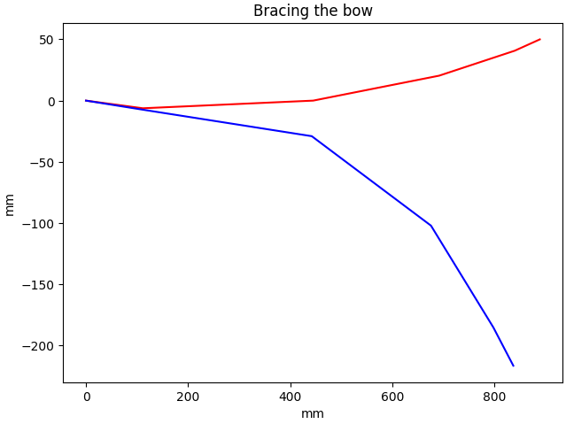
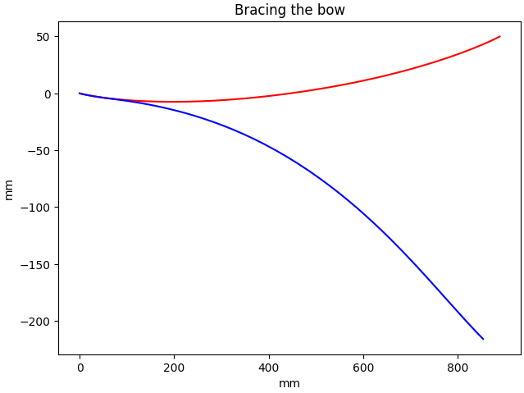
Example Bracing – Low and High Mesh Resolution

