Slide 1
Turbo Python Performance To Achieve 100x Faster
Turbo Python Performance To Achieve 100x Faster
June 2023
Challenges and Perceptions:
-Python GIL design is slow
-Python is a slow at runtime
-Python performance is slower comparing to c++ and java
Can it be improved?
-Let’s find it out

Slide 2
Techniques used in this performance testing
-Step up and use built-in functions
-Use vectorization
-Use math functions
-Use multi-processing, concurrency
-Memoization and caching
-Use different language at server backend
-Engineering thoughts
Note:
Often many things can impact python runtime performance
From hardware, cpu, memory, latency in addition to code
Ideas presented here focus on python source code only

Slide 3
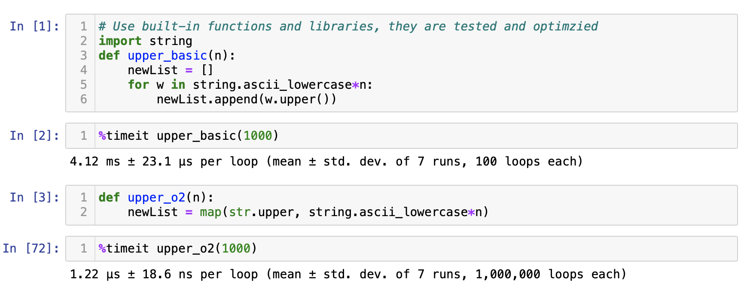
60% better when using map() which does elementwise operation

Slide 4
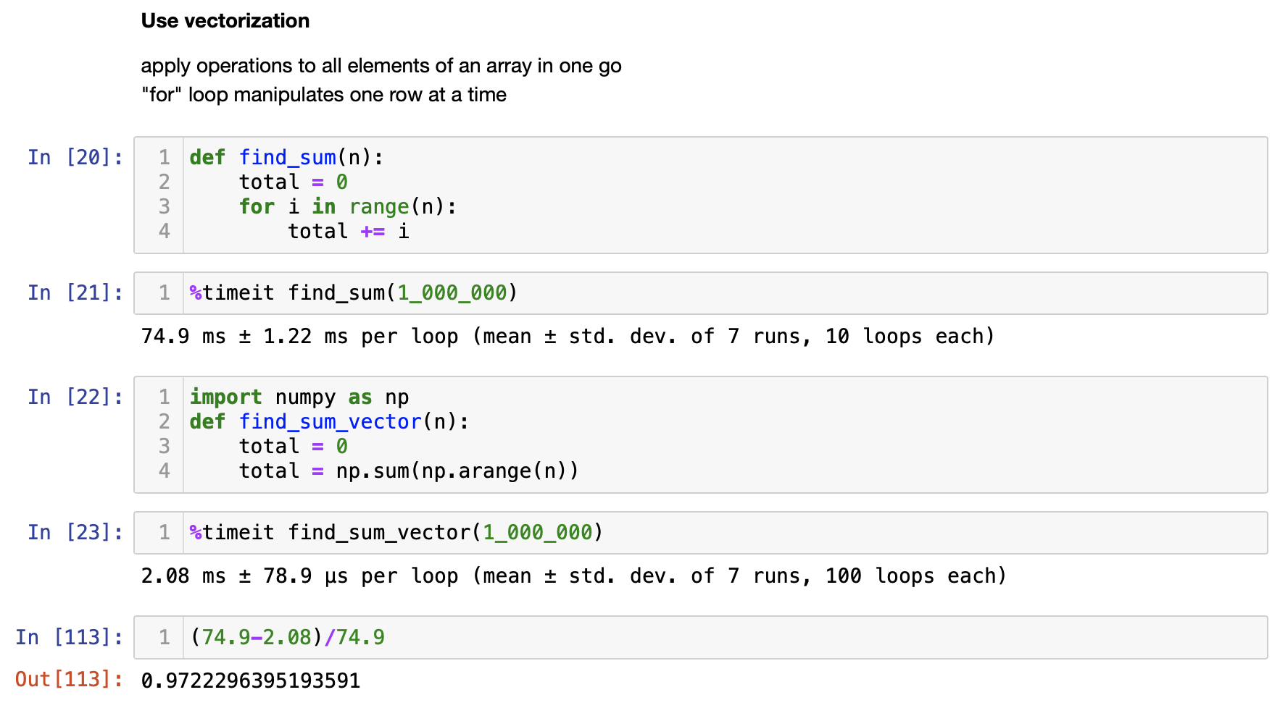
97% better when using vectorization in numpy

Slide 5
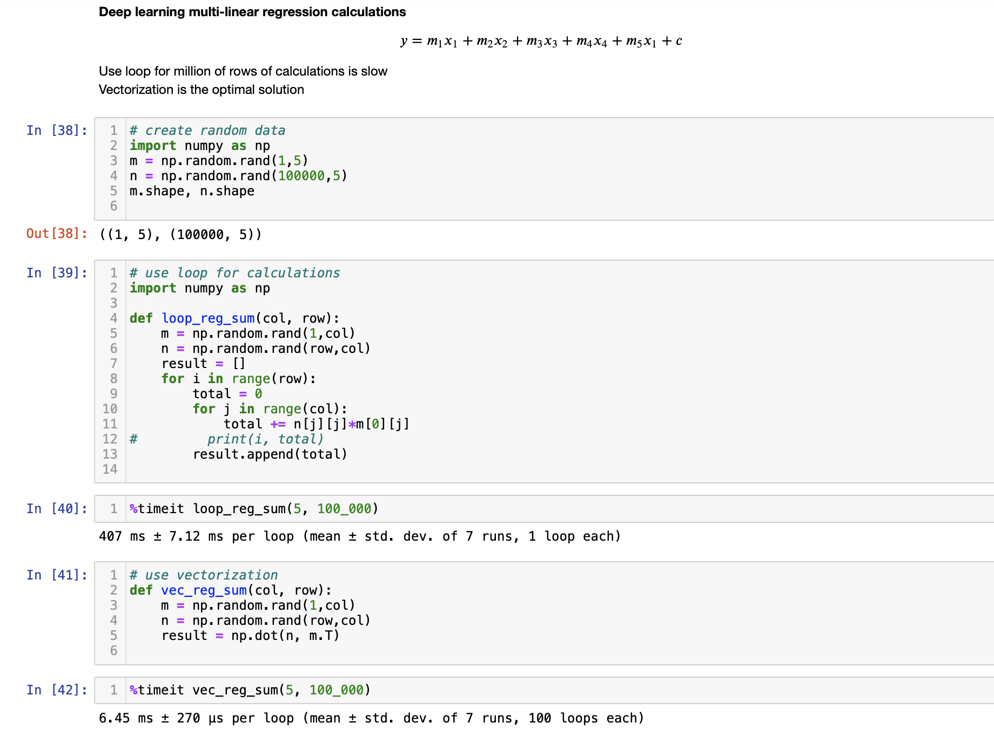
407 vs 6.45 Regression using python loop and numpy vectorization

Slide 6
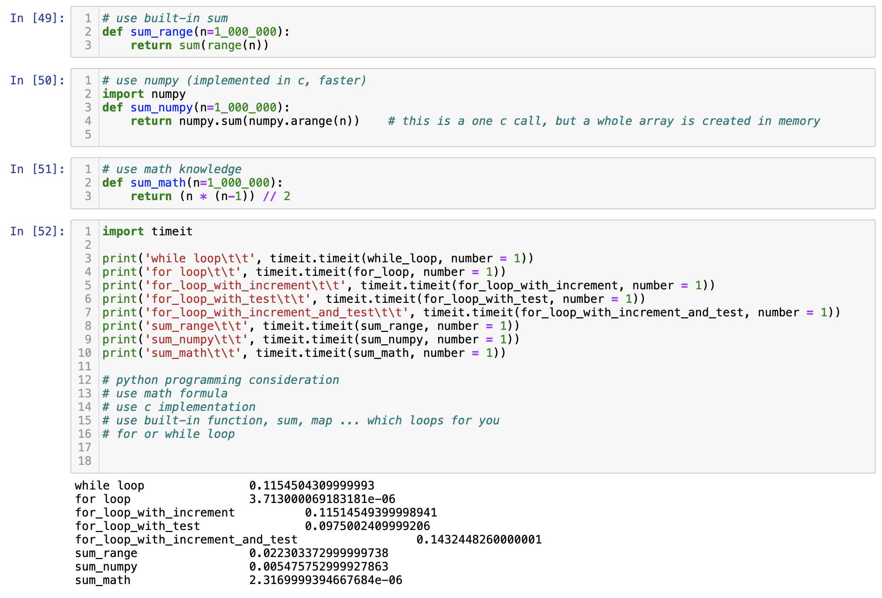
Different loops and their performances

Slide 7
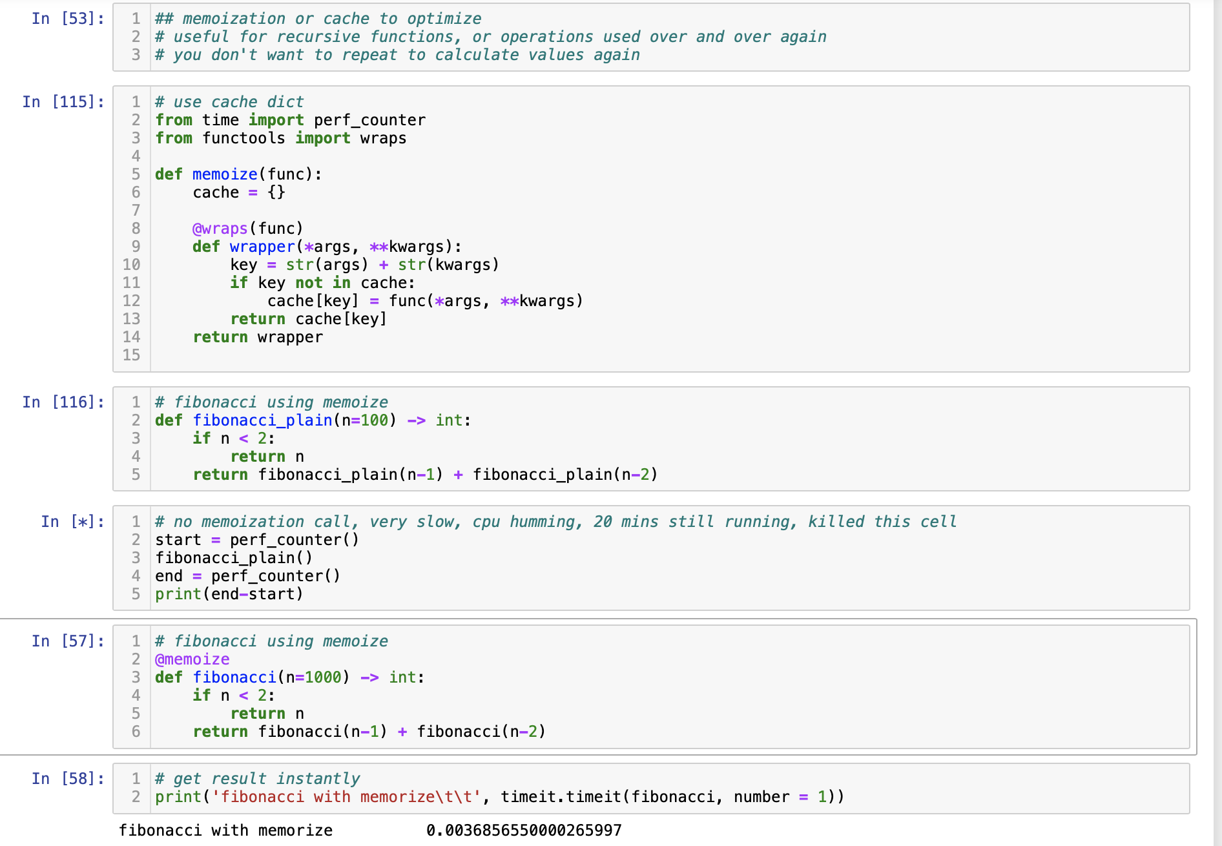
Memoization and caching reducing intermediate operations

Slide 8
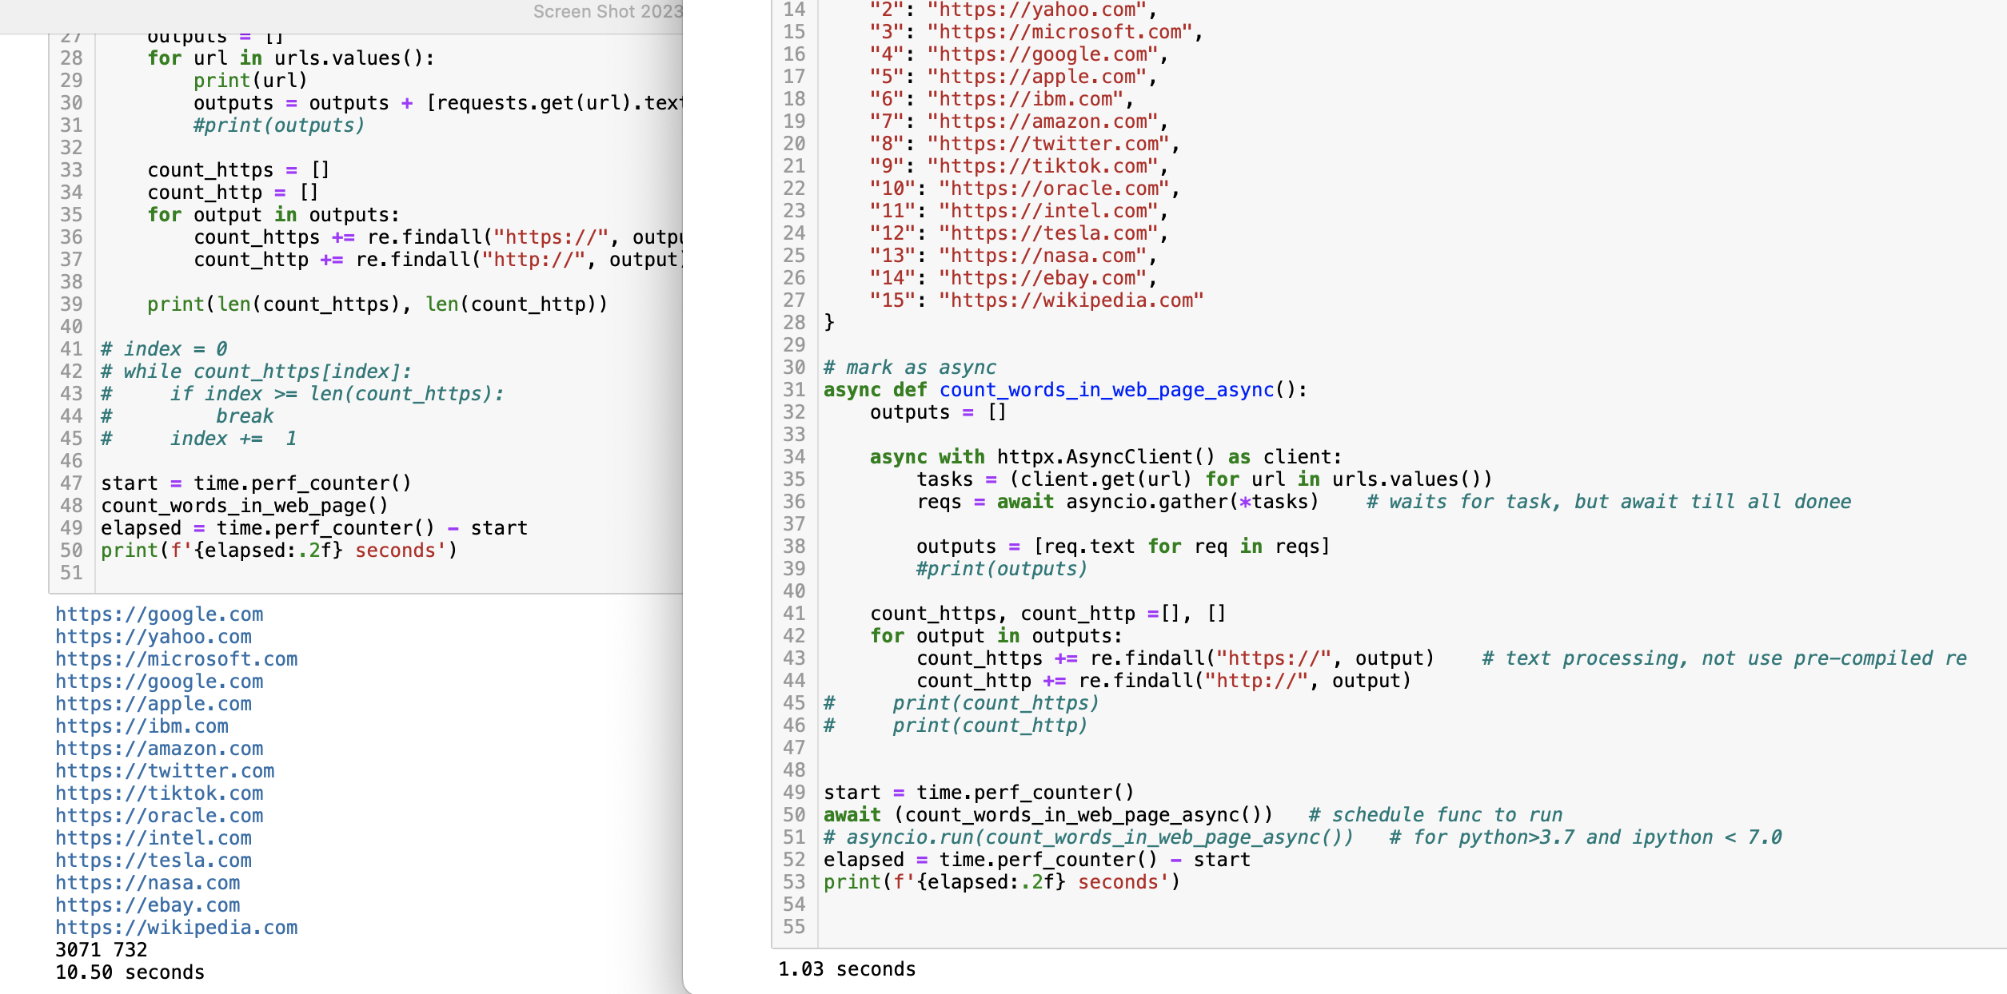
10.50 vs 1.03 - Use async for web text scraping

Slide 9
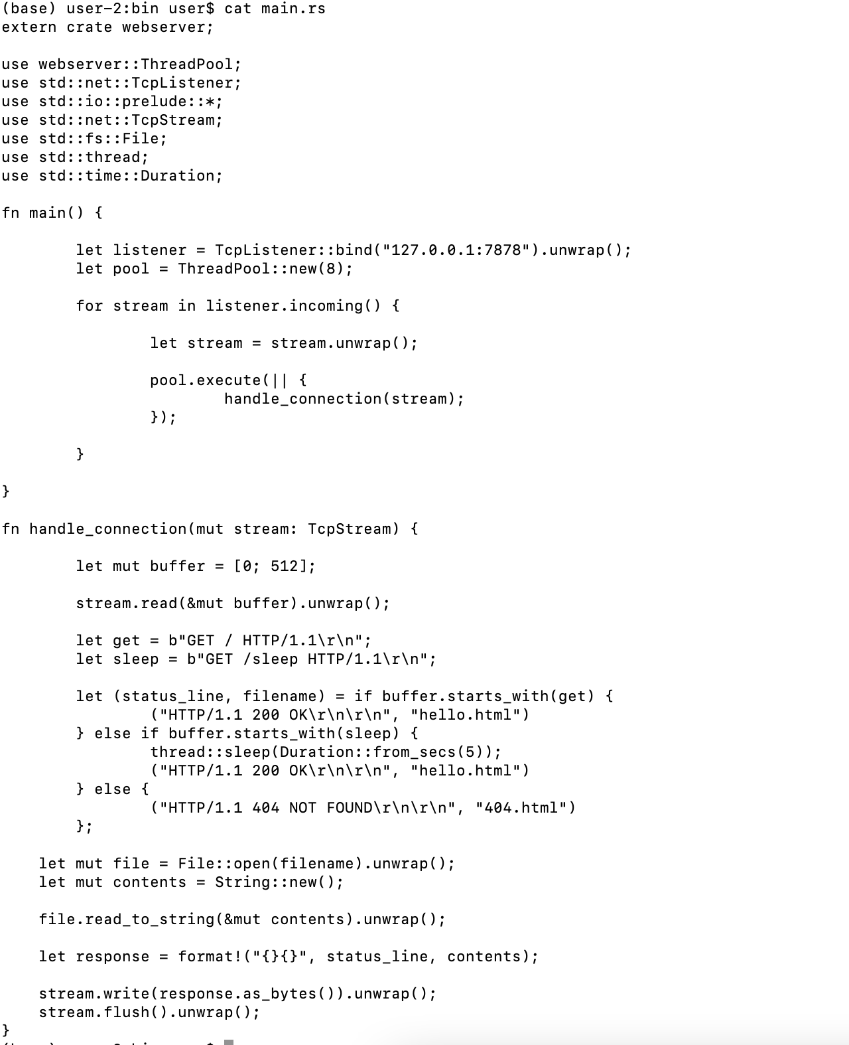
Rust multi thread server

Slide 10
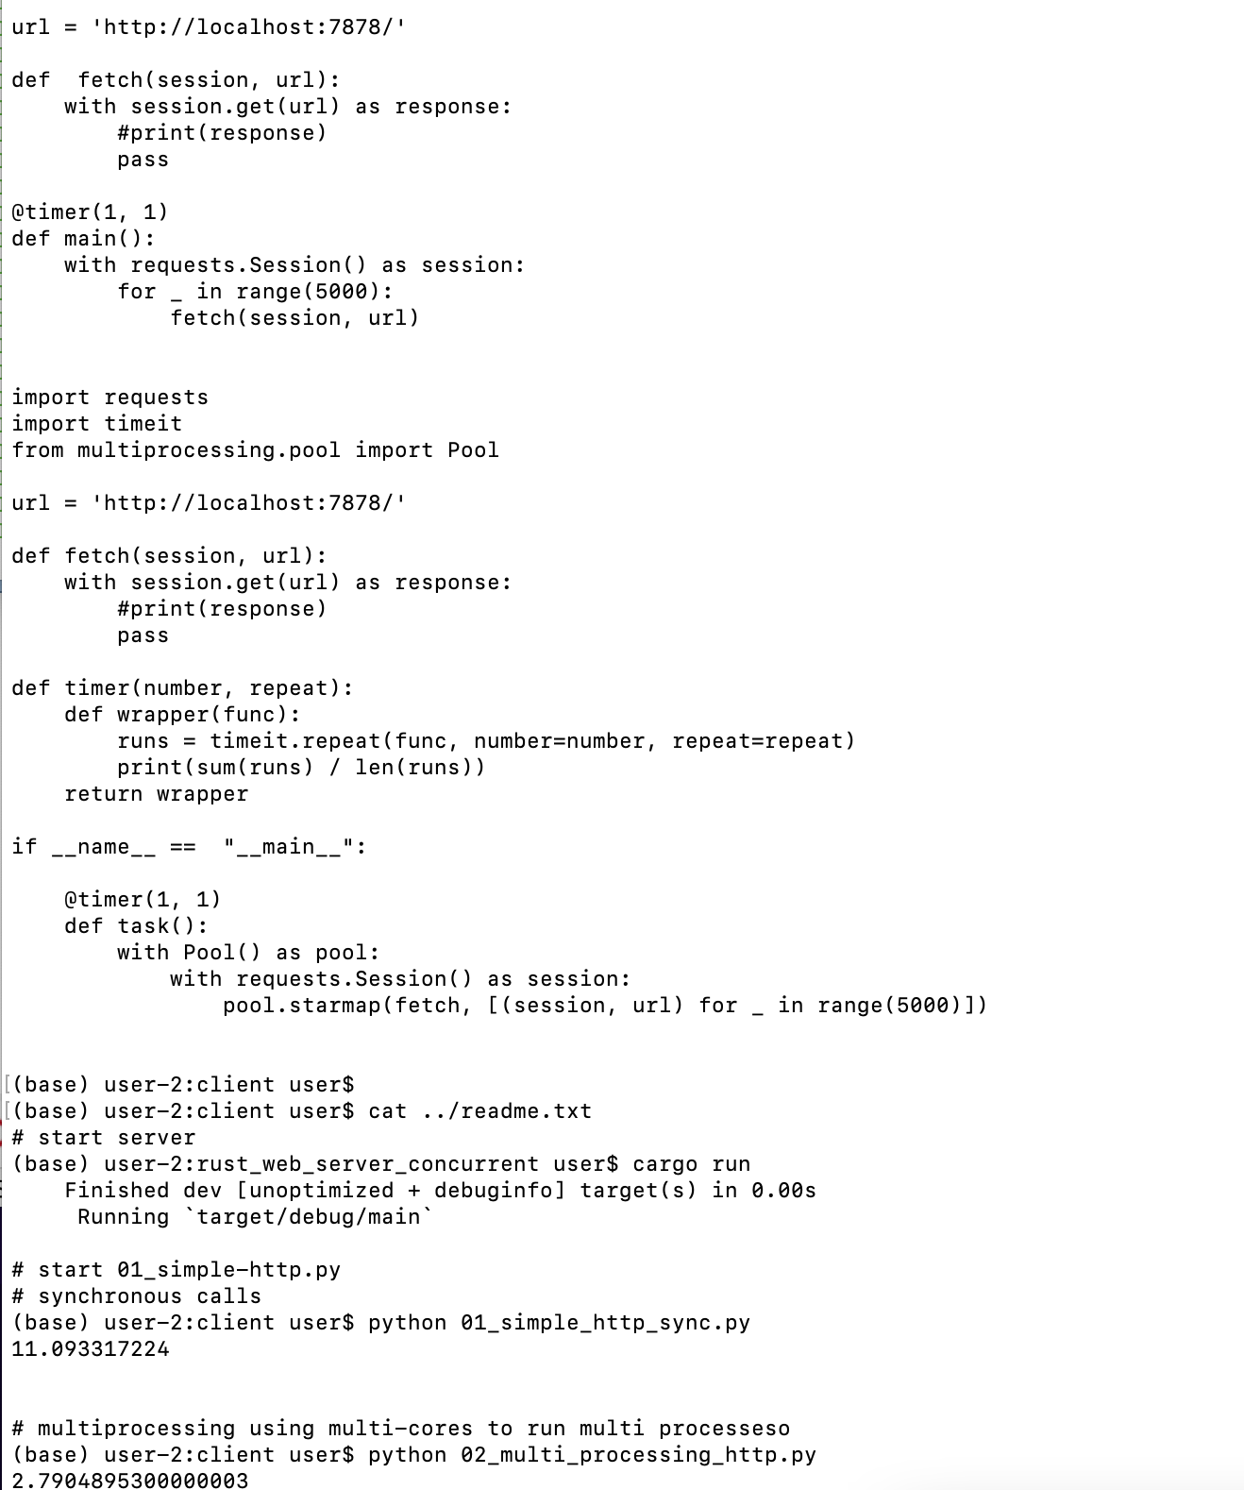
Python web api call

Slide 11
Python web api call

Slide 12
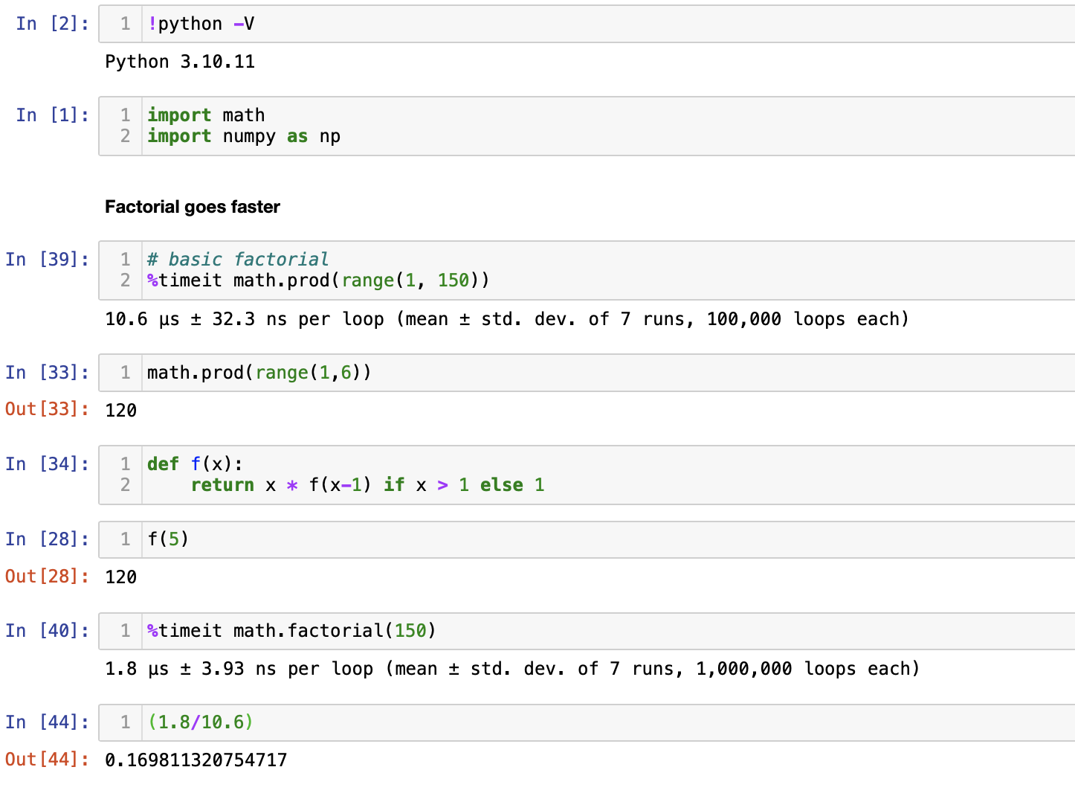
Use new versions

Slide 13
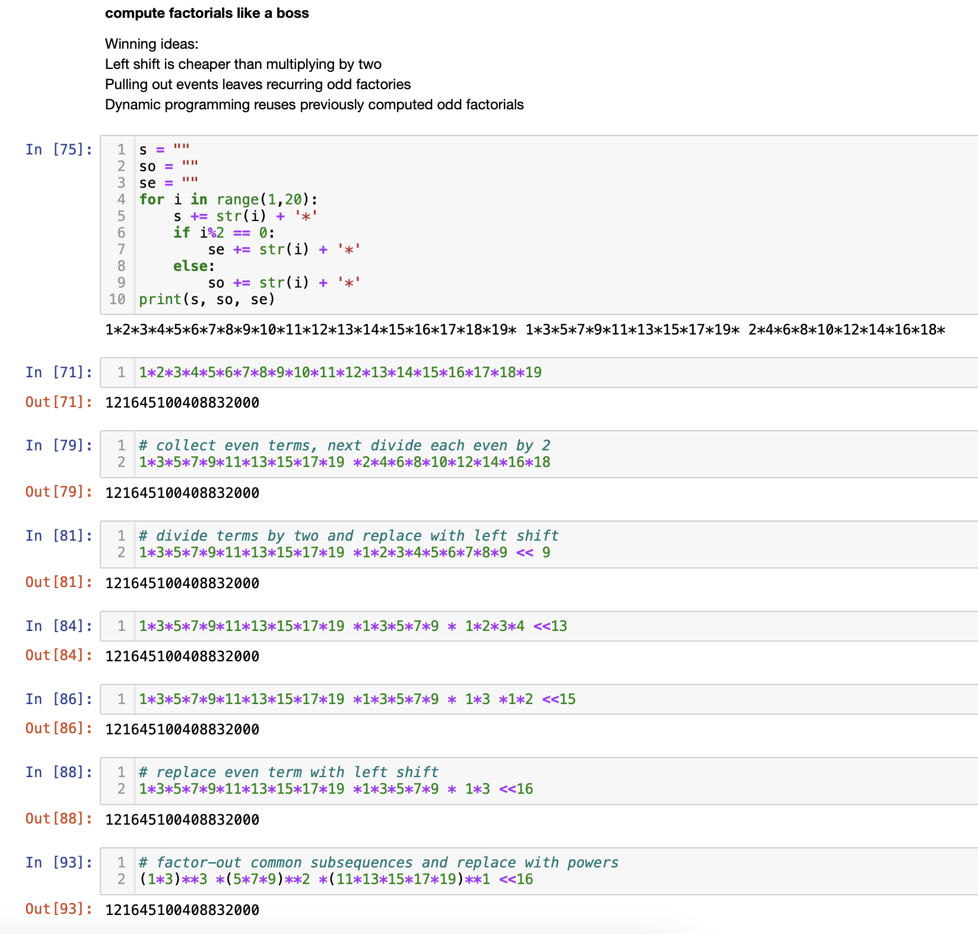
How python 3 implement factorial() performance

Slide 14
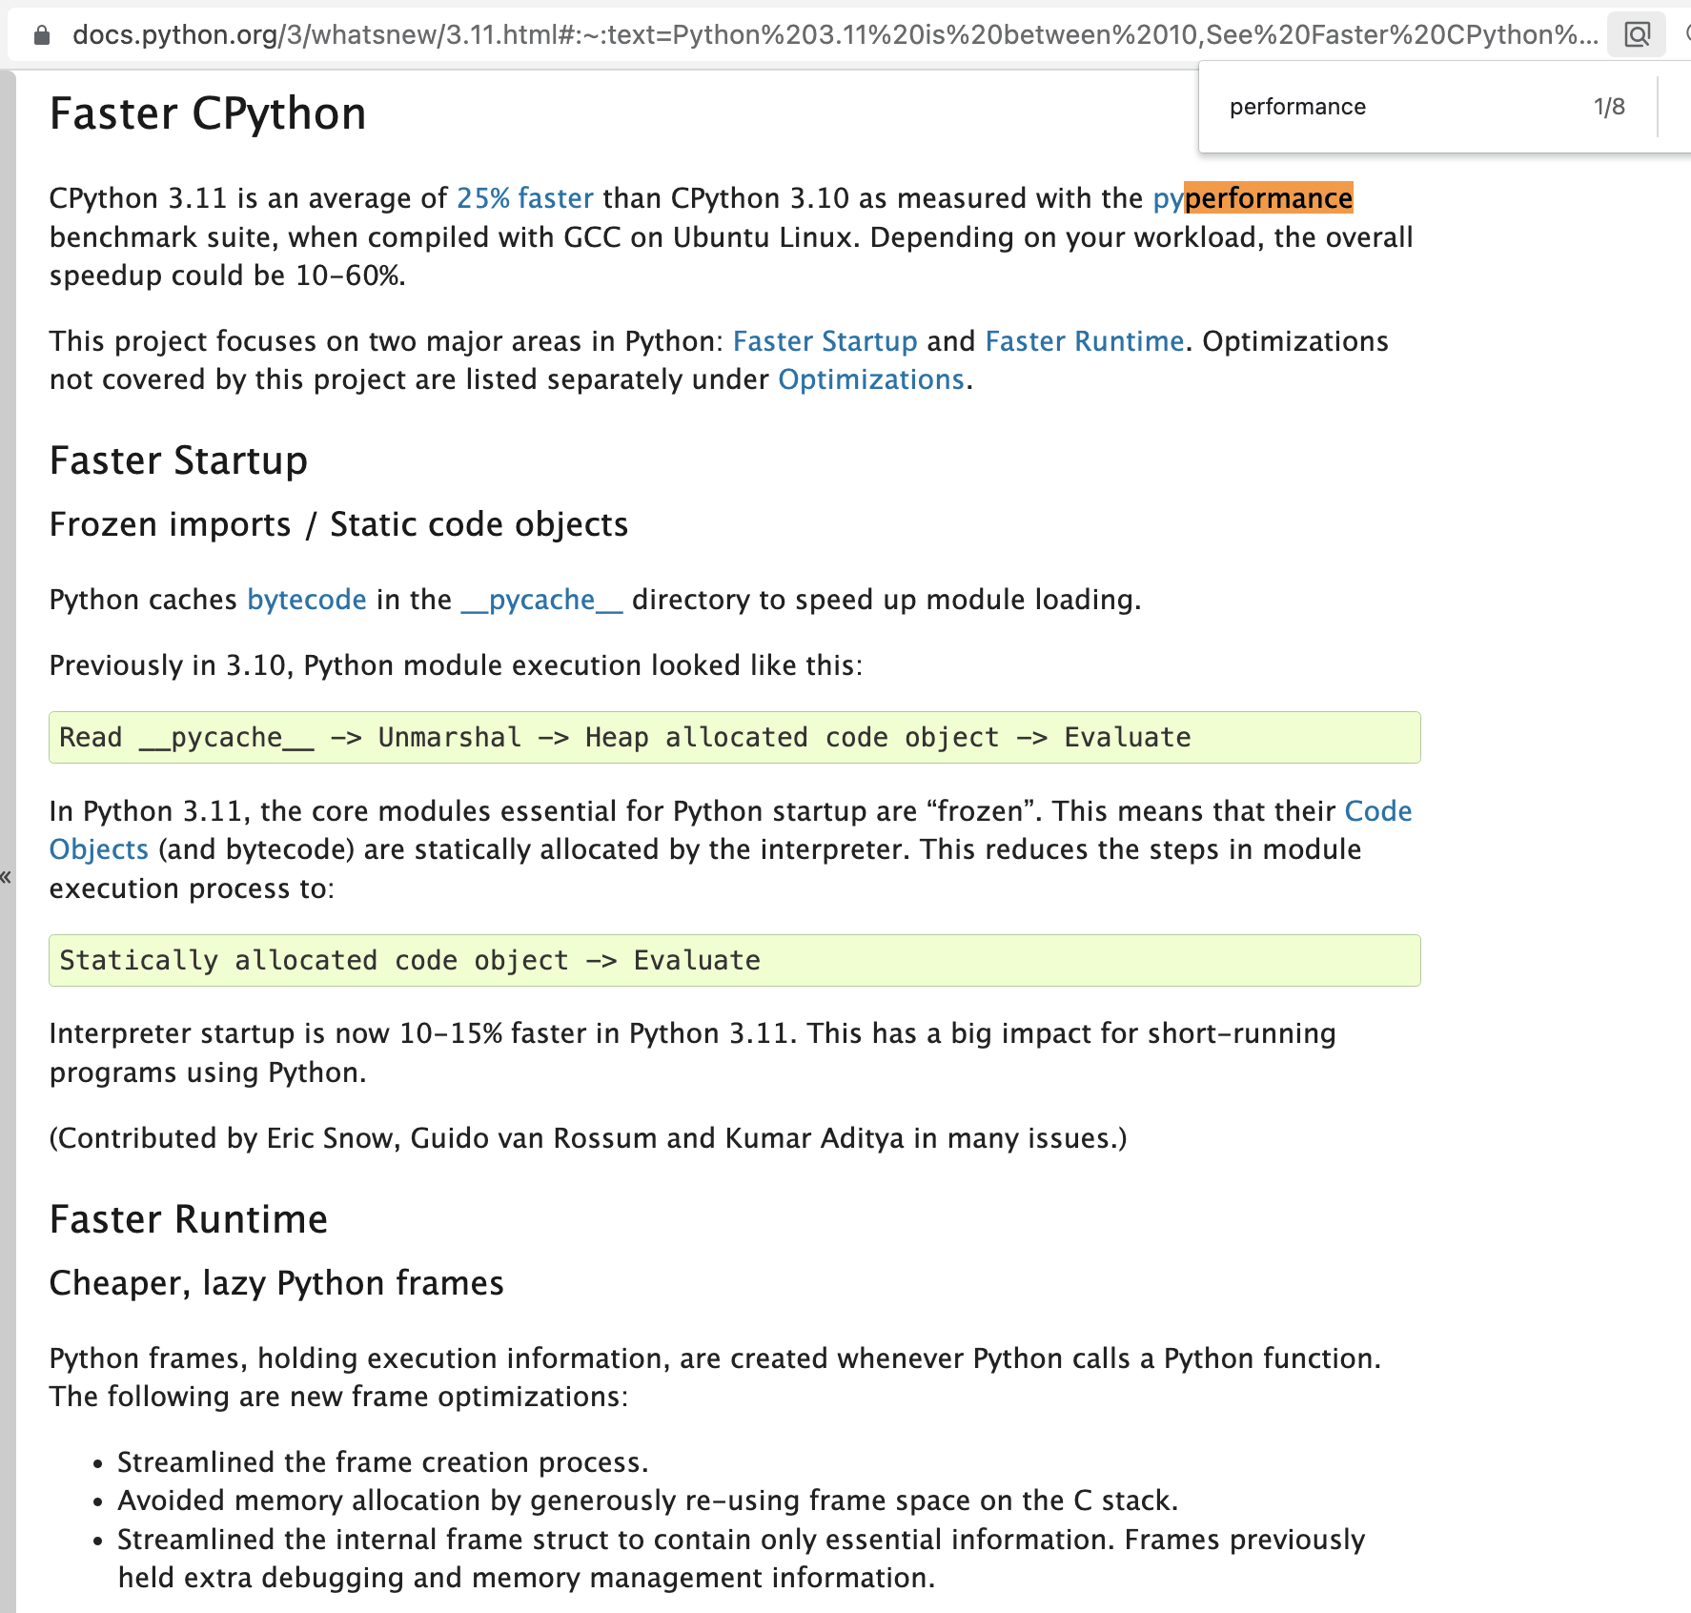
Faster python 3.11

Slide 15
Conclusions
-Python is NOT the programming language to solve all problems
-BUT Python is a popular language for many use cases
-Performance can be improved
-Python is improving, by itself and community
-In the era of ML/AI, no doubt python will become popular
-To learn, experiment, build quickly MVP in less time
Q & A

