Slide 1
Rotation Group

Slide 2






Metric Preserving
A metric is used to measure the distance in a space.
  Euclidean space is delta
An orthogonal transformation preserves the metric.
  Inverse is transpose
  Determinant squared is 1
The special orthogonal transformation has determinant of +1.
x₃
x₂
x₁

Slide 3

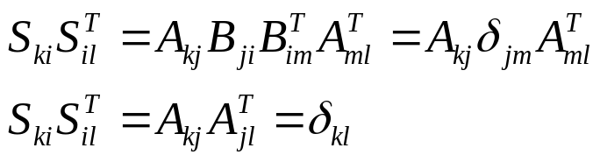
Special Orthogonal Group
Group definitions: A, B ∈ G
  Closure: AB ∈ G
  Associative: A(BC) = (AB)C
  Identity: 1A = A1 = A
  Inverse: A⁻¹ = AA⁻¹ = 1
Rotation matrices form a group.
  Inverse is the transpose
  Identity is δ or I
  Associativity from matrix multiplication
  Closure from orthogonality
For three dimensional rotations the group is SO(3,R).

Slide 4
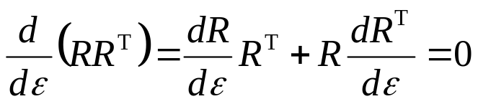
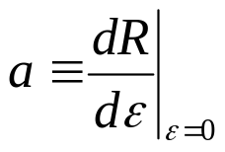

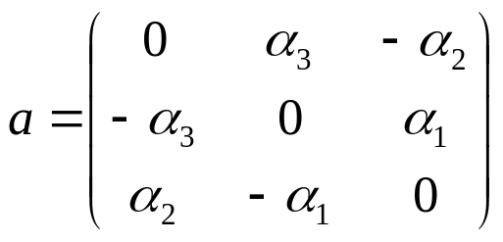
SO(3) Algebra
The Lie algebra comes from a parameterized curve.
  R(ε) ∈ SO(3,R)
  R(0) = I
The elements a must be antisymmetric.
  Three free parameters in general form

Slide 5
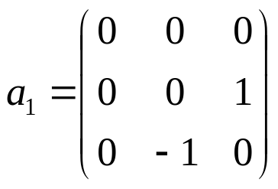
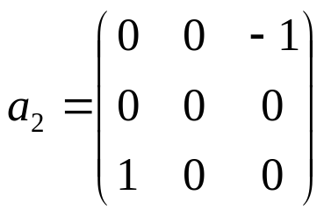

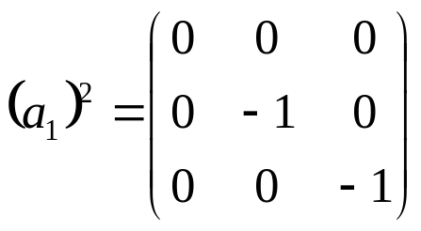

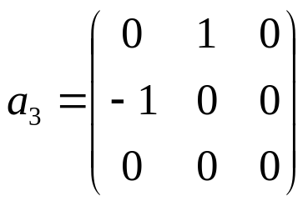

Algebra Basis
The elements can be written in general form.
  Use three parameters as coordinates
  Basis of three matrices

Slide 6
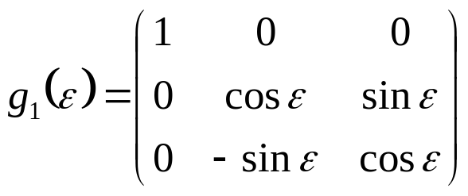

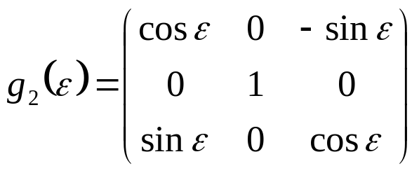

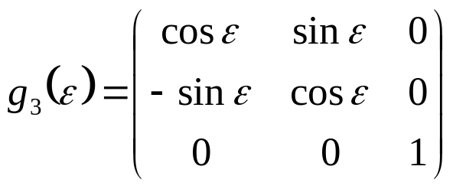
Subgroups
The one-parameter subgroups can be found through exponentiation.
These are rotations about the coordinate axes.

Slide 7

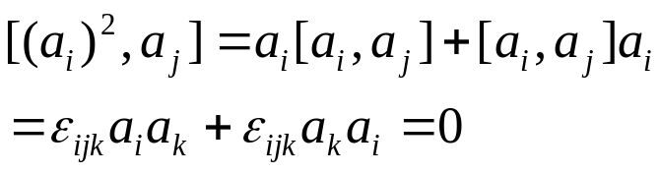
Commutator
The structure of a Lie algebra is found through the commutator.
  Basis elements squared commute
This will be true in any other representation of the Lie group.

Slide 8

Special Unitary
If a space is complex-valued metric preservation requires Hermitian matrices
  Inverse is complex conjugate
  Determinant squared is 1
The special unitary transformation has determinant of +1.
SU(2) has dimension 3
x₃
x₂
x₁

Slide 9
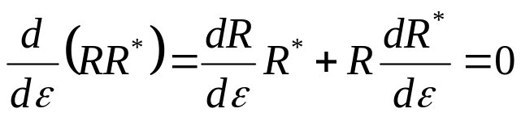

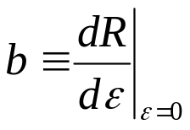
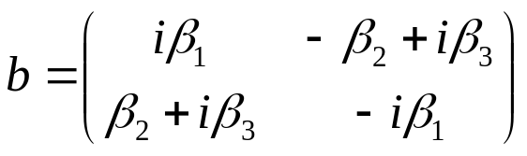

SU(2) Algebra
The Lie algebra follows as it did in SO(3,R).
The elements b must be Hermitian.
  Three free parameters in general form
The basis elements commute as with SO(3).

Slide 10
Homomorphism
The SU(2) and SO(3) groups have the same algebra.
  Isomorphic Lie algebras
The groups themselves are not isomorphic.
  2 to 1 homomorphism
SU(2) is simply connected and is the universal covering group for the Lie algebra.
next

