Slide 1
Pivot Table

Slide 2
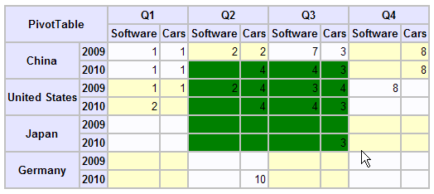
What’s pivot table
A pivot table is a data summarization tool found in data visualization programs such as spreadsheets (for example, in Microsoft Excel, OpenOffice.org Calc and Lotus 1-2-3) or business intelligence software.
Pivot tables can be seen as a simplification of the more complete and complex OLAP concepts.

Slide 3
A Pivot Table on Javascript
Based on http://www.gumption.org/2004/pivot_table/ since it is independent, simple, clear and easy to understand.
PivotTable.js:
To create and display the pivot table, based on the html table, in a div.
PivotTableData.js:
The data structure used by pivot table, include row axes, column axes, the measurer and the original data list.
PivotTableAggregator.js:
Define some aggregator used to get the values of pivot table item. Include, Count aggregator, NumberSumAggregator, NumberMaxAggregator……
PivotTablePlugin.js:
Plugins on pivot table used to add additional features on the pivot table. Now includes, SelectionPlugin used to select multi cells in the pivot table by [shift/ctrl] + [left click]……
PivotTableUtil.js:
Some common apis used to deal with id, arrray.

Slide 4
A Pivot Table on Javascript
Usage:
1. Get the data set:
var data1 = [
{country: "China", year: "2009", field:"Software", quarter: "Q1", value: "1"},
{country: "China", year: "2009", field:"Cars", quarter: "Q1", value: "1"},
……
]
2. Create a measurer:
var aggregator = new NumberSumAggregator();
var measurer = new Measurer('value', 'value', aggregator);
3. Create row axes:
var rowAxes = new Array();
rowAxes.push(new Axis("country", "country"));
rowAxes.push(new Axis("year", "year"));
4. Create column axes:
var columnAxes = new Array();
columnAxes.push(new Axis("quarter", "quarter"));
columnAxes.push(new Axis("field", "field"));

Slide 5
A Pivot Table on Javascript
Usage:
5. Create data structure
var dataVector = new DataVector(data1, columnAxes, rowAxes, measurer);
6. Create pivot table
var pivotTable = new PivotTable("tableOne", dataVector);
7. Analyze the data and display the pivot table
dataVector.updateData();
pivotTable.display();
8. Add plugin if needed
var selectionPlugin = new SelectionPlugin(pivotTable);

