Slide 1


A Project Seminar on “Basic Gates Simulations using Conway’s Game of Life”
A Project Seminar on “Basic Gates Simulations using Conway’s Game of Life”
Yash Vora, 1RN16CS123
Sagnik Das, 1RN16CS086
Department of Computer Science and Engineering
RNS Institute of Technology
Department of Computer Science and Engineering
RNS Institute of Technology
Dept. of CSE, RNSIT
1

Slide 2
Contents
Introduction
Cellular Automaton
Turing Machine
Automata Theory
Fundamental Rules
Special Life Forms
Implementing Logic Gates
Actual Gates

Slide 3
Introduction
Game of Life was invented in 1970 by John Horton Conway. It is one of the best-known example of Cellular automaton.
cellular automaton
Noun
Each of a set of units in a mathematical model which have simple rules governing their replication and destruction, used to model complex systems composed of simple units such as living things or parallel processors.

Slide 4
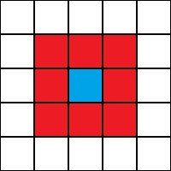
Cellular Automaton
A cellular automaton consists of a regular grid of cells, each in one of a finite number of states, such as on and off. The grid can be in any finite number of dimensions. For each cell, a set of cells called its neighborhood is defined relative to the specified cell.
neighbour
cell

Slide 5
Turing Machine
A Turing machine is a theoretical computing machine invented by Alan Turing to serve as an idealised model for mathematical calculation. Despite its simplicity, it can simulate any computer algorithm, no matter how complicated it might be.
It is a type of Finite State Machine. At any point of time, the machine is in any one of the finite states.

Slide 6
Automata Theory
Turing Machine
Pushdown automaton
Finite-state machine
Combinational logic

Slide 7
Fundamental Rules
The following rules govern the implementation of Game of Life.

Slide 8
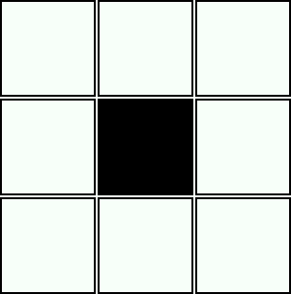

Any live cell with fewer than two live neighbors dies, as if caused by underpopulation.

Slide 9
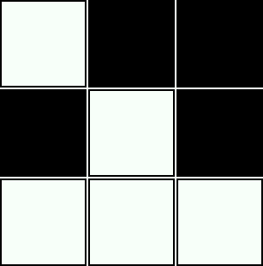

Any live cell with more than three live neighbors dies, as if by overcrowding.

Slide 10
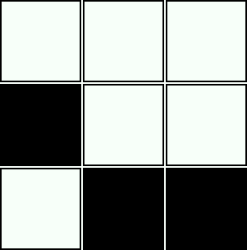
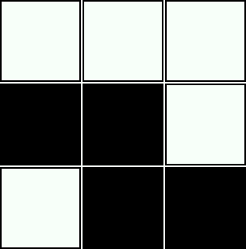
Any live cell with two or three live neighbors lives on to the next generation.

Slide 11
Special Life Forms

Slide 12




Still Life
These are stable patterns that do not change and can be used to build critical solid parts of complex patterns. These patterns stay in one state which enables them to store information or act as solid bumpers to stop other patterns or keep other unstable patterns stable.
Beehive
Block
Loaf
Boat

Slide 13
Oscillators
These patterns are more complex and change over a specific number of ticks. They repeat their pattern infinitely. These oscillators are very useful for setting off other reactions of bumping stable patterns to set off a chain reaction of instability.
Blinker
Beacon
Toad
Boat

Slide 14
Gliders and Spaceships
A spaceship is a pattern that moves, returning to the same configuration but shifted after a finite number of generations. The glider is an example of a simple spaceship and its generations each consist of five live cells.

Slide 15
Guns
Guns are repeating patterns which produce a spaceship after a finite number of generations. The simplest gun, called the Gosper glider gun, produces a glider every 30 generations.

Slide 16
Implementing logic gates
A logical gate is some kind of "black box" which is able to process two Boolean variables, inputs according to a specified Boolean operator.

Slide 17
Inputs
Electrical pulses to represent inputs in form of continuous streams.
We used a Gosper Glider Gun to generate gliders constantly. The stream of gliders represent an input line which is in ON state.

Slide 18
Processing devices
A “device” is required to compute the Boolean result of the operation pertaining to the rules of the automaton.
We used a constant eater pattern which would activate a particular cell if stimulated with an input stream of a Glider.

Slide 19
Actual gates
Final implementation of logic gates

Slide 20
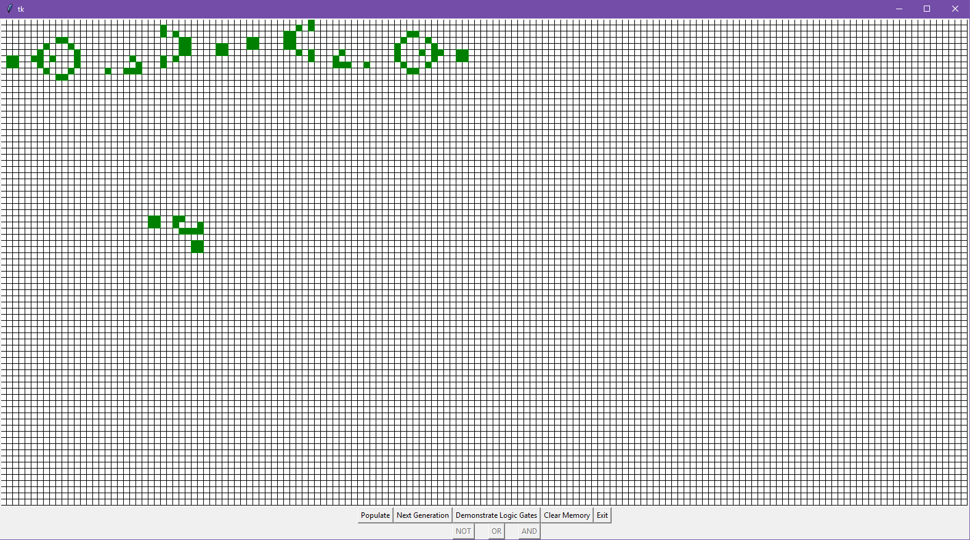
NOT
A
Y

Slide 21
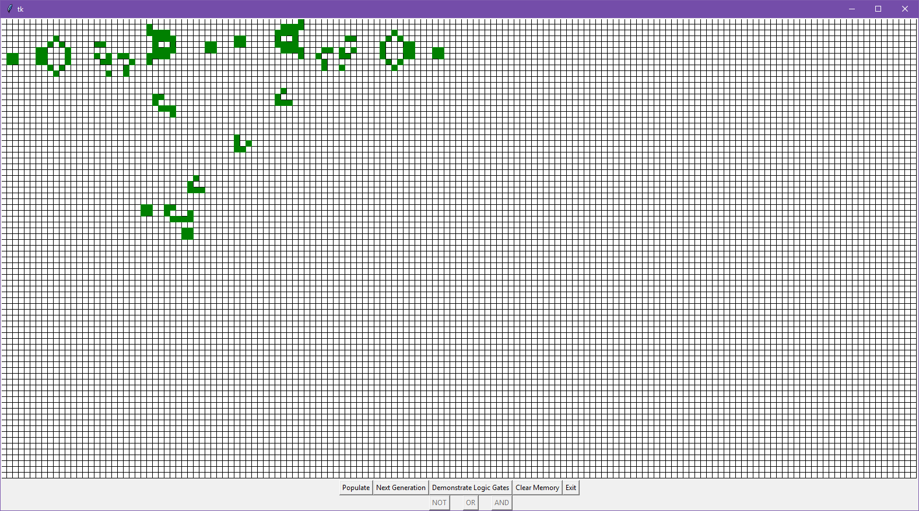
NOT (A = 0, Y = 1)
A
A
Y

Slide 22
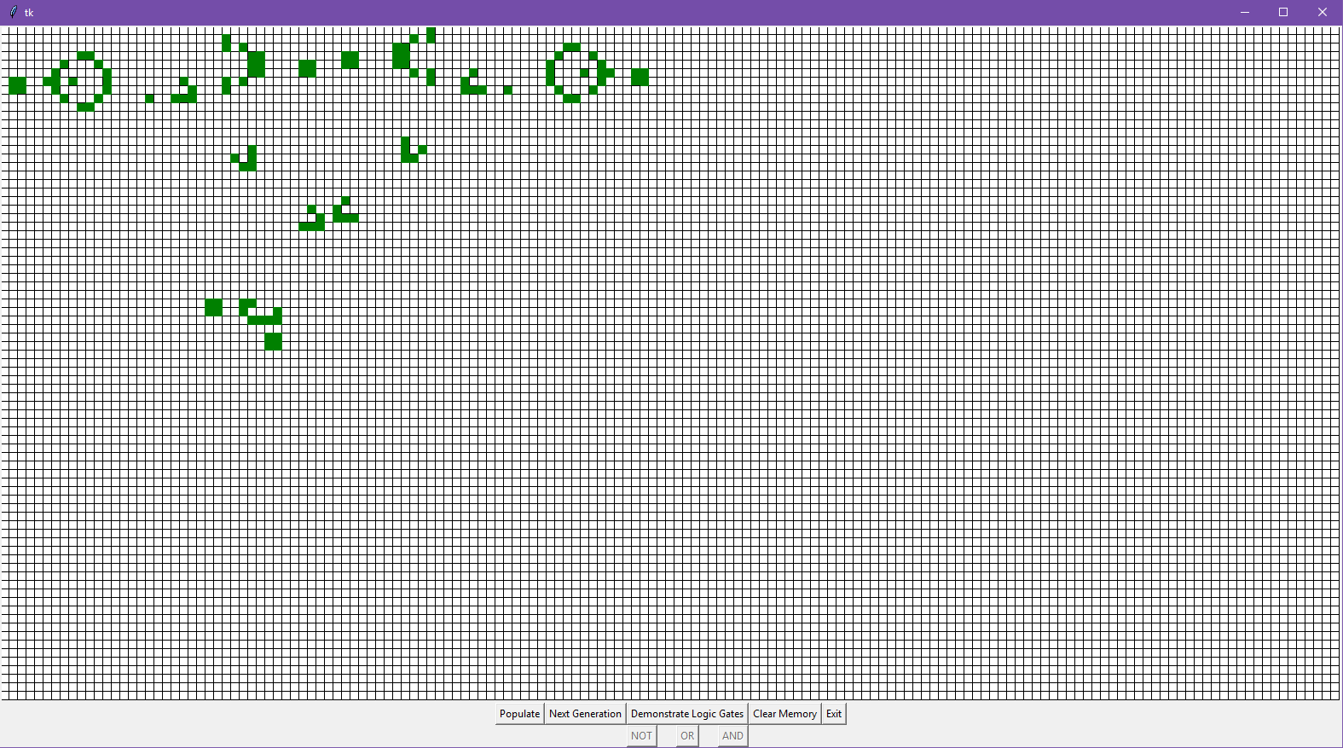
NOT (A = 1, Y = 0)
A
Y

Slide 23
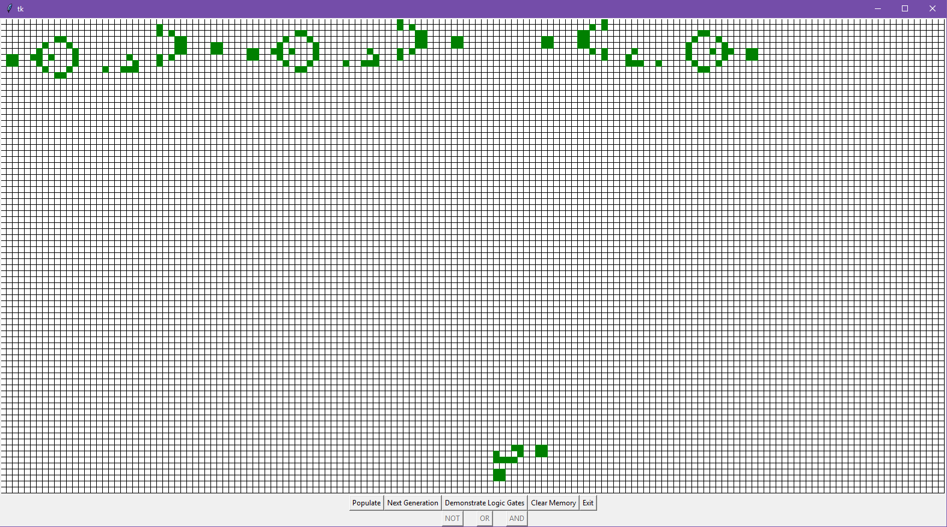
AND
A
B
Y

Slide 24
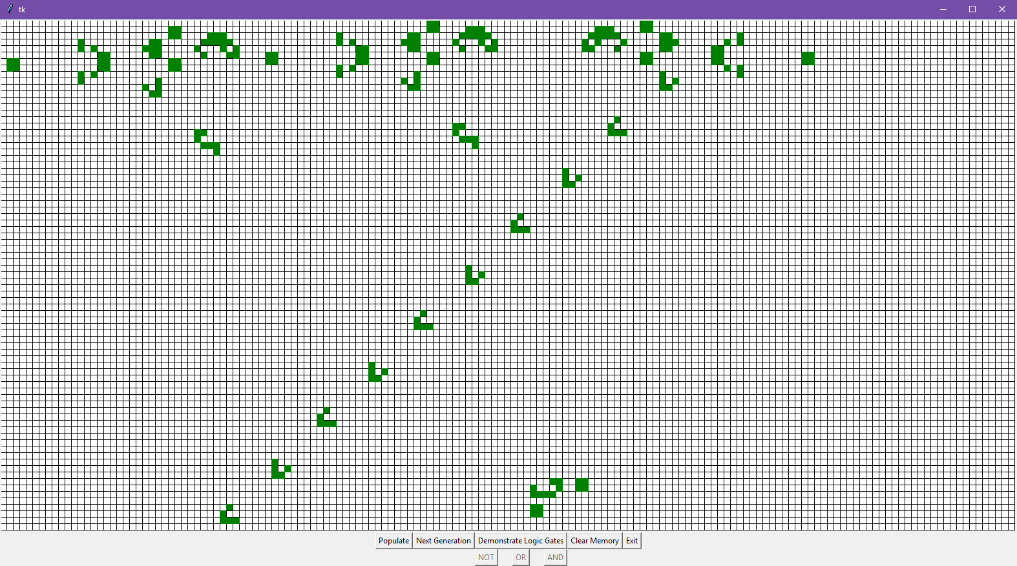
AND (A = 0, B = 0, Y = 0)
A
B
Y

Slide 25
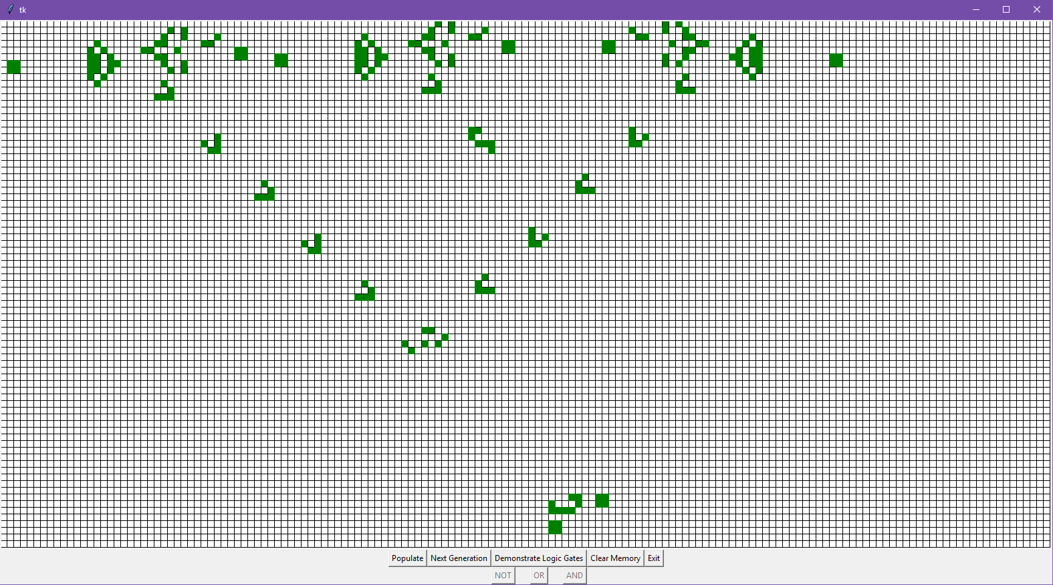
AND (A = 1, B = 0, Y = 0)
A
B
Y

Slide 26
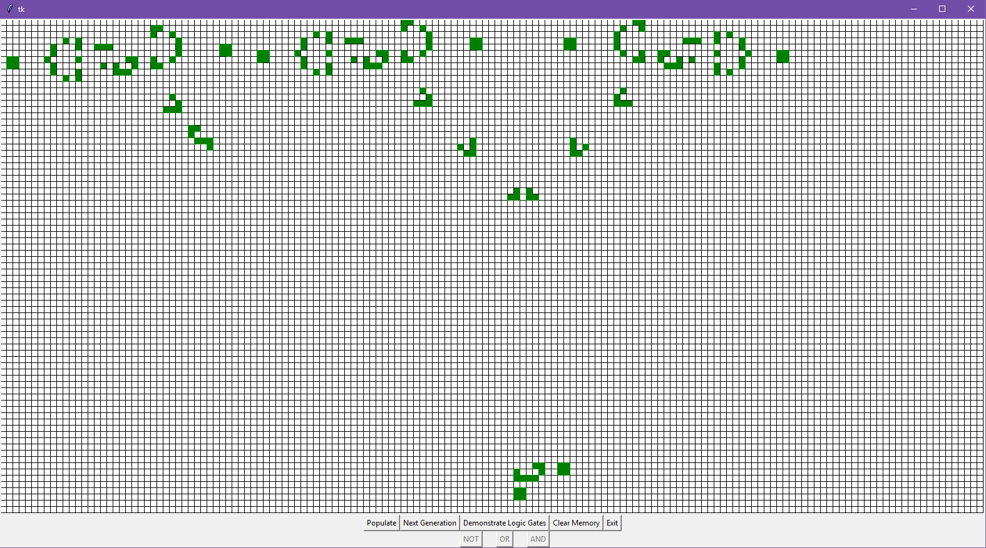
AND (A = 0, B = 1, Y = 0)
A
B
Y

Slide 27
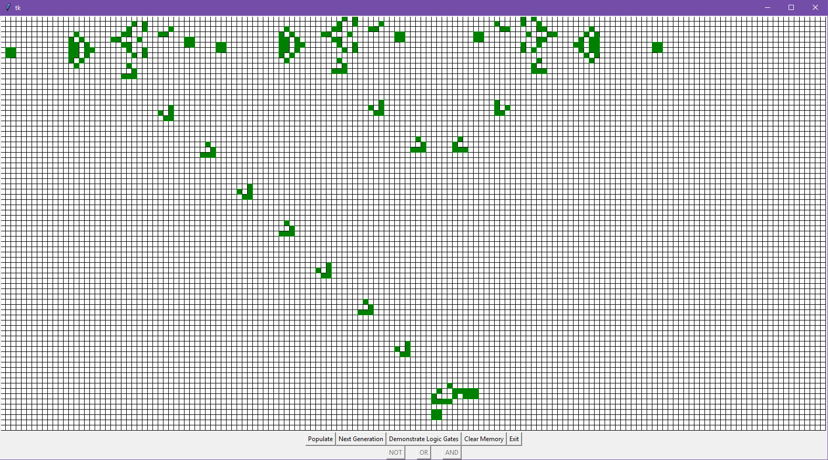
AND (A = 1, B = 1, Y = 1)
A
B
Y

Slide 28
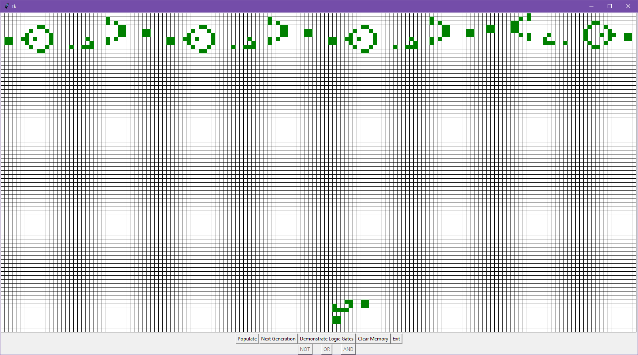
OR
A
B
Y

Slide 29
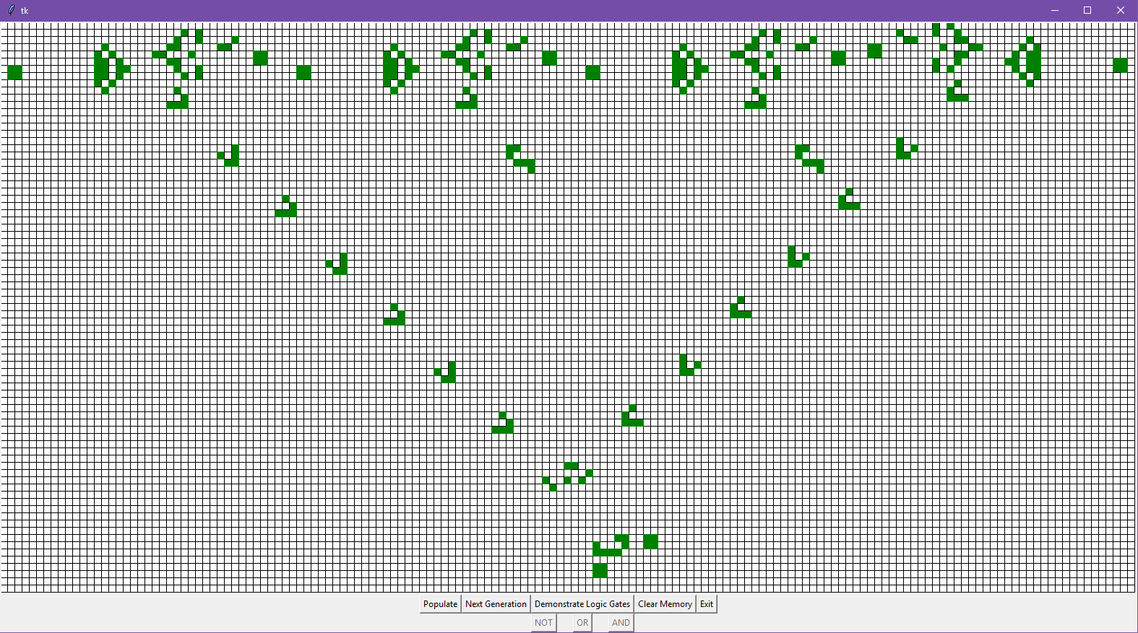
OR (A = 0, B = 0, Y = 0)
A
B
Y

Slide 30
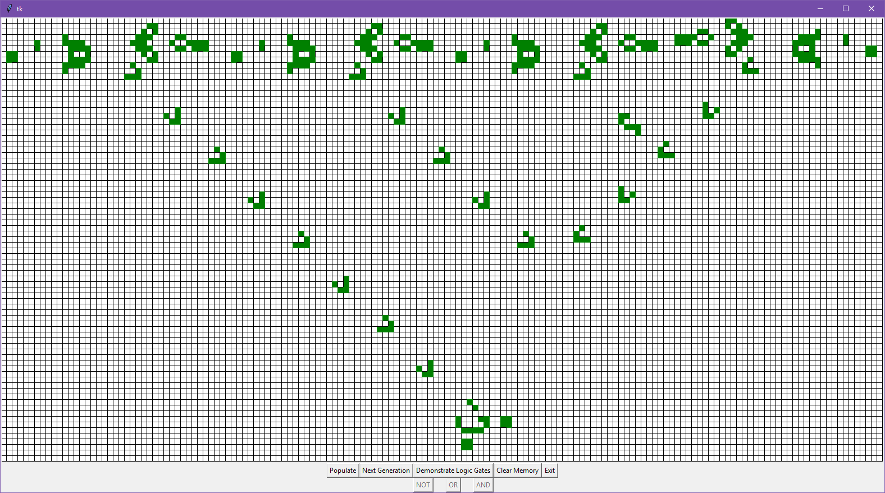
OR (A = 1, B = 0, Y = 1)
A
B
Y

Slide 31
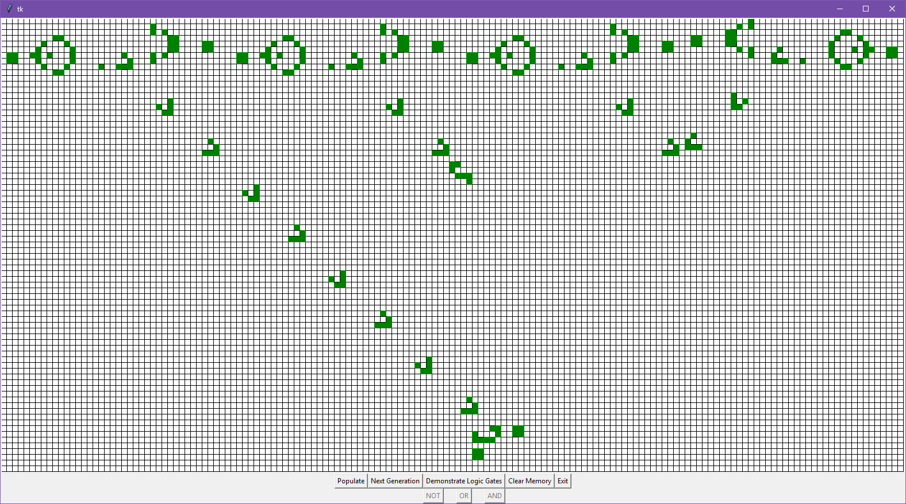
OR (A = 0, B = 1, Y = 1)
A
B
Y

Slide 32
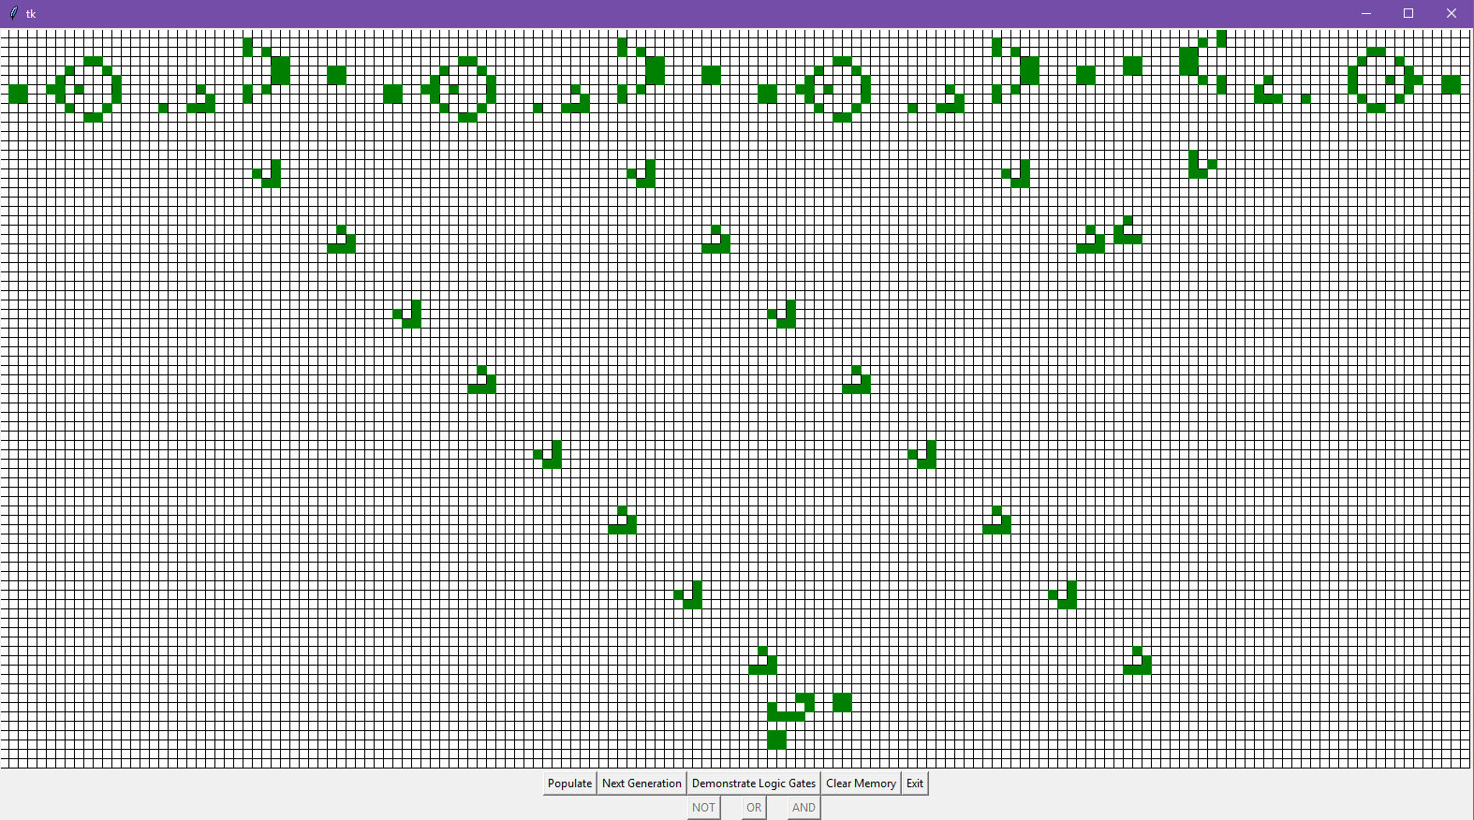
OR (A = 1, B = 1, Y = 1)
A
B
Y

Slide 33
Applications
To observe data evolution with pre-set rules.
Simulations of various kinds of complex phenomena.
Description of recrystallization in alloys
Crack propagation in materials
Traffic flow on highways
Simulations of biological ecosystems
Enabling theoretical study of self-organization and emergence.
In Cryptography for Hashing
As Proof of Work and Proof of Stake Algorithms in Blockchain.
Dept. of CSE, RNSIT

Slide 34
Conclusion
It is now accepted that cellular automata have great powers of computation. The Church-Turing thesis states that:
"No method of computation carried out by a mechanical process can be more powerful than a Turing machine.”
Therefore, the Game of Life is Turing complete i.e. given the correct set of rules, an answer to any question can be computed with disregard to runtime or memory.
Dept. of CSE, RNSIT

Slide 35
Bibliography
http://web.stanford.edu/~cdebs/GameOfLife/
http://home.iitk.ac.in/~tlavanya/14353FinalReport-GameOfLife.pdf
http://mathworld.wolfram.com/GameofLife.html
http://www.rennard.org/alife/CollisionBasedRennard.pdf
https://en.wikipedia.org/wiki/Conway%27s_Game_of_Life

Slide 36
fin

