Slide 1
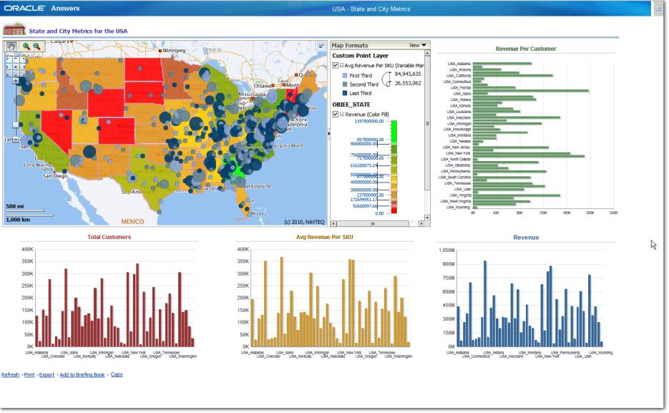
Oracle Spatial Workshop
Albert Godfrind
Geospatial and Graph Technologies
Oracle Corporation
V12.2-2

Slide 2
Agenda
Strategy and Positioning
Concepts
Managing Spatial Tables
Loading Spatial Data
Indexing Spatial Data
Spatial Queries
Spatial Processing
Advanced Indexing
MapViewer
Geocoding
Managing Raster data
Linear Referencing
Network Modeling
Routing Server
Elocation Server
3D
Web Services
Topology
Spatial Data Mining
Workspace manager
Performance and Exadata
Big Data Spatial and Graph
Oracle 12.2 New Features

Slide 3
Agenda – Day by Day
1
4
Strategy and Positioning
Concepts
Managing Spatial Tables
Loading Spatial Data
Indexing Spatial Data
Spatial Queries
Spatial Processing
Advanced Indexing
MapViewer
Geocoding
Managing Raster data
Linear Referencing
Network Modeling
Routing Server
Elocation Server
3D
Web Services
Topology
Spatial Data Mining
Workspace manager
Performance and Exadata
Big Data Spatial and Graph
Oracle 12.2 New Features
2
5
3

Slide 4
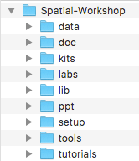
Course Material
http://bit.ly/2a1Fj2q
One PPT file per topic
One lab and data directory per topic
Files and directories are numbered per the agenda
Around 2.0 GB
Includes 900 MB of data and 170 MB of software and tools

Slide 5

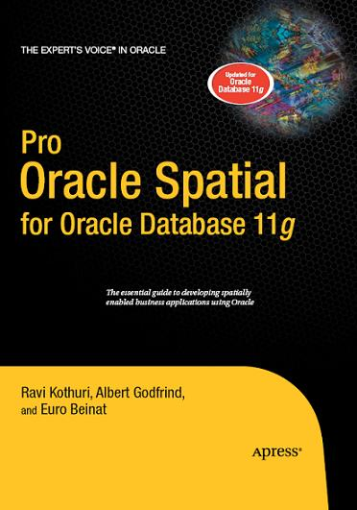


Suggested Reading Material
Expert One-on-One Oracle, Tom Kyte, Apress
ISBN 978-1-59059-243-4
Pro Oracle Spatial, Ravi Kothuri, Albert Godfrind, Euro Beinat, Apress, 2007
ISBN 978-1-59059-899-3
Optimizing Oracle Performance, Cary Millsap, O’Reilly,
ISBN 978-0-59600-527-6
Geospatial Power Tools, Tyler Mitchell, Locate Press
ISBN 978-0-98942-171-3

