Slide 1


<Insert Picture Here>
3 Spatial Data Structures

Slide 2
Spatial Data Structures
The MDSYS schema
Spatial vs Locator
The SDO_GEOMETRY object
Encoding geometry primitives
NURBs
Spatial Metadata
Coordinate Systems
Unit Support

Slide 3
MDSYS Schema
When Oracle Spatial or Oracle Locator is installed, the MDSYS user is created. The MDSYS user is:
The owner of the Spatial types, packages, functions, procedures, and metadata
Somewhat privileged user
This account is locked by default.
Be careful with this administrative account.
You should never need to log in as the MDSYS user.
Never create any data as the MDSYS user.
To enable the account: (connect as SYSTEM or SYS)
SQL> alter user mdsys account unlock;
SQL> alter user mdsys identified by mdsys;

Slide 4
Spatial vs Locator
Simple definition:
Locator = 2D Vector storage, querying and simple processing
Spatial = Advanced processing
See appendix B of Spatial reference manual
Oracle® Spatial and Graph Developer's Guide 12c Release 1 (12.1) Part Number E49172-04

Slide 5
Is Spatial Installed or Locator?
Check the database registry
SDO: means that Oracle Spatial is installed in the database
ORDIM only: means that only Oracle Locator is installed
select comp_id, comp_name, version, status
from dba_registry
where comp_id in ('SDO', 'ORDIM');
COMP_ID COMP_NAME VERSION STATUS
------- ------------------ ----------- ------
SDO Spatial 12.1.0.2.0 VALID
ORDIM Oracle Multimedia 12.1.0.2.0 VALID

Slide 6
Is Spatial Used ?
Check the database feature usage tracker
select name, version, detected_usages
from dba_feature_usage_statistics
where name in ('Locator', 'Spatial');
NAME VERSION DETECTED_USAGES
-------------------- ------------- ---------------
Locator 12.1.0.2.0 0
Spatial 12.1.0.2.0 18

Slide 7
Spatial vs Locator
Articles available from Metalink (« My Oracle Support »)
Note 1066837.1: Oracle Spatial and Oracle Locator Licensing Information
Note 357943.1: How to Install Oracle Locator
Note 1070647.1: How To Deinstall Oracle Spatial Keeping Oracle Locator
My Oracle Support : https://support.oracle.com

Slide 8
SDO_GEOMETRY Object
SDO_GEOMETRY object:
Example:
SDO_GTYPE NUMBER
SDO_SRID NUMBER
SDO_POINT SDO_POINT_TYPE
SDO_ELEM_INFO SDO_ELEM_INFO_ARRAY
SDO_ORDINATES SDO_ORDINATE_ARRAY
SQL> CREATE TABLE us_states (
2 state VARCHAR2(30),
3 totpop NUMBER(9),
4 geom SDO_GEOMETRY);

Slide 9
SDO_GEOMETRY Object
SDO_POINT_TYPE:
SDO_ELEM_INFO_ARRAY:
SDO_ORDINATE_ARRAY:
x NUMBER
y NUMBER
z NUMBER
VARRAY (1048576) OF NUMBER
VARRAY (1048576) OF NUMBER

Slide 10
SDO_GTYPE
Geometry Type | Description | 2D | 3D | 4D
POINT | Geometry contains one point. | 2001 | 3001 | 4001
LINESTRING | Geometry contains one line string. | 2002 | 3002 | 4002
POLYGON | Geometry contains one polygon. | 2003 | 3003 | 4003
4 HETEROGENEOUS COLLECTION | Geometry is a collection of elements of different types: points, lines, polygons. | 2004 | 3004 | 4004
5 MULTI-POINT | Geometry has multiple points. | 2005 | 3005 | 4005
6 MULTI-LINESTRING | Geometry has multiple line strings. | 2006 | 3006 | 4006
7 MULTI-POLYGON | Geometry has multiple polygons. | 2007 | 3007 | 4007

Slide 11
SDO_GEOMETRY Object
SDO_SRID:
Spatial Reference System ID (SRID)
Specifies the coordinate system of the object
SDO_POINT:
Optimized space for storing points (not point clusters)
Ignored if SDO_ELEM_INFO and SDO_ORDINATES are not NULL
Do not use SDO_POINT_TYPE outside the SDO_GEOMETRY object.

Slide 12
Element Example: Point
Load the SDO_POINT field to optimize point data storage.
SQL> INSERT INTO us_cities (id, city, state_abrv, location )
2> VALUES (196, 'Bismarck', 'ND',
3> SDO_GEOMETRY (
4> 2001, 4326,
5> SDO_POINT_TYPE (-100.74869, 46.7666667, null),
6> null, null)
7> );

Slide 13
SDO_GEOMETRY Object
SDO_ELEM_INFO:
Entries in the array should be considered in groups of three.
The triplet values stored in the array are interpreted as:
Ordinate offset: The position of the first ordinate of an element in the SDO_ORDINATES array
Element type: The type of element (point, line, polygon, and others)
Interpretation: Straight line, circular arc, or header

Slide 14
SDO_GEOMETRY Object
SDO_ORDINATES:
This is a simple VARRAY of numbers.
It contains the ordinates that make up geometry elements.
Elements stored in SDO_ORDINATE_ARRAY are defined in SDO_ELEM_INFO_ARRAY.

Slide 15
Element Types Summarized
Number Element Type Interpretation
0 UNKNOWN_ELEMENT
1 POINT # of points in collection; or
0 - oriented point
2 LINESTRING 1 - Straight lines
2 - Circular arcs
3 POLYGON 1 - Straight lines
1003 (Outer) 2 - Circular arcs
2003 (Inner) 3 - Optimized rectangle
4 - Circle
4 COMPOUND LINESTRING # of type 2 subelements that make up the line string
5 COMPOUND POLYGON # of type 2 subelements that make up 1005 (Outer) the polygon
2005 (Inner)

Slide 16
Element Example: Line String
Ordinate Offset
1
Element Type
2
Interpretation
1
(x2,y2)
(x1,y1)
(x3,y3)
(x4,y4)
Each line segment is defined by two points.
The last point from one segment is the first point of the next segment.
Line segments must be contiguous.
Line strings that close to form a ring have no implied area.
Line segments can cross.
Ordinate offset:
1 2 3 4 5 6 7 8
Ordinate array:
x1 y1 x2 y2 x3 y3 x4 y4

Slide 17
Element Example: Arc String
Ordinate Offset
1
Element Type
2
Interpretation
2
(x2,y2)
(x4,y4)
(x1,y1)
(x5,y5)
(x7,y7)
(x3,y3)
(x6,y6)
Each arc is defined by three distinct points on the circumference of a circle.
Last point from one arc is the first point of the next arc.
Arcs must be contiguous.
Arcs that close to form a ring have no implied area.
Arcs can cross.

Slide 18
Element Example: Polygon
Ordinate Offset
1
Element Type
1003
Interpretation
1
(x5,y5)
(x6,y6)
(x4,y4)
(x1,y1)
(x2,y2)
(x3,y3)
Interpretation 1: All line segments are straight lines.
Polygon has area.
Line segments cannot cross each other.
The last coordinate equals the first coordinate.
Order (rotation) matters.

Slide 19
Element Example: Arc Polygon
Ordinate Offset
1
Element Type
1003
Interpretation
2
(x6,y6)
(x7,y7)
(x5,y5)
(x8,y8)
(x4,y4)
(x9,y9)
(x3,y3)
(x1,y1)
(x2,y2)
Interpretation 2: All line segments are circular arcs.
Polygon has area.
Arcs cannot cross each other.
Order (rotation) matters.

Slide 20
Element Example: Rectangle
Ordinate Offset
1
Element Type
1003
Interpretation
3
(x2,y2)
(x1,y1)
Interpretation 3: Optimized rectangle
Optimal storage: Defined by lower-left point, upper-right point
Polygon has area.

Slide 21
Element Example: Circle
Ordinate Offset
1
Element Type
1003
Interpretation
4
(x2,y2)
(x1,y1)
(x3,y3)
Interpretation 4: Optimized circle
It is defined by any three distinct points on the circumference.
Optimized circle has area.
Order (rotation) matters.

Slide 22
Compound Line String
Ordinate Offset
1
1
5
13
Element Type
4
2
2
2
Interpretation
3
1
2
1
(x4,y4)
(x3,y3)
(x5,y5)
(x9,y9)
(x6,y6)
(x7,y7)
(x8,y8)
(x2,y2)
(x1,y1)
The first triplet (header) defines the number of subelements.
Subelements must be contiguous.
Element type 4 can only contain subelements of type 2 (lines).

Slide 23
Compound Polygon
Ordinate Offset
1
1
5
Element Type
1005
2
2
Interpretation
2
1
2
(x6,y6)
(x4,y4)
(x7,y7)
(x1,y1)
(x5,y5)
(x3,y3)
(x2,y2)
First triplet (header) defines the number of subelements.
Subelements must be contiguous.
Arcs and line segments of subelements cannot cross.
Element type 5 (or 1005, 2005) can only contain subelements of type 2 (line strings).
Polygon has area.

Slide 24
Details About Polygon Element Types
Element Types Interpretation
1003 OUTER_RING_POLYGON 1, 2, 3, or 4
2003 INNER_RING_POLYGON 1, 2, 3, or 4
1005 OUTER_RING # of type 2 elements that make up the polygon
COMPOUND_POLYGON
2005 INNER_RING # of type 2 elements that make up the polygon
COMPOUND_POLYGON
These are optimized element types for polygons with voids.
Outer rings (1003, 1005) must be followed by all their inner rings (2003, 2005).
Outer rings (1003, 1005) must have counterclockwise orientation.
Inner rings (2003, 2005) must have clockwise orientation.
Oracle Spatial includes a tool to migrate data to the new element types.

Slide 25
Polygon with a Void
Ordinate Offset
1
13
Element Type
1003
2003
Interpretation
1
3
(x5,y5)
(x6,y6)
(x8,y8)
(x4,y4)
(x1,y1)
(x7,y7)
(x2,y2)
(x3,y3)
A void can be modeled with any combination of type 2003 and type 2005 elements.
Voids can contain islands, and islands can contain voids.
Area is implied as the difference between the outer and inner polygons.
Order (rotation) matters

Slide 26
Compound Polygon with a Void
Ordinate Offset
1
1
7
17
Element Type
1005
2
2
2003
Interpretation
2
1
2
3
(x7,y7)
(x5,y5)
(x8,y8)
(x4,y4)
(x1,y1)
(x6,y6)
(x10,y10)
(x2,y2)
(x9,y9)
(x3,y3)
A void can be modeled with any combination of type 2003 and type 2005 elements.
Voids can contain islands, and islands can contain voids.
Area is implied as the difference between the outer and inner polygons.
Order (rotation) matters.

Slide 27
Collection Example: Multipoint
Ordinate Offset
1
Element Type
1
Interpretation
5
(x1,y1)
(x3,y3)
(x5,y5)
(x2,y2)
(x4,y4)
Interpretation is the number of points in the collection.

Slide 28
Collection Example: Multiline String
Ordinate Offset
1
7
Element Type
2
2
Interpretation
1
1
(x2,y2)
(x6,y6)
(x4,y4)
(x5,y5)
(x1,y1)
(x3,y3)
Elements can be line strings, circular arc strings, or compound line strings.

Slide 29
Collection Example: Multipolygon
Ordinate Offset
1
13
Element Type
1003
1003
Interpretation
1
3
(x5,y5)
(x8,y8)
(x6,y6)
(x4,y4)
(x1,y1)
(x2,y2)
(x3,y3)
(x7,y7)
Elements can be polygons, arc polygons, or compound polygons.

Slide 30
Constructing Geometries
SQL> INSERT INTO LINES VALUES (col_1, … col_n, g)
2> attribute_1, …. attribute_n,
3> SDO_GEOMETRY (
4> 2002, 4326, null,
5> SDO_ELEM_INFO_ARRAY (1,2,1),
6> SDO_ORDINATE_ARRAY (
7> 10,10, 20,25, 30,10, 40,10))
8> );
(20,25)
(10,10)
(30,10)
(40,10)

Slide 31
Constructing Geometries
SQL> INSERT INTO PARKS VALUES(col_1,…, col_n, g)
2> attribute_1, …, attribute_n,
3> SDO_GEOMETRY(
4> 2003, 1006, null,
5> SDO_ELEM_INFO_ARRAY
6> (1,1005,2, 1,2,1, 7,2,2, 17,2003,3),
7> SDO_ORDINATE_ARRAY
8> (10,50,10,30,50,30,50,50,45,60,
9> 30,50,15,60,10,50,25,35,35,40)));
(15,60)
(45,60)
(10,50)
(30,50)
(10,50)
(50,50)
(35,40)
(10,30)
(25,35)
(50,30)

Slide 32
Unknown Element
Ordinate Offset
1
11
Element Type
0
1003
Interpretation
1324
3
(x7,y7)
(x4,y4)
(x3,y3)
(x5,y5)
(x1,y1)
(x2,y2)
(x6,y6)
Element type 0 is for modeling unsupported element types (for example, curves, splines, and so on).
Element type 0 is ignored by Oracle Spatial.
A geometry with an element type 0 must contain at least one element of type 1, 2, 1003, 4, or 1005. The non-0 element is an approximation of the unsupported element. The approximation is indexed by Oracle Spatial.

Slide 33
Oriented Point
Oriented points are typically used for orienting symbology or text for maps and other display applications.
An oriented point includes:
The coordinates of the point
An additional set of coordinates that define the orientation vector. The origin (0,0) of the orientation vector is located at the coordinates of the point it is associated with.

Slide 34
Oriented Point
SDO_ELEM_INFO_ARRAY contains two triplets:
The first triplet describes the point, and includes:
The ordinate offset
Element type of 1 (for the point)
Interpretation of 1 (single point)
The second triplet describes the orientation, and includes:
The ordinate offset of the point used for orientation
Element type of 1 (for the point)
Interpretation of 0 (exclusively used for the orientation)

Slide 35
Oriented Point Example
The point location is (71, 42).
A symbol associated with the point would be oriented along a vector from (71, 42) through (72, 43), at a 45-degree angle.
Given the coordinates of the orientation vector (i,j), the angle is calculated as angle = arctan (j/i)
In the example arctan (1/1) is 0.785398163 in radians, i.e. 45°.
SDO_GEOMETRY(2001, 8307, NULL,
SDO_ELEM_INFO_ARRAY(
1,1,1,
3,1,0),
SDO_ORDINATE_ARRAY(
71,42,
1,1
)
)
71,42

Slide 36
Oriented Point Rules
The point must be followed by its orientation.
The origin (0,0) of the orientation vector is located at the coordinates of the point that it is associated with.
Multipoint oriented points are allowed, but orientation information must follow the point being oriented.
The orientation vector values must be between –1 and 1.

Slide 37
Oriented Point Rules
A 2D point will have a 2D orientation vector.
A 2D point with an LRS measure (SDO_GTYPE=3301) will have a 2D orientation vector.
A 3D point (SDO_GTYPE=3001) will have a 3D orientation vector.
A 3D point with an LRS measure (SDO_GTYPE=4401) will have a 3D orientation vector.
A 4D point (SDO_GTYPE=4001) will have a 3D orientation vector.

Slide 38
Element Types Summarized
Number Element Type Interpretation
0 UNKNOWN_ELEMENT
1 POINT # of points in collection; or
0 - oriented point
2 LINESTRING 1 - Straight lines
2 - Circular arcs
3 POLYGON 1 - Straight lines
1003 (Outer) 2 - Circular arcs
2003 (Inner) 3 - Optimized rectangle
4 - Circle
4 COMPOUND LINESTRING # of line string subelements that
make up the line string
5 COMPOUND POLYGON # of line string subelements that
1005 (Outer) make up the polygon
2005 (Inner)

Slide 39

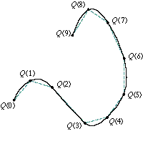
Generic Curves: NURBS
12c Release 1
Non-Uniform Rational B-Spline
NURBS curves allow representation of free-form shapes with arbitrary shapes
splines, polynomial splines, cubic splines, B-splines and Bezier curves
Highway ramps, railroad curves
NURBS representation allows control over the shape of the curve
Control points and knots guide the shape of the curve
Represent complex shapes with little data

Slide 40
NURBS Data type Representation
12c Release 1
Uses standard SDO_GEOMETRY object
Available for 2D and 3D curves
Projected only
Uses existing geometry types:
SDO_GTYPE_CURVE (d002), SDO_GTYPE_MULTICURVE (d006)
Uses existing element types:
SDO_ETYPE_CURVE (x,2,x), SDO_ETYPE_COMPOUNDCURVE (x,4,x)
New interpretation type:
SDO_INTERPRETATION_NURBSCURVE (x,2,3)
A single line can combine straight lines, circular arcs and NURBs

Slide 41
SDO_GEOMETRY for NURBS Curves
12c Release 1
SDO_ELEM_INFO_ARRAY stores:
(offset, 2, 3)
SDO_ORDINATE_ARRAY stores:
Degree d
m control points (x,y,w or x,y,z,w)
knot vector of size n
[d, m, x₁,y₁,(z₁),w₁, ... x_{m},y_{m}(z_{m}),w_{m}, n, k₁, … k_{n}]

Slide 42
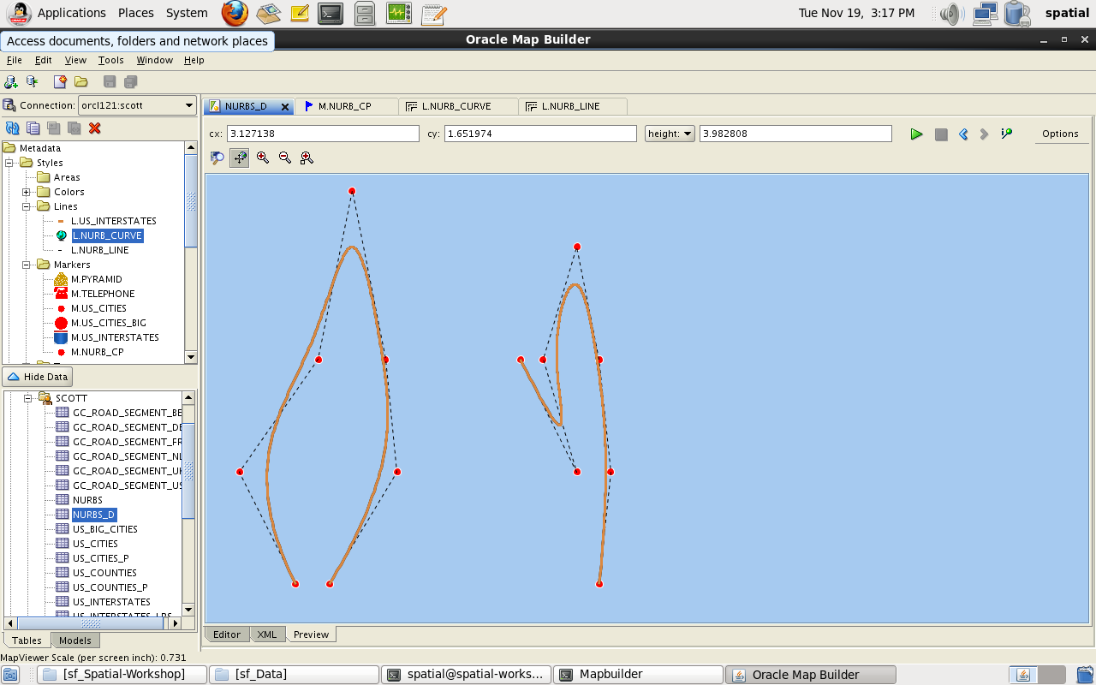
NURB Example (1)
SDO_GEOMETRY(
2002, NULL, NULL,
SDO_ELEM_INFO_ARRAY(
1, -- Offset in ordinates array
2, -- Element type 2 = SDO_ETYPE_CURVE
3 -- Interpretation value 3 = NURBS curve
),
SDO_ORDINATE_ARRAY (
3, -- d = Degree of the NURBS curve
7, -- m = Number of weighted Control Points
0, 0, 1, -- Control point 1 (x,y,w)
-0.5, 1, 1, -- Control point 2
0.2, 2, 1, -- Control point 3
0.5, 3.5, 1, -- Control point 4
0.8, 2, 1, -- Control point 5
0.9, 1, 1, -- Control point 6
0.3, 0, 1, -- Control point 7
11, -- n = Number of knot values (=d+m+1)
0, 0, 0, 0, 0.25, 0.5, 0.75, 1.0, 1.0, 1.0, 1.0
)
)
12c Release 1

Slide 43
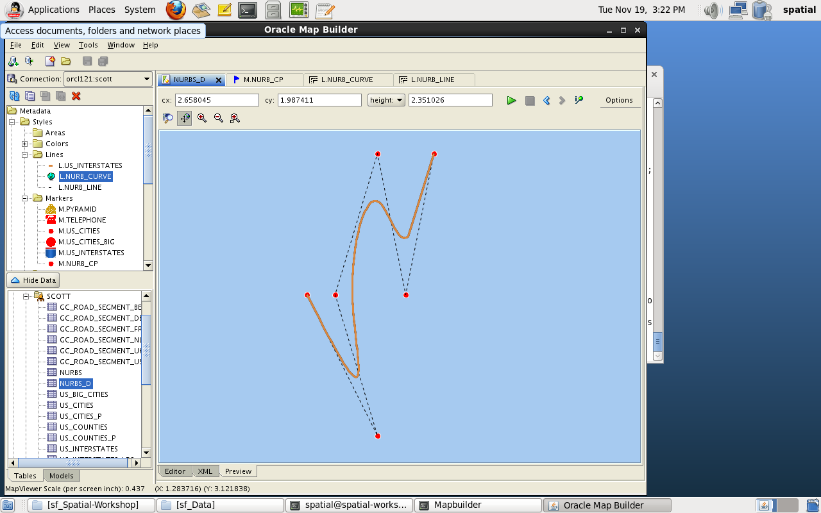
NURB Example (2)
SDO_GEOMETRY(
2002, NULL, NULL,
SDO_ELEM_INFO_ARRAY(
1, -- Offset in ordinates array
2, -- Element type 2 = SDO_ETYPE_CURVE
3 -- Interpretation value 3 = NURBS curve
),
SDO_ORDINATE_ARRAY (
3, -- d = Degree of the NURBS curve
6, -- m = Number of weighted Control Points
2, 2, 1, -- Control point 1 (x,y,w)
2.5, 1, 1, -- Control point 2
2.2, 2, 1, -- Control point 3
2.5, 3, 1, -- Control point 4
2.7, 2, 1, -- Control point 5
2.9, 3, 1, -- Control point 6
10, -- n = Number of knot values (=d+m+1)
0, 0, 0, 0, 0.5, 0.5, 1.0, 1.0, 1.0, 1.0
)
)
12c Release 1

Slide 44
Using NURBS
12c Release 1
WKT/WKB and GML functions for loading and storing of NURBS curve geometries in Oracle Spatial
Validation of NURBS curve geometries.
Spatial indexing of NURBS curve geometries
All operators and functions use an approximation of the curve for computation
SDO_RELATE, SDO_BUFFER, SDO_UNION, etc

Slide 45
OGC WKT Notation
12c Release 1
NURBSCURVE (
DEGREE 3,
CONTROLPOINTS (
NURBSPOINT (WEIGHTEDPOINT (0.0 0.0), WEIGHT 1.0),
NURBSPOINT (WEIGHTEDPOINT (-0.5 1.0), WEIGHT 1.0),
NURBSPOINT (WEIGHTEDPOINT (0.2 2.0), WEIGHT 1.0),
NURBSPOINT (WEIGHTEDPOINT (0.5 3.5), WEIGHT 1.0),
NURBSPOINT (WEIGHTEDPOINT (0.8 2.0), WEIGHT 1.0),
NURBSPOINT (WEIGHTEDPOINT (0.9 1.0), WEIGHT 1.0),
NURBSPOINT (WEIGHTEDPOINT (0.3 0.0), WEIGHT 1.0)
),
KNOTS (
KNOT (VALUE 0.0, MULTIPLICITY 4),
KNOT (VALUE 0.25, MULTIPLICITY 1),
KNOT (VALUE 0.5, MULTIPLICITY 1),
KNOT (VALUE 0.75, MULTIPLICITY 1),
KNOT (VALUE 1.0, MULTIPLICITY 4)
)
)
SDO_UTIL.TO_WKTGEOMETRY()

Slide 46
GML Notation
12c Release 1
<gml:Curve xmlns:gml="http://www.opengis.net/gml">
<gml:segments>
<gml:BSplineType>
<gml:degree>3</gml:degree>
<gml:posList srsDimension="2">
<gml:controlpoint><gml:weightedpoint>0.0 0.0</gml:weightedpoint><gml:weight> 1.0</gml:weight></gml:controlpoint>
<gml:controlpoint><gml:weightedpoint>-0.5 1.0</gml:weightedpoint><gml:weight> 1.0</gml:weight></gml:controlpoint>
<gml:controlpoint><gml:weightedpoint>0.2 2.0</gml:weightedpoint><gml:weight> 1.0</gml:weight></gml:controlpoint>
<gml:controlpoint><gml:weightedpoint>0.5 3.5</gml:weightedpoint><gml:weight> 1.0</gml:weight></gml:controlpoint>
<gml:controlpoint><gml:weightedpoint>0.8 2.0</gml:weightedpoint><gml:weight> 1.0</gml:weight></gml:controlpoint>
<gml:controlpoint><gml:weightedpoint>0.9 1.0</gml:weightedpoint><gml:weight> 1.0</gml:weight></gml:controlpoint>
<gml:controlpoint><gml:weightedpoint>0.3 0.0</gml:weightedpoint><gml:weight> 1.0</gml:weight></gml:controlpoint>
</gml:posList>
<gml:knot>
<gml:value>0.0</gml:value><gml:multiplicity>4</gml:multiplicity>
<gml:value>0.25</gml:value><gml:multiplicity>1</gml:multiplicity>
<gml:value>0.5</gml:value><gml:multiplicity>1</gml:multiplicity>
<gml:value>0.75</gml:value><gml:multiplicity>1</gml:multiplicity>
<gml:value>1.0</gml:value><gml:multiplicity>4</gml:multiplicity>
</gml:knot>
</gml:BSplineType>
</gml:segments>
</gml:Curve>
SDO_UTIL.TO_GML311_GEOMETRY()

Slide 47
Densification
12c Release 1
SDO_UTIL.GETNURBSAPPROX()
Densification of a NURBS curve is automatic and the densified polyline is used for all spatial operations
ORA 13107 error for unsupported operations
Use it explicitly to view the curve
select sdo_util.getNurbsApprox(geom, 0.005) approximation,
from nurbs;

Slide 48
Physical Storage of Geometries
The VARRAY structures are physically stored as BLOBS
LOBs less than 4000 bytes are stored « in-line » i.e. in the main table row
Larger LOBs are stored « out-of-line », i.e. in a separate storage segment
You can control the storage of those BLOBS
For example: using SECUREFILE lobs with compression may reduce storage costs
VARRAY GEOM.SDO_ORDINATES
STORE AS SECUREFILE LOB (
COMPRESS HIGH
)

Slide 49
Physical Storage of Geometries
You can control many storage characteristics
Tablespace, space allocation, caching and logging
Even choose the name of the storage segments
CREATE TABLE us_counties (
id NUMBER PRIMARY KEY,
county VARCHAR2(31),
…
geom MDSYS.SDO_GEOMETRY
)
VARRAY geom.sdo_ordinates
STORE AS SECUREFILE LOB us_counties_ord_lob (
TABLESPACE users STORAGE (INITIAL 20M)
COMPRESS HIGH
NOCACHE LOGGING
INDEX us_counties_ord_lobindex
);

Slide 50
Check the Storage of Geometries
You can find out the ways lobs are stored
Check USER_LOBS
Relate to USER_SEGMENTS to get actual sizes
SELECT table_name, column_name, segment_name, index_name, securefile, compression
FROM user_lobs;
TABLE_NAME COLUMN_NAME SEGMENT_NAME INDEX_NAME SEC COMP
----------- -------------------------- ------------------------- ------------------------ --- ----
US_CITIES "LOCATION"."SDO_ELEM_INFO" SYS_LOB0000086221C00012$$ SYS_IL0000086221C00012$$ NO NONE
US_CITIES "LOCATION"."SDO_ORDINATES" SYS_LOB0000086221C00013$$ SYS_IL0000086221C00013$$ NO NONE
US_COUNTIES "GEOM"."SDO_ELEM_INFO" US_COUNTIES_EI_LOB US_COUNTIES_EI_LOBINDEX YES NO
US_COUNTIES "GEOM"."SDO_ORDINATES" US_COUNTIES_ORD_LOB US_COUNTIES_ORD_LOBINDEX YES HIGH

Slide 51
Using Globally Unique Identifiers (GUIDs)
Oracle has built-in support for GUIDs
Use the SYS_GUID() builtin to generate them
Can be used to provide default values for identifiers
CREATE TABLE us_cities (
guid RAW(16) DEFAULT SYS_GUID() PRIMARY KEY,
id NUMBER,
city VARCHAR2(42),
state_abrv VARCHAR2(2),
pop90 NUMBER,
rank90 NUMBER,
location SDO_GEOMETRY
);

Slide 52
Spatial Metadata
The spatial routines require you to populate a view that contains metadata about the SDO_GEOMETRY columns.
The metadata view is created for all Oracle Spatial users when Oracle Spatial or Oracle Locator is installed.
The metadata view is called USER_SDO_GEOM_METADATA.
For every SDO_GEOMETRY column, insert a row in the USER_SDO_GEOM_METADATA view.

Slide 53
Spatial Metadata Structure
USER_SDO_GEOM_METADATA
MDSYS.SDO_DIM_ARRAY:
MDSYS.SDO_DIM_ELEMENT object:
Name Null? Type
-------------- ---------- ------------------
TABLE_NAME NOT NULL VARCHAR2(32)
COLUMN_NAME NOT NULL VARCHAR2(1024)
DIMINFO SDO_DIM_ARRAY
SRID NUMBER
VARRAY(4) OF SDO_DIM_ELEMENT
SDO_DIMNAME VARCHAR2(64)
SDO_LB NUMBER
SDO_UB NUMBER
SDO_TOLERANCE NUMBER

Slide 54
SDO_DIM_ELEMENT Object
SDO_DIMNAME:
The dimension name
SDO_LB:
The lowest possible value for this dimension
SDO_UB:
The largest possible value for this dimension
SDO_TOLERANCE:
The distance required between two coordinates so that they are considered distinct.
Expressed in units of the projected coordinate system
For geodetic systems: always in meters!

Slide 55
Populating Spatial Metadata
SQL> INSERT INTO USER_SDO_GEOM_METADATA
2> (TABLE_NAME, COLUMN_NAME, DIMINFO, SRID)
3> VALUES (
4> 'US_CITIES',
5> 'LOCATION',
6> SDO_DIM_ARRAY (
7> SDO_DIM_ELEMENT('Longitude', -180, 180, 0.5),
8> SDO_DIM_ELEMENT('Latitude', -90, 90, 0.5)
9> ),
9> 4326
10> );
Note: For geodetic data, the x-axis bounds should be –180 to 180, and y-axis bounds –90 to 90.

Slide 56
Other Metadata Views
USER_SDO_GEOM_METADATA:
Insert into this view
Defines your own spatial tables
ALL_SDO_GEOM_METADATA:
Select from this view.
Lists spatial tables you are allowed to read
SELECT privileges granted on the tables

Slide 57
Coordinate Systems

Slide 58
Coordinate Systems Library
There are some 6,000 different predefined coordinate systems provided.
The definitions are kept in the CS_SRS table, owned by MDSYS
Each coordinate system is identified by a unique Spatial Reference ID (SRID).
About 1000 are original (“legacy”, Oracle-defined) systems
About 5000 come from the EPSG database
Many systems have two definitions (“legacy” and EPSG”)
Name Null? Type
----------------------------------------------------
CS_NAME VARCHAR2(68)
SRID NOT NULL NUMBER(38)
AUTH_SRID NUMBER(38)
AUTH_NAME VARCHAR2(256)
WKTEXT VARCHAR2(2046)
CS_BOUNDS MDSYS.SDO_GEOMETRY

Slide 59
CS_SRS Table
The SRID column contains a unique spatial reference ID (SRID).
The WKTEXT column contains the Well Known Text description:
Geodetic SRIDs when WKTEXT column begins with “GEOGCS”
Projected SRIDs when WKTEXT column begins with “PROJCS”
The CS_NAME field contains a short name for the coordinate system.
The AUTH_NAME field contains “Oracle” for the original (“legacy”) definitions.
The AUTH_SRID field currently contains the SRID.
The CS_BOUNDS field is currently NULL.
(Really a view on table CS_SRS)

Slide 60
EPSG Coordinate Systems
Was maintained by the European Petroleum Support Group (EPSG)
Now absorbed into the OGP Geomatics Committee
But everyone still refers to EPSG definitions.
See http://www.epsg.org/ and http://www.epsg-registry.org/
Check SDO_CS.GET_EPSG_DATA_VERSION to find the current version
select sdo_cs.get_epsg_data_version from dual
Oracle 10gR2 | EPSG version
Oracle 11gR1 | EPSG version
Oracle 11gR2 | EPSG version 6.5
Oracle 12cR1 | EPSG version 7.1

Slide 61
Associating Geometries with Coordinate Systems
Defined in the metadata for a layer
In the SRID column of the USER_SDO_GEOM_METADATA view
Defined for each geometry in the layer
In the SDO_SRID field of the SDO_GEOMETRY object
Same SRID for all geometries in a layer
Must be correctly defined and the same in both
A geometry column can only contain geometries in one coordinate system

Slide 62
Some Common Coordinate Systems
Coordinate System | Oracle SRID | EPSG SRID
WGS84 (GPS coordinates) | 8307 | 4326
UTM Zone 1 N (WGS84) | 82208 | 32601
UTM Zone 1 S (WGS84) | 82209 | 32701
British National Grid | 81989 | 27700
Equal-Area Projection (United States) | 32775
Equal-Area Projection (Europe) | 32771

Slide 63
Finding about EPSG Coordinate Systems
Many web sites let you search the EPSG database:
http://www.epsg-registry.org
http://spatialreference.org
Direct access via http://spatialreference.org/ref/epsg/27700
http://epsg.io
Direct access via http://epsg.io/27700
http://www.georepository.com/

Slide 64
UNIT Support in Oracle Spatial
Units are used for:
SDO_LENGTH
SDO_AREA
SDO_DISTANCE
SDO_BUFFER
SDO_WITHIN_DISTANCE
SDO_NN_DISTANCE
All operations have default units.
For projected data: The default is the unit associated with the projected coordinate system.
For geodetic data: The default is meters.
For local coordinate system: The default is the unit specified in the local coordinate system.

Slide 65
UNIT Support in Oracle Spatial
Supported units are in the following tables:
SDO_DIST_UNITS, SDO_AREA_UNITS, SDO_ANGLE_UNITS
Really views on SDO_UNITS_OF_MEASURE
Include conversion factor from base unit
SQL> select sdo_unit,conversion_factor from sdo_dist_units;
SDO_UNIT CONVERSION_FACTOR
------------------------------ -----------------
METRE 1
M 1
METER 1
KM 1000
KILOMETER 1000
US_SURVEY_FOOT .30480061
...

