Slide 1


<Insert Picture Here>
6 Spatial Queries

Slide 2
Lesson Topics
Spatial Operators vs. Spatial Functions
The SDO_FILTER operator
The SDO_RELATE operator
The SDO_WITHIN_DISTANCE operator
The SDO_NN operator
Correlation search: SDO_JOIN
Combining Spatial and Non-Spatial predicates
Accessing remote databases

Slide 3
Spatial Operators vs. Spatial Functions
Spatial operators:
Require a spatial index on the first geometry specified in the operator
Take advantage of spatial indexes
Appear only in the WHERE clause
Implicitly transform the coordinate system of the window, if required
Spatial functions:
Do not take advantage of spatial indexes
Can be used on small tables that are not spatially indexed
Can be used in the SELECT list and the WHERE clause
If requiring two geometries, both must exist in the same coordinate system.

Slide 4
Spatial Operators vs. Spatial Functions
Operators
SDO_FILTER:
Performs a primary filter only
SDO_RELATE:
Returns all geometries that have some spatial relationship with a geometry
SDO_WITHIN_DISTANCE:
Returns all geometries that are within some distance from a geometry
SDO_NN:
Returns the N nearest neighbors from a geometry
Functions
SDO_GEOM.RELATE
Compares two geometries
SDO_GEOM.SDO_DISTANCE
Measures the distance between two geometries

Slide 5
The SDO_FILTER Operator

Slide 6
The SDO_FILTER Operator
Performs an approximate query (primary filter only)
Compare the result to TRUE
SDO_FILTER
( <geometry-1>,
<geometry-2>
) = 'TRUE'

Slide 7
SDO_FILTER Syntax
<geometry-1>: Layer to be searched
Must be a column in a table
Must be of type SDO_GEOMETRY
Must be indexed
<geometry-2>: Query window
Variable or column in a table
Must be of type SDO_GEOMETRY

Slide 8
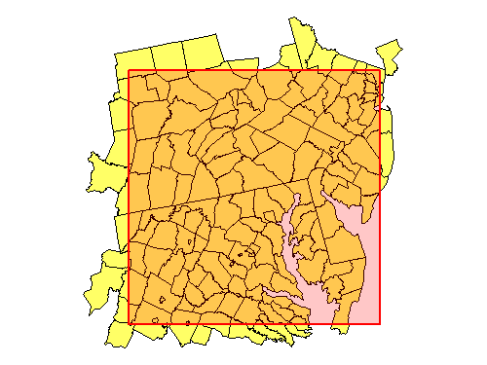
SDO_FILTER Example
Find all the counties in a selected rectangular area.
Result is approximate.

Slide 9
SDO_FILTER Example
Find all the counties likely to interact with a selected rectangular area:
SELECT county, totpop, geom
FROM us_counties_p
WHERE sdo_filter (
geom,
sdo_geometry (2003, 32775, null,
sdo_elem_info_array (1,1003,3),
sdo_ordinate_array (
1420300,1805461, 1820000,2210000))
) = 'TRUE';

Slide 10
SDO_FILTER before 10g
A third, required parameter for SDO_FILTER:
'QUERYTYPE=WINDOW'
Object constructors prefixed by type owner: MDSYS.
SELECT county, totpop, geom
FROM us_counties_p
WHERE mdsys.sdo_filter (
geom,
mdsys.sdo_geometry (2003, 32775, null,
mdsys.sdo_elem_info_array (1,1003,3),
mdsys.sdo_ordinate_array (
1420300,1805461, 1820000,2210000)),
'QUERYTYPE=WINDOW'
) = 'TRUE';

Slide 11
The SDO_RELATE Operator

Slide 12
The SDO_RELATE Operator
Performs a primary and secondary filter
Compare the result to TRUE
Mask values:
INSIDE, CONTAINS, COVERS, COVEREDBY, EQUAL, TOUCH, …
ANYINTERACT = all of the above
Can combine multiple mask values
SDO_RELATE
( <geometry-1>,
<geometry-2>,
'MASK=<mask>'
) = 'TRUE'

Slide 13
SDO_RELATE Syntax
<geometry-1>: The layer to be searched
Must be a column in a table
Must be of type SDO_GEOMETRY
Must be indexed
<geometry-2>: The query window
Variable or column in a table
Must be of type SDO_GEOMETRY
<mask>: Identify the spatial relationship to test
ORed masks are specified as follows:
INSIDE+COVEREDBY

Slide 14
SDO_RELATE Syntax
< min-resolution >:
Use to exclude geometries that are too small to be of interest
Return only geometries for which at least one side of the geometry's MBR is equal to or greater than the specified value.
Example: min_resolution=10 includes only geometries for which the width or the height (or both) of the geometry's MBR is at least 10 units
<max-resolution>:
Use to exclude geometries that are too large to be of interest
Return only geometries for which at least one side of the geometry's MBR is less than or equal to the specified value.
Example: max_resolution=10 includes only geometries for which the width or the height (or both) of the geometry's MBR is less than or equal to 10 units

Slide 15
Simplified Operators
Operator | Equivalent mask
SDO_INSIDE | mask=inside
SDO_CONTAINS | mask=contains
SDO_COVERS | mask=covers
SDO_COVEREDBY | mask=coveredby
SDO_OVERLAPS | mask=overlapbdyintersect+overlapbdydisjoint
SDO_OVERLAPBDYINTERSECT | mask=overlapbdyintersect
SDO_OVERLAPBDYDISJOINT | mask=overlapbdydisjoint
SDO_TOUCH | mask=touch
SDO_EQUAL | mask=equal
SDO_ANYINTERACT | mask=anyinteract
SDO_ON | mask=on

Slide 16
Spatial (Topological) Relationships
AnyInteract
B
A
A
A
B
B
A Contains B
B Inside A
A Covers B
B Coveredby A
Touch
A
A
A red
B green
B
B
OverlapBdyIntersect
OverlapBdyDisjoint
Equal
A
B
Disjoint

Slide 17
Spatial (Topological) Relationships
A
A
A
B
Contains
Inside
B
B
Contains
Inside
Covers
Coveredby
A
A
B
B
OverlapBdyIntersect
OverlapBdyDisjoint
A
B
A
Disjoint
B
Covers
On

Slide 18
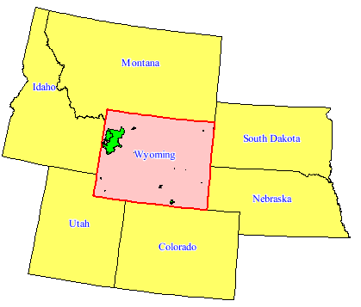
SDO_RELATE Example
Find all the parks fully inside the state of Wyoming
SELECT p.id, p.name
FROM us_parks p, us_states s
WHERE s.state = 'Wyoming'
AND SDO_INSIDE (
p.geom, s.geom
) = 'TRUE';

Slide 19
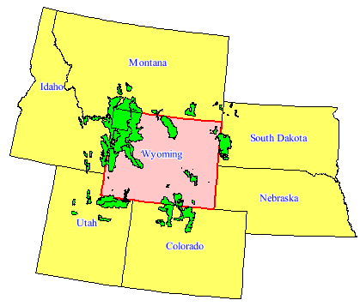
SDO_RELATE Example
Find all the parks that interact with the state of Wyoming
SELECT p.id, p.name
FROM us_parks p, us_states s
WHERE s.state = 'Wyoming'
AND SDO_ANYINTERACT (
p.geom, s.geom
) = 'TRUE';
Note that some parks are multi-polygons with only one element interacting!

Slide 20
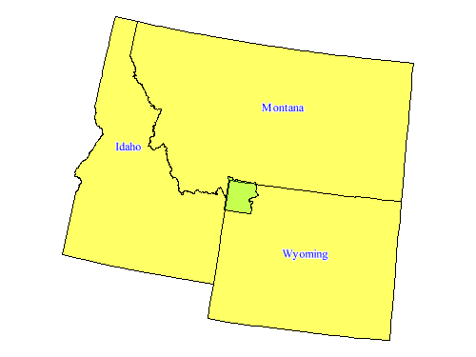
SDO_RELATE Example
Find the states that interact with Yellowstone National Park
SELECT s.state
FROM us_states s, us_parks p
WHERE p.name = 'Yellowstone NP'
AND SDO_ANYINTERACT (
s.geom, p.geom
) = 'TRUE';

Slide 21
Parameter Order is Important!
SELECT s.state
FROM us_states s, us_parks p
WHERE p.name = 'Yellowstone NP'
AND SDO_ANYINTERACT (
s.geom, p.geom
) = 'TRUE';
SELECT s.state
FROM us_states s, us_parks p
WHERE p.name = 'Yellowstone NP'
AND SDO_ANYINTERACT (
p.geom, s.geom
) = 'TRUE’;
GOOD
BAD
Idaho
Montana
Wyoming
3 rows selected.
Elapsed: 00:00:00.01
Idaho
Montana
Wyoming
3 rows selected.
Elapsed: 00:00:00.18

Slide 22
Very Important!
SELECT p.name
FROM us_parks p, us_states s
WHERE s.state = 'Wyoming'
AND SDO_ANYINTERACT (
p.geom, s.geom
) = 'TRUE';
SELECT p.name
FROM us_parks p, us_states s
WHERE s.state = 'Wyoming'
AND SDO_ANYINTERACT (
s.geom, p.geom
) = 'TRUE';
GOOD
BAD
Roosevelt NF
...
Wasatch NF
48 rows selected.
Elapsed: 00:00:00.01
Roosevelt NF
...
Wasatch NF
48 rows selected.
Elapsed: 00:00:05.56

Slide 23
Observe Query Plans
In SQLPLUS, use « Autotrace »
Must first define role PLUSTRACE (run as SYS)
Grant the PLUSTRACE role to the executing user(s)
Enable in your SQLPLUS session
Show query plan and statistics
Show plan and statistics only (without the output of the query)
Show plan only, without actually executing the query
SQL> @?/sqlplus/admin/plustrce.sql
SQL> grant PLUSTRACE to public;
SQL> set autotrace on;
SQL> set autotrace traceonly;
SQL> set autotrace trace explain;

Slide 24

Spatial Data Statistics Collection
12c Release 1
Improve Execution plans for Spatial queries
In 11gR2 and before: no statistics for spatial data
Spatial operators use a fixed selectivity
Can be a problem for queries that combine spatial and other predicates
Version 12c collects and uses spatial statistics
Input space is partitioned into regions (or buckets)
Each region contains information about
The number of contained geometry MBRs
The average length and width of each MBR

Slide 25
Spatial Data Statistics Collection
12c Release 1
How to collect statistics for spatial tables?
Statistics collection depends on an existing R-tree index
Execution of dbms_stats functions invokes spatial statistics collection algorithms.
DBMS_STATS.GATHER_INDEX_STATS(….)
DBMS_STATS.GATHER_SCHEMA_STATS(….)
Statistics kept in table MDXT_xxxx$ for each index
User must have explicit CREATE TABLE privilege !
If granted via role, statistics are not collected!

Slide 26
Vector Performance Acceleration (VPA)
12c Release 1
Is the name for a collection of performance improvements only available for Oracle Spatial (not Oracle Locator)
Spatial operators (SDO_RELATE etc)
Geometry comparisons (RELATE function)
Spatial joins (SDO_JOIN)
Union operations (SDO_UNION, SDO_AGGR_UNION, SDO_AGGR_SET_UNION)
Metadata Caching

Slide 27
Enabling Vector Performance Acceleration
12c Release 1
Only available for Oracle Spatial (not Oracle Locator)
But remember to enable it!
Set parameter SPATIAL_VECTOR_ACCELERATION
Can be set at session level for testing and comparisons
alter system set spatial_vector_acceleration = true;
alter session set spatial_vector_acceleration = true;

Slide 28
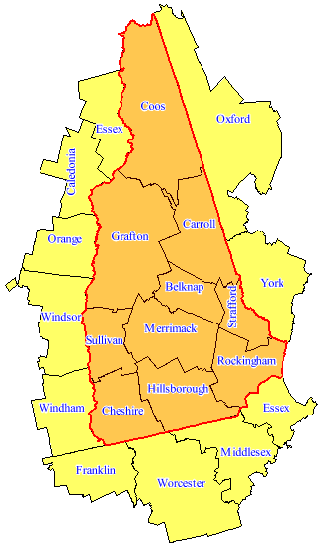
SDO_RELATE Example
Find all the counties in the state of New Hampshire:
SELECT c.county
FROM us_counties c,
us_states s
WHERE s.state = 'New Hampshire'
AND SDO_RELATE (
c.geom,s.geom,
'mask=INSIDE+COVEREDBY'
) = 'TRUE';

Slide 29
Exploit Hierarchical Relationships
STATES
COUNTIES
CITIES
SELECT c.county
FROM us_counties c,
us_states s
WHERE s.state = 'New Hampshire'
AND c.fipsst = s.fipsst;

Slide 30
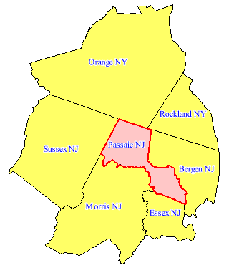
SDO_RELATE Example
Find all the counties around Passaic County in New Jersey:
SELECT c1.county, c1.state_abrv
FROM us_counties c1,
us_counties c2
WHERE c2.state = 'New Jersey'
AND c2.county = 'Passaic'
AND SDO_TOUCH (
c1.geom, c2.geom
)='TRUE';

Slide 31
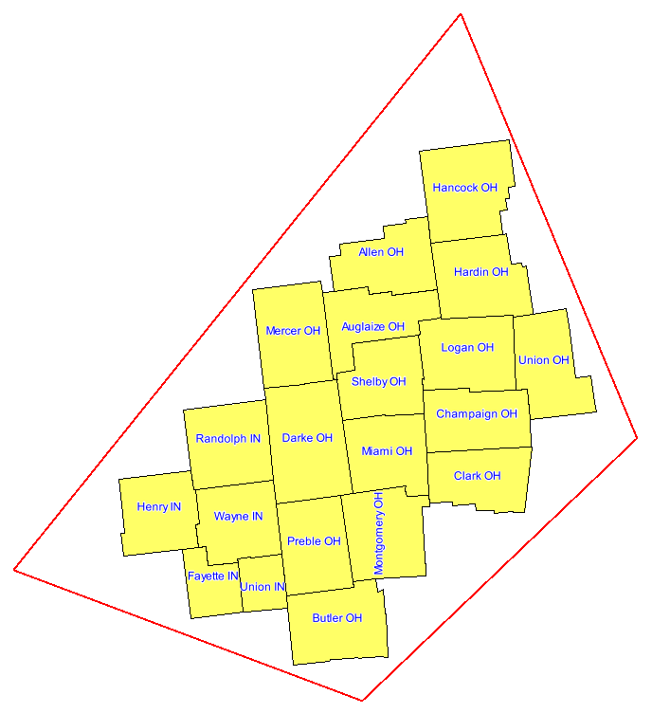
SDO_RELATE Example
Find all counties in a selected area:
SELECT county, state_abrv
FROM us_counties
WHERE SDO_INSIDE (
geom,
SDO_GEOMETRY(2003, 8307, NULL,
SDO_ELEM_INFO_ARRAY(1, 1003, 1),
SDO_ORDINATE_ARRAY(
-84.505957, 39.139801,
-82.987381, 39.988933,
-83.581649, 41.66395,
-86.145999, 39.7777,
-84.505957, 39.139801)
)
) ='TRUE';

Slide 32
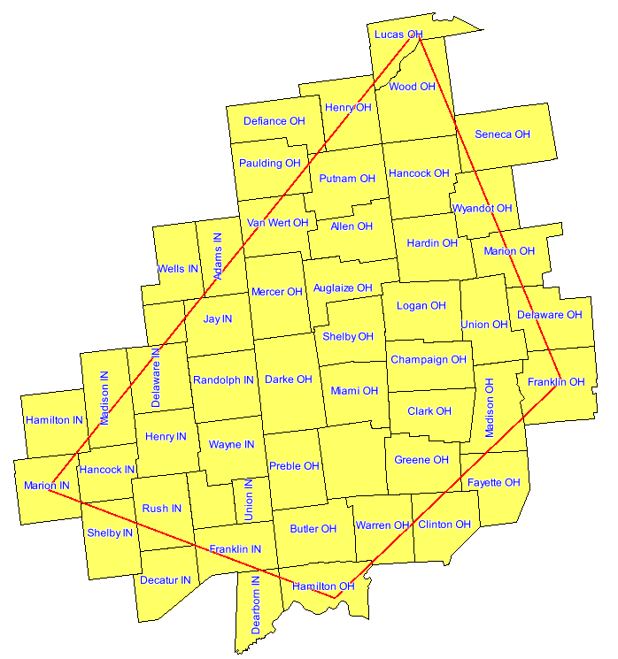

INSIDE or ANYINTERACT ?

Slide 33
INSIDE or ANYINTERACT ?

Slide 34
SDO_RELATE and PL/SQL
Find the total population in a selected rectangular area:
create or replace function get_population
(min_x number, min_y number, max_x number, max_y number)
return number
is
rectangle sdo_geometry;
total_population number;
begin
rectangle := sdo_geometry (2003, 8307, null,
sdo_elem_info_array (1,1003,3),
sdo_ordinate_array (min_x, min_y, max_x, max_y));
select sum(pop90) into total_population
from us_cities
where sdo_anyinteract (location, rectangle) = 'TRUE';
return total_population;
end;
/

Slide 35
SDO_RELATE Example
Find all interstates that interact with one county:
SELECT i.interstate
FROM us_counties c, us_interstates i
WHERE c.state = 'New Jersey'
AND c.county = 'Passaic'
AND sdo_anyinteract (i.geom, c.geom)='TRUE';

Slide 36
SDO_RELATE Example
Find all interstates that interact with a set of counties:
May need to switch the order of the columns in the operator
The second column (“geometry-2”) should represent the smallest set
Better way: use the SDO_JOIN function
SELECT i.interstate, c.county
FROM us_counties c, us_interstates i
WHERE c.state = 'Arizona'
AND c.poppsqmi < 10
AND sdo_anyinteract (i.geom, c.geom)='TRUE';

Slide 37
SDO_RELATE and DISJOINT
Spatial operators always use the spatial index.
Compare approximations for candidate result set
SDO_RELATE operator then always applies secondary filter.
Using DISJOINT mask returns DISJOINT geometries among those likely to interact.
This is (probably) not what we expect:
SELECT c.city, c.state_abrv
FROM us_states s, us_cities c
WHERE sdo_relate(c.location, s.geom, 'mask=disjoint‘
) = 'TRUE'
AND s.state_abrv='CA';
CITY ST
-------------------- --
Las Vegas NV
Reno NV
2 rows selected.

Slide 38
SDO_RELATE and DISJOINT
To get a true disjoint relationship, use the following:
SELECT *
FROM us_cities
WHERE ROWID NOT IN (
SELECT c.rowid
FROM us_states s, us_cities c
WHERE sdo_anyinteract(c.location,s.geom) = 'TRUE'
AND s.state_abrv='CA'
);

Slide 39
The SDO_WITHIN_DISTANCE Operator

Slide 40
The SDO_WITHIN_DISTANCE Operator
Generates an exact, or optionally an approximate, result
Compare the result to TRUE
SDO_WITHIN_DISTANCE
( <geometry-1>,
<geometry-2>,
'DISTANCE=<n>,
[other optional parameters]'
) = 'TRUE'

Slide 41
SDO_WITHIN_DISTANCE Syntax
<geometry-1>
Must be a column in a table
Must be of type SDO_GEOMETRY
Must be indexed
<geometry-2>
Variable or column in a table
Must be of type SDO_GEOMETRY
Is buffered by distance
<distance> (required)
The distance (expressed in the units used for the coordinate system, or by the UNIT parameter)

Slide 42
SDO_WITHIN_DISTANCE Syntax
<unit>
Unit of measure to associate with the <distance> parameter. If <unit> is not specified, <distance> defaults to the following:
For geodetic data, the default unit is meters.
For projected data, the default unit is the coordinate system unit.

Slide 43
SDO_WITHIN_DISTANCE: Examples
Find all cities within a distance from an interstate.
Find interstates within a distance from a city:
SELECT c.city
FROM us_interstates i, us_cities c
WHERE i.interstate = 'I275'
AND sdo_within_distance (
c.location, i.geom,'distance=15 unit=mile')
= 'TRUE';
SELECT i.interstate
FROM us_cities c, us_interstates i
WHERE c.city = 'Tampa'
AND sdo_within_distance (
i.geom, c.location, 'distance=15 unit=mile')
= 'TRUE';

Slide 44
SDO_WITHIN_DISTANCE: Examples
Find all the cities within 100 miles of Boston, ordered by distance.
SELECT c1.city,
SDO_GEOM.SDO_DISTANCE (
c1.location, c2.location,
0.5, 'unit=mile') distance
FROM us_cities c1, us_cities c2
WHERE c2.city = 'Boston'
AND SDO_WITHIN_DISTANCE(
c1.location, c2.location,
'distance=100 unit=mile'
) = 'TRUE'
ORDER BY distance;
Boston 0
Lowell 26.039707
Worcester 40.7874355
Providence 41.0584302
Springfield 79.5090887
Hartford 94.303397

Slide 45
SDO_WITHIN_DISTANCE: Examples
SELECT count(*)
FROM sales_regions r, customers c
WHERE r.region_id = 'R1'
AND sdo_within_distance (
c.location, r.geom,
'distance=10 unit=km')
= 'TRUE';
SELECT count(*)
FROM sales_regions r, customers c
WHERE r.region_id = 'R1'
AND sdo_within_distance (
c.location, r.geom,
'distance=10 unit=km')
= 'TRUE‘
AND SDO_GEOM.SDO_DISTANCE (
c.location, r.geom, 0.5) > 0;
How many customers are within 10 km of sales region R1 ?

Slide 46
NOT Within Distance
Find all cities further than 15 miles from I275
SELECT c.city, c.state_abrv, c.location
FROM us_cities c
WHERE ROWID NOT IN (
SELECT c.rowid
FROM us_interstates i, us_cities c
WHERE i.interstate = 'I275'
AND sdo_within_distance (
c.location, i.geom,'distance=15 unit=mile')
= 'TRUE'
);

Slide 47
Searching in Expanding Circles
First get all objects within 50km
Then expand the search to 100km (but do not return the ones already found)
Then expand to 150km etc

Slide 48
Searching in Expanding Circles
Find all cities between 15 and 30 miles from I275
SELECT c.city, c.state_abrv
FROM us_interstates i, us_cities c
WHERE i.interstate = 'I275'
AND sdo_within_distance (
c.location, i.geom,
'distance=30 unit=mile‘
) = 'TRUE'
AND sdo_geom.sdo_distance(
c.location,
i.geom, 0.5, 'unit=mile‘
) >= 15;
Results are unordered
Toledo OH
Detroit MI
Warren MI
Sterling Heights MI

Slide 49
Searching in Expanding Circles
Find all cities between 15 and 30 miles from I275
SELECT *
FROM (
SELECT c.city, c.state_abrv,
sdo_geom.sdo_distance (c.location, i.geom,
0.5, 'unit=mile') distance
FROM us_interstates i, us_cities c
WHERE i.interstate = 'I275'
AND sdo_within_distance (
c.location, i.geom,
'distance=30 unit=mile')
= 'TRUE'
)
WHERE distance >= 15
ORDER BY distance;
Results are ordered by distance
Detroit MI 16.9459536
Warren MI 21.8236416
Sterling Heights MI 24.2974932
Toledo OH 26.2219881

Slide 50
The SDO_NN Operator

Slide 51
The SDO_NN Operator
Returns the nearest neighbors to a geometry
Can choose the number of nearest neighbors
Results not returned in order of distance
Can combine with other attributes in the WHERE clause
Has an ancillary operator, SDO_NN_DISTANCE, that returns the distance associated with a nearest neighbor
SDO_NN
( <geometry-1>,
<geometry-2>
[,'parameters']
[,tag]
) = 'TRUE'

Slide 52
SDO_NN Syntax
<geometry-1>
Must be a column in a table
Must be of type SDO_GEOMETRY
Must be indexed
This is the layer being searched for nearest neighbors.
<geometry-2>
Variable or column in a table
Must be of type SDO_GEOMETRY
This is the geometry whose nearest neighbors you are looking for.

Slide 53
SDO_NN Parameters
SDO_NUM_RES (optional)
The number of nearest neighbors to return
SDO_BATCH_SIZE (optional)
When specified, SDO_NN continually returns neighbors in distance order, so other attributes can be evaluated in the WHERE clause.
Tuning parameter to instruct SDO_NN to compute <SDO_BATCH_SIZE> distances at a time
When set to 0, SDO_NN automatically tunes the batch size during query execution.
Cannot use both SDO_NUM_RES and SDO_BATCH_SIZE
If neither is specified, default is SDO_BATCH_SIZE=0.

Slide 54
SDO_NN Syntax
UNIT (optional with SDO_NN_DISTANCE)
Applied to SDO_NN_DISTANCE (next slide)
Unit of measure to associate with distance
TAG (required with SDO_NN_DISTANCE)
Must match with integer tag specified in SDO_NN_DISTANCE
Associates ancillary operator with a specific instance of SDO_NN
DISTANCE
Specifies the maximum distance of the returned objects from the window object

Slide 55
SDO_NN: Basic Example
Find the five cities nearest to Interstate I170:
Results are NOT ordered by distance
Results are NOT limited by distance
SELECT c.city, c.state_abrv
FROM us_interstates i,
us_cities c
WHERE i.interstate = 'I170'
AND sdo_nn(c.location, i.geom, 'sdo_num_res=5') = 'TRUE';

Slide 56
SDO_NN: Limit Results by Distance
Limit the results by distance
Find the five cities nearest to Interstate I170, but only those that are less than 150 miles from the interstate.
Can return less than 5 results.
Results are NOT ordered by distance
SELECT c.city, c.state_abrv, pop90
FROM us_interstates i,
us_cities c
WHERE i.interstate = 'I170'
AND sdo_nn (c.location, i.geom,
'sdo_num_res=5 distance=150 unit=mile') = 'TRUE';

Slide 57
SDO_NN: Order Results by Distance
Find the five cities nearest to Interstate I170, ordered by distance:
SELECT c.city, c.state_abrv,
sdo_geom.sdo_distance (
c.location, i.geom, 0.5, 'unit=mile') distance_in_miles
FROM us_interstates i,
us_cities c
WHERE i.interstate = 'I170'
AND sdo_nn(c.location, i.geom,'sdo_num_res=5) = 'TRUE'
ORDER BY distance_in_miles;

Slide 58
SDO_NN: Order Results by Distance
Find the five cities nearest to Interstate I170, ordered by distance:
Use the distance computed by the operator
SELECT c.city, c.state_abrv,
sdo_nn_distance (1) distance_in_miles
FROM us_interstates i,
us_cities c
WHERE i.interstate = 'I170'
AND sdo_nn(c.location, i.geom,'sdo_num_res=5 unit=mile', 1
) = 'TRUE'
ORDER BY distance_in_miles;

Slide 59
SDO_NN_DISTANCE “Ancillary” Operator
Returns the distance associated with nearest neighbors returned by SDO_NN
Distance unit conforms to the UNIT parameter. If UNIT was not specified, SDO_NN_DISTANCE defaults to the following units:
TAG associates the ancillary operator with a call to SDO_NN.
SDO_NN_DISTANCE (<TAG>) returns NUMBER

Slide 60
SDO_NN: Filter Results – the WRONG way
Find the five cities nearest to Interstate I170 that have population greater than 300,000 - the WRONG way:
This selects the five nearest cities, then only returns those among the five with a population greater than 300,000!
Not what you expect!
SELECT c.city, c.state_abrv, c.pop90
FROM us_interstates i,
us_cities c
WHERE i.interstate = 'I170'
AND sdo_nn (c.location, i.geom,'sdo_num_res=5') = 'TRUE'
AND c.pop90 > 300000;

Slide 61
SDO_NN: Filter Results
Find the five cities nearest to Interstate I170 with a population greater than 300,000 - the GOOD way:
Returns cities in distance order from the interstate, without limit
Retains only those with a population greater than 300,000
Stops once 5 results are found.
Results are implicitly ordered by distance
SELECT c.city, c.state_abrv, c.pop90
FROM us_interstates i,
us_cities c
WHERE i.interstate = 'I170'
AND sdo_nn(c.location, i.geom) = 'TRUE'
AND c.pop90 > 300000
AND rownum <= 5;

Slide 62
SDO_NN: Filter and Limit by Distance
Find the five cities nearest to Interstate I170, with a population greater than 300,000, but only those that are less than 230 miles from the interstate.
Can return less than 5 results.
SELECT c.city, c.state_abrv, c.pop90
FROM us_interstates i,
us_cities c
WHERE i.interstate = 'I170'
AND sdo_nn(c.location, i.geom,
'distance=230 unit=mile'
) = 'TRUE'
AND c.pop90 > 300000
AND rownum <= 5;

Slide 63
SDO_NN: Filter and Order by Distance
Find the five cities nearest to Interstate I170 with a population greater than 300,000, ordered by distance:
SELECT c.city, c.state_abrv, c.pop90,
sdo_nn_distance (1) distance_in_miles
FROM us_interstates i,
us_cities c
WHERE i.interstate = 'I170'
AND sdo_nn(c.location, i.geom,
‘unit=mile', 1) = 'TRUE'
AND c.pop90 > 300000
AND rownum <= 5
ORDER BY distance_in_miles;

Slide 64
SDO_NN Example
What if pop90 was indexed?
May need to “disable” this index
SELECT /*+ no_index(c pop90_idx) */
c.city, c.state_abrv, pop90,
sdo_nn_distance (1) distance_in_miles
FROM us_interstates i,
us_cities c
WHERE i.interstate = 'I170'
AND sdo_nn(c.location, i.geom,
'sdo_batch_size=0 unit=mile', 1) = 'TRUE'
AND c.pop90 > 300000
AND rownum < 6
ORDER BY distance_in_miles;

Slide 65
SDO_NN: Polygon Window
Find the five cities nearest to California
Returns 5 random cities inside California!
They are at a distance of “0” from the state geometry!
SELECT c.city, c.state_abrv
FROM us_states s,
us_cities c
WHERE s.state_abrv = 'CA'
AND sdo_nn(c.location, s.geom, 'sdo_num_res=5') = 'TRUE';
CITY ST
---------------- --
San Jose CA
Stockton CA
Fremont CA
Concord CA
Vallejo CA
5 rows selected.

Slide 66
SDO_NN: Polygon Window
Find the five cities nearest to California – outside California
Only retain the cities with a distance > 0
SELECT c.city, c.state_abrv
FROM us_states s,
us_cities c
WHERE s.state_abrv = 'CA'
AND sdo_nn(c.location, s.geom, 1) = 'TRUE'
AND sdo_nn_distance (1) > 0
AND rownum <= 5;
CITY ST
---------------- --
Reno NV
Las Vegas NV
Glendale AZ
Phoenix AZ
Scottsdale AZ
5 rows selected.

Slide 67
Implicit Coordinate System Transformations

Slide 68
Implicit Coordinate System Transformations
Oracle Spatial operators allow the query window to be in a different coordinate system than the layer that is being searched.
The query window is automatically transformed to the coordinate system of the layer.
This is known as implicit coordinate system transformation
SELECT c.county, c.state_abrv
FROM us_states_p s,
us_counties c
WHERE s.state = 'New Hampshire'
AND sdo_inside (c.geom,s.geom)='TRUE';

Slide 69
SDO_GEOM.RELATE() Function

Slide 70
The SDO_GEOM.RELATE Function
Performs an exact query (secondary filter only)
Does not use any spatial index
Returns TRUE or FALSE for an ANYINTERACT mask
Returns the matching relationship if any other mask or FALSE
Can be used in the SELECT list
SDO_GEOM.RELATE
( <geometry-1>, '<mask>', <geometry-2>, <tolerance> )
= '<relationship>'

Slide 71
SDO_GEOM.RELATE Syntax
<GEOMETRY-1>
<MASK>
Mask for operation
<GEOMETRY-2>
<TOLERANCE>
The tolerance value to be used
<RELATIONSHIP>
Returned value
TRUE for ANYINTERACT, or <MASK> if matches
Otherwise, FALSE

Slide 72
SDO_GEOM.RELATE Example
Determine the relationship of the state of New Jersey to its counties:
SDO_GEOM.RELATE
( <geometry-1>, '<mask>', <geometry-2>, <tolerance> )
= '<relationship>'

Slide 73
SDO_GEOM.RELATE Example
Determine the relationship of the state of New Jersey to its counties
SELECT c.county,
sdo_geom.relate (s.geom,'determine',c.geom, 0.5) relationship
FROM us_states s,
us_counties c
WHERE s.state = 'New Jersey'
AND s.state = c.state;
COUNTY RELATIONSHIP
------------------------------- --------------
Atlantic COVERS
Cape May COVERS
Cumberland COVERS
Essex CONTAINS
…

Slide 74
SDO_GEOM.RELATE Example
Determine the relationship of the state of New Jersey to its counties (reversed)
SELECT c.county,
sdo_geom.relate (c.geom,'determine',s.geom, 0.5) relationship
FROM us_states s,
us_counties c
WHERE s.state = 'New Jersey'
AND s.state = c.state;
COUNTY RELATIONSHIP
------------------------------- --------------
Atlantic COVEREDBY
Cape May COVEREDBY
Cumberland COVEREDBY
Essex INSIDE
…

Slide 75
SDO_GEOM.RELATE Example
Find all counties around New Jersey:
The function does not use the spatial index.
Will be very slow!
Use SDO_RELATE or SDO_TOUCH instead.
SELECT c.county, c.state
FROM us_states s,
us_counties c
WHERE s.state = 'New Jersey'
AND sdo_geom.relate(c.geom,'touch',s.geom, 0.5)
='TOUCH';

Slide 76
Spatial Joins: SDO_JOIN()

Slide 77
Spatial Joins: SDO_JOIN
Find correlations between two layers
Only use to compare all of the geometries in one layer with all of the geometries in another layer
Very similar to an operator
Requires two R-tree indexed layers
Technically not an operator, but a table function
Use in the select clause
Both layers must be in the same coordinate system

Slide 78
Spatial Join: the SDO_JOIN operator
Used to compare all of the geometries in one layer with all of the geometries in another layer
SDO_JOIN( table_name-1, column_name-1,
table_name-2, column_name-2
[,'parameters'] [, preserve_join_order])
RETURN SDO_ROWIDSET;
SQL> DESC sdo_rowidset;
SDO_ROWIDSET TABLE OF MDSYS.SDO_ROWIDPAIR
Name Null? Type
-------------- -------- -----------
ROWID1 VARCHAR2(24)
ROWID2 VARCHAR2(24)

Slide 79
SDO_JOIN Syntax: Arguments
TABLE_NAME-1 and TABLE_NAME-2
Names of the tables to compare (must be TABLES – not VIEWS)
COLUMN_NAME-1 and COLUMN_NAME-2
Names of the geometry columns to compare
Must be in the same coordinate system
PARAMETERS - one of the following
MASK=<mask> - Similar to SDO_RELATE
DISTANCE=N [UNIT=DISTANCE_UNIT] - Similar to SDO_WITHIN_DISTANCE
If not specified, SDO_JOIN does a primary filter operation
PRESERVE_JOIN_ORDER
SDO_JOIN will not automatically adjust the order in which the tables are joined
The second table/column is the driving table

Slide 80
Spatial JOIN: Spatial Correlation
Find all the city and county pairs that interact:
SELECT ci.city, ci.state_abrv, co.county
FROM us_cities ci,
us_counties co,
TABLE( SDO_JOIN(
'US_CITIES', 'LOCATION',
'US_COUNTIES', 'GEOM',
'MASK=ANYINTERACT') ) j
WHERE j.rowid1 = ci.rowid
AND j.rowid2 = co.rowid
ORDER BY ci.city, ci.state_abrv;
The TABLE keyword flattens SDO_ROWIDSET returned by SDO_JOIN to ROWID1, ROWID2 pairs

Slide 81
Spatial JOIN: Distance Correlation
Find all cities within 10 miles of any interstate:
SELECT c.city, i.interstate
FROM us_cities c,
us_interstates i,
TABLE(SDO_JOIN(
'US_CITIES', 'LOCATION',
'US_INTERSTATES', 'GEOM',
'DISTANCE=10 UNIT=MILE')) j
WHERE j.rowid1 = c.rowid
AND j.rowid2 = i.rowid
ORDER BY c.city;

Slide 82
Spatial JOIN: Correlation on Same Table
Find all couple of cities that are less than 10 miles from each other
SELECT c1.city, c2.city
FROM us_cities c1, us_cities c2,
TABLE(SDO_JOIN(
'US_CITIES', 'LOCATION',
'US_CITIES', 'LOCATION',
'DISTANCE=10 UNIT=MILE')) j
WHERE j.rowid1 = c1.rowid
AND j.rowid2 = c2.rowid
AND c1.rowid < c2.rowid
ORDER BY c1.city, c2.city;

Slide 83
Spatial JOIN: Fuzzy Spatial Correlation
If no join criteria is passed, the match happens only on the MBRs (primary filter)
Result is approximate – complement with exact filter using SDO_GEOM.RELATE or SDO_GEOM.SDO_DISTANCE
SELECT ci.city, ci.state_abrv, co.county
FROM us_cities ci, us_counties co,
TABLE( SDO_JOIN(
'US_CITIES', 'LOCATION',
'US_COUNTIES', 'GEOM')) j
WHERE j.rowid1 = ci.rowid
AND j.rowid2 = co.rowid
ORDER BY ci.city, ci.state_abrv;

Slide 84
Spatial JOIN: Restrictions
Only works on tables (not views or synonyms)
Both tables must have an RTREE index
Both tables must be in the same coordinate system
Both tables must be in the same schema as the user performing the SDO_JOIN
To join tables from different schemas, you need to grant SELECT on the MDRTxxx$ (index) tables to the user that performs the SDO_JOIN
To join tables with partitioned spatial indexes, you need to specify the partition names (and combine joins over partitions).

Slide 85
Point-in-Polygon Searches

Slide 86
Point In Polygon
12c Release 1
SELECT /*+ parallel(8) */ lon, lat, id, name
FROM TABLE (
sdo_pointinpolygon (
CURSOR (
select lon, lat, id, name
from customers
),
(
select geom
from us_states
where state_abrv='CA’
),
0.05
)
);
A stream of X,Y coordinates
A polygon geometry

Slide 87
Combining Spatial and Text searches

Slide 88
Combining Spatial and Text Searches
Find all parks that are mines, within 2000 km from Dallas.
SELECT p.id, p.name, p.fcc
FROM us_parks p, us_cities c
WHERE p.name like '%Mine%'
AND c.city = 'Dallas'
AND sdo_within_distance (
p.geom, c.location, 'distance=2000 unit=km'
) = 'TRUE';
ID NAME FCC
---------- ------------------------------ ---
5471 Hill Annex Mine D85
5454 Soudan Underground Mine D85
4506 Lake Mineral Wells State Park D85
3 rows selected.

Slide 89
Combining Spatial and Text Searches
Text based searches need a text index
This is also a “domain” index
Just like spatial indexes
Many features available
Language-specific stemming
Fuzzy searches
Soundex searches
Text expressions …
CREATE INDEX us_parks_tx ON us_parks (name)
INDEXTYPE IS ctxsys.context;

Slide 90
Combining Spatial and Text Searches
Using a text-based search
SELECT p.id, p.name, p.fcc
FROM us_parks p, us_cities c
WHERE contains (p.name,'mine') > 0
AND c.city = 'Dallas'
AND sdo_within_distance (
p.geom, c.location, 'distance=2000 unit=km'
) = 'TRUE';
ID NAME FCC
---------- ------------------------------ ---
5471 Hill Annex Mine D85
5454 Soudan Underground Mine D85
2 rows selected.

Slide 91
Combining Spatial and Text Searches
A more sophisticated text and spatial search combination
(“?” for a fuzzy search, “!” for a soundex search …)
SELECT p.id, p.name, p.fcc
FROM us_parks p, us_cities c
WHERE contains (p.name, 'mine or ?well') > 0
AND c.city = 'Dallas'
AND sdo_within_distance (
p.geom, c.location, 'distance=2000 unit=km'
) = 'TRUE';
ID NAME FCC
---------- ------------------------------ ---
2770 Drake Well State Park D85
5033 Weld Memorial Park D85
4770 Little Wall Lake County Park D85
5454 Soudan Underground Mine D85
5471 Hill Annex Mine D85
5 rows selected.

Slide 92
Accessing Remote Databases

Slide 93
Accessing Remote Databases
You can access tables in remote databases via « database links »
Creating a database link:
A dblink with explicit credentials
Using a database link:
CREATE DATABASE LINK orcl112 USING 'localhost:1521/orcl112‘;
CREATE DATABASE LINK orcl112_scott
CONNECT TO scott IDENTIFIED BY tiger
USING 'localhost:1521/orcl112';
SELECT * FROM us_cities@orcl112_scott;

Slide 94
Database Links and Spatial Types
Select from a remote table
Select from a remote table with a non-spatial filter
Join a remote table and a local table
SELECT * FROM us_cities@orcl112_scott;
SELECT * FROM us_cities@orcl112_scott WHERE pop90>1000000;
SELECT c.city, s.state
FROM us_cities c,
us_states@orcl112_scott s
WHERE c.state_abrv = s.state_abrv
AND c.pop90>1000000
ORDER BY s.state, c.city;
SELECT c.city, s.state
FROM us_cities@orcl112_scott c,
us_states s
WHERE c.state_abrv = s.state_abrv
AND c.pop90>1000000
ORDER BY s.state, c.city;

Slide 95
Database Links and Spatial Types
Spatial predicate on a remote table is not possible:
SELECT county, totpop, geom
FROM us_counties_p@orcl112_scott
WHERE sdo_filter (
geom,
sdo_geometry (2003, 32775, null,
sdo_elem_info_array (1,1003,3),
sdo_ordinate_array (
1420300,1805461, 1820000,2210000))
) = 'TRUE';
ORA-13226: interface not supported without a spatial index

Slide 96
Database Links and Spatial Types
Using a local table to search a remote table is not possible:
SELECT p.id, p.name
FROM us_parks@orcl112_scott p, us_states s
WHERE s.state = 'Wyoming'
AND SDO_INSIDE (
p.geom, s.geom
) = 'TRUE';
ORA-22804: remote operations not permitted on object tables or
user-defined type columns

Slide 97
Database Links and Spatial Types
But using a remote table to search a local table is possible:
SELECT p.id, p.name
FROM us_parks p, us_states@orcl112_scott s
WHERE s.state = 'Wyoming'
AND SDO_INSIDE (
p.geom, s.geom
) = 'TRUE';

Slide 98
Database Links and Spatial Types
Inserting or updating a geometry in a remote table is not possible:
INSERT INTO us_cities@orcl112_scott (id, city, state_abrv, location)
VALUES (196, 'Bismarck', 'ND',
SDO_GEOMETRY (
2001, 8307,
SDO_POINT_TYPE (-100.74869, 46.7666667, null),
null, null)
);
ORA-22804: remote operations not permitted on object tables or
user-defined type columns

Slide 99
Database Links and Spatial Types
But updating a local table from a remote table is possible:
Filling a local table from a remote table is possible
UPDATE us_cities c1
SET location = (
SELECT location
FROM us_cities@orcl112_scott
WHERE id = c1.id
);
CREATE TABLE us_cities_copy AS
SELECT * FROM us_cities@orcl112_scott;

