Slide 1


<Insert Picture Here>
7 Spatial Processing

Slide 2
Lesson Topics
Measurements: Area, Length and Distance calculations
Buffering
Combining Geometries (overlays): union, intersection, …
Deriving Geometries: convex hull, centroid, MBR
Spatial Aggregates
Arc Densification
Coordinate Transformation
Utility functions
WKT, WKB, GML
Processing Geometries in PL/SQL
Java API

Slide 3
Measurements: Length, Area, and Distance Calculations

Slide 4
Area and Length Calculations
SDO_GEOM.SDO_AREA
Computes the area of a polygon
SDO_GEOM.SDO_LENGTH
Computes the length or perimeter of a geometry
Both functions take an SDO_GEOMETRY object as input and return a number.

Slide 5
Area and Length Calculations
Projected data, or data with no SDO_SRID
Cartesian calculations
Results default to the coordinate system unit (area = units²).
Geodetic data
Calculations account for curvature of the Earth.
Results default to meter or meter2.
Result unit can be specified with the UNIT parameter.

Slide 6
The SDO_AREA Function
<geometry>
SDO_GEOMETRY that defines a polygon
Can be a variable or table column
<tolerance>
Number used as the tolerance
<unit>
A quoted string with the units for the result
Returned value
A number that is the area of the input polygon
area := SDO_GEOM.SDO_AREA
(<geometry>, <tolerance> [, <unit>])

Slide 7
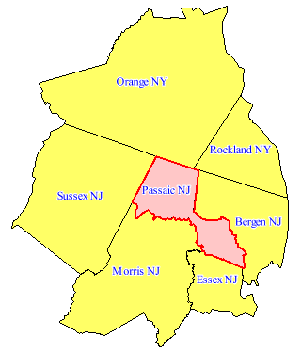
SDO_AREA Example
Calculate the total area of the counties around Passaic County:
SELECT SUM(SDO_GEOM.SDO_AREA (
c1.geom, 0.5, 'unit=sq_mile')
) area
FROM us_counties c1, us_counties c2
WHERE c2.state = 'New Jersey'
AND c2.county = 'Passaic'
AND SDO_TOUCH (c1.geom, c2.geom) = 'TRUE';
AREA
----------
2431.41332

Slide 8
SDO_AREA Example
Calculate the total area of the counties around Passaic County, split by state:
SELECT c1.state, SUM(SDO_GEOM.SDO_AREA(c1.geom,0.5,'unit=sq_mile')) area
FROM us_counties c1, us_counties c2
WHERE c2.state = 'New Jersey'
AND c2.county = 'Passaic'
AND SDO_TOUCH (c1.geom, c2.geom) = 'TRUE'
GROUP BY ROLLUP(c1.state);
See Database Data Warehousing Guide
Part IV Relational Analytics
STATE AREA
------------------------------ ----------
New Jersey 1392.35219
New York 1039.06113
2431.41332

Slide 9
SDO_AREA Example
Calculate the total area of the counties around Passaic County, split by state, with percentage
SELECT state, area, RATIO_TO_REPORT (area) OVER() * 100 as pct
FROM (SELECT c1.state,
SUM(SDO_GEOM.SDO_AREA(c1.geom,0.5,'unit=sq_mile')) area
FROM us_counties c1, us_counties c2
WHERE c2.state = 'New Jersey'
AND c2.county = 'Passaic'
AND SDO_TOUCH (c1.geom, c2.geom) = 'TRUE'
GROUP BY c1.state);
STATE AREA PCT
------------------------------ ---------- ----------
New Jersey 1392.35219 57.2651378
New York 1039.06113 42.7348622

Slide 10
The SDO_LENGTH Function
<geometry>: SDO_GEOMETRY that defines a polygon or line
Can be a variable or table column
<tolerance>: Number used as the tolerance
<unit>: Quoted string with the units for the result
<returned_value>: Numeric length
length := SDO_GEOM.SDO_LENGTH
( <geometry>, <tolerance> [, <unit>])

Slide 11
SDO_LENGTH Example
Calculate the length of an interstate highway
Select states on the basis of border length
SELECT SDO_GEOM.SDO_LENGTH (geom, 0.5,'unit=kilometer') length
FROM us_interstates
WHERE interstate = 'I95';
SELECT state
FROM us_states
WHERE SDO_GEOM.SDO_LENGTH (geom, 0.5,'unit=mile') > 1800;

Slide 12
Distance Calculations
SDO_GEOM.SDO_DISTANCE computes the minimum distance between two geometries.
This function takes two SDO_GEOMETRY objects as input and returns a number.
Projected data (or data with no SDO_SRID)
Returns straight line distance
Distance unit defaults to the coordinate system unit of the geometry.
Geodetic data
Returns the smaller distance along the geodesic
Distance unit defaults to meters.
Distance unit can be specified with the UNIT parameter.

Slide 13
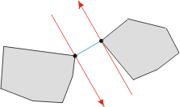
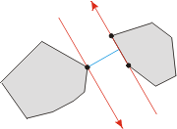
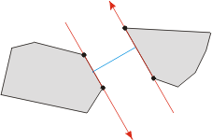
Minimum Distance: SDO_DISTANCE
distance := SDO_GEOM.SDO_DISTANCE
( <geometry-1>, <geometry-2>,
<tolerance> [, <unit>])
Illustration courtesy of http://cgm.cs.mcgill.ca/~orm/rotcal.html

Slide 14
SDO_DISTANCE Example
Distance from Buffalo to Syracuse in meters:
Minimum distance between I84 and Passaic County in miles:
SELECT SDO_GEOM.SDO_DISTANCE (
c1.location, c2.location, 0.5) distance
FROM us_cities c1, us_cities c2
WHERE c1.city = 'Buffalo' and c2.city = 'Syracuse';
SELECT SDO_GEOM.SDO_DISTANCE (
i.geom, c.geom, 0.5, 'unit=mile') distance
FROM us_interstates i, us_counties c
WHERE c.county = 'Passaic' and c.state_abrv = 'NJ'
AND i.interstate = 'I84';

Slide 15
SDO_DISTANCE Example
Find all the cities within 100 miles of Boston, ordered by distance.
SELECT c1.city,
SDO_GEOM.SDO_DISTANCE (
c1.location, c2.location,
0.5, 'unit=mile') distance
FROM us_cities c1, us_cities c2
WHERE c2.city = 'Boston'
AND SDO_WITHIN_DISTANCE(
c1.location, c2.location,
'distance=100 unit=mile‘
) = 'TRUE'
ORDER BY distance;
Boston 0
Lowell 26.039707
Worcester 40.7874355
Providence 41.0584302
Springfield 79.5090887
Hartford 94.303397

Slide 16
Accuracy of Geodetic Area Calculations
Areas the size of New Hampshire: Within 0.0001%
Area of New Hampshire is 24,042.6439 +/– 0.024 km2.
Areas the size of India (approximately 1/3 size of the U.S.): Within 0.001%
Area of India is approximately 3,277,093.11 +/– 32.77 km2.
Half the area of the Earth (biggest polygon element): Within 0.1%
Approximately 255,082,311 +/– 255,082 km2
Larger differences in latitude introduce larger error margins, not to exceed the error margins listed above.

Slide 17
Accuracy of Geodetic Length and Distance Calculations
Length calculations
Generalized algorithm for short or long lengths
Accurate to within 0.00000001%
Distance calculations
Point-to-point distances, same accuracy as length calculations
If not point-to-point, the algorithm is accurate to within 0.2%, and is generalized for short or long distances.

Slide 18
Buffering

Slide 19
SDO_BUFFER Function
SDO_GEOM.SDO_BUFFER
Generates a buffer polygon around a geometry
Takes an SDO_GEOMETRY object as input
Any kind (point, line, polygon, compound)
Can buffer geodetic geometries
Returns an SDO_GEOMETRY object containing the buffer (polygon)

Slide 20
Buffer Examples
Simple geometries
Collection geometries

Slide 21
Buffer Examples
Interior Buffer
Closed line
Polygon with void

Slide 22
The SDO_BUFFER Function
<geometry>:SDO_GEOMETRY object to buffer
Can be a variable or table column
<distance>: The buffer distance
<tolerance>: A number used as the tolerance
<distance> must be greater than <tolerance>
If smaller, the returned buffer is the same as the input geometry
SDO_GEOMETRY := SDO_GEOM.SDO_BUFFER
( <geometry>, <distance>,
<tolerance> [, '<params>'])

Slide 23
The SDO_BUFFER Function
<params>:
<unit>: Unit associated with distance. If <unit> is not specified:
For projected data, unit defaults to the coordinate system unit of the geometry being buffered
For geodetic data, unit defaults to meter
<arc_tolerance>
Only specify arc_tolerance if geometry to buffer is geodetic
If arc_tolerance is smaller than tolerance, an Oracle error is returned
The default arc_tolerance is 20 times the tolerance
Returns: An SDO_GEOMETRY object

Slide 24
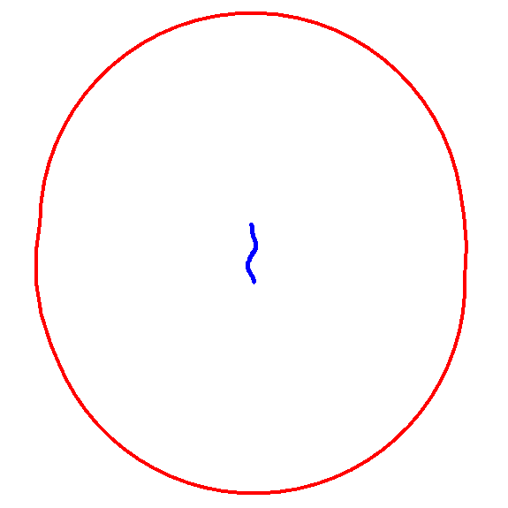
SDO_BUFFER Example
Generate a 60-kilometer buffer around Interstate I170
What is the area of the buffer in square kilometers?
SELECT sdo_geom.sdo_buffer (
geom, 60, 0.5,'unit=km')
FROM us_interstates
WHERE interstate = 'I170';
SELECT sdo_geom.sdo_area (
sdo_geom.sdo_buffer (
geom, 60, 0.5, 'unit=km'),
0.5, 'unit=sq_km')
FROM us_interstates
WHERE interstate = 'I170';

Slide 25
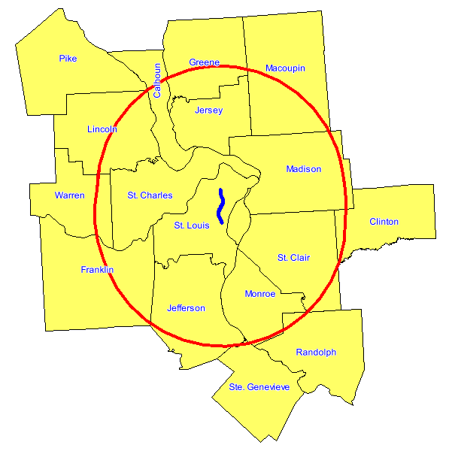
SDO_BUFFER Example
Find all counties that have any interaction with a 60 kilometer buffer around highway I170.
SELECT c.state_abrv, c.county
FROM us_interstates i, us_counties c
WHERE i.interstate = 'I170'
AND sdo_anyinteract (
c.geom,
sdo_geom.sdo_buffer (
i.geom, 60, 0.5,
'UNIT=KILOMETER')
) = 'TRUE';
This is better done using SDO_WITHIN_DISTANCE

Slide 26
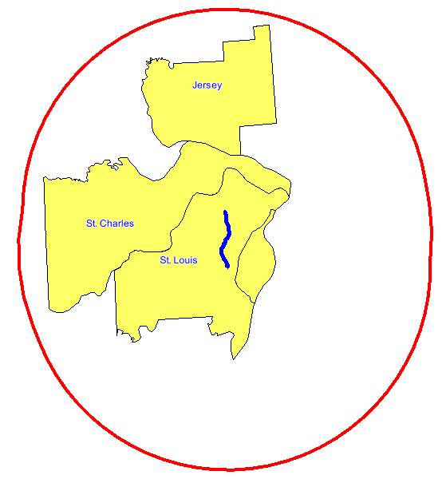
SDO_BUFFER Example
Find all counties that are entirely within a 60 kilometer buffer around highway I170.
SELECT c.state_abrv, c.county
FROM us_interstates i, us_counties c
WHERE i.interstate = 'I170'
AND sdo_inside (
c.geom,
sdo_geom.sdo_buffer (
i.geom, 60, 0.5,
'UNIT=KILOMETER')
) = 'TRUE';

Slide 27
Overlays - Combining Geometries

Slide 28
Geometric Union
SDO_GEOM.SDO_UNION
Generates a geometry representing the union of two geometries

Slide 29
Geometric Intersection
SDO_GEOM.SDO_INTERSECTION
Generates a geometry representing the intersection of two geometries

Slide 30
Geometric Difference
SDO_GEOM.SDO_DIFFERENCE
Generates a geometry representing the difference between two geometries
geometry1
geometry2

Slide 31
Geometric Symmetric Difference
SDO_GEOM.SDO_XOR
Generates a geometry representing the symmetric difference between two geometries

Slide 32
Geometry Operations
Union
Intersection
Disjoint
Touch
Touch
Overlap
A contains B
B contains A

Slide 33
Geometry Operations
Difference
XOR
Disjoint
Touch
Touch
Overlap
A contains B
B contains A

Slide 34
Using the functions
<operation>
UNION
INTERSECTION
DIFFERENCE
XOR
<geometry-1> <geometry-2>
SDO_GEOMETRY objects
Can be a variable or table column
<tolerance>
Numeric tolerance for function
Returns SDO_GEOMETRY object
SDO_GEOMETRY := SDO_GEOM.SDO_<operation>
( <geometry-1>, <geometry-2>, <tolerance> )

Slide 35
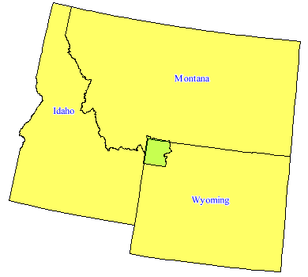
SDO_INTERSECTION Example
Find the states that interact with Yellowstone National Park
How much space does Yellowstone occupy in each state ?
SELECT s.state,
sdo_geom.sdo_area (
sdo_geom.sdo_intersection (
s.geom, p.geom, 0.5),
0.5, 'unit=sq_km') area
FROM us_states s, us_parks p
WHERE SDO_ANYINTERACT (s.geom, p.geom) = 'TRUE'
AND p.name = 'Yellowstone NP';
STATE AREA
---------- ----------
Wyoming 8100.7515
Montana 640.296007
Idaho 154.659879

Slide 36
SDO_INTERSECTION Example
What percentage of Yellowstone is in each state ?
WITH p AS (
SELECT s.state,
sdo_geom.sdo_area (
sdo_geom.sdo_intersection (
s.geom, p.geom, 0.5),
0.5, 'unit=sq_km') area
FROM us_states s, us_parks p
WHERE SDO_ANYINTERACT (s.geom, p.geom) = 'TRUE'
AND p.name = 'Yellowstone NP'
)
SELECT state, area,
RATIO_TO_REPORT(area) OVER () * 100 AS pct
FROM p
ORDER BY pct DESC;
STATE AREA PCT
---------- ---------- ----------
Wyoming 8100.7515 91.0636012
Montana 640.296007 7.19780878
Idaho 154.659879 1.73859

Slide 37
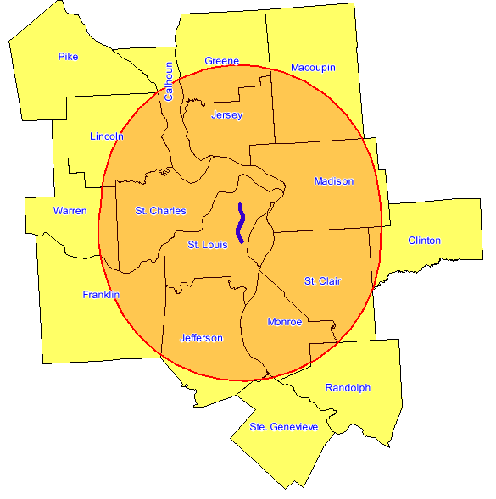
Putting it All Together
Calculate the area of the section of each county that intersects a 60 km buffer around highway I170
COUNTY GEOM_AREA
------------------------------- ----------
Warren 233.329819
Franklin 671.006186
St. Charles 1536.05519
Jefferson 1455.88499
St. Louis 1356.5239
Ste. Genevieve 10.0532109
Monroe 1015.38128
St. Louis city 170.86464
...
Greene 473.085084
Jersey 977.107609
Macoupin 807.551361

Slide 38
Putting it All Together
SELECT county,
sdo_geom.sdo_area (
sdo_geom.sdo_intersection (
c.geom,
sdo_geom.sdo_buffer (
i.geom, 60, 0.5,'unit=km'),
0.5),
0.5, 'unit=sq_km') geom_area
FROM us_interstates i, us_counties c
WHERE i.interstate = 'I170'
AND sdo_within_distance(
c.geom, i.geom, 'distance=60 unit=km') = 'TRUE';
3
2
1

Slide 39
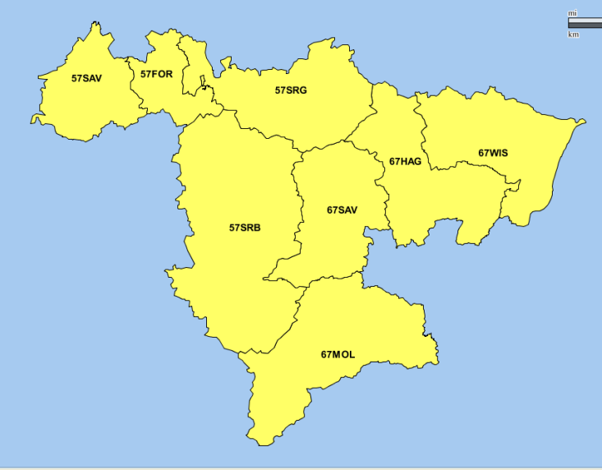
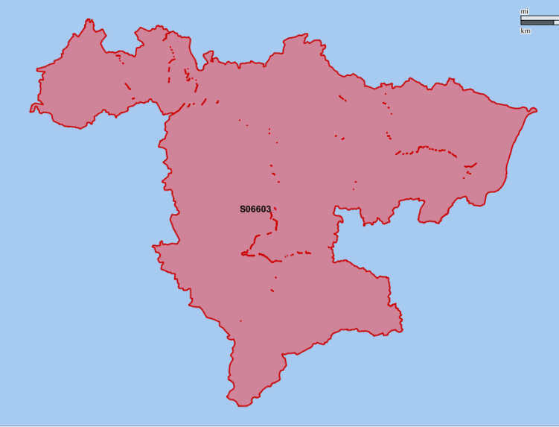
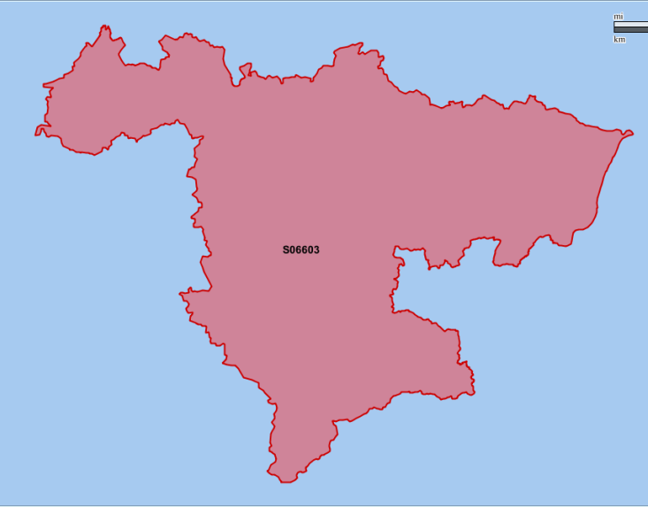
Notes on Tolerance
The tolerance you specify is applied to the result
If the tolerance is too small, “imperfections” may appear
Small gaps between polygons can turn into holes or slivers in the polygon resulting from the union
Original polygons
Union at tolerance 0.005
Union at tolerance 1

Slide 40
Derived Geometries

Slide 41
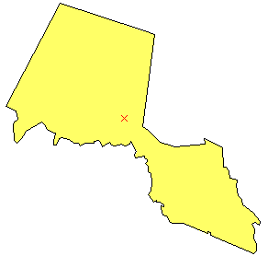
Centroid
SDO_CENTROID
“Center of gravity” function
Returns point geometry object
SELECT sdo_geom.sdo_centroid(
c.geom, 0.5) centroid
FROM us_counties c
WHERE c.county = 'Passaic'
AND c.state_abrv = 'NJ';

Slide 42
Interior Point
Returns a point that is guaranteed to be an interior point (not on the boundary or edge) on the surface of a polygon geometry object.
Typically used for placing labels
SDO_UTIL.INTERIOR_POINT(
geom IN SDO_GEOMETRY,
tol IN NUMBER
) RETURN SDO_GEOMETRY;

Slide 43
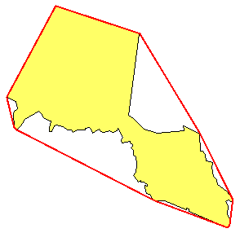
Convex Hull
SDO_CONVEXHULL
Returns a convex polygon (no concave angles)
SELECT sdo_geom.sdo_convexhull(
c.geom, 0.5) convexhull
FROM us_counties c
WHERE c.county = 'Passaic'
AND c.state_abrv = 'NJ';

Slide 44
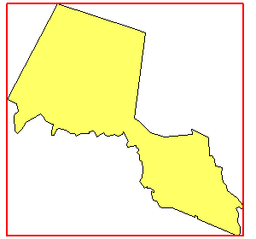
Minimum Bounding Rectangle (MBR)
SDO_MBR
Returns the minimum bounding rectangle around a geometry object
SELECT sdo_geom.sdo_mbr(
c.geom) mbr
FROM us_counties c
WHERE c.county = 'Passaic'
AND c.state_abrv = 'NJ';

Slide 45

Minimum Bounding Circle (MBC)
12c Release 1
SELECT sdo_geom.sdo_mbc(
c.geom)
FROM us_counties c
WHERE c.county = 'Passaic'
AND c.state_abrv = 'NJ';
SELECT sdo_geom.sdo_mbc_center(
c.geom)
FROM us_counties c
WHERE c.county = 'Passaic'
AND c.state_abrv = 'NJ';
SELECT sdo_geom.sdo_mbc_radius(
c.geom)
FROM us_counties c
WHERE c.county = 'Passaic'
AND c.state_abrv = 'NJ';

Slide 46
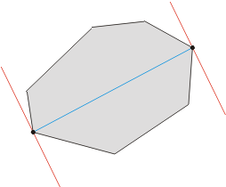
Diameter
12c Release 1
The diameter of a polygon is defined as the maximum distance between any two points of the polygon.
SELECT sdo_geom.sdo_diameter(
c.geom)
FROM us_counties c
WHERE c.county = 'Passaic'
AND c.state_abrv = 'NJ';
SELECT sdo_geom.sdo_diameter_line(
c.geom)
FROM us_counties c
WHERE c.county = 'Passaic'
AND c.state_abrv = 'NJ';
Illustration courtesy of http://cgm.cs.mcgill.ca/~orm/rotcal.html

Slide 47
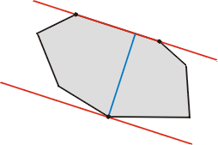
Width
12c Release 1
The width of a convex polygon is defined as the minimum distance between parallel lines of support.
SELECT sdo_geom.sdo_width(
c.geom)
FROM us_counties c
WHERE c.county = 'Passaic'
AND c.state_abrv = 'NJ';
SELECT sdo_geom.sdo_width_line(
c.geom)
FROM us_counties c
WHERE c.county = 'Passaic'
AND c.state_abrv = 'NJ';
Illustration courtesy of http://cgm.cs.mcgill.ca/~orm/rotcal.html

Slide 48
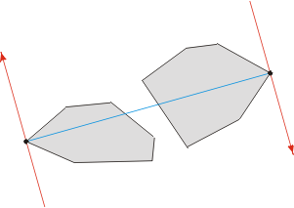
Maximum Distance
12c Release 1
The width of a convex polygon is defined as the minimum distance between parallel lines of support.
SELECT sdo_geom.sdo_maxdistance(
c.geom)
FROM us_counties c
WHERE c.county = 'Passaic'
AND c.state_abrv = 'NJ';
SELECT sdo_geom.sdo_maxdistance_line(
c.geom)
FROM us_counties c
WHERE c.county = 'Passaic'
AND c.state_abrv = 'NJ';
Illustration courtesy of http://cgm.cs.mcgill.ca/~orm/rotcal.html

Slide 49
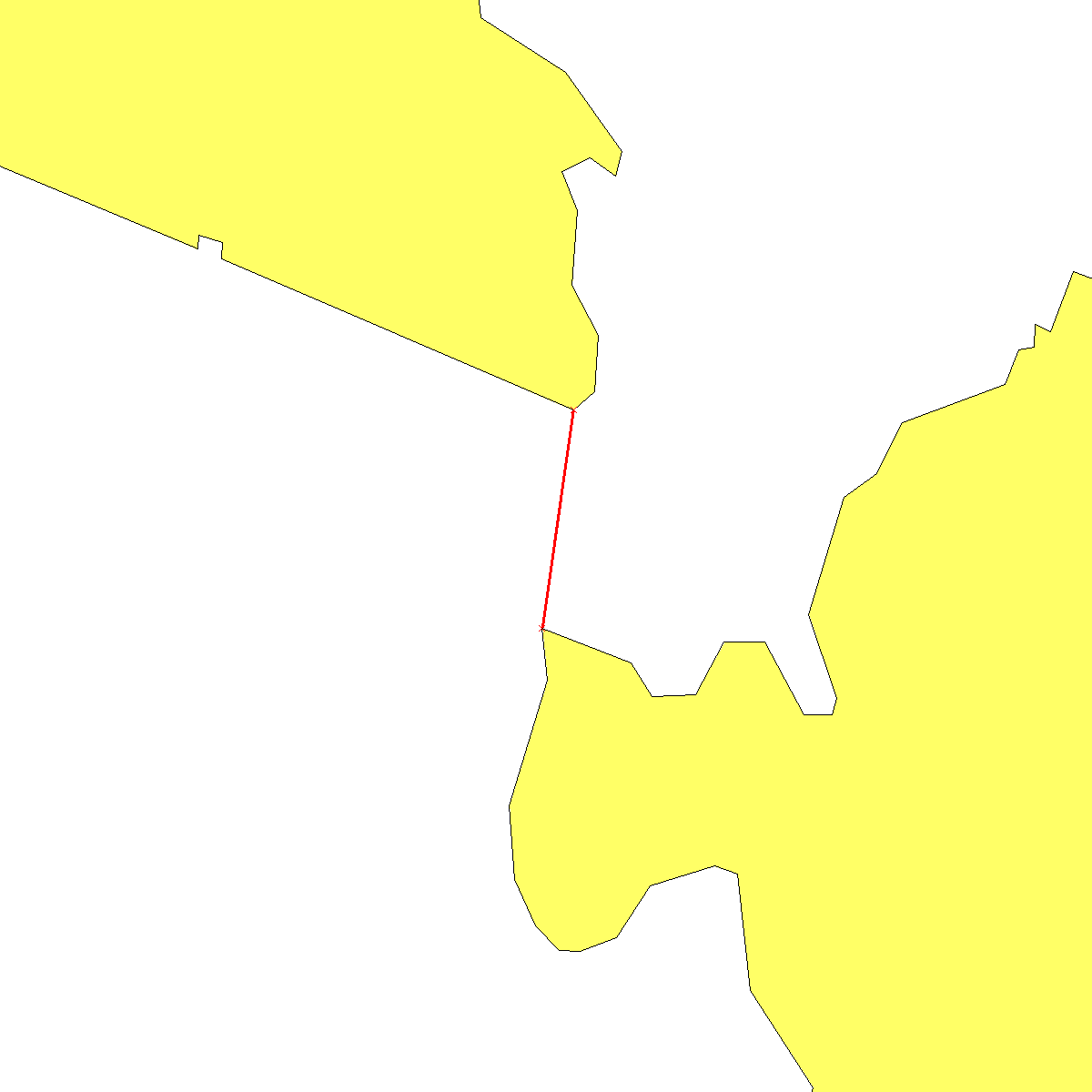
Closest Points
Given two geometries, return the distance between them and the points that are the closest in each
DECLARE
g1 sdo_geometry; g2 sdo_geometry;
g1_pt sdo_geometry; g2_pt sdo_geometry;
distance number;
BEGIN
SELECT geom INTO g1 FROM us_counties
WHERE state_abrv='NJ' AND county='Passaic';
SELECT geom into g2 FROM us_counties
WHERE state_abrv='NJ' AND county='Hudson';
sdo_geom.sdo_closest_points (g1, g2, 0.5,
'unit=km', distance, g1_pt, g2_pt
);
END;

Slide 50
Closest Points
Use a wrapper function to invoke the closest points procedure from SQL
Use a custom type as output from this function:
CREATE OR REPLACE TYPE closest_points_type AS OBJECT (
distance NUMBER,
point_1 sdo_geometry,
point_2 sdo_geometry,
line sdo_geometry
);

Slide 51
Closest Points: Wrapper Function
CREATE OR REPLACE FUNCTION closest_points (
p_geom1 sdo_geometry, p_geom2 sdo_geometry, p_tolerance IN NUMBER, p_unit VARCHAR2
)
RETURN closest_points_type
IS
v_distance NUMBER;
v_point_1 sdo_geometry;
v_point_2 sdo_geometry;
v_line sdo_geometry;
BEGIN
sdo_geom.sdo_closest_points (
p_geom1, p_geom2, p_tolerance, p_unit, v_distance, v_point_1, v_point_2
);
v_line := sdo_geometry (2002, v_point_1.sdo_srid, null, sdo_elem_info_array (1,2,1),
sdo_ordinate_array (
v_point_1.sdo_point.x, v_point_1.sdo_point.y, v_point_2.sdo_point.x, v_point_2.sdo_point.y
)
);
RETURN closest_points_type(v_distance, v_point_1, v_point_2, v_line);
END;

Slide 52
Closest Points: Example of Use
Extract info from the result of the function call
select t.cp.distance, t.cp.point_1, t.cp.point_2, t.cp.line
from (
select closest_points (c1.geom, c2.geom, 0.5, 'unit=km') cp
from us_counties c1, us_counties c2
where c1.state_abrv='NJ' and c1.county='Passaic'
and c2.state_abrv='NJ' and c2.county='Hudson'
) t;
4.0137305
SDO_GEOMETRY(2001, 8307, SDO_POINT_TYPE(-74.130447, 40.819862, NULL), NULL, NULL)
SDO_GEOMETRY(2001, 8307, SDO_POINT_TYPE(-74.148003, 40.786301, NULL), NULL, NULL)
SDO_GEOMETRY(2002, 8307, NULL, SDO_ELEM_INFO_ARRAY(1, 2, 1),
SDO_ORDINATE_ARRAY(-74.130447, 40.819862, -74.148003, 40.786301))
1 row selected.

Slide 53
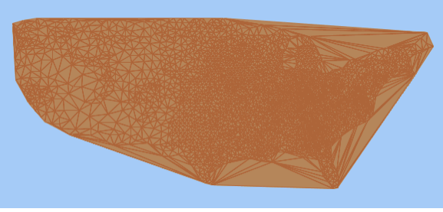
Delaunay Triangulation
Return a geometry with triangular elements that result from Delaunay triangulation of the input geometry
Input geometry is typically a point set - but any geometry is accepted
SDO_GEOM.SDO_TRIANGULATE(
geom IN SDO_GEOMETRY,
tol IN NUMBER
) RETURN SDO_GEOMETRY;

Slide 54
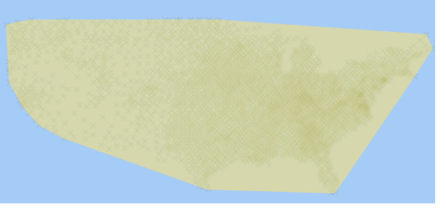
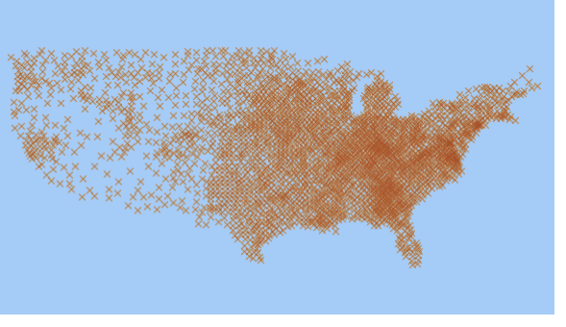
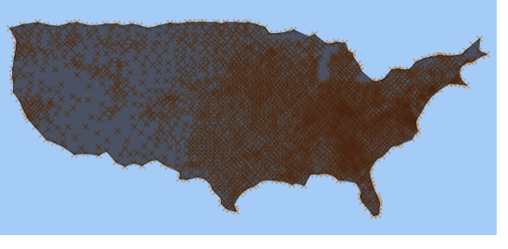
Concave Hull
SDO_GEOM.SDO_CONCAVEHULL(
geom IN SDO_GEOMETRY,
tol IN NUMBER
) RETURN SDO_GEOMETRY;
Note that the function only uses the vertices of the input geometry

Slide 55
Spatial Aggregates

Slide 56
Spatial Aggregate Functions
Operate on a set of geometries
Aggregate geometry returned based on operation
Simplifies coding
Users can define their own aggregate functions using Oracle’s user-defined aggregate framework.

Slide 57
SDOAGGRTYPE
SDOAGGRTYPE
Input parameter to most spatial aggregate functions
Can reuse type for user-defined aggregates
SQL> desc sdoaggrtype
Name Type
----------------------- -------------------
GEOMETRY MDSYS.SDO_GEOMETRY
TOLERANCE NUMBER

Slide 58
SDO_AGGR_UNION
Returns a geometry object that is the topological union of the set of input geometries.
Aggregating geometries in the server can reduce data transferred to the client.
Eliminates the need for PL/SQL code to UNION a set of geometries.

Slide 59
SDO_AGGR_UNION Example
UNION all the county boundaries for the states of New York and New Jersey, and generate a geometry for each state:
SELECT sdo_aggr_union(sdoaggrtype(geom, 0.5)),
state
FROM us_counties
WHERE state_abrv in ('NY', 'NJ')
GROUP by state;

Slide 60
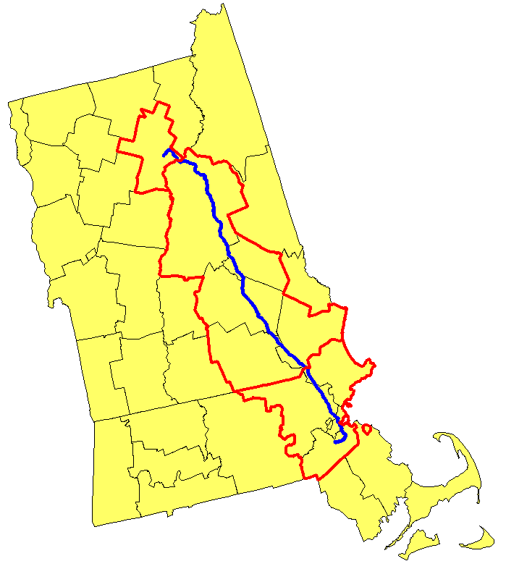
SDO_AGGR_UNION Example
Union all the counties that have any interaction with Interstate I93, grouped by state.
SELECT c.state,
sdo_aggr_union(
sdoaggrtype(c.geom,0.5))
FROM us_interstates i,
us_counties c
WHERE i.interstate = 'I93'
AND sdo_anyinteract(
c.geom, i.geom)='TRUE'
GROUP by c.state;

Slide 61
SDO_AGGR_UNION Performance
12c Release 1
Aggregate all 3230 counties and fuse them into a single polygon
Other techniques no longer needed with Spatial 12c
Using SDO_AGGR_SET_UNION
Recursive aggregation
Still needed for Spatial 11g and Locator 12c
SELECT sdo_aggr_union(sdoaggrtype(geom,0.5))
FROM us_counties;
Elapsed: 00:26:57.21
Without VPA
Elapsed: 00:00:12.56
With VPA
Elapsed: 00:00:26.89
Elapsed: 00:01:18.28

Slide 62
SDO_AGGR_SET_UNION
Operates on an in-memory array of geometries
Use when VPA is not available
Faster than SDO_AGGR_UNION
Operates on geometries in spatial order
But not as flexible
Requires first reading all geometries in an array
For very large aggregations, use SDO_AGGR_UNION with recursive processing

Slide 63
SDO_AGGR_SET_UNION- Example
CREATE OR REPLACE FUNCTION set_geometry (
query_crs SYS_REFCURSOR;
)
RETURN SDO_GEOMETRY_ARRAY deterministic
AS
geom sdo_geometry;
geom_array sdo_geometry_array;
BEGIN
geom_array := sdo_geometry_array();
LOOP
FETCH query_crs into geom;
EXIT when query_crs%NOTFOUND ;
geom_array.extend;
geom_array(geom_array.count) := geom;
END LOOP;
RETURN geom_array;
END;
/
Write a function to accumulate the geometries into an array
Then apply the aggregation on that function.
If many geometries, repeat recursively on batches of geometries
SELECT SDO_AGGR_SET_UNION(
set_geometry (
cursor (select geom from us_counties)
),
0.005
)
FROM DUAL;
This union completes in less than 30 seconds

Slide 64
Recursive Aggregation
SELECT sdo_aggr_union(sdoaggrtype(aggr_geom,0.5)) aggr_geom
FROM
(SELECT sdo_aggr_union(sdoaggrtype(aggr_geom,0.5)) aggr_geom
FROM
(SELECT sdo_aggr_union(sdoaggrtype(aggr_geom,0.5)) aggr_geom
FROM
(SELECT sdo_aggr_union(sdoaggrtype(aggr_geom,0.5)) aggr_geom
FROM
(SELECT sdo_aggr_union(sdoaggrtype(geom,0.5)) aggr_geom
FROM US_COUNTIES
GROUP BY mod(rownum, 128))
GROUP BY mod (rownum, 32))
GROUP BY mod (rownum, 8))
GROUP BY mod (rownum, 2)
);
This union completes in less than 2 minutes

Slide 65
SDO_AGGR_CENTROID
Returns a point that is the “center of gravity” of the set of input geometries
Centroid can be computed for:
Set of points and multipoints
Set of polygons and multipolygons
Example: Can be used to find the label location for a set of map features

Slide 66
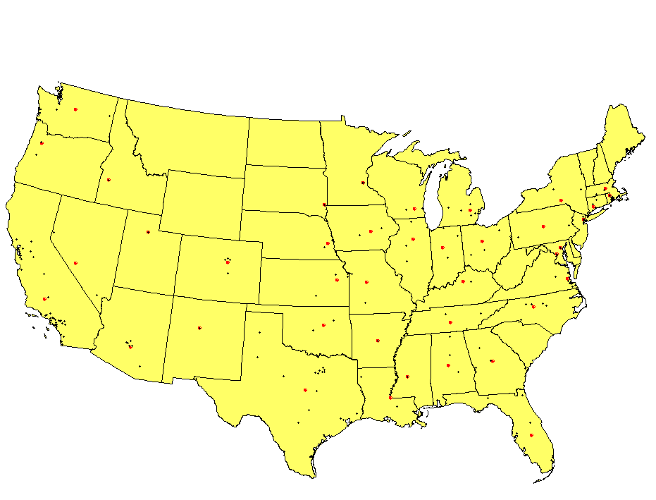
SDO_AGGR_CENTROID Example
For each state, find the centroid of the cities in that state:
SELECT state_abrv,
sdo_aggr_centroid(
sdoaggrtype (
location,0.5
)
)
FROM us_cities
GROUP by state_abrv;

Slide 67
SDO_AGGR_CENTROID Example
Find the centroid for the New England states:
This can be used to find the label location for the U.S. New England states.
SELECT sdo_aggr_centroid(sdoaggrtype(geom, 0.5)),
'New England'
FROM us_states
WHERE state_abrv in ('MA','NH','VT','RI','CT','ME');

Slide 68
SDO_AGGR_CONVEXHULL
Returns the convex hull around the set of input geometries
Convex hull can be computed for:
Points
Lines
Polygons
Example: Can be used to generalize a set of geometries

Slide 69
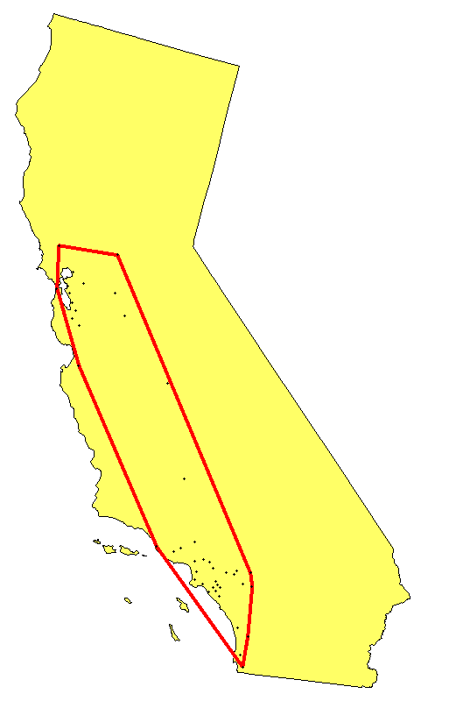
SDO_AGGR_CONVEXHUL
Find the convex hull around the major cities in California
SELECT count(*),
sdo_aggr_convexhull(
sdoaggrtype(location,0.5)
)
FROM us_cities
WHERE state_abrv in ('CA')

Slide 70
SDO_AGGR_CONVEXHULL: Example
Snap a rubber band around contaminated wells.
Dynamically generate new region
Further analysis with new region, for example:
Search for chemical plants within 5 miles of new region
Non-contaminated well
Contaminated well

Slide 71
SDO_AGGR_CONVEXHULL Example
Find all the chemical plants within 5 miles of the convex hull surrounding the contaminated wells:
SELECT cp.plant_name, cp.plant_address
FROM (SELECT sdo_aggr_convexhull(sdoaggrtype(b.geom, 0.5)) window
FROM wells w
WHERE w.well_status = 'Contaminated'
) cw,
chemical_plants cp
WHERE sdo_within_distance (
cp.location, cw.window,
'distance=5 unit=mile')='TRUE';

Slide 72
SDO_AGGR_MBR
Returns the minimum bounding rectangle of the set of input geometries
Works with any type of geometry
Useful for finding the extents of a set of geometries
No need to use the SDOAGGRTYPE type

Slide 73
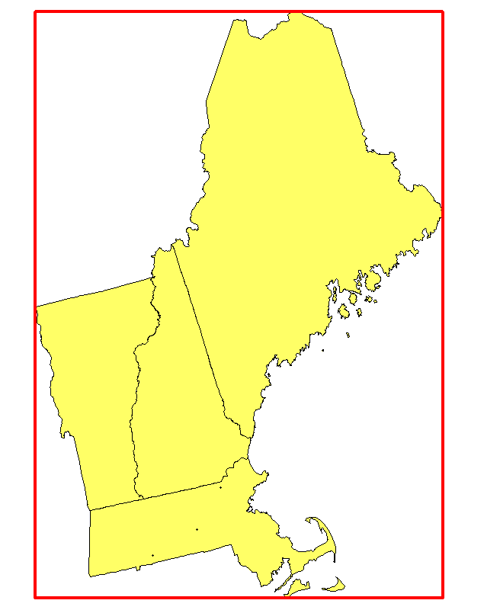
SDO_AGGR_MBR: Example
Generate the MBR for a set of states.
SELECT sdo_aggr_mbr(geom)
FROM us_states
WHERE state_abrv in (
'MA', 'NH', 'VT', 'ME‘
);

Slide 74
Arc Densification

Slide 75
Arc Densification
SDO_GEOM.SDO_ARC_DENSIFY takes a geometry as input that may have arcs, and returns a geometry that contains no arcs.
The spatial function SDO_BUFFER implicitly densifies arcs.
It is important for SDO_BUFFER to use this function when it buffers geodetic geometries, because the output geometry cannot have arcs or circles.
You may never have to call this function explicitly.

Slide 76
Arc Densification
SDO_GEOM.SDO_ARC_DENSIFY
Creates a geometry with no circles or circular arcs
Takes an SDO_GEOMETRY object as input
Any geometry (including compound)
Returns an SDO_GEOMETRY object containing no circles or circular arcs
Creates geometries that can be used in geodetic space

Slide 77
The SDO_ARC_DENSIFY Function
<geometry>:SDO_GEOMETRY object
Can be a variable or table column
<tolerance>:Numeric tolerance of data
<params>:
<arc_tolerance> (required): Maximum distance between an arc and a line approximating the arc
<unit> (optional): Unit for <arc_tolerance>
Returns: An SDO_GEOMETRY object with no arcs or circles
SDO_GEOMETRY := SDO_GEOM.SDO_ARC_DENSIFY
( <geometry>, <tolerance>, <params>)

Slide 78
SDO_ARC_DENSIFY
Arc tolerance
ARC_TOLERANCE is the maximum distance between the original arc, and the line string generated by Oracle Spatial to approximate the arc.
The ARC_TOLERANCE unit can be specified with the UNIT parameter.
If the ARC_TOLERANCE is smaller than TOLERANCE, an Oracle error is returned.

Slide 79
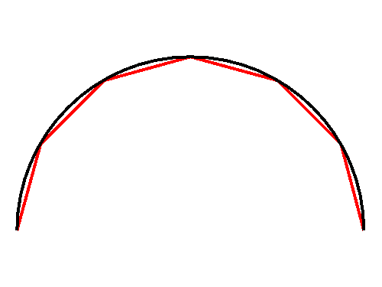
SDO_ARC_DENSIFY: Example
Densify a given arc.
Note that the output geometry has no arcs.
SDO_GEOMETRY(2002, 32775, NULL,
SDO_ELEM_INFO_ARRAY(1, 2, 1),
SDO_ORDINATE_ARRAY(
1832493.90, 2175555.32,
1832551.51, 2175770.32,
1832708.90, 2175927.71,
1832923.90, 2175985.32,
1833138.90, 2175927.71,
1833296.29, 2175770.32,
1833353.90, 2175555.32))
SELECT sdo_geom.sdo_arc_densify (
sdo_geometry(2002, 32775, NULL,
sdo_elem_info_array(1, 2, 2),
sdo_ordinate_array(1832493.9, 2175555.32,
1832923.9, 2175985.32,
1833353.9, 2175555.32)),
0.005,'arc_tolerance=15 unit=meter')
FROM dual;

Slide 80
Transforming arcs to Geodetic
Transforming an arc to a geodetic coordinate system will fail:
Must first densify the arcs before transforming
ORA-13285: Geometry coordinate transformation error
SELECT sdo_cs.transform (
sdo_geom.sdo_arc_densify (
sdo_geometry(2002, 32775, NULL,
sdo_elem_info_array(1, 2, 2),
sdo_ordinate_array(1832493.9, 2175555.32, 1832923.9, 2175985.32,
1833353.9, 2175555.32)
),
0.005,'arc_tolerance=15 unit=meter'
),
8307)
FROM dual;

Slide 81
Coordinate System Transformations

Slide 82
Transformation functions
SDO_CS.TRANSFORM: Transforms a geometry from one coordinate system to another
SDO_CS.TRANSFORM_LAYER: Transforms a layer from one coordinate system to another

Slide 83
The SDO_CS.TRANSFORM Function
SDO_GEOMETRY := SDO_CS.TRANSFORM (<geom>, <to_srid>)
<geom>
Geometry of type SDO_GEOMETRY
Can be a variable or a table column
<to_srid>
Spatial reference system ID to transform to
Return value
Geometry of type SDO_GEOMETRY

Slide 84
SDO_CS.TRANSFORM: Example
Single geometry transformed, for example, Hillsborough County in New Hampshire:
Note: All transformations require valid SDO_SRID field set in source geometry.
Note: 82151 = “New Hampshire 2800 (1983, meters)” - State Plane CS 1983
SELECT sdo_cs.transform (geom, 82151)
FROM us_counties_p
WHERE county = 'Hillsborough'
AND state = 'New Hampshire';

Slide 85
The SDO_CS.TRANSFORM_LAYER Procedure
SDO_CS.TRANSFORM_LAYER(<table_name>,
<geom_column_name>,
<destination_table>,
<to_srid>)
<table_name>:Table with column of type SDO_GEOMETRY
<geom_column_name>: Column of type SDO_GEOMETRY
<destination_table>:Table created by the procedure
<to_srid>: Spatial reference system ID to transform to

Slide 86
TRANSFORM_LAYER: Example
Entire layer transformed
<destination_table> created by the utility
<destination_table> contains two columns:
GEOMETRY
SDO_ROWID
begin
SDO_CS.TRANSFORM_LAYER (
'US_COUNTIES', 'GEOM', 'US_COUNTIES_P', 32775);
end;
/

Slide 87
Implicit vs. Explicit Transformations
With operators: Implicit transformations
Query window automatically transformed to same SDO_SRID of search layer if SDO_SRID in geometries are different
With functions: Explicit transformations
Must manually transform geometries to same SRID (if two geometries)
NOTES:
For operators to work correctly, one of the following must be true:
Both geometries must have geo-referenced coordinate systems.
Both geometries must have local (non-Earth) coordinate systems.
For functions to work correctly:
Both geometries must have the same SDO_SRID specified

Slide 88
Transformation Example
Compute the distance between a GPS point (geodetic) and a park (projected)
Both geometries must have the same SRID.
Transform the park geometry to geodetic
select sdo_geom.sdo_distance (
sdo_geometry(2001, 4326,
sdo_point_type(-116.2261, 43.606651, null),
null, null),
sdo_cs.transform(geom, 4326),
0.05) distance
from us_parks_p
where name = 'Yellowstone NP';

Slide 89
Transformation Example
Can also transform the GPS point to the coordinate system of the parks table
select sdo_geom.sdo_distance (
sdo_cs.transform(
sdo_geometry(2001, 4326,
sdo_point_type(-116.2261, 43.606651, null),
null, null),
p.geom.sdo_srid),
p.geom, 0.05) distance
from us_parks_p p
where p.name = 'Yellowstone NP';

Slide 90
Utility Functions

Slide 91
Package SDO_UTIL
simplify()
circle_polygon()
ellipse_polygon()
polygonToLine()
remove_duplicate_vertices
append()
concat_lines
reverseLinestring()
getNumElem
getNumVertices
convert_unit
point_at_bearing
AffineTransforms

Slide 92
simplify()
Simplifies a geometry using the Douglas-Peucker algorithm to generate a less detailed geometry
GEOM = SDO_UTIL.SIMPLIFY(GEOMETRY, THRESHOLD)
GEOMETRY
The geometry to be simplified
THRESHOLD
Removes vertices from a segment that deviate less than or equal to the threshold value
The smaller the threshold value, the more similar the returned geometry is to the input geometry
The larger the threshold value, the fewer points in the returned geometry

Slide 93
simplify()
Can be applied to lines or polygons
Does not alter tolerance at which data validates
Adjacent polygons with registered edges may not register after generalization

Slide 94
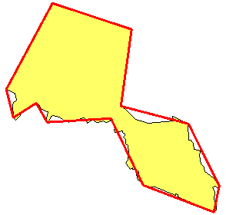
simplify() example
Generalize the border of county Passaic.
SELECT sdo_util.simplify(c.geom,2000)
FROM us_counties c
WHERE c.county = 'Passaic'
AND c.state_abrv = 'NJ';

Slide 95
circle_polygon()
Returns a geodetic polygon that approximates and is covered by the specified circle
GEOM = SDO_UTIL.CIRCLE_POLYGON ( CENTER_LONGITUDE, CENTER_LATITUDE, RADIUS, ARC_TOLERANCE )
CENTER_LONGITUDE and CENTER_LATITUDE
define the center point of the circle
RADIUS
specifies the radius of the circle in meters
ARC_TOLERANCE
is the maximum distance in meters between the arc and the line segments that approximate it

Slide 96
circle_polygon() example
SELECT SDO_UTIL.CIRCLE_POLYGON(
-71.017892, 42.336029, 5000, 50)
FROM dual;
SELECT SDO_GEOMETRY(2003, 4326, NULL,
SDO_ELEM_INFO_ARRAY(1, 1003, 1),
SDO_ORDINATE_ARRAY(
-71.017892,42.2910630, -70.974900,42.3042252,
-70.957062,42.3360129, -70.974857,42.3678167,
-71.017892,42.3809950, -71.060927,42.3678167,
-71.078722,42.3360129, -71.060884,42.3042252,
-71.017892,42.291063));

Slide 97
ellipse_polygon()
Returns a geodetic polygon that approximates and is covered by the specified ellipse
GEOM = SDO_UTIL.ELLIPSE_POLYGON (
CENTER_LONGITUDE, CENTER_LATITUDE,
SEMI_MAJOR_AXIS, SEMI_MINOR_AXIS,
AZIMUTH, ARC_TOLERANCE)
CENTER_LONGITUDE and CENTER_LATITUDE
define the center point of the ellipse
ARC_TOLERANCE
is the maximum distance in meters between the ellipse and the polygon that approximate it

Slide 98
ellipse_polygon()
45⁾
Semi-major axis
Azimuth
Semi-minor axis
SEMI_MAJOR_AXIS, SEMI_MINOR_AXIS
largest and smallest distances from the center of the ellipse in meters
AZIMUTH
The number of degrees of clockwise rotation of the major axis from north. It is a numeric value from 0 to 180

Slide 99
ellipse_polygon() example
SELECT SDO_UTIL.ELLIPSE_POLYGON(
-71.017892, 42.336029, 5000, 4000, 90, 200)
FROM dual;
SDO_GEOMETRY(2003, 4326, NULL,
SDO_ELEM_INFO_ARRAY(1, 1003, 1),
SDO_ORDINATE_ARRAY(
-71.078722,42.3360129, -71.067202,42.3149669,
-71.043386,42.3033686, -71.017892,42.3000562,
-70.992398,42.3033686, -70.968582,42.3149669,
-70.957062,42.3360129, -70.968549,42.3570699,
-70.992372,42.3686838, -71.017892,42.3720018,
-71.043412,42.3686838, -71.067235,42.3570699,
-71.078722,42.3360129))

Slide 100
polygontoline()
Generates a new geometry by converting all polygon elements in a geometry to line elements, and sets the proper SDO_GTYPE
GEOM = SDO_UTIL.POLYGONTOLINE (GEOM)

Slide 101
polygontoline() example
SELECT SDO_UTIL.POLYGONTOLINE(
SDO_GEOMETRY(2003, 4326, NULL,
SDO_ELEM_INFO_ARRAY(1, 1003, 3),
SDO_ORDINATE_ARRAY(-71.017892, 42.291063,
-70.424857, 42.9578167)))
FROM dual;
SDO_GEOMETRY(2002, 4326, NULL,
SDO_ELEM_INFO_ARRAY(1, 2, 1),
SDO_ORDINATE_ARRAY(
-71.017892, 42.2910630, -71.000000, 42.2910630,
-70.424857, 42.2910630, -70.424857, 42.9578167,
-71.000000, 42.9578167, -71.017892, 42.9578167,
-71.017892, 42.2910630))
Note the line returned is based on the densified optimized rectangle

Slide 102
remove_duplicate_vertices()
Generates a new geometry by removing adjacent vertices closer together than a specified tolerance
GEOM = SDO_UTIL.REMOVE_DUPLICATE_VERTICES (GEOM, TOLERANCE)

Slide 103
remove_duplicate_vertices example
SELECT SDO_UTIL.REMOVE_DUPLICATE_VERTICES(
SDO_GEOMETRY(2002, 4326, NULL,
SDO_ELEM_INFO_ARRAY(1, 2, 1),
SDO_ORDINATE_ARRAY(
-71.017892, 42.2910630, -70.974900, 42.3042252,
-70.957062, 42.3360129, -70.957062, 42.3360129,
-70.974857, 42.3678167)), 0.5)
FROM dual;
SDO_GEOMETRY(2002, 4326, NULL,
SDO_ELEM_INFO_ARRAY(1, 2, 1),
SDO_ORDINATE_ARRAY(
-71.017892, 42.2910630, -70.974900, 42.3042252,
-70.957062, 42.3360129, -70.974857, 42.3678167))

Slide 104
append()
Accepts two geometries as input and returns a single geometry with the second geometry appended to the first
GEOM = SDO_UTIL.APPEND (GEOM1, GEOM2)

Slide 105
append() example
SELECT SDO_UTIL.APPEND(
SDO_GEOMETRY(2002, null, null,
SDO_ELEM_INFO_ARRAY(1,2,1),
SDO_ORDINATE_ARRAY(4,4, 7,4, 10,5)),
SDO_GEOMETRY(2003, null, null,
SDO_ELEM_INFO_ARRAY(1,1003,3),
SDO_ORDINATE_ARRAY(6,6, 8,8)))
FROM dual;
SDO_GEOMETRY(2004, NULL, NULL,
SDO_ELEM_INFO_ARRAY(1, 2, 1, 7, 1003, 3),
SDO_ORDINATE_ARRAY(4, 4, 7, 4, 10, 5, 6, 6, 8, 8))

Slide 106
concat_lines()
Concatenates two linestring or multilinestring 2D geometries to create a new geometry, matching equivalent start/end points
Only matches endpoints, no other overlaps between linestrings are allowed
Faster than SDO_UNION()
Used for road networks
GEOM = SDO_UTIL.CONCAT_LINES (GEOM1, GEOM2)

Slide 107
concat_lines() example
SELECT SDO_UTIL.CONCAT_LINES(
SDO_GEOMETRY(2006,NULL,NULL,
SDO_ELEM_INFO_ARRAY(1,2,1,5,2,1),
SDO_ORDINATE_ARRAY(1,1,5,1,7,1,9,1)),
SDO_GEOMETRY(2006,NULL,NULL,
SDO_ELEM_INFO_ARRAY(1,2,1,5,2,1),
SDO_ORDINATE_ARRAY(9,1,10,1,7,1,5,1)))
FROM dual;
SDO_GEOMETRY(2002, NULL, NULL,
SDO_ELEM_INFO_ARRAY(1, 2, 1),
SDO_ORDINATE_ARRAY(10, 1, 9, 1, 7, 1, 5, 1, 1, 1))

Slide 108
concat_lines() example
Line 1:
(1,1)
(5,1)
(7,1)
(9,1)
Line 2:
(5,1)
(7,1)
(9,1)
(10,1)
Result:
(1,1)
(5,1)
(7,1)
(9,1)
(10,1)

Slide 109
reverse_linestring()
Accepts a two-dimensional linestring geometry as input and returns a linestring with the coordinates in reverse order
GEOM = SDO_UTIL.REVERSE_LINESTRING (GEOM)

Slide 110
reverse_linestring() example
SELECT SDO_UTIL.REVERSE_LINESTRING(
SDO_GEOMETRY(2002, 4326, NULL,
SDO_ELEM_INFO_ARRAY(1,2,1),
SDO_ORDINATE_ARRAY(
-72, 43, -71.5, 43.5, -71, 42, -70, 40)))
FROM dual;
SDO_GEOMETRY(2002, 4326, NULL,
SDO_ELEM_INFO_ARRAY(1, 2, 1),
SDO_ORDINATE_ARRAY(
-70, 40, -71, 42, -71.5, 43.5, -72, 43))

Slide 111
getnumelem() and getnumvertices()
getnumelem()
Returns the number of elements in a geometry
Elements are counted based on the OGC definitions:
A polygon with voids counts as one element.
getnumrings()
Returns the number of rings (points) in a geometry
A polygon with a void has 2 rings
getnumvertices()
Returns the number of vertices (points) in a geometry
N = SDO_UTIL.GETNUMELEM (GEOM)
N = SDO_UTIL.GETNUMRINGS (GEOM)
N = SDO_UTIL.GETNUMVERTICES (GEOM)

Slide 112
getnumelem() and getnumvertices() example
SELECT county,
sdo_util.getnumelem(geom) elements,
sdo_util.getnumrings(geom) rings,
sdo_util.getnumvertices(geom) points
FROM us_counties
WHERE county in ('Denver', 'Arapahoe');
COUNTY ELEMENTS RINGS POINTS
------------------ ---------- ---------- ----------
Arapahoe 2 2 123
Denver 1 2 248
Note that Denver is a polygon with a void

Slide 113
extract()
Extracts one element from a geometry
Elements are identified by their sequence number
Starting from 1
Useful to break a multi-elements geometry into its elements
You can also break polygon elements in individual rings
GEOM = SDO_UTIL.EXTRACT (GEOM, ELEM_NUMBER)
GEOM = SDO_UTIL.EXTRACT (GEOM, ELEM_NUMBER, RING_NUMBER)

Slide 114
extract() example
Define an object and an array type
create or replace type sdo_geometry_row as object (
element_id number,
element_geom sdo_geometry
);
/
create or replace type sdo_geometry_table
as table of sdo_geometry_row;
/

Slide 115
extract() example
Define a « pipelined » function
create or replace function get_elements (g sdo_geometry)
return sdo_geometry_table
pipelined
as
begin
for i in 1..sdo_util.getnumelem(g) loop
pipe row (sdo_geometry_row (i,sdo_util.extract(g,i)));
end loop;
return;
end;
/

Slide 116
extract() example
Decompose the state of California into its elements
Decompose all states
select element_id, element_geom
from us_states, table(get_elements(geom))
where state_abrv = 'CA'
order by element_id;
select id, state_abrv, element_id, element_geom
from us_states, table(get_elements(geom))
order by id, element_id;
create table us_states_elements as
select id, state_abrv, element_id, element_geom
from us_states, table(get_elements(geom));

Slide 117
convert_unit()
Converts a number from one unit to another
NUMBER = SDO_UTIL.CONVERT_UNIT (
START_NUMBER, FROM_UNIT, TO_UNIT )
START_NUMBER: The number to convert
FROM_UNIT: The unit to convert from
TO_UNIT: The unit to convert to
FROM_UNIT and TO_UNIT parameters must come from the SDO_UNIT column of the same table. Choose one of the following tables:
MDSYS.SDO_AREA_UNITS
MDSYS.SDO_DIST_UNITS
MDSYS.SDO_ANGLE_UNITS

Slide 118
convert_unit() examples
How many km in 1540 Nautical Miles ?
How may square km are 12000 Acres
SELECT SDO_UTIL.CONVERT_UNIT (
1540,'NAUT_MILE', 'km') FROM dual;
2852.08
SELECT SDO_UTIL.CONVERT_UNIT (
12000, 'acre', 'sq_km') FROM dual;
48.562272

Slide 119
point_at_bearing()
Returns a point a specified distance and bearing from a start point
GEOM = SDO_UTIL.POINT_AT_BEARING (
<GEOMETRY_START_POINT>, <BEARING>, <DISTANCE> )
GEOMETRY_START_POINT: The start point (must be longitude/latitude)
BEARING : The bearing, specified in radians
Valid values from -pi to pi (0 is North)
To convert degrees to radians use SDO_UTIL.CONVERT_UNIT
DISTANCE: The distance, specified in meters
Must be less than ½ the circumference of the Earth

Slide 120
point_at_bearing() example
Find the point 3,000 km due south of the point (160,85)
SELECT SDO_UTIL.POINT_AT_BEARING(
SDO_GEOMETRY(2001, 4326,
SDO_POINT_TYPE(-160, 85, NULL), NULL, NULL),
3.14159265,
3000000)
FROM dual;
SDO_GEOMETRY(2001, 4326, NULL,
SDO_ELEM_INFO_ARRAY(1, 1, 1),
SDO_ORDINATE_ARRAY(-160, 58.0203822))

Slide 121
point_at_bearing() example
Find the point 3,000 km due south of the point (160,85)
SELECT SDO_UTIL.POINT_AT_BEARING(
SDO_GEOMETRY(2001, 4326,
SDO_POINT_TYPE(-160, 85, NULL), NULL, NULL),
SDO_UTIL.CONVERT_UNIT(180, 'degree', 'radian'),
3000000)
FROM dual;
SDO_GEOMETRY(2001, 4326, NULL,
SDO_ELEM_INFO_ARRAY(1, 1, 1),
SDO_ORDINATE_ARRAY(-160, 58.0203822))

Slide 122
Affine Transformation
Applies various transformations to a geometry
Move (translate)
Scale (enlarge/reduce)
Rotate
Reflect
Shear
Combine multiple operations
Example: Move, scale and rotate
2D or 3D

Slide 123
General Syntax
Multiple sets of parameters
Each set has a “TRUE”/”FALSE” parameter
Indicates that the corresponding transform should be applied
GEOMETRY = SDO_UTIL.AFFINETRANSFORMS (
GEOMETRY,
<translation parameters>,
<scaling parameters>,
<rotation parameters>,
<shearing parameters>,
<reflection parameters>
)

Slide 124
Translation Example
select sdo_util.affinetransforms(
geometry => sdo_geometry(
2003, null, null,
sdo_elem_info_array (1,1003,1),
sdo_ordinate_array (
3,0, 5,1, 3,2, 1,2, 1,0, 3,0)
),
translation => ‘TRUE',
tx => 2.0,
ty => 3.0,
tz => 0.0,
scaling => 'FALSE', ...
rotation => 'FALSE', ...
shearing => 'FALSE', ...
reflection => 'FALSE', ...
)
from dual;

Slide 125
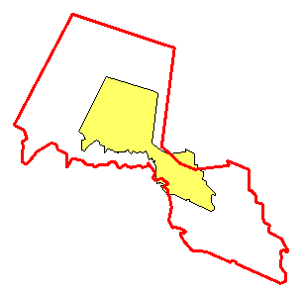
Scaling Example
Enlarge county Passaic around its centroid
SELECT
sdo_util.affinetransforms(
geometry => geom,
scaling => 'TRUE',
psc1 =>
sdo_geom.sdo_centroid(c.geom, 0.5),
sx => 2.0,
sy => 2.0,
sz => 0.0
)
FROM us_counties_p c
WHERE c.county = 'Passaic'
AND c.state_abrv = 'NJ'

Slide 126
OGC Methods and Constructors

Slide 127
OGC Methods
GET_WKT
Returns Well Known Text format of SDO_GEOMETRY
GET_WKB
Returns Well Known Binary format of SDO_GEOMETRY
ST_CoordDim
Returns dimensionality of input geometry
ST_IsValid
Determines validity of input geometry
Returns 1 if valid, 0 otherwise
NOTE: do not forget to use table aliases !

Slide 128
OGC Well Known Text: get_wkt()
Extract geometries to WKT
SELECT city, c.location.get_wkt()
FROM us_cities c
WHERE state_abrv = 'CO';
Denver POINT (-104.872655 39.768035)
Colorado Springs POINT (-104.759899 38.8632)
Aurora POINT (-104.729772 39.712267)
Lakewood POINT (-105.113556 39.6952)

Slide 129
OGC Well Known Text: get_wkt()
Extract geometries to WKT
SELECT c.geom.get_wkt()
FROM us_counties c
WHERE county = 'Denver';
POLYGON (
(-105.052597 39.791199, -105.064606 39.789928, ...
... -105.024757 39.790947,-105.052597 39.791199),
(-104.933578 39.698139, -104.936104 39.698299, ...
... -104.9338 39.696701, -104.933578 39.698139))
Output is a CLOB: can be displayed in SQLPLUS
Use “SET LONG 32000” to see all

Slide 130
OGC Well Known Binary: get_wkb()
Extract geometries to WKB
SELECT city, c.location.get_wkb()
FROM us_cities c
WHERE state_abrv = 'CO';
Aurora 0000000001C05A2EB4959E62564043DB2B90A78290
Colorado Springs 0000000001C05A30A22F6A50D740436E7D566CF41F
Denver 0000000001C05A37D9945B6C374043E24EF88B9778
Lakewood 0000000001C05A4744806290EF4043D8FC504816F0
Output is a BLOB: can be displayed (in hex) in SQLPLUS 11g
Use “SET LONG 32000” to see all

Slide 131
OGC Well Known Binary: get_wkb()
Create new tables with WKB geometries
CREATE TABLE us_counties_wkb AS
SELECT county, state_abrv, c.geom.get_wkb() wkb_geom
FROM us_counties c;
CREATE TABLE us_cities_wkb AS
SELECT id, city, state_abrv, pop90, rank90,
c.geom.get_wkb() location
FROM us_cities c;

Slide 132
OGC Constructors
Use OGC Well Known Text or Well Known Binary as input
For WKT: CLOB or VARCHAR string
For WKB: BLOB
Optionally, supply the SRID number
Simply supply the WKT string or the WKB blob as input to SDO_GEOMETRY()
NOTE: WKB and WKT do not contain SRIDs

Slide 133
Loading Well-Known Text
No SRID specified
SRID provided
INSERT INTO test_polygon(id, geom)
VALUES (1, SDO_GEOMETRY(
'POLYGON((33300 19200, 19200 30000, 8300 15000,
20000 4200, 33300 19200))')
);
INSERT INTO us_cities (id, city, state_abrv, location)
VALUES (196, 'Bismarck', 'ND',
SDO_GEOMETRY('POINT (-100.74869 46.7666667)', 4326)
);

Slide 134
Loading Well-Known Binary
INSERT INTO us_cities (id, city, state_abrv, location)
VALUES (196, 'Bismarck', 'ND',
SDO_GEOMETRY(
to_blob (
hextoraw('0000000001C0592FEA897635E7404762222269B754')
),
4326)
);
SELECT county, state_abrv,
sdo_geometry (wkb_geom)
FROM us_counties_wkb
WHERE county = 'Denver';

Slide 135
Utility Functions
Convert from WKB/WKT to SDO_GEOMETRY
sdo_geometry := SDO_UTIL.FROM_WKBGEOMETRY(blob)
sdo_geometry := SDO_UTIL. FROM_WKTGEOMETRY(clob)
Convert from SDO_GEOMETRY to WKB/WKT
blob := SDO_UTIL. TO_WKBGEOMETRY(blob)
clob := SDO_UTIL. TO_WKTGEOMETRY(clob)
Validations
status := SDO_UTIL. VALIDATE_WKBGEOMETRY(blob)
status := SDO_UTIL. VALIDATE_WKTGEOMETRY(clob)

Slide 136
GML Processing

Slide 137
Exporting Geometries to GML
SELECT sdo_util.to_gmlgeometry(location)
FROM us_cities
WHERE state_abrv = 'CO';
<gml:Point srsName="EPSG:4326"
xmlns:gml="http://www.opengis.net/gml">
<gml:coordinates decimal="." cs="," ts=" ">
-104.872655,39.768035
</gml:coordinates>
</gml:Point>

Slide 138
Generating complete XML documents List all Cities in one State
SELECT xmlelement ("Cities",
xmlattributes(
'http://www.opengis.net/gml' as "xmlns:gml"),
xmlagg (
xmlelement ( "City",
xmlforest (
city as "Name",
pop90 as "Population",
xmltype (sdo_util.to_gmlgeometry(location)) as "gml:geometryProperty"
)
)
)
)
FROM us_cities
WHERE state_abrv = ('CO');
Notes:
Geography Markup Language Support: XMLFOREST Functionality
The example on this slide invokes SDO_UTIL.TO_GMLGEOMETRY embedded within XMLFOREST functionality. The query returns more than one geometry and attributes in Geography Markup Language formatted within a single XML document.

Slide 139
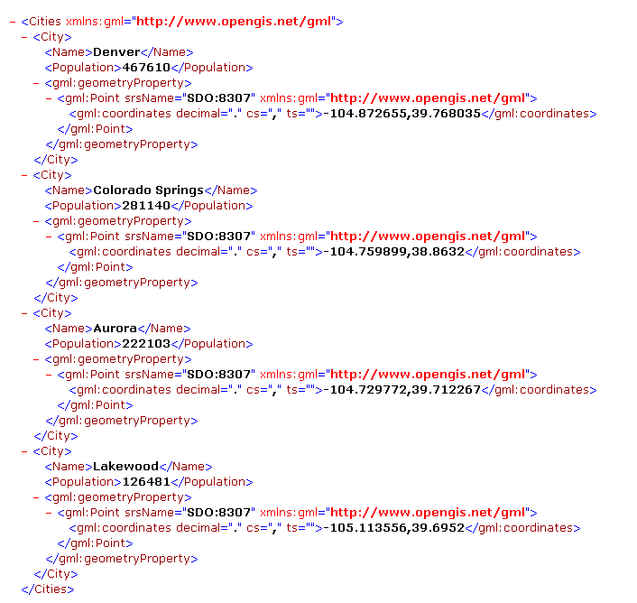
Generating complete XML documents
Multiple XML documents.
One document for each state
Notes:
Geography Markup Language Support: XMLFOREST Functionality
This is the result of the query on the previous slide. The result continues on the next slide.

Slide 140
Generating complete XML documents List Cities in all States
SELECT xmlelement ("States", xmlattributes('http://www.opengis.net/gml' as "xmlns:gml"),
xmlagg (
xmlelement ("State",
xmlattributes(s.id as "Id",s.state_abrv as "Code"),
xmlforest (
s.state as "Name",
s.totpop as "Population",
(select xmlagg (
xmlelement ( "City",xmlattributes(s.id as "Id"),
xmlforest (
c.city as "Name",
c.pop90 as "Population",
xmltype (sdo_util.to_gmlgeometry(c.location)) as "gml:geometryProperty"
)
)
)
from us_cities c where c.state_abrv = s.state_abrv
) as "Cities"
)
)
)
)
FROM us_states s ORDER BY s.state;
Notes:
Geography Markup Language Support: XMLFOREST Functionality
The example on this slide invokes SDO_UTIL.TO_GMLGEOMETRY embedded within XMLFOREST functionality. The query returns more than one geometry and attributes in Geography Markup Language formatted within a single XML document.

Slide 141
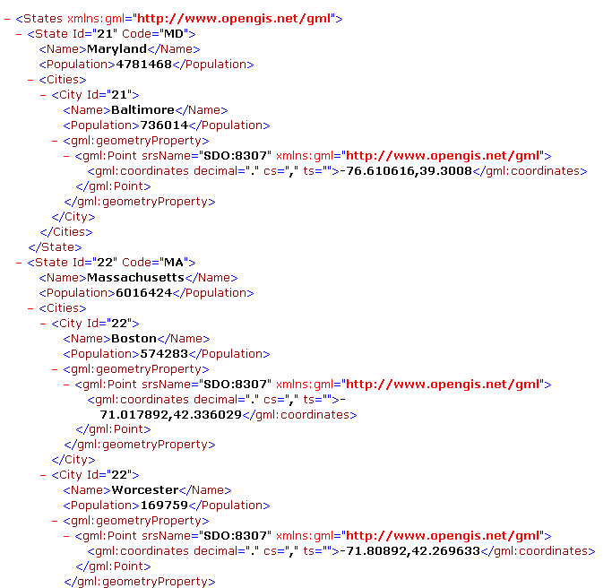
Generating complete XML documents
One single XML document.
Groups information for all states
Notes:
Geography Markup Language Support: XMLFOREST Functionality
This is the result of the query on the previous slide. The result continues on the next slide.

Slide 142
Importing from GML
INSERT INTO us_cities (id, city, state_abrv, location)
VALUES (196, 'Bismarck', 'ND',
sdo_util.from_gmlgeometry (
'<gml:Point srsName="EPSG:4326"
xmlns:gml="http://www.opengis.net/gml">
<gml:coordinates decimal="." cs="," ts=" ">
-100.74869, 46.7666667
</gml:coordinates>
</gml:Point>'
)
);

Slide 143
Processing in PL/SQL

Slide 144
Modifying Geometries in PL/SQL
PL/SQL collection (VARRAY) methods:
COUNT
EXTEND
TRIM
Others
Reference: PL/SQL User’s Guide and Reference, Using PL/SQL Collections and Records.
SDO_TOOLS package

Slide 145
Example: Appending a point to a line
create or replace function append_point (
line sdo_geometry, point sdo_geometry)
deterministic
return sdo_geometry
is
g sdo_geometry; -- Updated geometry
p number; -- Insertion point into ordinates array
begin
-- Initialize output line with input line
g := line;
-- Determine insertion point into ordinates array.
p := g.sdo_ordinates.count() + 1;
-- Extend the ordinates array (assume 2D)
g.sdo_ordinates.extend(2);
-- Store the new point
g.sdo_ordinates(p) := point.sdo_point.x;
g.sdo_ordinates(p+1) := point.sdo_point.y;
-- Return new line string
return g;
end;

Slide 146
Example: Reading a point from a line
create or replace function get_point (
geom sdo_geometry, point_number number)
deterministic
return sdo_geometry
is
i number; -- Index into ordinates array
px number; -- X of extracted point
py number; -- Y of extracted point
begin
-- Get index into ordinates array
i := (point_number-1) * geom.get_dims() + 1;
-- Extract the X and Y coordinates of the desired point
px := geom.sdo_ordinates(i);
py := geom.sdo_ordinates(i+1);
-- Construct and return the point
return
sdo_geometry (2001, geom.sdo_srid,
sdo_point_type (px, py, null), null, null);
end;

Slide 147
Example: Removing a point from a line
create or replace function remove_point (
line sdo_geometry, point_number number)
deterministic
return sdo_geometry
is
g sdo_geometry; -- Updated geometry
p number; -- Index into ordinates array
d number; -- Number of dimensions in geometry
i number;
begin
-- Get the number of dimensions of input geometry
d := line.get_dims();
-- Get index into ordinates array
p := (point_number-1) * d + 1;
-- Initialize output line with input line
g := line;
-- Shift the ordinates down
for i in p..g.sdo_ordinates.count()-d loop
g.sdo_ordinates(i) := g.sdo_ordinates(i+d);
end loop;
-- Trim the ordinates array
g.sdo_ordinates.trim (d);
-- Return new line string
return g;
end;

Slide 148
Why DETERMINISTIC functions ?
A DETERMINISTIC function always returns the same result, given the same inputs.
Most functions are deterministic. A few are not:
Get the current time of day, get a random number, …
By default, functions are not deterministic: declare them explicitly as such!
The optimizer knows to only call the function once in a statement execution, even if it appears multiple times (with the same inputs)
Function-based indexes require deterministic functions
All standard spatial functions are deterministic!

Slide 149
Functions returning objects
Consider a function that returns an geometry:
CREATE OR REPLACE FUNCTION f (geom SDO_GEOMETRY)
RETURN SDO_GEOMETRY
AS
new_geom SDO_GEOMETRY;
BEGIN
/* Your processing here */
RETURN new_geom;
END;

Slide 150
Functions returning objects
Use the function to apply some calculation on a set of geometries in a table:
The function is called N+1 times for each row where N is the number of properties in the object!
For an SDO_GEOMETRY type, that means 8 times per row !
This is a known and documented behavior. See bugs 6884275 and 7447633.
It applies to functions called in UPDATE, INSERT and CREATE TABLE … AS SELECT statements.
UPDATE CUSTOMERS SET LOCATION = f (LOCATION);

Slide 151
Functions returning objects
The solution: declare the function as DETERMINISTIC
All spatial functions in all packages are deterministic.
CREATE OR REPLACE FUNCTION f (geom SDO_GEOMETRY)
RETURN SDO_GEOMETRY
DETERMINISTIC
AS
new_geom SDO_GEOMETRY;
BEGIN
/* Your processing here */
RETURN new_geom;
END;

Slide 152
CREATE TABLE AS SELECT
The DETERMINISTIC flag is ignored for “CREATE TABLE AS SELECT”
The SDO_INTERSECTION function is called 8 times for each row.
CREATE TABLE parks_clipped as
SELECT p.id, p.name, s.state_abrv,
sdo_geom.sdo_intersection(p.geom,s.geom,0.05) shape
FROM us_parks p, us_states s
WHERE sdo_anyinteract(p.geom, s.geom) = 'TRUE';
Table created.
Elapsed: 00:08:44.31

Slide 153
INSERT … SELECT
The DETERMINISTIC flag is used for “INSERT … SELECT”
The SDO_INTERSECTION function is called once for each row.
INSERT INTO parks_clipped
SELECT p.id, p.name, s.state_abrv,
sdo_geom.sdo_intersection(p.geom,s.geom,0.05) shape
FROM us_parks p, us_states s
WHERE sdo_anyinteract(p.geom, s.geom) = 'TRUE';
6547 rows created.
Elapsed: 00:01:08.42

Slide 154
INSERT … SELECT with APPEND
The DETERMINISTIC flag is also used for “INSERT … SELECT” with the APPEND hint!
The SDO_INTERSECTION function is called once for each row.
INSERT /*+ append */ INTO parks_clipped
SELECT p.id, p.name, s.state_abrv,
sdo_geom.sdo_intersection(p.geom,s.geom,0.05) shape
FROM us_parks p, us_states s
WHERE sdo_anyinteract(p.geom, s.geom) = 'TRUE';
6547 rows created.
Elapsed: 00:01:12.33

Slide 155
INSERT … SELECT with APPEND and PARALLEL
The DETERMINISTIC flag is ignored for “INSERT … SELECT” with the APPEND hint when input is parallel
The SDO_INTERSECTION function is called 8 times for each park.
INSERT /*+ append */ INTO parks_clipped
SELECT /*+ parallel(2) */ p.id, p.name, s.state_abrv,
sdo_geom.sdo_intersection(p.geom,s.geom,0.05) shape
FROM us_parks p, us_states s
WHERE sdo_anyinteract(p.geom, s.geom) = 'TRUE';
6547 rows created.
Elapsed: 00:04:52.25

Slide 156
INSERT … SELECT with PARALLEL input and output
The DETERMINISTIC flag is used for “INSERT … SELECT” when both input and output are parallel
The SDO_INTERSECTION function is called once for each row.
INSERT /*+ parallel(2) */ INTO parks_clipped
SELECT /*+ parallel(2) */ p.id, p.name, s.state_abrv,
sdo_geom.sdo_intersection(p.geom,s.geom,0.05) shape
FROM us_parks p, us_states s
WHERE sdo_anyinteract(p.geom, s.geom) = 'TRUE';
6547 rows created.
Elapsed: 00:01:08.27

Slide 157
INSERT … SELECT performance summary
INSERT hints | SELECT hints | DETERMINISTIC used ?
None | None | Yes
APPEND | None | Yes
APPEND | PARALLEL | No
PARALLEL | PARALLEL | Yes
PARALLEL and APPEND | PARALLEL | No
PARALLEL and APPEND | None | Yes

Slide 158
Java API

Slide 159
Java API
Included in Oracle installation
$ORACLE_HOME/md/jlib
sdoapi.jar (oracle.spatial.geometry), sdoutl.jar (oracle.spatial.util)
Can be redistributed with your applications
Just like the JDBC drivers
class JGeometry
load() and store() methods to convert from/to SDO_GEOMETRY
Get/set/constructors and processing methods
Utility functions
Read and write GML
Read ESRI Shape Files
…

Slide 160
Notes on Java versions
In Oracle 11gR2: JDK 1.5.0
In Oracle 12cR1: JDK 1.6.0
To find out the version of the JDK shipped with the database:
To find the version of the JVM inside the database:
C:\>%ORACLE_HOME%\jdk\bin\java -version
java version "1.5.0_17"
Java(TM) 2 Runtime Environment, Standard Edition (build 1.5.0_17-b03)
Java HotSpot(TM) Client VM (build 1.5.0_17-b03, mixed mode)
create or replace function get_java_property(p_name in varchar2) return varchar2
is language java
name 'java.lang.System.getProperty(java.lang.String) return java.lang.String';
/
select get_java_property('java.version') from dual;
1.6.0_71

Slide 161
Fetching geometries
// Construct SQL query
String sqlQuery = "SELECT GEOM FROM US_COUNTIES"
// Execute query
Statement stmt = dbConnection.createStatement();
ResultSet rs = (ResultSet)stmt.executeQuery(sqlQuery);
// Fetch results
while (rs.next())
{
// Extract JDBC object from record into structure
STRUCT dbObject = (STRUCT) rs.getObject(1);
// Import from structure into Geometry object
JGeometry geom = JGeometry.load(dbObject);
}

Slide 162
Extracting information from geometries
int gType = geom.getType();
int gSRID = geom.getSRID();
int gDimensions = geom.getDimensions();
long gNumPoints = geom.getNumPoints();
long gSize = geom.getSize();
boolean isPoint = geom.isPoint();
boolean isCircle = geom.isCircle();
boolean hasCircularArcs = geom.hasCircularArcs();
boolean isGeodeticMBR = geom.isGeodeticMBR();
boolean isLRSGeometry = geom.isLRSGeometry();
boolean isMultiPoint = geom.isMultiPoint();
boolean isRectangle = geom.isRectangle();

Slide 163
Extracting information from geometries
// Point
double gPoint[] = geom.getPoint();
// Element info array
int gElemInfo[] = geom.getElemInfo();
// Ordinates array
double gOrdinates[] = geom.getOrdinatesArray();
// First and last point
double[] gFirstPoint = geom.getFirstPoint();
double[] gLastPoint = geom.getLastPoint();
// MBR
double[] gMBR = geom.getMBR();
// Java Shape
Shape gShape = geom.createShape();

Slide 164
Constructing geometries
// Point
JGeometry geom = new JGeometry(10,5, 8307);
// Point (3D)
JGeometry geom = new JGeometry(10,5,3, 8307);
// Rectangle
JGeometry geom = new JGeometry(10,135, 20,140, 8307);
// Any geometry (compound linestring)
JGeometry geom = new JGeometry(
2002,8307,
new int[] {1,4,3, 1,2,1, 3,2,2, 7,2,1},
new double[] {10,45, 20,45, 23,48, 20,51, 10,51});

Slide 165
Constructing geometries
// Point
JGeometry geom = JGeometry.createPoint(new double[] {10,5}, 2, 0);
// Linestring
JGeometry geom = JGeometry.createLinearLineString(
new double[] {10,25, 20,30, 25,25, 30,30}, 2, 0);
// Simple polygon
JGeometry geom = JGeometry.createLinearPolygon(
new double[] {10,105, 15,105, 20,110, 10,110, 10,105}, 2, 0);
// Polygon with voids
JGeometry geom = JGeometry.createLinearPolygon(
new double[][] {{50,105, 55,105, 60,110, 50,110, 50,105},
{52,106, 54,106, 54,108, 52,108, 52,106}}, 2, 0);

Slide 166
More geometries
// Multi-point
JGeometry geom = JGeometry.createMultiPoint(
new double[][] {{50,5}, {55,7}, {60,5}}, 2, 0);
// Multi-linestring
JGeometry geom = JGeometry.createLinearMultiLineString(
new double[][] {{50,15, 55,15}, {60,15, 65,15}}, 2, 0);
// Circle (using 3 points on the circumference)
geom = JGeometry.createCircle(15,145, 10,150, 20,150, 0);
// Circle (using a center point and radius)
geom = JGeometry.createCircle(10,150, 5, 0);

Slide 167
Writing geometries to database
// Construct the SQL statement
String SqlStatement = "INSERT INTO SHAPES (ID, GEOM) VALUES (?,?)";
// Prepare the SQL statement
PreparedStatement stmt =
dbConnection.prepareStatement(SqlStatement);
// Convert object into java STRUCT
STRUCT s = JGeometry.store (geom, dbConnection);
// Insert row in the database table
stmt.setInt (1, i);
stmt.setObject (2, s);
stmt.execute();

Slide 168
Full Working Examples
SdoPrint.java
Prints out the geometries in a table. Shows how to read geometries and examine their content.
SdoExport.java
Exports the geometries in a variety of formats (WKT, WKB, GML, ...). Shows how to read and convert geometries.
SdoImport.java
Imports back previously exported geometries. Shows how to convert geometries from various formats (GML, WKT, WKB, ...) and insert them into an existing database table.
SdoLoadShape.java
Loads an ESRI shape file into a database table. Shows how you can write your own loader. This loader automatically renames column names that are reserved words.

Slide 169
Loading Shape Files from SQL
Define a wrapper procedure to call the load method (loadShapeFile) in class SdoLoadShape
CREATE OR REPLACE PROCEDURE LoadShapeFile (
shpFileName VARCHAR2,
srid NUMBER,
tableName VARCHAR2
)
AS LANGUAGE JAVA
NAME 'SdoLoadShape.loadShapeFile(java.lang.String, int, java.lang.String)';
/
The loadShapeFile() method has several signatures. This is the simpler one with defaults values used for the name of the geometry column, etc

Slide 170
Loading Shape Files from SQL
Load the SdoLoadShape class into the database and compile it
Load a shape file
loadjava -user scott/tiger@orcl111 -force –resolve SdoLoadShape.java
call loadshapefile (
shpfilename
=> 'D:\Courses\Spatial11g-Workshop\data\04-loading\shape\world_countries',
srid => 8307,
tablename => 'WORLD_COUNTRIES'
);
exec loadshapefile ( -
'D:\Courses\Spatial11g-Workshop\data\04-loading\shape\world_countries', 8307, -
'WORLD_COUNTRIES');

Slide 171
Loading Shape Files from SQL See logging output
set serveroutput on
call dbms_java.set_output(1000000)
exec loadshapefile ( … );
Opening shapefile D:\Courses\Spatial1-Workshop\data\04-loading\shape\world_countries
Bounds:
X [-180.0,180.0]
Y [-90.0,83.62359619140625]
Number of records: 251
Reading geometries: 142 ms
Converting to SDO_GEOMETRY: 3564 ms
Inserting: 560 ms
Other: 47 ms
Total elapsed: 4313 ms
PL/SQL procedure successfully completed

Slide 172
Loading Shape Files from SQL Grant file access
Prior to load: must grant access to the files to the loading user
Grant access to individual files:
Grant access to all files in a directory :
Grant access to all files on the server :
Must also grant access to MDSYS :
call dbms_java.grant_permission('SCOTT', 'SYS:java.io.FilePermission',
'D:\Courses\Spatialg-Workshop\data\04-loading\shape\world_countries.shp‘, 'read');
call dbms_java.grant_permission('SCOTT', 'SYS:java.io.FilePermission',
'D:\Courses\Spatialg-Workshop\data\04-loading\shape\*', 'read');
call dbms_java.grant_permission('SCOTT',
'java.io.FilePermission', ‘<<ALL FILES>>','read');
call dbms_java.grant_permission('MDSYS',
'java.io.FilePermission', ‘<<ALL FILES>>','read');
Notes:
Writing queries is straightforward - at least for anyone having a basic understanding of the SQL language. All the developers will need to learn is a new predicate (SDO_RELATE)
Of course, users of «GIS» graphical tools do not need to worry about SQL: the tools will generate the SQL queries automatically, based on the graphical selections and operations performed.

Slide 173
Using the API methods from SQL
Write a Java class that invokes the proper methods
public class SdoTest {
public static String hasCircularArcs (STRUCT sdoGeometry) throws Exception {
// Import geometry object from the input structure
JGeometry geometry = JGeometry.load(sdoGeometry);
// Test the geometry
if (geometry.hasCircularArcs())
return "TRUE";
else
return "FALSE";
}
…
}

Slide 174
Using the API methods from SQL
Load the class into the database and compile it
Write PL/SQL wrappers on the methods
call loadjava -user scott/tiger@orcl112 -resolve -force SdoTest.java
create or replace package sdo_test as
function has_circular_arcs (g sdo_geometry) return varchar2;
end;
/
create or replace package body sdo_test as
function has_circular_arcs (g sdo_geometry) return varchar2 as language java
name 'SdoTest.hasCircularArcs (oracle.sql.STRUCT) return String';
end;
/

Slide 175
Using the API methods from SQL
Use the function
select id, state_abrv, sdo_test.has_circular_arcs(geom) from us_states;
ID ST SDO_TEST.HAS_CIRCULAR_ARCS(GEOM)
---- -- --------------------------------
1 AL FALSE
2 AK FALSE
3 AZ FALSE
. . .
54 MP FALSE
55 PR FALSE
56 VI FALSE
56 rows selected.

