Slide 1


<Insert Picture Here>
13 Network Data Model

Slide 2
Network Data Model
Concepts
Defining networks
Data structures
Network partitioning
Building Applications
Network Analysis
Advanced techniques
Network constraints
Dynamic costing
Priority routing
User data
Network Tutorial

Slide 3
<Insert Picture Here>
Network Concepts

Slide 4
What is a Network?
A network (also called a graph) is a model which represents relationships between objects of interest. In a network model:
Objects of interest are defined as nodes
A single link connects two nodes
The ability to traverse links to go from one node to another node is known as accessibility
The set(s) of ordered links between two nodes is called a path
A path can be a simple path where there is only one set of ordered links defined between two nodes
A path can be a complex path where there is more than one simple path defined between two nodes

Slide 5
Spatial Analysis vs. Network Analysis
Spatial analysis
Based on topology
Accomplished with spatial queries
Connectivity not required for proximity and distance
Maintains Topological relationships
Network analysis
Based on connectivity
Solely based on cost and direction of links (graph analysis)
Does not use spatial data, only uses link/node cost and link direction
spatial proximity
connectivity

Slide 6
Spatially nearest point
A
B
C
D
E
F
G
H
I
The nearest point from D is B
Using an SDO_NN query

Slide 7
Nearest point along a network
A
B
C
D
E
F
G
H
I
The nearest node from D is E
Follow the link(s) between D and E

Slide 8
Nearest point along a directed network
A
B
C
D
E
F
G
H
I
Links are directed
Nearest node from D is now G

Slide 9

Oracle Spatial Network Data Model
Contains the following elements
A storage model to represent networks
Logical or spatial networks
Directed or not
With or without cost
A PL/SQL API to manage the network
Creating network structures
Partitioning, validation, …
A Java API to perform network analysis
Shortest path, within cost, nearest neighbors
Traveling salesman problem, spanning tree, ...

Slide 10
<Insert Picture Here>
Defining Networks

Slide 11
Characteristics of an Oracle network
Network elements: links and nodes
Each link is defined by a start node and end node
Optional costs are assigned to each link
Can have links and reverse links with different costs
Nodes can have associated cost
Geometry information is optional

Slide 12
An undirected network with costs
N1
L1
N2
L2
N3
(1)
(2)
(1)
L3
N4
L9
N5
L10
L7
(2)
N6
(1.5)
(1)
(1)
L8
(1)
L11
(1)
L4
(2)
(1)
N7
L6
N8
L5
N9

Slide 13
A directed network with costs
N1
L1
N2
L2
N3
(1)
(2)
L3
(1)
N4
L9
N5
L10
L7
(2)
N6
(1.5)
(1)
(1)
L8
(1)
L11
L4
(1)
L6
(3)
L5
N7
-L6
(2)
N8
(1)
N9
Can use one or two links to represent a two-way connection
Can have different costs

Slide 14
Network Data Structures
Nodes
(Paths)
Metadata
Links
(Path Links)
(Partitions)
(Partition BLOBS)

Slide 15
A directed network with costs
Nodes
Links
Node ID
N1
N2
N3
N4
N5
N6
N7
N8
N9
Link Id | Start Node | End Node | Cost | Directed
L1 | N2 | N1 | 1 | YES
L2 | N3 | N2 | 2 | YES
L3 | N6 | N3 | 1 | NO
L4 | N6 | N9 | 1 | NO
L5 | N9 | N8 | 1 | NO
L6 | N8 | N7 | 3 | YES
-L6 | N7 | N8 | 2 | YES
L7 | N1 | N7 | 2 | YES
L8 | N4 | N7 | 1.5 | YES
L9 | N5 | N4 | 1 | YES
L10 | N5 | N6 | 1 | YES

Slide 16
Network Data Model Required elements
"NODES" table
Stores all nodes in the network
Must have a unique NODE_ID column
Can have a GEOMETRY column if the network is spatial
"LINKS" table
Stores all links in the network
Must have a unique LINK_ID column
Must have a START_NODE_ID and END_NODE_ID column
Can have a GEOMETRY column if network is spatial

Slide 17
Network Data Model Optional elements
"PATHS" table
Used for storing persistent paths resulting from analysis
Filled by the Analysis API
Can have a GEOMETRY column if the network is spatial
"PATH LINKS" table
Stores path details
Links that compose a path

Slide 18
Network Data Model Optional elements
"PARTITIONS" table
Distributes nodes in sub-networks called “partitions”
Partitions loaded on demand during analysis
Required for large networks
"PARTITION BLOBS" table
Stores binary-encoded structures of partitions sub-networks
Speeds-up the loading of network partitions

Slide 19
Network Data Model Optional information
NODE and LINK tables can contain additional columns
ACTIVE flag (Y/N)
Only active elements considered in analysis
NODE_NAME, LINK_NAME, LINK_TYPE
Can contain any information
LINK_LEVEL
Priority level for the link
Cost column(s)
Any numeric value
Any user-defined information

Slide 20
Network Metadata
Network elements can have any names
Table names, column names
Some columns have fixed names: NODE_ID, LINK_ID, etc
Others can have any name: cost, geometry
Names defined in network metadata
Can define networks on existing data (using views)
USER_SDO_NETWORK_METADATA

Slide 21
Network costing
Cost column to use (node and link) defined in the metadata
Multiple cost columns possible
Distance
Travel time
Can define multiple networks on the same tables
Using different cost columns
Can choose and modify the cost at run time

Slide 22
Spatial Networks
A spatial network contains geometry information:
SDO_GEOMETRY
Regular geometry columns
TOPO_GEOMETRY
Features defined using the topology model
LRS_GEOMETRY
Geometries defined on LRS geometries
Segment ID and start/end measures

Slide 23
Defining a network
Create tables yourself and populate metadata
Can also use views on existing tables
Create the node table:
CREATE TABLE net_nodes (
node_id NUMBER PRIMARY KEY,
node_geom SDO_GEOMETRY
);

Slide 24
Defining a network
Create the link table:
CREATE TABLE net_links (
link_id NUMBER PRIMARY KEY,
start_node_id NUMBER NOT NULL REFERENCES net_nodes,
end_node_id NUMBER NOT NULL REFERENCES net_nodes,
active CHAR(1),
link_geom SDO_GEOMETRY,
link_length NUMBER,
travel_time NUMBER,
bidirected CHAR(1)
);
INSERT INTO user_sdo_network_metadata VALUES (
'SPATIAL_NET', ... 'NET_NODES', ...);

Slide 25
Defining a network
Fill metadata
Verify that the metadata is consistent with the table structures using SDO_NET.VALIDATE_NETWORK()
INSERT INTO USER_SDO_NETWORK_METADATA (
network, network_category, geometry_type,
node_table_name, node_geom_column,
link_table_name, link_geom_column, link_direction, link_cost_column
)
VALUES (
'SPATIAL_NET','SPATIAL', 'SDO_GEOMETRY',
'NET_NODES', 'NODE_GEOM',
'NET_LINKS', 'LINK_GEOM', 'DIRECTED', 'LINK_LENGTH'
);

Slide 26
Network Levels
Problem
Computing a route in a large network can be expensive
Millions of solutions to consider
Solution
Distinguish “slow” local roads from “high-speed” long-distance roads (highways)
Use a priority level: slow to fast roads
Search using all roads, or favor roads at higher priority

Slide 27
Network Levels
Priority level is in LINK_LEVEL attributes
Level 1 = smaller roads, slow speed
Level 2 = larger roads, high speed (highways)
Searches can be at level 1 or level 2
Level 1 search: find the best route using all available links
Level 2 search:
Find the best route to the nearest level 2 link (nearest highway access)
Find the best route on level 2 links (on the highways) to the level 2 link nearest to the destination (highway exit)
Find the best route from that level 2 link to destination.
Levels are optional
If no LINK_LEVEL attributes, then all links are at level 1

Slide 28
Network Partitioning
Problem
Network analysis uses a memory-resident copy of the network.
Large networks (>1 000 000 nodes) hard to use
Memory limitation of the Java runtime
Long initialization times
Solution
Divide the network into sub-networks called “partitions”
Load partitions as needed
Limit the number of partitions in memory

Slide 29
Network Partitioning
Partition “level 1” network
begin
sdo_net.spatial_partition(
network => 'net_sf',
partition_table_name => 'net_partitions',
link_level => 1,
max_num_nodes => 5000,
log_loc => 'NET_LOG_DIR',
log_file => 'net_partitioning.log'
);
end;
/

Slide 30
Network Partitioning
Each priority level can have its own partitioning (or none)
begin
sdo_net.spatial_partition(
network => 'net_sf',
partition_table_name => 'net_partitions',
link_level => 2,
max_num_nodes => 400,
log_loc => 'NET_LOG_DIR',
log_file => 'net_partitioning.log'
);
end;
/

Slide 31
Partition BLOBs
Problem
Loading a partition is still expensive
Many nodes and links to load
Solution
Generate binary copies of the partitions
Ready for use by the NDM Java engine
Fast loading

Slide 32
Partition BLOBs
Generate partition lobs for level 1 network
begin
sdo_net.generate_partition_blobs (
network => 'net_sf',
partition_blob_table_name => 'net_partitions_blobs',
link_level => 1,
include_user_data => true,
log_loc => 'NET_LOG_DIR',
log_file => 'net_partitioning.log'
);
end;
/

Slide 33
User Data
Problem
Your application may need additional attributes
For example: time-dependent travel times
Solution
Use additional attributes from link or node table
Define them in USER_SDO_NETWORK_USER_DATA
Optionally include them in the partition blobs

Slide 34
User Data
Setup user data for links
Setup user data for nodes
insert into user_sdo_network_user_data
values ('NET_SF', 'LINK', 'LINK_NAME', 'VARCHAR2', 80);
insert into user_sdo_network_user_data
values ('NET_SF', 'LINK', 'SPEED_LIMIT', 'NUMBER', null);
insert into user_sdo_network_user_data
values ('NET_SF', 'LINK', 'LINK_TYPE', 'VARCHAR2', 1);
insert into user_sdo_network_user_data
values ('NET_SF', 'NODE', 'NODE_TYPE', 'VARCHAR2', 1);
commit;

Slide 35
Admin API: the SDO_NET package
Create, drop, copy networks and network tables
Partition a network
Find information about a network (names of tables, type, etc) and statistics (node count, ...)
Validate network tables structure (names, columns, data types, ...)
Verify network connectivity
Find isolated nodes, dangling links, invalid paths
Check network elements (nodes and links)
Nodes: in and out links, etc

Slide 36
PL/SQL example: getting node details
select node_id id,
SDO_NET.GET_NODE_DEGREE('unet',node_id),
SDO_NET.GET_NODE_IN_DEGREE('unet',node_id),
SDO_NET.GET_NODE_OUT_DEGREE('unet',node_id),
SDO_NET.GET_IN_LINKS('unet',node_id),
SDO_NET.GET_OUT_LINKS('unet',node_id)
from unet_nodes
order by node_id;
1 2 1 1 SDO_NUMBER_ARRAY(7) SDO_NUMBER_ARRAY(1)
6 3 2 1 SDO_NUMBER_ARRAY(3, 10) SDO_NUMBER_ARRAY(4)
8 4 2 2 SDO_NUMBER_ARRAY(5, 11) SDO_NUMBER_ARRAY(6, 8)

Slide 37
<Insert Picture Here>
Building Applications

Slide 38
Analysis API: Flow of operation
Persistent Network
Memory-resident Network
Network
Analysis
Network analysis is performed on a memory-resident copy of the network
The network must be loaded in memory first
If partitioned, only the partitions needed are loaded

Slide 39
Analysis API: Use the right API !
“In memory” API
oracle.spatial.network
Original API, introduced in 10gR1, improved in 10gR2
Loads the entire network in memory
Static costs
PL/SQL wrappers available
Will be deprecated
✖
“Load on Demand” API
oracle.spatial.network.lod
Introduced in 11gR1
Can partition the network
Loads and retains only the partitions needed
Dynamic costs
Multi-level / priority routing.
Subpath routing
Feature-based routing
Different from the original API

Slide 40
Analysis API: Main Classes
LODNetworkManager
Reads networks from the database
LODNetworkFactory
Creates networks and network elements
NetworkAnalyst
Performs network analysis

Slide 41
Connect to the Network
Get a connection to the database
Get the network metadata
Get network input/output object
Get a network analyst
Connection dbConnection = LODNetworkManager.getConnection(
connectionString, userName, userPassword
);
NetworkMetadata metadata = LODNetworkManager.getNetworkMetadata(
dbConnection, networkName, networkName
);
CachedNetworkIO nio = LODNetworkManager.getCachedNetworkIO(
dbConnection, networkName, networkName, metadata, dio
);
NetworkAnalyst analyst = LODNetworkManager.getNetworkAnalyst(nio);

Slide 42
NetworkAnalyst: analysis functions
shortestPathDijkstra() and shortestPathAStar()
Find the shortest path between two nodes
nearestNeighbors() and nearestReachingNeighbors()
Find the N nearest nodes from a node
withinCost() and withinReachingCost()
Find all nodes within a chosen distance (=cost) from a node

Slide 43
NetworkAnalyst : analysis functions
findReachableNodes()
Find all nodes that can be reached from a node
findReachingNodes()
Find all nodes capable of reaching a node
findConnectedNodes()
Finds all nodes connected to a node
isReachable()
Find whether a path exists between two nodes
traceIn()
Finds the nodes and partial links within a specified cost to a target node
traceOut()
Finds the nodes and partial links within the specified cost from a source node

Slide 44
Shortest path
N1
L1
N2
L2
N3
L3
N4
L9
N5
L10
L7
N6
L8
L11
L4
N7
L6
N8
L5
N9
Shortest path from node N4 to node N3
LogicalSubPath subPath =
analyst.shortestPathDijkstra (new PointOnNet(startNodeId),
new PointOnNet(endNodeId));

Slide 45
Shortest path (directed network)
N1
L1
N2
L2
N3
L3
N4
L9
N5
L10
L7
N6
L8
L11
L4
N7
L6
N8
L5
N9
Shortest path from node N4 to node N3
LogicalSubPath path =
analyst.shortestPathDijkstra (new PointOnNet(startNodeId),
new PointOnNet(endNodeId));

Slide 46
Nearest Nodes
N1
L1
N2
L2
N3
L3
N4
L9
N5
L10
L7
N6
(1)
L8
L11
L4
(1.5)
N7
L6
N8
L5
N9
2 nearest nodes from node N4
LogicalSubPath[] pathArray =
analyst.nearestNeighbors (new PointOnNet(startNodeId), numNeighbors);

Slide 47
Nearest Nodes (directed network)
N1
L1
N2
L2
N3
L3
N4
L9
N5
L10
L7
N6
L8
L11
L4
(1.5)
(3.5)
N7
L6
N8
L5
N9
2 nearest nodes from node N4
LogicalSubPath[] pathArray =
analyst.nearestNeighbors (new PointOnNet(startNodeId), numNeighbors);

Slide 48
Nodes “within distance”
N1
L1
N2
L2
N3
(1)
(2)
L3
N4
L9
N5
L10
L7
N6
(3)
L8
L11
L4
(3)
N7
L6
N8
L5
N9
Nodes less than 3 “cost units” from node N2
LogicalSubPath[] pathArray =
analyst.withinCost (new PointOnNet(startNodeId), maxCost);

Slide 49
Nodes within distance (directed network)
N1
L1
N2
L2
N3
(1)
L3
N4
L9
N5
L10
L7
N6
L8
L11
L4
(3)
N7
L6
N8
L5
N9
Nodes less than 3 “cost units” from node N2
LogicalSubPath[] pathArray =
analyst.withinCost (new PointOnNet(startNodeId), maxCost);

Slide 50
Reachability analysis
OrderedLongSet n = analyst.findReachableNodes (searchMethod, nodeId);
OrderedLongSet n = analyst.findReachingNodes (searchMethod, nodeId);
OrderedLongSet n = analyst.findConnectedNodes (searchMethod, nodeId);
Those methods could return a large number of matches
Additional parameters limit the number of matches
maximum cost, depth, solutions
boolean reachable =
analyst.isReachable(startNodeId, endNodeId)

Slide 51
<Insert Picture Here>
Advanced Techniques

Slide 52
Network Constraints
Real life problems need more complex navigation models
For example:
Time-based turn restrictions
Vehicle type restrictions
Exclusion zones
Can add your own contraints
Implement the LODNetworkConstraint interface
Pass your constraint to all analysis functions
Your constraint will be called for each link considered for analysis
Accept or reject the link

Slide 53
Network Constraint Example
public class PreferencesConstraint implements LODNetworkConstraint {
String preferences = "BRWS";
public PreferencesConstraint(String preferences) {
this.preferences = preferences;
}
public boolean isSatisfied(LODAnalysisInfo info) {
// Get the next link (the one we are considering using next)
LogicalLink nl = info.getNextLink();
// Get the user data for that link
UserData d = nl.getUserData(UserDataMetadata.DEFAULT_USER_DATA_CATEGORY);
// Get the link type
String linkType = (String) d.get(3);
// Check if the link type matches our preferences
if (preferences.indexOf(linkType) >= 0)
return true;
else
return false;
}
}
Only accepts links that match a chosen type

Slide 54
Using the Network Constraint
Setup the constraint
Use it in searches
PreferencesConstraint LODnetworkConstraint = new PreferencesConstraint("BR");
LogicalSubPath path = analyst.shortestPathDijkstra (
startPoint,
endPoint,
networkConstraint
);

Slide 55
Dynamic Costs: Link Cost Calculator
Implement the cost calculator
Enable the cost calculator
public class TravelTimeCalculator implements LinkCostCalculator {
boolean peakHour = false;
public TravelTimeCalculator (boolean peakHour) {
this.peakHour = peakHour ;
}
public double getLinkCost(LODAnalysisInfo analysisInfo) {
LogicalLink link = analysisInfo.getNextLink();
double linkCost = link.getCost();
if (peakHour)
return linkCost*2;
else
return linkCost;
}
Double travel time on all links at peak hours.
LinkCostCalculator[] lccs = { new TravelTimeCalculator(true) };
analyst.setLinkCostCalculators(lccs);

Slide 56
Priority Routing
Specify the link level to use
The application need to decide which level to use
Typically based on the distance between origin and destination do decide if this is a « short » route or a « long » route.
If short, then use a level 1 search. Otherwise, use a level 2 search
LogicalSubPath path = analyst.shortestPathDijkstra (
startPoint,
endPoint,
linkLevel
);

Slide 57
User Data
Must enable a « user data reader »
Fetch the data when needed.
LODUserDataIO[] dio = new LODUserDataIO[1];
dio[0] = new LODUserDataIOSDO(dbConnection, metadata,
UserDataMetadata.DEFAULT_USER_DATA_CATEGORY
);
// Get the user data for that link
UserData d = nl.getUserData(UserDataMetadata.DEFAULT_USER_DATA_CATEGORY);
// Get the user data attributes
String linkName = (String) d.get(0);
double speedLimit = (double) d.get(1);
String linkType = (String) d.get(2);

Slide 58
<Insert Picture Here>
Network Tutorial

Slide 59
Network Tutorial
Illustrates the major features of the API
Complete with source code
Download from http://www.oracle.com/technetwork/indexes/samplecode/ndm-graph-1947612.html
Uses a complete sample dataset from Here (Navteq) in the Oracle Delivery Format (ODF) for San Francisco
Can operate with any network

Slide 60
Installing the Tutorial
Setup user NDMDEMO
Create user NDMDEMO
Import and install styles for highlighting start and end nodes, paths, exclusion zones, etc
Load sample data (NAVTEQ_SF)
Create user NAVTEQ_SF
Import data
Install map definitions
Enable data for access by the tutorial
Deploy the tutorial in the application server
Deploy EAR file NDMDEMO.EAR
NOTE: initial startup will fail because of invalid configuration settings

Slide 61
Configuring MapViewer
Define two MapViewer data sources: NDMDEMO and NAVTEQ_SF
<map_data_source name="ndmdemo"
jdbc_host="127.0.0.1"
jdbc_port="1521"
jdbc_sid="orcl121"
jdbc_user="ndmdemo"
jdbc_password="!ndmdemo"
jdbc_mode="thin"
max_connections="5"
number_of_mappers="3"
allow_jdbc_theme_based_foi="true"
/>
<map_data_source name="navteq_sf"
jdbc_host="127.0.0.1"
jdbc_port="1521"
jdbc_sid="orcl121"
jdbc_user="navteq_sf"
jdbc_password="!navteq_sf"
jdbc_mode="thin"
max_connections="5"
number_of_mappers="3"
allow_jdbc_theme_based_foi="true"
/>

Slide 62
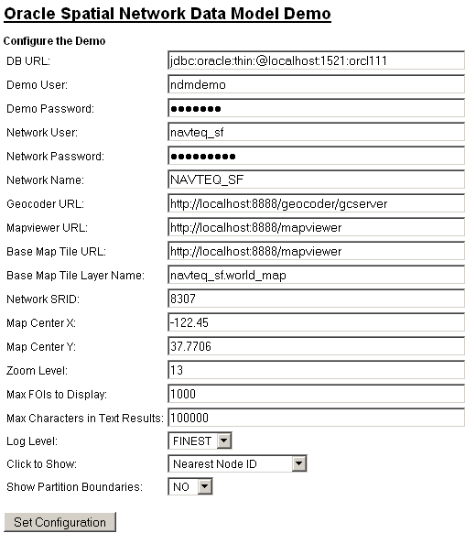
Configuring the Tutorial
Go to http://127.0.0.1:7001/ndmdemo/getConfiguration.jsp
Specify database connection parameters
User names
Network name
Mapviewer and geocoder URLs

Slide 63
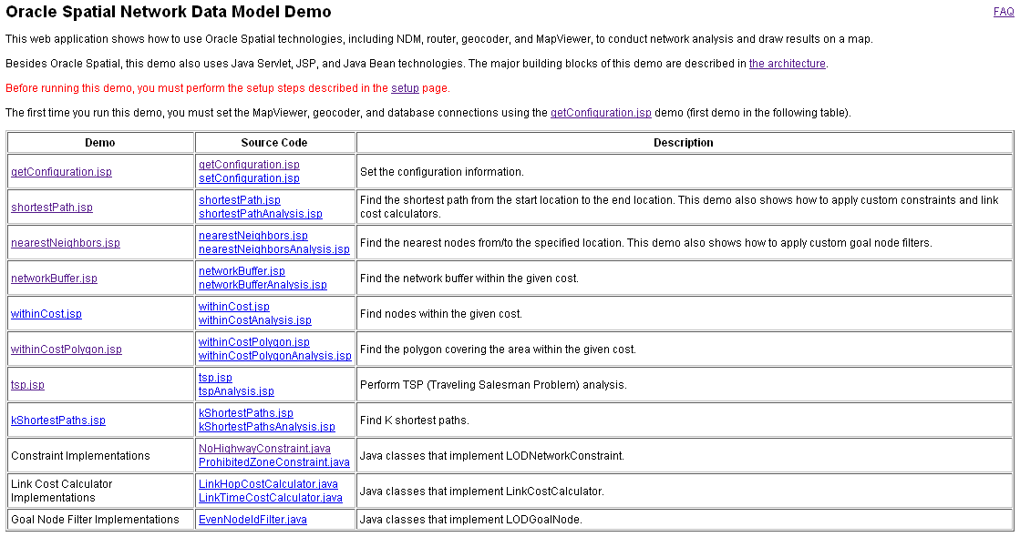
Tutorial Examples

Slide 64
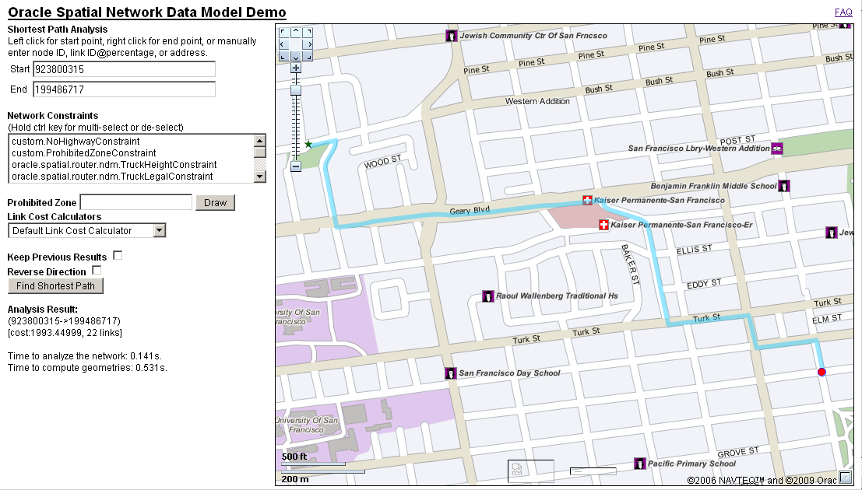
Shortest Path Calculation

Slide 65
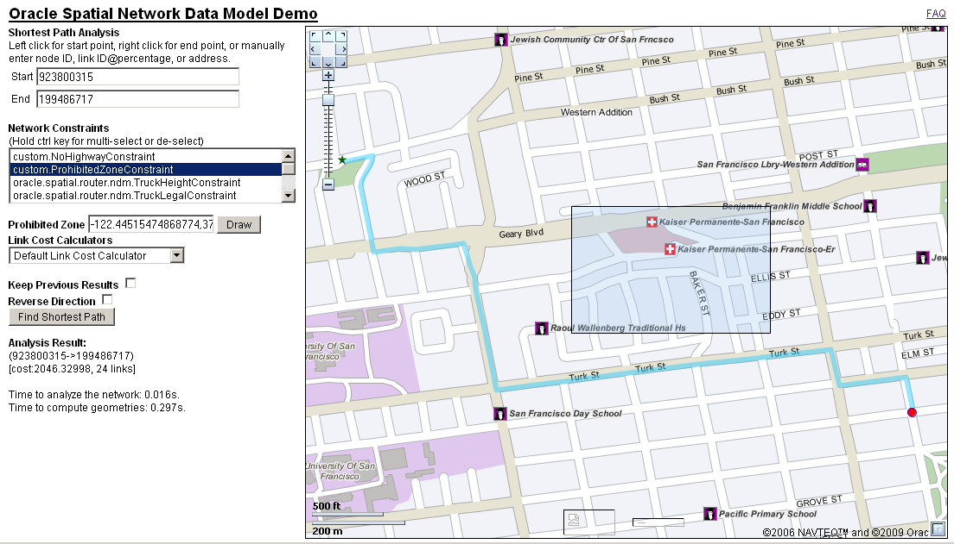
Shortest Path with Exclusion Zone

Slide 66
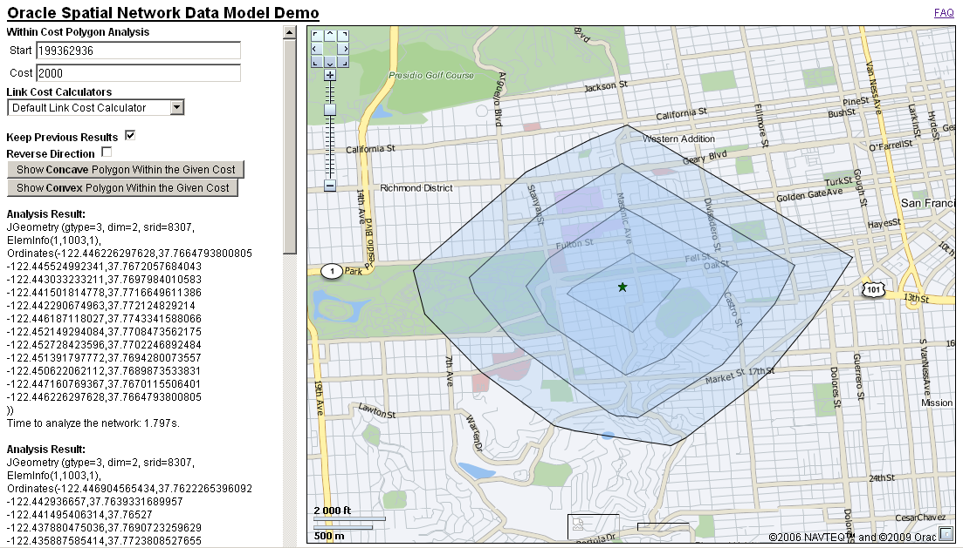
Generating Drive-time Polygons

