Slide 1


<Insert Picture Here>
14 Routing Server

Slide 2
Routing Server
Architecture
Routing tables: basic and extended
Installation and configuration
How to formulate route requests
Structure of the route responses
Partitioning the network
Tips and tricks
Notes:
Objectives
This section introduces you to the concepts associated with the Oracle Spatial Routing Engine.

Slide 3
<Insert Picture Here>
Router Architecture

Slide 4
The Oracle Spatial Routing Engine
The Oracle Spatial Routing Engine is an XML-based Web service.
Provides driving directions between two or more locations
Directions, estimated distance and drive time, geometry, …
Requires a suitable road network as well as geocoding data
Users can purchase data from Oracle Partners to use the Spatial routing and geocoding functions
Data available out of the box from Here (Navteq) and Tom Tom
Other providers: format the data to meet the data model of the router

Slide 5
Routing Web Service Architecture
Application
Client
XML/HTTP
Java Environment
Application
Server
Routing Engine
JDBC
Database
Routing Tables

Slide 6
<Insert Picture Here>
Routing Tables

Slide 7
Routing Tables
Base Tables
Turn Restrictions Data
(Optional)
SDO_ROUTER_
DATA_VERSION
SIGN_POST
Trucking Data
(Optional)
ROUTER_CONDITION
NODE
ROUTER_NAV_STRAND
EDGE
ROUTER_TRANSPORT
ROUTER_
TURN_RESTRICTION_DATA
PARTITION
ROUTER_
TRUCKING_DATA

Slide 8
Base Routing Tables
NODE table
Describes all road intersections
EDGE table
Describes all road segments in the network
Each segment has a unique identifier
Edges are all oriented: two edges for each two-way street
PARTITION table
One row per network partition
Contains a binary-encoding of the sub-network for each partition

Slide 9
NODE Table
Column | Data Type | Usage
NODE_ID | NUMBER | Unique ID of the node
GEOMETRY | SDO_GEOMETRY | Shape of the node (point geometry)
PARTITION_ID | NUMBER | ID of the partition that contains that node

Slide 10
EDGE Table
Column | Data Type | Usage
EDGE_ID | NUMBER | Unique ID of the edge
START_NODE_ID | NUMBER | ID of the start node of this edge
END_NODE_ID | NUMBER | ID of the end node of the edge
PARTITION_ID | NUMBER | ID of the partition that contains the start node for that edge
FUNC_CLASS | NUMBER | Functional road class from 1 to 5
LENGTH | NUMBER | Length of the edge (in meters)
SPEED_LIMIT | NUMBER | Speed limit for the edge (in meters per second)
GEOMETRY | SDO_GEOMETRY | Shape of the edge (line geometry)
NAME | VARCHAR2(64) | Name of the edge (street/road name)
DIVIDER | VARCHAR2(1) | ‘N’ if not divided

Slide 11
PARTITION Table
Column | Data Type | Usage
PARTITION_ID | NUMBER | ID of the partition
SUBNETWORK | BLOB | Binary-encoded sub-network for that partition
NUM_NODES | NUMBER | Number of nodes in that partition
NUM_NON_BOUNDARY_EDGES | NUMBER | Number of edges in this partition that are completely contained within the partition.
NUM_OUTGOING_BOUNDARY_EDGES | NUMBER | Number of edges that start in this partition and terminate in another partition.
NUM_INCOMING_BOUNDARY_EDGES | NUMBER | Number of edges that start in another partition and terminate in this partition.

Slide 12
Base Routing Tables
SIGN_POST table
Relates edges at intersections
Used for signposts at highway exits
SDO_ROUTER_DATA_VERSION table
Contains the version number used to produce the data
Allows the router to recognize the internal structure of the blobs in the PARTITION table
There are two recognized formats
For version 10.1
For later versions (10.2, 11.1, 11.2, 12.1)
If this table is missing, then the router assumes that the blobs are from version 10.1!

Slide 13
SIGN_POST Table
Column | Data Type | Usage
FROM_EDGE_ID | NUMBER | ID of the edge to which this sign applies (for example, the street segment containing the exit ramp).
TO_EDGE_ID | NUMBER | ID of the edge to which this sign points (for example, the street segment to which the exit ramp leads).
RAMP | VARCHAR2(64) | Ramp text (for example, US-3 SOUTH).
TOWARD | VARCHAR2(64) | Text indicating where the exit is heading (for example, WINCHESTER).
LANGUAGE | CHAR(3) | Three-letters language code for that sign

Slide 14
SDO_ROUTER_DATA_VERSION Table
Column | Data Type | Usage
DATA_VERSION | VARCHAR2(32) | Version used to create the data
This table contains only one row
Automatically created and filled when generating the partitions
SELECT * FROM sdo_router_data_version;
DATA_VERSION
--------------------------------
11.2.0.2.6
1 row selected.

Slide 15
Extended Routing Tables Transport Attributes
ROUTER_TRANSPORT table
Contains vehicle-specific attributes
Used for vehicle=truck routes
Currently available from NAVTEQ only
NAVTEQ “Transport” data product
In NAVTEQ’s Oracle Data Format (ODF)
ROUTER_TRUCKING_DATA table
Binary encoding of the trucking data
Divided into partitions (like PARTITION table)

Slide 16
ROUTER_TRANSPORT Table
Column | Data Type | Usage
EDGE_ID | NUMBER | Unique ID of the edge
MAINTYPE | NUMBER(2) | Code of main restriction
SUBTYPE | NUMBER(2) | Code of secondary restriction
VALUE | NUMBER(2) | Value for the restriction (height, width, weight, …)
Main Type | Description
10 | Height in meters
20 | Weight in metric tons
21 | Length in meters
30 | Per axle weight in metric tons
40 | Width in meters
50 | Legal
Restriction types 10 to 40 are physical restrictions
Secondary restriction explains why the restriction is there
Value is the height, weight, …
Restriction 50 is a legal restriction

Slide 17
ROUTER_TRANSPORT Table Physical Restrictions
Main Type | Description
10 | Height in meters
20 | Weight in metric tons
21 | Length in meters
30 | Per axle weight in metric tons
40 | Width in meters
50 | Legal
Sub Type | Description
1 | Bridge
2 | Tunnel
4 | Arch Bridge
5 | Arch Tunnel
7 | Other
99 | Unknown
Sub Type | Description
1 | Bridge
2 | Tunnel
6 | Road
99 | Unknown
Physical restriction types (main types10 to 40) are explained by the secondary type (sub type)

Slide 18
ROUTER_TRANSPORT Table Legal Restrictions
Main Type | Description
10 | Height in meters
20 | Weight in metric tons
21 | Length in meters
30 | Per axle weight in metric tons
40 | Width in meters
50 | Legal
Sub Type | Description
21 | All trucks forbidden
22 | All trailers forbidden
26 | All trucks forbidden except RESIDENT or DELIVERY
27 | All trucks forbidden except RESIDENT
28 | All trucks forbidden except DELIVERY
29 | All trucks forbidden except PUBLIC
Sub types 21 and 22 are inclusive: all trucks (or trucks with trailers) are forbidden
Sub types 22 to 29 are exclusive: all trucks except DELIVERY or PUBLIC or … are forbidden.

Slide 19
ROUTER_TRUCKING_DATA Table
Column | Data Type | Usage
PARTITION_ID | NUMBER | ID of the base routing partition with which this trucking data is associated
NUM_EDGES | NUMBER | Number of edges in this partition with trucking restrictions.
TRUCKING_DATA | BLOB | Trucking restrictions in binary format

Slide 20

Extended Routing Tables Turn Restrictions
12c Release 1
ROUTER_TURN_RESTRICTION_DATA table
ROUTER_CONDITION table
ROUTER_NAV_STRAND table

Slide 21
ROUTER_TURN_RESTRICTION_DATA

Slide 22
ROUTER_CONDITION

Slide 23
ROUTER_NAV_STRAND

Slide 24
A Note on Versions
Several tables contain binary encoded data in BLOBs
The format of those BLOBs may vary from one version to the next
The version of the base routing BLOBS (table PARTITION) is stored in SDO_ROUTER_DATA_VERSION
For optional components (trucking data, turn restrictions) the version is stored inside the BLOBs

Slide 25
A Note on Versions
SELECT TURN_RESTRICTION_DATA
FROM ROUTER_TURN_RESTRICTION_DATA
WHERE PARTITION_ID = 0;
TURN_RESTRICTION_DATA
------------------------------------------------------------
0000000A00310032002E0031002E0030002E0032002E0030000000000002

Slide 26
<Insert Picture Here>
Installation and Configuration

Slide 27
Defining a NDM Network
Since Oracle 11g Release 2 the router uses the Network Data Model engine internally
Must define a “NDM” network on top of the routing tables
Call SDO_ROUTER_PARTITION.CREATE_ROUTER_NETWORK()
This procedure writes to a log file
Must first define a directory to access the log file:
Then grant the rights to write to the log file
CREATE OR REPLACE DIRECTORY sdo_router_log_dir AS '/tmp';
GRANT READ, WRITE ON DIRECTORY sdo_router_log_dir TO scott;

Slide 28
Defining a NDM Network
Define the network:
This procedure performs the following :
Creates two indexes on the EDGE table (on the FUNC_CLASS column)
This will take time for a large EDGE table!
Creates views on the NODE, EDGE and PARTITION tables
Populates network metadata (USER_SDO_NETWORK_METADATA and USER_SDO_NETWORK_USER_DATA)
EXECUTE SDO_ROUTER_PARTITION.CREATE_ROUTER_NETWORK(
'define_network.log', 'route_sf');

Slide 29
Installation and configuration
Deploy ROUTESERVER.EAR in your application server
File is in $ORACLE_HOME/md/jlib
The initial startup will fail because the default configuration has no database connection.
Update router configuration
Manually update file WEB-INF/web.xml
Set connection to user for routing tables
Set name of the NDM network
Choose type of geocoder to use and configure it
Database or web service
Set default language, default driving side, etc.
Restart the routeserver application

Slide 30
Router Configuration
Parameters are in “web.xml” file.
Parameters specified as “key/value” pairs
Must restart the routeserver application after any change
<init-param>
<param-name>log_level</param-name>
<param-value>FINEST</param-value>
</init-param>

Slide 31
Router Configuration Parameters
Database connection for routing tables
Parameter | Notes
routeserver_schema_jdbc_connect_string | Database connection string: jdbc:oracle:thin:@127.0.0.1:1521:orcl112
routeserver_schema_username | Owner of routing tables
routeserver_schema_password | Prefix with “!” to force encryption
routeserver_schema_connection_cache_min_limit | Minimum connections in connection pool
routeserver_schema_connection_cache_max_limit | Maximum number of connections
NDM network name
Parameter | Notes
routeserver_network_name | Name of the network you specified in the CREATE_ROUTER_NETWORK() call
Partition cache size
Parameter | Notes
partition_cache_size_limit | Number of partitions to retain in memory in the partition cache

Slide 32
Router Configuration Parameters
Type of geocoder to use
Parameter | Notes
geocoder_type | thinclient = use a JDBC connection to invoke the geocoder in a database httpclient = use an HTTP connection to the geocoding web service none = no geocoder. Only “pre-geocoded” locations are possible
geocoder_match_mode | The matching mode for the geocoding calls

Slide 33
Router Configuration Parameters
Database connection for geocoding tables (if “thinclient” geocoder)
Parameter | Notes
geocoder_schema_host | Name or IP address of database server
geocoder_schema_port | Listener port
geocoder_schema_sid | Database SID
geocoder_schema_username | Owner of geocoding tables
geocoder_schema_password | Prefix with “!” to force encryption
URL for geocoding web service (if “httpclient” geocoder)
Parameter | Notes
geocoder_http_url | Full URL to HTTP server (including protocol and port). For example: http://127.0.0.1:7001/geocoder/gcserver
geocoder_http_proxy_host | Name or IP address of proxy server (if any)
geocoder_http_proxy_port | Port of proxy server
geocoder_http_proxy_username | Username required to access the proxy server
geocoder_http_proxy_password | Prefix with “!” to force encryption

Slide 34
Router Configuration Parameters
Logging and tracing
Parameter | Notes
log_filename | Name of log file (relative to the “web” directory) For example: “log/routeserver.log” will create the log file in “web/log/routeserver.log”. The file is appended for each execution and never rotates.
log_level | Level of detail as one of: FATAL, ERROR, WARN, INFO, DEBUG or FINEST. The default is INFO. WARNING: level FINEST is very verbose! Do not use in production
log_thread_name | “true” to log the name of the thread that logged a message
log_time | “true” to include a timestamp with each log entry.

Slide 35
Router Configuration Parameters
General Parameters
Parameter | Notes
language | Default language for driving directions as one of ENGLISH, FRENCH, SPANISH, GERMAN or ITALIAN
local_road_threshold | Controls the use of multi-level routing If the straight-line distance from origin to destination is less than this value, then we compute the best route using all possible road segments If the distance is larger, then we use multi-level routing Expressed in miles!
highway_cost_multiplier | Used to make highways less attractive when computing routes with road_preference="local". A factor applied to the cost of highway segments to make them more expensive.
max_speed_limit | In meters per second
driving_side | “R” or “L”

Slide 36
Router Configuration Parameters Two important parameters
local_road_threshold
Controls the use of multi-level routing
If the straight-line distance from origin to destination is less than this value, then we compute the best route using all possible road segments
If the distance is larger, then we use multi-level routing
Expressed in miles!
highway_cost_multiplier
Used to make highways less attractive when computing routes with road_preference="local".
A factor applied to the cost of highway segments to make them more expensive.

Slide 37
Memory Requirements
The router will keep partitions in memory up to the number specified by parameter partition_cache_size_limit
Each partition occupies approximately 5 times the size of its BLOB in the PARTITION table.
Partition 0 (the largest) is always loaded and remains in memory

Slide 38
<Insert Picture Here>
Network Partitioning

Slide 39
Network Partitioning
The network used by the router must be partitionned and partition lobs must be generated
The result is in the PARTITION table
Call SDO_ROUTER_PARTITION.PARTITION_ROUTER()
This procedure writes to a log file
You need to define a directory and grant access
You also need to grant access to the files from java (also to MDSYS)
CREATE OR REPLACE DIRECTORY sdo_router_log_dir AS '/tmp';
GRANT READ, WRITE ON DIRECTORY sdo_router_log_dir TO scott;
CALL dbms_java.grant_permission( 'SCOTT', 'java.io.FilePermission', '/tmp/partition.log', 'write' );
CALL dbms_java.grant_permission( 'MDSYS', 'java.io.FilePermission', '/tmp/partition.log', 'write' );

Slide 40
Network Partitioning
Name of log file
Perform the partitioning
Check the log file for progress and errors
BEGIN
SDO_ROUTER_PARTITION.PARTITION_ROUTER(
LOG_FILE_NAME => 'sdo_router_partition.log',
MAX_V_NO => 2000,
NETWORK_NAME => 'ROUTE_SF'
);
END;
/
Maximum number of nodes per partition
Name of NDM network

Slide 41
Network Partitioning
The number of partitions P is a power of 2
It is computed like this:
P = 2**(floor(ln(N/K)/ln(2.0)+1)
where N is the total number of nodes, and K is the number of nodes per partition (parameter MAX_V_NO).
Column PARTITION_ID in the NODE and EDGE tables is filled in with numbers from 1 to P
The PARTITION table contains P+1 rows: one row per partition, plus one for partition 0.

Slide 42
Network Partitioning
If the PARTITION table does not exist, it will be created
If it does exist, it is replaced with a new copy (and the old one is dropped).
The SDO_ROUTER_DATA_VERSION table is created and filled with the version of the database (for example: ’12.1.0.2’)
The NDM network is also defined

Slide 43
<Insert Picture Here>
Routing Queries

Slide 44
Routing Queries
Client Application
A route request consists of:
Preferences
A start location
One or more destination locations
A route response consists of:
Driving directions
Optional route geometry
Optional geometry for each segment (maneuver)
XML
XML
Routing engine
Routing Tables

Slide 45
Types of Route Requests
Point-to-point routes
From one origin location to one destination
Multi-destination routes
One origin location
Multiple destinations
Fixed or optimal order
Closed or open
Batch routes
One origin location
Multiple destinations
Compute routes from origin to each destination

Slide 46
Point-to-Point Routes
One start location
One end location
Optionally, one or more preferences:
Route preference: fastest or shortest
Road preference: highway or local
Vehicle type and parameters
Whether to return the geometry of the route
Whether to return driving directions
Time and distance units
Language for driving directions
…

Slide 47
A Simple Route Request
<?xml version="1.0" standalone="yes"?>
<route_request id="1" route_preference="shortest"
return_driving_directions="true“
distance_unit="mile" time_unit="minute"
return_route_geometry="false">
<start_location>
<input_location id="1" >
<input_address>
<unformatted country="US" >
<address_line value="747 Howard Street" />
<address_line value="San Francisco, CA" />
</unformatted >
</input_address>
</input_location>
</start_location>
<end_location>
<input_location id="2" >
<input_address>
<unformatted country="US" >
<address_line value="1300 Columbus" />
<address_line value="San Francisco, CA" />
</unformatted >
</input_address>
</input_location>
</end_location>
</route_request>
Start and end locations are street addresses.
Preferences indicate the preferred units for the response
Shortest vs. fastest
Language for the directions
Avoid highways or not
…

Slide 48
Route Request Attributes
Attribute | Possible Values
route_preference | FASTEST SHORTEST
road_preference | HIGHWAY LOCAL
return_driving_directions | TRUE or FALSE
driving_directions_detail | LOW MEDIUM HIGH
return_hierarchical_driving_directions | TRUE or FALSE
return_route_geometry | TRUE or FALSE
return_segment_geometry | TRUE or FALSE
return_detailed_geometry | TRUE or FALSE
return_route_edge_ids | TRUE or FALSE
return_segment_edge_ids | TRUE or FALSE
language | ENGLISH FRENCH GERMAN ITALIAN SPANISH
distance_unit | KM MILE METER
time_unit | HOUR MINUTE SECOND
return_locations | TRUE of FALSE

Slide 49
XML Response to a Simple Route Request
<route_response>
<route id="1"
step_count="6"
distance="2.291574024808923"
distance_unit="mile"
time="5.5876215616861975"
time_unit="minute"
start_location="1"
end_location="2">
<segment sequence="1"
instruction="Start out on Howard St"
distance="0.2576523998129889"
time="0.6282424370447794"/>
...
<segment sequence="6"
instruction="Turn SLIGHT LEFT onto Columbus"
distance="0.2540794154006995"
time="0.6195303122202556"/>
</route>
</route_response>
The response contains the elements requested
Driving directions with distance and time
Geometry of the route
Geometry of each segment
List of edges
…

Slide 50
JSON responses
[{
id:1,
stepCnt:6,
dist:2.2916,
distUnit:"mile",
time:5.5876,
timeUnit:"minute",
routeMBR:[],
steps:[
{seq:1,inst:"Start out on Howard St (Going Southwest)",dist:0.2577,time:0.6282},
{seq:2,inst:"Turn RIGHT onto 5th St (Going Northwest)",dist:0.2426,time:0.5916},
{seq:3,inst:"Stay STRAIGHT to go onto Cyril Magnin St",dist:0.1087,time:0.2652},
{seq:4,inst:"Turn LEFT onto Ellis St (Going West)",dist:0.1368,time:0.3337},
{seq:5,inst:"Turn RIGHT onto Taylor St (Going North)",dist:1.2916,time:3.1494},
{seq:6,inst:"Turn SLIGHT LEFT onto Columbus Ave (Going Northwest)",dist:0.2541,time:0.6195}
]
}]
Include &format=JSON in the request URL

Slide 51
Truck Request Specific Attributes
Attribute | Possible Values
vehicle_type | AUTO or TRUCK
truck_type | DELIVERY or PUBLIC or TRAILER
truck_height | Meters or feet
truck_length | Meters or feet
truck_width | Meters or feet
truck_per_axle_weight | Metric tons or US tons
truck_weight | Metric tons or US tons
length_unit | METRIC or US
weight_unit | METRIC or US
Length unit: meter for METRIC, foot for US
Weight unit: metric ton for METRIC, US ton for US.

Slide 52
A Truck Route Request
<?xml version="1.0" standalone="yes"?>
<route_request id="1" route_preference="shortest"
return_driving_directions="true"
vehicle_type="truck" truck_type="trailer"
distance_unit="mile" time_unit="minute"
return_route_geometry="true">
<start_location>
. . .
</start_location>
<end_location>
. . .
</end_location>
</route_request>

Slide 53
Origin and Destinations
The previous route requests used addresses for the start and end locations.
Can also specify spatial coordinates
This is useful for telematics and other applications.
From a location specified by coordinates, what is the route to a particular address?
Given a current location, what is the route to a location specified by coordinates?
Can also specify a pre-geocoded location
Edge id, side, relative position (0.0 to 1.0)
Returned by a separate call to the geocoder.

Slide 54

Using Geographical Locations
This will trigger a request to the geocoder to perform a “reverse geocode” operation.
<?xml version="1.0" standalone="yes"?>
<route_request id="1" route_preference="fastest"
return_driving_directions="true"
distance_unit="mile" time_unit="minute">
<start_location>
<input_location id="1"
longitude="-122.4014128" latitude="37.7841193" />
</start_location>
<end_location>
<input_location id="2" >
<input_address>
<unformatted country="US" >
<address_line value="1300 Columbus" />
<address_line value="San Francisco, CA" />
</unformatted >
</input_address>
</input_location>
</end_location>
</route_request>
Specify return_locations=“true” to get the actual addresses
NOTE: Using geographical locations is only possible when using the “httpclient” geocoder.

Slide 55
Using Pre-Geocoded Locations
<?xml version="1.0" standalone="yes"?>
<route_request id="1" route_preference="fastest"
return_driving_directions="true"
distance_unit="mile" time_unit="minute"
pre_geocoded_locations="true">
<start_location>
<pre_geocoded_location id="1">
<edge_id>23607005</edge_id>
<percent>0.53</percent>
<side>R</side>
</pre_geocoded_location>
</start_location>
<end_location>
<pre_geocoded_location id="2">
<edge_id>23601015</edge_id>
<percent>0.33</percent>
<side>R</side>
</pre_geocoded_location>
</end_location>
</route_request>
Edge id = unique id of street segment
Percent = relative position on segment (0 to 1)
Side = which side (relative to digitizing order)
This information is returned by the geocoder

Slide 56
Multi-Destination Routes (TSP)
12c Release 1
One start location
One or more intermediate locations
Optionally one end location (if route is open)
Optionally, the usual preferences:
Fastest or shortest, highway or local, time and distance units
Vehicle type, output (geometry, driving directions, language), …
Visitation order:
In the order indicated or in an optimal order (TSP)
Open or closed
Closed = come back to start location
Open = end at end location (default)
Result route is divided into “sub-routes”

Slide 57
Multi-Destination Request Attributes
Attribute | Possible Values
return_subroutes | TRUE or FALSE
return_subroute_geometry | TRUE or FALSE
optimize_route | TRUE or FALSE
route_type | OPEN or CLOSED

Slide 58
A Multi-Destination Route: Open, Fixed Order
<?xml version="1.0" standalone="yes"?>
<route_request id="1”
route_preference="fastest”
return_driving_directions="true">
<start_location>
<input_location id="0" >
<input_address>
<unformatted country="US" >
<address_line value="747 Howard Street”/>
<address_line value="San Francisco, CA”/>
</unformatted >
</input_address>
</input_location>
</start_location>
<location>
<input_location id="1" >
<input_address>
<unformatted country="US" >
<address_line value="1300 Columbus”/>
<address_line value="San Francisco, CA”/>
</unformatted >
</input_address>
</input_location>
</location>
<location>
<input_location id="2" >
<input_address>
<unformatted country="US" >
<address_line value="1450 California St”/>
<address_line value="San Francisco, CA”/>
</unformatted >
</input_address>
</input_location>
</location>
<end_location>
<input_location id="3" >
<input_address>
<unformatted country="US" >
<address_line value="800 Sutter Street”/>
<address_line value="San Francisco, CA”/>
</unformatted >
</input_address>
</input_location>
</end_location>
</route_request>
Locations are visited in the order of appearance

Slide 59
Route Response: Open, Fixed Order
<route_response>
<route id="1" step_count="15" distance="3.9290249918806897" distance_unit="mile"
time="9.580272801717122" time_unit="minute"
start_location="0" end_location="3">
<subroute id="1" step_count="6" ... start_location="0" end_location="1">
<segment sequence="1" instruction="Start out on Howard St (Going Southwest)"/>
...
<segment sequence="6" instruction="Turn SLIGHT LEFT onto Columbus Ave"/>
</subroute>
<subroute id="2" step_count="6" ... start_location="1" end_location="2">
<segment sequence="1" instruction="Start out on Columbus Ave (Going Southeast)"/>
...
<segment sequence="6" instruction="Turn RIGHT onto California St (Going West)" />
</subroute>
<subroute id="3" step_count="3" ... start_location="2" end_location="3">
<segment sequence="1" instruction="Start out on California St (Going East)"/>
...
<segment sequence="3" instruction="Turn RIGHT onto Sutter St (Going West)"/>
</subroute>
</route>
</route_response>

Slide 60
A Multi-Destination Route: Closed, Optimized
<?xml version="1.0" standalone="yes"?>
<route_request id="1”
route_preference="fastest”
return_driving_directions="true”
route_type="closed" optimize_route="true">
<start_location>
<input_location id="0" >
<input_address>
<unformatted country="US" >
<address_line value="747 Howard Street”/>
<address_line value="San Francisco, CA”/>
</unformatted >
</input_address>
</input_location>
</start_location>
<location>
<input_location id="1" >
<input_address>
<unformatted country="US" >
<address_line value="1300 Columbus”/>
<address_line value="San Francisco, CA”/>
</unformatted >
</input_address>
</input_location>
</location>
<location>
<input_location id="2" >
<input_address>
<unformatted country="US" >
<address_line value="1450 California St”/>
<address_line value="San Francisco, CA”/>
</unformatted >
</input_address>
</input_location>
</location>
<location>
<input_location id="3" >
<input_address>
<unformatted country="US" >
<address_line value="800 Sutter Street”/>
<address_line value="San Francisco, CA”/>
</unformatted >
</input_address>
</input_location>
</location>
</route_request>
Locations are visited in an optimal order
Route goes back to start location

Slide 61
Route Response: Closed, Optimized
<route_response>
<route id="1" step_count="17” start_location="0" end_location="0">
<subroute id="1" step_count="6" start_location="0" end_location="3">
<segment sequence="1" instruction="Start out on Howard St (Going Southwest)"/>
...
<segment sequence="6" instruction="Turn LEFT onto Sutter St (Going West)"/>
</subroute>
<subroute id="2" step_count="3" start_location="3" end_location="2">
<segment sequence="1" instruction="Start out on Sutter St (Going West)"/>
...
<segment sequence="3" instruction="Turn LEFT onto California St (Going West)"/>
</subroute>
<subroute id="3" step_count="4" start_location="2" end_location="3">
<segment sequence="1" instruction="Start out on California St (Going East)"/>
...
<segment sequence="4" instruction="Turn SHARP LEFT onto Columbus"/>
</subroute>
<subroute id="4" step_count="4" start_location="3" end_location="0">
<segment sequence="1" instruction="Start out on Columbus Ave (Going Southeast)"/>
...
<segment sequence="4" instruction="Turn RIGHT onto Howard St (Going Southwest)"/>
</subroute>
</route>
</route_response>

Slide 62
Summary of Multi-Destination Routes
Open routes (route_type=“open”)
Normal routes (optimize_route=“false”)
Fixed end: S->L1->L2->…->Ln->E
No fixed end: S->L1->L2->L3…->Ln
Optimized routes: (optimize_route=“true”)
Fixed end: S->{L1,L2,L3,…,Ln}->E
No fixed end: S->{L1,L2,L3,…,Ln}
Closed routes (route_type=“closed”)
Normal routes (optimize_route=“false”): S->L1->L2->L3…->Ln->S
Optimized routes (optimize_route=“true”): S->{L1,L2,L3,…,Ln}->S

Slide 63
Batch Routes
One start location, multiple end locations
Optionally, one or more preferences:
Route preference: fastest or shortest
Road preference: highway or local
Time and distance units
The response only contains the time and distance for each route
You can control the results:
sort_by_distance: Sorts the returned information in ascending order by distance (FALSE by default)
cutoff_distance: Returns information only if the distance is less than or equal to a specified distance (no limit by default)

Slide 64
A Batch Route Request
<?xml version="1.0" standalone="yes"?>
<batch_route_request id="8"
route_preference="fastest"
road_preference="highway"
return_driving_directions="false"
sort_by_distance = "true"
cutoff_distance="35"
distance_unit="mile"
time_unit="minute">
<start_location>
<input_location id="1">
<input_address>
<us_form1
street="1000 Winter St"
lastline="Waltham, MA" />
</input_address>
</input_location>
</start_location>
<end_location>
<input_location id="10">
<input_address>
<us_form1
street="1 Oracle Dr"
lastline="Nashua, NH" />
</input_address>
</input_location>
</end_location>
. . . .
<end_location>
<input_location id="11">
<input_address>
<us_form1
street="22 Monument Sq"
lastline="Concord, MA" />
</input_address>
</input_location>
</end_location>
</batch_route_request>

Slide 65
Batch Route Response
<?xml version="1.0" standalone="yes" ?>
<batch_route_response id="8">
<route id="11"
step_count="0"
distance="9.132561517429938"
distance_unit="mile"
time="12.4705078125"
time_unit="minute" />
<route id="12"
step_count="0"
distance="17.74747391140558"
distance_unit="mile"
time="20.413236490885417"
time_unit="minute" />
<route id="10"
step_count="0"
distance="30.28667355371901"
distance_unit="mile"
time="35.02037760416667"
time_unit="minute" />
</batch_route_response>
One <route> element per destination
Includes distance and time
Destinations ordered by distance

Slide 66
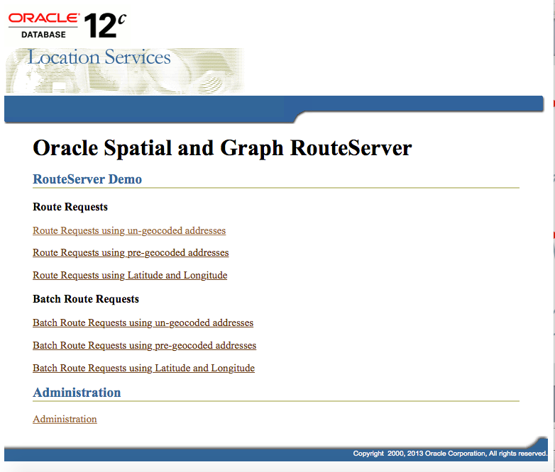
Sample RouteServer

Slide 67
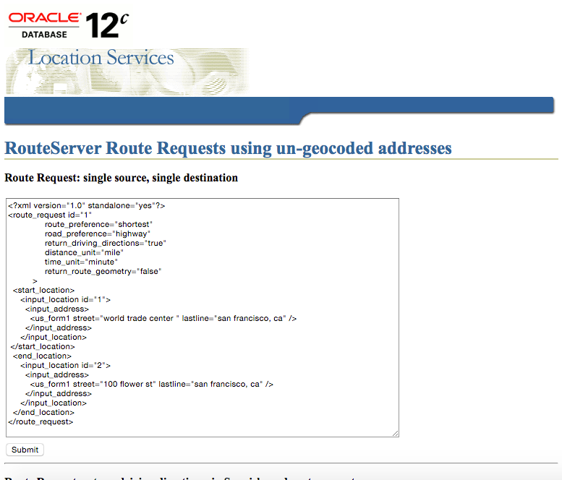
Sample RouteServer Request

Slide 68
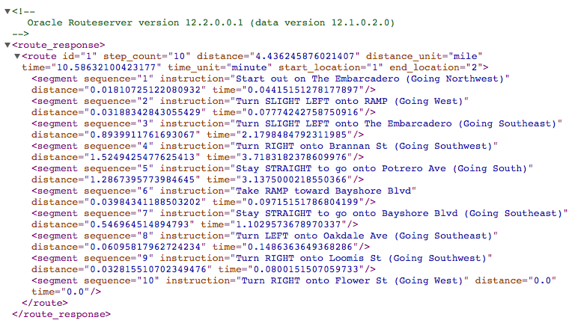
Sample RouteServer Response

Slide 69
<Insert Picture Here>
Tips and Tricks

Slide 70
Invalid Addresses
The origin and destination addresses may contain mistakes (wrong house number, street not recognized)
The geocoder tries its best to return a location
The router uses whatever the geocoder returns
This may lead to incorrect routes
For example: « 1300 Oracle St, San Francisco, CA » does not exist.
The geocoder falls back to an unspecified default location in San Francisco
The router will use that location and guide you there
Unless you are certain of the validity of the origin or destination addresses, you should geocode them first before calling the router.
You can then pass « pre-geocoded » locations to the router.

Slide 71
Non-Routable Edges
The router database typically contains only street segments that are accessible by motor vehicles
Pedestrian-only streets are not included
The geocoder database typically contains all street segments
Pedestrian-only streets are included
When the geocoder returns an edge that does not exist in the router database …
… the router « snaps » to the nearest edge in its database
This requires a spatial index on the EDGE table

Slide 72
Non-Routable Edges Example Request
Start address: 747 Howard St, San Francisco, CA
Destination: 33 Yerba Buena Ln, San Francisco CA
The destination is pedestrian access only
It has no edge in the EDGE table
<route_request id="1" route_preference="fastest" return_driving_directions="true"
return_route_edge_ids ="true" distance_unit="mile" time_unit="minute">
<start_location> <input_location id="1" > <input_address> <unformatted country="US" >
<address_line value="747 Howard Street"/><address_line value="San Francisco,CA"/>
</unformatted > </input_address> </input_location>
</start_location>
<end_location> <input_location id="2" > <input_address> <unformatted country="US" >
<address_line value="33 Yerba Buena Lane"/><address_line value="San Francisco,CA"/>
</unformatted > </input_address> </input_location>
</end_location>
</route_request>

Slide 73
Non-Routable Edges Example Response
<route_response>
<route id="1" step_count="3" distance="0.5543466770781551" distance_unit="mile"
time="1.3516817728678385" time_unit="minute“>
<route_edge_ids>
<edge_ids>
-917724446, -917724445, -1510141634, -917723642, -917723645, -917723644,
-198595633, 199082614, 199139293, 199113693, 1529997051, 1529997052,
797415915, 198926288
</edge_ids>
</route_edge_ids>
Destination edge for the computed route
<start_location>
<location id="1" longitude="-122.4016" latitude="37.78415" house_number="747"
street="HOWARD ST" city="SAN FRANCISCO" state="CA" country="US"
postal_code="94103"
edge_id="917724446" percent="0.0"/>
</start_location>

Slide 74
Non-Routable Edges Example Response
<segment sequence="1" instruction="Start out on HOWARD ST (Going Southwest)"
distance="0.2576586138370253" time="0.6282575905323029"/>
<segment sequence="2" instruction="Turn RIGHT onto 5TH ST (Going Northwest)"
distance="0.1205368791041051" time="0.2939090967178345"/>
<segment sequence="3" instruction="Turn RIGHT onto MISSION ST (Going Northeast)"
distance="0.17615112546943176" time="0.42951515714327493"/>
<end_location>
<location id="2" longitude="-122.40398918367347" latitude="37.78551795918367"
house_number="33“ street="YERBA BUENA LN" city="SAN FRANCISCO" state="CA"
country="US" postal_code="94103"
edge_id="647710501" percent="0.32653061224489793"/>
</end_location>
</route>
</route_response>
Edge for the geocoded destination address

Slide 75
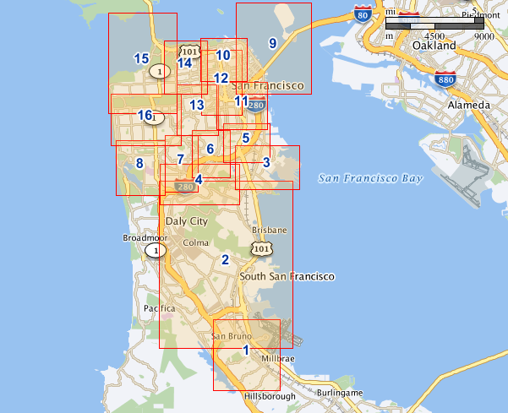
Viewing the Partitions
The following query generates the MBR of each partition
Use it to view the partitions
SELECT partition_id,
sdo_aggr_mbr(geometry)
FROM node
GROUP BY partition_id;

