Slide 1


<Insert Picture Here>
17 OGC Web Services

Slide 2
Web Services
Overview
Web Map Service (WMS)
Licensing, configuration, example requests
Web Feature Service (WFS)
Licensing, configuration, example requests
Using OGC Web Services in Mapviewer
OpenLS Services
Catalog Service (CSW)

Slide 3
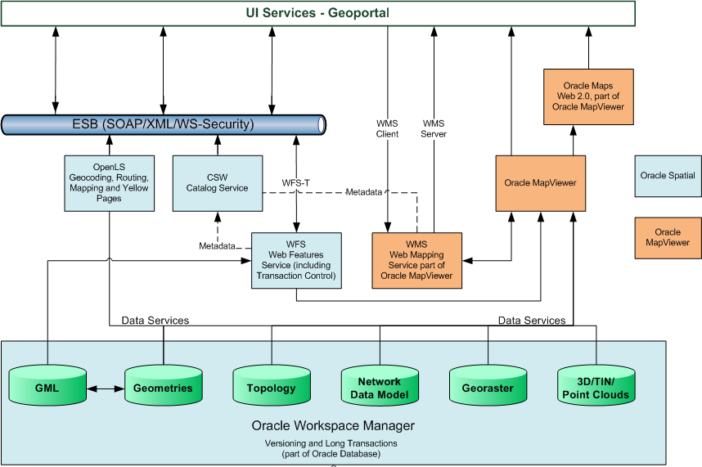
Overview of Spatial Web Services

Slide 4
Overview of Spatial Web Services
Open Geospatial Consortium Standards
Web Map Service (WMS)
Request/Provide maps
Request/Provide information about content of a map
Web Feature Service (WFS)
Request/Provide data
Access/search/update/delete geo-spatial feature instances
Based on spatial/non-spatial search criteria
Using a standard interface over the web
Catalog Service for Web (CSW)
Defines a common interface that enables diverse but conformant applications to perform discovery, browse and query operations against catalog servers.
Location Services (OpenLS)
Geocoding Service
Routing Service
Mapping Service
Directory Service

Slide 5
Overview of Spatial Web Services
Oracle Specific Services
Geocoder
Converts an address into geographical coordinates
Router
Returns optimal driving directions between two locations
Mapper
Mapviewer and Oracle Maps

Slide 6
<Insert Picture Here>
WMS Web Mapping Service

Slide 7
Web Mapping Service
Provided by Mapviewer
Need to license Oracle Fusion Middleware
Can also license the “TopLink and Application Development Framework” for deployment in other application servers
OGC Conformance
Versions 1.1.1 and 1.3.0
Processes WMS requests:
GetCapabilities
GetMap
GetFeatureInfo

Slide 8
MapViewer WMS
Client
WMS Client
WMS Requests/responses
HTTP
WMS Server API
Application Server
Map Rendering Engine
JDBC
Database
Spatial
Tables
Map
Definitions
Mapbuilder

Slide 9
WMS Configuration
Set in MapViewer’s configuration file
Section <wms_config>
Set explicit service URL (Host, port, protocol)
Returned in the capabilities document
<wms_config
host="www.oracle.com"
port="80"
protocol="http“
>
...
</wms_config>

Slide 10
WMS Configuration: Data Sources
Set the “default” datasource
Layers specified in GetMap requests are fetched from that datasource.
If no default set, then GetMap will use a datasource called “WMS”
You can specify an explicit datasource in GetMap requests
This is non-standard!
Set the public datasources
Datasources that can be accessed by GetMap requests
By default, all are accessible
<wms_config
default_datasource="mvdemo"
public_datasources="scott,mvdemo"
> ... </wms_config>

Slide 11
WMS Configuration: Service Description
<wms_config>
<title>WMS interface for MapViewer</title>
<abstract>
This WMS service is provided through
Oracle MapViewer.
</abstract>
<keyword_list>
<keyword>roadrunner</keyword>
<keyword>ambush</keyword>
</keyword_list>
<contact_information>
<ContactPersonPrimary>
<ContactPerson>
John Doe
</ContactPerson>
<ContactOrganization>
My Corp.
</ContactOrganization>
</ContactPersonPrimary>
. . .
</contact_information>
<Fees>None</Fees>
<AccessConstraints>None</AccessConstraints>
</wms_config>
Set descriptive information for the service :
Title and description (abstract) of the service
Contact information, costs, access restrictions, …
Keywords
Fixed set of tags
Cannot extend with your own

Slide 12
WMS Configuration: SRID Mapping
SRIDs are advertised using the SDO: namespace. For example
SRS="SDO:81989"
EPSG codes are better known
SRS="EPSG:27700"
The mappings are defined in a configuration file:
<wms_config> ...
<sdo_epsg_mapfile>
../conf/epsg_srids.properties
</sdo_epsg_mapfile>
</wms_config>

Slide 13
WMS Configuration: SRID Mapping
The mapping file contains lines like sdo_srid=epsg_srid
For example, the following associates Oracle SRIDs 82208, 82771 and 91989 with their EPSG equivalents:
Note that Oracle SRID 8307 (Longitude Latitude WGS84) is automatically associated with EPSG SRID 4326.
EPSG codes still need a specific definition
So that SRS="SDO:27700" becomes SRS="EPSG:27700"
82208=32601
82271=32602
81989=27700
27700=27700

Slide 14
GetCapabilities request and response version 1.1.1
http://127.0.0.1:7001/mapviewer/wms
?VERSION=1.1.1&REQUEST=GetCapabilities&SERVICE=WMS
<WMT_MS_Capabilities version="1.1.1">
<Service> ... </Service>
<Capability>
<Request> ... </Request>
<Exception> ... </Exception>
<Layer> ... </Layer>
</Capability>
</WMT_MS_Capabilities>
Lists all layers accessible via the WMS service
Request version 1.1.1 or 1.3.0
Response version <= request version

Slide 15
GetCapabilities request and response version 1.3.0
http://127.0.0.1:7001/mapviewer/wms
?VERSION=1.3.0&REQUEST=GetCapabilities&SERVICE=WMS
<WMSCapabilities version="1.3.0">
<Service> ... </Service>
<Capability>
<Request> ... </Request>
<Exception> ... </Exception>
<Layer> ... </Layer>
</Capability>
</WMSCapabilities>
Lists all layers accessible via the WMS service
Request version 1.1.1 or 1.3.0
Response version <= request version

Slide 16
Layers in GetCapabilities response
WMS | Top element
MVDEMO | Data source
CUSTOMER_MAP | Base map
CUSTOMERS | Theme used in that base map
DEMO_MAP | Base map
THEME_DEMO_STATES | Theme used in that base map
THEME_DEMO_COUNTIES | Theme used in that base map.
…
THEME_DEMO_CITIES | Theme used in that base map
DENSITY_MAP
THEME_DEMO_STATES | Theme used in that base map
…
THEME_DEMO_CITIES | Theme used in that base map
CUSTOMER_BY_CITIES | Stand-alone theme (not used in any map)
DYNAMIC_CUSTOMERS | Stand-alone theme (not used in any map)
SCOTT
US_BASE_MAP
WORLD_COUNTRIES | Theme used in that base map
…
US_CITIES | Theme used in that base map
Layers are organized in a nested list
<layer> elements contain other <layer> elements
Top layer is called « WMS » and contains data sources.
Data sources contain base maps
Base maps contain themes
Themes used in multiple base maps are repeated
Only « leaf » layers (themes) can be queried.
Only « public » data sources are returned

Slide 17
Layer Information (version 1.1.1)
<Layer queryable="1" >
<Name>WARDS</Name>
<Title>District Borough Wards</Title>
<SRS>EPSG:27700</SRS>
<LatLonBoundingBox
minx="-9.23063998580595" miny="50.083018150987"
maxx="2.70178130481733" maxy="60.7831502220447" />
<BoundingBox SRS="EPSG:27700" minx="5513.0" miny="34914.4"
maxx="655989.0" maxy="1220301.5" resx="0.05" resy="0.05" />
</Layer>
Each queryable layer corresponds to a MapBuilder theme
Layer title comes from the theme description
Bounding box computed from actual data, if possible (*)
Resolution comes from spatial metadata
(*) If an index exists on the underlying table, then its root node provides the bounding box. If not it is extracted from the spatial metadata

Slide 18
Layer Information (version 1.3.0)
<Layer queryable="true" >
<Name>WARDS</Name>
<Title>District Borough Wards</Title>
<CRS>EPSG:27700</CRS>
<EX_GeographicBoundingBox>
<westBoundLongitude> -9.23063998580595 </westBoundLongitude>
<eastBoundLongitude> 2.70178130481733 </eastBoundLongitude>
<southBoundLatitude> 50.083018150987 </southBoundLatitude>
<northBoundLatitude> 60.7831502220447 </northBoundLatitude>
</EX_GeographicBoundingBox>
<BoundingBox CRS="EPSG:27700" minx="5513.0" miny="34914.4"
maxx="655989.0" maxy="1220301.5" resx="0.05" resy="0.05" />
</Layer>

Slide 19
GetMap request
Specify coordinate systems using EPSG codes
Mapping table in Mapviewer configuration file
Specify the list of layers to include
They correspond to Mapviewer themes
List them in the order of rendering
http://127.0.0.1:7001/mapviewer/wms
?VERSION=1.1.0
&REQUEST=GetMap
&FORMAT=image/png
&SRS=EPSG:4326
&BBOX=-80,38,-78,40
&WIDTH=480
&HEIGHT=400
&LAYERS=US_STATES,US_COUNTIES,US_PARKS,US_CITIES

Slide 20
GetMap request
Coordinate system (SRS)
Used to specify the coordinates of the bounding box
Also used to specify the coordinate system of the resulting map
Layer results will be automatically transformed to this coordinate system!
http://127.0.0.1:7001/mapviewer/wms
?VERSION=1.1.0
&REQUEST=GetMap
&FORMAT=image/png
&SRS=EPSG:3857
&BBOX=-8905559.3,4579425.81,-8682920.3,4865942.28
&WIDTH=480
&HEIGHT=400
&LAYERS=US_STATES,US_COUNTIES,US_PARKS,US_CITIES

Slide 21
GetMap request MapViewer-specific parameters
Specify a base map
Corresponds to a Mapviewer base map
Used as a backdrop for explicit layers (specified by LAYERS=)
Specify an explicit datasource
If none specified: use the default datasource
http://127.0.0.1:7001/mapviewer/wms
?VERSION=1.1.0
&REQUEST=GetMap
&FORMAT=image/jpeg
&SRS=SDO:8307
&BBOX=-126,33,-114,45
&WIDTH=480
&HEIGHT=400
&BASEMAP=US_BASE_MAP
&DATASOURCE=spatial
&LAYERS=US_PARKS

Slide 22
GetFeatureInfo request
Same parameters as GetMap, but specify one layer only
Layer must be set as “queryable” in the capabilities
X and Y parameters are pixels in image coordinates counted from top left corner of the image
Results contain the “info” columns specified for that theme
http://127.0.0.1:7001/mapviewer/wms
?VERSION=1.1.0
&REQUEST=GetFeatureInfo
&query_Layers=US_STATES
&SRS=SDO:8307
&BBOX=-126,33,-114,45
&WIDTH=480
&HEIGHT=400
&X=200
&y=200
<GetFeatureInfo_Result>
<ROWSET name="US_STATES">
<ROW num="1">
<STATE>California</STATE>
<STATE_ABRV>CA</STATE_ABRV>
<TOTPOP>29760016</TOTPOP>
<POPPSQMI>190.8347</POPPSQMI>
</ROW>
</ROWSET>
</GetFeatureInfo_Result>

Slide 23
<Insert Picture Here>
WFS, CSW, OpenLS
Installation and Configuration

Slide 24
Spatial Web Services Architecture
Client
WS Client
Requests/responses
HTTP
Application Server
WS Server API
JDBC
WS Processing
Database
Spatial
Tables
Admin API
(PL/SQL)
Metadata

Slide 25
Spatial Web Services Architecture
Web application
Handles user authentication
Processes user requests or passes them to the proper PL/SQL functions and procedures
Returns responses to the requestor
Database functions
PL/SQL functions that process user requests
Metadata repository
A set of tables owned by MDSYS
Administration tools
PL/SQL packages
Publish WFS features, etc

Slide 26

Installation and Configuration Notes
11g Release 2
All instructions for installation and configuration are for Oracle Database 11g Release 2
Make sure you are running 11.2.0.2 or later
Spatial Web Services in 11.2.0.2 are incompatible with earlier database versions.
Patch is available to install web services from 11.2.0.2 in earlier releases

Slide 27
Installation Steps
Deploy the SDOWS web application
Configure database accounts
Configure data sources
Configure generic web services parameters
Restart the web application

Slide 28
1. Deploy the Application
Deploy SDOWS.EAR in your application server
File is in $ORACLE_HOME/md/jlib
Application name should be “sdows”

Slide 29
2. Configure Database Accounts
Administration accounts are locked by default
Need to unlock them:
Also need to set a password for those accounts
Make sure the passwords match those you will specify for the datasources in step 3
alter user mdsys account unlock;
alter user spatial_csw_admin_usr account unlock;
alter user spatial_wfs_admin_usr account unlock;
alter user mdsys identified by <password>;
alter user spatial_csw_admin_usr identified by <password>;
alter user spatial_wfs_admin_usr identified by <password>;

Slide 30
Configure Database Accounts (cont’d)
Create the “anonymous” user: “SpatialWsXmlUser”
Will be used for all XML/HTTP requests
The user connects via proxy authentication (through MDSYS)
The password you specify is not important (will never be used)
This is the anonymous user name defined in “WSConfig.xml”
Same name used for all services
Edit WSConfig.xml to use a different user for each service
-- Create the anonymous user account
create user spatialwsxmluser identified by whatever;
-- Must be able to connect through this account
grant create session to spatialwsxmluser;
-- Account uses proxy authentication via MDSYS
alter user spatialwsxmluser grant connect through mdsys;
-- Make sure the account can be used for WFS and CSW requests
grant wfs_usr_role to spatialwsxmluser;
grant csw_usr_role to spatialwsxmluser;

Slide 31
Configure Database Accounts (cont’d)
Roles may have been defined to require a password
If necessary, remove the password from those roles
WFS_USR_ROLE: used to allow users to access existing WFS-published tables
SPATIAL_WFS_ADMIN: allows a user to publish his/her own table to WFS
alter role WFS_USR_ROLE not identified;
alter role CSW_USR_ROLE not identified;
alter role SPATIAL_WFS_ADMIN not identified;
alter role SPATIAL_CSW_ADMIN not identified;

Slide 32
3. Configure Data Sources
You need to define a number of datasources
« Proxy » data sources for connections to the individual services
« Admin » data sources
Data Source Name | JNDI Name | Database User | Usage
WfsProxyConnection | jdbc/WfsProxyConnectionCoreDS | mdsys | WFS User connections
WFS_ADMIN_CONN_NAME | jdbc/WFS_ADMIN_CONN_NAME | spatial_wfs_admin_usr | WFS Administration
CatalogProxyConnection | jdbc/CatalogProxyConnectionCoreDS | mdsys | CSW User connections
CSW_ADMIN_CONN_NAME | jdbc/CSW_ADMIN_CONN_NAME | spatial_csw_admin_usr | CSW Administration
OpenLsProxyConnection | jdbc/OpenLsProxyConnectionCoreDS | mdsys | OpenLS User connections

Slide 33
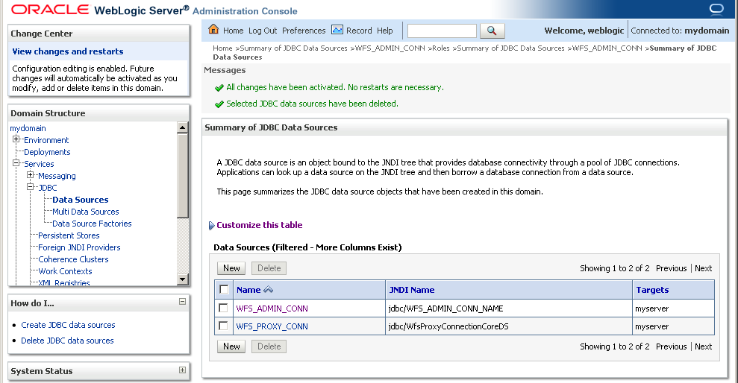
Configure Data Sources - WebLogic
For deployments in WebLogic, define the datasources using the WebLogic console

Slide 34
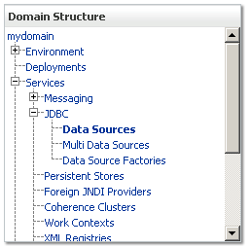
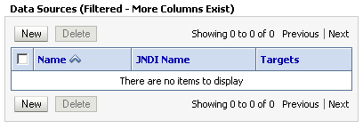
Configure Data Sources - WebLogic
Go to WebLogic console (http://localhost:7001/console)
In Domain Structure, select Services/JDBC/Data Sources
Click on « New » and create the data source

Slide 35
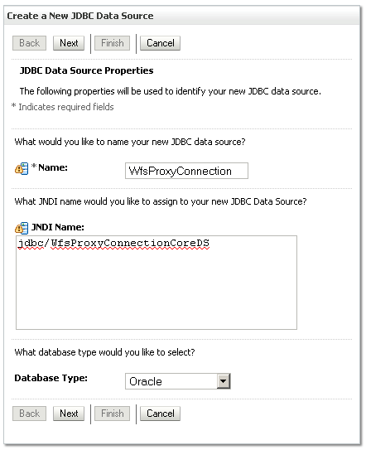
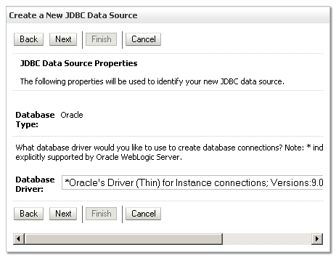
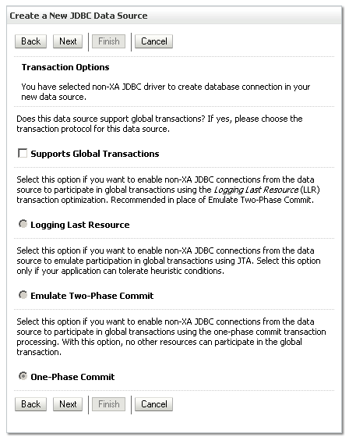
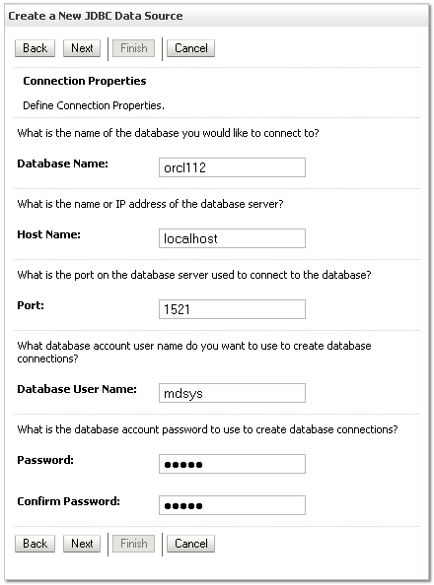
Configure Data Sources - WebLogic
Name: (see preceding table)
JNDI Name: (see preceding table)
Database Driver: « Oracle’s Driver (Thin) for Instance Connections; Versions 9.0.1, 9.2.0, 10,11 »
Supports Global Transactions: uncheck
Database connection details: name, host, port, user name, password
Test configuration
Select Target: check « myserver »

Slide 36
4. Configure Web Services Parameters
Edit file WEB-INF/conf/wsconfig.xml
Configure the following aspects:
Logging level
Name of anonymous database users for each service
Can also configure parameters specific to each web service (WFS, CSW)
Caching, timeouts, XSD URLs, etc.
Discussed later for each service
Restart sdows application after changes

Slide 37
Logging and debugging
Set logging level to “finest” while setting up and testing your web services
All logging and debugging information written to file WEB-INF/log/ws.log
Highly detailed information: all requests and responses, all SQL statements, exceptions, etc
Essential for debugging problems
<logging log_level="finest" log_thread_name="true"
log_time="true">
<log_output name="System.err" />
<log_output name="log/ws.log" />
</logging>

Slide 38
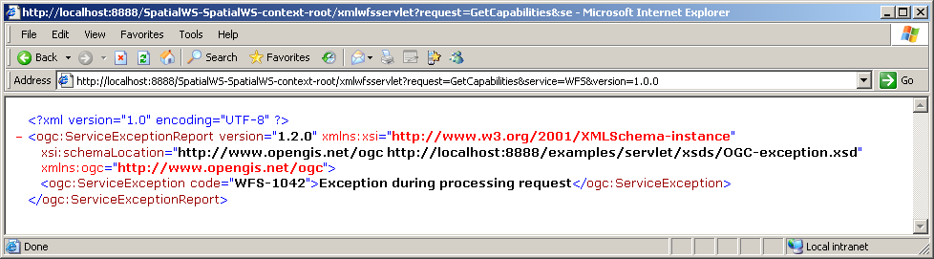
Verify the installation
http://<server>:<port>/SpatialWS-SpatialWS-context-root/xmlwfsservlet?request=GetCapabilities&service=WFS&version=1.0.0
The exception you get is because you have not yet configured your Web Feature Server.

Slide 39
<Insert Picture Here>
WFS Web Feature Service

Slide 40
Web Feature Service
Provided with Oracle Spatial
Need to license the Oracle Spatial option
Can deploy in any application server
11gR1: only certified with Oracle Application Server
11gR2: certified with Oracle Weblogic Server
OGC Conformance
Versions 1.0 and 1.1
Processes all WFS requests:
Basic
Transactional (WFS-T)
SOAP and XML interfaces

Slide 41
Web Feature Service Overview
- GML - Published feature types
OGC standard (and ISO 19142)
A WFS is a Web interface that allows one to publish and deploy geographic feature data locally or across the Internet.
Two types of services:
“standard” WFS
“transactional” WFS (WFS-T)
WFS-T operations include the ability to insert, delete, update, get and query features on spatial and non-spatial constraints
request
response
Web Feature Service
Feature Schema
Mapping
Data
repository
Data base
& internal data model

Slide 42
Web Feature Service Architecture
Client
WFS Client
WFS Requests/responses
HTTP
Application Server
WFS Server API
Feature cache
JDBC
Database
Spatial
Tables
Feature
Mapping
Admin API
(PL/SQL)

Slide 43
Web Feature Service – WFS
Configuration

Slide 44
WFS Configuration Steps
1. Set capabilities info
All administration steps performed in SQL
Using packages SDO_WFS_PROCESS and SDO_WFS_LOCK
2. Enable the schema
3. Publish table
Updatable ?
Set server capabilities info
Enable database schemas
Publish tables as WFS feature types
Register tables for updates
Notify the WFS server
Grant access to database tables
Set configuration parameters
4. Register table for updates
5. Notify WFS server
6. Grant access rights
7. Set configuration params

Slide 45
1. Set server capabilities info
Sets the base content of the information returned by the GetCapabilities request:
Name and description of the server
List of supported requests
List of supported OGC filter operations
Provide it as an XML document
Really a template that will be filled with actual data by the GetCapabilities request
URLs will be replaced with the actual server URLs
Published feature types will be added
Restart the web application or wait for wfs_cache_sync_interval to expire

Slide 46
Set server capabilities info
Run as SYSTEM
Load the capabilities info from an XML file
Define a directory that points to the XML file :
Load the file using the “BFILE” mechanism :
create or replace directory WFS_XML
as ‘<directory that contains the template>';
begin
SDO_WFS_PROCESS.insertCapabilitiesInfo(
xmltype(
bfilename('WFS_XML', 'WFScapabilitiesTemplate.xml'),
nls_charset_id('AL32UTF8')
)
);
end;
/
commit;

Slide 47
Set server capabilities info Load in PL/SQL
declare
capabilitiesXML CLOB :=
'<WFS_Capabilities version="1.0.0" xmlns="http://www.opengis.net/wfs"
xmlns:ogc="http://www.opengis.net/ogc" >
<Service>
<Name> Oracle WFS </Name>
<Title> Oracle Web Feature Service </Title>
<Abstract> Web Feature Service maintained by Oracle </Abstract>
<OnlineResource> http://www.someserver.com/wfs/cwwfs.cgi?
</OnlineResource>
</Service>
...
</WFS_Capabilities>';
begin
SDO_WFS_PROCESS.insertCapabilitiesInfo (
xmltype(capabilitiesXML));
end;
/
Commit;
Service URL. Do not specify - will be automatically filled at run time

Slide 48
Set server capabilities info
This is a required step!
If you miss it, then the getCapabilities request will fail and your WFS will be unusable

Slide 49
Updating and viewing the capabilities info
If you need to update the capabilities info, just reload it
Use the same call as for the initial definition: SDO_WFS_PROCESS.insertCapabilitiesInfo ()
This will replace the capability template
To view the template that you loaded:
The table also shows the time the template was last updated and the WFS version.
SELECT * FROM MDSYS.WFS_CAPABILITIESINFO$;

Slide 50
Clearing server capabilities info
You can also just clear the table
EXEC SDO_WFS_PROCESS.deleteCapabilitiesInfo();
COMMIT;
DELETE FROM MDSYS.WFS_CAPABILITIESINFO$;
COMMIT;

Slide 51
Service URLs in Capabilities Document
Service URLs are automatically filled in at runtime
Host name and port filled from the name and port of the actual application server
May not be what you want
<WFS_Capabilities xmlns="http://www.opengis.net/wfs" version="1.0.0"
xmlns:ogc="http://www.opengis.net/ogc"
xmlns:myns="http://www.myserver.com/myns">
<Service>
<Name> Oracle WFS </Name>
<Title> Oracle Web Feature Service </Title>
<Abstract> Web Feature Service maintained by Oracle </Abstract>
<OnlineResource>
http://localhost:7001/SpatialWS-SpatialWS-context-root/wfsservlet
</OnlineResource>
</Service>
. . .
Service URL - automatically filled at run time

Slide 52
Customizing the Service URL
Needed if accessing the WFS via a front-end server
Firewall, reverse proxy, load balancer, web cache ,…
Modify file WEB-INF/web.xml
The following sets the service URL to https://www.oracle.com:443
<env-entry>
<env-entry-name>oracle/spatial/ws/publish_url_as/host</env-entry-name>
<env-entry-type>java.lang.String</env-entry-type>
<env-entry-value>www.oracle.com</env-entry-value>
</env-entry>
<env-entry>
<env-entry-name>oracle/spatial/ws/publish_url_as/port</env-entry-name>
<env-entry-type>java.lang.String</env-entry-type>
<env-entry-value>443</env-entry-value>
</env-entry>
<env-entry>
<env-entry-name>oracle/spatial/ws/publish_url_as/protocol</env-entry-name>
<env-entry-type>java.lang.String</env-entry-type>
<env-entry-value>https</env-entry-value>
</env-entry>

Slide 53
Service URLs in Capabilities Document
Capabilities document now has the right URL
<WFS_Capabilities xmlns="http://www.opengis.net/wfs" version="1.0.0"
xmlns:ogc="http://www.opengis.net/ogc"
xmlns:myns="http://www.myserver.com/myns">
<Service>
<Name> Oracle WFS </Name>
<Title> Oracle Web Feature Service </Title>
<Abstract> Web Feature Service maintained by Oracle </Abstract>
<OnlineResource>
https://www.oracle.com:443/SpatialWS-SpatialWS-context-root/wfsservlet
</OnlineResource>
</Service>
. . .

Slide 54
2. Enable Database Schemas
Run as SYSTEM
Schemas that contain tables to be published must be enabled for WFS.
This allows data in those schemas to be published via WFS
Run as MDSYS, SYSTEM or SYS
To revoke access:
SQL> exec SDO_WFS_PROCESS.GrantMDAccessToUser('SCOTT');
SQL> exec SDO_WFS_PROCESS.RevokeMDAccessFromUser('SCOTT');

Slide 55
3. Publish Tables as Feature Types
Run as SYSTEM
Perform this step for all tables or views that you want to publish to WFS
Use SDO_WFS_PROCESS.publishFeatureType()
Inserts the definition of the table or view in the metadata repository used by WFS
Grants all rights on the table to SPATIAL_WFS_ADMIN
Use it for publishing tables as well as views
Must run as SYS or SYSTEM (not the owner of the tables, not MDSYS)

Slide 56
Publish a Database Table
declare
featureDescriptorXML CLOB :=
'<?xml version="1.0" ?>
<FeatureType xmlns:scottns="http://www.myserver.com/scott"
xmlns="http://www.opengis.net/wfs">
<Name> scottns:USCities</Name>
<Title>U.S Cities</Title>
<SRS>SDO:8307</SRS>
</FeatureType>';
begin
SDO_WFS_PROCESS.publishFeatureType(
dataSrc => 'SCOTT.US_CITIES',
ftNsUrl => 'http://www.myserver.com/scott',
ftName => 'UsCities',
ftNsAlias => 'scottns' ,
featureDesc => xmltype(featureDescriptorXML),
schemaLocation => null,
pkeyCol => 'ID',
columnInfo => MDSYS.StringList('PointMemberType'),
pSpatialCol => 'LOCATION',
featureMemberNs => null,
featureMemberName => null,
srsNs => null,
srsNsAlias => null
);
end;
/
Feature descriptor as you want it to appear in the capabilities document.
Schema and table
Feature type name
Name of primary key column(s)
Type of GML geometry
Name of spatial column

Slide 57
Usage Notes: Parameters
Parameter | Description | Notes
dataSrc | Name of the feature table or view containing the spatial features. | Must be in the format <schema-name>.<table-name>
ftNsUrl | Uniform resource locator (URL) of the namespace for the feature type
ftName | Name of the feature type
ftNsAlias | Alias of the namespace for the feature type
featureDesc | Feature type description to be reported in the capabilities document, as a document of type XMLTYPE. | Optional. If null, a default description will be generated with only the feature type name and alias.
schemaLocation | String to be used to populate the xsi:schemaLocation attribute in the feature type XSD. | Optional. If null, it is automatically set to http://www.opengis.net/wfs ../wfs/1.0.0/WFS-basic.xsd

Slide 58
Usage Notes: Parameters
Parameter | Description | Notes
pkeyCol | Name of the primary key columns of the feature table | Required. If the feature type table has a multicolumn primary key, use a semicolon to separate the columns in the primary key. For example: <col1>;<col3>
columnInfo | Type of geometry in gml notation | Required. Specify as a string array, for example: MDSYS.StringList (‘GeometryCollectionType’)
pSpatialCol | Name of the spatial column in the feature table. | Optional. If null then it is automatically filled in with the name of the SDO_GEOMETRY column
mandatoryColumnInfo | Names of the mandatory columns, i.e. those columns that are always returned in getFeatures requests | Optional. If not specified, then all columns are mandatory. If specified as NULL, then no columns are mandatory, i.e. only the requested columns are returned.

Slide 59
Usage Notes: Parameters
Parameter | Description | Notes
featureMemberNs | Namespace of the feature member element that will contain feature instances in a feature collection. | Optional. The default is http://www.opengis.net/gml
featureMemberName | Name of the feature member element that will contain feature instances in a feature collection. | Optional. The default is featureMember.
srsNs | User-defined namespace of the spatial reference system (coordinate system) associated with the spatial data for the feature type. | Optional. The default is to use the Oracle Spatial coordinate systems
srsNsAlias | Namespace alias of the namespace of the spatial reference system | Optional. The default is SDO:

Slide 60
Publish Multiple Tables
Use PL/SQL
Identify the tables to publish
For example, all tables in a schema
For each table
Get the name of the primary key column
Dynamically generate the feature descriptor
Publish it

Slide 61
Publishing all tables in a schema
begin
for t in (
select g.owner, g.table_name, g.column_name, g.srid
from all_sdo_geom_metadata g, all_tab_cols c
where g.owner = ‘SCOTT’ and c.owner = g.owner
and c.table_name = g.table_name and c.column_name = g.column_name
and c.data_type = 'SDO_GEOMETRY'
)
loop
-- Construct feature descriptor
featureDescriptorXML :=
'<?xml version="1.0" ?>' ||
' <FeatureType xmlns:myns="http://www.myserver.com/myns" ||
‘ xmlns="http://www.opengis.net/wfs">' ||
' <Name> ' || namespace_alias || ':' || t.table_name || '</Name>' ||
' <Title>Database Table ' || t.table_name || '</Title>' ||
' <SRS>SDO:' || t.srid || '</SRS>' ||
'</FeatureType>';
. . .

Slide 62
Publishing all tables in a schema (cont’d)
. . .
-- Publish the type
SDO_WFS_PROCESS.publishFeatureType(
dataSrc => t.owner || '.' || t.table_name,
ftNsUrl => p_namespace_url,
ftName => t.table_name,
ftNsAlias => p_namespace_alias ,
featureDesc => xmltype(featureDescriptorXML),
schemaLocation => null,
pkeyCol => pkey,
columnInfo => MDSYS.StringList('GeometryCollectionType'),
pSpatialCol => t.column_name,
featureMemberNs => null,
featureMemberName => null,
srsNs => null,
srsNsAlias => null
);
end loop;
end;

Slide 63
List Published Feature Types
Query table MDSYS. WFS_FeatureType$
FEATURETYPEID NUMBER
FEATURETYPENAME VARCHAR2(80)
FEATUREDESC PUBLIC.XMLTYPE
DESCRIBEFEATURETYPE PUBLIC.XMLTYPE
LASTDESCRIBEFEATURETYPEGENTS TIMESTAMP(6)
LASTFEATUREUPDATETS TIMESTAMP(6)
NAMESPACEPREFIX VARCHAR2(20)
NAMESPACEURL VARCHAR2(2083)
SCHEMALOCATION VARCHAR2(2083)
KEYCOLS VARCHAR2(4000)
DATAPOINTER VARCHAR2(61)
ISDOCBASED VARCHAR2(1)
SPATIALCOLS MDSYS.STRINGLIST
MANDATORYCOLS MDSYS.STRINGLIST
TSCOLS MDSYS.STRINGLIST
DOCIDPATHS MDSYS.STRINGLIST
SPATIALPATHARRSEP MDSYS.STRINGLIST
PRIMARYSPATIALCOL VARCHAR2(4000) FEATUREMEMBERNAME VARCHAR2(2200)
SRSNS VARCHAR2(2083)
SRSNSALIAS VARCHAR2(80)
FTXSDREFID VARCHAR2(80)
ISMTABLEVIEW VARCHAR2(1)
VTABLELIST MDSYS.STRINGLIST
VKEYCOLSLIST MDSYS.STRINGLIST
TKEYCOLSLIST MDSYS.STRINGLIST
NUMCOLS MDSYS.STRINGLIST
IDXPATHS MDSYS.STRINGLIST
IDXPATHTYPES MDSYS.STRINGLIST
XTIDXCREATED VARCHAR2(1)
FEATURECOLLECTIONNAME VARCHAR2(2200)
FORMATTEDKEYCOLS MDSYS.STRINGLIST
FORMATTEDTKEYCOLLIST MDSYS.STRINGLISTLIST
ISGML3 VARCHAR2(1)
SPATIALARRLIST MDSYS.STRINGLISTLIST
SPATIALPATHSSRSNSLIST MDSYS.STRINGLISTLIST
SPATIALARRPATHSSRSNSLIST MDSYS.STRINGLISTLIST

Slide 64
List Published Feature Types
List all feature types published in a database schema:
List feature types published by the current schema
select featureTypeName, dataPointer, namespacePrefix, namespaceURL
from mdsys.WFS_FeatureType$
where dataPointer like 'SCOTT.%'
order by featureTypeId;
select featureTypeName, dataPointer, namespacePrefix, namespaceURL
from mdsys.WFS_FeatureType$
where dataPointer like user || '.%'
order by featureTypeId;

Slide 65
Unpublish a Feature Type
Use the SDO_WFS_PROCESS.dropFeatureType() procedure to unpublish one specific type.
Must “unpublish” first before re-publishing
For example, if your table structure changed
begin
SDO_WFS_PROCESS.dropFeatureType (
'http://www.myserver.com/scott', 'UsCities' );
end;
/

Slide 66
Unpublish all Feature Types in a Namespace
Use SDO_WFS_PROCESS.dropFeatureTypes()
exec SDO_WFS_PROCESS.dropFeatureTypes('http://www.myserver.com/scott');

Slide 67
Unpublish all Feature Types in a Schema
Use a PL/SQL loop
begin
for f in (
select featureTypeId, featureTypeName, dataPointer, namespaceURL
from mdsys.WFS_FeatureType$
where dataPointer like 'SCOTT.%'
order by featureTypeId
)
loop
SDO_WFS_PROCESS.dropFeatureType(f.namespaceURL, f.featureTypeName);
dbms_output.put_line ('Table '|| f.dataPointer || ' unpublished');
end loop;
end;
/
commit;

Slide 68
4. Register tables for updating
Database tables updated in WFS-T transactions must be registered
Registering a feature table enables the table for WFS transaction locking
Run this as the user that owns the tables
To un-register the table:
SQL> exec SDO_WFS_LOCK.registerFeatureTable('SCOTT', 'US_CITIES');
SQL> exec SDO_WFS_LOCK.unRegisterFeatureTable('SCOTT', 'US_CITIES');

Slide 69
Register tables for updating
The owning schema must have been enabled (see step 2)
If not:
Implementation notes
Creates triggers on the table to implement feature locking
Before and after update, before and after delete
Table names must be less than 26 characters long
SQL> exec SDO_WFS_LOCK.registerFeatureTable('SCOTT', 'US_CITIES');
ERROR:
ORA-24344: success with compilation error
ORA-06512: at "MDSYS.SDO_WFS_LOCK", line 22

Slide 70
Is this table registered ?
Registrations not recorded anywhere
Check the presence of the locking triggers on the table
select table_name from (
select table_name from user_triggers
where trigger_name = table_name || '_UL'
and trigger_type = 'AFTER EACH ROW' and triggering_event = 'UPDATE'
union all
select table_name from user_triggers
where trigger_name = table_name || '_DL'
and trigger_type = 'AFTER EACH ROW' and triggering_event = 'DELETE'
union all
select table_name from user_triggers
where trigger_name = table_name || '_CUL'
and trigger_type = 'BEFORE EACH ROW' and triggering_event = 'UPDATE'
union all
select table_name from user_triggers
where trigger_name = table_name || '_CDL'
and trigger_type = 'BEFORE EACH ROW' and triggering_event = 'DELETE'
)
group by table_name having count(*) = 4;

Slide 71
5. Notify the WFS server
Changes are not automatically visible by the WFS
Use SDO_WFS_PROCESS. insertFtMDUpdated() to notify the WFS
The WFS checks for notification at regular intervals
Based on wfs_cache_sync_interval parameter
Default is 10 seconds
exec SDO_WFS_PROCESS.InsertFtMDUpdated(
'http://www.myserver.com/scott','UsCities', sysdate);
<wfs_cache_sync_interval>10000</wfs_cache_sync_interval>

Slide 72
Usage Note:
Make sure the information you pass (namespace URL, feature type name) is valid!
If it is invalid (for example, the type does not exist, i.e. it was not published) …
… then the WFS server goes into an infinite loop!
Correct by clearing the notification table:
SQL> delete from mdsys.wfs_featuretablemdupdated$;
SQL> commit;

Slide 73
6. Grant Access to Database Tables
If you use the anonymous interface, you may need to grant access to the database tables
You also need to grant access to any user account that needs access
If you want to allow updates, you also need to grant the proper UPDATE, INSERT and/or DELETE privileges.
GRANT SELECT ON US_CITIES TO spatialwsxmluser;
GRANT SELECT ON US_CITIES TO wfs_user_1;

Slide 74
7. Set Configuration Parameters
Edit file WEB-INF/conf/wsconfig.xml
Cache synchronization interval (in milliseconds)
The WFS refreshes its status at this interval
Checks for notifications of new table registrations
Updates the capabilities response
Checks for any updates to cached tables
Updates the cache
<wfs_cache_sync_interval>10000</wfs_cache_sync_interval>

Slide 75
Set Configuration Parameters
Locking:
Default lock duration (in minutes)
Lock timeout (in seconds)
Caching:
<wfs_query_timeout>10</wfs_query_timeout>
<wfs_lock_expiry>4</wfs_lock_expiry>
<cached_feature_types>
<feature_type ns="http://www.myserver.com/scott"
name="UsCities" />
<feature_type ns="http://www.myserver.com/scott"
name="UsCounties" />
</cached_feature_types>

Slide 76
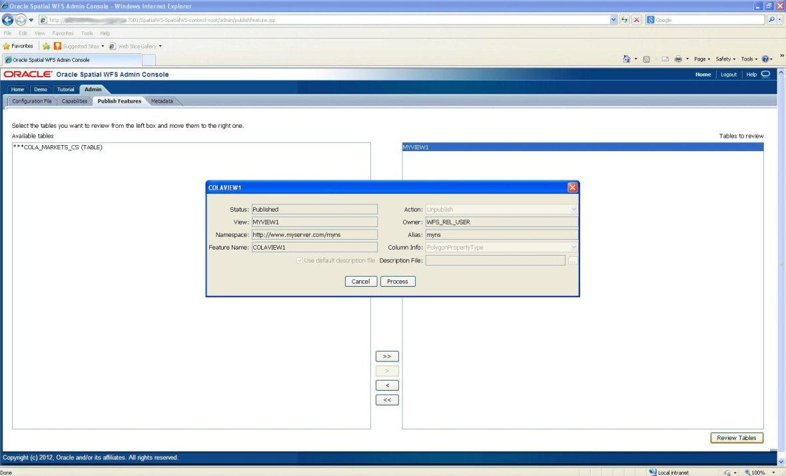
Using the Administration Console
Simplifies registration of spatial tables
Eliminates the need for DBA to run PL/SQL scripts to publish spatial layers
Includes tutorial on how to configure and use WFS
Provide sample request and response pages for WFS queries
Can also be used as a client to other WFS servers

Slide 77
Using the Web Feature Server
BASIC - Data Publishing
GetCapabilities
Gets the metadata about the types / operations that the feature server supports
DescribeFeature
Gets the structural information about a feature type
GetFeature
Gets a set of features
WFS-T – Data Editing
GetFeatureWithLock
Get a set of features, and lock them for a certain period of time.
LockFeature
Lock a set of feature instances
Transaction
Insert , update, delete feature instances

Slide 78
WFS Operations – Basic Data Publishing
Client
WFS
GetCapabilities
Gets the metadata about the types / operations that the feature server supports
DescribeFeature
Gets the structural information about a feature type
GetFeature
Gets a set of features from one or more feature types
<GetCapabilities> Request
<WFS_Capabilities> document
<DescribeFeatureType> Request
<schema> document
<GetFeatures> Request
<FeatureCollection> document
Network

Slide 79
GetCapabilities request
Two interfaces are possible
Annotated URL (key-value pairs)
XML request
http://host:port/SpatialWS-SpatialWS-context-root/xmlwfsservlet
?request=GetCapabilities
&service=WFS
&version=1.0.0
<GetCapabilities
service="WFS" version="1.0.0" xmlns="http://www.opengis.net/wfs" />

Slide 80
GetCapabilities response
Response formed using the template you provided
Service URLs filled in
Lists all published feature types
<WFS_Capabilities xmlns="http://www.opengis.net/wfs" version="1.0.0"
xmlns:ogc="http://www.opengis.net/ogc"
xmlns:scottns="http://www.myserver.com/scottns">
<Service>
<Name> Oracle WFS </Name>
<Title> Oracle Web Feature Service </Title>
<Abstract> Web Feature Service maintained by Oracle </Abstract>
<OnlineResource>
http://localhost:7001/SpatialWS-SpatialWS-context-root/wfsservlet
</OnlineResource>
</Service>
. . .
<FeatureType xmlns:scottns="http://www.myserver.com/scott">
<Name>scottns:UsStates </Name> <Title> US States </Title> <SRS> SDO:8307</SRS>
</FeatureType>
. . .
</WFS_Capabilities>

Slide 81
DescribeFeatureType request
<wfs:DescribeFeatureType
service="WFS"
version="1.0.0"
xmlns:wfs="http://www.opengis.net/wfs"
xmlns:scottns="http://www.myserver.com/scottns"
xmlns:xsi="http://www.w3.org/2001/XMLSchema-instance"
xmlns:xsd="http://www.w3.org/2001/XMLSchema"
xsi:schemaLocation="http://www.opengis.net/wfs ../wfs/1.0.0/WFS-basic.xsd">
<wfs:TypeName>scottns:UsCities</wfs:TypeName>
</wfs:DescribeFeatureType>
Feature type to describe

Slide 82
DescribeFeatureType response
<xsd:schema targetNamespace="http://www.myserver.com/scott" xmlns:wfs="http://www.opengis.net/wfs" xmlns:scottns="http://www.myserver.com/scott" xmlns:xsi="http://www.w3.org/2001/XMLSchema-instance" xsi:schemaLocation="http://www.opengis.net/wfs ../wfs/1.0.0/WFS-basic.xsd" xmlns:gml="http://www.opengis.net/gml" elementFormDefault="qualified" version="1.0.0" xmlns:xsd="http://www.w3.org/2001/XMLSchema">
<xsd:import namespace="http://www.opengis.net/gml" schemaLocation="http://localhost:7001/examples/servlet/xsds/feature.xsd"/>
<xsd:element name="UsCities" type="scottns: UsCitiesType" substitutionGroup="gml:_Feature"/>
<xsd:complexType name="UsCities Type">
<xsd:complexContent>
<xsd:extension base="gml:AbstractFeatureType">
<xsd:sequence>
<xsd:element name="ID" type="xsd:double"/>
<xsd:element name="CITY" nillable="true">
<xsd:simpleType>
<xsd:restriction base="xsd:string">
<xsd:maxLength value="42"/>
</xsd:restriction>
</xsd:simpleType>
</xsd:element>
<xsd:element name="STATE_ABRV" nillable="true">
<xsd:simpleType>
<xsd:restriction base="xsd:string">
<xsd:maxLength value="2"/>
</xsd:restriction>
</xsd:simpleType>
</xsd:element>
<xsd:element name="POP90" type="xsd:double" nillable="true"/>
<xsd:element name="RANK90" type="xsd:double" nillable="true"/>
<xsd:element name="LOCATION" type="gml:GeometryCollectionType" nillable="true"/>
</xsd:sequence>
<xsd:attribute name="fid" type="xsd:double"/>
</xsd:extension>
</xsd:complexContent>
</xsd:complexType>
</xsd:schema>
Schema (xsd) of the feature type

Slide 83
Feature Type Schemas
Can also retrieve the schema of a feature type by direclty calling a URL such as this:
Substitute <feature_type_id> with the numeric identifier for the feature type
Available using:
http://<server>:<port>/SpatialWS-SpatialWS-context-root/xmlwfsservlet?featureTypeId=<feature_type_id>
select featuretypeid, namespacePrefix, featureTypeName
from mdsys.WFS_FeatureType$
where dataPointer = 'SCOTT.US_CITIES';
FEATURETYPEID NAMESPACEPREFIX FEATURETYPENAME
------------- -------------------- -----------------
765 scottns UsCities

Slide 84
GetFeature request
Spatial filter can be in any coordinate system
<wfs:GetFeature
service="WFS"
version="1.0.0"
handle="Example Query"
xmlns:gml="http://www.opengis.net/gml"
xmlns:wfs="http://www.opengis.net/wfs"
xmlns:ogc="http://www.opengis.net/ogc"
xmlns:scottns="http://www.myserver.com/scott">
<wfs:Query typeName="scottns:UsCities">
<ogc:PropertyName>scottns:STATE_ABRV</ogc:PropertyName>
<ogc:PropertyName>scottns:CITY</ogc:PropertyName>
<ogc:Filter>
<ogc:Within>
<ogc:PropertyName>scottns:LOCATION</ogc:PropertyName>
<gml:Box srsName=“EPSG:4326">
<gml:coordinates>-105.11, 38.86 -104.72, 39.76</gml:coordinates>
</gml:Box>
</ogc:Within>
</ogc:Filter>
</wfs:Query>
</wfs:GetFeature>
Feature query using the OGC query syntax
A request can have any number of queries.

Slide 85
GetFeature Response
<wfs:FeatureCollection xsi:schemaLocation="http://www.myserver.com/scott http://localhost:7001/SpatialWS-SpatialWS-context-root/xmlwfsservlet?featureTypeId=765 " xmlns:wfs="http://www.opengis.net/wfs" xmlns:xsi="http://www.w3.org/2001/XMLSchema-instance">
<gml:boundedBy xmlns:gml="http://www.opengis.net/gml">
<gml:Box srsName="SDO:8307">
<gml:coordinates>-104.759899,38.8632 -104.729772,39.712267</gml:coordinates>
</gml:Box>
</gml:boundedBy>
<gml:featureMember xmlns:gml="http://www.opengis.net/gml">
<scottns:UsCities fid="54" xmlns:scottns="http://www.myserver.com/scott">
<scottns:ID>54</scottns:ID>
<scottns:CITY>Colorado Springs</scottns:CITY>
<scottns:STATE_ABRV>CO</scottns:STATE_ABRV>
<scottns:POP90>281140</scottns:POP90>
<scottns:RANK90>54</scottns:RANK90>
<scottns:LOCATION>
<gml:Point srsName="SDO:8307" xmlns:gml="http://www.opengis.net/gml">
<gml:coordinates decimal="." cs="," ts=" ">-104.759899,38.8632 </gml:coordinates>
</gml:Point>
</scottns:LOCATION>
</scottns:UsCities>
</gml:featureMember>
…
</wfs:FeatureCollection>
Bounding box of the result set
Selected features
Results are in the coordinate system of the stored data.

Slide 86
WFS Operations – Transactional Data Editing
GetFeatureWithLock
Get a set of features, and lock them for a certain period of time.
LockFeature
Lock a set of feature instances
Transaction
Insert new feature instances
Update existing feature instances based on filter criteria
Delete existing feature instances based on filter criteria
Can issue multiple update/insert/delete operations in a single transaction request
Tables to be edited must have been previously registered using SDO_WFS_LOCK.registerFeatureTable()

Slide 87

Performing Updates and Deletes
This is “optimistic” locking
This is “pessimistic” locking
“Direct” updates
Use the Transaction Update or Transaction Delete operations without specifying any LockId
Will fail if anyone has locked one or more features to update
Features are not locked after the update completes
“Transactional” updates
First lock the features with a GetFeatureWithLock or LockFeature operation
Then use the Transaction Update or Transaction Delete operations specifying the LockId you obtained
Will fail if features not locked by that lock id
(The lock expired and/or someone else locked them)
Features are unlocked when the update completes

Slide 88

The WFS Transaction and Locking Model
Get your Token!
You need to hold a « token » in order to update selected features
Must obtain this token before updating features
Grants exclusive access to a specific set of features
Present the token when updating those features
Tokens have a limited life time
Use them before they expire.
(You can also perform updates without tokens!)

Slide 89
The WFS Transaction and Locking Model
Implementation: « Locks »
Lock features while reading (GetFeatureWithLock), or lock them explicitly without reading (LockFeature)
Present the returned lock id for subsequent updates of locked features
Locks are persistent and last for a specified duration
Duration expressed in minutes. The default is specified in the Web Services Configuration – 4 minutes if nothing specified
Locks are exclusive: only one requestor can hold a lock on a feature
Reads are still possible without any conflict (GetFeature)
Locks are released when the Transaction request completes
If no Transaction is performed locks remain until they expire.

Slide 90
Locking Configuration Parameters
Default lock duration (in minutes)
Lock timeout (in seconds)
This is the time a lock request will wait for a lock to be released before reporting failure.
<wfs_lock_expiry>4</wfs_lock_expiry>
<wfs_query_timeout>10</wfs_query_timeout>

Slide 91
GetFeatureWithLock request
<wfs:GetFeatureWithLock
service="WFS"
version="1.0.0"
expiry="5"
xmlns:gml="http://www.opengis.net/gml"
xmlns:wfs="http://www.opengis.net/wfs"
xmlns:ogc="http://www.opengis.net/ogc"
xmlns:scottns="http://www.myserver.com/scott">
<wfs:Query typeName="scottns:UsCities">
<ogc:PropertyName>scottns:STATE_ABRV</ogc:PropertyName>
<ogc:PropertyName>scottns:CITY</ogc:PropertyName>
<ogc:Filter>
<ogc:Within>
<ogc:PropertyName>scottns:LOCATION</ogc:PropertyName>
<gml:Box srsName="SDO:8307">
<gml:coordinates>-105.11, 38.86 -104.72, 39.76</gml:coordinates>
</gml:Box>
</ogc:Within>
</ogc:Filter>
</wfs:Query>
</wfs:GetFeatureWithLock>
Lock duration (in minutes)

Slide 92
GetFeatureWithLock response
System-generated lock id
<wfs:FeatureCollection lockId="2567" xsi:schemaLocation="http://www.myserver.com/scott http://localhost:7001/SpatialWS-SpatialWS-context-root/xmlwfsservlet?featureTypeId=765 " xmlns:wfs="http://www.opengis.net/wfs" xmlns:xsi="http://www.w3.org/2001/XMLSchema-instance">
<gml:boundedBy xmlns:gml="http://www.opengis.net/gml">
<gml:Box srsName="SDO:8307">
<gml:coordinates>-104.759899,38.8632 -104.729772,39.712267</gml:coordinates>
</gml:Box>
</gml:boundedBy>
<gml:featureMember xmlns:gml="http://www.opengis.net/gml">
<scottns:UsCities fid="54" xmlns:scottns="http://www.myserver.com/scott">
<scottns:ID>54</scottns:ID>
<scottns:CITY>Colorado Springs</scottns:CITY>
<scottns:STATE_ABRV>CO</scottns:STATE_ABRV>
<scottns:POP90>281140</scottns:POP90>
<scottns:RANK90>54</scottns:RANK90>
<scottns:LOCATION>
<gml:Point srsName="SDO:8307" xmlns:gml="http://www.opengis.net/gml">
<gml:coordinates decimal="." cs="," ts=" ">-104.759899,38.8632 </gml:coordinates>
</gml:Point>
</scottns:LOCATION>
</scottns:UsCities>
</gml:featureMember>
...
</wfs:FeatureCollection>

Slide 93
LockFeature request
<wfs:LockFeature
service="WFS"
version="1.0.0"
expiry="5"
xmlns:gml="http://www.opengis.net/gml"
xmlns:wfs="http://www.opengis.net/wfs"
xmlns:ogc="http://www.opengis.net/ogc"
xmlns:scottns="http://www.myserver.com/scott">
<wfs:Lock typeName="scottns:UsCities">
<ogc:Filter>
<ogc:Within>
<ogc:PropertyName>scottns:LOCATION</ogc:PropertyName>
<gml:Box srsName="SDO:8307">
<gml:coordinates>-105.11, 38.86 -104.72, 39.76</gml:coordinates>
</gml:Box>
</ogc:Within>
</ogc:Filter>
</wfs:Lock>
</wfs:LockFeature>
Lock duration (in minutes)
Features to lock selected using the OGC query syntax

Slide 94
LockFeature response
Response contains the unique, system-generated id for the lock used
<WFS_LockFeatureResponse
xmlns="http://www.opengis.net/wfs"
xmlns:xsi="http://www.w3.org/2001/XMLSchema-instance"
xsi:schemaLocation="http://www.opengis.net/wfs ../wfs/1.0.0/WFStransaction.xsd">
<LockId>2568</LockId>
</WFS_LockFeatureResponse>
System-generated lock id

Slide 95
Locking failure
Returned when unable to lock one of more features
Usually because they are already locked
<ogc:ServiceExceptionReport version="1.2.0"
xsi:schemaLocation="http://www.opengis.net/ogc http://localhost:7001/examples/servlet/xsds/OGC-exception.xsd">
<ogc:ServiceException code="WFS-1027">
Message:Requested Feature instances cannot be locked
Original exception :
java.sql.SQLException: ORA-13199: Row cannot be locked
ORA-06512: at "MDSYS.MD", line 1723
ORA-06512: at "MDSYS.MDERR", line 17
ORA-06512: at "MDSYS.SDO_WFS_LOCK", line 215
ORA-06512: at "MDSYS.SDO_WFS_LOCK", line 86
ORA-06512: at line 1
</ogc:ServiceException>
</ogc:ServiceExceptionReport>

Slide 96
Transaction request
<wfs:Transaction service="WFS“ version="1.0.0"
xmlns:gml="http://www.opengis.net/gml" xmlns:wfs="http://www.opengis.net/wfs"
xmlns:ogc="http://www.opengis.net/ogc“
xmlns:scottns="http://www.myserver.com/scott">
<wfs:Insert handle="INSERT-01">…</wfs:Insert>
<wfs:Insert handle="INSERT-02">…</wfs:Insert>
<wfs:Update>…</ wfs:Update>
<wfs:Update>…</ wfs:Update>
<wfs:Update>…</ wfs:Update>
<wfs.Delete>…</ wfs.Delete>
</wfs:Transaction>
A single request can group multiple individual updates (inserts, updates, deletes)
Executed as a single atomic transaction
Automatically committed

Slide 97
Transaction Insert
<wfs:Transaction service="WFS“ version="1.0.0"
xmlns:gml="http://www.opengis.net/gml" xmlns:wfs="http://www.opengis.net/wfs"
xmlns:ogc="http://www.opengis.net/ogc“
xmlns:scottns="http://www.myserver.com/scott">
<wfs:Insert handle="INSERT-01">
<scottns:UsCities xmlns:scottns="http://www.myserver.com/scott">
<scottns:ID>196</scottns:ID>
<scottns:CITY>Bismarck</scottns:CITY>
<scottns:STATE_ABRV>ND</scottns:STATE_ABRV>
<scottns:POP90>280000</scottns:POP90>
<scottns:RANK90>212</scottns:RANK90>
<scottns:LOCATION>
<gml:Point srsName="SDO:8307" xmlns:gml="http://www.opengis.net/gml">
<gml:coordinates decimal="." cs="," ts=" ">
-100.74869 46.7666667
</gml:coordinates>
</gml:Point>
</scottns:LOCATION>
</scottns:UsCities>
</wfs:Insert>
</wfs:Transaction>
Feature attributes and their values

Slide 98
Transaction Update
<wfs:Transaction
service="WFS"
version="1.0.0"
xmlns:gml="http://www.opengis.net/gml"
xmlns:wfs="http://www.opengis.net/wfs"
xmlns:ogc="http://www.opengis.net/ogc"
xmlns:scottns="http://www.myserver.com/scott">
<wfs:LockId>2568</wfs:LockId>
<wfs:Update handle="UPDATE-01" typeName="scottns:UsCities">
<wfs:Property>
<wfs:Name>scottns:POP90</wfs:Name>
<wfs:Value>30000</wfs:Value>
</wfs:Property>
<ogc:Filter>
<ogc:PropertyIsGreaterThan>
<ogc:PropertyName>scottns:RANK90</ogc:PropertyName>
<ogc:Literal> 200 </ogc:Literal>
</ogc:PropertyIsGreaterThan>
</ogc:Filter>
</wfs:Update>
</wfs:Transaction>
Lock ID
List of updated properties
Filter that selects the features to update

Slide 99
Transaction Delete
<wfs:Transaction
service="WFS"
version="1.0.0"
xmlns:gml="http://www.opengis.net/gml"
xmlns:wfs="http://www.opengis.net/wfs"
xmlns:ogc="http://www.opengis.net/ogc"
xmlns:scottns="http://www.myserver.com/scott">
<LockId>2568</LockId>
<wfs:Delete handle="DELETE-01" typeName="scottns:UsCities">
<ogc:Filter>
<ogc:PropertyIsGreaterThan>
<ogc:PropertyName>scottns:RANK90</ogc:PropertyName>
<ogc:Literal> 200 </ogc:Literal>
</ogc:PropertyIsGreaterThan>
</ogc:Filter>
</wfs:Delete>
</wfs:Transaction>
Lock ID
Features to delete selected using the OGC query syntax

Slide 100
Transaction response
Contains the ids of the new features inserted (if any)
<wfs:WFS_TransactionResponse version="1.0.0">
<wfs:InsertResult handle="INSERT-01">
<ogc:FeatureId fid="196"/>
</wfs:InsertResult>
<wfs:TransactionResult>
<wfs:Status>
<wfs:SUCCESS/>
</wfs:Status>
</wfs:TransactionResult>
</wfs:WFS_TransactionResponse>

Slide 101
Transaction errors
For example: unique constraint violation
<ogc:ServiceExceptionReport version="1.2.0“
xsi:schemaLocation="http://www.opengis.net/ogc
http://localhost:7001/examples/servlet/xsds/OGC-exception.xsd">
<ogc:ServiceException code="WFS-1038">
Message:Exception during processing DB content
Original exception :
java.sql.SQLException:
ORA-00001: unique constraint (SCOTT.US_CITIES_PK) violated
</ogc:ServiceException>
</ogc:ServiceExceptionReport>

Slide 102
Transaction errors
Trying to update a feature with an invalid lock id
The lock may have expired
<ogc:ServiceExceptionReport version="1.2.0
xsi:schemaLocation="http://www.opengis.net/ogc
http://localhost:7001/examples/servlet/xsds/OGC-exception.xsd">
<ogc:ServiceException code="WFS-1028">
Message:Exception occured during locking feature instances
Original exception :
java.sql.SQLException: ORA-13199: Cannot lock exception
ORA-06512: at "MDSYS.MD", line 1723
ORA-06512: at "MDSYS.MDERR", line 17
ORA-06512: at "MDSYS.SDO_WFS_LOCK", line 396
ORA-06512: at line 1
</ogc:ServiceException>
</ogc:ServiceExceptionReport>

Slide 103
Transaction errors
Trying to update a feature locked by someone else
<ogc:ServiceExceptionReport version="1.2.0
xsi:schemaLocation="http://www.opengis.net/ogc
http://localhost:7001/examples/servlet/xsds/OGC-exception.xsd">
<ogc:ServiceException code="WFS-1028">
Message:Exception occured during locking feature instances
Original exception :
java.sql.SQLException: ORA-13199: Row cannot be locked
ORA-06512: at "MDSYS.MD", line 1723
ORA-06512: at "MDSYS.MDERR", line 17
ORA-06512: at "MDSYS.SDO_WFS_LOCK", line 215
ORA-06512: at "MDSYS.SDO_WFS_LOCK", line 86
ORA-06512: at line 1
</ogc:ServiceException>
</ogc:ServiceExceptionReport>

Slide 104
Concurrent Updating in SQL
Once a table is registered for updating by WFS it can no longer be updated in regular SQL
SQL> delete from us_cities where id = 42;
ERROR at line 1:
ORA-13199: Table not locked
ORA-06512: at "MDSYS.MD", line 1723
ORA-06512: at "MDSYS.MDERR", line 17
ORA-06512: at "SCOTT.US_CITIES_CDL", line 1
ORA-04088: error during execution of trigger 'SCOTT.US_CITIES_CDL'

Slide 105
Concurrent Updating in SQL
Need to specifically enable database transactions on WFS tables
Then perform the updates
The update will fail if the WFS has a lock on one or more of the rows being updated.
SQL> exec SDO_WFS_LOCK.EnableDBTxns();
SQL> delete from us_cities where id = 42;

Slide 106
Usage Notes
All changes are final!
Take effect immediately (auto-commit)
One commit for all update operations in the Transaction request
Cannot rollback!
Careful with lock duration
Nothing prevents a user from specifying an inordinately long lock duration and lock all rows in a table
Prevents further locking of any of those rows

Slide 107
Locking Implementation
Uses triggers on feature tables/views to make sure that the user in the current session has shown a non-expired lock token, which was obtained previously for updating/deleting the concerned rows.
Locking logic enforced uniformly for Java or PLSQL interfaces.

Slide 108
Locking Implementation
Locks stored in persistent tables owned by MDSYS
TOKENSESSIONMAP_T$
One row per lock
Lock id, owning session, expiration time stamp
ROWTOKENMAP_T$
One row per locked feature
Lock id, table name, feature rowid
CURRENTSESSIONTOKENMAP_T$
One row per lock
Lock id, session id

Slide 109
What are the current locks ?
Check the locking tables
Active locks, their expiry time, and the number of rows locked for each table
select t.tokenid lockid, t.expirytime, r.tablename, count(*) numrows
from mdsys.tokensessionmap_t$ t,
mdsys.rowtokenmap_t$ r
where t.expirytime >= current_timestamp
and t.tokenid = r.tokenid
group by t.tokenid, t.expirytime, r.tablename;
LOCKID EXPIRYTIME TABLENAME NUMROWS
-------- ------------------------------ -------------------- ----------
104 05-MAR-09 07.51.33.000000 PM SCOTT.US_CITIES 1
105 05-MAR-09 07.51.50.000000 PM SCOTT.US_CITIES 2
2 rows selected.

Slide 110
What are the current locks ?
Active locks, their expiry time, and the rows locked for each table
select t.tokenid lockid, t.expirytime, r.tablename, r.rowid
from mdsys.tokensessionmap_t$ t,
mdsys.rowtokenmap_t$ r
where t.expirytime >= current_timestamp
and t.tokenid = r.tokenid
order by t.tokenid, t.expirytime, r.tablename;
LOCKID EXPIRYTIME TABLENAME ROWID
-------- ------------------------------ -------------------- ------------------
104 05-MAR-09 07.51.33.000000 PM SCOTT.US_CITIES AAAPdOAACAAAHnuAAD
105 05-MAR-09 07.51.50.000000 PM SCOTT.US_CITIES AAAPdOAACAAAHnuAAF
105 05-MAR-09 07.51.50.000000 PM SCOTT.US_CITIES AAAPdOAACAAAHnuAAE
3 rows selected.

Slide 111
Releasing “dead” locks
Rows remain locked even though the session that locked them has disappeared
Could happen if a session specified a long lock duration
Just delete the locks from the locking tables
delete from mdsys.tokensessionmap_t$ where tokenid = <lockid>;
delete from mdsys.rowtokenmap_t$ where tokenid = <lockid>;
commit;

Slide 112
Caching
Caching entire tables
Specify tables to be cached in WSConfig.xml file
Cached tables loaded in memory at startup
We still always query database
Only record “ids” returned
This is the column specified as “pkeyCol” when publishing the table
Record “ids” then matched with rows in cache
<cached_feature_types>
<feature_type ns="http://www.myserver.com/scott" name="UsCities" />
<feature_type ns="http://www.myserver.com/scott" name="UsCounties" />
</cached_feature_types>

Slide 113
Caching
Cache refreshed from database at regular intervals
Interval set in WSConfig.xml file (in milliseconds)
Default interval is 10000 (10 seconds)
Changed rows are recorded in “change table” mdsys.WFS_featureTableUpdated$
Applications must call SDO_WFS_PROCESS.InsertFtDataUpdated() to record updated rows in the change table
<wfs_cache_sync_interval>60000</wfs_cache_sync_interval>

Slide 114
WFS Metadata
Feature Types
Feature Type Tags
Feature Type Attributes
Complex Types

Slide 115
WFS Metadata
Type Metadata populated automatically during type publication
Type Metadata used to serve DescribeFeatureType response
Capabilities metadata used to serve GetCapabilities response

Slide 116
WFS Metadata Implementation
Metadata repository tables owned by MDSYS
WFS_CAPABILITIESINFO$
WFS_FEATUREINSTANCEMETADATA$
WFS_FEATURETABLEMDUPDATED$
WFS_FEATURETABLEUPDATED$
WFS_FEATURETYPE$
WFS_FEATURETYPEATTRS$
WFS_FEATURETYPECOMPLEXTAGS$
WFS_FEATURETYPENESTEDSDOS$
WFS_FEATURETYPESIMPLETAGATTRS$
WFS_FEATURETYPETAGS$
WFS_FEATURETYPEXMLCOLINFO$
WFS_FTTYPECOMPLEXTAGATTRS$
WFS_FTXSDINFO$

Slide 117
Using Workspace Manager
Can only publish non-versioned tables
First publish the tables
SDO_WFS_PROCESS.publishFeatureType()
Then register them for updating
SDO_WFS_LOCK.registerFeatureTable()
Then multi-version the tables
DBMS_WM.enableVersioning()
The WFS only shows data from the LIVE workspace.

Slide 118
<Insert Picture Here>
Mapviewer Access to WMS and WFS

Slide 119
Using WMS and WFS in MapViewer
Application
JavaScript Map API
HTTP
Map Cache
Map Cache Server
FOI Server
Map Rendering Engine
JDBC
WMS
WFS
Spatial
Tables
Map
Definitions
Mapbuilder

Slide 120
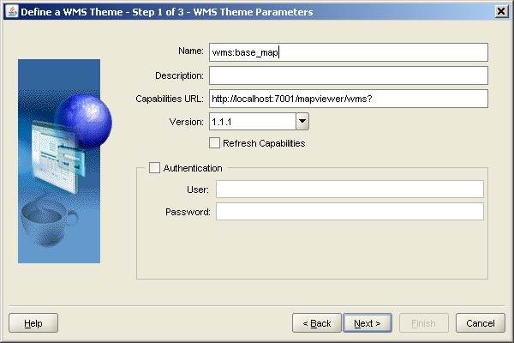
Define a WMS Theme
URL to get the capabilities document
NOTE: This needs an internet connection in order to fetch the XML schema to parse the capabilities XML response

Slide 121
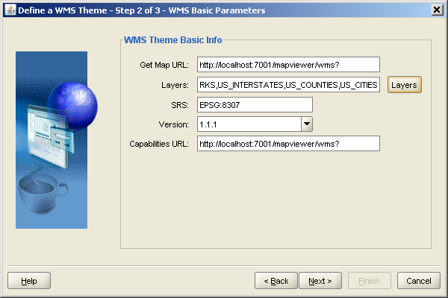
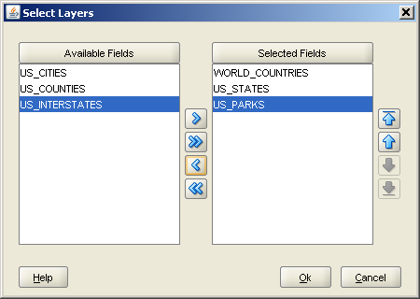
Define a WMS Theme
Choose layers
Choose coordinate system

Slide 122
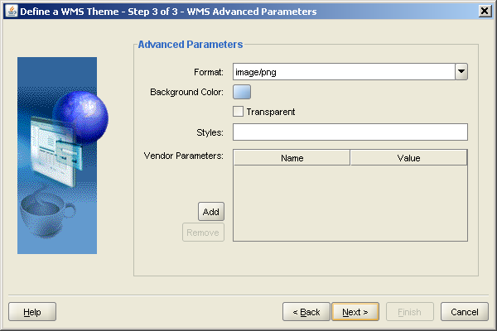
Define a WMS Theme
Choose image format, background, transparency

Slide 123
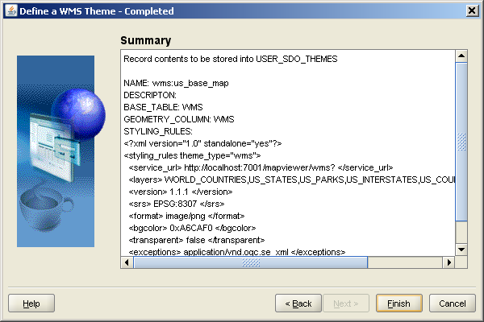
Define a WMS Theme

Slide 124
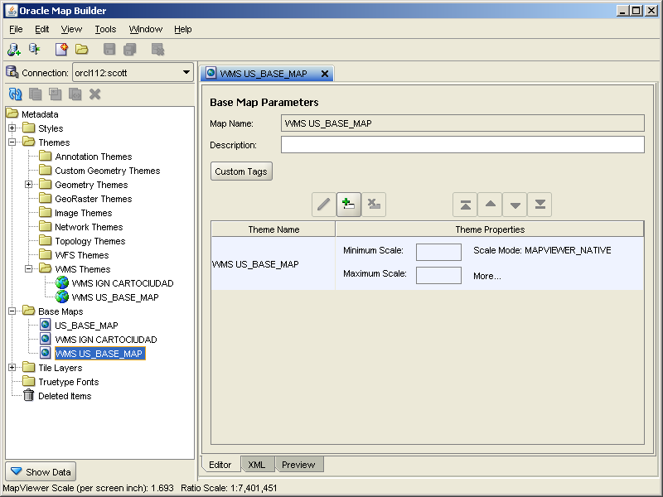
Define a Map over the WMS theme

Slide 125
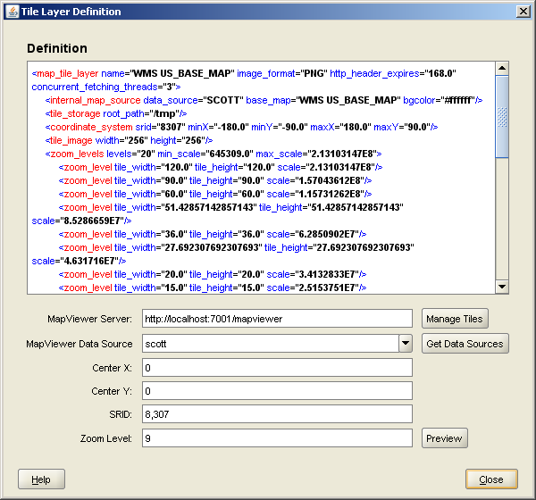
Define a Cache on the Base Map

Slide 126
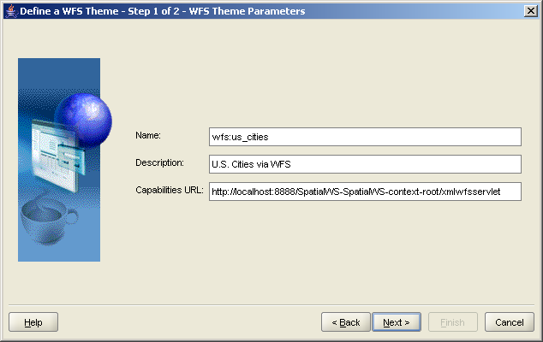
Define a WFS Theme
URL to get the capabilities document

Slide 127
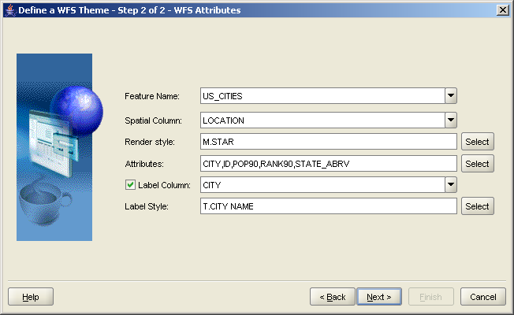
Define a WFS Theme
Choose feature type
Choose spatial column
Choose attributes

Slide 128
Using WMS/WFS Themes in Applications
Just use them like any other theme in your map definitions
Can mix and match regular themes and WFS themes on the same base map
Can also use WMS/WFS themes in map requests
Can use WMS themes for base maps in Oracle Maps
Can use WFS themes as FOI theme for Oracle Maps

Slide 129
<Insert Picture Here>
CSW Catalog Service

Slide 130
Catalog Service
Provided with Oracle Spatial
Need to license the Oracle Spatial option
Can deploy in any application server
Deployed together with WFS
OGC Conformance
Versions 1.0
Processes all CSW requests:
Queries
Updates (Transaction)
Harvesting
SOAP and XML interfaces

Slide 131
Catalog Service Architecture
Client
CSW Client
Requests/responses
HTTP
Application Server
CSW Server API
Catalog cache
JDBC
CSW Processing
Database
Catalog
Repository
Admin API
(PL/SQL)

Slide 132
CSW Operations
GetCapabilities – get the metadata about the types / operations a catalog server supports
DescribeRecord – get the structural information about a catalog record type
GetRecords – query different parts of record instances
GetRecordById – find record from its id
GetDomain – get information about the range of values of a metadata record element
Transaction
Insert, update or delete catalog records
Harvest
"pulls" data into the catalogue.

Slide 133
Catalog Service – CSW
Configuration

Slide 134
CSW Configuration Steps
Set server capabilities info
Publish records
Set configuration parameters

Slide 135
1. Set server capabilities info
Sets the base content of the information returned by the GetCapabilities request:
Name and description of the server
List of supported requests
List of supported OGC filter operations
Provide it as an XML document
Really a template that will be filled with actual data by the GetCapabilities request
URLs will be replaced with the actual server URLs
Published feature types will be added

Slide 136
Set server capabilities info
NOTE:
Must run as SYSTEM
Load the capabilities info from an XML file
Define a directory that points to the XML file :
Load the file using the “BFILE” mechanism :
create or replace directory CSW_XML
as ‘<directory that contains the template>';
begin
mdsys.SDO_CSW_PROCESS.insertCapabilitiesInfo(
xmltype(
bfilename('CSW_XML', 'CSWcapabilitiesTemplate.xml'),
nls_charset_id('AL32UTF8')
)
);
end;
/
commit;

Slide 137
Set server capabilities info Load in PL/SQL
NOTE:
Must run as SYSTEM
declare
capabilitiesXML CLOB :=
'<Capabilities
version="2.0.0"
updateSequence="0"
xmlns="http://www.opengis.net/cat/csw"
xmlns:ows="http://www.opengis.net/ows"
xmlns:ogc="http://www.opengis.net/ogc"
xmlns:csw="http://www.opengis.net/cat/csw"
xmlns:xlink="http://www.w3.org/1999/xlink" >
<ows:ServiceIdentification>
<ows:ServiceType>CSW</ows:ServiceType>
<ows:ServiceTypeVersion>2.0.0</ows:ServiceTypeVersion>
<ows:Title>Company CSW</ows:Title>
...
</Capabilities>';
begin
mdsys.SDO_CSW_PROCESS.insertCapabilitiesInfo (
xmltype(capabilitiesXML));
end;
/

Slide 138
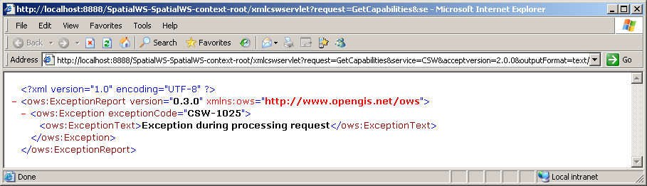
Set server capabilities info
This is a required step!
If you miss it, then the getCapabilities request will fail and your CSW will be unusable

Slide 139
Updating and viewing the capabilities info
If you need to update the capabilities info, just reload it
Use the same call as for the initial definition: SDO_CSW_PROCESS.insertCapabilitiesInfo ()
This will replace the capability template
To view the template that you loaded:
The table also shows the time the template was last updated.
SELECT * FROM MDSYS.CSW_CAPABILITIESINFO$;

Slide 140
Clearing server capabilities info
This will render the CSW unusable!
exec mdsys.SDO_CSW_PROCESS.deleteCapabilitiesInfo();
commit;

Slide 141
3. Set Configuration Parameters
Edit “wsconfig.xml”
Configure caching:
Cache synchronization interval (in milliseconds)
Cached records
<csw_cache_sync_interval>10000</csw_cache_sync_interval>
<cached_record_types>
<record_type ns="http://www.opengis.net/cat/csw"
name="Record" />
</cached_record_types>

Slide 142
Catalog Service – CSW
Queries

Slide 143
GetCapabilities request
Two interfaces are possible
Annotated URL
XML request
http://host:port/SpatialWS-SpatialWS-context-root/xmlcswservlet
?request=GetCapabilities&service=CSW
&acceptversion=2.0.0
&outputFormat=text/xml
<csw:GetCapabilities service="CSW" xmlns:csw="http://www.opengis.net/cat/csw"
xmlns:ows="http://www.opengis.net/ows">
<ows:AcceptVersions>
<ows:Version>2.0.0</ows:Version>
</ows:AcceptVersions>
<ows:AcceptFormats>
<ows:OutputFormat>text/xml</ows:OutputFormat>
</ows:AcceptFormats>
</csw:GetCapabilities>

Slide 144
GetCapabilities response
Response formed using the template you provided
<Capabilities version="2.0.0" updateSequence="0">
<ows:ServiceIdentification>
<ows:ServiceType>CSW</ows:ServiceType>
<ows:ServiceTypeVersion>2.0.0</ows:ServiceTypeVersion>
<ows:Title> ... </ows:Title> <ows:Abstract> ... </ows:Abstract>
<ows:Keywords> ...</ows:Keywords> <ows:Fees>NONE</ows:Fees>
<ows:AccessConstraints>NONE</ows:AccessConstraints>
</ows:ServiceIdentification>
<ows:ServiceProvider> ...</ows:ServiceProvider>
<ows:OperationsMetadata>
<ows:Operation name="GetCapabilities"> ...
</ows:Operation>
<ows:Operation name="DescribeRecord"> ...
</ows:Operation>
...
</ows:OperationsMetadata>
</Capabilities>

Slide 145
DescribeRecord request
<csw:DescribeRecord service="CSW"
version="2.0.0"
xmlns:csw="http://www.opengis.net/cat/csw" >
<csw:TypeName targetNamespace="http://www.opengis.net/cat/csw">
Record
</csw:TypeName>
</csw:DescribeRecord>
Record type to describe

Slide 146
DescribeRecord response
<xsd:schema targetNamespace="http://www.opengis.net/cat/csw" elementFormDefault="qualified" version="2.0.0" id="csw-record" xmlns:csw="http://www.opengis.net/cat/csw" xmlns:dc="http://www.purl.org/dc/elements/1.1/" xmlns:dct="http://www.purl.org/dc/terms/" xmlns:ows="http://www.opengis.net/ows" xmlns:xsd="http://www.w3.org/2001/XMLSchema">
<xsd:annotation>
<xsd:appinfo>
<dc:identifier xmlns:dc="http://www.purl.org/dc/elements/1.1/">
http://schemas.opengis.net/csw/2.0.0/record
</dc:identifier>
</xsd:appinfo>
</xsd:annotation>
<xsd:import namespace="http://www.purl.org/dc/terms/" schemaLocation="./recdcterms.xsd"/>
<xsd:import namespace="http://www.purl.org/dc/elements/1.1/" schemaLocation="./recdcmes.xsd"/>
<xsd:import namespace="http://www.opengis.net/ows" schemaLocation="./owsboundingbox.xsd"/>
<xsd:element name="AbstractRecord" type="csw:AbstractRecordType" abstract="true" id="AbstractRecord"/>
<xsd:complexType name="AbstractRecordType" abstract="true" id="AbstractRecordType"/>
<xsd:element name="DCMIRecord" type="csw:DCMIRecordType" substitutionGroup="csw:AbstractRecord"/>
<xsd:complexType name="DCMIRecordType">
<xsd:complexContent>
<xsd:extension base="csw:AbstractRecordType">
<xsd:sequence>
<xsd:group ref="dct:DCMI-terms"/>
</xsd:sequence>
</xsd:extension>
</xsd:complexContent>
</xsd:complexType>
<xsd:element name="BriefRecord" type="csw:BriefRecordType" substitutionGroup="csw:AbstractRecord"/> …
<xsd:element name="SummaryRecord" type="csw:SummaryRecordType" substitutionGroup="csw:AbstractRecord"/> …
<xsd:element name="Record" type="csw:RecordType" substitutionGroup="csw:AbstractRecord"/> …
</xsd:schema>
Lists server capabilities and all known feature types
Schema (xsd) of the record type

Slide 147
GetRecords request
<csw:GetRecords
service="CSW" version="2.0.0"
xmlns:csw="http://www.opengis.net/cat/csw"
xmlns:ogc="http://www.opengis.net/ogc"
xmlns:dc="http://www.purl.org/dc/elements/1.1/"
xmlns:dct="http://www.purl.org/dc/terms/"
outputFormat="text/xml"
resultType="results"
outputSchema="csw:Record">
<csw:Query typeNames="csw:Record">
<csw:ElementName>/csw:Record/dc:identifier</csw:ElementName>
<csw:ElementName>/csw:Record/dc:contributor</csw:ElementName>
<csw:Constraint version="2.0.0" >
<ogc:Filter>
<ogc:PropertyIsEqualTo>
<ogc:PropertyName>/csw:Record/dc:contributor</ogc:PropertyName>
<ogc:Literal>Raja</ogc:Literal>
</ogc:PropertyIsEqualTo>
</ogc:Filter>
</csw:Constraint>
</csw:Query>
</csw:GetRecords>
Record query using the OGC query syntax

Slide 148
GetRecords response
<csw:GetRecordsResponse xmlns:csw=http://www.opengis.net/cat/csw
xmlns:dc="http://www.purl.org/dc/elements/1.1/"
xmlns:dct="http://www.purl.org/dc/terms/"
xsi:schemaLocation="http://www.opengis.net/cat/csw
http://localhost:7001/SpatialWS-SpatialWS-context-root/cswservlet?recordTypeId=1"
version="2.0.0" xmlns:xsi="http://www.w3.org/2001/XMLSchema-instance">
<csw:RequestId>4</csw:RequestId> <csw:SearchStatus status="complete"/>
<csw:SearchResults recordSchema="http://www.opengis.net/cat/csw"
numberOfRecordsMatched="1" numberOfRecordsReturned="1" nextRecord="0"
expires="2007-02-09T16:32:35.29Z">
<csw:Record xmlns:dc="http://www.purl.org/dc/elements/1.1/"
xmlns:ows="http://www.opengis.net/ows"
xmlns:dct="http://www.purl.org/dc/terms/">
<dc:contributor xmlns:dc="http://www.purl.org/dc/elements/1.1/"
scheme="http://www.altova.com">Raja</dc:contributor>
<dc:identifier xmlns:dc="http://www.purl.org/dc/elements/1.1/">
REC-1
</dc:identifier>
</csw:Record>
</csw:SearchResults>
</csw:GetRecordsResponse>

Slide 149
GetRecordById request
<csw:GetRecordById
service="CSW"
version="2.0.0"
xmlns:csw="http://www.opengis.net/cat/csw"
xmlns:ogc="http://www.opengis.net/ogc" >
<csw:Id> REC-1 </csw:Id>
<csw:ElementSetName>brief</csw:ElementSetName>
</csw:GetRecordById>

Slide 150
GetRecordById response
<csw:GetRecordByIdResponse xmlns:csw="http://www.opengis.net/cat/csw"
xmlns:dc="http://www.purl.org/dc/elements/1.1/"
xmlns:dct="http://www.purl.org/dc/terms/"
xsi:schemaLocation="http://www.opengis.net/cat/csw
http://localhost:7001/SpatialWS-SpatialWS-context-root/cswservlet?recordTypeId=2
http://www.opengis.net/cat/csw
http://localhost:7001/SpatialWS-SpatialWS-context-root/cswservlet?recordTypeId=1“
xmlns:xsi="http://www.w3.org/2001/XMLSchema-instance">
<csw:BriefRecord xmlns:dc="http://www.purl.org/dc/elements/1.1/"
xmlns:ows="http://www.opengis.net/ows"
xmlns:dct="http://www.purl.org/dc/terms/">
<dc:identifier xmlns:dc="http://www.purl.org/dc/elements/1.1/">
REC-1
</dc:identifier>
</csw:BriefRecord>
</csw:GetRecordByIdResponse>

Slide 151
GetDomain request
<csw:GetDomain service="CSW"
version="2.0.0"
xmlns:csw="http://www.opengis.net/cat/csw" >
<csw:ParameterName>GetRecords.resultType</csw:ParameterName>
</csw:GetDomain>

Slide 152
GetDomain response
<csw:GetDomainResponse xmlns:csw="http://www.opengis.net/cat/csw"
xmlns:dc="http://www.purl.org/dc/elements/1.1/"
xmlns:dct="http://www.purl.org/dc/terms/">
<csw:DomainValues type="csw:SampleRecord">
<csw:ParameterName>GetRecords.resultType</csw:ParameterName>
<csw:ListOfValues>
<csw:Value>hits</csw:Value>
<csw:Value>results</csw:Value>
<csw:Value>validate</csw:Value>
</csw:ListOfValues>
</csw:DomainValues>
<csw:DomainValues type="csw:Record">
<csw:ParameterName>GetRecords.resultType</csw:ParameterName>
<csw:ListOfValues>
<csw:Value>hits</csw:Value>
<csw:Value>results</csw:Value>
<csw:Value>validate</csw:Value>
</csw:ListOfValues>
</csw:DomainValues>
</csw:GetDomainResponse>
Lists server capabilities and all known feature types

Slide 153
Transaction Insert request
<?xml version="1.0" standalone="yes"?>
<csw:Transaction service="CSW"
version="2.0.0"
xmlns:csw="http://www.opengis.net/cat/csw" >
<csw:Insert>
<Record xmlns="http://www.opengis.net/cat/csw"
xmlns:dc="http://www.purl.org/dc/elements/1.1/"
xmlns:dct="http://www.purl.org/dc/terms/"
xmlns:ows="http://www.opengis.net/ows" >
<dc:contributor scheme="http://www.altova.com">John</dc:contributor>
<dc:identifier >REC-2</dc:identifier>
<ows:WGS84BoundingBox crs="urn:opengis:crs:OGC:2:84" dimensions="2">
<ows:LowerCorner>12 12</ows:LowerCorner>
<ows:UpperCorner>102 102</ows:UpperCorner>
</ows:WGS84BoundingBox>
</Record>
</csw:Insert>
</csw:Transaction>

Slide 154
Transaction Insert response
Returns the count of records inserted
<csw:TransactionResponse xmlns:csw="http://www.opengis.net/cat/csw"
xmlns:dc="http://www.purl.org/dc/elements/1.1/"
xmlns:dct="http://www.purl.org/dc/terms/"
xsi:schemaLocation="http://www.opengis.net/cat/csw
http://localhost:7001/SpatialWS-SpatialWS-context-root/cswservlet?recordTypeId=1"
xmlns:xsi="http://www.w3.org/2001/XMLSchema-instance">
<csw:TransactionSummary>
<csw:totalInserted>1</csw:totalInserted>
</csw:TransactionSummary>
</csw:TransactionResponse>

Slide 155
Transaction Update request
<csw:Transaction service="CSW"
version="2.0.0"
xmlns:csw="http://www.opengis.net/cat/csw"
xmlns:ogc="http://www.opengis.net/ogc"
xmlns:dc="http://www.purl.org/dc/elements/1.1/">
<csw:Update>
<csw:RecordProperty>
<csw:Name>/csw:Record/dc:contributor</csw:Name>
<csw:Value>Jane</csw:Value>
</csw:RecordProperty>
<csw:Constraint version="2.0.0">
<ogc:Filter>
<ogc:PropertyIsEqualTo>
<ogc:PropertyName>/csw:Record/dc:contributor</ogc:PropertyName>
<ogc:Literal>John</ogc:Literal>
</ogc:PropertyIsEqualTo>
</ogc:Filter>
</csw:Constraint>
</csw:Update>
</csw:Transaction>
List of updated properties
Filter that selects the records to update

Slide 156
Transaction Update response
Returns the count of records updated
<csw:TransactionResponse xmlns:csw="http://www.opengis.net/cat/csw"
xmlns:dc="http://www.purl.org/dc/elements/1.1/"
xmlns:dct="http://www.purl.org/dc/terms/"
xsi:schemaLocation="http://www.opengis.net/cat/csw
http://localhost:7001/SpatialWS-SpatialWS-context-root/cswservlet?recordTypeId=1"
xmlns:xsi="http://www.w3.org/2001/XMLSchema-instance">
<csw:TransactionSummary>
<csw:totalUpdated>1</csw:totalUpdated>
</csw:TransactionSummary>
</csw:TransactionResponse>

Slide 157
Transaction Delete request
<csw:Transaction service="CSW"
version="2.0.0"
xmlns:csw="http://www.opengis.net/cat/csw"
xmlns:dc="http://www.purl.org/dc/elements/1.1/"
xmlns:ogc="http://www.opengis.net/ogc">
<csw:Delete typeName="csw:Record">
<csw:Constraint version="2.0.0">
<ogc:Filter>
<ogc:PropertyIsEqualTo>
<ogc:PropertyName>/csw:Record/dc:contributor</ogc:PropertyName>
<ogc:Literal>Jane</ogc:Literal>
</ogc:PropertyIsEqualTo>
</ogc:Filter>
</csw:Constraint>
</csw:Delete>
</csw:Transaction>
Records to delete selected using the OGC filter syntax

Slide 158
Transaction Delete response
Returns the count of records deleted
<csw:TransactionResponse xmlns:csw="http://www.opengis.net/cat/csw"
xmlns:dc="http://www.purl.org/dc/elements/1.1/"
xmlns:dct="http://www.purl.org/dc/terms/"
xsi:schemaLocation="http://www.opengis.net/cat/csw
http://localhost:7001/SpatialWS-SpatialWS-context-root/cswservlet?recordTypeId=1"
xmlns:xsi="http://www.w3.org/2001/XMLSchema-instance">
<csw:TransactionSummary>
<csw:totalDeleted>1</csw:totalDeleted>
</csw:TransactionSummary>
</csw:TransactionResponse>

Slide 159
<Insert Picture Here>
OLS Open Location Services

Slide 160
Open Location Services
Provided with Oracle Spatial
Need to license the Oracle Spatial option
Can deploy in any application server
Deployed together with WFS
OGC Conformance
Versions 1.0
Processes all OpenLS requests:
Location Utility Service (geocoding)
Presentation Service (mapping)
Route Service (driving directions)
Directory Service (YP, or "Yellow Pages")
SOAP and XML interfaces

Slide 161
OpenLS General Architecture
Client
OpenLS Client
Requests/responses
HTTP
Application Server
WS Server API
JDBC
PL/SQL Client
OpenLS Processing
External Services
HTTP
Database
Local data
Local data

Slide 162
OpenLS General Architecture
Services run in the database
Stored packages invoked by the WS web application
Some services are implemented “locally”
Execute inside the database (stored packages)
Some services are implemented “externally”
Calls out to external web services over HTTP
Local Services
Geocoding
Calls the database geocoder (SDO_GCDR package)
Directory
Uses own package functions and data
External Services
Mapping
Calls out to MapViewer over HTTP
Routing
Calls out to the Oracle Router over HTTP

Slide 163
Available APIs:XML or PL/SQL
XML API
This is the API used by the web services clients
Clients send XML requests and receive XML responses
PL/SQL API
Can also call the web services directly using PL/SQL calls
Construct the XML request as an XMLTYPE of CLOB
Call function SDO_OLS. MAKEOPENLSREQUEST() or SDO_OLS. MAKEOPENLSCLOBREQUEST() passing the XML request
The function returns an XML response (in XMLTYPE or CLOB)
Useful for testing and debugging the services

Slide 164
Example of PL/SQL call
declare
request CLOB :=
'<?xml version="1.0" standalone="yes"?>
<XLS version="1.1"
xmlns="http://www.opengis.net/xls" xmlns:gml="http://www.opengis.net/gml"
xmlns:xsi="http://www.w3.org/2001/XMLSchema-instance"
xsi:schemaLocation="http://www.opengis.net/xls">
<RequestHeader clientName="USERNAME" clientPassword="PASSWORD"/>
<Request methodName="GeocodeRequest" maximumResponses="10" requestID="123" version="1.0">
<GeocodeRequest>
<Address countryCode="FR">
<StreetAddress>
<Building number="150"/>
<Street>Boulevard Hausman</Street>
</StreetAddress>
<Place type="Municipality">Paris</Place>
</Address>
</GeocodeRequest>
</Request>
</XLS>';
response CLOB;
begin
response := sdo_ols.makeOpenLSClobRequest(request);
dbms_output.put_line (response);
end;
/

Slide 165
OpenLS
Configuration

Slide 166
OpenLS Configuration Steps
Grant user access
Grant network access

Slide 167
1. Grant User Access
NOTE:
Must run as SYSTEM
No standard role provided for OpenLS access
Need to create the role manually
Then grant it to the anonymous user (and any others)
CREATE ROLE ols_usr_role;
GRANT SELECT ON mdsys.OpenLSServices TO ols_usr_role;
GRANT SELECT ON mdsys.OpenLS_Nodes TO ols_usr_role;
GRANT SELECT ON mdsys.OpenLS_XPaths TO ols_usr_role;
GRANT SELECT ON mdsys.OpenLS_Classifications TO ols_usr_role;
GRANT SELECT ON mdsys.OpenLS_Namespaces TO ols_usr_role;
GRANT ols_usr_role TO spatialwsxmluser;

Slide 168
2. Grant Network Access
NOTE:
Must run as SYSTEM
External services (mapping and routing) use HTTP from the database
This is secured in Oracle 11g
Need to explicitly grant access to external servers
First: create an access control list and grant access to the role OLS_USR_ROLE we just created
begin
dbms_network_acl_admin.create_acl (
acl => 'openls-services.xml',
description => 'Controls access to external HTTP services',
principal => 'OLS_USR_ROLE',
is_grant => TRUE,
privilege => 'connect'
);
end;
/

Slide 169
Grant Network Access (cont’d)
Then: assign the ACL to the network hosts you need to access
The following allows the owners of role OLS_USR_ROLE to access the local web server on port 8888 only
Can have multiple hosts and multiple port ranges
Do not forget to commit!
begin
dbms_network_acl_admin.assign_acl (
acl => 'openls-services.xml',
host => 'localhost',
lower_port => 8888,
upper_port => 8888
);
/
commit;

Slide 170
OpenLS - Geocoding Service

Slide 171
Geocoding Data Configuration
Geocoding tables are expected to be in MDSYS!
Use geocoding tables from any schema(s) by defining synonyms for MDSYS.
Also need to grant access to the geocoding tables
create or replace synonym mdsys.GC_COUNTRY_PROFILE for scott.GC_COUNTRY_PROFILE;
…
create or replace synonym mdsys.GC_POSTAL_CODE_US for scott.GC_POSTAL_CODE_US;
grant select on scott.GC_COUNTRY_PROFILE to OLS_USR_ROLE;
…
grant select on scott.GC_POSTAL_CODE_US to OLS_USR_ROLE;

Slide 172
GeocodeRequest request
<XLS version="1.1"
xmlns="http://www.opengis.net/xls"
xmlns:gml="http://www.opengis.net/gml"
xmlns:xsi="http://www.w3.org/2001/XMLSchema-instance"
xsi:schemaLocation="http://www.opengis.net/xls">
<RequestHeader clientName="USERNAME" clientPassword="PASSWORD"/>
<Request methodName="GeocodeRequest"
maximumResponses="10" requestID="123" version="1.0">
<GeocodeRequest>
<Address countryCode="US">
<StreetAddress>
<Building number="400"/>
<Street>Post Street</Street>
</StreetAddress>
<Place type="CountrySubdivision">CA</Place>
<Place type="Municipality">San Francisco</Place>
</Address>
</GeocodeRequest>
</Request>
</XLS>
Username and password are not used

Slide 173
GeocodeRequest response
<xls:XLS version="1.0">
<xls:ResponseHeader/>
<xls:Response requestID="123" version="1.0">
<xls:GeocodeResponse>
<xls:GeocodeResponseList numberOfGeocodedAddresses="1">
<xls:GeocodedAddress>
<gml:Point>
<gml:pos dimension="2" srsName="4326">-122.4083257 37.788208</gml:pos>
</gml:Point>
<xls:Address countryCode="US">
<xls:StreetAddress>
<xls:Building number="400"/>
<xls:Street>POST ST</xls:Street>
</xls:StreetAddress>
<xls:Place type="CountrySubdivision">CA</xls:Place>
<xls:Place type="Municipality">SAN FRANCISCO</xls:Place>
<xls:PostalCode>94102</xls:PostalCode>
</xls:Address>
</xls:GeocodedAddress>
</xls:GeocodeResponseList>
</xls:GeocodeResponse>
</xls:Response>
</xls:XLS>
Coordinates
Corrected address

Slide 174
Restrictions / Issues
Geocoding tables are expected to be in MDSYS
But can use synonyms to reach any set of geocoding tables
Reverse geocoding (ReverseGeocodeRequest) is not supported
Free format addresses are not supported
Internal conversion of addresses is US specific
House number always assumed to be in front of street name

Slide 175
OpenLS - Mapping Service

Slide 176
Configure Mapviewer URL
NOTE:
Must run as SYSTEM
URLs to external services are defined in table OPENLSSERVICES
One URL for each OpenLS service
Make sure that you also have granted access to the target host / port via the network access ACL!
UPDATE mdsys.openlsservices
SET url = 'http://localhost:7001/mapviewer/omserver'
WHERE service = 'Presentation Service';
COMMIT;

Slide 177
PortrayMapRequest request
<XLS version="1.1" xmlns="http://www.opengis.net/xls"
xmlns:gml="http://www.opengis.net/gml"
xmlns:xsi="http://www.w3.org/2001/XMLSchema-instance"
xsi:schemaLocation="http://www.opengis.net/xls">
<RequestHeader clientName="USERNAME" clientPassword="PASSWORD"/>
<Request methodName="PortrayMapRequest"
requestID="456" version="1.1">
<PortrayMapRequest>
<Output
width="800" height="600“
format="jpg_url" BGcolor="#a6cae0">
<CenterContext>
<CenterPoint srsName="8307">
<gml:pos>-122.2615 37.5266</gml:pos>
</CenterPoint>
<Radius unit="M">50000</Radius>
</CenterContext>
</Output>
<Basemap filter="Include">
<Layer name="mvdemo.demo_map.THEME_DEMO_COUNTIES"/>
<Layer name="mvdemo.demo_map.THEME_DEMO_HIGHWAYS"/>
</Basemap>
</PortrayMapRequest>
</Request>
</XLS>

Slide 178
PortrayMapRequest response
<xls:XLS xsi:schemaLocation="http://www.opengis.net/xls" version="1.1">
<xls:ResponseHeader/>
<xls:Response numberOfResponses="1" requestID="456" version="1.1">
<xls:PortrayMapResponse>
<xls:Map>
<xls:Content format="jpg_url" height="600" width="800">
<xls:URL>
http://127.0.0.1:80/mapviewer/images/map1_96.gif?refresh=-5556010202
</xls:URL>
</xls:Content>
<xls:BBoxContext srsName="4326">
<gml:pos>-122.86037685607968 37.07744235794024</gml:pos>
<gml:pos>-121.66262314392031 37.97575764205976</gml:pos>
</xls:BBoxContext>
</xls:Map>
</xls:PortrayMapResponse>
</xls:Response>
</xls:XLS>
URL of map image
Map bounding box
Set the URL of returned images in the Mapviewer configuration file

Slide 179
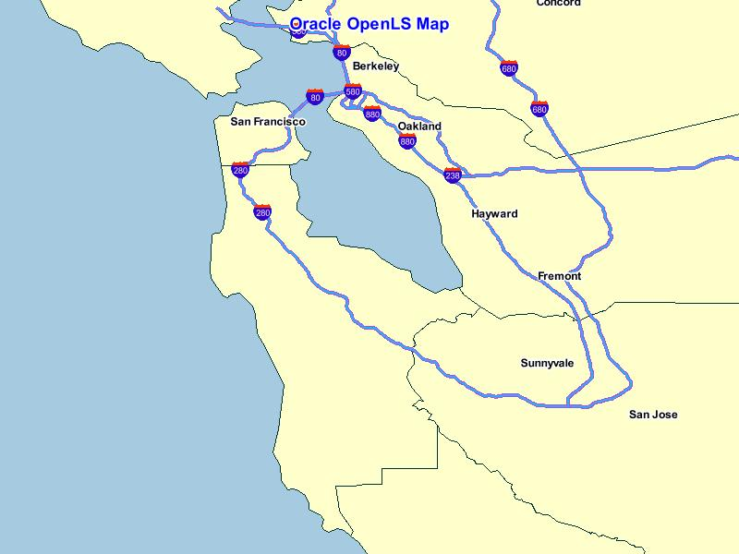
Resulting Map

Slide 180
Restrictions / Issues
Get capabilities (GetPortrayMapCapabilitiesRequest) is not implemented
BGColor attribute always required
Request will fail if omitted
Format must be specified in Mapviewer notation
I.e. “JPEG_URL”, not “image/jpg”
If missing or invalid, the resulting image will be in “image/gif”

Slide 181
Restrictions / Issues
Resulting maps produced with hard coded title string
Remove by modifying the template for Mapviewer requests:
Responses contain invalid schema specification
Remove by modifying the template for map responses:
UPDATE openls_nodes
SET openls = REPLACE (openls,'title="Oracle OpenLS Map"','')
WHERE name = 'Oracle Mapviewer request';
COMMIT;
UPDATE mdsys.openls_nodes
SET openls = REPLACE (openls,'xsi:schemaLocation="http://www.opengis.net/xls C:\WebServicesProject\OPENLS~2\PresentationService.xsd"','')
WHERE name = 'map response';
COMMIT;

Slide 182
OpenLS - Routing Service

Slide 183
Configure Router URL
NOTE:
Must run as SYSTEM
URLs to external services are defined in table OPENLSSERVICES
One URL for each OpenLS service
Make sure that you also have granted access to the target host / port via the network access ACL!
UPDATE mdsys.openlsservices
SET url =
'http://localhost:7001/routeserver/servlet/RouteServerServlet'
WHERE service = 'Route Service';
COMMIT;

Slide 184
DetermineRouteRequest request
<XLS version="1.1"
xmlns="http://www.opengis.net/xls"
xmlns:gml="http://www.opengis.net/gml"
xmlns:xsi="http://www.w3.org/2001/XMLSchema-instance"
xsi:schemaLocation="http://www.opengis.net/xls">
<RequestHeader clientName="USERNAME" clientPassword="PASSWORD"/>
<Request version="1.0" requestID="12345"
methodName="DetermineRouteRequest">
<DetermineRouteRequest>
<RoutePlan>
<RoutePreference>Fastest</RoutePreference>
<WayPointList>
<StartPoint>
<Address countryCode="US">
<StreetAddress>
<Building number="100"/>
<Street>Cambridgeside Pl</Street>
</StreetAddress>
<Place type="CountrySubdivision">MA</Place>
<Place type="Municipality">Cambridge</Place>
<PostalCode>02141</PostalCode>
</Address>
</StartPoint>
. . .
Start address

Slide 185
DetermineRouteRequest request (cont’d)
. . .
<EndPoint>
<Address countryCode="US">
<StreetAddress>
<Building number="1"/>
<Street>Oracle Dr</Street>
</StreetAddress>
<Place type="CountrySubdivision">New Hampshire</Place>
<Place type="Municipality">Nashua</Place>
<PostalCode>03062</PostalCode>
</Address>
</EndPoint>
</WayPointList>
</RoutePlan>
</DetermineRouteRequest>
</Request>
</XLS>
Destination address

Slide 186
DetermineRouteRequest response
<xls:XLS xsi:schemaLocation="http://www.opengis.net/xls version="1.1">
<xls:ResponseHeader/>
<xls:Response numberOfResponses="1" requestID="12345" version="1.0">
<xls:DetermineRouteResponse>
<xls:RouteSummary>
<xls:TotalTime>P0DT0H46M30S</xls:TotalTime>
<xls:TotalDistance uom="M" value="63754.3"/>
<xls:BoundingBox srsName="4326">
<gml:pos dimension="2" srsName="4326">-71.45937 42.36241</gml:pos>
<gml:pos dimension="2" srsName="4326">-71.05701 42.70824</gml:pos>
</xls:BoundingBox>
</xls:RouteSummary>
<xls:RouteGeometry>
<gml:LineString srsName="4326">
<gml:pos dimension="2" srsName="4326">-71.0731,42.36914</gml:pos>
...
<gml:pos dimension="2" srsName="4326">-71.45937,42.70781</gml:pos>
</gml:LineString>
</xls:RouteGeometry>
. . .
Total time and distance
Route geometry

Slide 187
DetermineRouteRequest response (cont’d)
. . .
<RouteInstructionsList>
<xls:RouteInstruction duration="P0D0H">
<xls:Instruction>
Start out on CAMBRIDGESIDE PL (Going East)
</xls:Instruction>
<xls:distance uom="M" value="50.3"/>
</xls:RouteInstruction>
...
<xls:RouteInstruction duration="P0D0H">
<xls:Instruction>
Turn RIGHT onto ORACLE DR (Going North)
</xls:Instruction>
<xls:distance uom="M" value="0"/>
</xls:RouteInstruction>
</RouteInstructionsList>
</xls:DetermineRouteResponse>
</xls:Response>
</xls:XLS>
Route instructions

Slide 188
Restrictions / Issues
If route calculation fails, no error returned
Only an empty route
Repeat the request using the PL/SQL interface for debugging
Responses contain invalid schema specification
Can remove by modifying the template for route responses:
UPDATE mdsys.openls_nodes
SET openls = REPLACE (openls,'xsi:schemaLocation="http://www.opengis.net/xls C:\WebServicesProject\OPENLS~2\PresentationService.xsd"','')
WHERE name = ‘route response';
COMMIT;

Slide 189
OpenLS - Directory Service

Slide 190
Business Directory (“Yellow Pages”)
Provide lists of businesses in a given area and matching a specified name or category
Business directory data comes from third-party providers of such data
Business data structured along a specific data model
Businesses classified in categories
A single business can belong to multiple categories
Category structuring can be flat or hierarchical

Slide 191
Data Model for Business Directory
OLS_DIR_BUSINESS_CHAINS
OLS_DIR_CATEGORY_TYPES
OLS_DIR_BUSINESSES
OLS_DIR_SYNONYMS
OLS_DIR_CATEGORIZATIONS
OLS_DIR_CATEGORIES

Slide 192
Businesses
OLS_DIR_BUSINESSES
Stores information about each business that has an address
Each business is uniquely identified by its BUSINESS_ID and has a full address and geographic location
A business can be part of a chain, specified by CHAIN_ID, a foreign key to the OPENLS_DIR_BUSINESS_CHAINS table.
OLS_DIR_BUSINESS_CHAINS
Stores information about each business chain. A business chain is a business that has multiple associated businesses with the same CHAIN_ID

Slide 193
Categories and Category Types
OLS_DIR_CATEGORIES
Businesses are grouped in categories. Each category is uniquely identified by its CATEGORY_ID.
Categories can form a hierarchy: PARENT_ID is the id of a parent category (a foreign key to OPENLS_DIR_CATEGORIES).
Categories are organized in several ways ( = category types) identified by their CATEGORY_TYPE_ID, a foreign key to OPENLS_DIR_CATEGORY_TYPES
OLS_DIR_CATEGORY_TYPES
The table is pre-filled with two category types
1 = SIC (Standard Industrial Classification) (*)
2 = NAICS (North American Industry Classification System) (**)
(*) http://www.osha.gov/pls/imis/sic_manual.html
(**) http://www.census.gov/eos/www/naics/

Slide 194
Relating Businesses and Categories
OLS_DIR_CATEGORIZATIONS
Associates categories and businesses. A business can be in multiple categories and a category contains multiple businesses.
For example, a store that sells books and music CDs might be in the categories for Bookstores, Music, and its child category Music Stores, in which case there will be three rows for that business in this table.
CATEGORY_TYPE_ID and CATEGORY_ID are a foreign key to OPENLS_DIR_CATEGORIES. BUSINESS_ID is a foreign key to OPENLS_DIR_BUSINESSES
OLS_DIR_SYNONYMS
Alternate names for categories

Slide 195
Directory Data Configuration
Directory tables are expected to be in MDSYS!
Use directory tables from any schema(s) by defining synonyms for MDSYS:
First drop the pre-created tables
Create the synonyms
Grant access to the directory tables
drop table mdsys.OLS_DIR_BUSINESSES; …
create or replace synonym mdsys.OLS_DIR_BUSINESSES
for scott.OLS_DIR_BUSINESSES; …
grant select on scott.OLS_DIR_BUSINESSES to OLS_USR_ROLE; …

Slide 196
DirectoryRequest request Search for a specific POI by name
<?xml version="1.0" standalone="yes"?>
<XLS version="1.1"
xmlns="http://www.opengis.net/xls"
xmlns:gml="http://www.opengis.net/gml"
xmlns:xsi="http://www.w3.org/2001/XMLSchema-instance"
xsi:schemaLocation="http://www.opengis.net/xls">
<RequestHeader clientName="USERNAME" clientPassword="PASSWORD"/>
<Request version="1.1" methodName="DirectoryRequest">
<DirectoryRequest>
<POIProperties>
<POIProperty name="POIName" value="MERCURE ROYAL MADELEINE"/>
</POIProperties>
</DirectoryRequest>
</Request>
</XLS>

Slide 197
DirectoryRequest request All tourist offices in San Francisco
<?xml version="1.0" standalone="yes"?>
<XLS version="1.1"
xmlns="http://www.opengis.net/xls"
xmlns:gml="http://www.opengis.net/gml"
xmlns:xsi="http://www.w3.org/2001/XMLSchema-instance"
xsi:schemaLocation="http://www.opengis.net/xls">
<RequestHeader clientName="USERNAME" clientPassword="PASSWORD"/>
<Request version="1.1" methodName="DirectoryRequest" maximumResponses="10">
<DirectoryRequest>
<POILocation>
<Address countryCode="US">
<Place type="CountrySubdivision">CALIFORNIA</Place>
<Place type="Municipality">SAN FRANCISCO</Place>
</Address>
</POILocation>
<POIProperties>
<POIProperty name="SIC_type" value="TOURIST INFORMATION"/>
</POIProperties>
</DirectoryRequest>
</Request>
</XLS>
Address-based selection
Kind of POIs to return

Slide 198
DirectoryRequest request Search for the nearest restaurant from a geographical point
<?xml version="1.0" standalone="yes"?>
<XLS version="1.1"
xmlns="http://www.opengis.net/xls"
xmlns:gml="http://www.opengis.net/gml"
xmlns:xsi="http://www.w3.org/2001/XMLSchema-instance"
xsi:schemaLocation="http://www.opengis.net/xls">
<RequestHeader clientName="USERNAME" clientPassword="PASSWORD"/>
<Request version="1.1" methodName="DirectoryRequest">
<DirectoryRequest>
<POILocation>
<Nearest nearestCriterion="Proximity">
<Position>
<gml:Point xmlns:gml="http://www.opengis.net/gml">
<gml:pos dimension="2" srsName="4326">
-122.4083257 37.788208
</gml:pos>
</gml:Point>
</Position>
</Nearest>
</POILocation>
<POIProperties>
<POIProperty name="SIC_type" value="RESTAURANT"/>
</POIProperties>
</DirectoryRequest>
</Request>
</XLS>
Spatial selection
Kind of POIs to return

Slide 199
DirectoryRequest request Search for restaurants within a distance from a geographical point
<?xml version="1.0" standalone="yes"?>
<XLS version="1.1"
xmlns="http://www.opengis.net/xls"
xmlns:gml="http://www.opengis.net/gml"
xmlns:xsi="http://www.w3.org/2001/XMLSchema-instance"
xsi:schemaLocation="http://www.opengis.net/xls">
<RequestHeader clientName="USERNAME" clientPassword="PASSWORD"/>
<Request version="1.1" methodName="DirectoryRequest" maximumResponses="10">
<DirectoryRequest>
<POILocation>
<WithinDistance>
<POI>
<gml:Point xmlns:gml="http://www.opengis.net/gml">
<gml:pos dimension="2" srsName="4326">
-122.4083257 37.788208
</gml:pos>
</gml:Point>
</POI>
<MaximumDistance value="50"/>
</WithinDistance>
</POILocation>
<POIProperties>
<POIProperty name="SIC_type" value="RESTAURANT"/>
</POIProperties>
</DirectoryRequest>
</Request>
</XLS>
Spatial selection
Kind of POIs to return

Slide 200
DirectoryRequest response
<xls:XLS version="1.0">
<xls:ResponseHeader/>
<xls:Response requestID="123" version="1.1">
<DirectoryResponse>
<xls:POIContext>
<xls:POI ID="17546683" POIName="SAN FRANCISCO CHAMBER OF COMMERCE" phoneNumber="415-3924520">
<xls:POIAttributeList>
<ReferenceSystem>
<xls:SIC category="TOURIST INFORMATION" code="7389" subType="" type=""/>
</ReferenceSystem>
</xls:POIAttributeList>
<gml:Point>
<gml:pos dimension="2" srsName="4326">-122.40224 37.79283</gml:pos>
</gml:Point>
<xls:Address countryCode="US">
<xls:StreetAddress>
<xls:Building number="465"/>
<xls:Street>CALIFORNIA ST</xls:Street>
</xls:StreetAddress>
<xls:Place type="CountrySubdivision">CALIFORNIA</xls:Place>
<xls:Place type="CountrySecondarySubdivision"/>
<xls:Place type="Municipality">SAN FRANCISCO</xls:Place>
<xls:Place type="MunicipalitySubdivision"/>
<xls:PostalCode>94104</xls:PostalCode>
</xls:Address>
</xls:POI>
</xls:POIContext>
. . .
</DirectoryResponse>
</xls:Response>
</xls:XLS>
POI details
Location
POI address

Slide 201
Restrictions / Issues
Directory tables must be in the MDSYS schema
But can use synonyms to reach any set of directory tables
Hierarchical searches not implemented
Searches from an address or from another POI are not implemented
No error returned: the spatial criteria is ignored
Searches are case-sensitive
Category names (SIC_CODE)
Address elements (municipality, region, …)
Distance unit (for WithinDistance) is not used
Ignored if specified
Searches on category synonyms not implemented

