Slide 1


<Insert Picture Here>
18 Topology Data Model

Slide 2
Topology Data Model
Concepts
Storage model
Defining and loading topologies
Defining features
Topology queries
Editing

Slide 3
Why Topology?
Spatial analysis determines relationships between objects
Containment, intersection, contact, ...
This process is expensive:
Requires complex geometry calculations
Issues with precision, tolerance, ...
Another approach is to persistently store those relationships
Searches can then use those relationships using classical relational queries
Relationships are based on common reference set
Topology primitives: nodes, edges, faces
Notes:
What is a Topology?
Topology is a branch of mathematics that defines objects in space and how they interact.
Topological relationships between features are those relationships that remain invariant when a coordinate space undergoes continuous deformations, such as twisting and stretching, but not tearing. For this reason, topology is sometimes called rubber-sheet geometry.
Examples of topological relationships include the following:
TOUCH
INSIDE
CONTAINS
COVERS
COVEREDBY
Some relationships between objects do change when a coordinate space is deformed. Examples include the length of an object, the distance between two objects, and the area of an object.
You can also use topology to model the topological relationships between features using a database.

Slide 4
Geometries vs. Topology
Geometry Storage
Topology Storage

Slide 5
Advantages of Using Topology
No redundant storage of data
Shared edges between objects stored only once
Features from different tables can share edges, such as roads and land parcels
Data consistency
No “registration” issues between geometries
Moving a boundary between objects is done once
Topological relationships are quickly and easily determined
Notes:
Advantages of Using Topology
There are several advantages to using a topological data model over an object data model.
There is no redundant storage of data. In the object data model, edges between two adjacent land parcels are stored twice, once for each land parcel. In the topology data model, the shared edges are stored only once. In addition, Oracle’s topological data model allows features from different columns to share topological primitives, for example, roads and land parcels.
Data remains consistent in the topological data model. In the object data model, shared edges between adjacent parcels are stored twice. Parcel boundaries may be slightly inconsistent, because edge coordinates of adjacent parcels may not be perfectly aligned. Also, if an adjacent edge between parcels changes, it must be changed in two places. The topology data model eliminates data consistency issues.
The topological relationships are very easily and quickly determined using the topology data model.
The benefits described are not narrowly focused in one application space, but cut broadly across a large range of application areas.

Slide 6
Topology Structures
Based on topological primitives:
Nodes, Edges, Faces
Each primitive stored once only
Each topological primitive can be associated with one or more features. For example:
An edge may be associated with two adjacent parcel boundaries
An edge may also be associated with a land parcel and a river
Features can form a hierarchical structure:
Faces -> parcels -> block groups -> tracts -> ...
Notes:
Topological Model
Spatial features can be real-world spatial objects. Examples of these features include roads, land boundaries such as cadastral (land parcel) boundaries and United States county boundaries, and electric utility cables.
In a topological data model, primitives (NODEs, EDGEs, and FACEs) are stored first. Each primitive has a unique ID, and is only stored once.
Initially, no spatial features are associated with the topological primitives. Spatial features are created by associating the list of primitive IDs with the feature.
Topological primitives can be related to one or more features. For example, an edge may be associated with adjacent county boundaries. The same edge may be associated with a different class of feature, such as a river. This capability provides an extremely flexible model for topology applications.

Slide 7
Oracle Spatial "Topology Data Model"
The topology data model includes:
Storage of topological primitives, each with a unique ID
SDO_TOPO_GEOMETRY, a data type to create a spatial feature derived from a set of primitive IDs
Procedures to create, populate, and validate topology related structures
Topology Operators
“Spatial” index for topological data
PL/SQL and Java APIs for data editing
Notes:
Oracle Spatial’s Topology Data Model
The Oracle Spatial Topology Data Model includes:
Storage of topological primitives, each with a unique ID
SDO_TOPO_GEOMETRY, which is a data type that associates a spatial feature with its component NODE, EDGE, or FACE primitives
Metadata views
Procedures to create, populate, and validate topology related tables and metadata
A spatial index for topological data

Slide 8
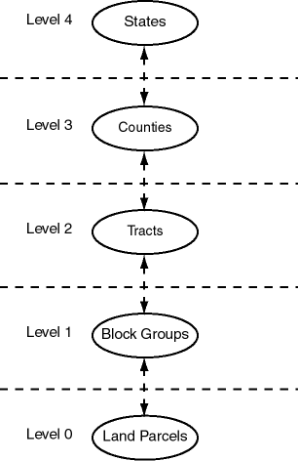
Hierarchical organization Example: US Census Data
Level 0: Land parcels. Derived from the topological primitives (faces)
Level 1: Census Block Groups. Each census block group is derived from a list of parcels
Level 2: Census Tracts. Each census tract is derived from a list of census block groups
Level 3: Counties. Each county is derived from a list of census tracts
Level 4: States. Each state is derived from a list of counties
Notes:
Hierarchical Feature Model Example: US Census Data
This example of the Oracle Spatial Topology Manager hierarchical feature model shows that at the lowest level in the hierarchy (level 0) the census blocks features layer includes information about the topological primitives each of the features are composed if.
At the next highest level in the hierarchy (level1), each census block group feature is derived from a list of census blocks.
This model continues, with each higher level in the hierarchy pointing to features in a single feature layer at the previous level in the hierarchy.

Slide 9
Flow of Operation
Create the Topology
Create the Feature Tables
Register the Feature Tables with the Topology
Populate the Topology Primitives
Generate Topology Primitives and Features from existing Geometries
Define the Features using the Topology Primitives
Define Hierarchical Features
Perform Queries
Perform Edits

Slide 10
1. Creating a Topology
A "Topology" stores all the primitives that define related features
For example: a "Land Use" topology is used for features such as "Land Parcels", "Forests"; "Roads", "Rivers", ...
Another topology, "Networks" describes "Electric Lines", "Gas Pipes", etc.
A database can contain any number of topologies
SQL> EXECUTE SDO_TOPO.CREATE_TOPOLOGY('LAND_USE');
LAND_USE_NODE$ TABLE
LAND_USE_EDGE$ TABLE
LAND_USE_FACE$ TABLE

Slide 11
Tables in Topology Data Model
Three tables to represent topology data
<topology-name>_NODE$
<topology-name>_EDGE$
<topology-name>_FACE$
One table to maintain relationships between primitives and features that use them
<topology-name>_RELATION$
Also three sequences to generate unique IDs:
<topology-name>_NODE_S
<topology-name>_EDGE_S
<topology-name>_FACE_S
Notes:
Tables in Topology Data Model
The data model used to store topology information in the database includes:
Three tables to store NODE, EDGE, and FACE topological primitives. These three tables are:
<topology-name>_NODE$
<topology-name>_EDGE$
<topology-name>_FACE$
A single table that maintains the transaction history for merges and splits of edges and faces:
<topology-name>_HISTORY$

Slide 12
Topology Nodes (NODE$ table)
NODE_ID
Unique ID number for this node (primary key)
EDGE_ID
ID number (signed) of an edge (if any) associated with this node
FACE_ID
ID number of a face (if any) associated with this node.
GEOMETRY
Geometry object (point) representing this node.

Slide 13
Topology Edges (EDGE$ table)
EDGE_ID
Unique ID number for this edge (primary key).
START_NODE_ID
ID number of the start node for this edge.
END_NODE_ID
ID number of the end node for this edge.
NEXT_LEFT_EDGE_ID
ID number (signed) of the next left edge for this edge
PREV_LEFT_EDGE_ID
ID number (signed) of the previous left edge for this edge.
NEXT_RIGHT_EDGE_ID
ID number (signed) of the next right edge for this edge
PREV_RIGHT_EDGE_ID
ID number (signed) of the previous right edge for this edge.
LEFT_FACE_ID
ID number of the left face for this edge.
RIGHT_FACE_ID
ID number of the right face for this edge.
GEOMETRY
Geometry object (line string) representing this edge.

Slide 14
Topology Faces (FACE$ table)
FACE_ID
Unique ID number for this face (primary key)
BOUNDARY_EDGE_ID
ID number of a boundary edge for this face.
ISLAND_EDGE_ID_LIST
Island edges (if any) in this face.
ISLAND_NODE_ID_LIST
Island nodes (if any) in this face
MBR_GEOMETRY (optional)
Minimum bounding rectangle (MBR) that encloses this face

Slide 15
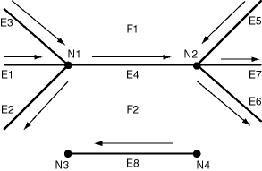
Relationships between nodes, edges and faces
EDGE_ID E4 E8
START_NODE_ID N1 N4
END_NODE_ID N2 N3
NEXT_LEFT_EDGE_ID -E5 -E8
PREV_LEFT_EDGE_ID E3 -E8
NEXT_RIGHT_EDGE_ID E2 E8
PREV_RIGHT_EDGE_ID -E6 E8
LEFT_FACE_ID F1 F2
RIGHT_FACE_ID F2 F2

Slide 16
2. Create feature tables
A spatial feature contains a column of type SDO_TOPO_GEOMETRY
A spatial feature is defined by a set of topological primitive IDs
The SDO_TOPO_GEOMETRY column stores the internal unique identifier for the spatial feature.
This unique identifier links the spatial feature to the topological primitives that describe it
Notes:
Defining Spatial Features
Initially, the topological primitives (the NODEs, EDGEs, and FACEs) are not associated with any spatial features.
When a spatial feature is created, it is defined by a set of topological primitive Ids.
SDO_TOPO_GEOMETRY is a new native data type in Oracle which stores the topological primitives associated with a spatial feature.

Slide 17
Creating a feature table
Create the table
Use the SDO_TOPO_GEOMETRY type
Then register it with the topology
This also creates the spatial topology index on the feature column
CREATE TABLE LAND_PARCELS (
PARCEL_ID NUMBER PRIMARY KEY,
BLOCK_ID NUMBER
PARCEL_NAME VARCHAR2(30),
FEATURE SDO_TOPO_GEOMETRY
);
SDO_TOPO.ADD_TOPO_GEOMETRY_LAYER(
'LAND_USE', 'LAND_PARCELS', 'FEATURE','POLYGON');

Slide 18
3. Populating Topologies
Two approaches
The "Top-Down" approach
We have existing features in standard spatial tables (using the SDO_GEOMETRY type)
Use the SDO_TOPO_MAP.CREATE_FEATURE () function to populate the topology primitives and define the features
The "Bottom-up" approach
Populate the topology primitives (nodes, edges, faces)
Define features based on the primitives, using the constructor of the SDO_TOPO_GEOMETRY type.

Slide 19
Top-down Approach Loading from existing geometries
Use function SDO_TOPO_MAP.CREATE_FEATURE
It generates the primitives from the geometries
It builds an SDO_TOPO_GEOMETRY object on the primitives
DECLARE
topo_geom SDO_TOPO_GEOMETRY;
BEGIN
FOR p IN (SELECT * FROM PARCELS_G) LOOP
topo_geom := SDO_TOPO_MAP.CREATE_FEATURE (
'LAND_USE', 'LAND_PARCELS', 'FEATURE', p.GEOM);
INSERT INTO LAND_PARCELS (PARCEL_ID, BLOCK_ID, PARCEL_NAME, FEATURE)
VALUES (p.PARCEL_ID, p.BLOCK_ID, p.PARCEL_NAME, topo_geom);
END LOOP;
END;

Slide 20
Bottom-up Approach Loading the Primitives
Use SQL INSERT statements or any other tool – for example SQL Loader
INSERT INTO land_use_node$ VALUES(1, 1, NULL, SDO_GEOMETRY(2001,
NULL,SDO_POINT_TYPE(8,30,NULL),NULL,NULL));
INSERT INTO land_use_edge$ VALUES(1, 1, 1, 1, 1, -1, -1, 1, -1,
SDO_GEOMETRY(2002, NULL, NULL, SDO_ELEM_INFO_ARRAY(1, 2, 1),
SDO_ORDINATE_ARRAY(8,30, 16,30, 16,38, 3,38, 3,30, 8,30)));
INSERT INTO land_use_face$ VALUES(1, 1, SDO_LIST_TYPE(25,-26),
SDO_LIST_TYPE(),SDO_GEOMETRY(2003, NULL, NULL,
SDO_ELEM_INFO_ARRAY (1,1003,3), SDO_ORDINATE_ARRAY(3,30, 15,38)));

Slide 21
Bottom-up Approach Defining features
Use the SDO_TOPO_GEOMETRY constructor
Pass the list of topology primitives that define this feature
For area features: a list of faces
For line features: a list of edges
For point feature: a node
Each feature table is a layer in the topology
Unique id (TG_LAYER_ID) assigned by the ADD_TOPO_GEOMETRY_LAYER() procedure

Slide 22
Bottom-up Approach Define features on primitives
INSERT INTO land_parcels VALUES (3421, 621, 'Copeland Park',
SDO_TOPO_GEOMETRY(
'CITY_DATA', -- Topology name
'LAND_PARCELS', -- Table name
'FEATURE', -- Feature column name
3, -- Feature type
SDO_TOPO_OBJECT_ARRAY (
SDO_TOPO_OBJECT (3, 3), -- face_id = 3
SDO_TOPO_OBJECT (6, 3), -- face_id = 6
SDO_TOPO_OBJECT (7, 3))) -- face_id = 7
);

Slide 23
4. Hierarchical Features
Create the feature table
Register it with the topology and associate it with the "child" table.
Note that the function needs the numeric ID of the child layer – obtained by looking up USER_SDO_TOPO_INFO.
CREATE TABLE BLOCK_GROUPS (
BLOCK_ID NUMBER PRIMARY KEY,
BLOCK_NAME VARCHAR2(30),
FEATURE SDO_TOPO_GEOMETRY
);
SDO_TOPO.ADD_TOPO_GEOMETRY_LAYER(
'LAND_USE', 'BLOCK_GROUPS', 'FEATURE','POLYGON', NULL
land_parcels_id);

Slide 24
Define features on "child" features
Use function SDO_TOPO_MAP.CREATE_FEATURE
Specify the name of the "child" table
Specify the criteria that selects the "child" features to assemble.
INSERT INTO block_groups VALUES (621,'BLK00ABU621',
SDO_TOPO_MAP.CREATE_FEATURE (
'LAND_USE', -- Topology name
'LAND_PARCEL', -- Table name
'FEATURE', -- Feature column name
'BLOCK_ID=621') -- Selection predicate
);

Slide 25
Features and Primitives Summary of relationships
LAND_PARCELS
CITY_STREETS
PARCEL_ID NUMBER
...
FEATURE SDO_TOPO_GEOMETRY
STREET_ID NUMBER
...
FEATURE SDO_TOPO_GEOMETRY
<topology_name>_RELATION$
<topology_name>_NODE$
<topology_name>_EDGE$
<topology_name>_FACE$
Notes:
Mapping Between Features and Topology
The RELATION$ table is an association table that manages the many to many relationship between features and topological primitives. The RELATION$ table is partitioned table. Each new feature layer added with SDO_TOPO.ADD_TOPO_GEOMETRY_LAYER creates a new partition in the RELATION$ association table.
As topological primitives are modified using the Oracle Topology PL/SQL or Java APIs, the mapping between the features and their underlying topological primitives is automatically maintained.

Slide 26
The RELATION$ table
Created when registering the first feature layer (using the SDO_TOPO.ADD_TOPO_GEOMETRY_LAYER() function
Partitioned table (one partition per feature layer)
CREATE TABLE LAND_USE_RELATION$ (
TG_LAYER_ID NUMBER NOT NULL,
TG_ID NUMBER NOT NULL,
TOPO_ID NUMBER NOT NULL,
TOPO_TYPE NUMBER NOT NULL,
TOPO_ATTRIBUTE VARCHAR2(100) )
PARTITION BY LIST (TG_LAYER_ID) (
PARTITION TOPO_REL_0 VALUES (0),
PARTITION LAND_USE1 VALUES (1),
PARTITION LAND_USE2 VALUES (2),
PARTITION LAND_USE3 VALUES (3) );

Slide 27
Setting up topology metadata
Use function SDO_TOPO.INITIALIZE_METADATA()
This function does the following:
Initialize the sequences to match the primitives loaded
Create spatial indexes on the geometry columns in the primitives
Creates additional indexes on the primitives
Edges: start node, end node, left face, right face
Nodes: face
This is a required step! If missing, then:
Topological queries will be very slow
Spatial queries on features will not be possible
EXEC SDO_TOPO.INITIALIZE_METADATA ('LAND_USE');

Slide 28
5. Topology Queries
Use the regular spatial operators (SDO_ANYINTERACT, SDO_INSIDE, SDO_CONTAINS, SDO_TOUCH, etc.)
Example: find all parcels around a chosen parcel
Can mix SDO_TOPO_GEOMETRY and SDO_GEOMETRY types
SELECT p1.parcel_name
FROM land_parcels p1, land_parcels p2
WHERE p2.parcel_name = 'OConnor Place'
AND SDO_TOUCH (p1.feature, p2.feature) = 'TRUE';

Slide 29
Extracting feature geometries
Use the GET_GEOMETRY() method of the SDO_TOPO_GEOMETRY type
Remember to use a table alias!
SELECT parcel_id, parcel_name,
p.feature.get_geometry()
FROM land_parcels p;

Slide 30
Extracting feature topology details
List the topology primitives for a feature
List the edges that form the boundary of a face
List all topology primitives that interact with a feature
SELECT parcel_id, parcel_type,
p.feature.get_topo_elements()
FROM land_parcels p;
SELECT SDO_TOPO.GET_FACE_BOUNDARY('LAND_USE', 3) FROM DUAL;
SELECT SDO_TOPO.GET_TOPO_OBJECTS('LAND_USE',1,1) FROM DUAL;

Slide 31
6. Editing topologies
The topology data model includes JAVA and PL/SQL APIs to insert, update, and delete topological primitives
Editing applications must use the JAVA or PL/SQL APIs to manage all the topology primitive editing operations
Add topological primitives
Remove topological primitives
Update topological primitives
The JAVA and PL/SQL APIs ensures consistency of:
Topological primitives
How topological primitives map to features
Notes:
Oracle Spatial’s Topology Data Model
In addition to the previous components of topology management there is also a special set of APIs useful for updating topology data.
The JAVA and PL/SQL APIs are for use by editing applications which modify topological primitives. Applications must use the JAVA or PL/SQL APIs to manage all topological primitive editing operations.
Using the JAVA or PL/SQL APIs ensures the required consistency checks are done to keep the topology and topological features in a valid state with respect to nodes, edges, and faces.

Slide 32
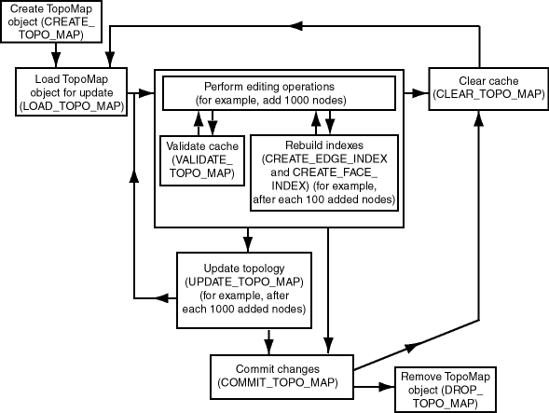
PL/SQL API: the TOPO_MAP package

Slide 33
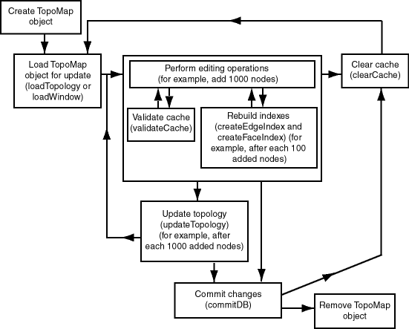
Java API: the TopoMap class

