Slide 1
Shark Repellent
Janna Julian, Joma Chase, Julia Ribeiro and Rafael Cabral

Slide 2
Where to launch a shark repellent device?
Company
Context
Hypothesis
We are a company selling a device for surfboards which has a led light capable of repel shark attacks.
We are planning to launch the product in the USA and considering to explore the markets in California, Florida and Hawaii.
We are planning to open one physical store and wonder in what city would be better to start.
The USA is the country with the most shark attacks.
California, Hawaii and Florida are the states with the most shark attacks in the US.
Is there a specific location where is worth opening a physical store?

Slide 3
Challenges and Solutions
Missing data
Duplicates
Formatting issues
We dropped rows with only missing data.
We checked for duplicates and there were none.
We have cleaned extra characters using strip, upper and replace method.

Slide 4
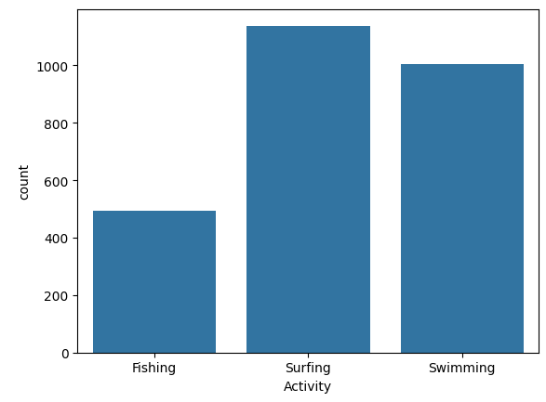
Analyzing attacks by activities
Surfing is the activity with the highest amount of attacks, what confirms that we are exploring a market that needs our product.
05.9.XX
7.09.XX

Slide 5
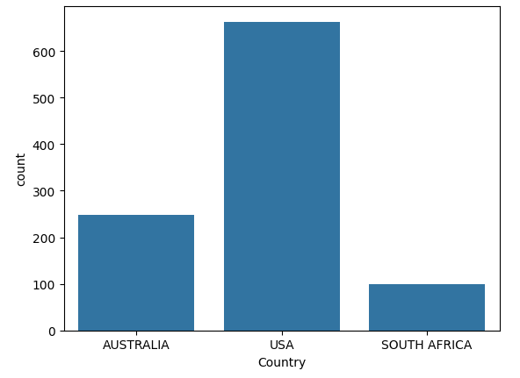
Attacks to surfers in the world
USA is the country with the highest number of attacks to surfers and the number is approximately triple the number of Australia, the second higher number.
That shows that we are correct in choosing the USA as the country where to launch our product.
05.9.XX
7.09.XX

Slide 6
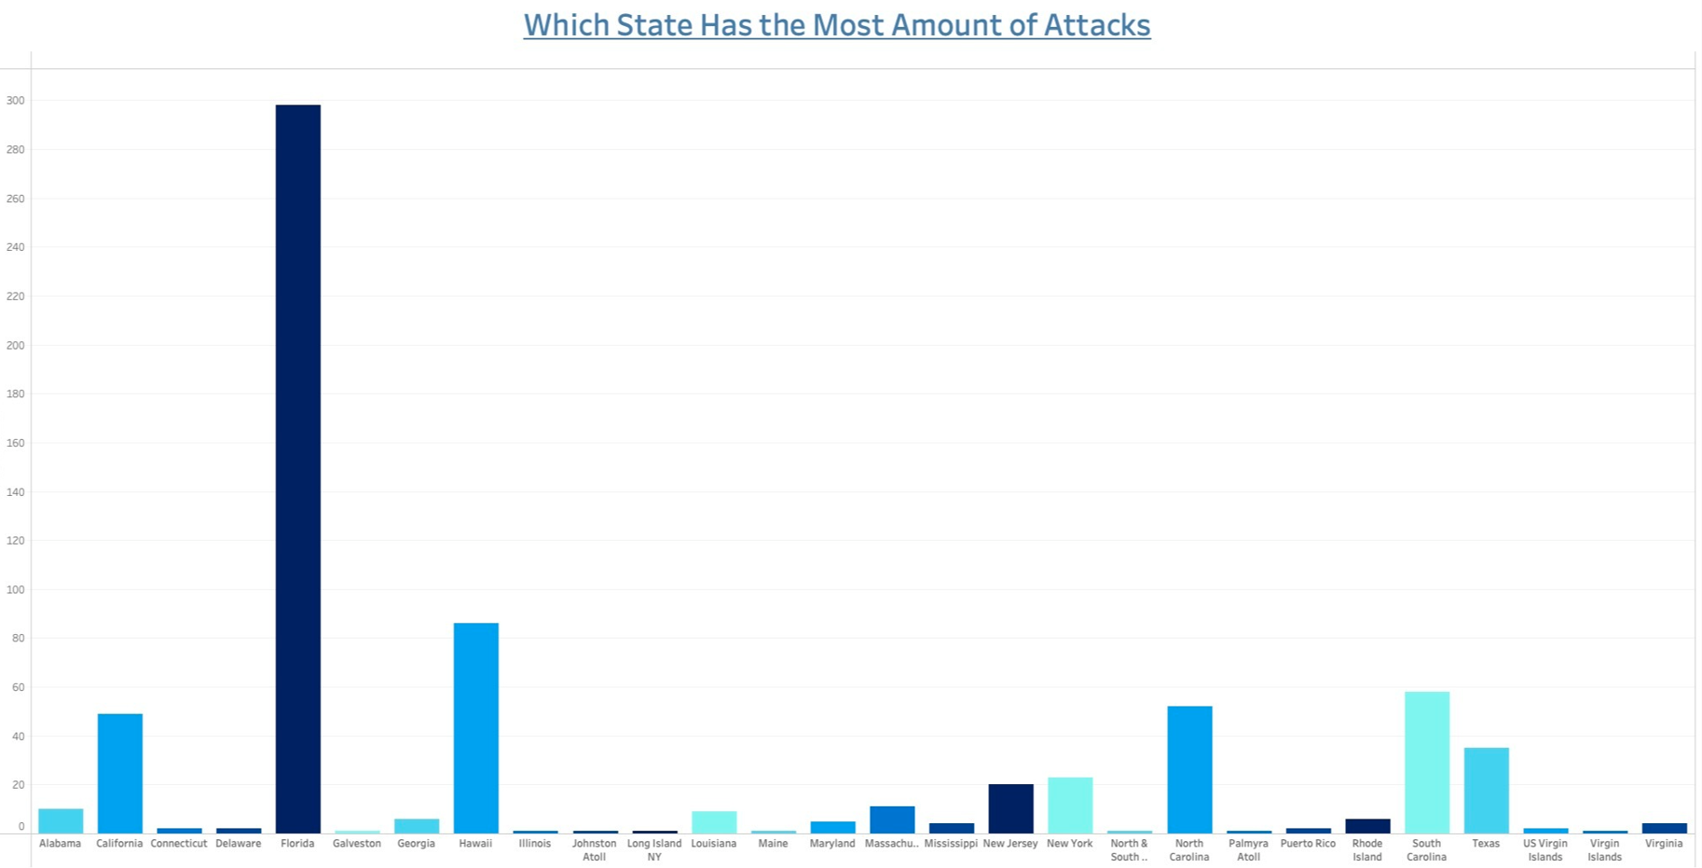

Slide 7
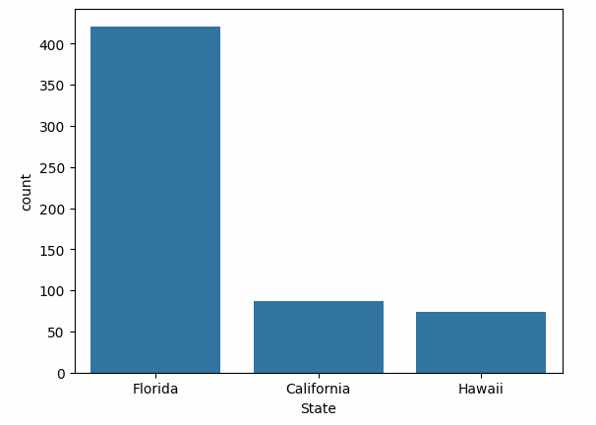
Attacks to surfers in the USA
Florida is the state in the USA with the highest number of attacks to surfers and the number is approximately four times higher than California, the second higher number.
Considering the difference on the number of attacks that Florida shows, we decided to focus only on Florida to launch our product.
05.9.XX
7.09.XX

Slide 8
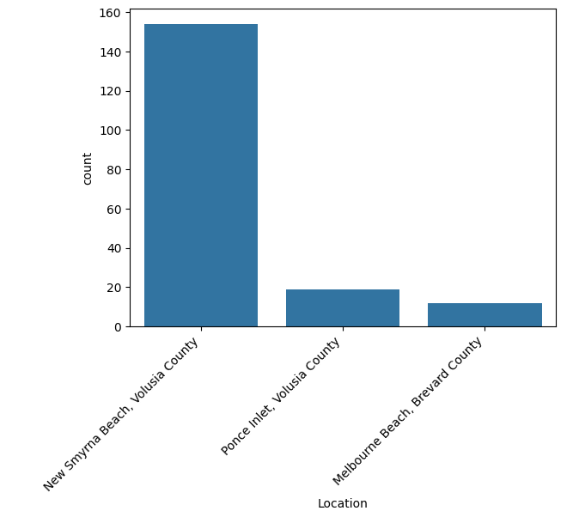
Attacks to surfers in Florida
New Smyrna Beach, Volusia County is the location in Florida with the highest number of attacks to surfers with an expressive difference to the remaining locations.
Considering the above, we have decided to open a shop in New Smyrna Beach, Volusia County.
05.9.XX
7.09.XX

Slide 9
Major obstacles
What we have learned
The dataset was extremely long in the beginning with a lot of null and unformatted values.
The biggest obstacle were the formulas, a lot of times it didn't work and we had to learn new formulas in order to get the information we needed.
It was difficult to decide what to remove as different important information were null in different rows. In the end, we kept only the relevant columns for us.
05.9.XX
7.09.XX
The importance of the cleaning process as it made the analysis extremely easier and faster.
That some data are more important than others as they have a bigger impact on the analysis, therefore we have to focus on them.
Using the data is helpful to realise that some obvious facts may be actually false.

Slide 10
Conclusion and Insights
Comparing the analysis to our initial hypothesis:
The USA is the country with the most shark attacks. ✔
California, Hawaii and Florida are the states with the most shark attacks in the US. ✔
To find a specific location that is worth opening a physical store: looking at the data, we can conclude that the best strategy for the company is to focus on surfing activities in New Smyrna Beach, Volusia County, Florida, USA.
California is not the state with most shark attacks. In the first moment, giving a quick look at the table we thought that California would be the state with more shark attacks → Thanks to the data cleaning and deep analysis, we could reach to Florida as the correct state with most attacks.
05.9.XX
7.09.XX

Slide 11
New Smyrna Beach, Volusia County
(the shark bite capital of the world)
will be the location of our brand new store.
05.9.XX
7.09.XX
Joma Chase
Janna Julian
Julia Ribeiro
Rafael Cabral
Thank you! :)

