Slide 1
Localebnb
An Airbnb Contextual Recommender
G Scott Stukey
Notes:
Backgroun an image of my app.

Slide 2
Motivation
When booking a private residence,
how do you find the perfect neighborhood?

Slide 3
Problem
AirBnB Search Page
AirBnB Neighborhood Guide
Listings belong to Neighborhoods
(many:1)
Neighborhoods exhibit traits
(many:many)
No ability to explicitly search/filter directly by trait!

Slide 4
Hypothesis
We can use listing descriptions to tease out neighborhood traits & customize search.
Customer:
Increased Satisfaction
Business:
Increased Revenue
AirBnB Listing Page

Slide 5
Methodology
ETL
Scrape Listing Descriptions (feature text)
Scrape Neighborhood Traits (target variables)
Requests + Beautiful Soup Logo
MongoDB Logo
Prepping
Created Training ‘documents’ (joined documents, aggregated text, cleaned text)
NLTK Logo
Word2Vec / Doc2Vec
TFIDF & Naïve Bayes
TFIDF & Gradient Boosted Trees
Modeling
Gensim Logo
Scikit Logo
Implemented Custom Weighting & Scoring Function
Moz Logo
Re-Ranking

Slide 6
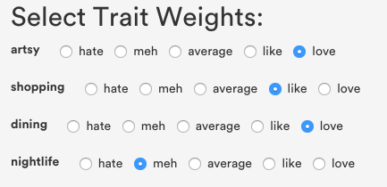
Example
AirBnB Listing Thumbnail A
AirBnB Listing Thumbnail C
Artsy | Shopping | Dining | Nightlife
👍 | 👍 | 🚫 | 👍
AirBnB Listing Thumbnail A
AirBnB Listing Thumbnail B
X
=
Artsy | Shopping | Dining | Nightlife
🚫 | 🚫 | 👍 | 🚫
AirBnB Listing Thumbnail C
AirBnB Listing Thumbnail B
Artsy | Shopping | Dining | Nightlife
👍 | 👍 | 👍 | 🚫
Notes:
(ALTERNATIVE VIDEO)

Slide 7
:30 Video of App > ReScoring

Slide 8
Results / Outcomes / Extensions
Trait Models Achieved 75-80% Accuracy
+15 pt lift over benchmark
Business Outcome Modeling showed Revenue lift of xx% (?)

Slide 9
Thank You
G Scott Stukey
Notes:
Backgroun an image of my app.

