Slide 1


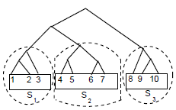
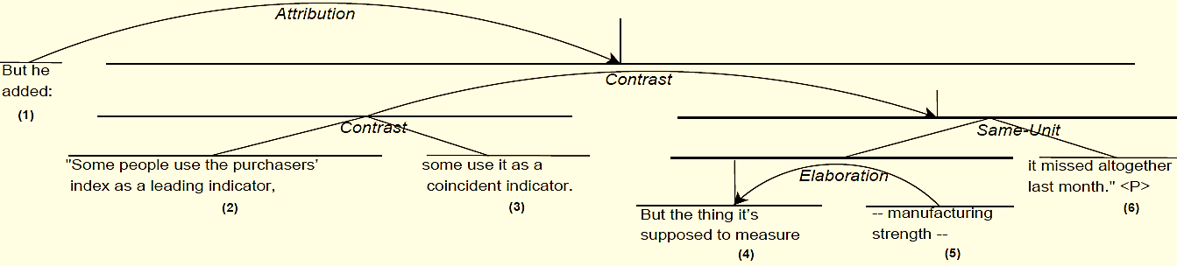
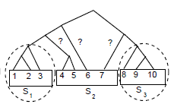
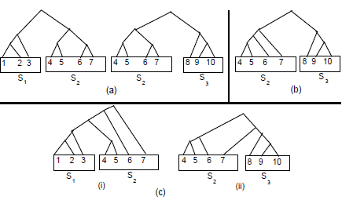
Combining Intra- and Multi-sentential Rhetorical Parsing for Document-level Discourse Analysis
Shafiq Joty, Giuseppe Carenini, Raymond T. Ng and Yashar Mehdad
The Problem
Parsing Models
Combining Intra- and multi-sentential
[But he added:]₁ [“some people use the purchasers’ index as a leading indicator,]₂ [some use it as a coincident indicator.]₃ [But the thing it’s supposed to measure]₄ [-- manufacturing strength --]₅ [It missed altogether last month” <P>]₆
1(a). Intra-sentential Parsing model
[Joty et al, EMNLP’12]
1S-1S (1 Sentence- 1 Sub-tree)
R₂
R₃
R_{j}
R_{k-1}
R_{k}
Relation at level i
R ϵ {1 .. M}
The Intra-sentential parser first constructs a DT for every sentence, then the multi-sentential parser builds full DT on top of those.
--
--
Sliding Window
Discourse Tree (DT)
S₂
S₃
S_{j}
S_{k-1}
S_{k}
Structure at level i S ϵ {0, 1}
Discourse structures may violate sentence boundaries.
--
--
5% and 12% sentences don’t have a DT in
RST-DT and Instructional corpora, respectively.
W₁
W₂
W₃
--
W_{j}
--
W_{k-1}
W_{k}
Often the units are connected to adjacent sentences.
Spans at level i
In Sliding Window, the intra-sentential parser builds a DT for each window of two consecutive sentences and then consolidates the decisions.
Discourse Parsing Framework
Obtaining probabilities: Apply the DCRF model to all possible sequences at different levels and compute posterior marginals of relation-structure pairs.
Consolidation: 3 cases3
Same in both
Different but no cross
Cross
Level 1
R₂
R₃
R₄
Level 3
R₄
R₂₋₄
R₃₋₄
Text
Segmented
into EDUs
Parsing Algorithm
Parsing Algorithm
S₄
S₂₋₄
S₃₋₄
S₂
S₃
S₄
Experiments
Parsing Model
Parsing Model
Discourse
Tree
e₁
e₂
e₃
e₄
e₁₋₃
e₄
e₁
e₂₋₄
e₁₋₂
e₃₋₄
Experimental Setup
Intra-sentential parser
Multi-sentential parser
Corpora
RST-DT: 347 train, 38 test; 18 relations (41 with Nucleus Satellite attached).
Instructional: 151 train, 25 test; 26 relations (76 with Nuc. Sat. attached).
Level 2
R₂₋₃
R₂
1. Parsing model
assigns probabilities to all possible DTs
R₃
R₄
R₄
R₃₋₄
Systems Compared with
HILDA (Hernault et al., 2010) on RST-DT corpus.
ILP-based system of Subba and Di-Eugenio, (2009) on Instructional corpus.
R ranges over set of relations
S₃
S₄
S₂₋₃
S₄
S₂
S₃₋₄
R₁₋₃
R₁₋₃
Discriminative
Structure and Label Jointly
Sequential Dependencies
Hierarchical Dependencies
Support Optimal Parsing
e₁₋₂
e₁
e₂
e₃₋₄
Parsing Results
R₂₋₃
R₁₋₂
e₃
e₄
e₁
e₂₋₃
e₄
Used standard unlabeled (span) and labeled (nuclearity, relation) metrics [Marcu’00]
e₁
e₂
e₃
e₁
e₂
e₃
1(b). Multi-sentential Parsing model
 | RST-DT |  |  |  | Instructional
 | HILDA | TSP 1-1 | TSP SW | Human | ILP | TSP 1-1 | TSP SW
Span | 74.7 | 82.5 | 82.7 | 88.7 | 70.35 | 79.67 | 80.88
Nuclearity | 58.9 | 68.4 | 68.4 | 77.7 | 49.47 | 63.03 | 63.10
Relation | 44.3 | 55.7 | 55.7 | 65.8 | 35.44 | 43.52 | 43.58
R_{k}
Chain-structured intra-sentential model doesn’t scale up.
Break the chain structure.
Allows us to balance the data.
2. Parsing algorithm
finds the most probable DT
r₁₋₃
S_{k}
Our parsers TSP 1-1 and TSP SW outperform existing systems by a wide margin.
TSP SW outperforms TSP 1-1 only in span (i.e., tree structure).
TSP SW tends to induce noise from its neighbours for relation labels.
r₁₋₂
Probabilistic CKY-like
bottom-up algorithm
Obtaining probabilities: Apply the CRF model to all possible adjacent units at different levels and compute posterior marginals of relation-structure pairs.
Reference: [1] S. Joty, G. Carenini and R. T. Ng. Combining Intra- and Multi-sentential Rhetorical Parsing for Document-level Discourse Analysis. In ACL’13.
[2] S. Joty, G. Carenini and R. T. Ng. A Novel Discriminative Framework for Sentence-Level Discourse Analysis. In EMNLP’12.
e₁
e₂
e₃
W_{k-1}
W_{k}

