Slide 1


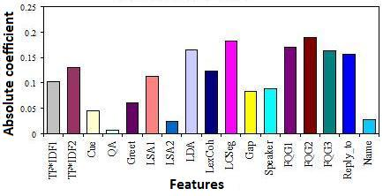
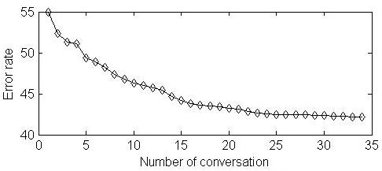
Supervised Topic Segmentation of Email Conversations
Shafiq Joty, Giuseppe Carenini, Gabriel Murray, and Raymond Ng
Step1 Sentence Pair Classification
A binary classifier marks each pair of sentences of a conversation as ‘same’ or ‘different’ topics.
Relative importance of the features:
Motivation
Email conversations often discuss multiple topics
e.g. a conversation about arranging a conference may cover:
Location and time, Registration, Food menu, Workshops
Two subtasks:
Segmentation: Grouping sentences into coherent clusters
Identification: Assigning topic labels to the clusters
Prerequisite for:
Higher-level conversation analysis (e.g., speech act tagging).
Text summarization & Automatic question answering.
Intelligent user interfaces for emails.
A conversation of n sentences produces O(n²) training examples.
Comparison of classifiers:
Classifier | Regularizer | Train error | Test error
KNN SVM (lin) SVM (rbf) LR LR RMLR (rbf) | - - - l₂ l₁ l₂ | 47.7% 33.2% 26.4% 30.6% 32.1% 10.8% | 46.7% 32.6% 34.3% 30.9% 33.3% 38.9%
Accuracy vs. amount of labeled data:
• Features with average performance:
Lexical Acc: 59.6 Pre: 59.7 Rec: 99.8
TF.IDF1 TF.IDF similarity (k=1). TF.IDF2 TF.IDF similarity (k=2). Cue Words Either one contains a cue word. QA x asks a question explicitly using ‘?’ & y contains any of (yes, yea, ok, etc.) Greet Either one has a greeting word.
Topic Acc: 65.2 Pre: 64.4 Rec: 79.6
LSA1 LSA function for x & y (k=1). LSA2 LSA function for x & y (k=2). LDA LDA decision on x & y. LCSeg LCSeg decision on x & y. LexCoh Lexical cohesion function of x & y.
Conv Acc: 65.3 Pre: 66.7 Rec: 85.1
Gap The gap between y & x in # of sent. Speaker x & y have the same sender. FQG1 Dist. between x & y in Dir. FQG (frag. Id). FQG2 Dist. between x & y in Dir. FQG (#edges). FQG3 Dist. between x & y in Undir. FQG (#edges) Reply-to Both are in the same email or one is a reply Name x mentions y or vice versa.
Conv Acc: 69.1 Pre: 68.4 Rec: 81.5
Challenge
Topics in emails do not change in a sequential way
Models in monolog & sync. dialog not so effective
Step2&3 Graph Construction and Partitioning
Construct the graph:
Nodes => Sentences
Edge-weights => Probability (‘same’ class)
Partition the graph by optimizing the ‘normalized cut’ criterion.
u
P (u, v)
Our Supervised Graph-theoretic Approach
Integrates lexical and ?topic? features with conversational ones.
v
(1) Sentence Pair Classification
(2) Graph Construction
(3) Graph Partitioning
Evaluation of our Sup Topic Segmenter
Dataset: BC3 email corpus. See [Joty et al. 2010] for corpus stats.
 | Baseline |  | Models |  |  |  |  | Human
Scores | Speaker | Block 5 | LDA | LDA+FQG | LCSeg | LCSeg+FQG | Supervised
Mean 1-1 | 0.52 | 0.38 | 0.57 | 0.62 | 0.62 | 0.68 | 0.70 | 0.80
Mean loc₃ | 0.64 | 0.57 | 0.54 | 0.61 | 0.72 | 0.71 | 0.75 | 0.83
Results
Our sup approach achieves better accuracy than unsup method [Joty et al. 2010] with very limited amount of training data.
Reference Joty, S.; Carenini, G.; Murray, G.; Ng, R. Exploiting conversation structure in unsupervised topic segmentation for emails. In EMNLP-2010.

