Slide 1



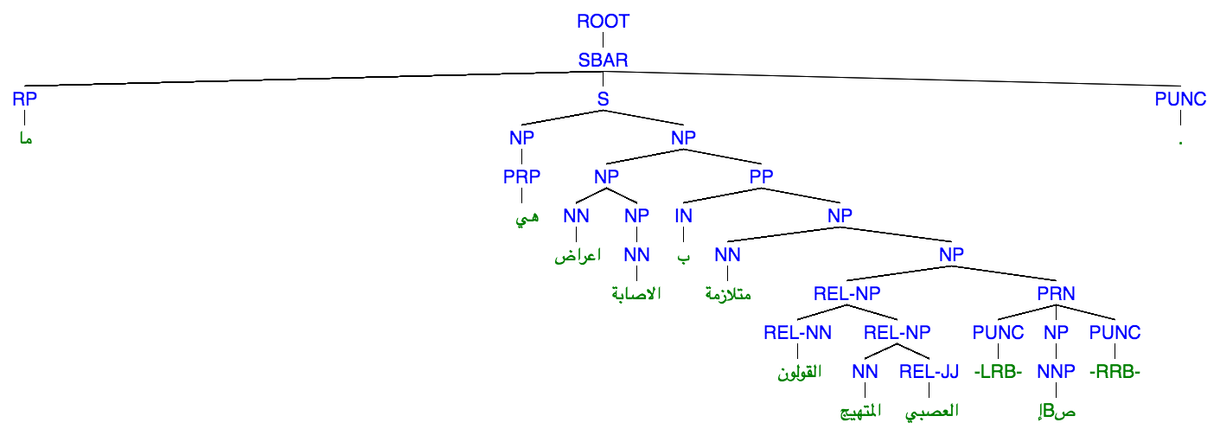

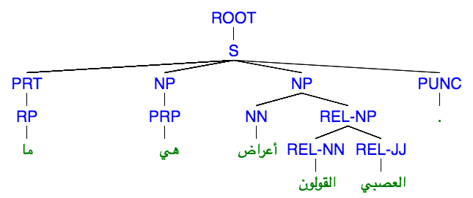
Arabic Community Question Answering
Yonatan Belinkov, Mitra Mohtarami, James Glass, MIT-CSAIL, Cambridge, MA 02139, USA
Shafiq Joty, Alessandro Moschitti, Preslav Nakov, Fahad A. Al Obaidli, QCRI, HKBU, Qatar
Background
Preprocessing with Keyword Extraction
Experiments
Community forums where user post questions and answers are becoming increasingly popular
Arabic community question answering (cQA) received little attention in the past
The SemEval-2016 Task 3 offered a cQA Arabic dataset in the medical domain, where:
Given a question and 30 related question-answer pairs, rank the pairs with respect to the original question
QA pairs annotated as Direct, Relevant, or Irrelevant
Challenges: long texts, user-generated content, medical terminology, mixed standard and colloquial language
Example:
Q’: ما هي اعراض الاصابة بمتلازمة القولون المتهيج العصبي
Q: ما هي أعراض القولون العصبي
A: تتباين علامات وأعراض الاصابة بمتلازمة القولون العصبي بين الأشخاص [...] كالتالي : - ألم أو تشنج البطن . - الشعور بالانتفاخ . - امتلاء البطن بالغازات . - الاسهال أو الامساك [...]
Text preprocessing in order to deal with several challenges:
Long texts: average question/answer length is 50/120 words
Rich morphology: multiple surface forms per lemma
Latin terminology in the medical domain
Keyword extraction with TextRank
Treat every thread as a document
Form a graph where nodes are word types and edges represent co-occurrence in N-sized window
Compute importance weight iteratively and keep top P% of words
Lemmatization: we apply MADA for finding lemmas and part-of-speech tags
Stop-word removal: we keep only content words, Latin words, and words with no morphological analysis.
Sentence Splitting: We use the splitter from Stanford’s core NLP toolkit.
Syntactic parsing: We use the Berkeley parser to get the syntactic tree for each each sentence.
Preprocessing settings
No preprocessing
Only keeping content lemmas
Only content lemmas and keyword extraction with TextRank params N=3, P=5
Same, with TextRank params N=4, P=1
Tree kernels settings
ConvKN-contrastive1: only basic features
ConvKN-contrastive2: MT features
ConvKN-primary: basic features + tree kernels
 | MAP | AvgRec | MRR | P | R | F1 | ACC
Rand | 29.79 | 31.00 | 33.71 | 19.53 | 20.66 | 20.08 | 68.35
a | 38.33 | 42.09 | 43.75 | 20.38 | 96.95 | 33.68 | 26.58
b | 39.98 | 43.68 | 46.41 | 26.26 | 68.39 | 37.95 | 57.00
c | 45.50 | 50.13 | 52.55 | 28.55 | 64.53 | 39.58 | 62.10
i | 44.94 | 49.72 | 51.58 | 62.96 | 2.40 | 4.62 | 80.95
iii | 42.95 | 47.61 | 49.55 | 27.20 | 74.40 | 39.84 | 56.76
i-iv | 45.83 | 51.01 | 53.66 | 34.45 | 52.33 | 41.55 | 71.67
Feature Representation
Tree Kernels
Given a question q’ and a related question-answer pair q-a, compute features between the pairs q’-q and q’-a
Text-based features
Various text-similarity metrics such as Longest Common Substring, Longest Common Subsequence, Greedy String Tiling, etc. (Belinkov et al. 2015)
Vector-based features
Vector representations of closest pairs of words or sentences in q’-q and q’-a
Word vectors computed from Arabic Gigaword and medical domain raw data using Word2Vec
Sentence representation is average of word vectors
Machine translation evaluation features
BlEU, TER, Meteor
Syntactic
Tree Kernels
Constituency Trees with relational labels
Future Work
Combine keyword extraction with tree kernels
How do deal with grammatical structure after keyword extraction?
Automatically detecting the most important sentences to be matched with the tree kernels
References
Belinkov et al. 2015. VectorSLU: A Continuous Word Vector Approach to Answer Selection in Community Question Answering Systems.
Mohtarami et al. 2016. SLS at SemEval-2016 Task 3: Neural-based Approaches for Ranking in Community Question Answering.
ConvKN at SemEval-2016 Task 3: Answer and Question Selection for Question Answering on Arabic and English Fora

