Slide 1


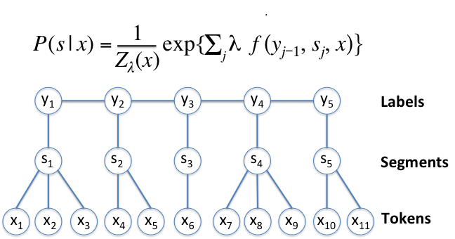
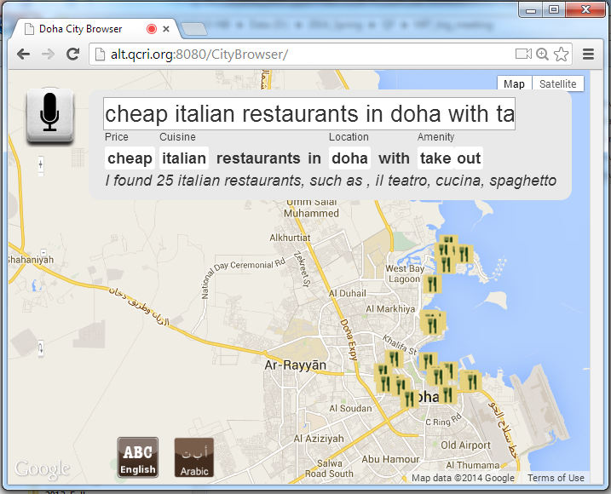
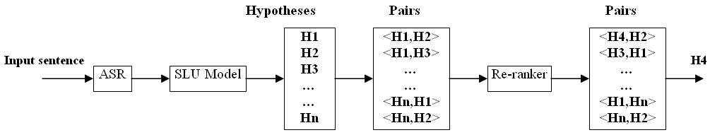
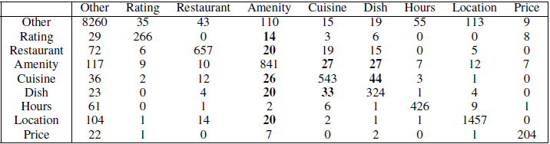


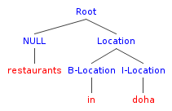
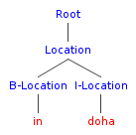
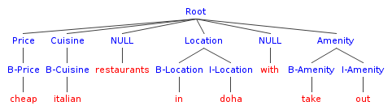
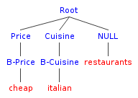




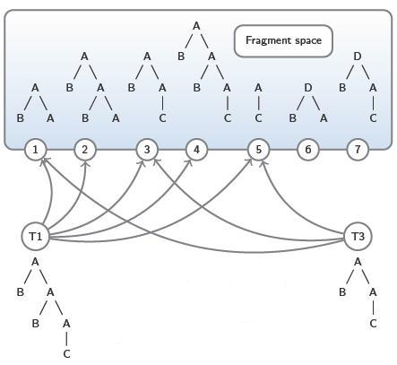
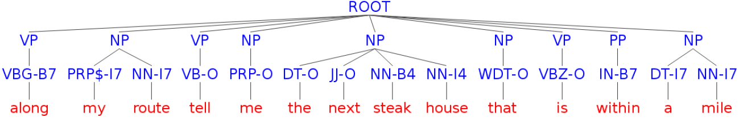


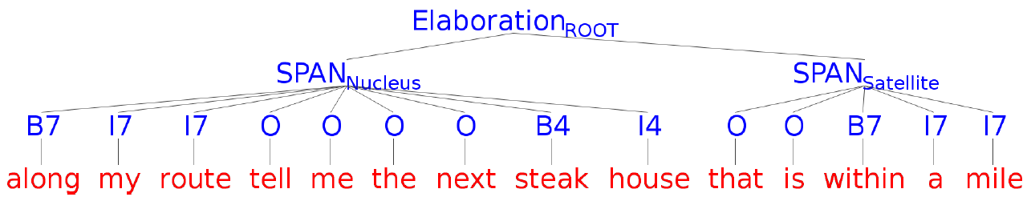


A Study of using Syntactic and Semantic Structures for
Concept Segmentation and Labeling
(ALT-QCRI) Iman Saleh, Shafiq Joty, Lluís Màrquez, Alessandro Moschitti, Preslav Nakov
Scott Cyphers, James Glass (CSAIL-MIT)
Motivation
Computation Models for Semantic Tagging
Experiments
State-of-the-art system
N-best Oracle accuracy shows great headroom for improving on the CRF baseline
N | Oracle F1
1 | 83.03
2 | 87.76
5 | 92.63
10 | 95.23
100 | 98.72
Joint sequential segmentation/classification
Semi-Markov CRFs (Sarawagi & Cohen 04)
Discriminative probabilistic sequential model
Undirected graphical model
F1 scores for different tree kernels on basic tree
F1 scores for different feature combinations
Our Approach: Reranking with Kernel Machines
Subtree kernel | Syntactic tree kernel | Syntactic tree kernel + BOW | Partial tree kernel | Sequence kernel
84.08 | 83.19 | 83.20 | 84.61 | 82.93
How do we convert a spoken request like
“cheap italian restaurants in doha with take out”
into a database query?
 | CRF Feat. | All Feat. | All Feat. + Basic Tree | All Feat. + Shallow Tree | All Feat. + Discourse Tree
F1 | 83.44 | 83.86 | 84.76 | 84.79 | 84.55
Rel. Imp | 2.4% | 4.8% | 10.2% | 10.3% | 8.9%
Semi-CRF generates n-best hypotheses
SVMs and convolution tree kernels are then used to learn a reranking function
Such function can choose the best hypothesis by exploiting structural representations
Error analysis
Processing Steps
Text/Speech
“cheap italian restaurants in doha with take out”
Semantically segmented text
(cheap) (italian) restaurants in (doha) with (take out)
<Price> <Cuisine> <City> <Amenity>
Semantic representation
{“Price” : “low”,
“Amenity” : “take out”,
“City” : “doha”,
“Cuisine” : “italian”}
DB query
{$and [{“cuisine”:{“$regex”:“italian”}},
{“city”:{“$regex”:“doha”}},
{“price”:{“$regex”:“low”}},
{“amenity”:{“$regex”:“carry out”}}]}
Hypothesis representations in
form of semantic trees
Common Tree Fragment Set
Semantic tagger
Basic
Inaccuracies and inconsistencies in human annotations
Requires lexical semantics and more coverage
Shallow
Classification function with
kernels
Rule normalizer
Conclusions
SVM:
Structural kernels yield significant improvements.
Partial tree kernel gives best results.
Shallow tree is more helpful than other deep structures.
Still large room for further improvement in the future.
Discourse
Dual:
Re-ranking Kernel:
Query builder
References
Dataset
Acknowledgements
[1] McGraw, S. Cyphers, P. Pasupat, J. Liu, and J. Glass. 2012. Automating crowd-supervised learning for spoken language systems. In Proceedings of INTERSPEECH 2012.
[2] M. Dinarelli, A. Moschitti, and G. Riccardi. Discriminative Reranking for Spoken Language Understanding. IEEE Transaction on Audio, Speech and Language Processing, 2012.
[3] S. Sarawagi, W. W. Cohen, Semi-Markov Conditional Random Fields for Information Extraction, in proceedings of NIPS, 2004 .
Amazon Mechanical Turk was used to collect a corpus of sentences and gold-standard human annotations: 7,661 sentences (McGraw et al. 12)
This research is developed by the Arabic Language Technologies (ALT) group at Qatar Computing Research Institute (QCRI) within the Qatar Foundation in collaboration with MIT. It is part of the Interactive sYstems for Answer Search (Iyas) project.
Train | Test | Train RR | Test RR
6,922 | 1,521 | 28,482 | 7,605

