Slide 1



Adversarial Unsupervised Representation Learning for Activity Time-Series
Karan Aggarwal, Shafiq Joty, Luis Fernandez-Luque, Jaideep Srivastava

Slide 2



Motivation: Contemporary Regime
Recommends
Diagnosis
Therapy and Lifestyle Changes
Follow-ups
PSG test
Information
Information
Timeline

Slide 3
Motivation: New Regime
Recommends
Diagnosis
Therapy and Lifestyle Changes
Follow-ups
PSG test
Information
Timeline

Slide 4
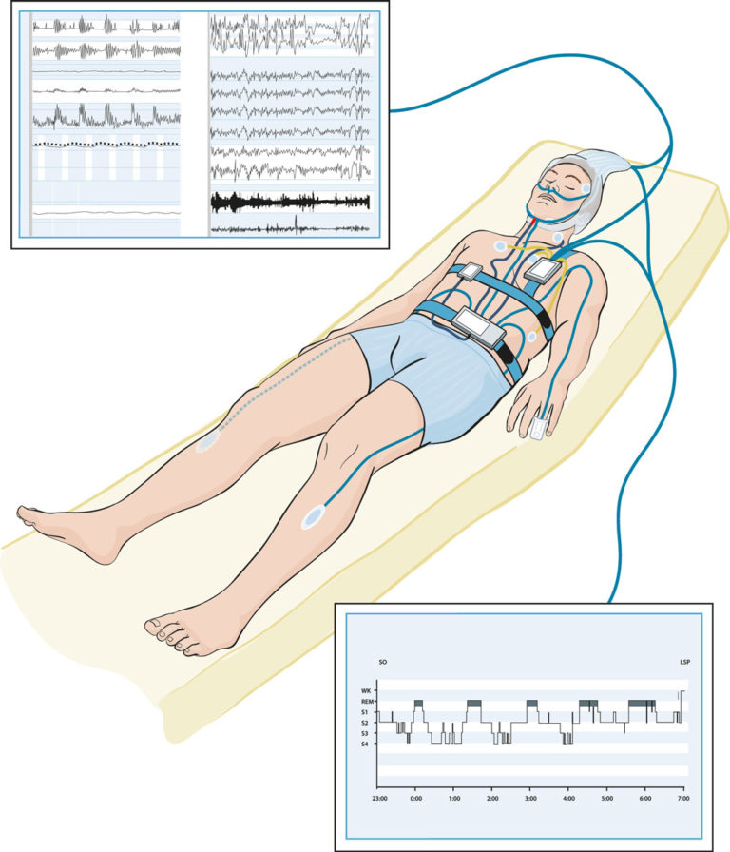


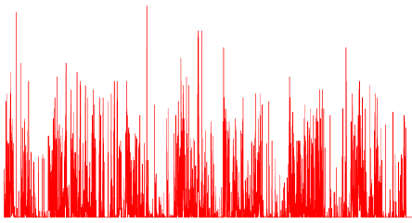

Motivation
Current disorder screening requires various diagnosis tests and an overnight lab stay for polysomnography (PSG) test
Long waiting for PSG
Extremely difficult to do longitudinal tracking, patient has to show up often at the lab
Wearable devices provide real time and continuous stream of lower quality activity data
Picture taken from https://aystesis.com/polysomnography/
Sleep
24 X 7 monitoring
Awake

Slide 5

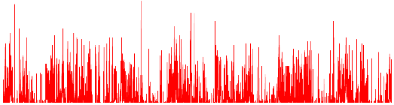
Motivation
Subjects
Real time data for all subjects
Activity Data from Wearables
Fitbit
GoogleFit
HealthKit
Disorders Data
EHRs
Cohort Study
Surveys
From a subset of subjects

Slide 6
Motivation
Subjects
Real time data for all subjects
Supervised Learning
Activity Data from Wearables
Fitbit
GoogleFit
HealthKit
Disorders Data
EHRs
Cohort Study
Surveys
From a subset of subjects

Slide 7
Motivation
Subjects
Real time data for all subjects
Supervised Learning
Activity Data from Wearables
Fitbit
GoogleFit
HealthKit
Disorders Data
EHRs
Cohort Study
Surveys
From a subset of subjects

Slide 8
Proposed Approach
Unsupervised Representation Learning
Subjects
Real time data for all subjects
activity2vec
Supervised Learning
Activity Data from Wearables
Fitbit
GoogleFit
HealthKit
Disorders Data
EHRs
Cohort Study
Surveys
From a subset of subjects

Slide 9
Proposed Approach
Unsupervised Representation Learning
Subjects
Real time data for all subjects
activity2vec
Pre-trained embeddings
Supervised Learning
Activity Data from Wearables
Fitbit
GoogleFit
HealthKit
Disorders Data
EHRs
Cohort Study
Surveys
From a subset of subjects

Slide 10
Proposed Approach & Challenges
Convert the time-series S into segments = (T₁, T₂,T₃ , ……, T_{m} )
Learn mapping function Φ: T_{k} R^{d} for each segment T_{k}
Challenges:
Accounting for the magnitude of time-series values in the segment (e.g., 25>24)
Capturing the dependencies between the segments
Accounting for the subject’s environment specific noise that wearables suffers from
Activity time-series is a discrete valued time series like number of steps, activity levels

Slide 11
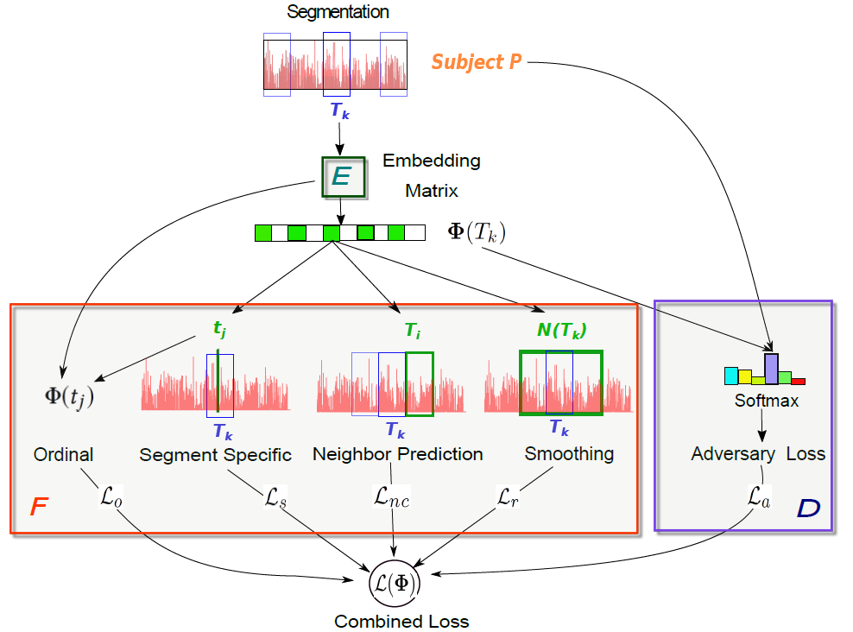
Proposed Approach

Slide 12
Proposed Approach
Inter-Segment

Slide 13
Proposed Approach
Inter-Segment
Intra -Segment

Slide 14
Proposed Approach
Subject Environment Invariance
Inter-Segment
Intra -Segment

Slide 15
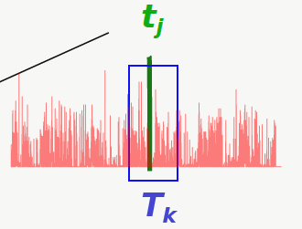
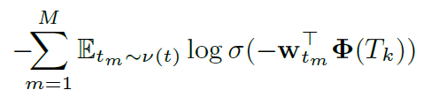
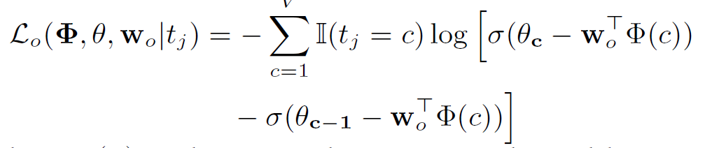
Segment Content
1) Noise Contrastive Estimation for time-segment values
Noise distribution
2) Ordinal Regression for magnitude of time-series values

Slide 16

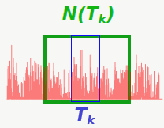
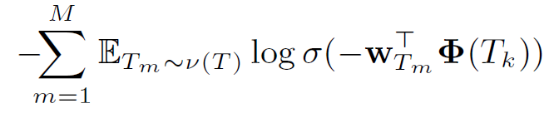
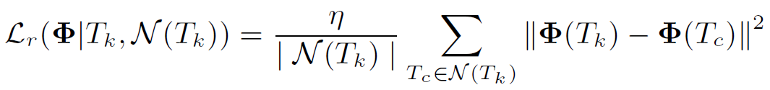
Segment Context
3) Noise Contrastive Estimation for segment neighbors
Noise distribution
4) Smoothing with Neighbors

Slide 17
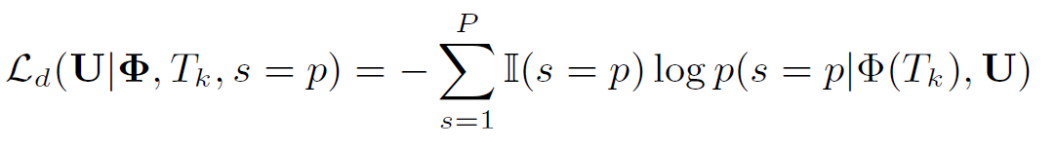
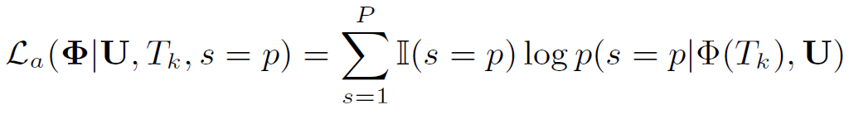
Subject Invariance
The idea is to remove the subject’s environment noise using adversarial learning over subject, i.e., producing subject invariant representations.
Discriminator Loss:
Adversary Loss:
Predicting subject from representation Φ(T_{k})

Slide 18
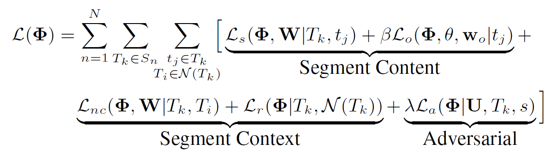
Total Loss

Slide 19
Experimental Materials
Datasets:
Hispanic Community Health Study (HCHS): 1887 subjects
Multi-Ethnic Study of Atherosclerosis (MESA): 2237 subjects
Disorder Identification Tasks:
Sleep Apnea
Insomnia
Diabetes
Hypertension
7 days of actigraphy data per subject
We only have labels from HCHS but no labels from MESA

Slide 20
Baselines
Traditional time-series classification:
SAX-VSM
BOSS
BOSS-VSM
HCTSA
Deep Learning Methods:
Supervised CNN
Semi-supervised LSTM

Slide 21
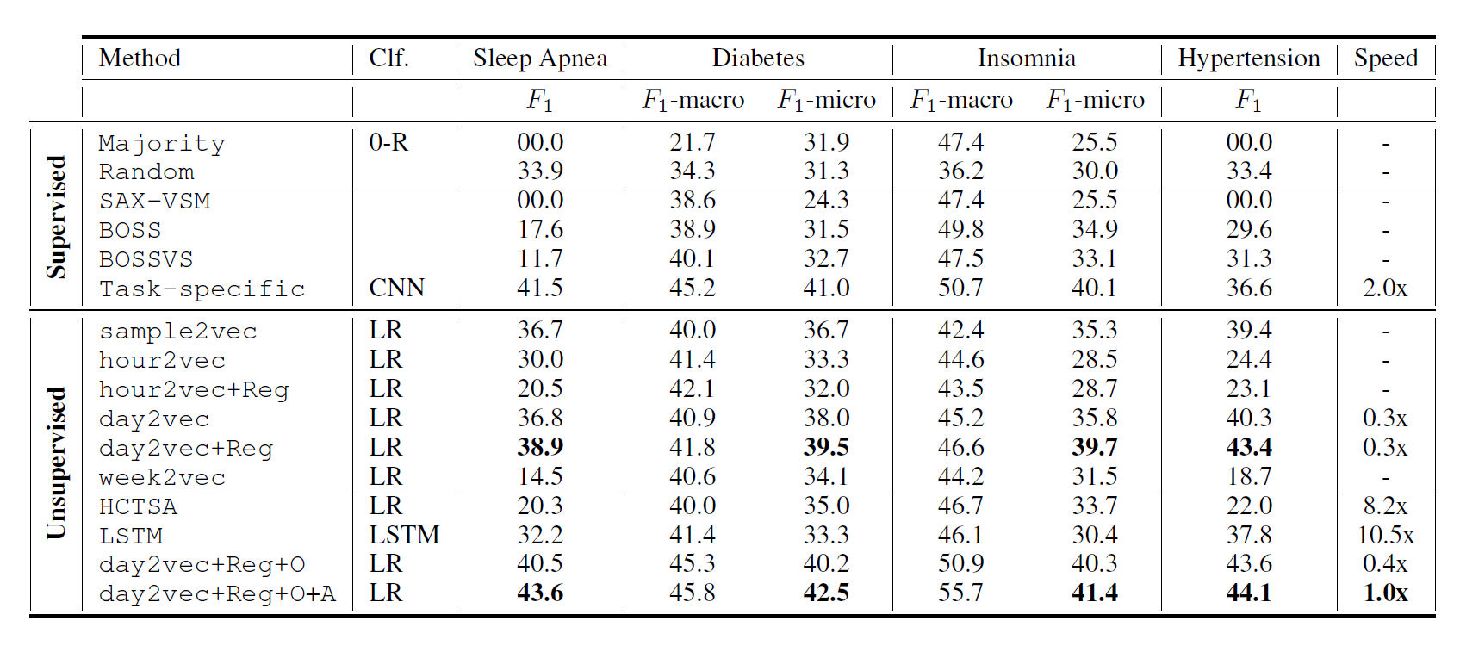
Results
Different time-segment granularities

Slide 22
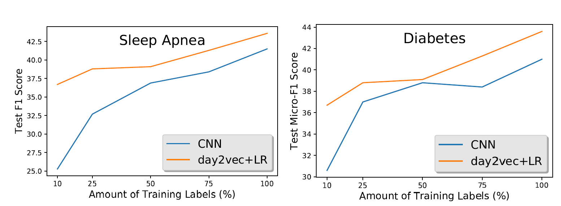
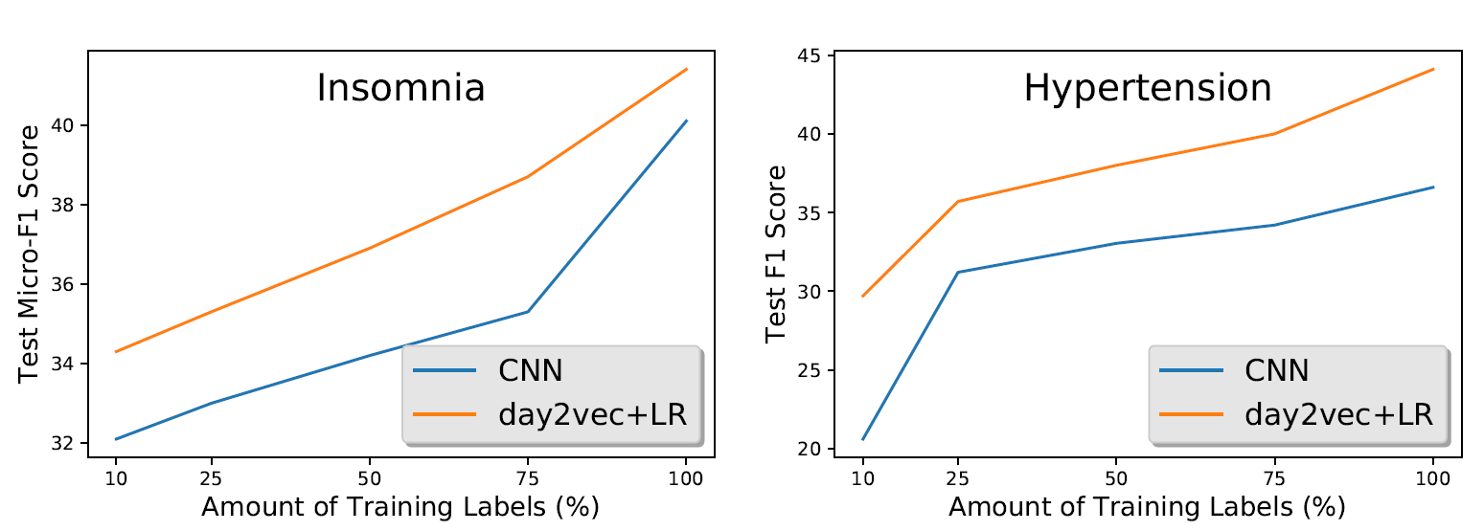
Results: Supervised vs Unsupervised

Slide 23
Conclusions
Novel model for learning representations of human activity time-series for utilizing large amount of unlabeled data
activity2vec encodes human activity time-series by modeling local (inter-segment) and global activity (intra-segment) patterns
Day-level granularity preserves the best representations since human activities are structured around daily routines usually
Adversarial loss promotes subject invariance reducing the effect of environmental noise on the representations

Slide 24
Thank you!

Slide 25
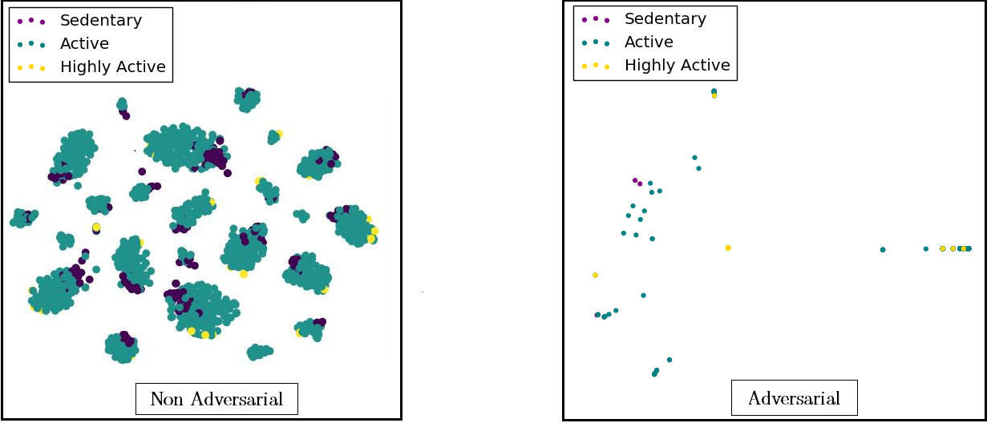
Results
Clusters collapse with in-cluster class separations giving way to global class separations
t-SNE plots of HCHS subjects

Slide 26

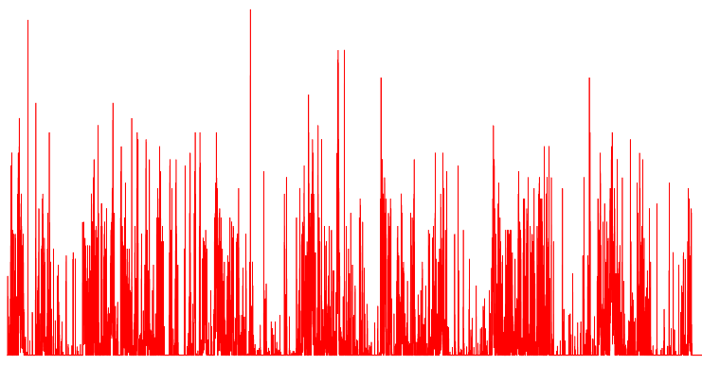
Motivation
Traditional Problems
Activity Tracking
Sleep
Sleep Quality
24 X 7 monitoring
Our focus
Disorder Monitoring
Awake
Insufficient sleep and/or activity lead to chronic disorders → can be uncovered by analyzing the actigraphy data

Slide 27
Motivation
Polysomnography
(gold standard)
Multi-sensor input
Expensive
In-clinic monitoring
High Fidelity
Actigraphy
24X7 Monitoring
Wearable
Noisy
Wearable devices provide real time and continuous stream of lower quality activity data – can be used for real-time monitoring?

