Slide 1



A Structured Learning Approach with Neural Conditional Random Fields for Sleep Staging
Karan Aggarwal, Swaraj Khadanga, Shafiq Joty,
Louis Kazaglis, Jaideep Srivastava

Slide 2
Background
Brain undergoes different activities during the sleep representing neurological functions
These activities have been identified as different stages of sleep
Four major types of sleep stages: wake, light, deep, and REM

Slide 3
Background: Sleep Stages
Wake
Lying in the bed
Light
Transition state,
Heart rate and breathing slow
Deep
Restorative sleep, physical recovery processes
REM
“Dreaming” state, memory consolidation, emotion regulation

Slide 4
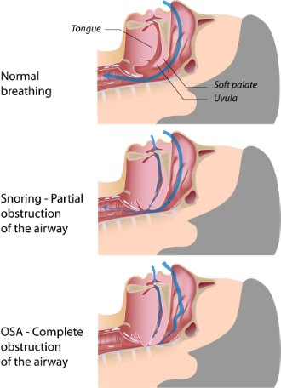
Background: Obstructive Sleep Apnea
Airway collapse leads to a reduced oxygen supply during the sleep
Highly underdiagnosed disease
Estimated to affect nearly 10% of the US population
Restless Sleep, snoring, fatigue and potentially fatal for heart
Image credits: https://www.alaskasleep.com/blog/types-of-sleep-apnea-explained-obstructive-central-mixed

Slide 5
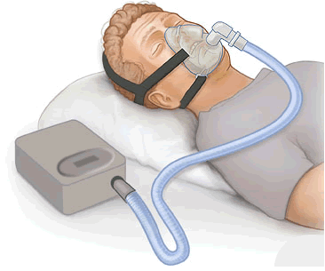
Background: CPAP Therapy
Continuous Positive Airway Pressure (CPAP) therapy is the most common therapy sleep apnea patients are administered
User wears a mask, connected to a flow generating device, which delivers an adaptive pressure to prevent the airway collapse

Slide 6
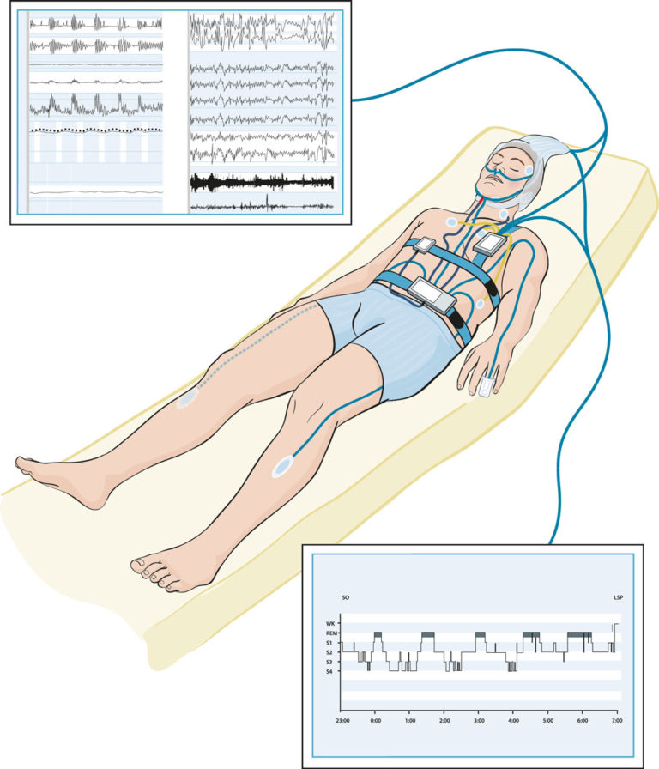
Background: Polysomnography
Currently patients undergo an overnight lab stay for polysomnography (PSG) test
Extremely difficult to do longitudinal tracking, patient has to visit the lab at regular intervals
By determining the sleep stages from the PSG, doctors can monitor their progress
Picture taken from https://aystesis.com/polysomnography/

Slide 7


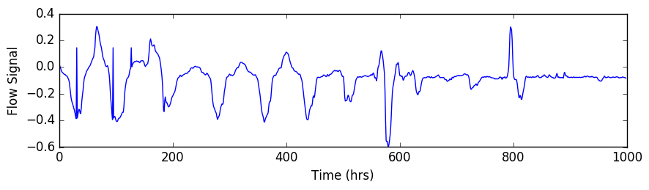
Motivation
Automated Sleep Staging from Flow Signal
Patient
Recommends
Monitoring
PSG test
Sleep Apnea Diagnosed
CPAP Device
Flow signal

Slide 8
Related Works
The literature focuses on reducing the number of sensors from PSG or evaluating new medical devices
Machine Learning Models for Sleep Staging: Recent deep networks have shown state-of-the-art results:
Supratak et al. and Biswal et al. showed human level annotation on EEG signals using a Recurrent-Convolution Network
Zhao et al. showed state-of-the-art results on radio-frequency signals using a conditional adversarial architecture
However, these methods either don’t have existing use cases owing to infancy of device adoption (Zhao et al.) or impracticality (EEG based methods)

Slide 9
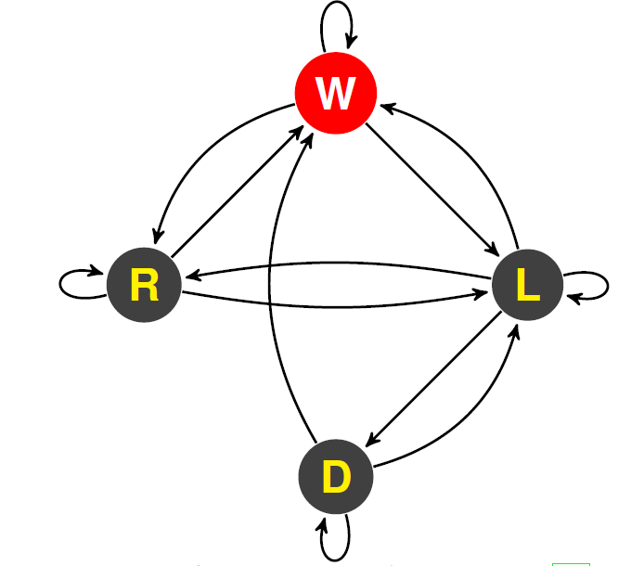
Sleep State Transition Diagram
Four sleep states shown are: (W)ake, (R)EM, (L)ight and (D)eep.

Slide 10
Contributions
Application: First Study on using sleep staging using flow signal that can be used to track the Obstructive Sleep Apnea patients on the CPAP therapy
Technical: Current state-of-the-art on sleep staging focuses entirely on extracting best possible features from the input signal for sleep staging ignoring the sleep staging transition dynamics. We use structural learning with CRFs for better accuracy

Slide 11
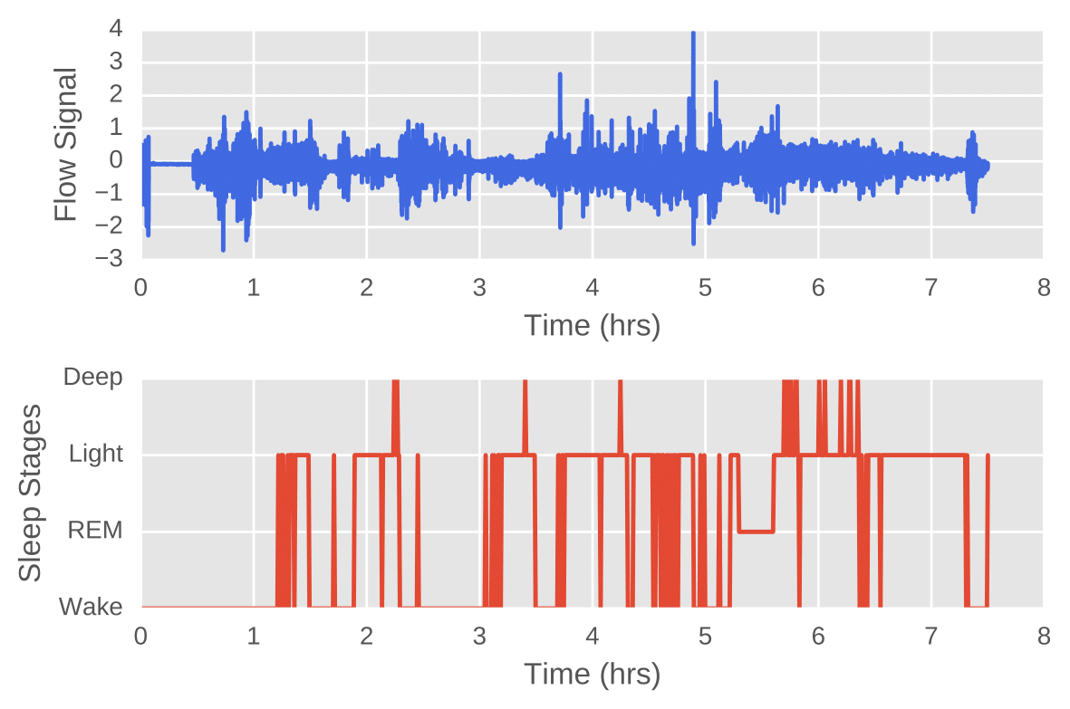
Sample Sleep Stage Annotation
An example of sleep stage evolution

Slide 12
Neural Conditional Random Field Architecture
ResNet CNN
GRU
Global Sequence Inference
CRF layer

Slide 13
Neural Conditional Random Field Architecture
5 layered ResNet CNN with ReLU + maxpool + dropout
GRU recurrent layer
ResNet CNN
GRU
CRF layer

Slide 14
Neural Conditional Random Field Model
Flow Signal
30 sec
30 sec
30 sec
e₁
e₂
y_{t-1}
y_{t}
y_{t+1}
Conditional Random Field models the edge transitions in addition to the probability of a sleep stage class at each step t

Slide 15


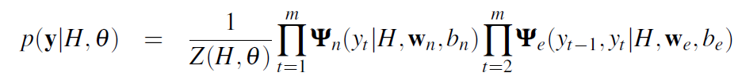


Neural Conditional Random Field Model
Node Potential
Edge Potential
Likelihood
Negative Log
Likelihood
RNN Output

Slide 16
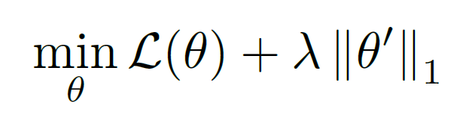
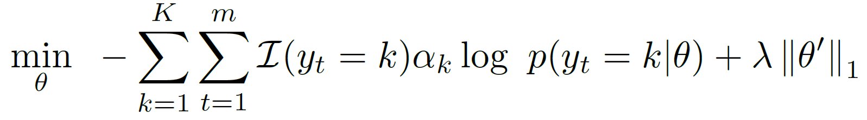
Cost Sensitive Training and Regularization
l1 Regularization of
Edge Weights
Cost Sensitive Training
Inverse of class k’s samples

Slide 17
Dataset
From MESA (Multi-Ethnic Study of Atherosclerosis) dataset
400 Sleep Apnea patients
7.5 hours of sleep data per person
Flow signal is sampled at 32 Hz -> 960 samples for every 30 second epoch.
Has inter-rater agreement of 85% on the annotated sleep stages

Slide 18
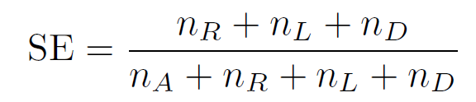
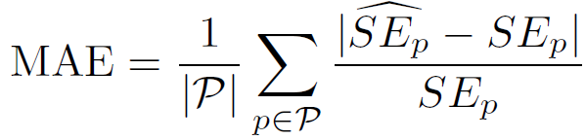
Evaluation Metrics Used
Accuracy: % of states accurately classified
Cohen’s Kappa: Degree of concordance between prediction and ground truth
Sleep Efficiency Mean Absolute Error (in %):
Sleep efficiency is a metric used for measuring the quality of sleep

Slide 19
Baselines
Conditional Random Field: With signal power density features as input
R-CNN (ResNet-RNN)
Conditional Adversarial R-CNN (Zhao et al.)
Attention R-CNN

Slide 20
Results
Method | Accuracy (%) | Kappa | Sleep Efficiency MAE %
Conditional Random Field | 52.4 | 0.28 | 29.4
R-CNN | 71.5 | 0.49 | 12.5
Conditional Adversarial (Zhao et al.) | 71.1 | 0.49 | 12.6
Attentional R-CNN | 70.7 | 0.48 | 12.8
Neural CRF | 72.3 | 0.54 | 10.9
Neural CRF (order 2) | 72.5 | 0.55 | 10.8
Cost Sensitive Neural CRF | 73.9 | 0.56 | 10.3
Regularized Cost Sensitive Neural CRF | 74.1 | 0.57 | 9.9

Slide 21
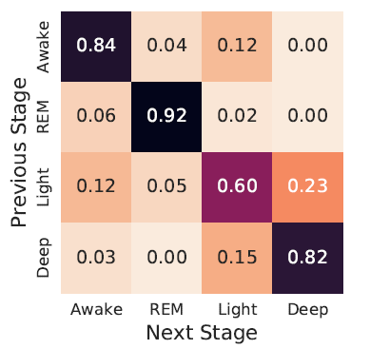
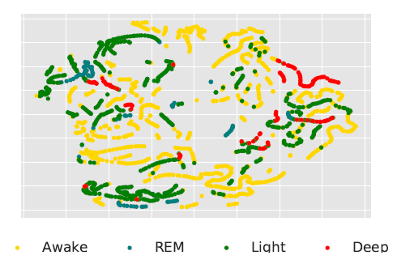
Results
t-SNE clusters for embeddings from the GRU layer
Sleep stage transition matrix from CRF layer

Slide 22
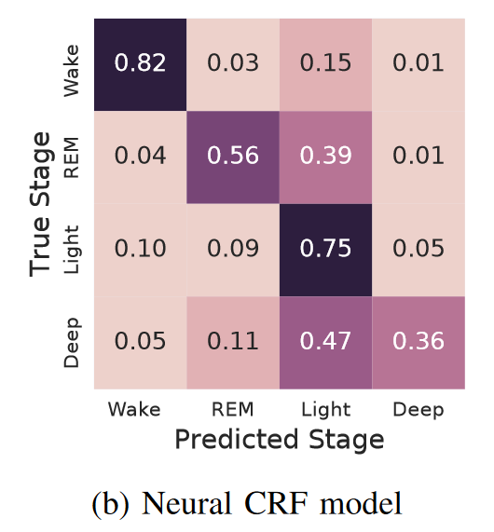
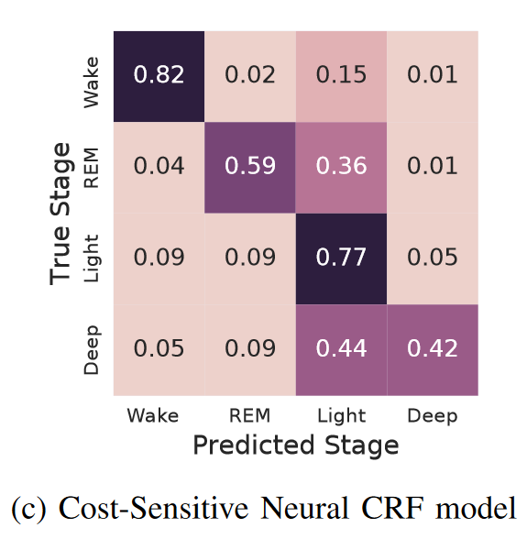
Results

Slide 23
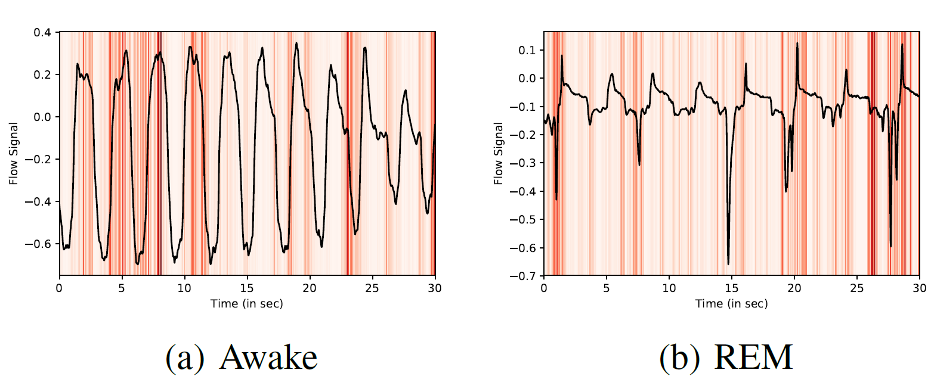
Sample Saliency Map
View decision made by the deep network using saliency map technique from Simonyan et al. [2]
(a) Awake sleep has smooth and deep inhale and exhale cycle
(b) REM sleep has irregular pattern inhale and exhale cycle
Notes:
Saliency map (borrowed from computer vision) helps look at how neural network arrived at a decision of classifying the above segments into respective sleep stage. Models seem to focus on two phases of the respiratory cycle, namely plateaus in flow closest to zero between inhalation and exhalation and periods of maximal change in flow rates. Respiratory rate variability and respiratory effort amplitude differ depending on stage of sleep. Thus it is conceivable that the models may be extracting information that approximates respiratory physiology features in trying to classify sleep stage.

Slide 24
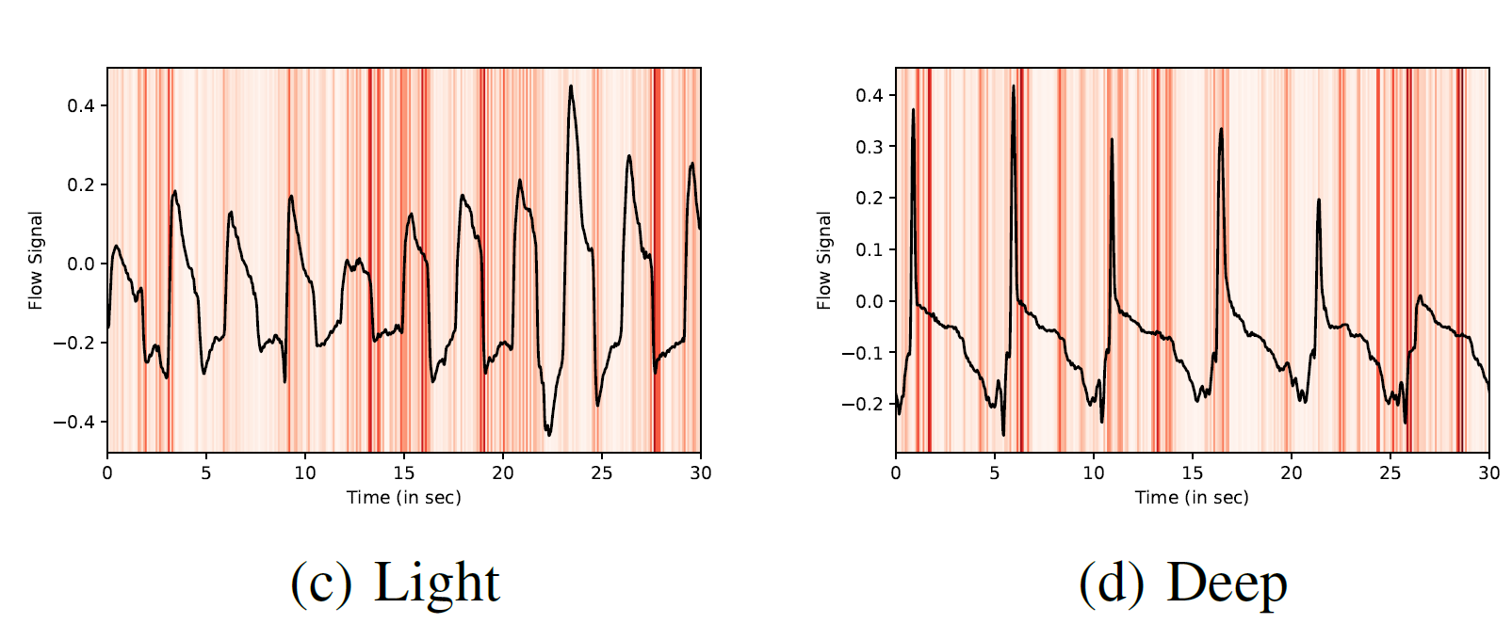
Sample Saliency Map
(c) Light sleep has comparatively shallow respiratory cycle
(d) Deep sleep has sharp inhale but slow exhale patterns

Slide 25
Conclusions
Our first study on using flow signal for automated sleep staging shows that we can find the wake and light sleep with a high accuracy
Using a structured learning approach by taking into account the transition structure helps in more accurate sleep staging
This method can be used to track the sleep efficiency of the patients under CPAP therapy with a high accuracy, providing an existing use-case unlike the most of other methods

Slide 26
Thank you!

Slide 27
References
[1] M. Zhao, S. Yue, D. Katabi, T. S. Jaakkola, and M. T. Bianchi, “Learning sleep stages from radio signals: A conditional adversarial architecture,” in International Conference on Machine Learning, 2017, pp. 4100–4109.
[2] K. Simonyan, A. Vedaldi, and A. Zisserman, “Deep inside convolutional networks: Visualising image classification models and saliency maps,” arXiv preprint arXiv:1312.6034, 2013.
[3] T. Lajnef, S. Chaibi, P. Ruby, P.-E. Aguera, J.-B. Eichenlaub, M. Samet, A. Kachouri, and K. Jerbi, “Learning machines and sleeping brains: automatic sleep stage classification using decision-tree multi-class support vector machines,” Journal of neuroscience methods, vol. 250, pp. 94–105, 2015.
[4] A. Supratak, H. Dong, C. Wu, and Y. Guo, “Deepsleepnet: A model for automatic sleep stage scoring based on raw single-channel EEG,” IEEE Transactions on Neural Systems and Rehabilitation Engineering, vol. 25, no. 11, pp. 1998–2008, 2017.
[5] S. Biswal, J. Kulas, H. Sun, B. Goparaju, M. B. Westover, M. T. Bianchi, and J. Sun, “Sleepnet: Automated sleep staging system via deep learning,” arXiv preprint arXiv:1707.08262, 2017.

Slide 28
Backup slides: Saliency Map

Slide 29
Accuracy vs convinience of different signals
Signal | Accuracy | Convenient?
ECG | High | No
Actigraphy (wearables) | Low | Yes
No-contact | Low | Yes
EKG | Medium | No

