Slide 1

A Novel Discriminative Framework for Sentence-Level Discourse Analysis
Shafiq Joty
In collaboration with
Giuseppe Carenini, Raymond T. Ng
Notes:
In this talk, I will present a novel discriminative framework for sentence-level discourse analysis. But as we will see our approach can easily be extended to multi-sentential text.

Slide 2
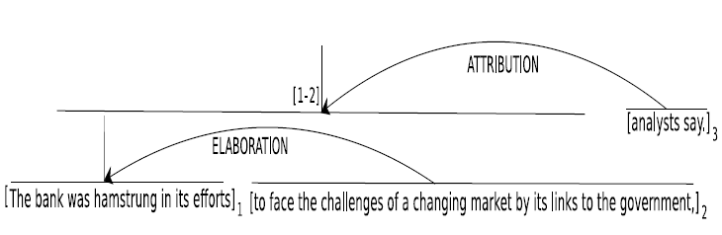
Discourse Analysis in RST
The bank was hamstrung in its efforts to face the challenges of a changing market by its links to the government, analysts say.
Nucleus
Relation
Satellite
Relation
Nucleus
Satellite
EDU
EDU
EDU
Notes:
Rhetorical structure theory posits a tree structure of discourse called a DT. The leaves of a DT correspond to contiguous atomic textual spans, also called EDUs. The adjacent EDUs and larger textual spans are connected by a rhetorical relation. A span linked by a relation can be either nucleus or satellite depending on how central the message is to the author.

Slide 3
Computational Tasks
The bank was hamstrung in its efforts to face the challenges of a changing market by its links to the government, analysts say.
Discourse Segmentation
The bank was hamstrung in its efforts
to face the challenges of a changing
market by its links to the government,
analysts say.
1
2
3
Discourse Parsing
Notes:
Discourse analysis in RST involves two subtasks. 1. breaking the text into EDUs, known as discourse segmentation, 2. linking the EDUs into a labeled hierarchical tree structure, known as discourse parsing.

Slide 4
Motivation
Text summarization (Marcu, 2000)
Text generation (Prasad et al., 2005)
Sentence compression (Sporleder & Lapata, 2005)
Question Answering (Verberne et al., 2007)
Notes:
So why do we care about discourse parsing? It has been

Slide 5
Outline
Previous work
Discourse parser
Discourse segmenter
Corpora/datasets
Evaluation metrics
Experiments
Conclusion and future work

Slide 6
Previous Work (1)
Soricut & Marcu, (2003)
Hernault et al. (2010)
SPADE
Segmenter
&
Parser
HILDA
Segmenter
&
Parser
Sentence
level
Document
level
Generative approach √
Lexico-syntactic features √
Structure & Label dependent Х
Sequential dependencies Х
Hierarchical dependencies Х
SVMs √
Large feature set √
Optimal Х
Sequential dependencies Х
Hierarchical dependencies √
Newspaper articles

Slide 7
Previous Work (2)
Subba & Di-Eugenio, (2009)
Fisher & Roark (2007)
Shift-reduce
Only
Parser
Binary log-linear
Only
Segmenter
Sentence + Document level
State-of-the-art performance
Parse-tree features are important
ILP-based classifier √
Compositional semantics √
Optimal Х
Sequential dependencies Х
Hierarchical dependencies Х
Instructional manuals

Slide 8
Discourse Parsing
Assume a sentence is already segmented into EDUs.
e₁
e₂
e₃
Discourse parsing
Structure
Label
Relation +
Nuclearity
e₁₋₃
e₁₋₃
r₁₋₃
e₂₋₃
e₁₋₂
r₂₋₃
e₁
e₂
e₃
e₁
e₂
e₃
e₁
e₂
e₃
Notes:
Let’s move on to our discourse parser. For now, assume that a sentence is already segmented into EDUs either by an automatic segmenter or manually. Let’s say we’ve three EDUs in a sentence. Now, the discourse parsing problem is to find the right structure of the DT. For example, here given these three EDUs, whether to connect EDU 2 and 3 first, then connect the resultant span with EDU1 or whether to connect EDU 1 and 2 first, then the larger span with 3. Then, finding the labels of the internal nodes. That is , the rhetorical relation and the nuclearity statuses of the spans.

Slide 9
Our Discourse Parser
Parsing model
R₁₋₃
R₁₋₃
R ranges over set of relations
Assign probabilities to DTs.
R₂₋₃
R₁₋₂
e₁
e₂
e₃
e₁
e₂
e₃
Parsing algorithm
r₁₋₃
Find the most probable DT
r₁₋₂
e₁
e₂
e₃

Slide 10
Requirements for Our Parsing Model
Discriminative
Joint model for Structure and Label
Sequential dependencies
Hierarchical dependencies
Should support an optimal parsing algorithm

Slide 11
Our Parsing Model
Model structure and label jointly
R₂
R₃
R_{j}
R_{k-1}
R_{k}
Relation at level i
R ϵ {1 .. M}
--
--
S₂
S₃
S_{j}
S_{k-1}
S_{k}
Structure at level i
S ϵ {0, 1}
--
--
W₁
W₂
W₃
--
W_{j}
--
W_{k-1}
W_{k}
Spans at level i
Dynamic Conditional Random Field (DCRF) [Sutton et al, 2007]
Models sequential dependencies
Notes:
Keeping all these requirements in mind we have come up with the following parsing model. Given this observed sequence of spans at level i of a DT, we put a hidden sequence of binary structure nodes where node S3 indicates whether spans W2 and W3 should be connected or not and so on. Then on top of that we put another hidden sequence of multinomial nodes. Here R3 indicates if W2 and W3 are connected then what should be the relation.

Slide 12
Obtaining probabilities
Apply DCRF recursively at different levels and compute posterior marginals of relation-structure pairs
R₂
R₃
R₄
Level 1
S₂
S₃
S₄
Level 2
e₁
e₂
e₃
e₄
R₃
R₄
R₂₋₃
R₄
R₂
R₃₋₄
S₃
S₄
S₂₋₃
S₄
S₂
S₃₋₄
e₁₋₂
e₃
e₄
e₁
e₂₋₃
e₄
e₁
e₂
e₃₋₄

Slide 13
Obtaining probabilities
Apply DCRF recursively at different levels and compute posterior marginals of relation-structure pairs
Level 3
R₄
R₂₋₄
R₃₋₄
S₄
S₂₋₄
S₃₋₄
e₁₋₃
e₄
e₁
e₂₋₄
e₁₋₂
e₃₋₄

Slide 14
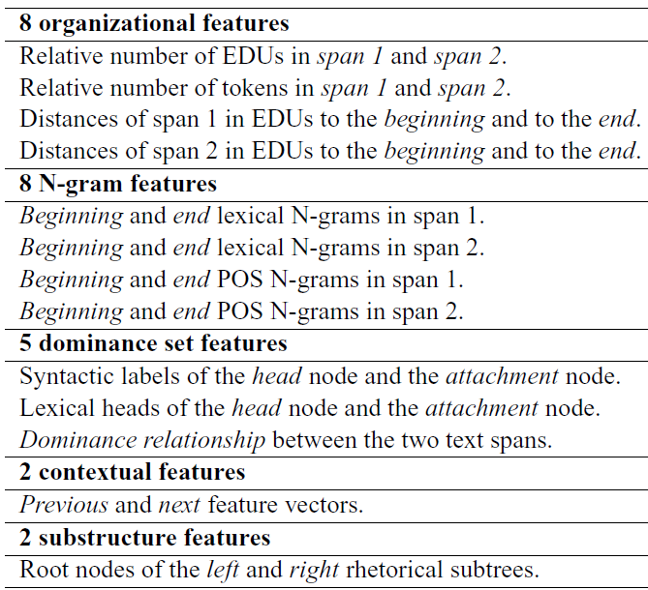
Features Used in Parsing Model
(SPADE)
Hierarchical dependencies

Slide 15
Parsing Algorithm
Probabilistic CKY-like bottom-up algorithm
4Х4
4 EDUs
DPT
T
T(i, j) = P(R[i, m, j])
m = argmax _{i ≤ k ≤ j} P(R[i, k, j])
R ranges over set of relations
Finds global optimal
Notes:
Given that we know the prob of all possible DT constituents, the job of the parsing algorithm is to find the most probable DT.

Slide 16
Outline
Previous work
Discourse parser
Discourse segmenter
Corpora/datasets
Evaluation metrics
Experiments
Conclusion and future work

Slide 17
Discourse Segmentation
The bank was hamstrung in its efforts to face the challenges of a changing market by its links to the government, analysts say.
Discourse Segmentation
The bank was hamstrung in its efforts
to face the challenges of a changing
market by its links to the government,
analysts say.
EDU
EDU
EDU
Segmentation is the primary source of inaccuracy (Soricut & Marcu, 2003)
Notes:
Discourse analysis in RST involves two subtasks. 1. breaking the text into EDUs, known as discourse segmentation, 2. linking the EDUs into a labeled hierarchical tree structure, known as discourse parsing.

Slide 18
Our Discourse Segmenter
Binary classification: boundary or no-boundary
Logistic Regression with L₂ regularization
Bagging to deal with sparse boundary tags
Features used
SPADE features
Chunk and POS features
Positional features
Contextual features

Slide 19
Corpora/Datasets
RST-DT corpus
(Carlson & Marcu, 2001)
Instructional corpus
(Subba & Di-Eugenio, 2009)
385 news articles
-Train: 347 (7673 sentences)
-Test: 38 (991 sentences)
176 how-to-do manuals
3430 sentences
Relations
26 primary relations
Reversal of non-commutative as separate relations
70 with Nucleus-Satellite
Relations
18 relations
39 with Nucleus-Satellite

Slide 20
Evaluation Metrics
Metrics for parsing accuracy
(Marcu, 2000)
Unlabeled (Span)
Labeled (Nuclearity, Relation)
Precision, Recall
F-measure
Metric for segmentation accuracy
(Soricut & Marcu, 2003; Fisher & Roark, 2007)
Precision, Recall
F-measure
Intra-sentence EDU boundary
Notes:
To measure the parsing accuracy, we are using the unlabeled and labelled precision, recall and f-measure as described in Marcu’s book, these metrics are actually adopted from the syntactic parsing area. To measure the segmentation accuracy we are measuring the agreement based on intra-sentence EDU boundary. If a sentence contains 3 EDUs which correspond to 2 intra-sentence EDU boundaries, We measure the model’s ability to find these 2 boundaries.

Slide 21
Experiments (1)
Parsing based on manual segmentation
 | RST-DT |  |  |  | Instructional
 | Test set |  | 10-fold | Doubly | S&E | 10-fold
Scores | SPADE | DCRF | DCRF | Human | ILP | DCRF
Span | 93.5 | 94.6 | 93.7 | 95.7 | 92.9 | 97.7
Nuclearity | 85.8 | 86.9 | 85.2 | 90.4 | 71.8 | 87.2
Relation | 67.6 | 77.1 | 75.4 | 83.0 | 63.0 | 73.6
Our model outperforms the state-of-the-art by a wide margin, especially on relation labeling

Slide 22
Experiments (2)
Discourse segmentation
 | RST-DT |  |  |  |  |  | Instructional
 | Test set |  |  |  | 10-fold |  | 10-fold | 10-fold
Scores | HILDA | SPADE | F&R | LR | SPADE | LR | SPADE | LR
Precision | 77.9 | 83.8 | 91.3 | 88.0 | 83.7 | 87.5 | 65.1 | 73.9
Recall | 70.6 | 86.8 | 89.7 | 92.3 | 86.2 | 89.9 | 82.8 | 89.7
F-measure | 74.1 | 85.2 | 90.5 | 90.1 | 84.9 | 88.7 | 72.8 | 80.9
Human agreement (F-measure): 98.3
Our model outperforms SPADE and comparable to F&R
We use fewer features than F&R
Notes:
HILDA performs very poorly.

Slide 23
Experiments (3)
Parsing based on automatic segmentation
 | RST-DT |  |  | Instructional
 | Test set |  | 10-fold | 10-fold
Scores | SPADE | DCRF | DCRF | DCRF
Span | 76.7 | 80.3 | 78.7 | 71.9
Nuclearity | 70.2 | 73.6 | 72.2 | 64.3
Relation | 58.0 | 65.4 | 64.2 | 54.8
Our model outperforms SPADE by a wide margin
Inaccuracies in segmentation affects parsing on
Instructional corpus

Slide 24
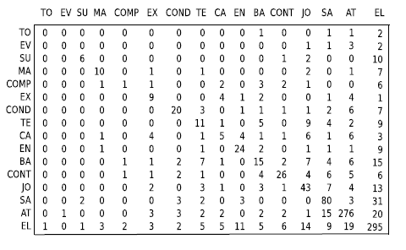
Error analysis (Relation labeling)
Most frequent ones confuse less frequent ones
Hard to distinguish semantically similar relations

Slide 25
Conclusion
Discriminative framework for discourse analysis.
Our parsing model:
Discriminative
Structure and label jointly
Sequential and hierarchical dependencies
Supports an optimal parsing algorithm
Our approach outperforms the state-of-the-art by a wide margin.

Slide 26
Future Work
Extend to multi-sentential text.
Can segmentation and parsing be done jointly?

