Slide 1
Chapter 5: 高级 SQL

Slide 2
Outline
使用程序设计语言访问SQL
函数和过程
触发器
递归查询
高级聚集特性

Slide 3
5.1 使用程序设计语言访问SQL
程序开发人员必须能够使用编程语言访问SQL:
SQL语言并没有提供编程语言的全部表达能力.
非声明式动作 -- 如打印一份报告, 与用户交互, 或把查询结果发送到图形化用户界面中 -- 都不能使用SQL完成.

Slide 4
使用程序设计语言访问SQL
编程语言访问SQL有两种方式：
动态SQL -- 编程语言可以通过一组函数或方法来连接到数据库服务器并与之通信。
嵌入式SQL -- 提供一种用于程序与数据库服务器进行交互的方式.
编译时，将SQL命令请求转换为函数调用
运行时，这些函数调用使用提供动态SQL设施的API连接到数据库

Slide 5
动态SQL（Dynamic SQL）
允许程序在运行时去构造和提交SQL查询
C程序内使用动态SQL的使用实例. char * sqlprog = “update account set balance = balance * 1.05 where account_number = ?” EXEC SQL prepare dynprog from :sqlprog; char account [10] = “A-101”; EXEC SQL execute dynprog using :account;
dynamic SQL程序包含 ?, 它是一个当SQL程序执行时提供值的占位符.

Slide 6
ODBC 和 JDBC
它是一个程序和一个数据库服务器交互的API
应用程序做出以下调用
连接数据库服务器
发送SQL命令到数据库服务器
将结果元组一个一个地取到程序变量
ODBC (Open Database Connectivity)用于 C, C++, C#, and Visual Basic
JDBC (Java Database Connectivity) 用于 Java

Slide 7
5.1.2 JDBC
JDBC：用于将Java程序连接到数据库服务器的应用程序接口（API）
JDBC 支持许多特性，如查询和更新数据,检索查询结果
JDBC 也支持元数据检索,如查询数据库中存在的关系和关系属性的名字和类型
和数据库通信的模型:
打开连接
创建一个语句对象
通过使用语句对象去发送查询和取回结果执行查询
处理错误的异常机制

Slide 8
JDBC 代码
public static void JDBCexample(String dbid, String userid, String passwd)
{
try (Connection conn = DriverManager.getConnection( "jdbc:oracle:thin:@db.yale.edu:2000:univdb", userid, passwd);
Statement stmt = conn.createStatement(); )
{
… Do Actual Work ….
}
catch (SQLException sqle) {
System.out.println("SQLException : " + sqle);
}
}
NOTE: Above syntax works with Java 7, and JDBC 4 onwards. Resources opened in “try (….)” syntax (“try with resources”) are automatically closed at the end of the try block

Slide 9
JDBC Code (Cont.)
Update to database
try { stmt.executeUpdate( "insert into instructor values('77987', 'Kim', 'Physics', 98000)"); } catch (SQLException sqle) { System.out.println("Could not insert tuple. " + sqle); }
Execute query and fetch and print results
ResultSet rset = stmt.executeQuery( "select dept_name, avg (salary) from instructor group by dept_name"); while (rset.next()) { System.out.println(rset.getString("dept_name") + " " + rset.getFloat(2)); }

Slide 10
JDBC 说明
连接到数据库
向数据库系统传递SQL命令
异常与资源管理
获取查询结果
预备语句
可调用语句
元数据特性
其他特性

Slide 11
预备语句
PreparedStatement pStmt = conn.prepareStatement( "insert into instructor values(?,?,?,?)"); pStmt.setString(1, "88877"); pStmt.setString(2, "Perry"); pStmt.setString(3, "Finance"); pStmt.setInt(4, 125000); pStmt.executeUpdate(); pStmt.setString(1, "88878"); pStmt.executeUpdate();
WARNING: always use prepared statements when taking an input from the user and adding it to a query
NEVER create a query by concatenating strings
"insert into instructor values(' " + ID + " ', ' " + name + " ', " + " ' + dept name + " ', " ' balance + ')“
What if name is “D'Souza”?

Slide 12
SQL 注入攻击
假设有如下的查询：
"select * from instructor where name = '" + name + "'"
如果用户输入如下信息:
X' or 'Y' = 'Y
那么，产生的语句就变成:
"select * from instructor where name = '" + "X' or 'Y' = 'Y" + "'"
即为:
select * from instructor where name = 'X' or 'Y' = 'Y'
用户甚至可能使用更新语句
X'; update instructor set salary = salary + 10000; --
预备语句可以避免这类问题，生成的最终查询为: "select * from instructor where name = 'X\' or \'Y\' = \'Y'
正确使用预备语句可以避免SQL注入。

Slide 13
元数据特性
ResultSet 的元数据
E.g.查询后得到 ResultSet rs:
ResultSetMetaData rsmd = rs.getMetaData();
for(int i = 1; i <= rsmd.getColumnCount(); i++) {
System.out.println(rsmd.getColumnName(i));
System.out.println(rsmd.getColumnTypeName(i));
}
元数据有什么用?
查找数据库的所有关系
查询数据库中查询结果或关系的列的名字和类型

Slide 14
5.1.3 ODBC
Open DataBase Connectivity(ODBC) 标准
应用程序和数据库服务器通讯的标准.
application program interface (API)
打开和数据库的连接,
发送查询和更新
取回结果.
诸如 GUI, spreadsheets电子制表软件, etc.等应用程序可以使用 ODBC

Slide 15
每个支持ODBC的数据库系统提供一个驱动程序库 a “driver” library ，它必须连接到客户程序
当客户程序做出ODBC API调用时,库中的代码和服务器通讯以执行请求的动作并取回结果.
ODBC 程序首先分配 SQL环境，然后是数据库连接句柄.
打开数据库连接使用 SQLConnect().参数为:
连接句柄,
要连接的服务器
用户标识符,
密码
还必须指定参数的类型:
SQL_NTS表示前面的参数是一个null结尾的字符串.

Slide 16
5.1.4 嵌入式 SQL
SQL标准定义了SQL在各种程序设计语言如 C, Java, and Cobol 中的嵌入
SQL查询所嵌入的语言被称为宿主语言 ,宿主语言所许可的SQL结构组成 embedded SQL.
EXEC SQL语句用于识别对preprocessor的嵌入式SQL请求
EXEC SQL <embedded SQL statement > END_EXEC
Note: 这会根据语言而变化 (例如有, Java嵌入使用 # SQL { …. }; )

Slide 17
查询示例
在一宿主语言内，查找在某些账户内大于变量amount的客户的名字和城市.
Specify the query in SQL and declare a cursor for it
EXEC SQL
declare c cursor for select depositor.customer_name, customer_city from depositor, customer, account where depositor.customer_name = customer.customer_name and depositor account_number = account.account_number and account.balance > :amount
END_EXEC

Slide 18
嵌入式的SQL (Cont.)
Open语句导致查询被求值
EXEC SQL open c END_EXEC
Fetch语句 导致在查询结果中的一个元组的值被放入宿主语言变量.
EXEC SQL fetch c into :cn, :cc END_EXEC 反复调用 fetch可以获得查询结果中的后继元
一个在SQL通讯区(SQLCA)的名为 SQLSTATE的变量被设为 ‘02000’ 时表明没有数据可用
close语句导致数据库系统去删除保持查询结果的临时关系.
EXEC SQL close c END_EXEC
注意: 上述细节会随语言而变. 例如,Java embedding定义Java iterators 来遍历结果元组.

Slide 19
5.2 函数和过程

Slide 20
Functions and Procedures
函数和过程允许“业务逻辑”被存储在数据库中，并用SQL命令执行；
SQL可以定义函数和过程:
可以通过SQL的过程性组件来定义
也可以在 Java, C, or C++等编程语言中定义

Slide 21
5.2.1 声明及调用SQL函数和过程
假定定义一个函数： 给定一个系的名称，返回该系的教师数量.
create function dept_count (dept_name varchar(20)) returns integer begin declare d_count integer; select count (* ) into d_count from instructor where instructor.dept_name = dept_name return d_count; end
函数调用：返回多于12位教师的所有系的名称和预算；.
select dept_name, budget from department where dept_count (dept_name ) > 12

Slide 22
表函数
表函数：SQL标准支持以返回表作为结果的函数
如: 返回指定系的所有教师的表
create function instructor_of (dept_name char(20))
returns table (
ID varchar(5), name varchar(20), dept_name varchar(20), salary numeric(8,2))
return table (select ID, name, dept_name, salary from instructor where instructor.dept_name = instructor_of.dept_name)
调用：
select * from table (instructor_of ('Music'))

Slide 23
SQL 过程
dept_count 函数也可以写出一个过程:
create procedure dept_count_proc (in dept_name varchar(20), out d_count integer) begin
select count(*) into d_count from instructor where instructor.dept_name = dept_count_proc.dept_name
end
关键字 in 和out 分别表示待赋值的参数和为了返回结果而在过程中设置值的参数.

Slide 24
SQL 过程
过程既可以从一个SQL过程调用，也可以从嵌入式SQL调用，方法是使用call语句.
.
declare d_count integer; call dept_count_proc( 'Physics', d_count);

Slide 25
SQL 过程
过程和函数还可以从动态SQL中调用
SQL允许多个过程具有相同的名称，只要同名过程的参数数量是不同的.
名称和参数数量一起用于标识过程.

Slide 26
5.2.2 用于过程和函数的语言结构
复合语句Compound statement: begin … end,
可以在begin 和 end间包含多条SQL语句.
在复合语句内可以声明局部变量
While and repeat 语句:
declare n integer default 0;
while n < 10 do
set n = n + 1
end while
repeat
set n = n – 1
until n = 0
end repeat

Slide 27
语言结构 (Cont.)
For loop
允许对查询结果迭代
Example: 找出所有系的预算 declare n integer default 0; for r as select budget from department where dept_name = 'Music' do set n = n + r.budget end for

Slide 28
语言结构 – if-then-else
条件语句 (if-then-else)
if boolean expression then statement or compound statement elseif boolean expression then statement or compound statement else statement or compound statement end if

Slide 29
案例：过程
学生选课时，如果没有超出教室容量，则允许学生注册该门课程
函数返回0表示成功，返回-1表示超出课程容量
函数具体实现见教材(page 129)
SQL的过程化语言还支持对异常情况的处理：
declare out_of_classroom_seats condition declare exit handler for out_of_classroom_seats begin … end
begin 和 end 之间的语句可以通过 “signal out_of_classroom_seats”来引发一个异常。
这个句柄说明：如果异常发生，将会采取动作从 begin end 语句中退出。

Slide 30
5.2.3 外部语言例程
SQL 允许是哦那个 Java, C#, C or C++等程序设计语言来定义函数.
效率更高
SQL中无法执行的计算可以由这些函数来执行.
申明外部语言过程和函数
create procedure dept_count_proc(in dept_name varchar(20), out count integer) language C external name '/usr/avi/bin/dept_count_proc' create function dept_count(dept_name varchar(20)) returns integer language C external name '/usr/avi/bin/dept_count'

Slide 31
外部语言例程 (Cont.)
优点:
对许多操作更高效，表达能力更强
缺点:
实现函数的代码可能需要加载到数据库系统，并在数据库系统的地址空间内执行
可能破坏数据库的内部结构
可能绕过数据库系统的访问控制功能

Slide 32
外部语言的安全
为处理安全问题
可以使用 sandbox技术
或者, 在一个独立的进程中运行外部语言函数、过程，而不必访问数据库进程的内存空间
参数和结果通过进程间通信传递
两者都有性能开销
许多数据库系统同时支持上述两种方法，也支持在数据库系统地址空间直接执行

Slide 33
5.3 触发器
触发器是由系统自动执行的可以对数据库进行操作的命令。
定义一个触发器，需要:
指明什么时候执行触发器
指明触发器执行时，采取的动作
SQL:1999标准中引入了触发器.

Slide 34
触发器的事件和行动
触发器的事件为： insert, delete or update
对update事件来说，触发器可以指定是哪些属性的更新导致触发器的执行
如, after update of takes on grade
可以创建一个变量，用于存储属性更新之前或之后的值
referencing old row as : 存储已更新或删除行的旧值
referencing new row as : 存储插入或更新的新值
触发器可以在事件之前被激活, 可以作为一种约束. 如, convert blank grades to null将空字符串转换为null空值.
create trigger setnull_trigger before update of takes referencing new row as nrow for each row when (nrow.grade = ' ') begin atomic set nrow.grade = null; end;

Slide 35
使用触发器来维护credits_earned字段的值
create trigger credits_earned after update of takes on (grade) referencing new row as nrow referencing old row as orow for each row when nrow.grade <> 'F' and nrow.grade is not null and (orow.grade = 'F' or orow.grade is null) begin atomic update student set tot_cred= tot_cred + (select credits from course where course.course_id= nrow.course_id) where student.id = nrow.id; end;

Slide 36
命令级的 触发器
命令级的触发器可以对所有受影响的行执行一次操作：
使用 for each statement 代替 for each row
使用 referencing old table 或 referencing new table 子句来指代包含所有受影响行的临时表
当更新很多条行时，这种方法更高效

Slide 37
何时不用触发器
早期，触发器可以用来
维护汇总数据 (e.g., 每个系的工资总额)
维护数据库的备份或副本。
现在，有了更好的方法:
数据库系统提供了物化视图机制，可以维护汇总数据
数据库系统提供了内置的数据库复制工具
在许多场景下，可以封装方法来代替触发器
对更新字段定义方法
调用该方法而不是使用触发器

Slide 38
5.4 递归查询（自学）

Slide 39
Recursion in SQL
SQL:1999 permits recursive view definition
Example: find which courses are a prerequisite, whether directly or indirectly, for a specific course with recursive rec_prereq(course_id, prereq_id) as ( select course_id, prereq_id from prereq union select rec_prereq.course_id, prereq.prereq_id, from rec_rereq, prereq where rec_prereq.prereq_id = prereq.course_id ) select ∗ from rec_prereq;
This example view, rec_prereq, is called the transitive closure of the prereq relation

Slide 40
The Power of Recursion
Recursive views make it possible to write queries, such as transitive closure queries, that cannot be written without recursion or iteration.
Intuition: Without recursion, a non-recursive non-iterative program can perform only a fixed number of joins of prereq with itself
This can give only a fixed number of levels of managers
Given a fixed non-recursive query, we can construct a database with a greater number of levels of prerequisites on which the query will not work
Alternative: write a procedure to iterate as many times as required
See procedure findAllPrereqs in book

Slide 41
The Power of Recursion
Computing transitive closure using iteration, adding successive tuples to rec_prereq
The next slide shows a prereq relation
Each step of the iterative process constructs an extended version of rec_prereq from its recursive definition.
The final result is called the fixed point of the recursive view definition.
Recursive views are required to be monotonic. That is, if we add tuples to prereq the view rec_prereq contains all of the tuples it contained before, plus possibly more

Slide 42
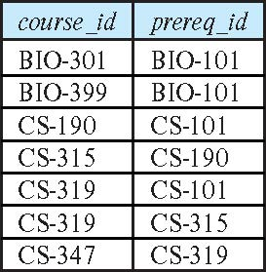
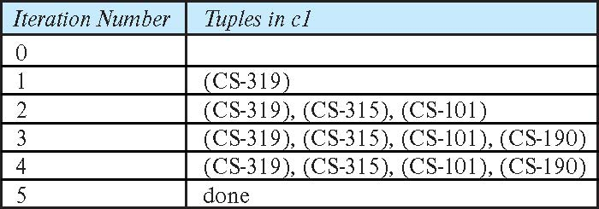
Example of Fixed-Point Computation

Slide 43
高级聚集特性

Slide 44
Ranking
Ranking is done in conjunction with an order by specification.
Suppose we are given a relation student_grades(ID, GPA) giving the grade-point average of each student
Find the rank of each student.
select ID, rank() over (order by GPA desc) as s_rank from student_grades
An extra order by clause is needed to get them in sorted order
select ID, rank() over (order by GPA desc) as s_rank from student_grades order by s_rank
Ranking may leave gaps: e.g. if 2 students have the same top GPA, both have rank 1, and the next rank is 3
dense_rank does not leave gaps, so next dense rank would be 2

Slide 45
Ranking
Ranking can be done using basic SQL aggregation, but resultant query is very inefficient
select ID, (1 + (select count(*) from student_grades B where B.GPA > A.GPA)) as s_rank from student_grades A order by s_rank;

Slide 46
Ranking (Cont.)
Ranking can be done within partition of the data.
“Find the rank of students within each department.”
select ID, dept_name, rank () over (partition by dept_name order by GPA desc) as dept_rank from dept_grades order by dept_name, dept_rank;
Multiple rank clauses can occur in a single select clause.
Ranking is done after applying group by clause/aggregation
Can be used to find top-n results
More general than the limit n clause supported by many databases, since it allows top-n within each partition

Slide 47
Ranking (Cont.)
Other ranking functions:
percent_rank (within partition, if partitioning is done)
cume_dist (cumulative distribution)
fraction of tuples with preceding values
row_number (non-deterministic in presence of duplicates)
SQL:1999 permits the user to specify nulls first or nulls last
select ID, rank ( ) over (order by GPA desc nulls last) as s_rank from student_grades

Slide 48
Ranking (Cont.)
For a given constant n, the ranking the function ntile(n) takes the tuples in each partition in the specified order, and divides them into n buckets with equal numbers of tuples.
E.g.,
select ID, ntile(4) over (order by GPA desc) as quartile from student_grades;

Slide 49
Windowing
Used to smooth out random variations.
E.g., moving average: “Given sales values for each date, calculate for each date the average of the sales on that day, the previous day, and the next day”
Window specification in SQL:
Given relation sales(date, value)
select date, sum(value) over (order by date between rows 1 preceding and 1 following) from sales

Slide 50
Windowing
Examples of other window specifications:
between rows unbounded preceding and current
rows unbounded preceding
range between 10 preceding and current row
All rows with values between current row value –10 to current value
range interval 10 day preceding
Not including current row

Slide 51
Windowing (Cont.)
Can do windowing within partitions
E.g., Given a relation transaction (account_number, date_time, value), where value is positive for a deposit and negative for a withdrawal
“Find total balance of each account after each transaction on the account”
select account_number, date_time, sum (value) over (partition by account_number order by date_time rows unbounded preceding) as balance from transaction order by account_number, date_time

Slide 52
OLAP

Slide 53
Data Analysis and OLAP
Online Analytical Processing (OLAP)
Interactive analysis of data, allowing data to be summarized and viewed in different ways in an online fashion (with negligible delay)
Data that can be modeled as dimension attributes and measure attributes are called multidimensional data.
Measure attributes
measure some value
can be aggregated upon
e.g., the attribute number of the sales relation
Dimension attributes
define the dimensions on which measure attributes (or aggregates thereof) are viewed
e.g., attributes item_name, color, and size of the sales relation

Slide 54
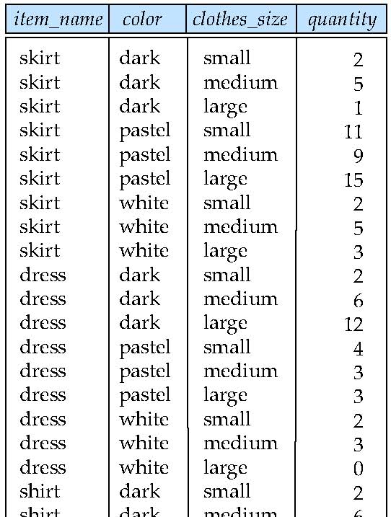
Example sales relation
...
...
...
...
...
...
...
...

Slide 55
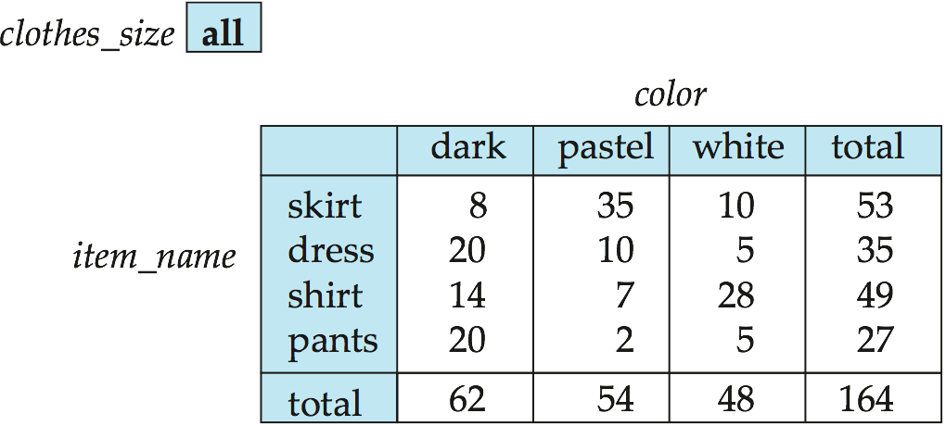
Cross Tabulation of sales by item_name and color
The table above is an example of a cross-tabulation (cross-tab), also referred to as a pivot-table.
Values for one of the dimension attributes form the row headers
Values for another dimension attribute form the column headers
Other dimension attributes are listed on top
Values in individual cells are (aggregates of) the values of the dimension attributes that specify the cell.

Slide 56
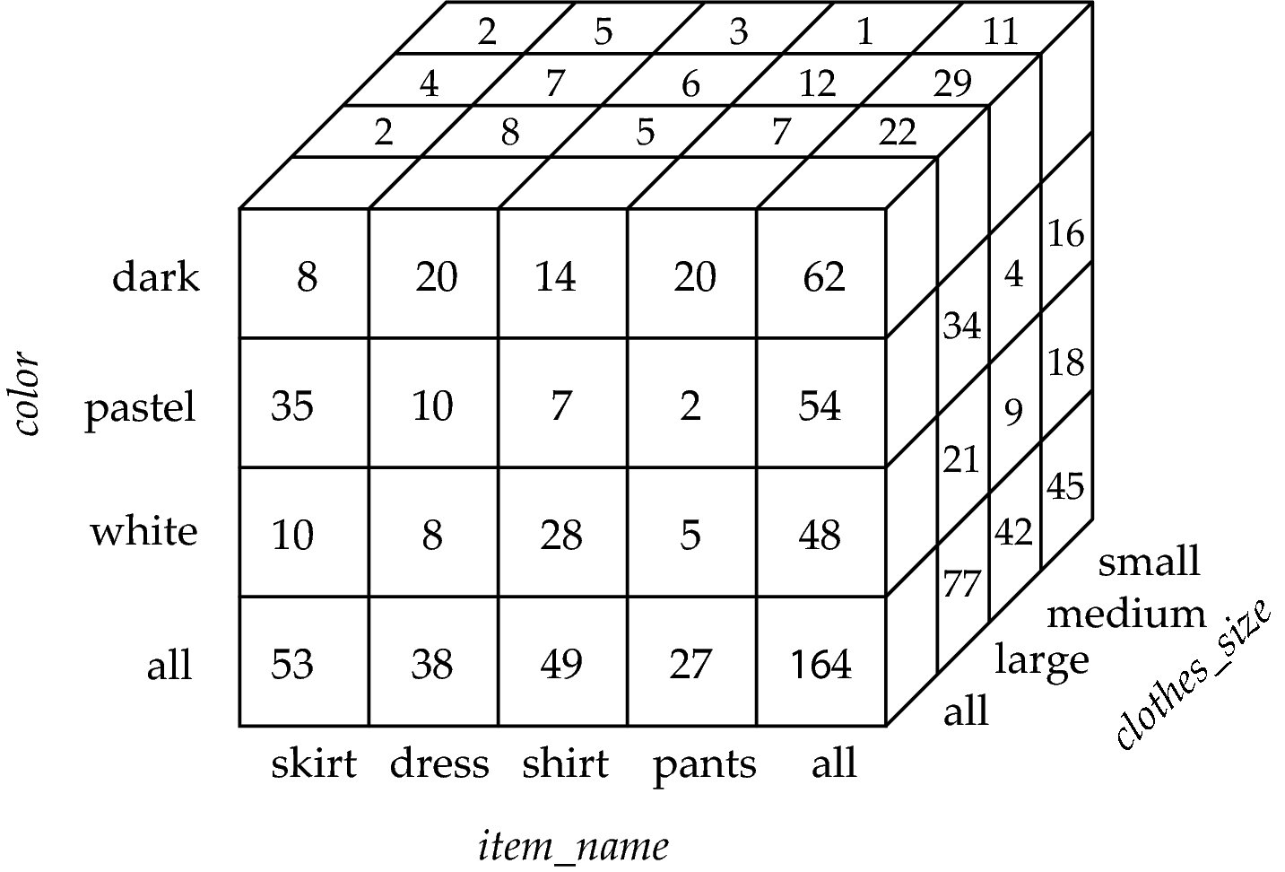
Data Cube
A data cube is a multidimensional generalization of a cross-tab
Can have n dimensions; we show 3 below
Cross-tabs can be used as views on a data cube

Slide 57
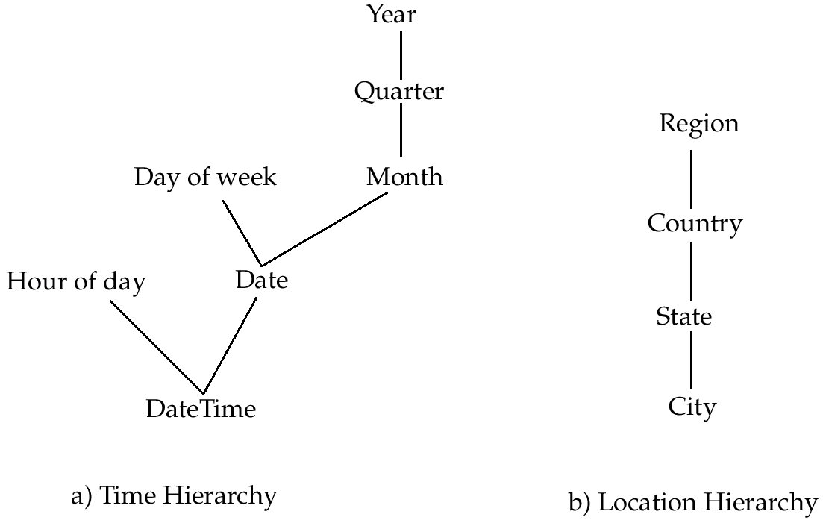
Hierarchies on Dimensions
Hierarchy on dimension attributes: lets dimensions to be viewed at different levels of detail
E.g., the dimension DateTime can be used to aggregate by hour of day, date, day of week, month, quarter or year

Slide 58
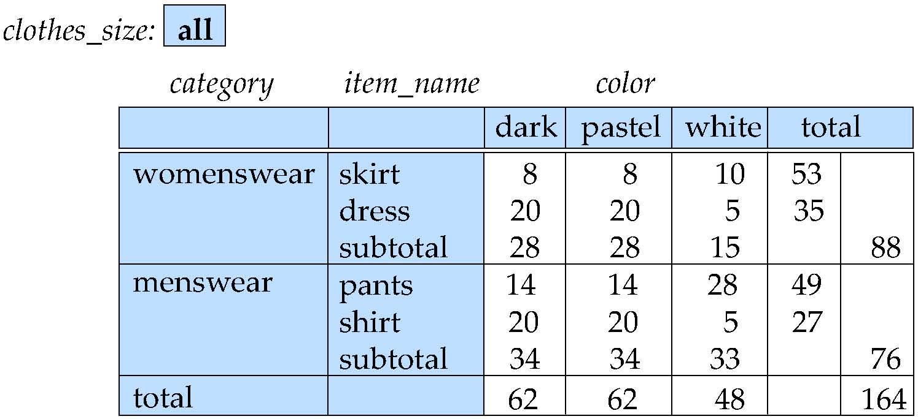
Cross Tabulation With Hierarchy
Cross-tabs can be easily extended to deal with hierarchies
Can drill down or roll up on a hierarchy

Slide 59
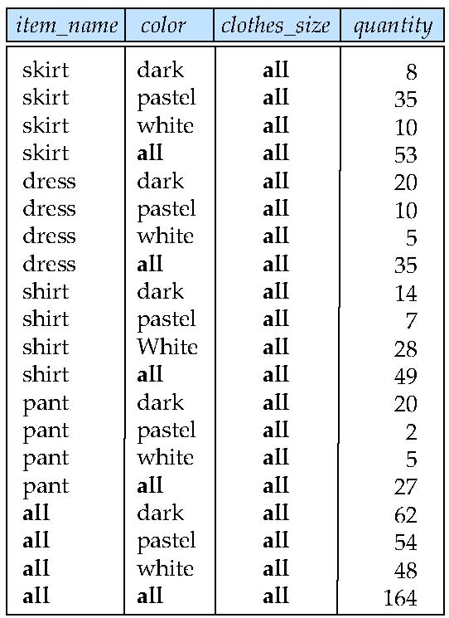
Relational Representation of Cross-tabs
Cross-tabs can be represented as relations
We use the value all is used to represent aggregates.
The SQL standard actually uses null values in place of all despite confusion with regular null values.

Slide 60
Extended Aggregation to Support OLAP
The cube operation computes union of group by’s on every subset of the specified attributes
Example relation for this section sales(item_name, color, clothes_size, quantity)
E.g., consider the query
select item_name, color, size, sum(number) from sales group by cube(item_name, color, size)
This computes the union of eight different groupings of the sales relation:
{ (item_name, color, size), (item_name, color), (item_name, size), (color, size), (item_name), (color), (size), ( ) }
where ( ) denotes an empty group by list.
For each grouping, the result contains the null value for attributes not present in the grouping.

Slide 61
Online Analytical Processing Operations
Relational representation of cross-tab that we saw earlier, but with null in place of all, can be computed by
select item_name, color, sum(number) from sales group by cube(item_name, color)
The function grouping() can be applied on an attribute
Returns 1 if the value is a null value representing all, and returns 0 in all other cases.
select item_name, color, size, sum(number), grouping(item_name) as item_name_flag, grouping(color) as color_flag, grouping(size) as size_flag, from sales group by cube(item_name, color, size)

Slide 62
Online Analytical Processing Operations
Can use the function decode() in the select clause to replace such nulls by a value such as all
E.g., replace item_name in first query by decode( grouping(item_name), 1, ‘all’, item_name)

Slide 63
Extended Aggregation (Cont.)
The rollup construct generates union on every prefix of specified list of attributes
E.g.,
select item_name, color, size, sum(number) from sales group by rollup(item_name, color, size)
Generates union of four groupings:
{ (item_name, color, size), (item_name, color), (item_name), ( ) }
Rollup can be used to generate aggregates at multiple levels of a hierarchy.
E.g., suppose table itemcategory(item_name, category) gives the category of each item. Then
select category, item_name, sum(number) from sales, itemcategory where sales.item_name = itemcategory.item_name group by rollup(category, item_name)
would give a hierarchical summary by item_name and by category.

Slide 64
Extended Aggregation (Cont.)
Multiple rollups and cubes can be used in a single group by clause
Each generates set of group by lists, cross product of sets gives overall set of group by lists
E.g.,
select item_name, color, size, sum(number) from sales group by rollup(item_name), rollup(color, size)
generates the groupings
{item_name, ()} X {(color, size), (color), ()}
= { (item_name, color, size), (item_name, color), (item_name), (color, size), (color), ( ) }

Slide 65
Online Analytical Processing Operations
Pivoting: changing the dimensions used in a cross-tab is called
Slicing: creating a cross-tab for fixed values only
Sometimes called dicing, particularly when values for multiple dimensions are fixed.
Rollup: moving from finer-granularity data to a coarser granularity
Drill down: The opposite operation - that of moving from coarser-granularity data to finer-granularity data

Slide 66
OLAP Implementation
The earliest OLAP systems used multidimensional arrays in memory to store data cubes, and are referred to as multidimensional OLAP (MOLAP) systems.
OLAP implementations using only relational database features are called relational OLAP (ROLAP) systems
Hybrid systems, which store some summaries in memory and store the base data and other summaries in a relational database, are called hybrid OLAP (HOLAP) systems.

Slide 67
OLAP Implementation (Cont.)
Early OLAP systems precomputed all possible aggregates in order to provide online response
Space and time requirements for doing so can be very high
2^{n} combinations of group by
It suffices to precompute some aggregates, and compute others on demand from one of the precomputed aggregates
Can compute aggregate on (item_name, color) from an aggregate on (item_name, color, size)
For all but a few “non-decomposable” aggregates such as median
is cheaper than computing it from scratch
Several optimizations available for computing multiple aggregates
Can compute aggregate on (item_name, color) from an aggregate on (item_name, color, size)
Can compute aggregates on (item_name, color, size), (item_name, color) and (item_name) using a single sorting of the base data

Slide 68
End of Chapter 5

