Slide 1


Slide 2
实验内容
PPP配置
帧中继配置

Slide 3

PPP
Left
router
Dialup or
Circuit-Switched
Network
Right
router
PPP (Point to Point Protocol)是SLIP (Serial Line IP Protocol)协议的继承者，是一种标准的串行线路封装方法，提供了跨过同步和异步电路，实现路由器到路由器或主机到网络的点对点连接。PPP支持的密码认证协议（PAP，Password Authentication Protocol）和握手验证协议（CHAP，Challenge Handshake Authentication Protocol）；还支持动态地址分配、多种协议，及同步、异步通信等。

Slide 4
PPP
建立PPP会话
  1、链路的建立和配置协商
  2、链路质量检测（包含身份验证）
  3、网络层协议的配置协商
  4、链路中止

Slide 5
PPP身份认证协议
PAP
CHAP（一般作为首选）

Slide 6

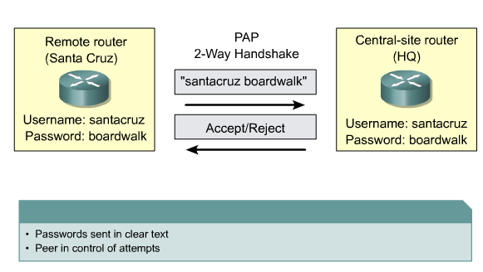

Slide 7

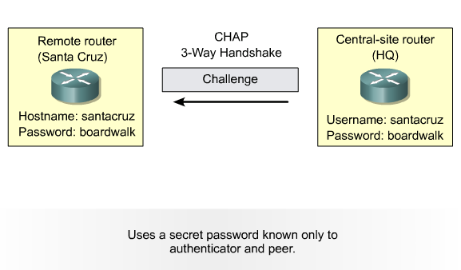

Slide 8

CHAP in Action—Call
User dials in
766_1
5200_1
Notes:
This slide and the following few slides show the series of events that occur during a CHAP authentication between two routers. The steps shown in this slide are:
1. The call comes in to 5200_1
2. The incoming interface is configured with the ppp authentication chapcommand.
3. LCP negotiates CHAP and MD5.
4. A CHAP challenge is required on this call.

Slide 9
CHAP in Action—Challenge
User dials in
766_1
5200_1
01
id
random
5200_1
Notes:
This slide illustrates the following steps in the CHAP authentication between the two routers:
1. A CHAP challenge packet is built with the following characteristics:
01 = challenge
id = sequential number which identifies the challenge
random = a reasonably random number
5200_1 = the authentication name of the challenger
2. The id and random values are kept on the access server. A list of outstanding challenges is maintained.
3. The challenge packet is sent to the caller.

Slide 10
CHAP in Action—Response
User dials in
766_1
5200_1
user pass
5200_1 pc1
01
id
random
5200_1
MD5
hash
Notes:
This slide illustrates the receipt and MD5 processing of the challenge packet from the server.
The calling router processes the CHAP challenge packet in the following manner:
The id is fed into the MD5 algorithm handler
The random value is fed into the MD5 algorithm handler
The name 5200_1 is used to look up the password
The password is fed into the MD5 algorithm handler
The result is the one-way MD5 hashed CHAP challenge that will be sent back in the CHAP response.

Slide 11
CHAP in Action—Response
User dials in
766_1
5200_1
user pass
5200_1 pc1
01
id
random
5200_1
02
id
hash
766_1
MD5
hash
Notes:
This slide illustrates the building of the CHAP response packet that will be sent to the access server.
The response packet is assembled from the following components:
02 = CHAP response packet type
id = copied from the challenge packet
hash = the output from the MD5 algorithm handler. (The hashed information from the challenge packet.)
766_1 is the authentication name of this caller
The packet is then sent to the challenger.

Slide 12
CHAP in Action—Verification
User dials in
766_1
5200_1
user pass
5200_1 pc1
01
id
random
5200_1
user pass
766_1 pc1
02
id
hash
766_1
MD5
MD5
hash
=?
hash
Notes:
This slide shows the process of processing the response packet that occurs on the challenger.
The CHAP response packet is processed in the following manner:
The id is used to find original challenge packet
The id is fed into the MD5 algorithm handler
The original challenge random is fed into the MD5 meat grinder
The name 766_1 is used to look up the password (this name can be used to identify this session) from one of the following sources:
local username and password database
TACACS server with Cisco IOS version 11.1 and before for the password or Cisco IOS version 11.2
and later to verify the hash
RADIUS server is asked for the password
The password is fed into the MD5 algorithm handler
The hash value received in the response packet is then compared to the MD5 hashed value calculated
CHAP authentication succeeds if they’re equal.

Slide 13
CHAP in Action—Result
User dials in
766_1
5200_1
user pass
5200_1 pc1
01
id
random
5200_1
user pass
766_1 pc1
02
id
hash
766_1
MD5
MD5
hash
hash
03
id
“Welcome in”
Notes:
The slide illustrates the success message being sent to the calling router.
If authentication was successful, a CHAP success packet is built as follows:
03 = CHAP success message type
id = copied from the response packet
“Welcome in” is simply a text message of some kind meant to be a user readable explanation
If authentication failed a CHAP failure packet is built:
04 = CHAP failuremessage type
id = copied from the response packet
“Authentication failure” or some such message meant to be a user readable explanation
The packet is then sent to the caller.

Slide 14

PPP配置实验拓扑
S0
10.0.0.0/30
left
S1
right
F0/0
F0/0
192.168.1.2/24
192.168.2.2/24

Slide 15
PPP配置
基本接口配置
  Router(config-if)#ip address
  Router(config-if)# clock rate
  Router(config-if)# no shutdown
  …

Slide 16
PPP配置
在全局模式下配置主机名，这里指定的名称必须和链路另一端路由器中username所使用的主机名相匹配（大小写敏感）。
  Router(config)#hostname {host-name}
定义验证时远端路由器需要的用户名和密码，在全局模式下使用username name password password命令。在Cisco路由器中，两台路由器必须具有相同的密码。
  Router(config)#uesrname {name} password {password}

Slide 17
PPP配置
在接口配置模式下启动PPP封装
  Router(config)#interface serial {serial-number}
  Router(config-if)#encapsulation ppp
配置PPP身份验证功能，可同时启动pap、chap两种验证协议，则配置中指定的第一种验证方式在链路协商过程中将被请求使用。如果另一端设备建议使用第二种验证方式，或简单的拒绝了第一种验证方式，那么这两台设备之间就开始尝试使用第二种验证方式。
  Router(config-if)#ppp authentication {chap | chap pap | pap chap | pap}

Slide 18
PAP配置
Left
router
Dialup or
Circuit-Switched
Network
Right
router
hostname left
username right password cisco
interface serial 0
encapsulation ppp
ppp authentication PAP
ppp pap sent-username left
password cisco
hostname right
username left password cisco
interface serial 0
encapsulation ppp
ppp authentication PAP
ppp pap sent-username right
password cisco

Slide 19
CHAP配置
Left
router
Dialup or
Circuit-Switched
Network
Right
router
hostname left
username right password cisco
int serial 0
encapsulation ppp
ppp authentication CHAP
hostname right
username left password cisco
int serial 0
encapsulation ppp
ppp authentication CHAP

Slide 20
PPP配置
查看与验证ppp封装
  Router#show running-config
  Router#show interface serial 0
  Router#ping
监视认证过程
  Router(config)#intreface serial 0
  Router(config-if)#shutdown
  Router#debug ppp authentication
  Router(config-if)#no shutdown

Slide 21
帧中继配置
帧中继介绍
帧中继（FRAME RELAY）是在用户－网络接口之间提供用户数据流的双向传送，并保持顺序不变的一种承载业务，它是以帧为单位，在网络上传输，并将流量控制、纠错等功能，全部交由智能终端设备处理的一种网络接口技术。

Slide 22
帧中继配置
相关术语
  PVC－永久虚拟电路，连接两DTE的路径；
  DLCI－数据链路标识；
  LMI－本地管理接口，负责管理连接和维护状态（ansi，cisco，q933a）；

Slide 23



帧中继配置
Frame Relay
Cloud
DLCI = 100
DLCI = 400
172.168.5.5
172.168.5.7

Slide 24
帧中继配置
DLCI=102
S0
S1
DLCI=201
Router1
帧中继交换机
Router2
10.0.0.1
F0/0
10.0.0.2
F0/0
192.168.1.2/24
192.168.2.2/24

Slide 25
帧中继配置
配置帧中继交换机
  Router(config)#hostname Frsw
  Frsw(config)#frame-relay switching (!enable frame relay pvc switching)
  Frsw(config)#interface serial 0
  Frsw(config-if)#no ip address
  Frsw(config-if)#no shutdown
  Frsw(config-if)#encapsulation frame-relay
  Frsw(config-if)#clock rate 64000
  Frsw(config-if)#frame-relay intf-type dce
  Frsw(config-if)#frame-relay route 102 interface serial 1 201
  Frsw(config-if)#frame-relay lmi-type {ansi|cisco|q933a}

Slide 26
帧中继配置
  Frsw(config)#interface serial 1
  Frsw(config-if)#no ip address
  Frsw(config-if)#no shutdown
  Frsw(config-if)#encapsulation frame-relay
  Frsw(config-if)#clock rate 64000
  Frsw(config-if)#frame-relay intf-type dce
  Frsw(config-if)#frame-relay route 201 interface serial 0 102
  Frsw(config-if)# frame-relaylmi-type {ansi|cisco|q933a}

Slide 27
帧中继配置
Router1配置
  Router1(config)#interface serial 0
  Router1(config-if)#encapsulation frame-relay
  Router1(config-if)# ip address 10.0.0.1 255.255.255.0
  Router1(config-if)# frame-relay map ip 10.0.0.2 102 broadcast
  Router1(config-if)# frame-relay lmi-type {ansi|cisco|q933a}
  Router1(config-if)# no shutdown

Slide 28
帧中继配置
Router2配置
  Router2(config)#interface serial 0
  Router2(config-if)#encapsulation frame-relay
  Router2(config-if)# ip address 10.0.0.2 255.255.255.0
  Router2(config-if)# frame-relay map ip 10.0.0.1 201 broadcast
  Router2(config-if)# frame-relay lmi-type {ansi|cisco|q933a}
  Router2(config-if)# no shutdown

Slide 29
帧中继配置
查看与验证
  Router#show interface serial 0
  Router#show frame-relay pvc
  Router#show frame-relay map
  Router#show frame-relay lmi
  Router#ping…

Slide 30
帧中继配置
配置点到点子接口
  Router1(config)# interface serial 0
  Router1(config-if)#no ip address 10.0.0.1 255.255.255.0
  Router1(config-if)# no frame map ip 10.0.0.2 102 broadcast
  Router1(config-if)# interface serial 0.1 point-to-point
  Router1(config-subif)# ip address 10.0.0.1 255.255.255.0
  Router1(config-subif)frame-relay interface-dlci 102

Slide 31
帧中继配置
  Router2(config)# interface serial 0
  Router2(config-if)#no ip address 10.0.0.2 255.255.255.0
  Router2(config-if)# no frame map ip 10.0.0.1 201 broadcast
  Router2(config-if)# interface serial 0.1 point-to-point
  Router2(config-subif)# ip address 10.0.0.2 255.255.255.0
  Router2(config-subif)frame-relay interface-dlci 201

