Slide 1
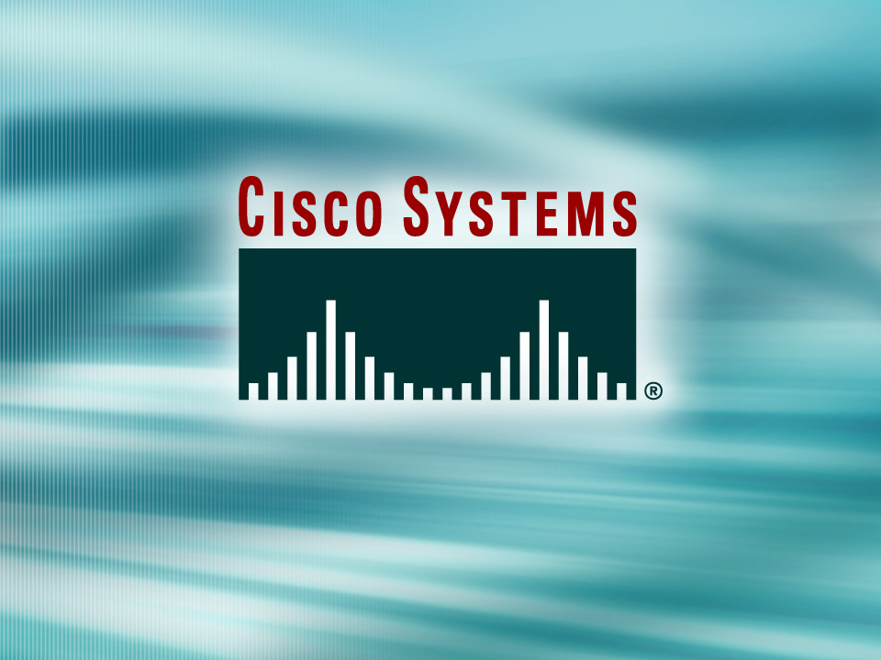
Presentation_ID
© 2001, Cisco Systems, Inc. All rights reserved.

Slide 2
Network Address Translation
Torrey Y. Suzuki
Cisco Systems, Inc.

Slide 3
NAT and Private addresses
NAT, as defined by RFC 1631, is the process of swapping one address for another in the IP packet header.
In practice, NAT is used to allow hosts that are privately addressed to access the Internet.

Slide 4
Network Address Translation (NAT)
Why?
NAT conserves IP addresses by relying on reusable private IP address spaces specified in RFC 1918: 10.0.0.0/8, 172.16.0.0/12, and 192.168.0.0/16.
Security - NAT hides the ‘inside’ address space from the public.

Slide 5
NAT
NAT comes as a great relief to organizations that outgrow their address space.
  If a corporation with a Class C address suddenly finds that over 500 nodes on campus need occasional Internet access, NAT (used in conjunction with RFC 1918 addresses) may provide a convenient solution.

Slide 6
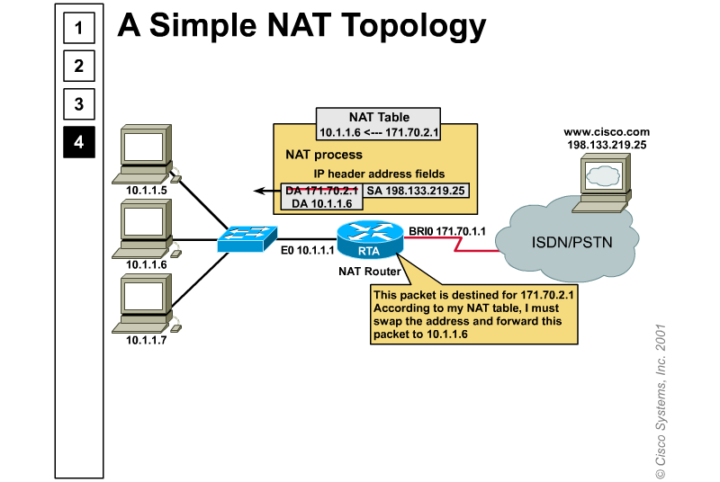
Network Address Translation (Cont.)

Slide 7
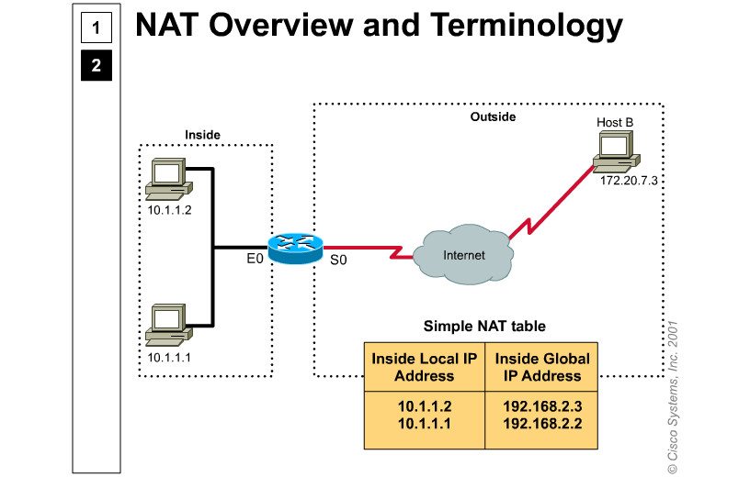
NAT Terminology

Slide 8
Types of NAT
Static NAT
Dynamic NAT
Overloading NAT (PAT)
TCP Load distribution

Slide 9
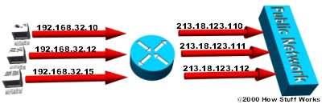
Static NAT - Mapping an unregistered IP address to a registered IP address on a one-to-one basis. Particularly useful when a device needs to be accessible from outside the network.
In static NAT, the computer with the IP address of 192.168.32.10 will always translate to 213.18.123.110.

Slide 10
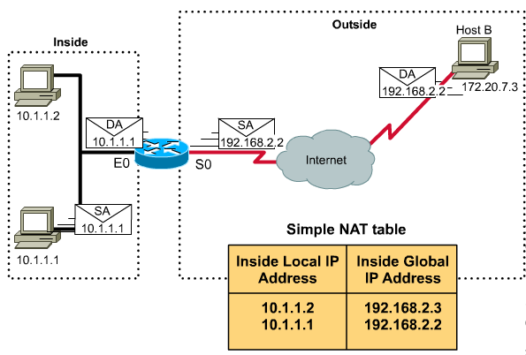
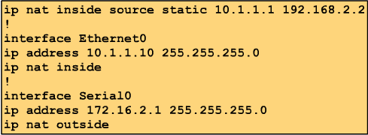
NAT Configuration: Static
192.168.2.0/24
172.16.2.1
ip route 192.168.2.0 255.255.255.0 172.16.2.1
192.168.2.2

Slide 11
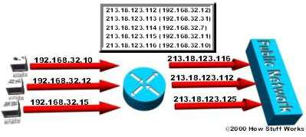
Dynamic NAT - Maps an unregistered IP address to a registered IP address from a group of registered IP addresses.
In dynamic NAT, the computer with the IP address of 192.168.32.10 will translate to the first available address in the range from 213.18.123.100 to 213.18.123.150.

Slide 12
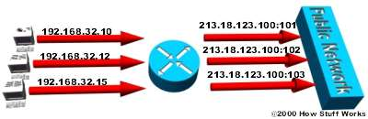
Overloading - A form of dynamic NAT that maps multiple unregistered IP addresses to a single registered IP address by using different ports. Known also as PAT (Port Address Translation), single address NAT or port-level multiplexed NAT.
In overloading, each computer on the private network is translated to the same IP address (213.18.123.100) but with a different port number assignment.

Slide 13
NAT
One advantage of NAT is that, since not every inside host needs outside access at the same time, you can get away with using a small pool of public addresses or single address to serve a relatively large number of privately addressed hosts.

Slide 14
PAT: Address overloading
The most powerful feature of NAT routers is their ability to use Port Address Translation (PAT), which allows multiple inside addresses to map to the same global address.
  This is sometimes called a “many-to-one” NAT.
  literally hundreds of privately address nodes can access the Internet using only one global address.

Slide 15
PAT
The NAT router keeps track of the different conversations by mapping TCP and UDP port numbers.
  This works well for client applications like web browsers because they grab port numbers as needed, typically from the unassigned range between 1024 and 65,535.

Slide 16
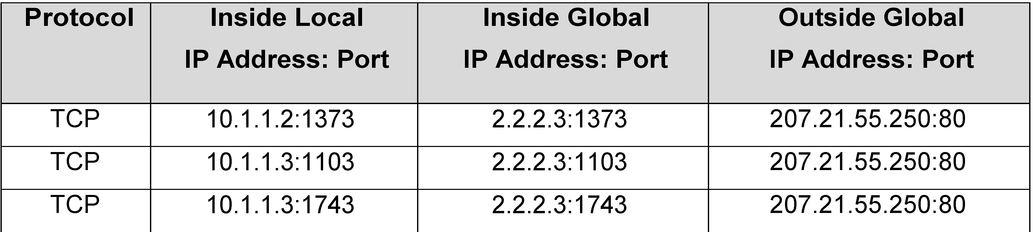
PAT
An example PAT translation table

Slide 17
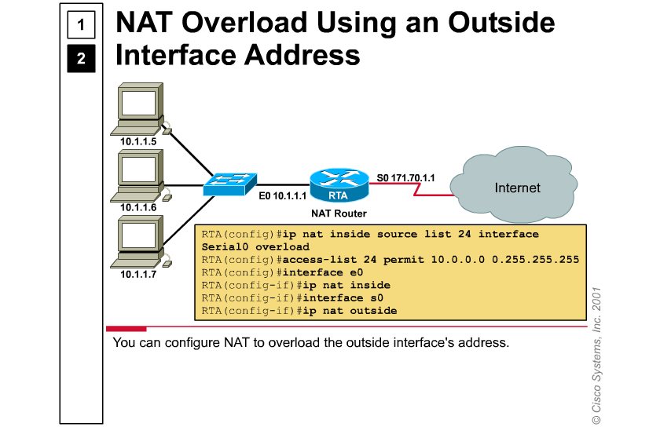
Configuring NAT Overload

Slide 18
TCP Load distribution
Cisco routers support TCP load distribution, a powerful NAT feature that allows you to map one global address to multiple inside addresses for the purpose of distributing conversations among multiple (usually mirrored) hosts.

Slide 19
NAT drawbacks
The tradeoff for address translation is a loss of functionality, particularly with any protocol or application that involves sending IP address information outside the IP header.

Slide 20
NAT drawbacks
The following traffic types are not supported by Cisco IOS NAT:
  Routing table updates
  Domain Name System (DNS) zone transfers
  BOOTP
  Simple Network Management Protocol (SNMP)

Slide 21
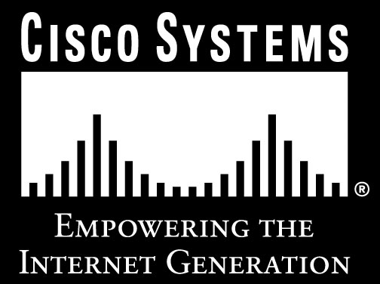
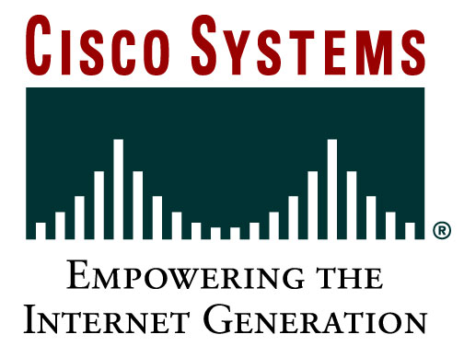
Presentation_ID
© 2001, Cisco Systems, Inc. All rights reserved.

