Slide 1
CCNA – Delta Training
VLSM
J. Straube
Box Hill Institute of TAFE - Melbourne

Slide 2
Advanced IP addressing Management
Classful Addressing Scheme
Classless Inter-Domain Routing
Variable Length Subnet Masks
Route Summarization

Slide 3
Classful Addressing Scheme
Addressing using a combination of:
  Network + Host Address
IP Classes:
  A, B, C, D & E
IP address exhaustion (1993-1994)
Larger Networks require more RAM and CPU power.
Notes:
The Internet uses this two-level address hierarchy. Rather than calculating and tracking routes to each known host, however, the Internet advertises just the network addresses. End systems that need to access hosts in other networks address their datagrams with the full address, including both network and host numbers, but the routers in the internetwork could assume that the destination network would know how to deliver datagrams to all the end systems within its domain. Therefore, the Internet's routers would only have to track routes to every known network.
A: 0 – 127; B: 128 – 191; C: 192 – 223; D: 224 – 239; E: 240 – 255;

Slide 4
IP Addressing Solutions
  Hierarchical addressing
  RFCs 950, 1812: Subnet masking
  RFC 1918: Private Network Numbers
  RFC 1631: Network Address Translation
  RFC 1812: Variable-length subnet masks (VLSM)
  RFCs 1518, 1519, 2050 : CIDR

Slide 5

Why use an IP Address Hierarchy?
Long distance
Exchange
California
Long distance
Exchange
Virginia
Path to 555
(A prefix
summarizes
a smaller area
in VA)
Path to 1
(A number
indicates
destination
is remote)
Path to 703
(An area code
summarizes
an area in VA)
Local
Exchange
Local Exchange
Alexandria
Path to 1212
(Number)
California
Aunt Judy
Does a telephone switch in California know how to reach a specific phone in Virginia?
(1-703-555-1212)
Notes:
19

Slide 6

Classless Inter-Domain Routing
CIDR – Classless Inter-Domain Routing
  RFCs 1518, 1519, 2050
IETF proposed
  IPv6 (or IPng – next generation)
CIDR features:
  The replacement of classful addressing by classless
  Enhanced route aggregation
  Supernetting
Notes:
CIDR is a temporary fix (patch) while IPv6 is not ready to implement.
CIDR enables Internet routers (or any CIDR-compliant router) to more efficiently aggregate routing information. In other words, a single entry in a routing table can represent the address spaces of many networks. This can greatly reduce the size of the routing tables that are needed in any given internetwork and directly translates into an increased scalability.
Supernetting : Supernetting is nothing more than using contiguous blocks of Class C address spaces to simulate a single larger block.(e.g. contiguous Class C addresses, could be redefined and simulate a Class B address)
Example of classless ip>> 192.125.61.8 /20

Slide 7

Variable Length Subnet Masks
Advantages:
  efficient use of IP addresses
  better route summarization
Protocols:
  RIP2
  OSPF
  EIGRP
  BGP v4
Lab Exercise
Notes:
Variable-Length Subnet Masks --- RFC 1009 (1987). Developed to allow the network designer to utilize multiple address schemes within a given class of address. This strategy can be used only when it is supported by the routing protocol, such as OSPF and EIGRP.
Routing protocols capable of VLSM send the Subnet Mask together with the network information on routing updates.

Slide 8

VLSM Design exercise
196.123.23.0
N.N.N. x x x x x x x x
N.N.N.12 /30
N.N.N. x x x x x x h h
N.N.N.4 /30
26
N.N.N. 0 0 0 0 0 1 h h
N.N.N.8 /30
N.N.N. 0 0 0 0 1 0 h h
N.N.N. 0 0 0 0 1 1 h h
10
12
Serial Links
60
N.N.N. 0 0 0 1 0 0 h h
N.N.N.16 /30
N.N.N. 0 0 0 1 0 1 h h
N.N.N. 0 0 0 1 1 0 h h
19
N.N.N. 0 0 0 1 h h h h
IP: 196.123.23.0

Slide 9
VLSM Design exercise cont.
196.123.23.0
N.N.N. x x x x x x x x
N.N.N.12 /30
N.N.N. 0 0 0 1 h h h h
<< Already in Use
N.N.N.4 /30
N.N.N.96 /27
26
N.N.N. 0 0 1 0 h h h h
N.N.N.8 /30
N.N.N. 0 0 1 1 h h h h
N.N.N. 0 0 1 h h h h h
<< Already in Use
10
12
60
N.N.N. 0 1 0 h h h h h
N.N.N.32 /28
N.N.N.48 /28
N.N.N.16 /30
N.N.N. 0 1 1 h h h h h
N.N.N.128 /26
N.N.N. 0 1 h h h h h h
<< Already in Use
N.N.N.64 /27
19
N.N.N. 1 0 h h h h h h
IP: 196.123.23.0

Slide 10
Route Summarization
Also called route Aggregation or Supernetting
Advantages:
  Reduction of the number of Routing Table entries.
  May be used to isolate Topological changes
Examples
Notes:
Route Summarization reduces the number of routes that a router must maintain because it represents a series of network numbers as a single summary address.
Route summarization is not always a good solution. You would not want to use route summarization when you have discontiguous networks. Protocols such as EIGRP and RIP2 allow you to disable automatic summarization.

Slide 11
Route Summarization 2
Problem:
  Noncontiguous Subnets can not be summarized correctly.
Solution:
  Use of IP Unnumbered
Problem: Multiple Summaries may cause routing loops.
Solution: Turn OFF “Auto-Summary” in routing protocols that allow it.
(e.g.: EIGRP)

Slide 12



Problems Summarizing Routes
172.16.5.0/24
172.16.6.0/24
172.16.1.0/24
172.16.2.0/24
B
A
C
EIGRP Advertises 172.16.0.0/16
EIGRP Advertises 172.16.0.0/16
  EIGRP on both Router A and Router C advertise a summarized route to 172.16.0.0/16
  Router B receives two routes to 172.16.0.0/16
  Router A & B should be configured with:
  router(config-router)# no auto-summary

Slide 13

Private IP and NAT
Private IP Addresses:
  Class A --- 10.0.0.0 to 10.255.255.255 (= /8)
  Class B --- 172.16.0.0 to 172.31.255.255 (= /12)
  Class C --- 192.168.0.0 to 192.168.255.255 (= /16)
RFC 1631 - Network Address Translator (NAT)
Ip Unnumbered
NAT & IP
Unnumbered

Slide 14
NAT Issues
BootP/ DHCP/SNMP –
  Requires storing the IP address in the BootP/DHCP/SNMP data field. NAT does not change these field.
DNS –
  Relies on a static IP address mapping to a host name. Use static translation.
Security –
  When using NAT there will be no encryption of the TCP header.
Difficult Debugging

Slide 15
IP Unnumbered
Saving some IP addresses
Issues:
  MUST be a point-to-point connection.
  MUST use the same network and SM.

Slide 16
DHCP (Easy IP)
Configuration:
  Define the DHCP database agent
  Define the DHCP pool
  Specify the DHCP client options (Optional)
  Configure the DCHP forwarding if necessary
View it

Slide 17
End of the session

Slide 18
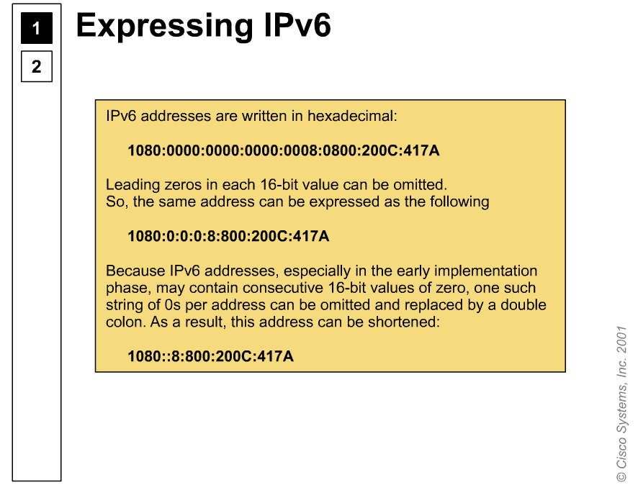

Expressing IPV6

Slide 19
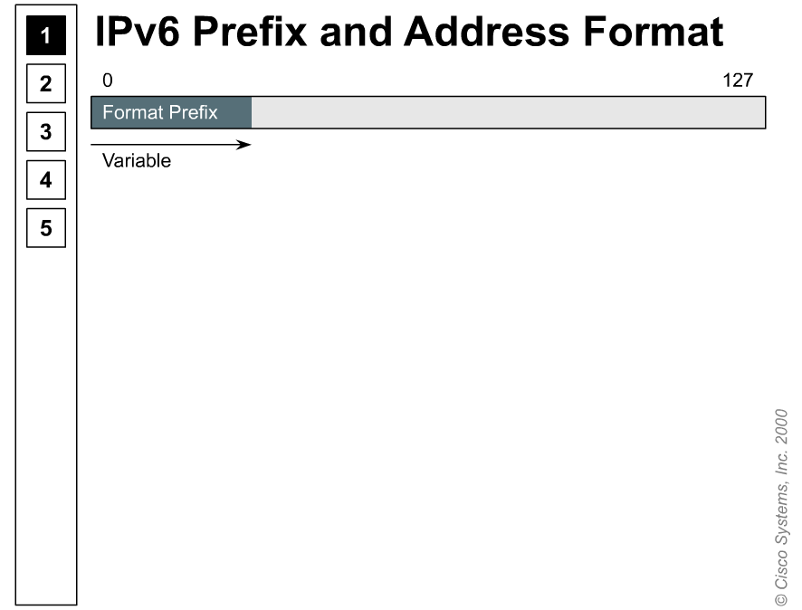
IPV6 prefix format

Slide 20
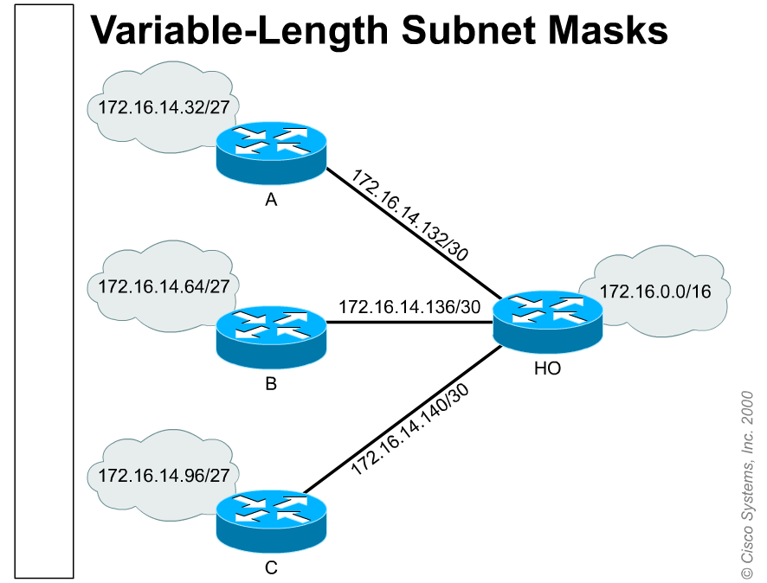
VLSM

Slide 21
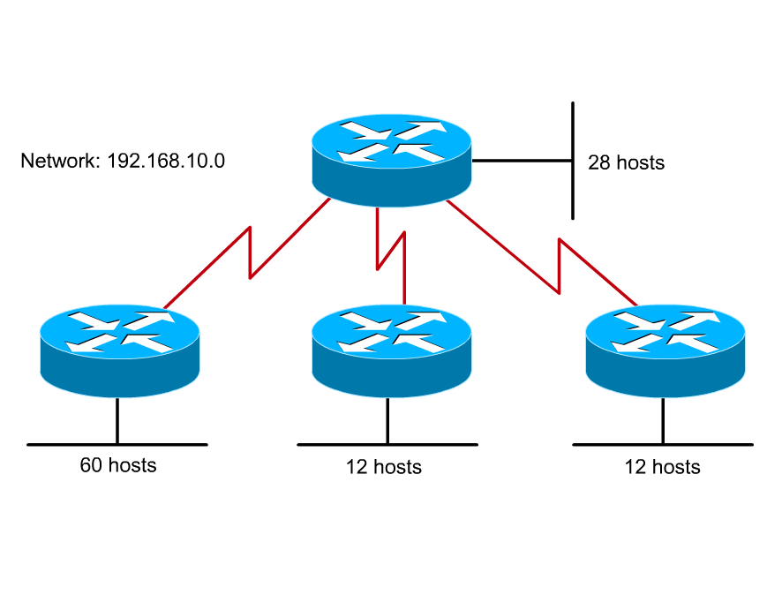
VLSM Excercise

Slide 22
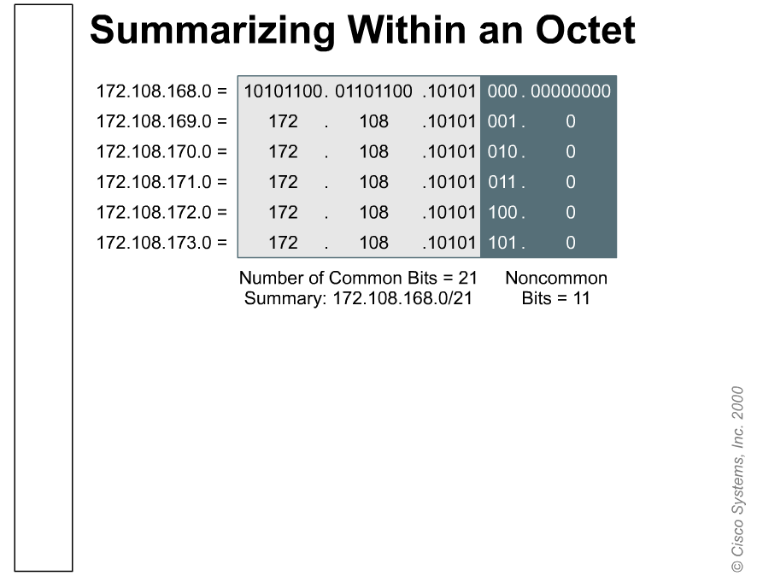

Summarizing in 1 octet

Slide 23
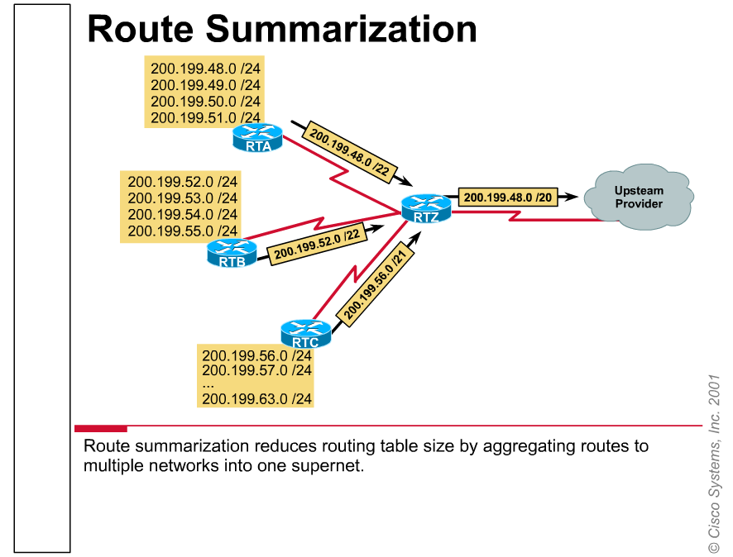
Route Summarization

Slide 24
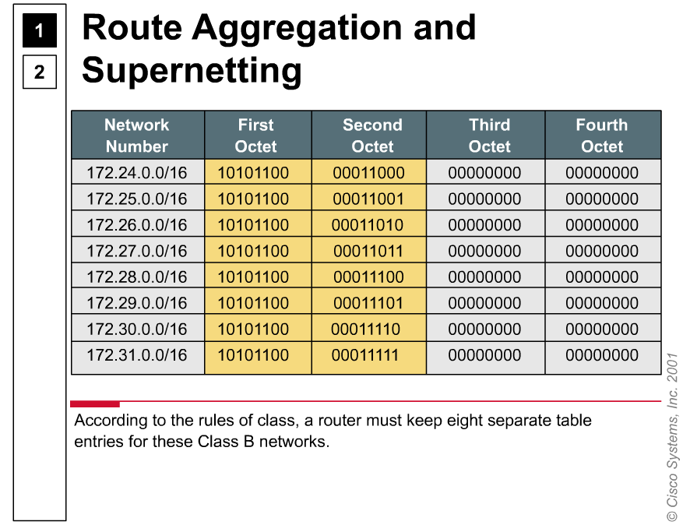
Aggregation & Suppernetting

Slide 25
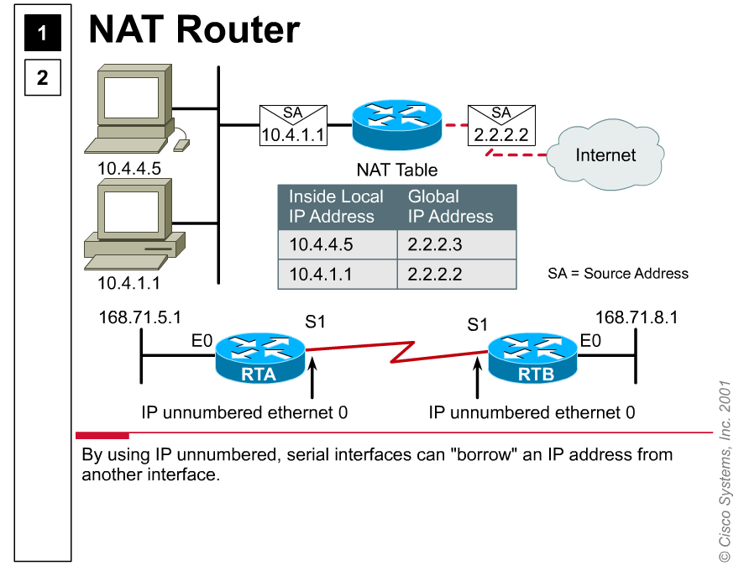
Nat Router

Slide 26
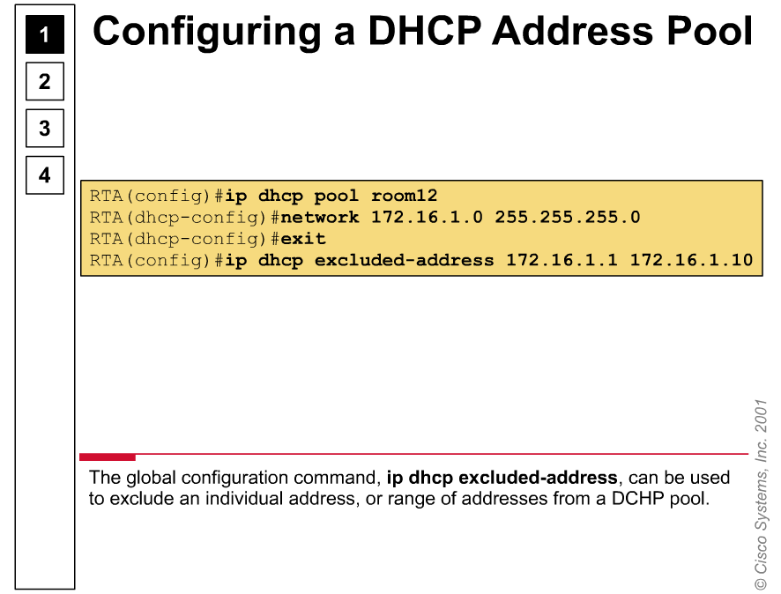
Config DHCP

Slide 27


