Slide 1
CCNA – Delta Training
EIGRP
J. Straube
Location: Box Hill Institute of TAFE - Melbourne

Slide 2

EIGRP
Major points:
  - Class Full, Classless & VLSM compatible
  - Fully compatible with IGRP
  IGRP 20 bits long metric
  EIGRP 32 bits long metric ( x 256 rule)
  Automatically Redistributes IGRP ( for same AS)
  DUAL: Diffusing Update Algorithm

Slide 3
Advantages
Rapid convergence
Loop Free technology
Efficient use of bandwidth during convergence
Minimal consumption of bandwidth when the network is stable
Support for VLSM and CIDR
Complete independence from routed protocols
Multiple network-layer support (PDMs > protocol dependent modules)
Notes:
Rapid convergence --- EIGRP routers store every path they have learned to every destination in the network. Therefore, a router running EIGRP can quickly converge on an alternative route after any topological change. EIGRP uses an algorithm called the Diffusing Update Algorithm (DUAL) to achieve rapid convergence. A router running Enhanced IGRP stores backup routes, when available, for destinations so that it can quickly adapt to alternative routes. If no appropriate route or backup route exists in the local routing table, EIGRP queries its neighbors to discover an alternative route. These queries are propagated until an alternative route is found. The DUAL algorithm guarantees loop-free operation at every instant throughout a route computation and allows all routers involved in a topology change to synchronize at the same time. Routers that are not affected by topology changes are not involved in recomputations. The convergence time with DUAL rivals that of any other existing routing protocol.
Efficient use of bandwidth during convergence --- EIGRP does not make periodic updates. Instead, it sends partial updates about a route when the path changes or when the metric for that route changes. When path information changes, the DUAL algorithm sends an update about that link only, rather than about the entire table. In addition, the information is sent only to the routers that need it, in contrast to link-state protocol operation, which sends a change update to all routers in an area. In EIGRP, this is known as a partial, bounded update.
Minimal consumption of bandwidth when the network is stable --- During normal, stable network operation, the only EIGRP packets exchanged between EIGRP nodes are hello packets. This simple handshake enables the EIGRP routers to know that all remains well in the network.
Support for VLSM and CIDR --- EIGRP supports the definition of network and host numbers on any bit boundary, per interface, for both IP addresses and subnet masks.
Complete independence from routed protocols --- EIGRP is designed to be completely independent of routed protocols. Support for routed protocols is via individual, protocol-specific modules. Therefore, evolution of a protocol, such as IP, won't threaten EIGRP with obsolescence. Nor will such technological advances force a painful revision of EIGRP.
Multiple network-layer support --- EIGRP supports AppleTalk, IP, and Novell NetWare through the use of protocol dependent modules (PDMs). These modules are responsible for network-layer-specific protocol requirements

Slide 4
EIGRP Terminology
Neighbour table:
  Each EIGRP router maintains a neighbour table that lists adjacent routers. This table is comparable to the adjacency database used by OSPF. There is a neighbour table for each protocol that EIGRP supports.
Topology table:
  Each EIGRP router maintains a topology table for each configured network protocol. This table includes route entries for all destinations that the router has learned. All learned routes to a destination are maintained in the topology table.

Slide 5
EIGRP Terminology
Routing table:
  EIGRP chooses the best (successor) routes to a destination from the topology table and places these routes in the routing table. Each EIGRP router maintains a topology table table for each network protocol.
Successor:
  A route selected as the primary route to use to reach a destination. Successors are the entries kept in the routing table.
Feasible successor:
  A backup route. These routes are selected at the same time the successors are identified, but they are kept in the topology table. Multiple feasible successors for a destination can be retained in the topology table.

Slide 6
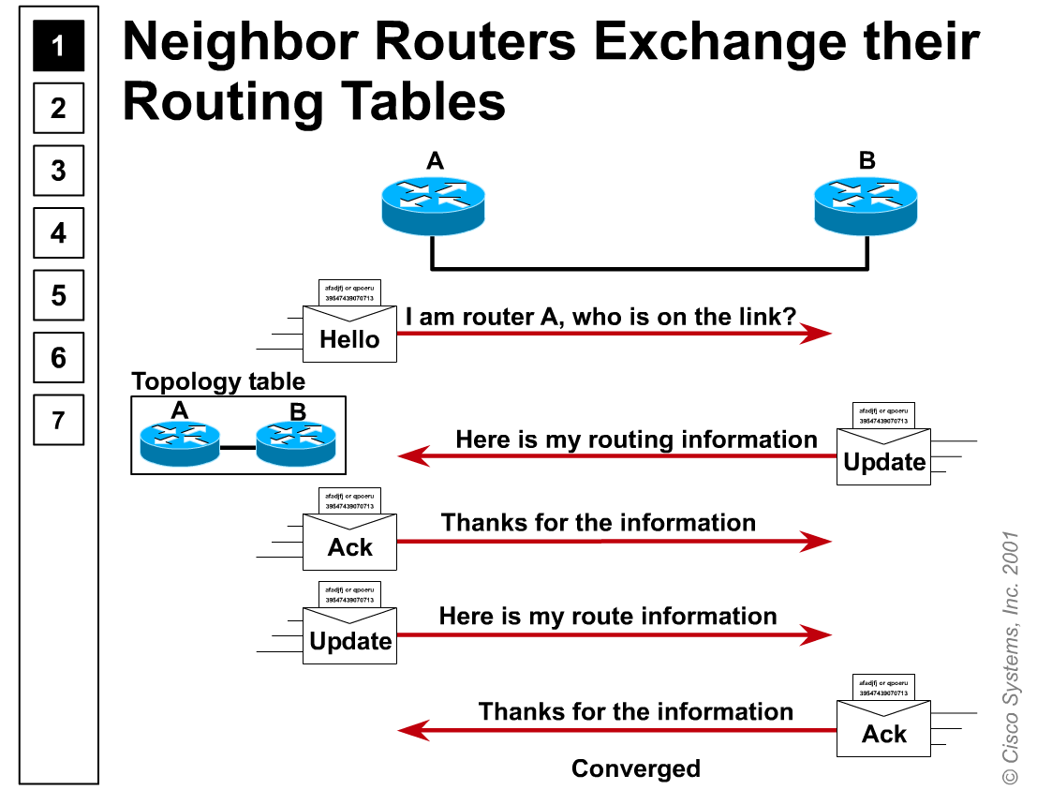

Neighbour Routers Exchange

Slide 7
Reliable Transport Protocol
RTP is a transport-layer protocol that correlates to the functionality identified by Layer 4 of the Open System Interconnection (OSI) reference model. RTP is a private innovation of Cisco Systems, however, and is not an open standard.
RTP can also support Multicast and Unicast simultaneously to different peers.
EIGRP Reliable Packets:
  Updates
  Query
  Reply
EIGRP Unreliable packets:
  Hello
  Ack

Slide 8

DUAL Algorithm
  Diffusing Update Algorithm:
    Convergence algorithm used in Enhanced IGRP that provides loop-free operation at every instant throughout a route computation. Allows routers involved in a topology change to synchronize at the same time, while not involving routers that are unaffected by the change.

Slide 9
EIGRP Tables
EIGRP Protocol
Protocol Dependent Modules
PDM Type
IPX PDM
A. T. PDM
IP PDM
NEWPDM
Neighbors
Table
Table
Table
…
Topology
Table
Table
Table
Routing
Table
Table
Table

Slide 10
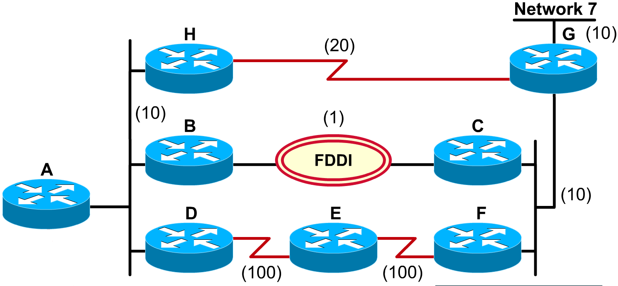

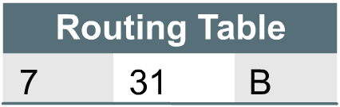
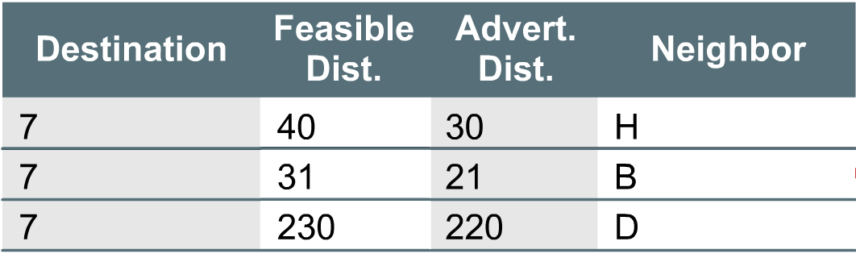

Forming the routing table
FS

Slide 11
Configuring EIGRP for IP
Router(config)# router eigrp 100
Router(config-router)# network 192.1.16.0
Router(config-if)# bandwidth 56
At this point you can nominate a % value of the bandwidth for different protocols:
Router(config-router)# ip bandwidth-percent eigrp
To stop auto summarization:
Router(config-router)# no auto-summary

Slide 12
What happens if I want to summarize.
Router(config-if)# ip summary-address eigrp 100 192.1.0.0 255.255.0.0
Note: the prompt “config-if“ informing that the summarization is done at the interface level for that particular AS and IP.

Slide 13
Show commands
router# show ip route eigrp
router# show ip eigrp neighbors
router# show ip eigrp topology
router# show ip eigrp traffic
router# show ip eigrp interfaces
router# show ip protocols

Slide 14
Debug Commands
router# debug eigrp fsm
router# debug eigrp neighbors
router# debug eigrp packets
router# debug eigrp transmit

Slide 15
End of the session

Slide 16
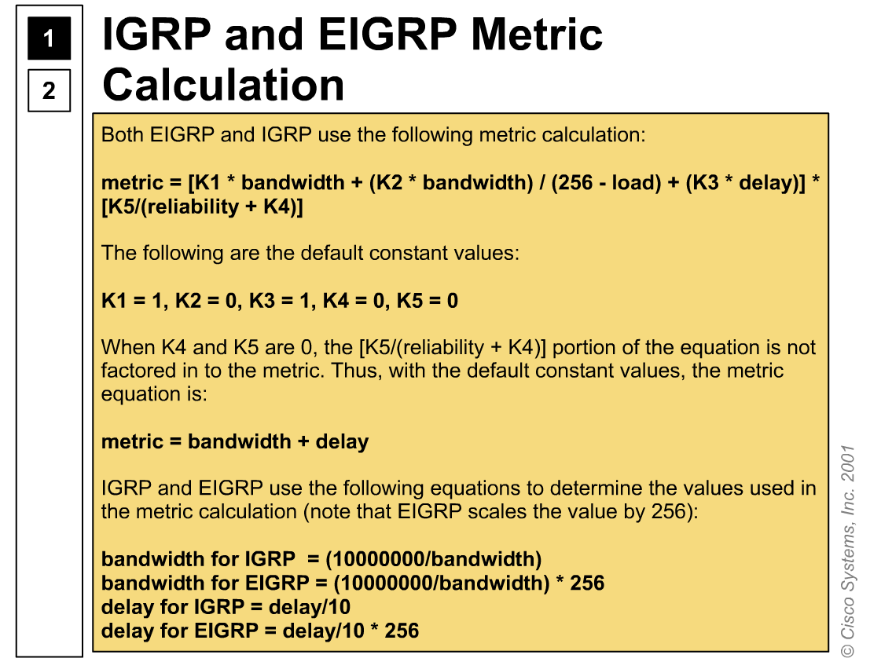


Slide 17
