Slide 1
CCNA 4 v3.0 Module 4
ISDN and DDR

Slide 2
Objectives
ISDN concepts
ISDN configuration
DDR configuration

Slide 3
What is ISDN?
  Integrated Services Digital Network (ISDN)
  • ISDN can carry a variety of user traffic signals. ISDN provides access to data , voice, and digital video network services.
  • ISDN offers much faster call setup than modem connections because it uses out-of-band (D, or delta, channel) signaling. For example, some ISDN calls can be setup in less than one second.
  • ISDN provides a faster data transfer rate than modems by using the bearer channel (B channel).
Notes:
Purpose: This figure describes the ISDN standards.
Emphasize: The following ISDN standards relate back to the ISO/OSI model:
Layer 3—The ITU-T Q.931 provides a network-layer protocol. This ISDN call control protocol follows the ITU-T recommendations for the ISDN signaling layer. Signaling information is sent so the network will operate correctly. ISDN uses out-of-band signaling, even from home to the central office. There are many variations on how a provider’s switch implements Q.931. At this layer, ISDN addressing generally follows conventions from E.164.
Layer 2— In the ITU-T Q.921 LAPD data link protocol, the recommendation specifies the framing format for the ISDN call control message (in other words, LAPD encapsulated the Q.931 signaling message).
Layer 1—The ITU-T I.430/I.431 recommendation specifies the ISDN physical-layer interfaces: I.430 for the basic interface, and I.431 for the primary interface.

Slide 4
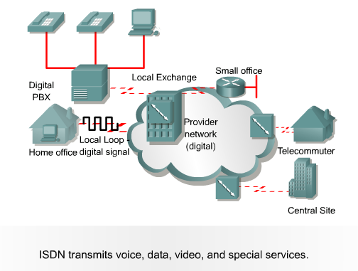
Digital Communication with ISDN

Slide 5
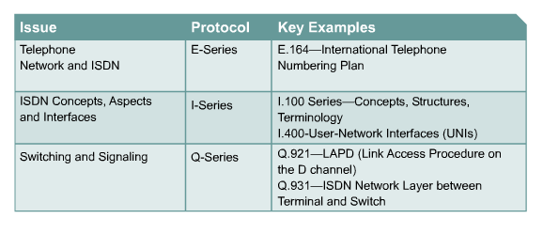
ISDN Standards

Slide 6


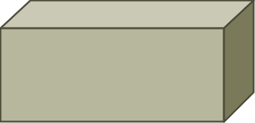
ISDN Access Options
Channel
Capacity
Mostly Used For
B
64 kbps
Circuit-switched data (HDLC, PPP)
D
16/64 kbps
Signaling information (LAPD)
BRI
NT1
D
2B
Service
Provider
Network
PRI
CSU/DSU
D
23 or 30B
BRI and PRI are used globally for ISDN.

Slide 7


ISDN Access Options
Async
Central site
ISDN, PPP, CHAP, DDR
AAA server
BRI
PRI
Frame Relay
ISDN/analog
Windows 95 PC
Modem
Async
Frame Relay
service
Small office
ISDN, PPP, CHAP, DDR
BRI
Frame Relay
Branch office

Slide 8
ISDN Services and Channelized E1 and T1
2B
D
}
Basic Rate Inerface
{
BRI
64 kbps
64 kbps
16 kbps
192 kbps
(144 kbps)
23B (T1) or
30B (E1)
D
PRI
64 kbps
each
64 kbps
Primary Rate Inerface
}
31 64 kbps
channels
2.048 Mbps
(includes sync)
E1
}
24
1.544 Mbps
(includes sync)
DS0s
T1

Slide 9
ISDN BRI and PRI
ISDN BRI: total speed is 64 kbps x 2 (B channels) + 16 kb/s (D channel) + 48 kb/s (framing and synchronization) = 192 kb/s
ISDN PRI:
E1 -- total speed is 64 kbps x 30 (B channels) + 64 kb/s (D channel) + 64 kb/s (framing and synchronization) = 2048 kb/s
T1 -- total speed is 64 kbps x 23 (B channels) + 64 kb/s (D channel) + 8 kb/s (framing and synchronization) = 1544 kb/s
(144 kbps)

Slide 10
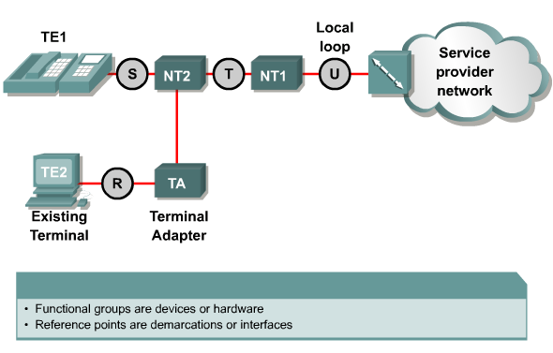
BRI Functions and Reference Points
ISDN-enabled Equipment (TE1)
non-ISDN device(TE2)

Slide 11
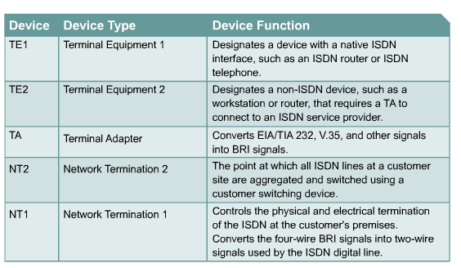
Basic ISDN components

Slide 12
ISDN reference points
  R -- (Rate) references the connection between a non-ISDN-compatible device and a TA
  S -- (System) references the points that connect into the NT2 or customer switching device. It is the interface that enables call between the various parts of CPE.
  T -- (Terminal) electrically identical to the S interface, a T interface references the outbound connection from the NT2 to the ISDN network or NT1.
  U -- (User) references the connection between the NT1 and the ISDN network owned by the phone cpmpany.
Notes:
Purpose:

Slide 13
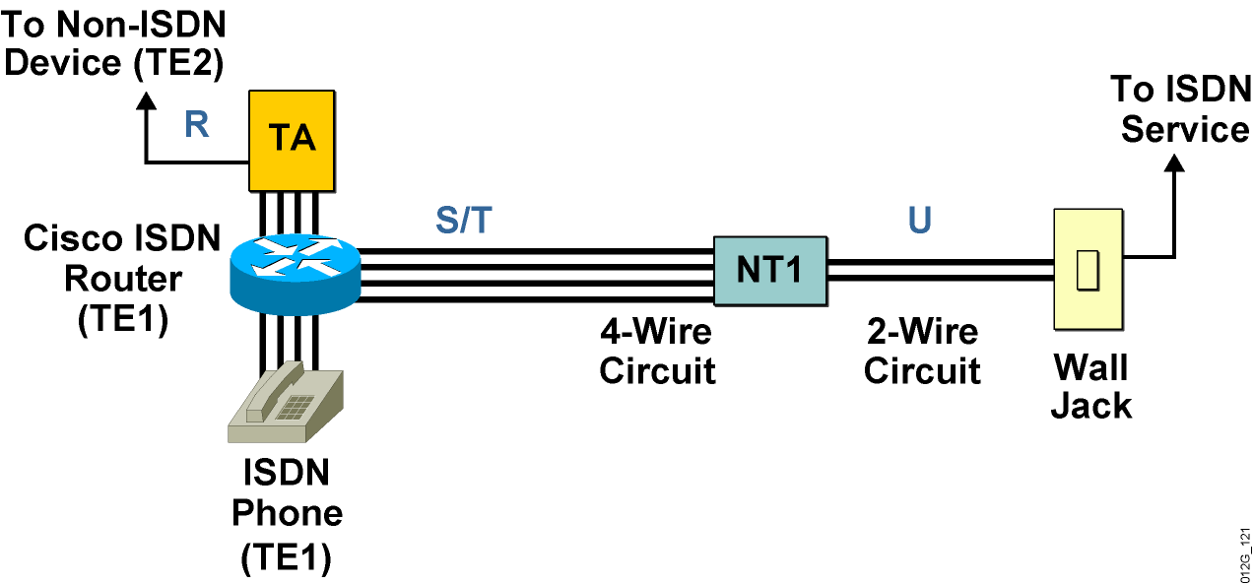
BRI Reference Points
S/T interface as a
multipoint connection
Notes:
Purpose: This figure assigns well-known devices to the abstract reference points and functional groups.
Emphasize: The Network Termination 1 (NT1) is part of the customer premises equipment (CPE) equipment in the U.S. and is part of the central office (CO) equipment in Europe. Cisco routers for small offices, (700, 800, 1600, and 1700 series) come with or without internal NT1 devices.

Slide 14
BRI Functional Groups and Reference Points
S
T
U
TE1
NT2
NT1
LE
ISDN terminal equipment
Customer premises switching equipment
Local loop terminator
ISDN local exchange
R
TE2
TA
U.S. demarcation
Non-ISDN terminal equipment
Terminal adapter
Non-U.S. demarcations
Notes:
Purpose: This figure introduces the standard ISDN BRI functional elements.
Emphasize: Discussions of BRI usually speak in terms of the device initialisms (NT1, TA, and so on) and the demarcation points (S, T, S/T, and U). It is very important to become familiar with these terms and identifiers.
Note: Often the ST demarcation point is used to describe non-U.S. implementations. This ST reference point exists when there is no NT2 device and the S and T reference points converge.

Slide 15
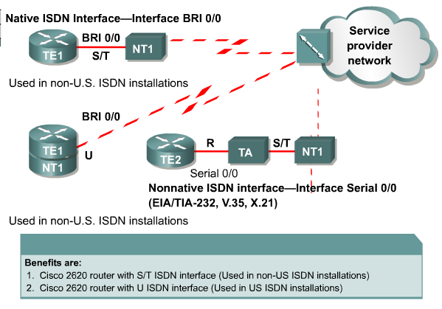
Cisco ISDN BRI Interfaces

Slide 16
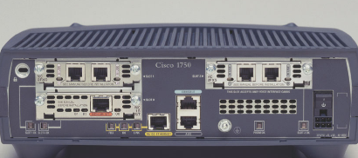
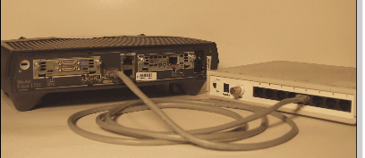
ISDN Interfaces
S/T ISDN Interface
U ISDN Interface

Slide 17

PRI—Standards and Reference Points
S/T
ITU-T
I.430
U
ITU-T
I.431
ANSI T1.601
CSU/
DSU
TE
LE
ISDN local exchange
23B (T1) or
30B (E1)
D
PRI
64 kbps
each
64 kbps
Notes:
Purpose: This figure shows the reference points and standards for ISDN PRI.
Emphasize: PRI requires a channel service unit/data service unit (CSU/DSU) and no NT1 device.

Slide 18


Written Exercise: Identifying ISDN Components
BRI 0
S 0
Customer Premises
Local Loop
Service Provider
Label the functional elements and reference points

Slide 19
Written Exercise: Answers
S/T
NT1
U
BRI 0
U
R
TA
S/T
NT1
S 0
Customer Premises
Local Loop
Service Provider
Label the functional elements and reference points

Slide 20
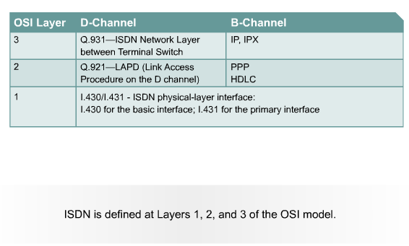
ISDN 3-Layer Model

Slide 21
BRI Layer 1—I.430 Framing
NT TE Frame
1
1
8
1
1
1
1
1
8
1
1
1
8
1
1
1
8
1
1
1
F
L
B1
L
D
L
F
L
B2
L
D
L
B1
L
D
L
B2
L
D
L
TE NT Frame
1
1
8
1
1
1
1
1
8
1
1
1
8
1
1
1
8
1
1
1
F
L
B1
E
D
A
F
F
B2
E
D
S
B1
E
D
S
B2
E
D
S

Slide 22

ISDN Layer 2
TEI/SAPI
Daisy-chain
S/T bus
ISDN
TEI/SAPI
LE
NT1
ISDN switch (local exchange)
  ITU-T Q.920 and Q.921
  Defines logical link between TE/TA and NT2/LE
  Carries Layer 3 D-channel messages

Slide 23
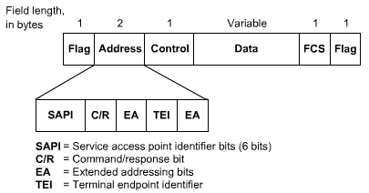
ISDN Layer 2 encapsulation
Notes:
Purpose: This figure highlights the Layer 2 protocol Q.921 and its usage.
Emphasize: Q.921 is the protocol by which the ISDN switch assigns a terminal endpoint identifier (TEI) to an end device. Use the analogy of a protocol or service access point (SAP) field in a LAN protocol data unit (PDU) that is used to map to a higher-layer protocol suite to demonstrate the need for TEIs and service access point identifiers (SAPIs).

Slide 24
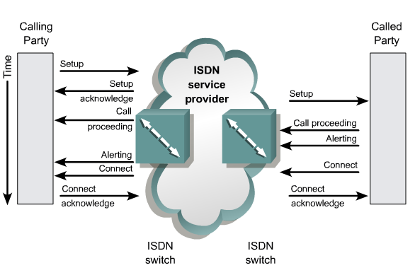
Q.931 Messaging-Call Setup Example

Slide 25
Call Processing
The D channel is used to send the called number to the local ISDN switch.
The local switch uses the SS7 signaling protocol to set up a path and pass the called number to the remote ISDN switch.
The remote ISDN switch signals the destination over the D channel.
The destination ISDN NT-1 device sends the remote ISDN switch a call-connect message.
The remote ISDN switch uses SS7 to send a call-connect message to the local switch.
The local ISDN switch connects one B channel end-to-end, leaving the other B channel available for a new conversation or data transfer. Both B channels can be used simultaneously.

Slide 26
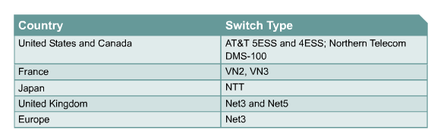
ISDN Switch Types

Slide 27
Configuring ISDN BRI
Step 1: Specify the ISDN switch type.
Router(config)#isdn switch-type switch-type
Router(config-if)#isdn switch-type switch-type
• The command specifies the type of ISDN switch with which the router communicates.
• Other configuration requirements vary for specific providers.
Notes:
Router(config)#isdn switch-type ?
basic-1tr6
basic-5ess
basic-dms100
basic-net3
basic-ni1
basic-nwnet3
basic-nznet3
basic-ts013
ntt
vn2
vn3

Slide 28
Configuring ISDN BRI (cont.)
Step 2: (Optional) Setting SPIDs
Router(config-if)#isdn spid1 spid-number [ldn]
  Sets a B channel SPID required by many service providers
Router(config-if)#isdn spid2 spid-number [ldn]
  Sets a SPID for the second B channel

Slide 29


BRI Configuration Example
10.170.0.1
4085554000
BRI 0
10.170.0.2
ISDN
Cisco-a
Cisco-b
192.168.1.1
hostname Cisco-a
isdn switch-type basic-net5
username Cisco-b password samepass
interface bri0
ip address 10.170.0.1 255.255.0.0
isdn switch-type basic-net5
encapsulation ppp
ppp authentication chap
!
ip route 192.168.1.0 255.255.255.0 10.170.0.2

Slide 30
Verifying ISDN Configuration
Displays the status of an ISDN connection
Router#show isdn status
Displays D channel’s traffic of Router’s interface BRI0
Router#show int bri0
Displays B1’s traffic of Router’s interface BRI0
Router#show int bri0:1
Displays controller information of Router
Router#show controller e1 0/0
Displays PRI D channel traffic of Router’s interface S1/0
Router#show int s0/0:15

Slide 31
Verifying ISDN Configuration
Router#show isdn status
The current ISDN Switchtype = basic-net5
ISDN BRI0 interface
Layer 1 Status:
ACTIVE
Layer 2 Status:
TEI = 65, State = MULTIPLE_FRAME_ESTABLISHED
Layer 3 Status:
1 Active Layer 3 Call(s)
Activated dsl 0 CCBs = 1
CCB:callid=2, sapi=0, ces=1, B-chan=1
Total Allocated ISDN CCBs = 1
When using ISDN, displays call status while call is in progress
Router#show isdn active
Displays current status of link, including amount of time link is connected
Router#show dialer

Slide 32
Troubleshooting ISDN Configuration
Router#debug isdn q921
Shows ISDN Layer 2 messages
Router#debug isdn q931
Shows ISDN call setup and teardown activity
Router#clear int bri0
Clears currently established
connections from the interface
Clears currently established
connections from B1 of Router’s interface BRI0
Router#clear int bri0:1

Slide 33
Monitoring ISDN BRI B Channels
BranchF#sh int bri 0:1
BRI0:1 is up, line protocol is up
Hardware is BRI
MTU 1500 bytes, BW 64 Kbit, DLY 20000 usec, rely 255/255, load 1/255
Encapsulation PPP, loopback not set, keepalive set (10 sec)
LCP Open
Open: IPCP, CDPCP
Last input 00:00:01, output 00:00:01, output hang never
Last clearing of "show interface" counters never
Input queue: 0/75/0 (size/max/drops); Total output drops: 0
Queueing strategy: weighted fair
Output queue: 0/1000/64/0 (size/max total/threshold/drops)
Conversations 0/1/256 (active/max active/max total)
Reserved Conversations 0/0 (allocated/max allocated)
5 minute input rate 0 bits/sec, 0 packets/sec
5 minute output rate 0 bits/sec, 0 packets/sec
82 packets input, 2844 bytes, 0 no buffer
Received 82 broadcasts, 0 runts, 0 giants, 0 throttles
0 input errors, 0 CRC, 0 frame, 0 overrun, 0 ignored, 0 abort
82 packets output, 2838 bytes, 0 underruns
0 output errors, 0 collisions, 0 interface resets
0 output buffer failures, 0 output buffers swapped out
5 carrier transitions
(output omitted)

Slide 34
Troubleshooting ISDN Layer 2
BranchF# debug isdn q921
ISDN BR0: TX -> INFOc sapi = 0 tei = 65 ns = 4 nr = 3 i = 0x080102050402889
01801837009803634383534353738
ISDN BR0: RX <- RRr sapi = 0 tei = 65 nr = 5
ISDN BR0: RX <- INFOc sapi = 0 tei = 65 ns = 3 nr = 5 i = 0x0801820D180189
ISDN BR0: TX -> RRr sapi = 0 tei = 65 nr = 4
ISDN BR0: RX <- INFOc sapi = 0 tei = 65 ns = 4 nr = 5 i = 0x080182072905000
A090A0B
ISDN BR0: TX -> RRr sapi = 0 tei = 65 nr = 5
%LINK-3-UPDOWN: Interface BRI0:1, changed state to up
ISDN BR0: TX -> INFOc sapi = 0 tei = 65 ns = 5 nr = 5 i = 0x0801020F
ISDN BR0: RX <- RRr sapi = 0 tei = 65 nr = 6
%LINEPROTO-5-UPDOWN: Line protocol on Interface BRI0:1, changed state to up
%ISDN-6-CONNECT: Interface BRI0:1 is now connected to 12344578 CentralA
BranchF#
ISDN BR0: RX <- RRp sapi = 0 tei = 65 nr = 6
ISDN BR0: TX -> RRf sapi = 0 tei = 65 nr = 5
(output omitted)

Slide 35
ISDN Layer 2 encapsulation
Notes:
Purpose: This figure highlights the Layer 2 protocol Q.921 and its usage.
Emphasize: Q.921 is the protocol by which the ISDN switch assigns a terminal endpoint identifier (TEI) to an end device. Use the analogy of a protocol or service access point (SAP) field in a LAN protocol data unit (PDU) that is used to map to a higher-layer protocol suite to demonstrate the need for TEIs and service access point identifiers (SAPIs).

Slide 36
Troubleshooting ISDN Layer 3
BranchF# debug isdn q931
ISDN BR0: TX -> SETUP pd = 8 callref = 0x01
Bearer Capability i = 0x8890
Channel ID i = 0x83
Called Party Number i = 0x80, '61234578'
ISDN BR0: RX <- SETUP_ACK pd = 8 callref = 0x81
Channel ID i = 0x89
ISDN BR0: RX <- CONNECT pd = 8 callref = 0x81
Date/Time i = 0x000A090A08
%LINK-3-UPDOWN: Interface BRI0:1, changed state to up
ISDN BR0: TX -> CONNECT_ACK pd = 8 callref = 0x01
%LINK-3-UPDOWN: Interface Virtual-Access1, changed state to up
%LINEPROTO-5-UPDOWN: Line protocol on Interface BRI0:1, changed state to up
%LINEPROTO-5-UPDOWN: Line protocol on Interface Virtual-Access1, changed state to up
BranchF#
%ISDN-6-CONNECT: Interface BRI0:1 is now connected to 12344578 CentralA
(output omitted)

Slide 37

Configuring ISDN with DDR
© 2003, Cisco Systems, Inc. All rights reserved.

Slide 38



What Is Dial-on-Demand Routing?
Corporate
Dallas
PSTN
Chicago
ISDN
I need to send
data to Dallas.
• Connects when needed
• Disconnects when finished
• ISDN or PSTN

Slide 39
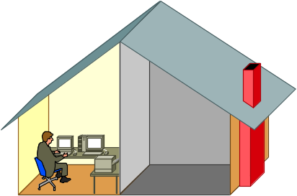
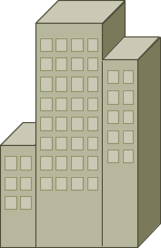
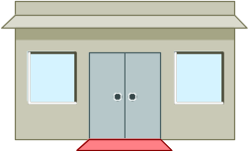
When to Use DDR
Telecommuter
Headquarters
• Periodic connections
• Small amounts of data
Vendor

Slide 40

Generic DDR Operation
“Interesting”
Packet Arrives
DCE
1. Route to destination is determined.

Slide 41
Generic DDR Operation
“Interesting”
Packet Arrives
DCE
1. Route to destination is determined.
2. Interesting packets dictate DDR call.

Slide 42
Generic DDR Operation
“Interesting”
Packet Arrives
Dial Connection
DCE
ISDN or
Basic
Service
1. Route to destination is determined.
2. Interesting packets dictate DDR call.
3. Dialer information is looked up.

Slide 43
Generic DDR Operation
“Interesting”
Packet Arrives
Dial Connection
DCE
ISDN or
Basic
Service
1. Route to destination is determined.
2. Interesting packets dictate DDR call.
3. Dialer information is looked up.
4. Traffic is transmitted.
5. Call is terminated.

Slide 44
Configuring Legacy DDR
“Interesting”
Packet Arrives
DCE
1
Define static routes—What route do I use?

Slide 45
Configuring Legacy DDR
“Interesting”
Packet Arrives
DCE
1
Define static routes—What route do I use?
Specify interesting traffic—What traffic enables the link?
2

Slide 46
Configuring DDR
“Interesting”
Packet Arrives
Dial Connection
DCE
ISDN or
Basic
Service
1
Define static routes—What route do I use?
Specify interesting traffic—What traffic enables the link?
Configure the dialer information—What number do I call?
2
3

Slide 47
1: Defining Static Routes
(Route to Destination)
Subnet
10.40.0.0
10.1.0.1
10.1.0.2
Subnets
10.10.0.0
10.20.0.0
Home
ISDN
Central
bri 0
5551000
bri 0
5552000
ip route 10.40.0.0 255.255.0.0 10.1.0.1
Specify Address of Next-Hop Router
ip route 10.10.0.0 255.255.0.0 10.1.0.2
ip route 10.20.0.0 255.255.0.0 10.1.0.2
Network Prefix
and Prefix Mask

Slide 48
2: Specifying Interesting Traffic
(What Enables the Connection?)
Router(config)# dialer-list 1 protocol ip permit
Any IP traffic will initiate the link without access lists.
dialer-list 1 protocol ip list 101
access-list 101 deny tcp any any eq ftp
access-list 101 deny tcp any any eq telnet
access-list 101 permit ip any any
Deny FTP
Deny Telnet
Any IP traffic, except FTP and Telnet, will initiate the linking with access lists (for better control).

Slide 49
2: Specifying Interesting Traffic (cont.)
hostname Home
!
isdn switch-type basic-net3
!
username central password cisco
interface BRI0
ip address 10.1.0.1 255.255.255.0
encapsulation ppp
dialer idle-timeout 180
dialer string 5552000
dialer-group 1
no fair-queue
ppp authentication chap
!
router rip
network 10.0.0.0
!
no ip classless
ip route 10.10.0.0 255.255.0.0 10.1.0.2
ip route 10.20.0.0 255.255.0.0 10.1.0.2
!
dialer-list 1 protocol ip permit
Applies rules defined by dialer-list to individual interfaces
Both Values
Must Match

Slide 50
3: Configuring the Dialer Information
How do I get to
subnetwork 10.10.0.0?
Subnets
10.10.0.0
10.20.0.0
10.1.0.1
10.1.0.2
Home
ISDN
Central
bri 0
5551000
bri 0
5552000
interface BRI0
ip address 10.1.0.1 255.255.255.0
encapsulation ppp
dialer idle-timeout 180
dialer string 5552000
dialer-group 1
no fair-queue
ppp authentication chap
Number to Dial

Slide 51
3: Configuring the Dialer Information (cont.)
Subnets
10.10.0.0
How do I get to
subnetwork 10.10.0.0?
Dallas
bri 0
5552000
10.1.0.1
10.1.0.2
Home
ISDN
bri 0
5551000
Chicago
10.1.0.3
bri 0
5553000
Subnets
10.20.0.0
interface BRI0
ip address 10.1.0.1 255.255.255.0
encapsulation ppp
dialer idle-timeout 180
dialer map ip 10.1.0.2 name Dallas 5552000
dialer map ip 10.1.0.3 name Chicago 5553000
dialer-group 1
no fair-queue
ppp authentication chap
Number to Dial
Remote Host Name
Used for PPP CHAP

Slide 52
Legacy DDR Configuration Tasks Summarized
hostname Home
!
isdn switch-type basic-net3
!
username central password cisco
interface BRI0
ip address 10.1.0.1 255.255.255.0
encapsulation ppp
dialer idle-timeout 180
dialer map ip 10.1.0.2 name Central 5552000
dialer-group 1
no fair-queue
ppp authentication chap
!
router rip
network 10.0.0.0
!
no ip classless
ip route 10.10.0.0 255.255.0.0 10.1.0.2
ip route 10.20.0.0 255.255.0.0 10.1.0.2
dialer-list 1 protocol ip permit
!
3
1
2

Slide 53
Optional Legacy DDR Commands
Router(config-if)#dialer wait-for-carrier-time seconds
  Specifies a maximum time for the provider to respond after the call initiates
Router(config-if)#dialer idle-timeout seconds
  Establishes the idle time before disconnect
Notes:
The dialer idle-timeout has a default value of 120.
The dialer wait-for-carrier-time seconds has a default value of 30 seconds

Slide 54
Legacy DDR Using ACLs Configuration Example
access-list 101 permit tcp any any eq smtp
access-list 101 permit tcp any any eq telnet
dialer-list 1 protocol ip list 101
!
ip route 192.168.12.0 255.255.255.0 10.108.126.2
ip route 192.168.14.0 255.255.255.0 10.108.126.2
!
interface bri 0
ip address 10.108.126.1 255.255.255.0
dialer-group 1
dialer map ip 10.108.126.2 name B 5551234
dialer wait-for-carrier-time
dialer idle-timeout 300
Access list defining
interesting packets
on Cisco A
Static routes to
reach destination
Interface
configuration for
DDR
Time to wait
before dropping
call
10.108.126.1
10.108.126.2
Subnets
192.168.12.0
192.168.14.0
A
ISDN
B

Slide 55
Verifying Legacy DDR and ISDN Operation
Triggers a link (assuming it is part of interesting traffic)
Router#ping or telnet
Displays current status of link, including amount of time link is connected
Router#show dialer
When using ISDN, displays call status while call is in progress
Router#show isdn active
Router#debug dialer
Shows call setup and teardown
activity

Slide 56
Troubleshooting DDR
BranchF#debug dialer
BranchF#ping 10.115.0.135
Type escape sequence to abort.
Sending 5, 100-byte ICMP Echos to 10.115.0.135, timeout is 2 seconds:
BRI0: Dialing cause ip (s=10.155.0.1, d=10.115.0.135)
BRI0: Attempting to dial 6000
%LINK-3-UPDOWN: Interface BRI0:2, changed state to up
dialer Protocol up for BR0:2.
%LINEPROTO-5-UPDOWN: Line protocol on Interface BRI0:2, changed state to up!!!!
Success rate is 80 percent (4/5), round-trip min/avg/max = 32/34/36 ms
BranchF#
BRI0: rotary group to 6000 overloaded (1)
BRI0: Attempting to dial 6000
%ISDN-6-CONNECT: Interface BRI0:2 is now connected to 6000 CentralF
Notes:
.

Slide 57


Dialer Profiles Overview
User X
Physical interface
User Y
ISDN
User Z
User X
Profile 1
Profile 2
User Y
Profile 3
Profile 4
LAN
User Z
Logical interface

Slide 58
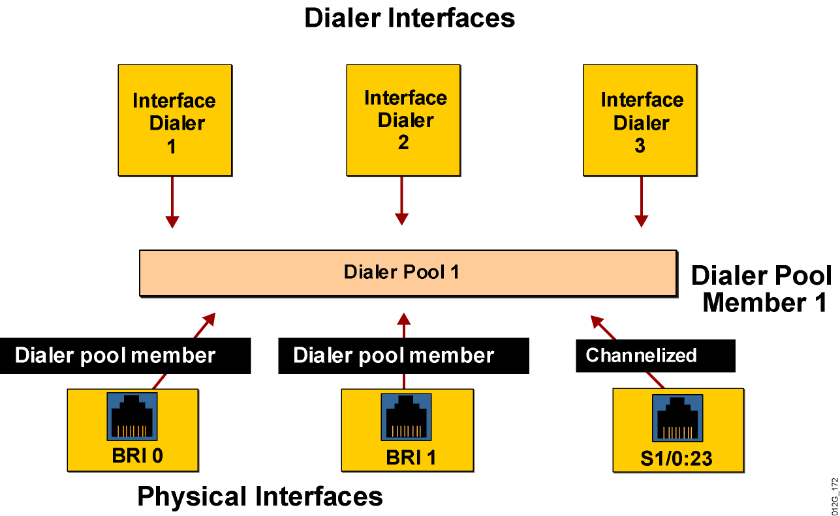
Dialer Profile Elements

Slide 59
Configuring Dialer Profile
Step 1: Specify the Dialer Interfaces.
Router(config)#interface dialer number
Step 2: Define dialer pool .
Router(config-if)#dialer pool number
Step 3: Configuring Physical Interfaces.
Router(config)# interface bri number
Router(config-if)#dialer pool-member number
[priority number]
Notes:
(Optional) Priority of this interface within the dialing pool, in the range 0 (lowest) to 255 (highest). Interfaces with the highest priority are selected first for dialing out. Default is 0.

Slide 60
Configuring Dialer Interfaces
interface dialer1
ip address 10.1.1.1 255.255.255.0
encapsulation ppp
dialer remote-name Smalluser
dialer string 5554540
dialer pool 0
dialer-group 1
ppp authentication chap
!
interface dialer2
ip address 10.2.2.1 255.255.255.0
encapsulation ppp
dialer remote-name Mediumuser
dialer string 5551234 class Eng
dialer load-threshold 50 either
dialer pool 1
dialer-group 2
interface dialer3
ip address 10.3.3.1 255.255.255.0
encapsulation ppp
dialer remote-name Poweruser
dialer string 4155551234 class Eng
dialer hold-queue 10
dialer idle-timer 9999
dialer pool 2
dialer-group 3
!
(cont.)

Slide 61
Configuring Physical Interfaces
interface bri0
encapsulation ppp
dialer pool-member 0 priority 100
ppp authentication chap
!
interface bri1
encapsulation ppp
dialer pool-member 1 priority 150 ppp authentication chap
!
interface bri2
encapsulation ppp
dialer pool-member 0 priority 50
dialer pool-member 1 priority 50
dialer pool-member 2 priority 50
ppp authentication chap
dialer pool 0
bri0 (priority 100)
bri2 (priority 50)
dialer pool 1
bri1 (priority 150)
bri2 (priority 50)
dialer pool 2
bri2 (priority 50)

Slide 62
Dialer Profiles Configuration Example
interface bri0
encapsulation ppp
dialer pool-member 1
ppp authentication chap
!
interface serial0
ip address 10.1.1.1 255.255.255.0
backup interface dialer0
backup delay 5 10
!
interface serial1
ip address 10.2.2.1 255.255.255.0
backup interface dialer1
backup delay 5 10
interface dialer0
ip address 10.1.1.1 255.255.255.0
encapsulation ppp
dialer remote-name Remote0
dialer pool 1
dialer string 5551212
dialer-group 3
!
interface dialer1
ip address 10.2.2.1 255.255.255.0
encapsulation ppp
dialer remote-name Remote1
dialer pool 1
dialer string 5551234
dialer-group 1
(cont.)

Slide 63
Verifying Dialer Profiles Operation
NASX#show dialer interface bri0
Dial String Successes Failures Last called Last status
5553872 6 0 19 secs Successful
0 incoming call(s) have been screened.
BRI0: B-Channel 1
Idle timer (120 secs), Fast idle timer (20 secs)
Wait for carrier (30 secs), Re-enable (15 secs)
Time until disconnect 102 secs
Current call connected 00:00:19
Connected to 5553872 (system1)
BRI0: B-Channel 2
Idle timer (120 secs), Fast idle timer (20 secs)
Wait for carrier (30 secs), Re-enable (15 secs)
Dialer state is idle
BRI0 - dialer type = ISDN
Dialer state is data link layer up
Dial reason: ip (s=10.1.1.8, d=10.1.1.1)
Interface bound to profile Dialer0

Slide 64
Verifying DDR
show dialer
show dialer interface [BRI]
show interface BRI number
show controller {t1 | e1} {slot/port | unit-number}
show interface {slot/port | unit:}{23 | 15}
show isdn status
show isdn active

Slide 65
Troubleshooting DDR
debug isdn q921
debug isdn q931
debug dialer [events|packets]
debug ppp authentication
clear interface bri

Slide 66


